Slide 1
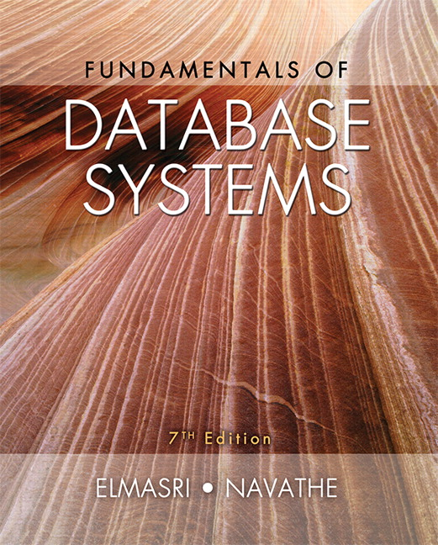

Slide 2
CHAPTER 7
More SQL: Complex Queries, Triggers, Views, and Schema Modification

Slide 3
Chapter 7 Outline
More Complex SQL Retrieval Queries
Specifying Semantic Constraints as Assertions and Actions as Triggers
Views (Virtual Tables) in SQL
Schema Modification in SQL

Slide 4
More Complex SQL Retrieval Queries
Additional features allow users to specify more complex retrievals from database:
Nested queries, joined tables, and outer joins (in the FROM clause), aggregate functions, and grouping

Slide 5
Comparisons Involving NULL and Three-Valued Logic
Meanings of NULL
Unknown value
Unavailable or withheld value
Not applicable attribute
Each individual NULL value considered to be different from every other NULL value
SQL uses a three-valued logic:
TRUE, FALSE, and UNKNOWN (like Maybe)
NULL = NULL comparison is avoided

Slide 6
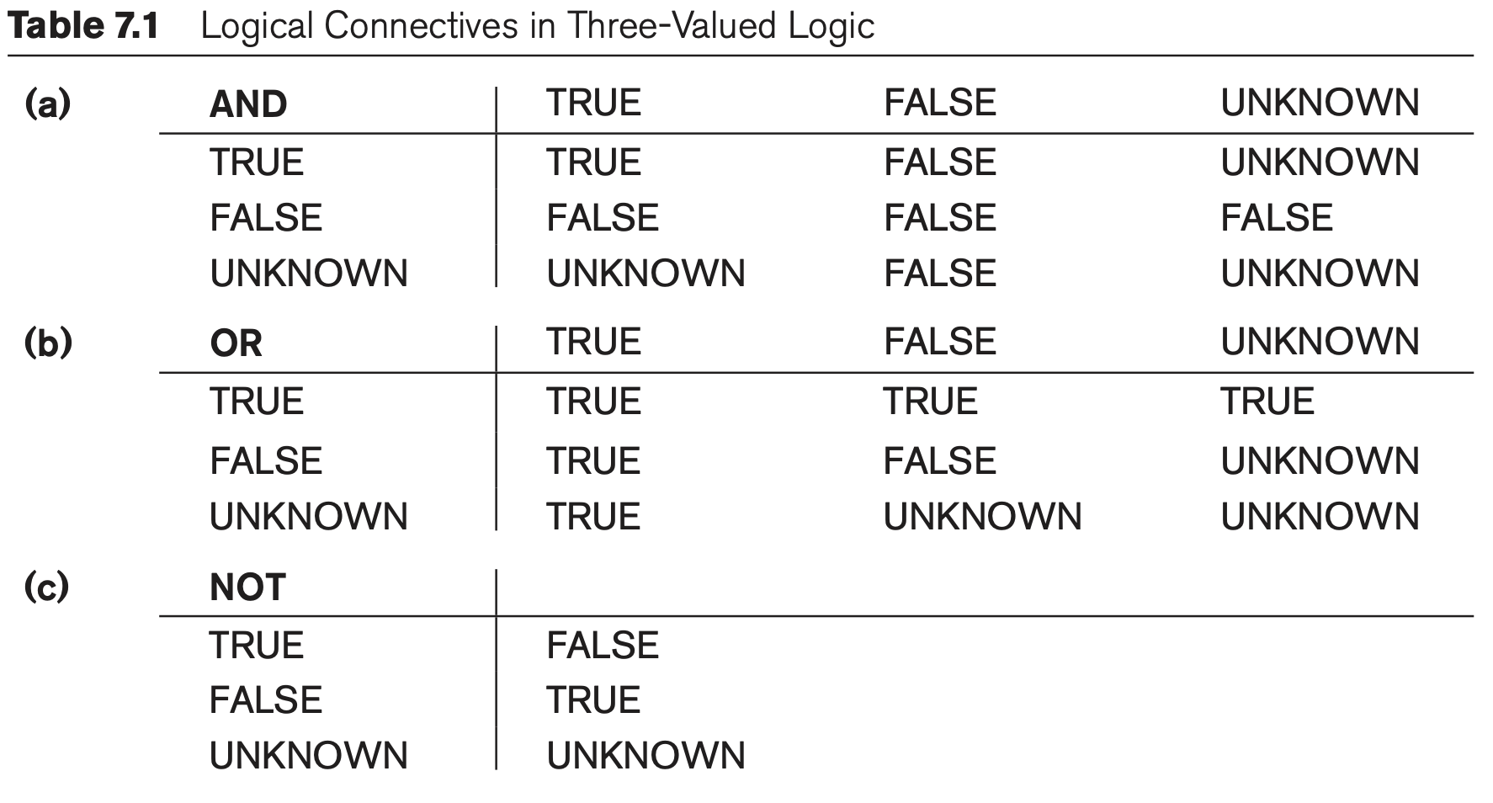
Comparisons Involving NULL and Three-Valued Logic (cont’d.)

Slide 7
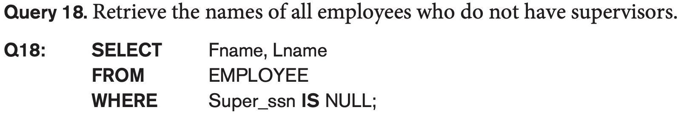
Comparisons Involving NULL and Three-Valued Logic (cont’d.)
Tuple combinations that evaluate to FALSE or UNKNOWN are not selected.
SQL allows queries that check whether an attribute value is NULL
IS or IS NOT NULL (use them instead of = or <>)

Slide 8
Nested Queries, Tuples, and Set/Multiset Comparisons
Nested queries
Complete select-from-where blocks within WHERE clause of another query
Outer query and nested subqueries
Comparison operator IN
Compares value v with a set (or multiset) of values V
Evaluates to TRUE if v is one of the elements in V

Slide 9
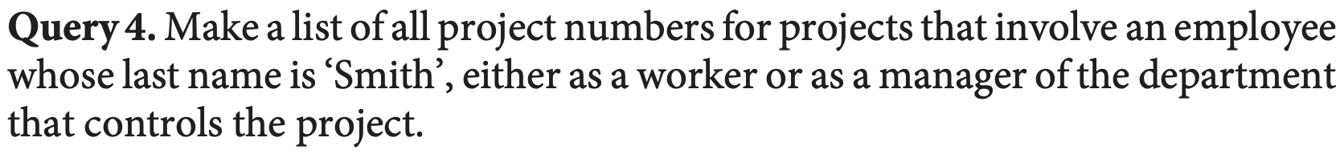
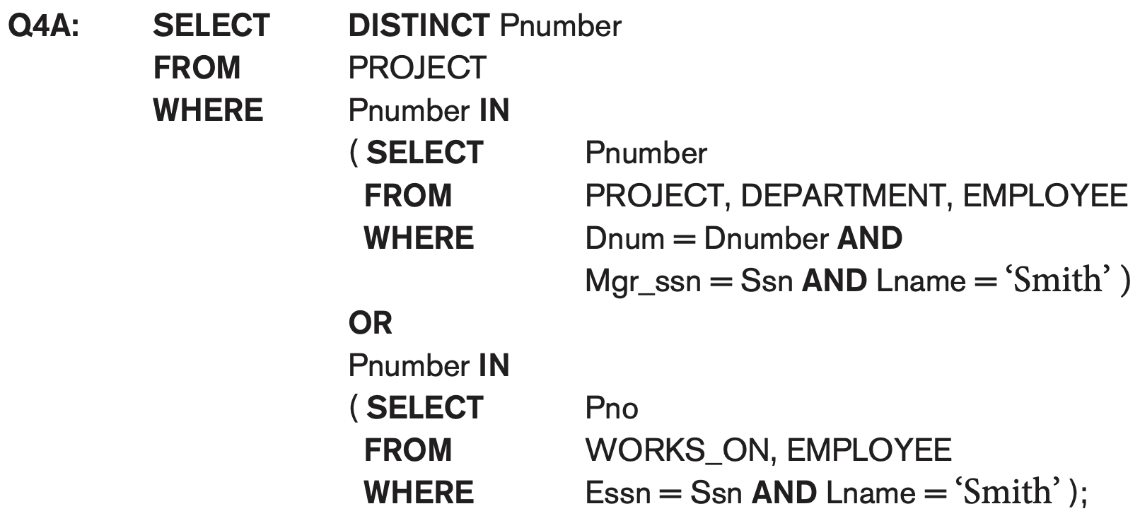
Nested Queries (cont’d.)

Slide 10
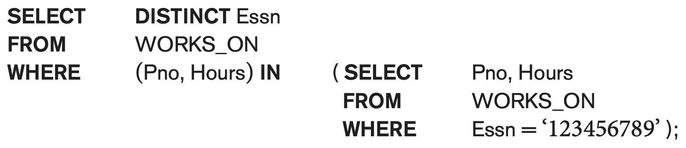
Nested Queries (cont’d.)
Use tuples of values in comparisons
Place them within parentheses
This query will select the Essns of all employees who work the same (project, hours) combination on some project that employee ‘John Smith’ (whose Ssn = ‘123456789’) works on.

Slide 11
Nested Queries (cont’d.)
Use other comparison operators to compare a single value v
= ANY (or = SOME) operator
Returns TRUE if the value v is equal to some value in the set V and is hence equivalent to IN
Other operators that can be combined with ANY (or SOME): >, >=, <, <=, and <>
SELECT *
FROM Orders
WHERE Amount > ANY ( SELECT Amount
FROM Orders
WHERE CustomerID = 5);

Slide 12
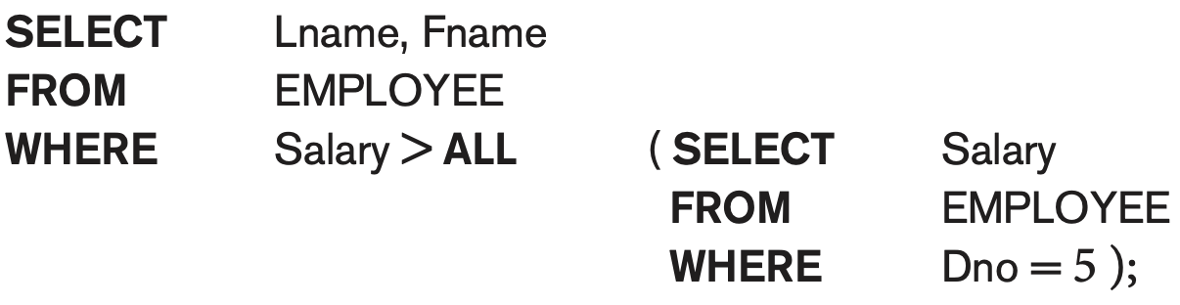
ALL: value must exceed all values from nested query

Slide 13
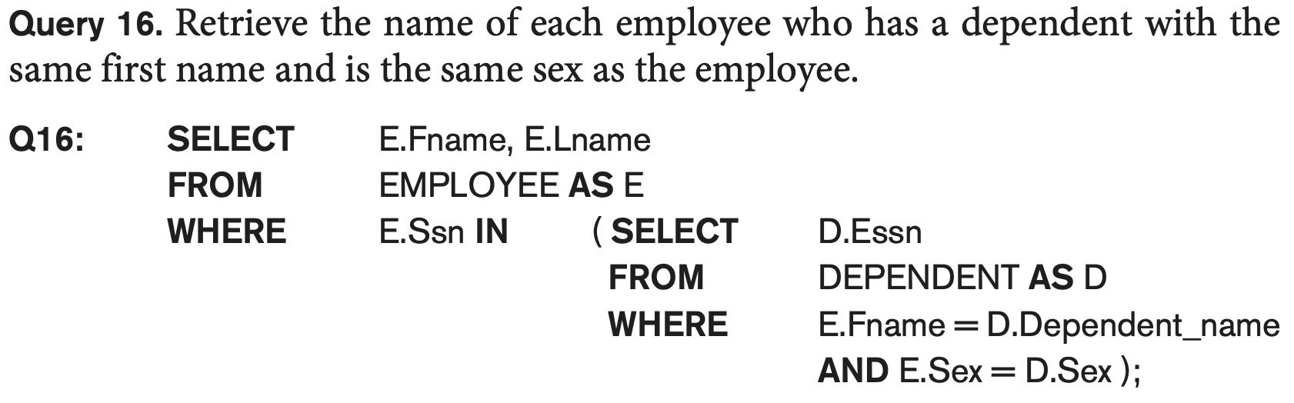
Nested Queries (cont’d.)
Avoid potential errors and ambiguities
Create tuple variables (aliases) for all tables referenced in SQL query

Slide 14
Correlated Nested Queries
Queries that are nested using the = or IN comparison operator can be collapsed into one single block: E.g., Q16 can be written as:
Q16A: SELECT E.Fname, E.Lname
FROM EMPLOYEE AS E, DEPENDENT AS D
WHERE E.Ssn=D.Essn AND E.Sex=D.Sex
AND E.Fname=D.Dependent_name;
Correlated nested query
Evaluated once for each tuple in the outer query

Slide 15
The EXISTS and UNIQUE Functions in SQL for correlating queries
EXISTS function
Check whether the result of a correlated nested query is empty or not. They are Boolean functions that return a TRUE or FALSE result.
EXISTS and NOT EXISTS
Typically used in conjunction with a correlated nested query
SQL function UNIQUE(Q)
Returns TRUE if there are no duplicate tuples in the result of query Q

Slide 16
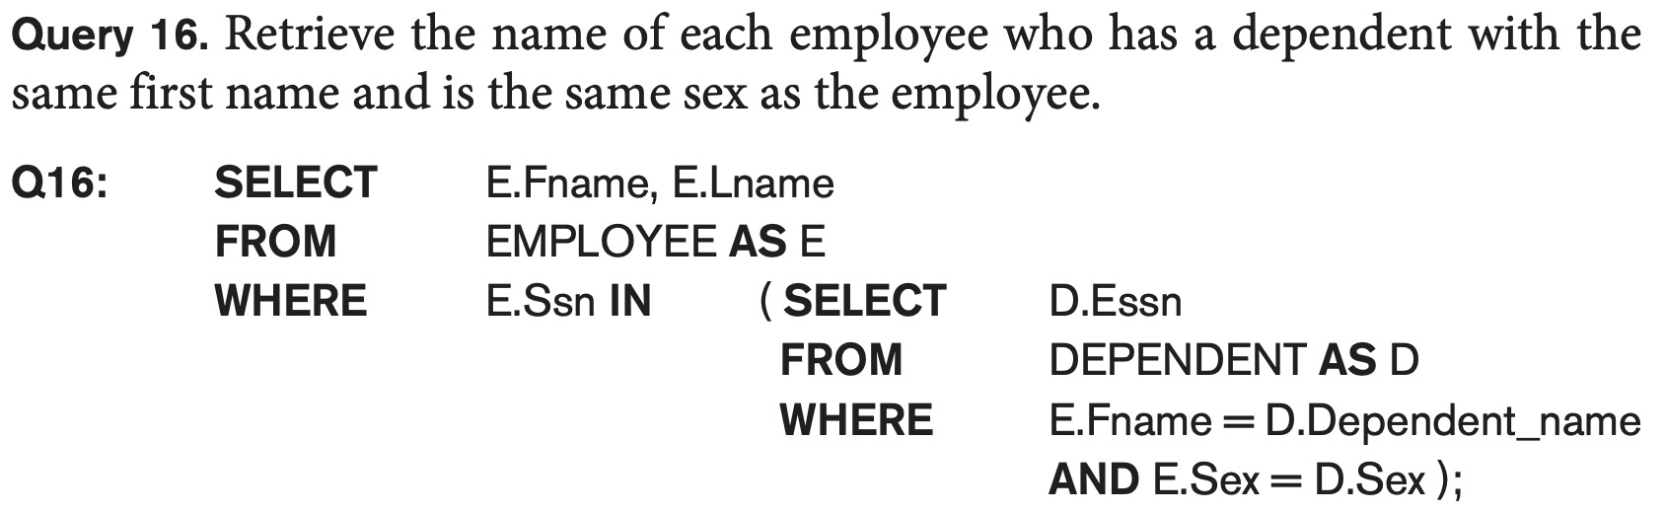
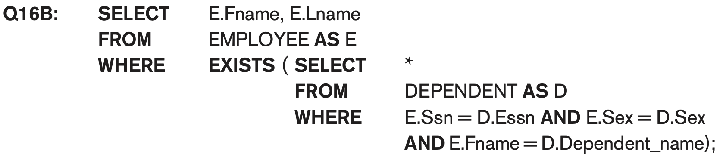
USE of EXISTS

Slide 17
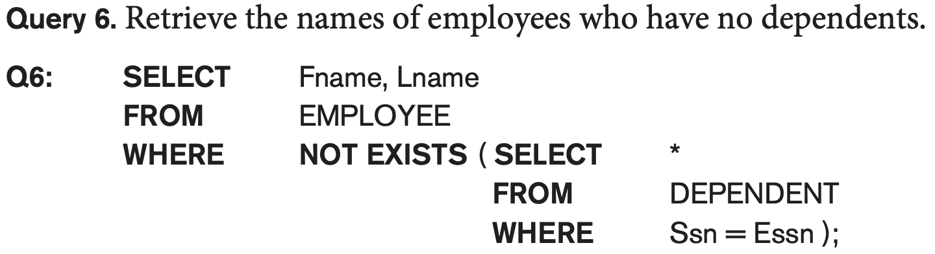
USE of EXISTS

Slide 18
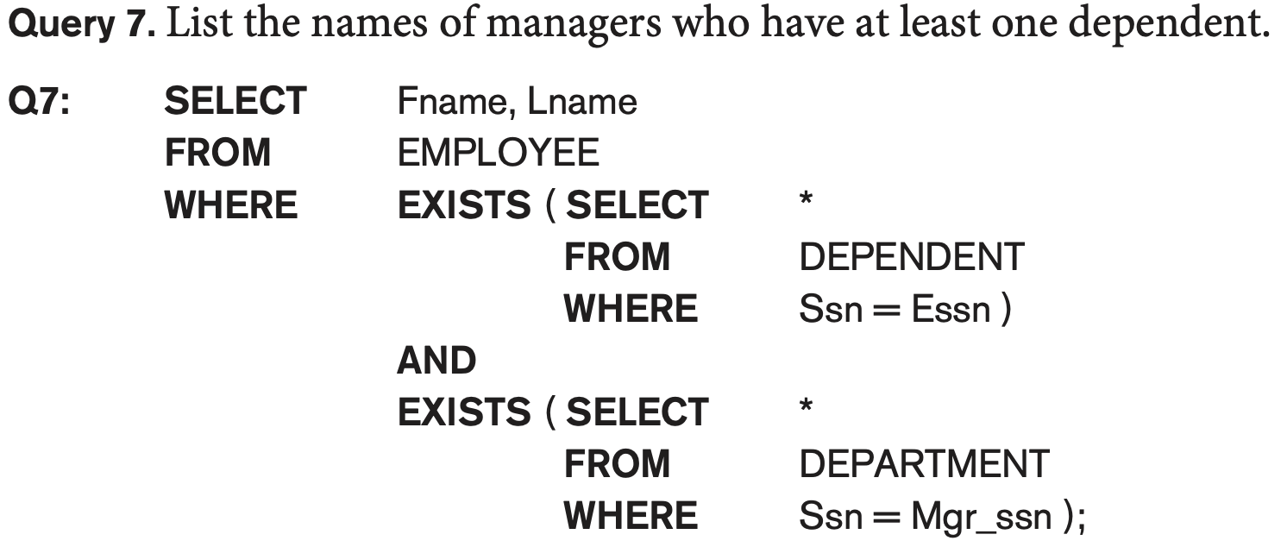
USE of EXISTS

Slide 19
USE OF NOT EXISTS
To achieve the “for all” (universal quantifier- see Ch.8) effect, we use double negation this way in SQL:
Query: List first and last name of employees who work on ALL projects controlled by Dno=5.
SELECT Fname, Lname
FROM Employee
WHERE NOT EXISTS ( (SELECT Pnumber
FROM PROJECT
WHERE Dno=5)
EXCEPT (SELECT Pno
FROM WORKS_ON
WHERE Ssn= ESsn)
The above is equivalent to double negation: List names of those employees for whom there does NOT exist a project managed by department no. 5 that they do NOT work on.

Slide 20

Explicit Sets and Renaming of Attributes in SQL
Can use explicit set of values in WHERE clause
Q17: SELECT DISTINCT Essn
FROM WORKS_ON
WHERE Pno IN (1, 2, 3);
Use qualifier AS followed by desired new name
Rename any attribute that appears in the result of a query

Slide 21

Specifying Joined Tables in the FROM Clause of SQL
Joined table
Permits users to specify a table resulting from a join operation in the FROM clause of a query
The FROM clause in Q1A
Contains a single joined table. JOIN may also be called INNER JOIN

Slide 22
Different Types of JOINed Tables in SQL
Specify different types of join
NATURAL JOIN
Various types of OUTER JOIN (LEFT, RIGHT, FULL )
NATURAL JOIN on two relations R and S
No join condition specified
Is equivalent to an implicit EQUIJOIN condition for each pair of attributes with same name from R and S

Slide 23
NATURAL JOIN
Rename attributes of one relation so it can be joined with another using NATURAL JOIN:
Q1B: SELECT Fname, Lname, Address
FROM (EMPLOYEE NATURAL JOIN
(DEPARTMENT AS DEPT (Dname, Dno, Mssn,
Msdate)))
WHERE Dname=‘Research’;
The above works with EMPLOYEE.Dno = DEPT.Dno as an implicit join condition

Slide 24
INNER and OUTER Joins
INNER JOIN (versus OUTER JOIN)
Default type of join in a joined table
Tuple is included in the result only if a matching tuple exists in the other relation
LEFT OUTER JOIN
Every tuple in left table must appear in result
If no matching tuple
Padded with NULL values for attributes of right table
RIGHT OUTER JOIN
Every tuple in right table must appear in result
If no matching tuple
Padded with NULL values for attributes of left table

Slide 25
Example: LEFT OUTER JOIN
Get all employees even if he/she does not have a supervisor
SELECT E.Lname AS Employee_Name
S.Lname AS Supervisor_Name
FROM Employee AS E LEFT OUTER JOIN EMPLOYEE AS S
ON E.Super_ssn = S.Ssn)
ALTERNATE SYNTAX:
SELECT E.Lname , S.Lname
FROM EMPLOYEE E, EMPLOYEE S
WHERE E.Super_ssn + = S.Ssn

Slide 26
Multiway JOIN in the FROM clause
FULL OUTER JOIN – combines result if LEFT and RIGHT OUTER JOIN
Can nest JOIN specifications for a multiway join:
Q2A: SELECT Pnumber, Dnum, Lname, Address, Bdate
FROM ((PROJECT JOIN DEPARTMENT ON Dnum=Dnumber) JOIN EMPLOYEE ON Mgr_ssn=Ssn)
WHERE Plocation=‘Stafford’;

Slide 27
Aggregate Functions in SQL
Used to summarize information from multiple tuples into a single-tuple summary
Built-in aggregate functions
COUNT, SUM, MAX, MIN, and AVG
Grouping
Create subgroups of tuples before summarizing
To select entire groups, HAVING clause is used
Aggregate functions can be used in the SELECT clause or in a HAVING clause

Slide 28
Renaming Results of Aggregation
Following query returns a single row of computed values from EMPLOYEE table:
Q19: SELECT SUM (Salary), MAX (Salary), MIN (Salary), AVG (Salary)
FROM EMPLOYEE;
The result can be presented with new names:
Q19A: SELECT SUM (Salary) AS Total_Sal, MAX (Salary) AS Highest_Sal, MIN (Salary) AS Lowest_Sal, AVG (Salary) AS Average_Sal
FROM EMPLOYEE;

Slide 29
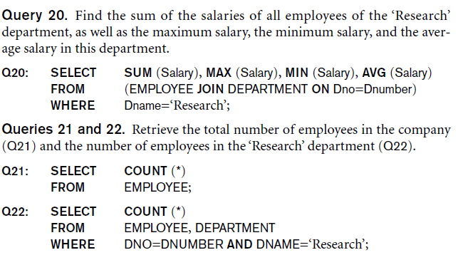
Aggregate Functions in SQL (cont’d.)
NULL values are discarded when aggregate functions are applied to a particular column

Slide 30
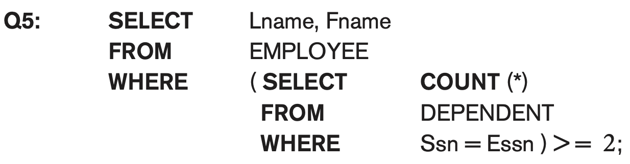
Aggregate Functions in SQL (cont’d.)
Retrieve the names of all employees who have two or more
dependents

Slide 31
Grouping: The GROUP BY Clause
Partition relation into subsets of tuples
Based on grouping attribute(s)
Apply function to each such group independently
GROUP BY clause
Specifies grouping attributes
COUNT (*) counts the number of rows in the group

Slide 32
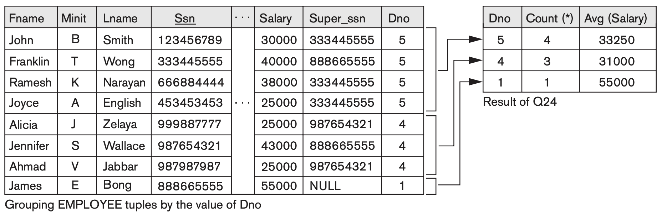
Examples of GROUP BY
The grouping attribute must appear in the SELECT clause:
Q24: SELECT Dno, COUNT (*), AVG (Salary)
FROM EMPLOYEE
GROUP BY Dno;
If the grouping attribute has NULL as a possible value, then a separate group is created for the null value (e.g., null Dno in the above query)

Slide 33
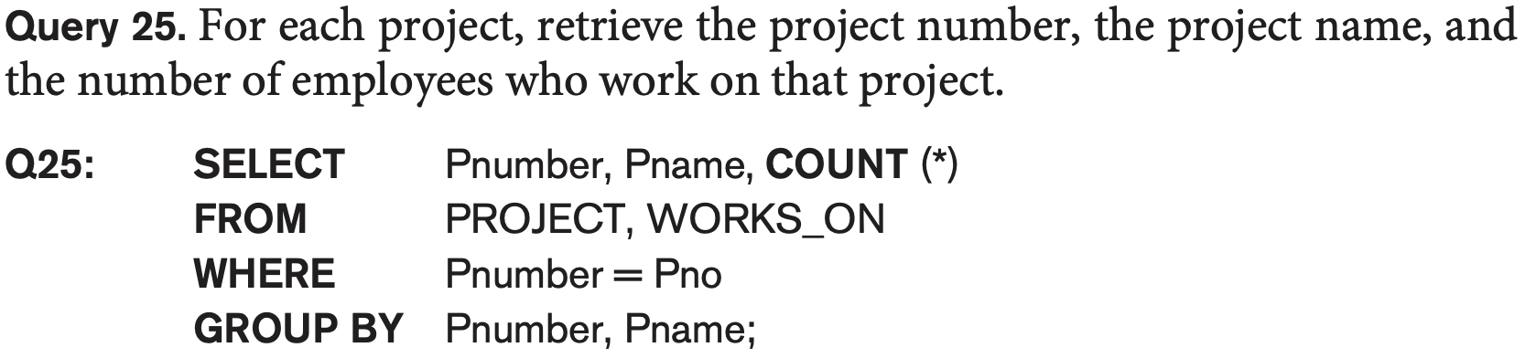
Examples of GROUP BY
Q25 shows how we can use a join condition in conjunction with GROUP BY. In this case, the grouping and functions are applied after the joining of the two relations in the WHERE clause.
Each unique combination of Pnumber and Pname will form a separate group.

Slide 34
Grouping: The GROUP BY and HAVING Clauses (cont’d.)
HAVING clause
Provides a condition to select or reject an entire group:
Query 26. For each project on which more than two employees work, retrieve the project number, the project name, and the number of employees who work on the project.
Q26: SELECT Pnumber, Pname, COUNT (*)
FROM PROJECT, WORKS_ON
WHERE Pnumber=Pno
GROUP BY Pnumber, Pname
HAVING COUNT (*) > 2;

Slide 35
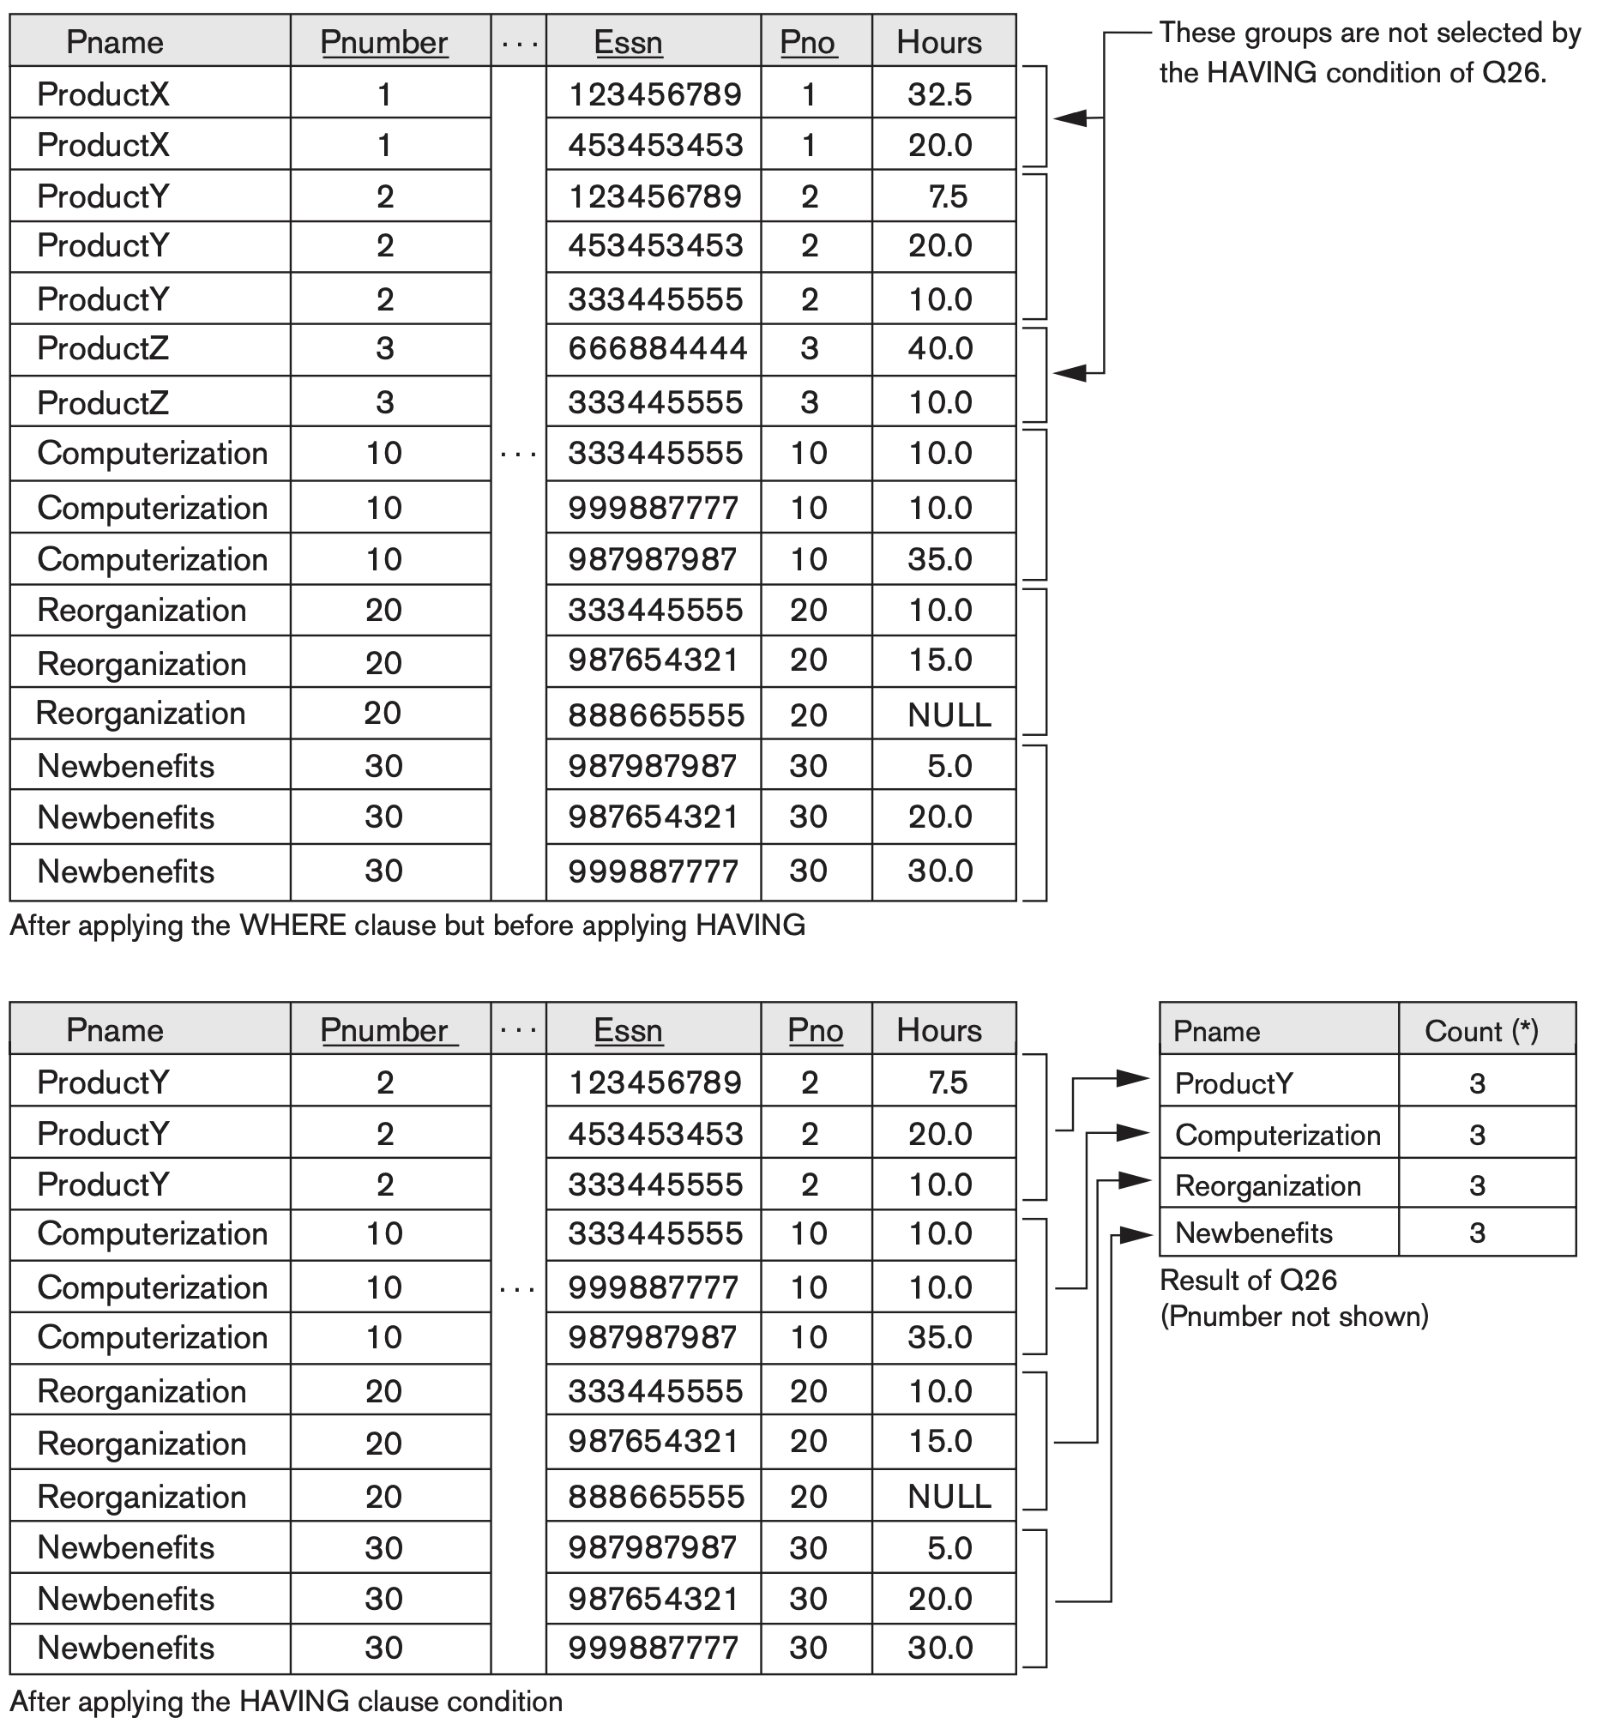

Slide 36
Combining the WHERE and the HAVING Clause
Consider the query: we want to count the total number of employees whose salaries exceed $40,000 in each department, but only for departments where more than five employees work.
INCORRECT QUERY:
SELECT Dno, COUNT (*)
FROM EMPLOYEE
WHERE Salary>40000
GROUP BY Dno
HAVING COUNT (*) > 5;
This is incorrect because it will select only departments that have more than five employees who each earn more than $40,000. Where clause executed first (before HAVING).

Slide 37
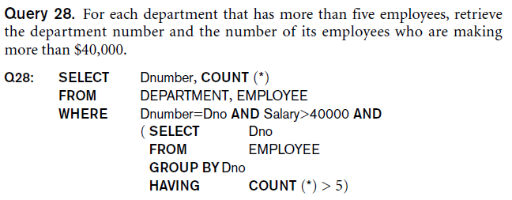
Combining the WHERE and the HAVING Clause (continued)
Correct Specification of the Query:
Note: the WHERE clause applies tuple by tuple whereas HAVING applies to entire group of tuples

Slide 38
Use of WITH
The WITH clause allows a user to define a table that will only be used in a particular query (not available in all SQL implementations)
Used for convenience to create a temporary “View” and use that immediately in a query
Allows a more straightforward way of looking a step-by-step query

Slide 39
Example of WITH
See an alternate approach to doing Q28:
Q28’: WITH BIGDEPTS (Dno) AS
( SELECT Dno
FROM EMPLOYEE
GROUP BY Dno
HAVING COUNT (*) > 5)
SELECT Dno, COUNT (*)
FROM EMPLOYEE
WHERE Salary>40000 AND Dno IN BIGDEPTS
GROUP BY Dno;

Slide 40
Use of CASE
SQL also has a CASE construct
Used when a value can be different based on certain conditions.
Can be used in any part of an SQL query where a value is expected
Applicable when querying, inserting or updating tuples

Slide 41
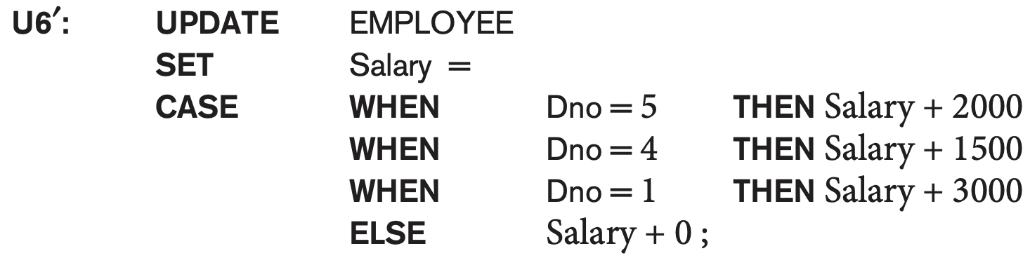
EXAMPLE of use of CASE
The following example shows that employees are receiving different raises in different departments (A variation of the update U6)

Slide 42
Recursive Queries in SQL
An example of a recursive relationship between tuples of the same type is the relationship between an employee and a supervisor.
This relationship is described by the foreign key Super_ssn of the EMPLOYEE relation
An example of a recursive operation is to retrieve all supervisees of a supervisory employee e at all levels—that is, all employees e′ directly supervised by e, all employees e′’ directly supervised by each employee e′, all employees e″′ directly supervised by each employee e″, and so on. Thus the CEO would have each employee in the company as a supervisee in the resulting table. Example shows such table SUP_EMP with 2 columns (Supervisor,Supervisee(any level)):

Slide 43
An EXAMPLE of RECURSIVE Query
Q29: WITH RECURSIVE SUP_EMP (SupSsn, EmpSsn) AS
SELECT SupervisorSsn, Ssn
FROM EMPLOYEE
UNION
SELECT E.Ssn, S.SupSsn
FROM EMPLOYEE AS E, SUP_EMP AS S
WHERE E.SupervisorSsn = S.EmpSsn)
SELECT *
FROM SUP_EMP;
The above query starts with an empty SUP_EMP and successively builds SUP_EMP table by computing immediate supervisees first, then second level supervisees (union of tables), etc. until a fixed point is reached and no more supervisees can be added

Slide 44
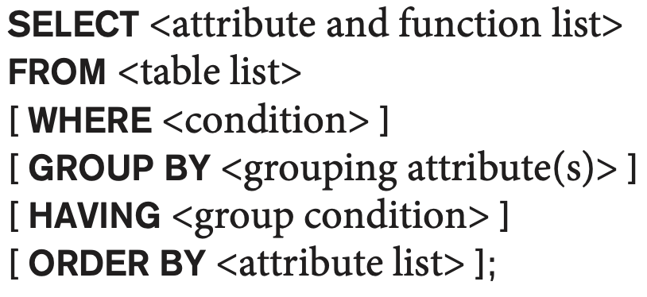
EXPANDED Block Structure of SQL Queries

Slide 45
Specifying Constraints as Assertions and Actions as Triggers
Semantic Constraints: The following are beyond the scope of the EER and relational model
CREATE ASSERTION
Specify additional types of constraints outside scope of built-in relational model constraints
CREATE TRIGGER
Specify automatic actions that database system will perform when certain events and conditions occur

Slide 46
Specifying General Constraints as Assertions in SQL
CREATE ASSERTION
Specify a query that selects any tuples that violate the desired condition
Use only in cases where it goes beyond a simple CHECK which applies to individual attributes and domains
Each assertion is given a constraint name
DBMS make sure the assertion condition satisfied at all states of the database.

Slide 47
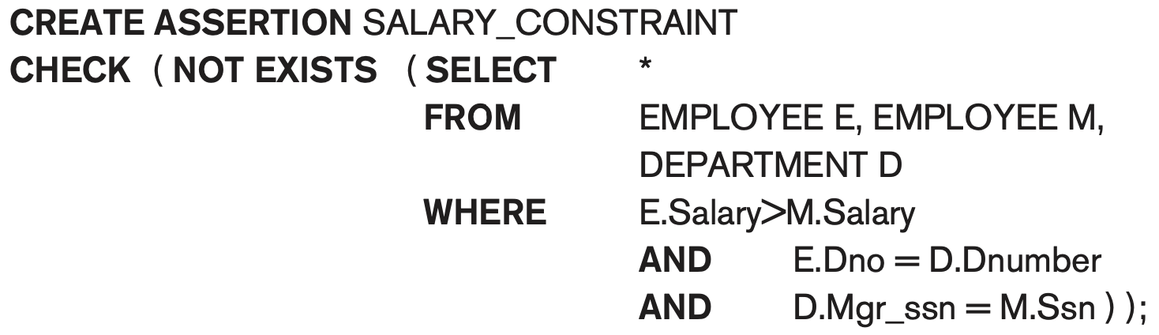
The salary of an employee must not be greater than the salary of the manager of the department that the employee works for

Slide 48
Introduction to Triggers in SQL
CREATE TRIGGER statement
Used to monitor the database
E.g., A manager may want to be informed if an employee’s travel expenses exceed a certain limit by receiving a message whenever this occurs.
Typical trigger has three components which make it a rule for an “active database “ (more on active databases in section 26.1) :
Event(s)
Condition
Action

Slide 49

USE OF TRIGGERS
AN EXAMPLE with standard Syntax.(Note : other SQL implementations like PostgreSQL use a different syntax.)
Event
R5:
CREATE TRIGGER SALARY_VIOLATION
BEFORE INSERT OR UPDATE OF Salary, Supervisor_ssn ON EMPLOYEE
FOR EACH ROW
WHEN (NEW.SALARY > ( SELECT Salary FROM EMPLOYEE
WHERE Ssn = NEW. Supervisor_Ssn)) INFORM_SUPERVISOR (NEW.Supervisor.Ssn, New.Ssn)
In case supervisor change
Condition
Action (stored procedure)

Slide 50
Views (Virtual Tables) in SQL
Concept of a view in SQL
Single table derived from other tables called the defining tables
Considered to be a virtual table that is not necessarily populated
A view does not necessarily exist in physical form
E.g., We may frequently issue queries that retrieve the employee name and the project names that the employee works on (rather than joining three tables every time)

Slide 51
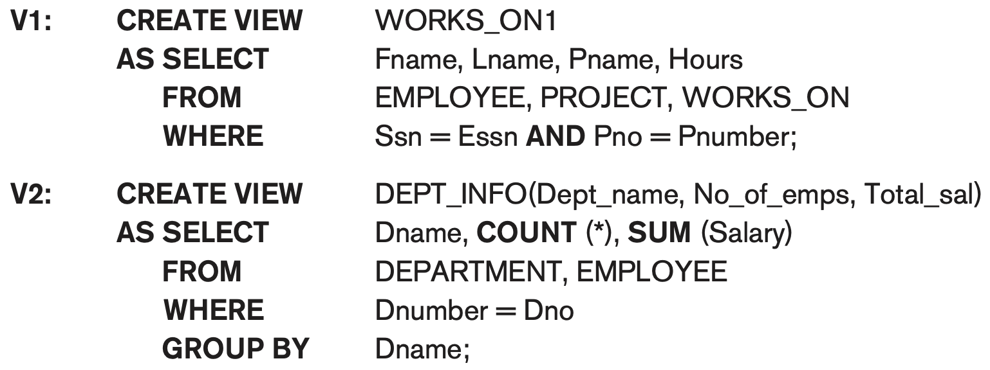
Specification of Views in SQL
CREATE VIEW command
Give table name, list of attribute names, and a query to specify the contents of the view
In V1, attributes retain the names from base tables. In V2, attributes are assigned names

Slide 52
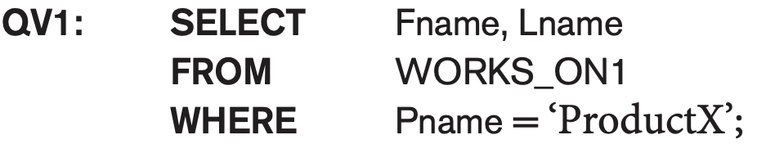
Specification of Views in SQL
We can now specify SQL queries on a view—or virtual table—in the same way we specify queries involving base tables.
For example, to retrieve the last name and first name of all employees who work on the ‘ProductX’ project, we can utilize the WORKS_ON1 view and specify the query as in QV1

Slide 53
Specification of Views in SQL (cont’d.)
Once a View is defined, SQL queries can use the View relation in the FROM clause
View is always up-to-date
Responsibility of the DBMS and not the user
DROP VIEW command
Dispose of a view

Slide 54
View Implementation, View Update, and Inline Views
Complex problem of efficiently implementing a view for querying
Strategy1: Query modification approach
Compute the view as and when needed. Do not store permanently
Modify view query into a query on underlying base tables
Disadvantage: inefficient for views defined via complex queries that are time-consuming to execute

Slide 55
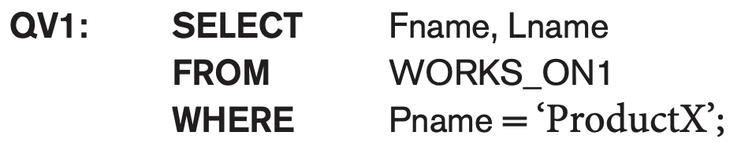
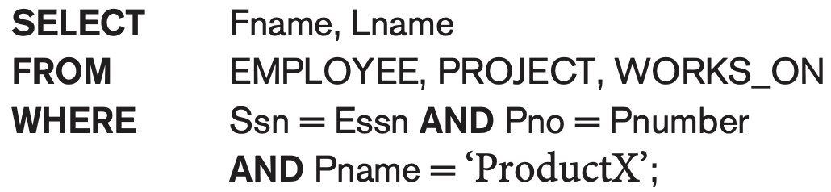
Query modification approach
Convert the query on the fly

Slide 56
View Materialization
Strategy 2: View materialization
Physically create a temporary view table when the view is first queried
Keep that table on the assumption that other queries on the view will follow
Requires efficient strategy for automatically updating the view table when the base tables are updated
Incremental update strategy for materialized views
DBMS determines what new tuples must be inserted, deleted, or modified in a materialized view table

Slide 57
View Materialization (contd.)
Multiple ways to handle materialization:
immediate update strategy updates a view as soon as the base tables are changed
lazy update strategy updates the view when needed by a view query
periodic update strategy updates the view periodically (in the latter strategy, a view query may get a result that is not up-to-date). This is commonly used in Banks, Retail store operations, etc.

Slide 58
View Update
Update on a view defined on a single table without any aggregate functions
Can be mapped to an update on underlying base table- possible if the primary key is preserved in the view
Update not permitted on aggregate views. E.g.,
UV2: UPDATE DEPT_INFO
SET Total_sal=100000
WHERE Dname=‘Research’;
cannot be processed because Total_sal is a computed value in the view definition

Slide 59
View Update and Inline Views
View involving joins
Often not possible for DBMS to determine which of the updates is intended
Clause WITH CHECK OPTION
WITH CHECK OPTION is a clause used when creating a view in SQL. It ensures that any inserted or updated row through the view still satisfies the view’s defining condition.
In-line view
Defined in the FROM clause of an SQL query (e.g., we saw its used in the WITH example)

Slide 60
Views as authorization mechanism
SQL query authorization statements (GRANT and REVOKE) are described in detail in Chapter 30
Views can be used to hide certain attributes or tuples from unauthorized users
E.g., For a user who is only allowed to see employee information for those who work for department 5, he may only access the view DEPT5EMP:
CREATE VIEW DEPT5EMP AS
SELECT *
FROM EMPLOYEE
WHERE Dno = 5;

Slide 61
Summary
Complex SQL:
Nested queries, joined tables (in the FROM clause), outer joins, aggregate functions, grouping
Handling semantic constraints with CREATE ASSERTION and CREATE TRIGGER
CREATE VIEW statement and materialization strategies
Schema Modification for the DBAs using ALTER TABLE , ADD and DROP COLUMN, ALTER CONSTRAINT etc.

