Slide 1
MicroPlanter

Slide 2
Part 1
Our Project

Slide 3
1.
Project Overview

Slide 4
Proposal
Home Gardening IoT Device
Monitoring Sunlight, Temperature, Humidity
Visualisation of Monitored Data

Slide 5
What we promised
Must Have
Working and calibrated sensors
Sensors communicating through MQTT
PySense as the controller

Slide 6
What we promised
Nice Haves (completed)
3D printed box for the sensor suite
Recommender system

Slide 7
Key Technologies Used
Sensors
3D Printing
MQTT
Pysense
Recommender System

Slide 8
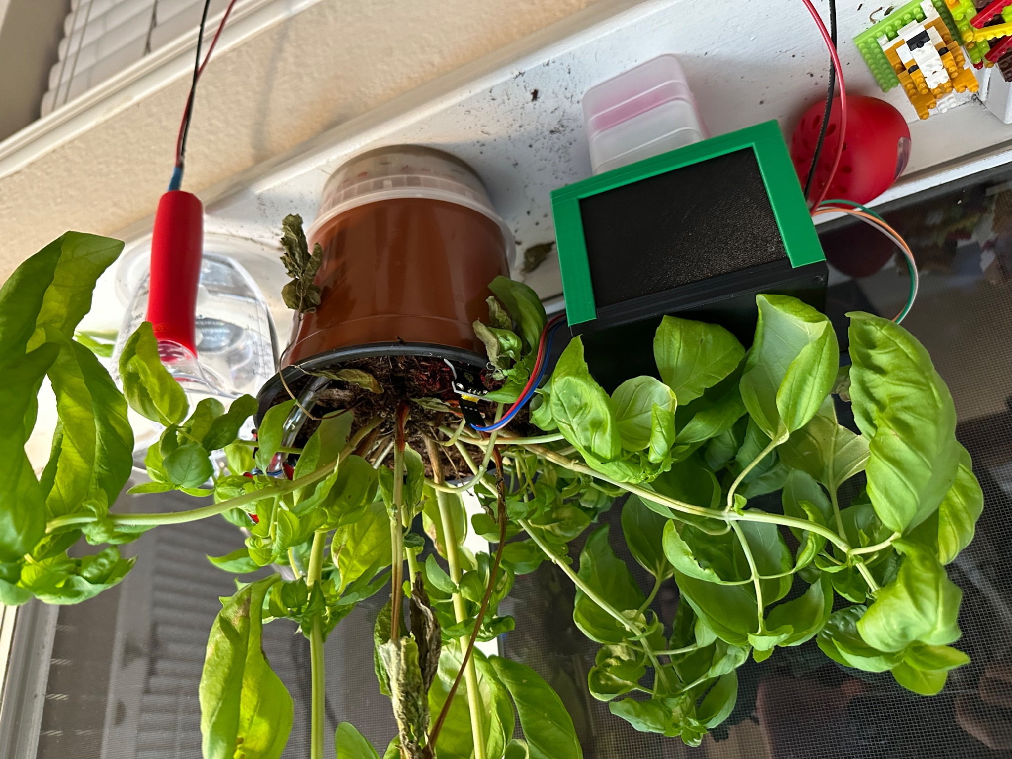
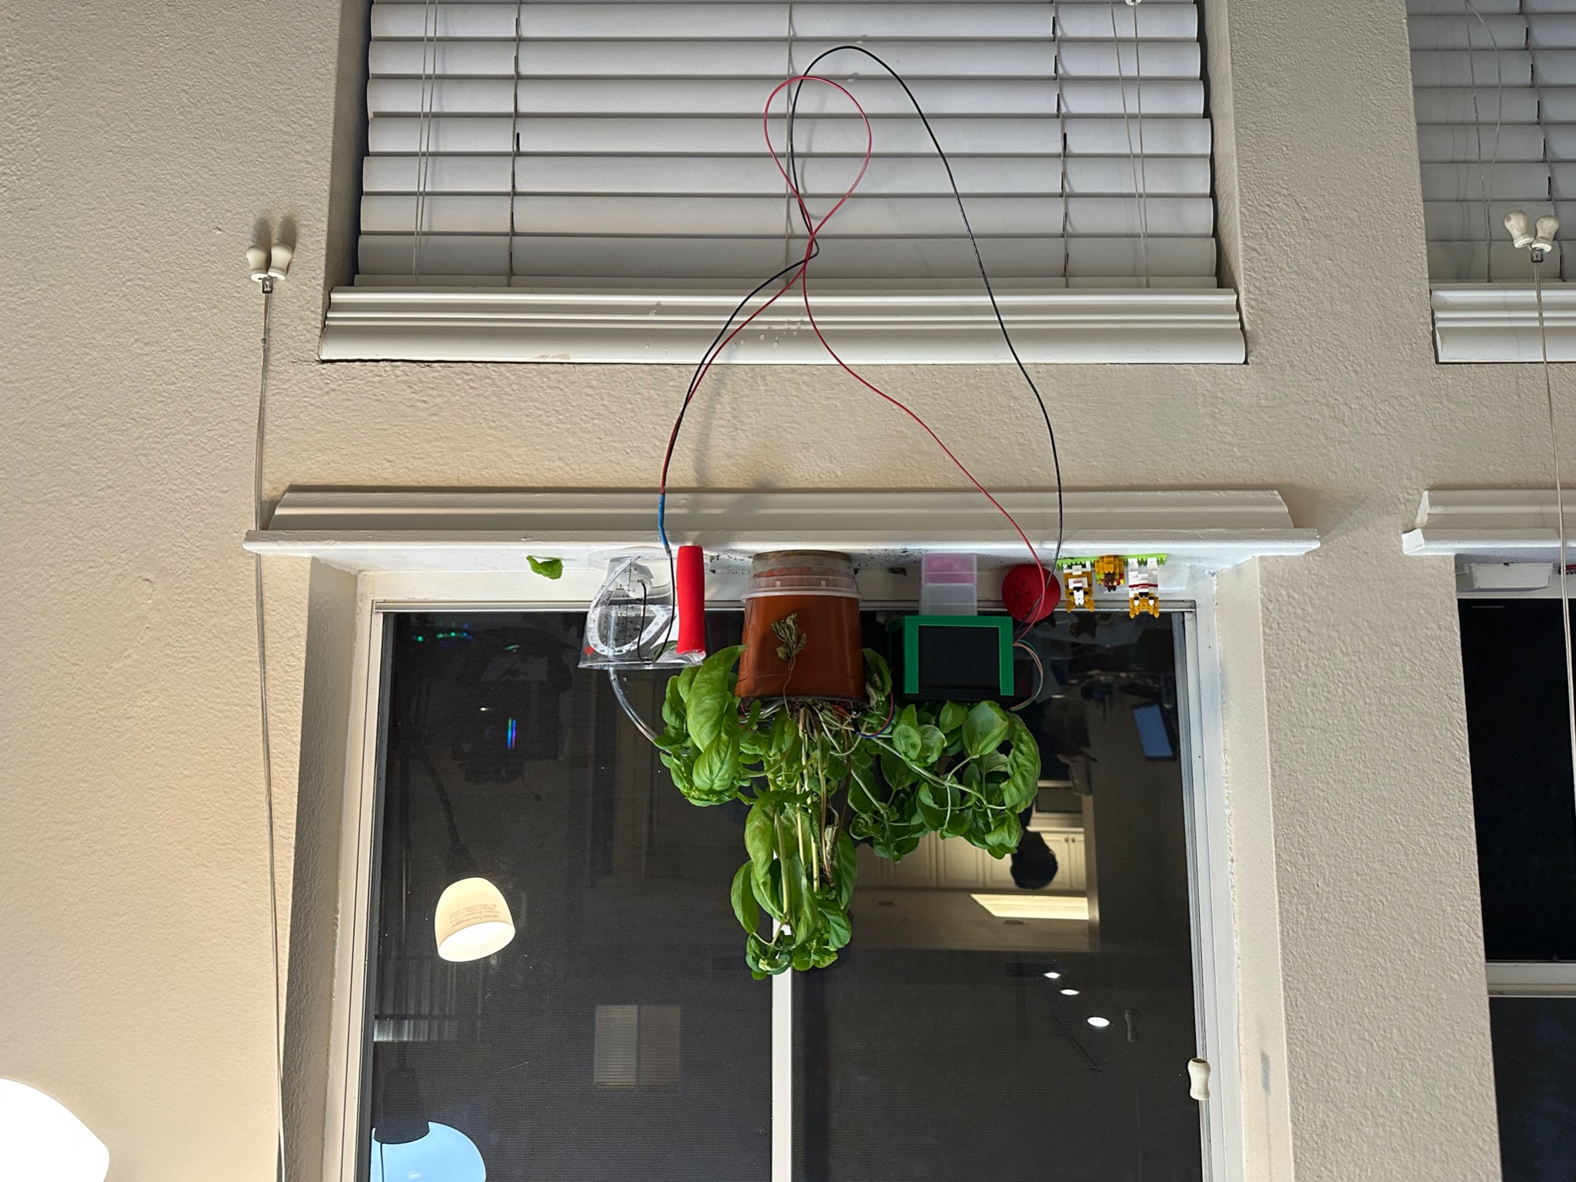
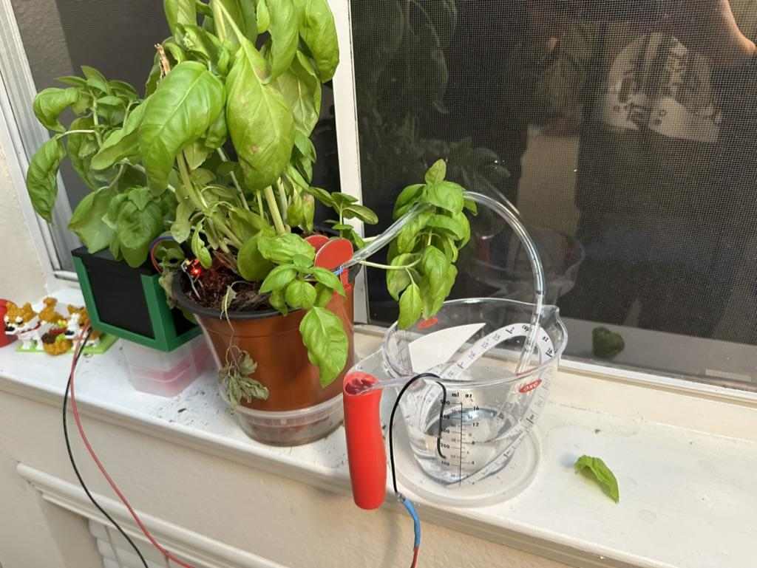

Slide 9
2.
Hardware

Slide 10
Sensors
Soil Moisture Sensor
UV Light Sensor
PyNode+ Air
Temperature
Humidity
Air Quality

Slide 11
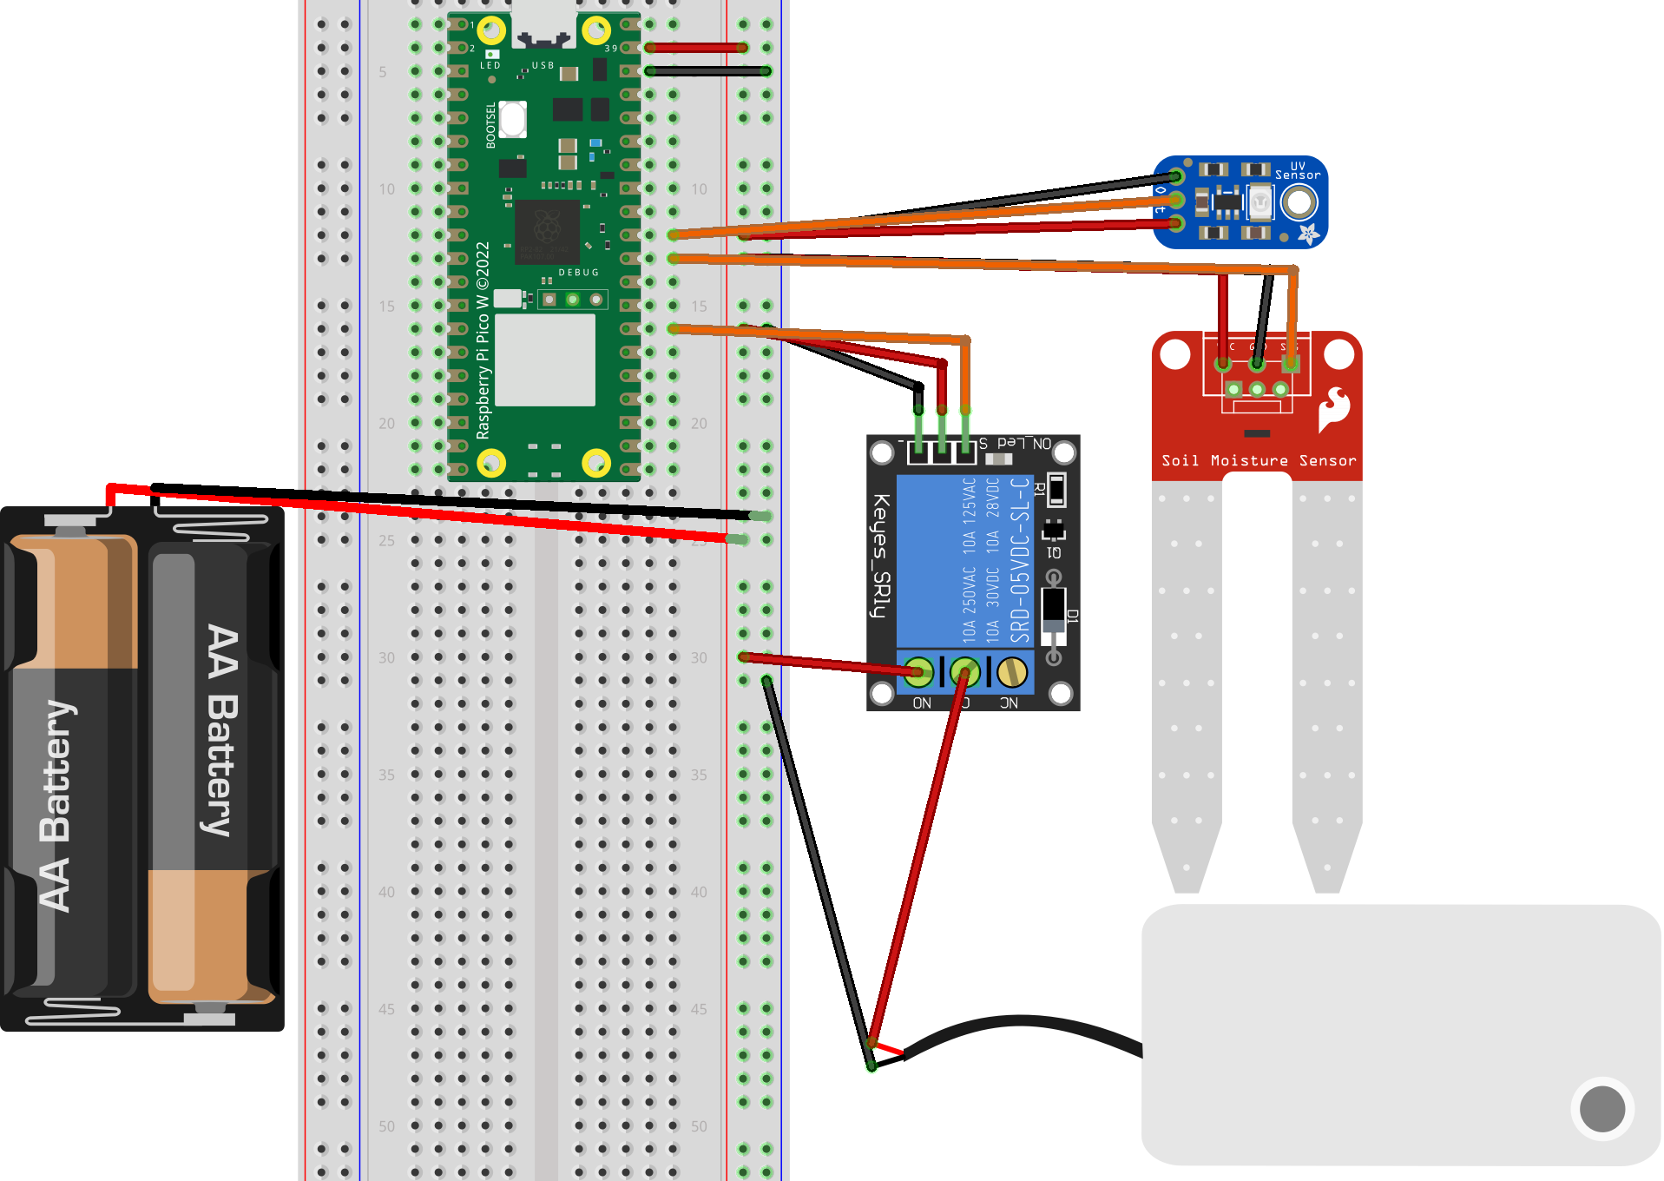
Wiring Diagram

Slide 12
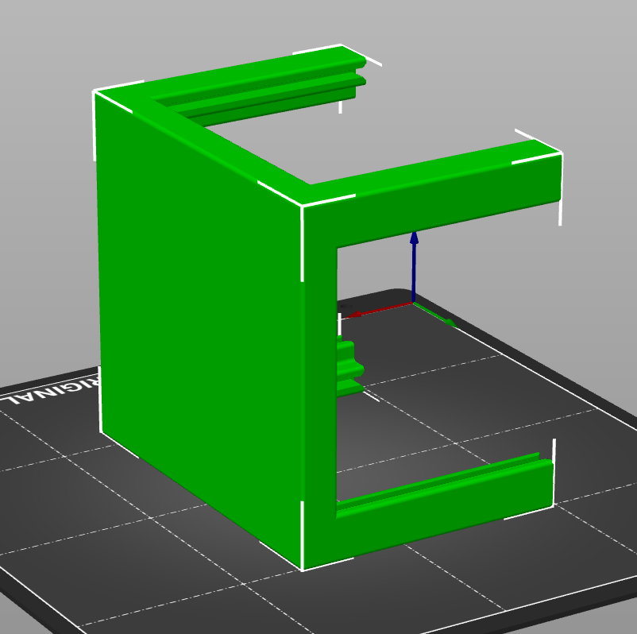
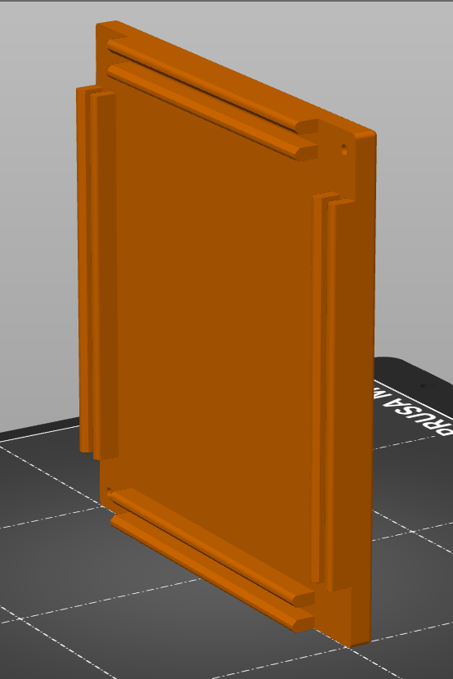
Box Base
Box Lid

Slide 13
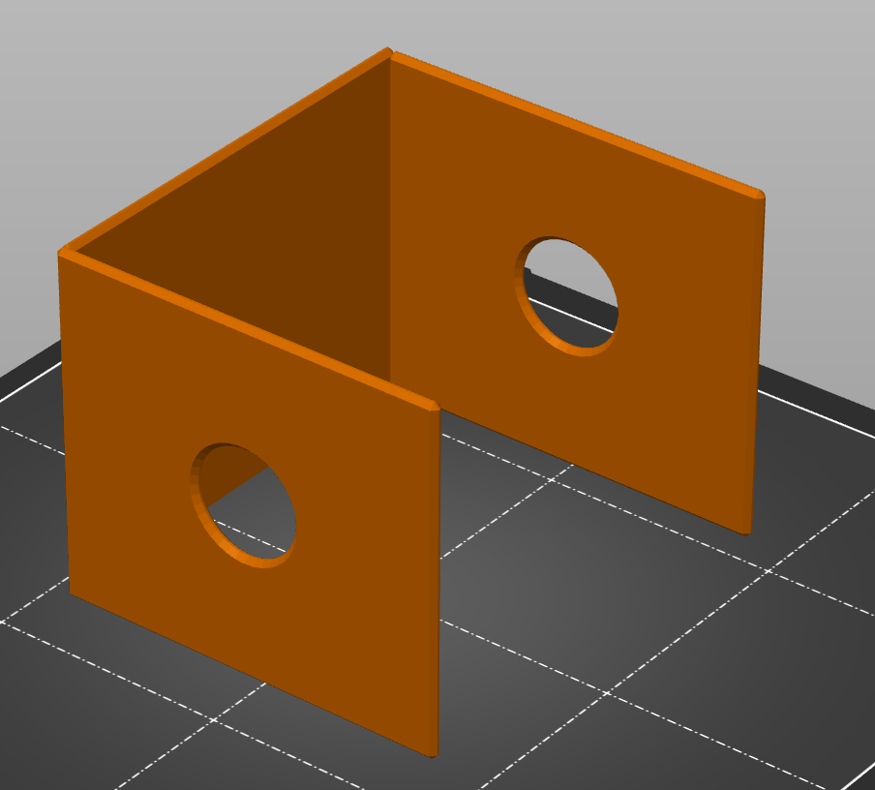
Box Walls

Slide 14
3.
Software

Slide 15
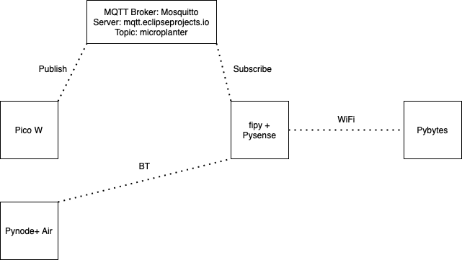
Network Setup

Slide 16
Original Plan: BT
Bought wrong part (bought slave module)
Pysense only has library for BLE
Notes:
Qos 0: At most once
Qos 1: At least once
Qos 2: Exactly once

Slide 17
Alternative: MQTT
No Network Information Exchanged
Publish/Subscribe
Broker
Retain Flag
Persistent Session
QoS
0: Fire & Forget
1: Acknowledged Delivery
2: Assured Delivery
Notes:
Qos 0: At most once
Qos 1: At least once
Qos 2: Exactly once

Slide 18
Pybytes
Cloud based MQTT service baked into pysense board
Easy visualization of sensor data
Easy implementation of python on top of data collection for analysis

Slide 19
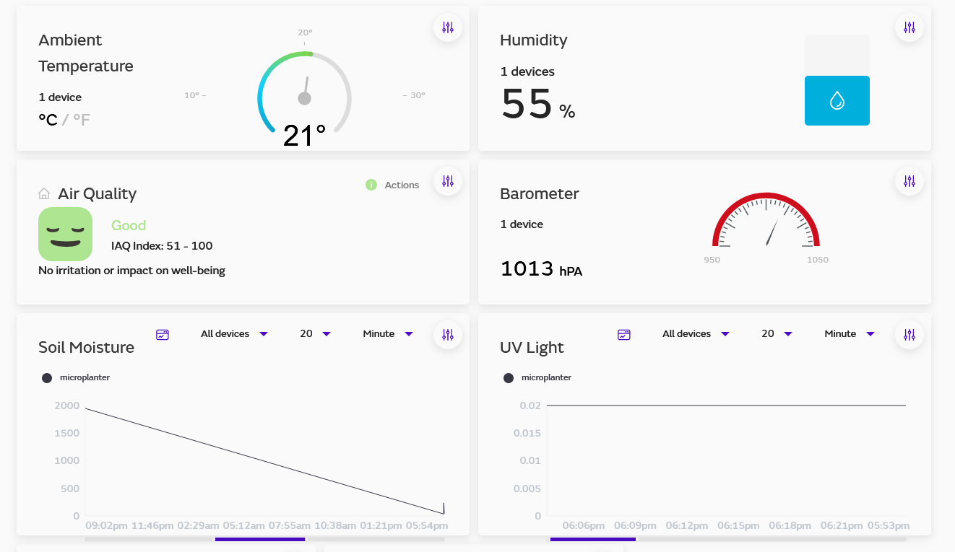

Slide 20
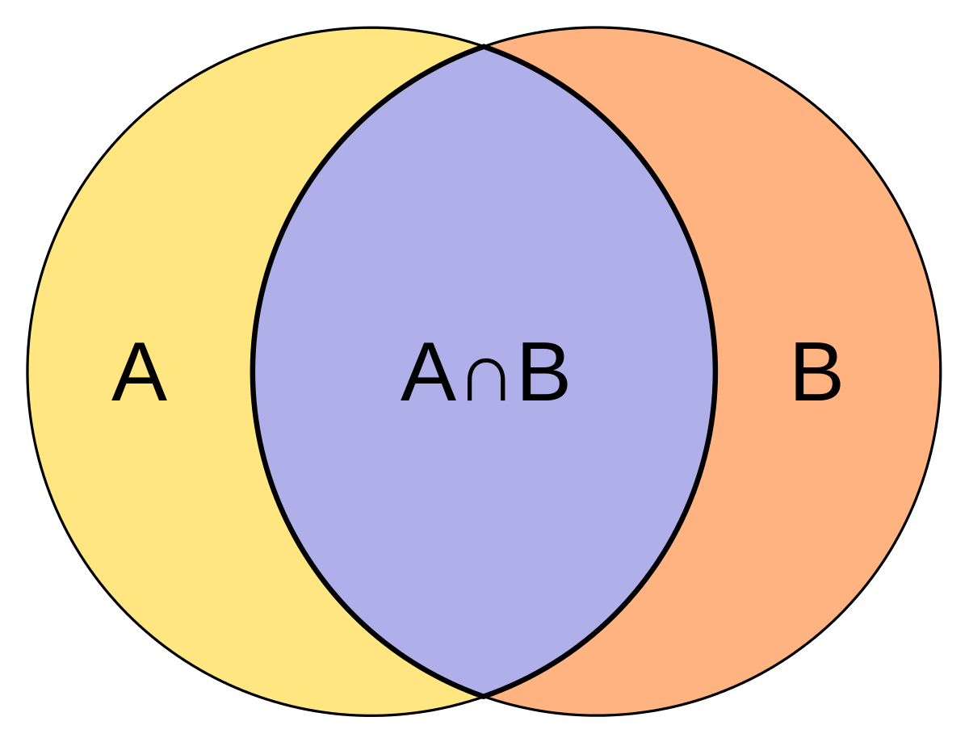
Recommender System
Jaccard Similarity

Slide 21
Similarity Score
Intersection of the soil temperature, harvest days, spacing divided by the union
Ensure that neither plant are on the avoid list
Bonus point for companion list and similar plant and harvest season

Slide 22
Category Weights
On Companion list = 30%
Soil temperature = 25%
Days to harvest = 25%
Spacing = 10 %
Similarity in plant months = 10%

Slide 23
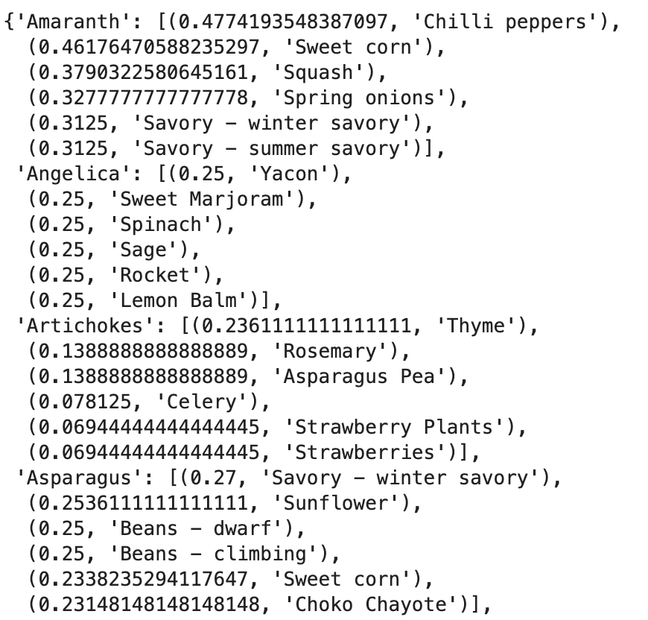
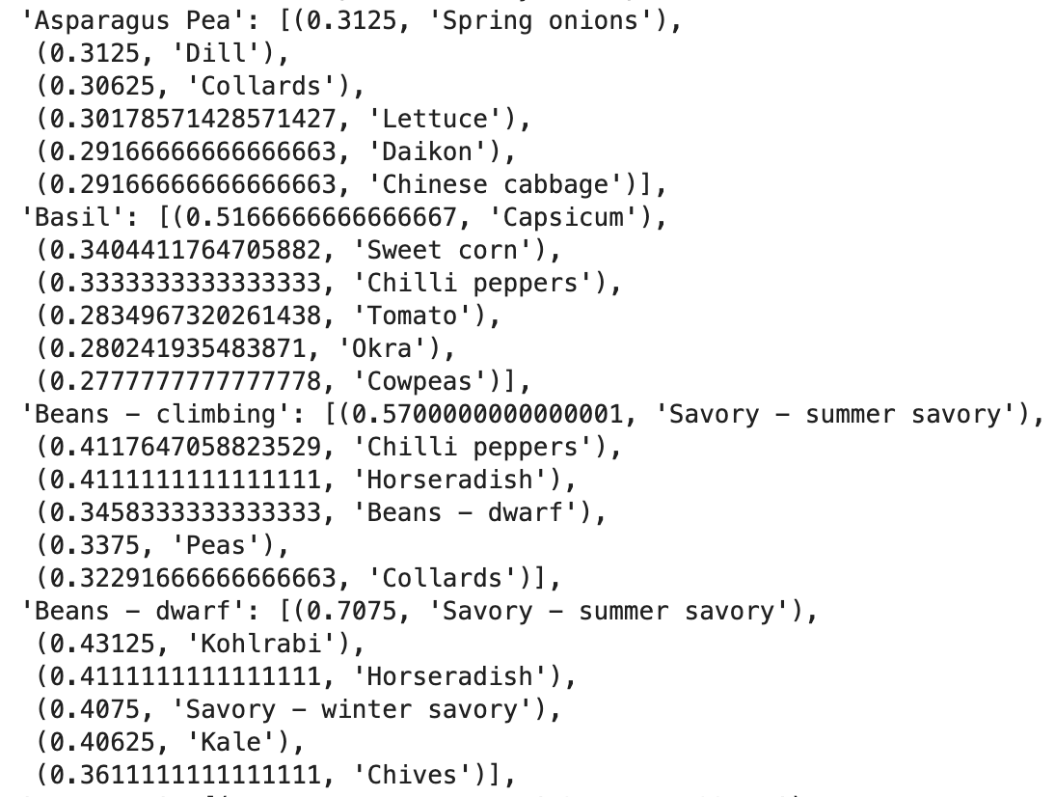

Slide 24
Things we can work on
Website
Recommender System Integration
Database Backend

Slide 25
Part 2
Contribution to HDSI IoT Infrastructure

Slide 26
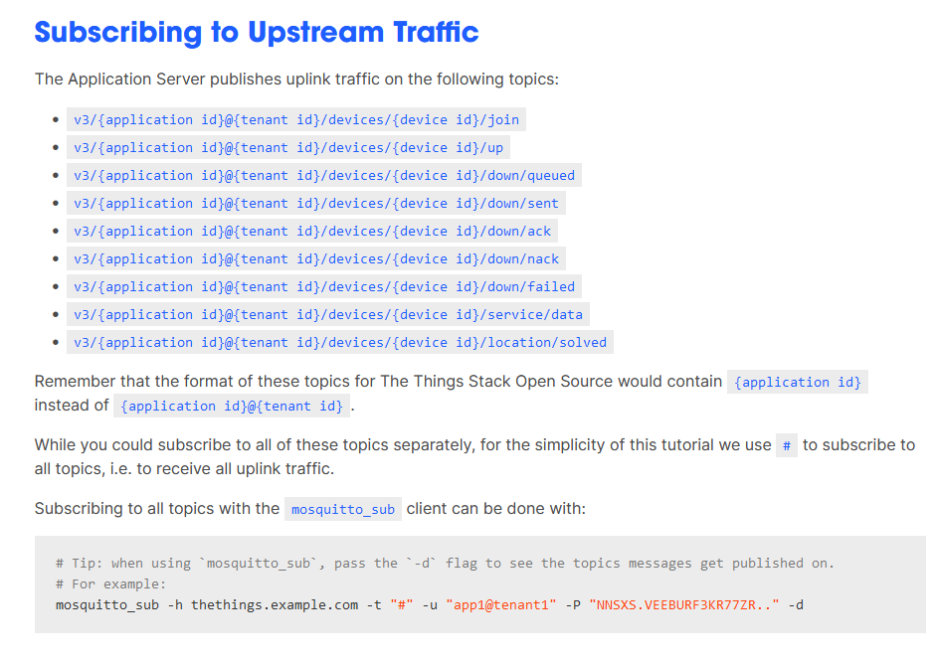
Pulling data from Things Network
MQTT Server is available to pull data to private database
Runnable on python, third-party client, java, etc

Slide 27
Q/A

