Slide 1

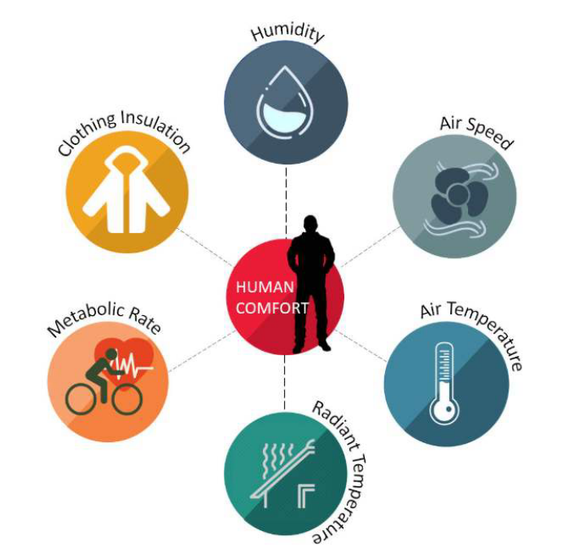
Assessing Thermal Comfort during Occupancy Periods: A Case Study of Residence Hall I
Theodore KABANGU NKASHAMA
Digital Innovation
Applied Artificial Intelligence

Slide 2
Objective
Data wrangling
Questions
EDA
Conclusions
Outline

Slide 3
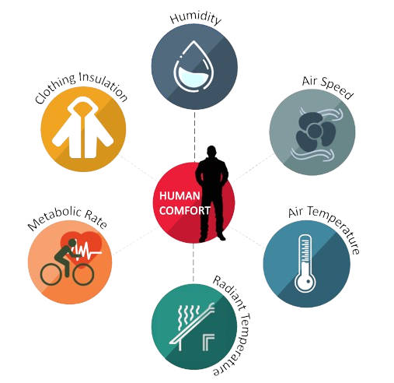
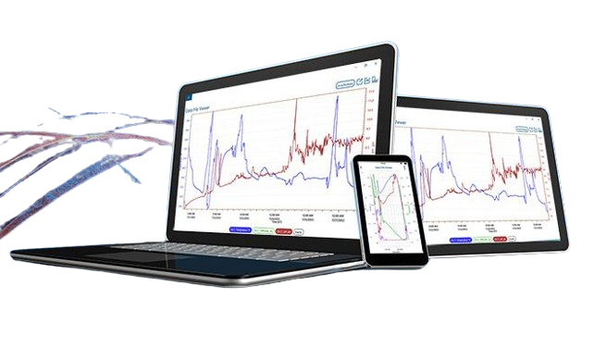
Objective
Understand the factors affecting thermal comfort according to ASHRAE 55 and utilize tools provided for thermal comfort assessment

Slide 4

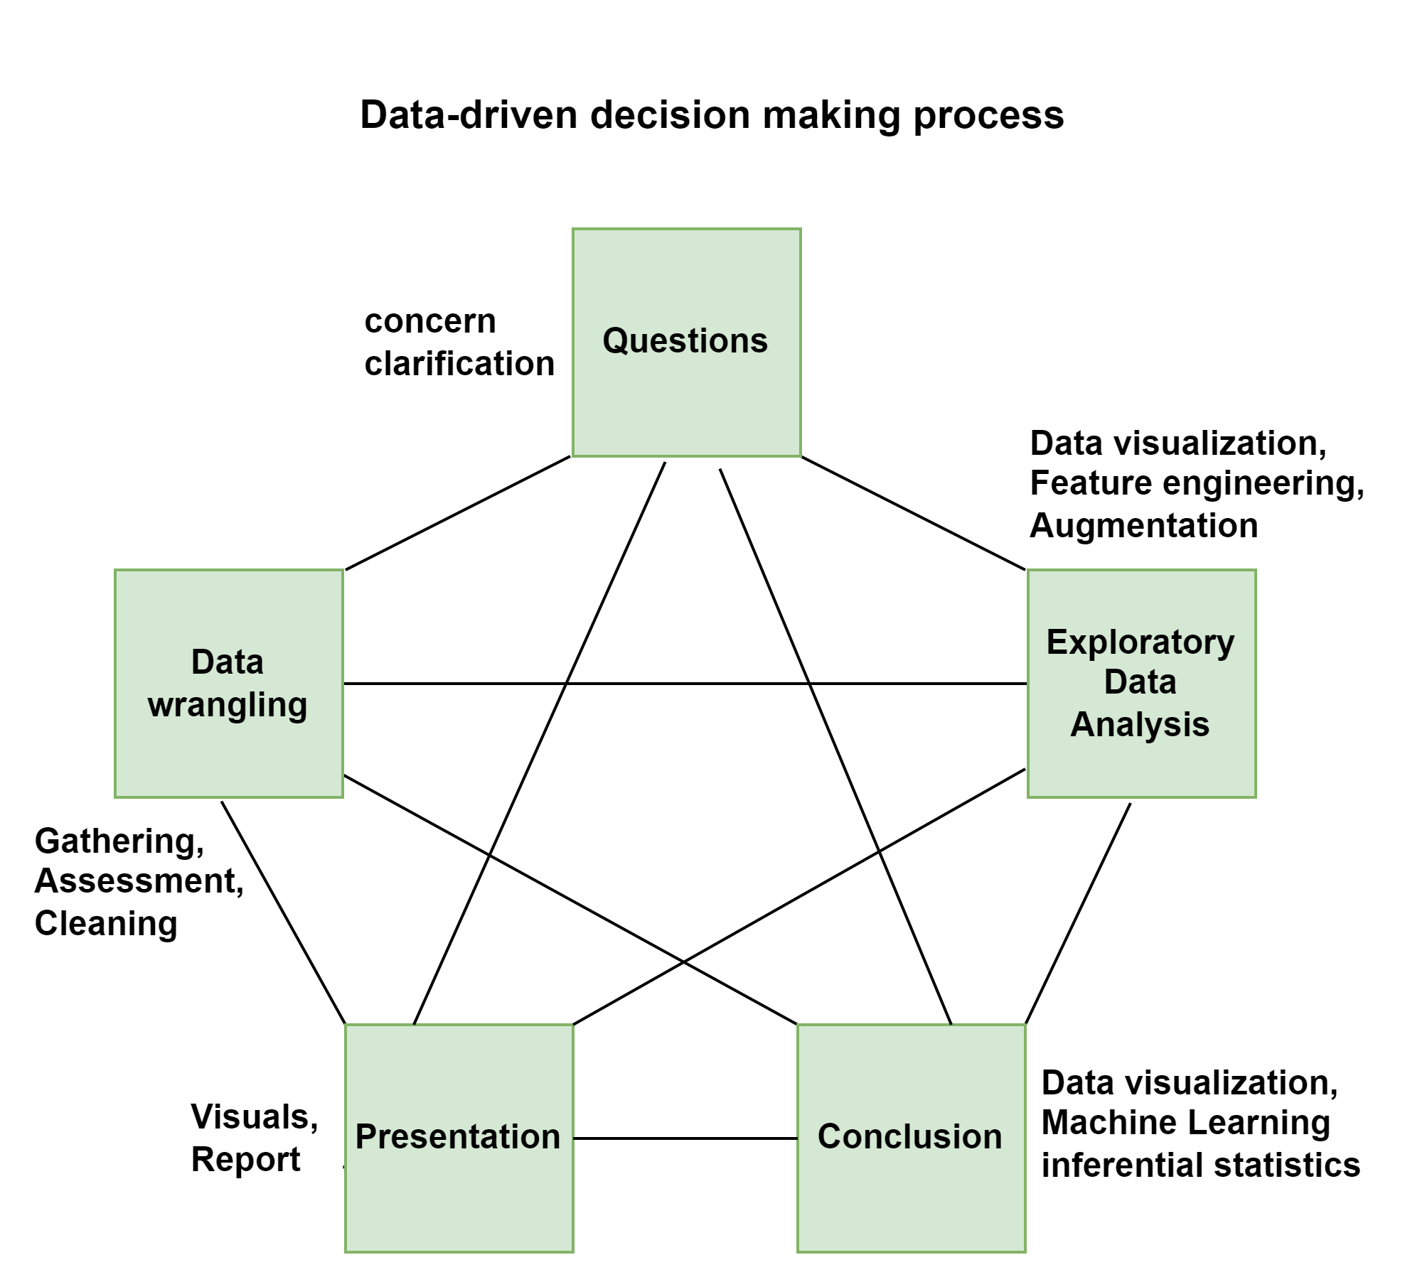

Methodology

Slide 5
Data Wrangling
Gathering
Assessment
Cleaning

Slide 6
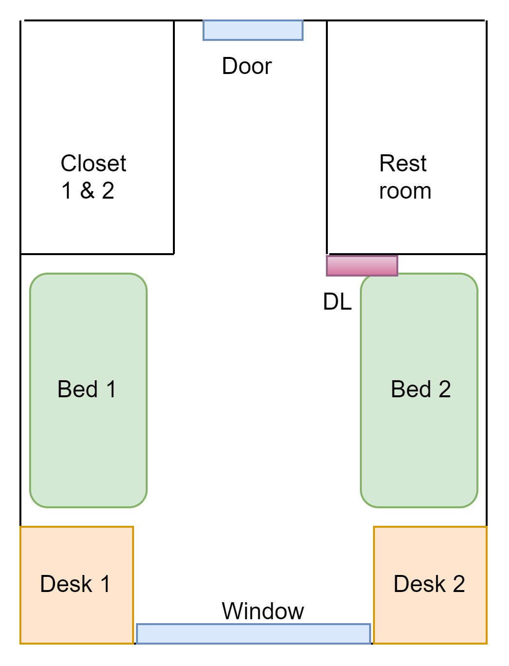
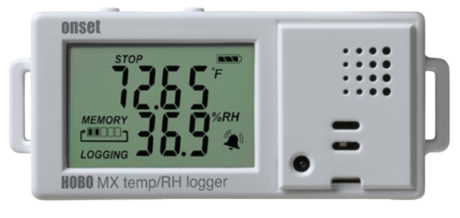





1. Data wrangling - Gathering
Room view
Tools:
Hobo Data Logger MX 1101
2. Hobo Connect monitoring app
Data:
1874x4 originally (Timestamp, T°, RH, and Dew point)
1874x11 after augmentation and feature engineering
Duration: 2024-05-08 12:38:46 to 2024-05-21 12:48:46
Source: Own elaboration using Draw.io

Slide 7
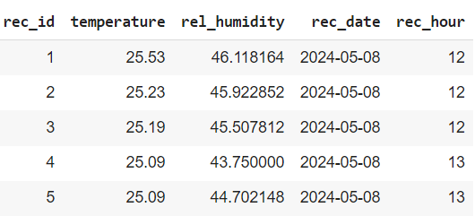
1. Data wrangling – Assessment & cleaning
Data description
Cleaning tasks
Factor | Min | Max | Mean | Count | Data type
T [°C] | 22.35 | 26.77 | 25.06 | 1874 | float
RH [%] | 33.00 | 62.71 | 48.34 | 1874 | float
DP [°C] | 7.66 | 18.23 | 13.30 | 1874 | Float
Date-time | - | - | - | 1874 | datetime64
Rename columns
Separate date and time in date-time column
Delete date-time column
Save the new dataset (1874x5)
Missing value, Duplicates
No missing value
No duplicates

Slide 8
2. Questions
The Power of Exploratory Data Analysis

Slide 9
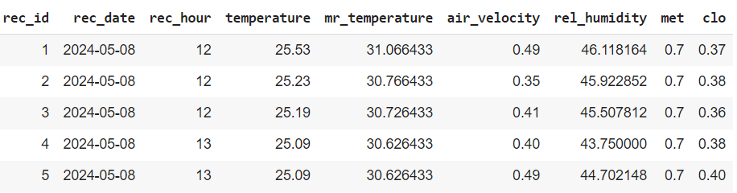
Requirements
Fix occupancy periods
Assumptions based on ASHRAE 55
Period | From | To
Morning | 6 | 9
Afternoon | 15 | 21
Evening | 22 | 5
Mean radiant temperature (tr) should be the dry bulb temperature plus a random number between 1 and 10
Air velocity, should be 0.1 plus a random number between 0.05 and 0.5 for a minimum of 0.15 and a maximum of 0.5 m/s
Metabolic rate should be 1 met when reading or seated (time slot: 6-9 or 15-21:59) and 0.7 when sleeping (time slot: 22-5) or outside 10-14:59
Clothing level should be between 0.36 and 0.4
Missing factors
Dimensions:
1874x9
Mean radiant temperature
Air velocity
Metabolic rate
Clothing insulation

Slide 10
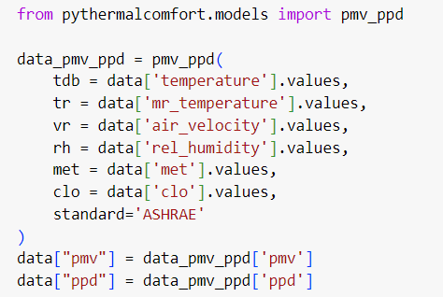


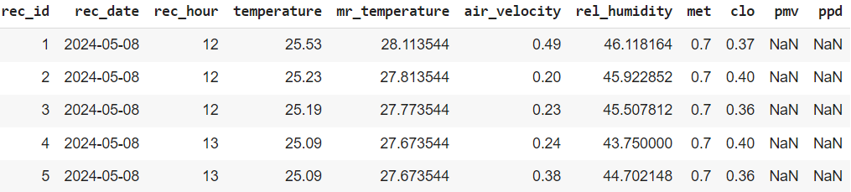
PMV-PPD calculation
Pythermalcomfort
Tartarini, F., Schiavon, S., 2020. pythermalcomfort: A Python package for thermal comfort research. SoftwareX 12, 100578.
Dimension:
1874x11
NAN: discomfort

Slide 11
Q1. How many times was the thermal comfort violated?

Slide 12
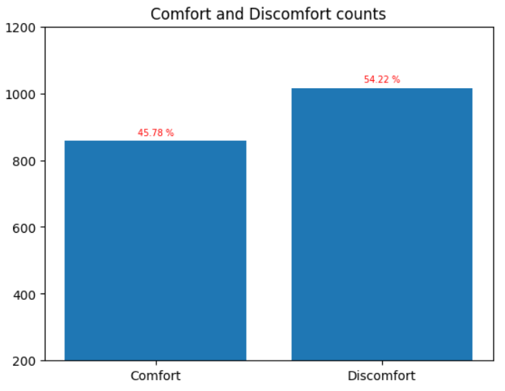
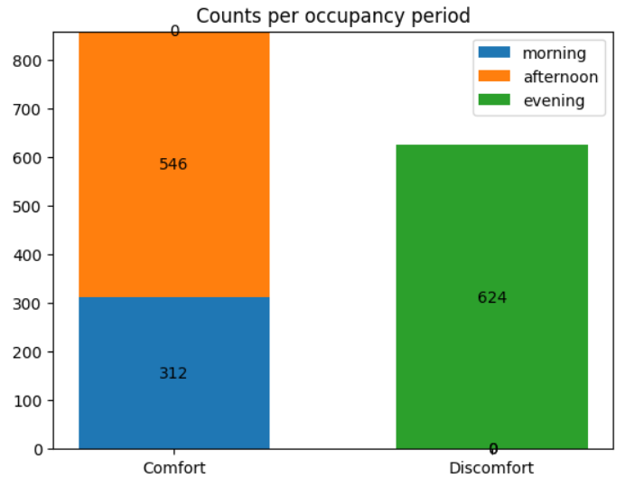
Comfort and Discomfort counts
All records
During occupancy
Comfort | Discomfort
858 | 1016
No cooling, nor heating during recording time. Only open window

Slide 13
Q2. When did the highest discomfort occur during occupancy?

Slide 14
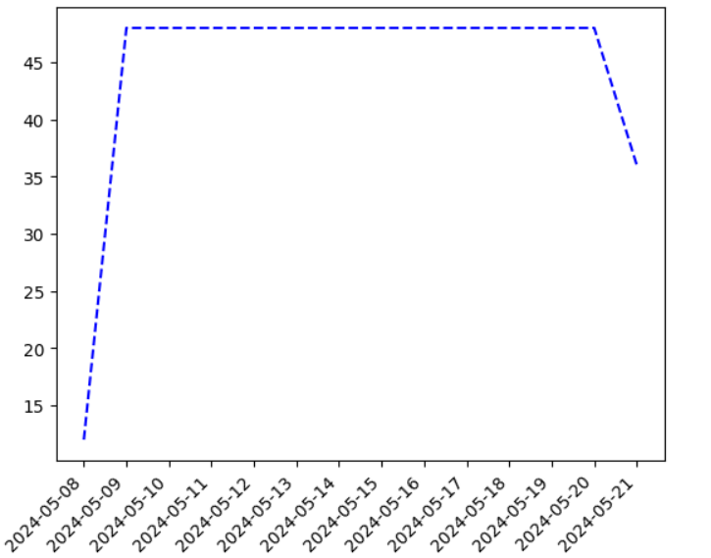

Highest discomfort count
The number of violations has been the same over all the recording time, except for the first and the last days where recording did not cover 24 hours.
Again, all these violations occurred during sleeping (between 22:00 and 5:00). No violation recorded in the morning nor in the afternoon.

Slide 15
Q3. What are the ranges of temperature and humidity that provided comfort?

Slide 16
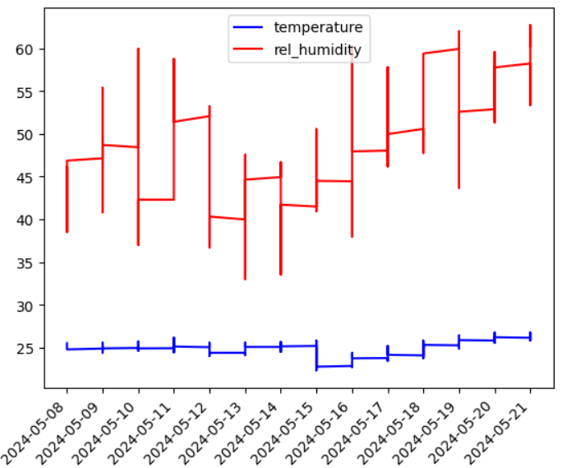
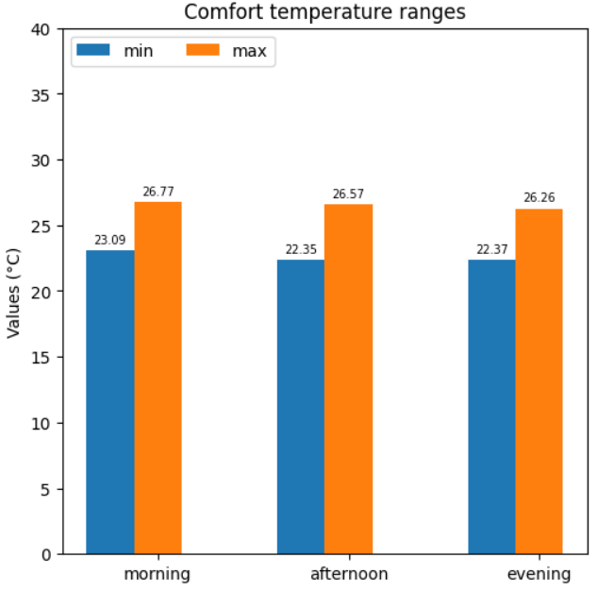
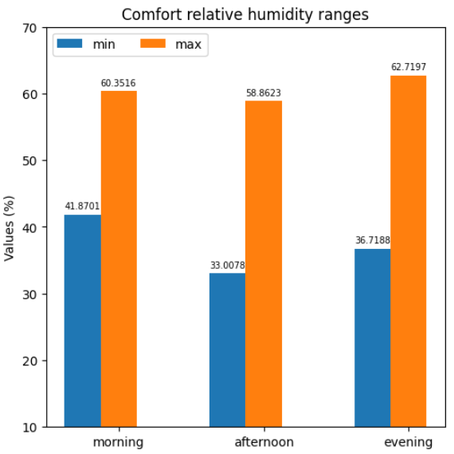
Temperature and Humidity over time
Temperature varied between 22.35 and 26.77 °C
Relative humidity varied between 33.00 and 62.71 %

Slide 17
Conclusions

Slide 18
Conclusions
1
2
3
Discomfort happens almost always in the evening. This must be due to the increase of relative humidity at night while the window was left open. The temperature did not change that much.
Comfort occurs almost always in the morning and afternoon. This must be due to human control over the window and the balance between sun heat and air humidity, which is not the case in the evening.
Given that data was recorded during Summer, the result prove that comfort is likely to be achieved while maintaining the temperature between 22.35 and 26.77 °C and relative humidity between 33 and 60.35 %, with the lowest clothing possible (i.e. shorts) and common activities (sleeping, seated and reading).

Slide 19
Remember !!!
Wrangle, Question, Explore, Infer, Communicate

Slide 20


Thank You
Theodore Kabangu Nkashama
Software Engineer & Data Analyst
Email: theobathresearch@gmail.com
My LinkedIn
+821073292315

