Slide 1

IOT Dashboard
Christopher Benson
Igor Raigorodskyi
Theodore Tsimiklis

Slide 2



Agenda
Our Dashboard
Phase 1
Phase 2
Phase 3
Phase 4

Slide 3
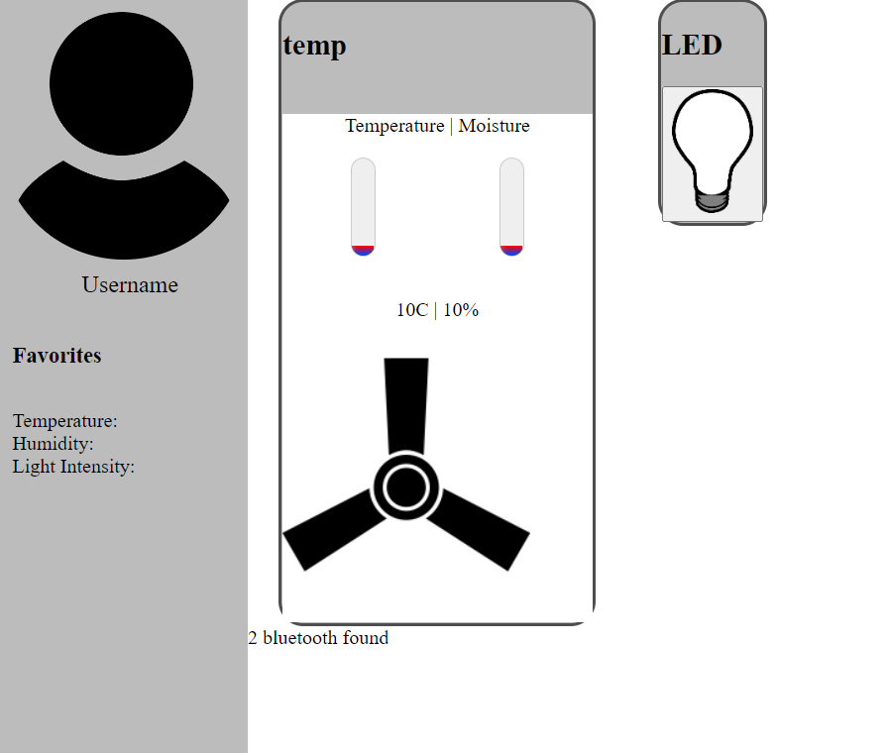
Our Dashboard
By using the Raspberry-Pi, Arduino UNO, NodeMCU ESP-8266 and more we developed a Web-based IOT Dashboard that is:
User friendly
Has multiple functionalities/features
Clean design

Slide 4
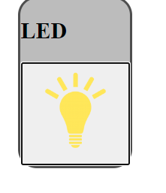
Phase 1
The purpose of this phase was to develop a button on the dashboard to work as a ‘light switch.
The Difficulty of implementation was fairly easy as it only required us to capture the data from the web app and send it directly to the Raspberry-Pi which we did using Flask.

Slide 5
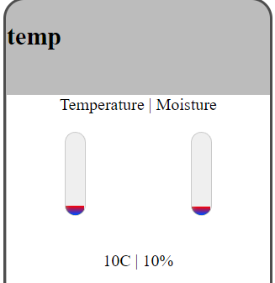
Phase 2
The purpose of this phase was to capture data from the DHT 11 Temperature and Humidity sensor and to send an email to the user when the temperature exceeded a certain amount
The gauges to display the Temperature and humidity were created using CSS.

Slide 6
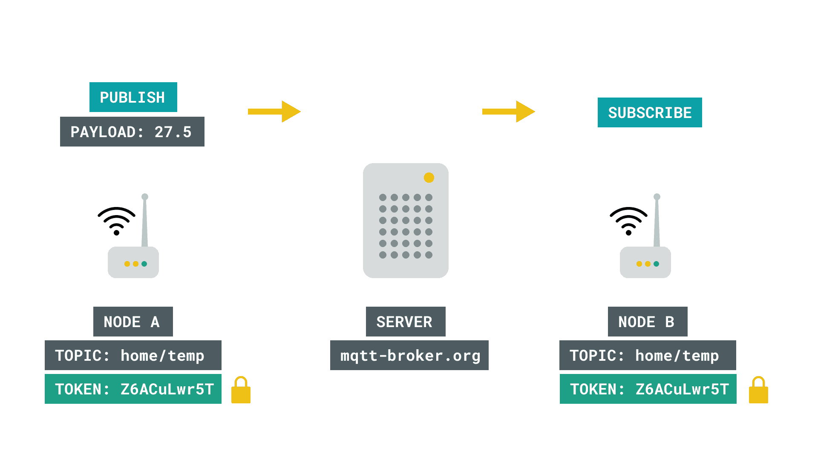
Phase 3
The main purpose of this phase was to capture data from a photoresistor to the RPI using the MQTT broker(WIFI).
A database was also created

Slide 7

Phase 4
Task 1
The purpose of this task was to create a user profile. In which, an assigned RFID tag number is given. Any information related to the RFID is sent using the MQTT broker.
Task 2
The purpose of this task was to count the number of Bluetooth devices-enables nearby.

Slide 8


Thank You
Christopher Benson
Igor Raigorodskyi
Theodore Tsimiklis

