Slide 1
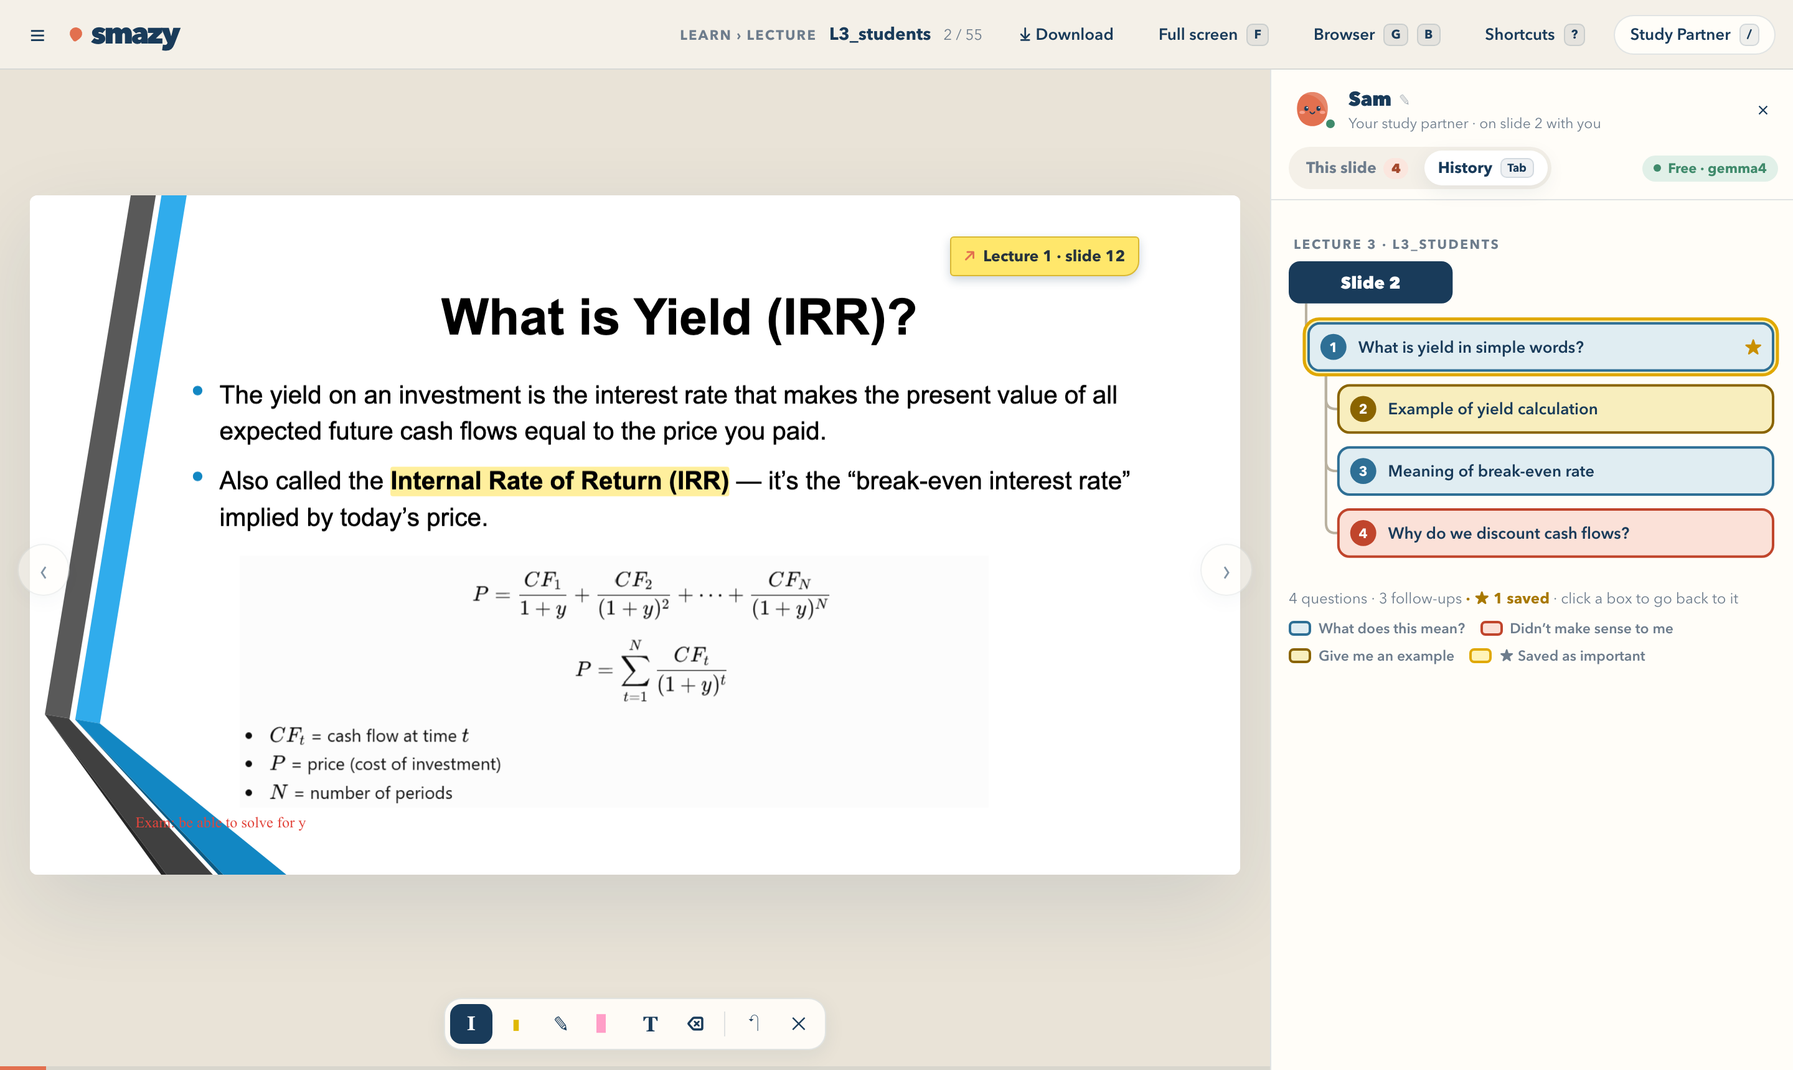
smazy
Smart about being lazy.
A study platform where the help comes to the lecture slide, so students never have to leave it.
The working prototype: a lecture with notes and a link, beside the Study Partner’s history tree
AWS Hackathon · October 2026 · Team Smazy
Notes:
SPEAKER 1
Hi everyone, we’re Team Smazy. Smazy blends “smart” and “lazy”. It’s a study platform for students who want to learn well with the least friction, and it’s built on one idea: when you’re locked in on a lecture slide, you should never have to leave it.

Slide 2



Studying with AI today pulls students out of their flow
THE PROBLEM
Context switching breaks flow
AI study chats get messy
Information overload
Every jump to a browser tab or a chatbot window to ask “what does this mean?” costs attention, even when it takes a moment.
Explanations, follow-ups and side questions pile up. The answer that finally clicked is buried in one huge conversation.
Slides, syllabus, rubrics and project guidelines are scattered across the course system, and searching for them breaks momentum.
Too much in one place overwhelms students. That is the problem Smazy exists to fix.
Notes:
SPEAKER 1
Here’s the problem. When a slide confuses you, you switch to a browser tab or a chatbot to ask “what does this mean?” Even a quick switch costs attention and breaks your flow. Second, studying with AI creates long, messy chats. The one explanation that finally made sense gets buried, and scrolling back for it kills your momentum. And third, course material is scattered: slides, syllabus, rubrics and guidelines, all in different places. Too much in one place overwhelms students. That’s what Smazy fixes.

Slide 3
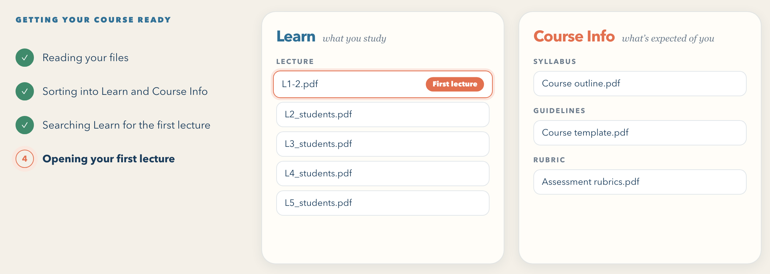
Upload the course once. Study without leaving the slide
THE IDEA
1
Upload the whole course folder
Lecture slides, syllabus, homework, rubrics and books: PDF, PowerPoint or Excel.
2
Smazy sorts every file
Learn: lectures, in order. Course Info: syllabus, homework, guidelines, rubric, readings, books.
3
The first lecture opens
Real course folder, sorted in seconds. The first lecture is flagged and opened.
Read from names like Lecture 01, Week 1 or L1. If unsure, it asks.
Built for students who are smart but lazy: they want to do well with the least friction.
4
Everything lives on the slide
Your Study Partner, notes, links and even the web. No new tabs.
Simplicity
Orderliness
Flow state
Learning momentum
Notes:
SPEAKER 2
Here’s how it works. A student uploads the whole course folder once, straight from their learning system. Smazy sorts every file by what the student does with it. Lectures go into Learn, in order. The syllabus, homework, project guidelines, rubrics, readings and textbooks go into Course Info. Then it finds the first lecture by reading the file names, whether they say Lecture 01, Week 1 or L1, and opens it. If it isn’t sure, it asks. From then on, everything lives right on the slide: your Study Partner, your notes, your links and even the web. We follow four principles: simplicity, orderliness, protecting flow, and keeping learning momentum. Our users are university students who are smart but lazy: they want to do well, with no wasted effort.

Slide 4




Quality education now means less distraction and burnout
WHY IT MATTERS · UN SUSTAINABLE DEVELOPMENT GOAL 4
4
Fairness for everyone
Too many tabs and messy files tire students out before they even start. Smazy organizes everything, so everyone gets an equal chance to learn.
QUALITY
EDUCATION
Helping every mind
Every student learns differently. Students with ADHD often struggle to stay focused on long, plain pages. Smazy breaks information into clear, bite-sized pieces.
We usually think of schools and books. Today’s students face a new problem: too much distraction, and feeling very tired.
Protecting mental health
Focusing with too many windows open is stressful. Smazy keeps things simple, so students can stay calm.
Good education isn’t staying up all night. It’s learning well without burning out.
Notes:
SDG 4: QUALITY EDUCATION (right after Speaker 2)
When we think about SDG 4: Quality Education, we usually think of building schools and buying books. But today, students face a new problem: too much distraction and feeling very tired.
Smazy helps with SDG 4 in three easy ways:
- Fairness for Everyone: Too many tabs and messy files make students tired before they even study. Smazy organizes everything so everyone has an equal chance to learn.
- Helping Every Mind: Every student learns differently. For example, students with ADHD often find it hard to stay focused on long, plain text pages. Smazy adapts to help each person by breaking information into clear, bite-sized pieces.
- Protecting Mental Health: Trying to focus with too many windows open is very stressful. Smazy keeps things simple so students can stay calm.
In the end, Smazy helps people study smarter and protect their mental health. Good education is not about staying up all night; it is about learning well without burning out.

Slide 5
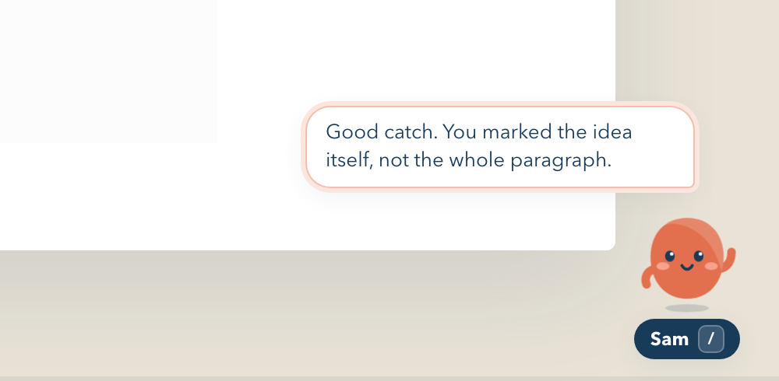




A companion that studies beside you, not a chatbot
FEATURE 1 · STUDY PARTNER
Always there on the slide
Built
A small character keeps you company: it blinks, looks around and nods as you move on. It speaks rarely, so it never breaks your focus.
Make it yours
Built
Give it a name, then pick a character, a colour and an extra: glasses, a grad cap, headphones, coffee.
Praise that means something
After a highlight, the Study Partner says what was good about it
Built
It notices highlights, notes and links, and says what you did well and why it helps. It is honest when you overdo it.
Notes:
SPEAKER 3
Feature one is the Study Partner: the classmate who already read the syllabus and knows the rubric by heart. It is not a chatbot you summon. It is a small character that sits on the slide and keeps you company while you study. You can name it and choose how it looks. And it notices good habits: highlight a key line or link two lectures, and it tells you what you did well and why it helps. It is honest too: highlight everything, and it tells you to pick the lines that matter.

Slide 6
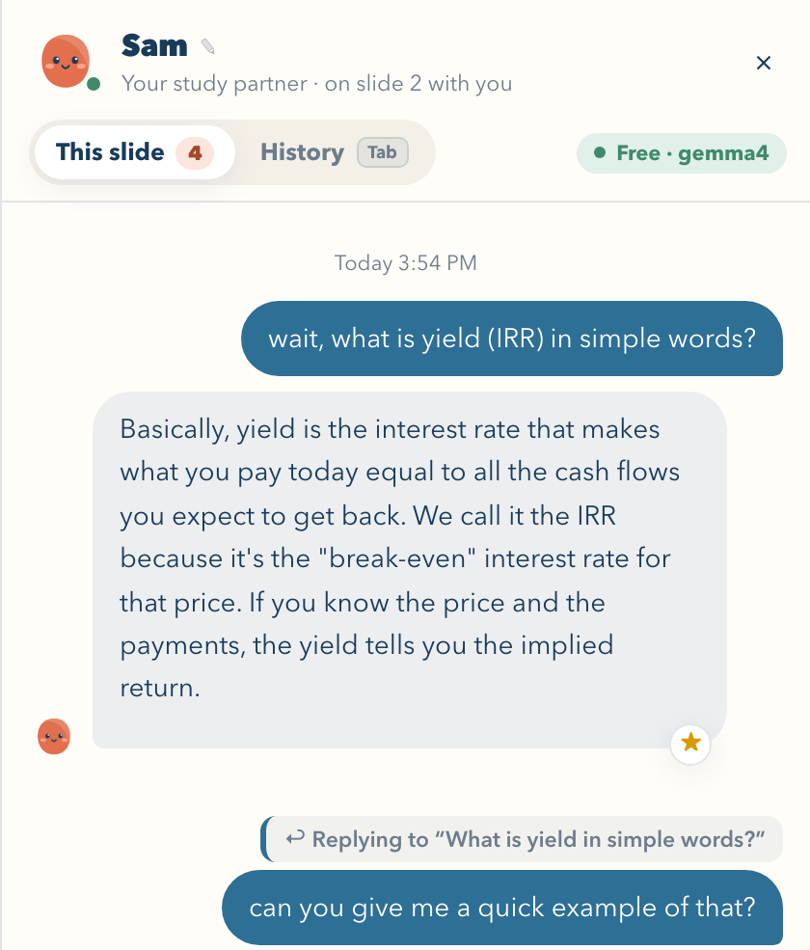




Talking to it feels like messaging a friend
FEATURE 1 · STUDY PARTNER
Back and forth, in bubbles
Built
Press / and it opens like a direct message: “typing…”, “Seen”, and follow-ups shown as replies.
Knows your slide and your course
Built
It reads the slide you are on and your course files, so answers come from your own material.
Quick or Deep, typed or spoken
Built
Choose the key point or the full explanation. Speak your question, and listen to the answer.
Matched to your personality
Planned
A few questions set how proactive it is and its tone. This needs a larger AI model than our demo’s.
Notes:
SPEAKER 3
Press slash, and talking to it looks like messaging a friend, not filling in a chatbot. It knows which slide you are on and has read your course files. You choose a quick answer or a deep one, and you can simply speak. The plan is to match it to each student’s personality: a few short questions decide how proactive it is and what tone it uses. That part is not built yet, and it needs a larger AI model than the free one in our demo.

Slide 7
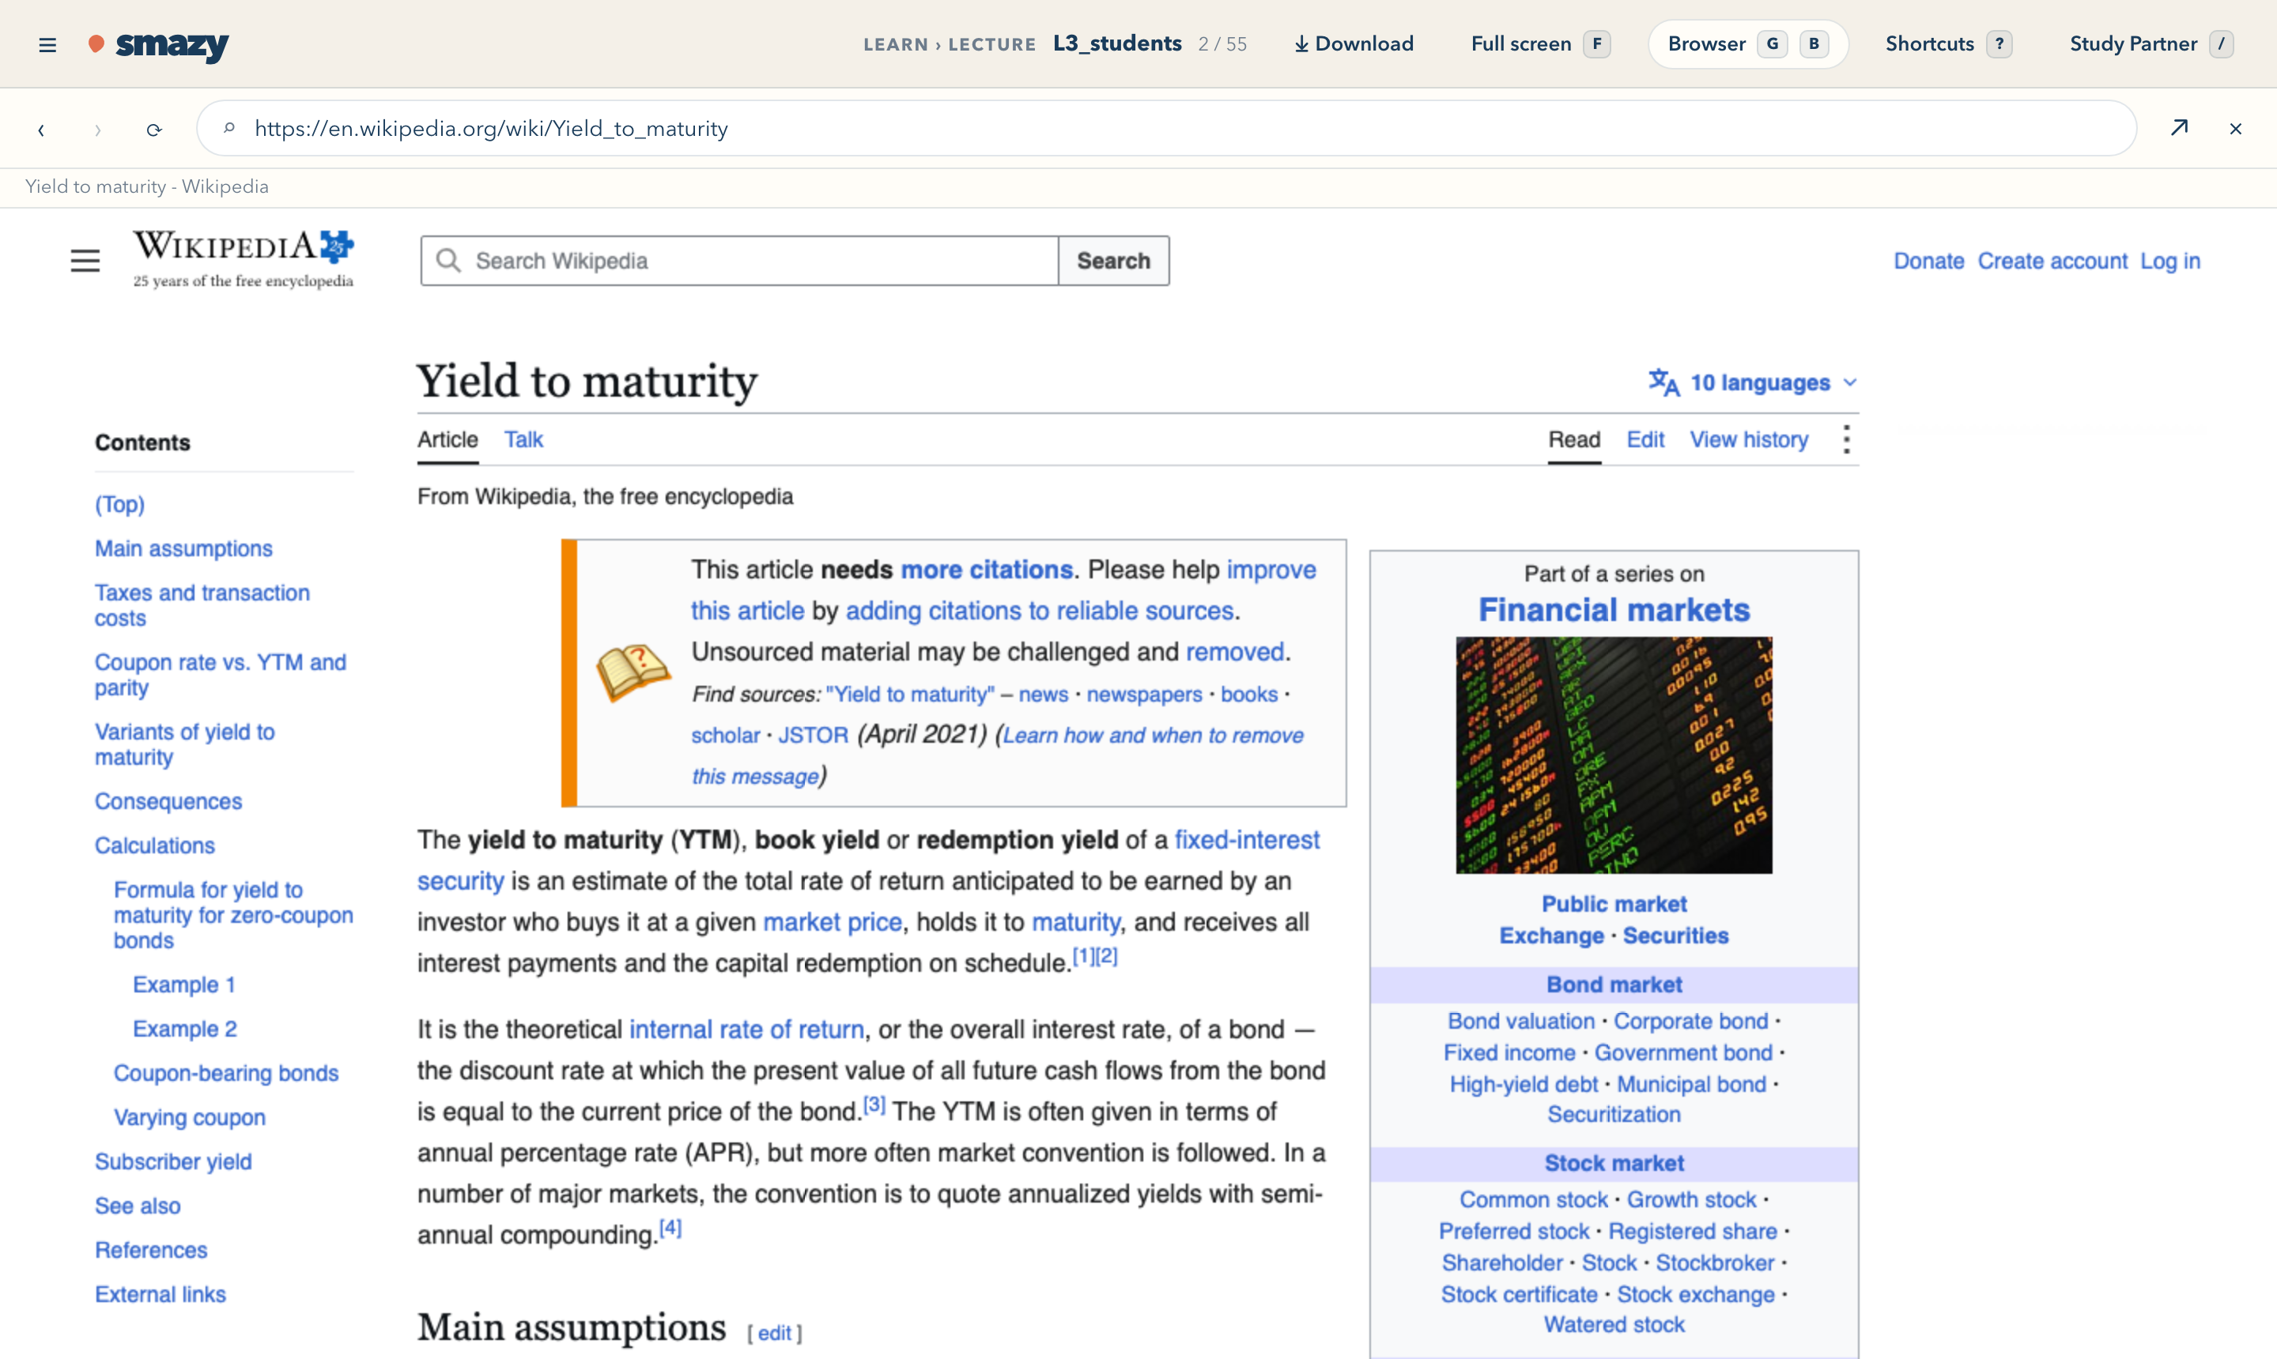

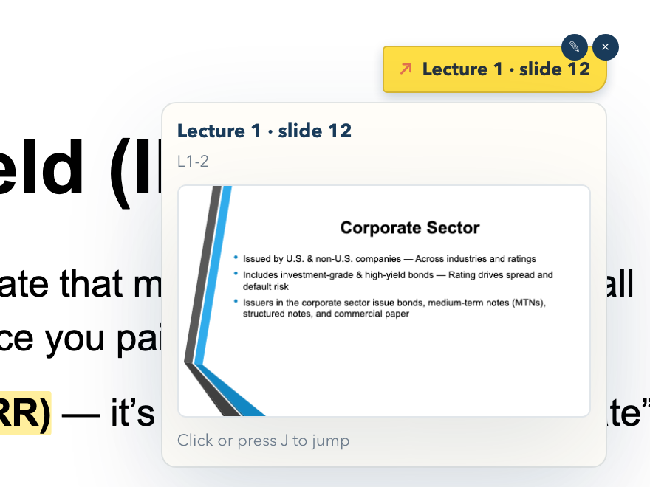

Jump anywhere in about a second, like game controls
FEATURE 2 · QUICK LINKS
Links between your materials
A lecture that mentions the project gets a button to the guidelines. Pin a sticky note to link a slide to an earlier lecture, with a private note on why.
G
2
Lecture 2
K
S
Syllabus
L
Link two slides
J
Jump there, and back
/
Study Partner
G
B
Web browser
Above: a web search opened with G B, without leaving Smazy.
Left: a sticky note linking to Lecture 1, slide 12.
A mini web browser inside Smazy
Search and read without leaving. Web links on your slides open in it too.
Notes:
SPEAKER 4
Feature two is quick links. When a lecture mentions the project, a button takes you straight to the guidelines. Shortcuts work like game controls: G then 2 opens Lecture 2, K then S opens the syllabus. You can pin a sticky note that links this slide to a slide in an earlier lecture: J jumps there, and J again brings you back. And when you need the web, G then B opens a small browser inside Smazy, so even a search doesn’t take you away. No shortcut clashes with your browser, and single keys pause while you type.

Slide 8
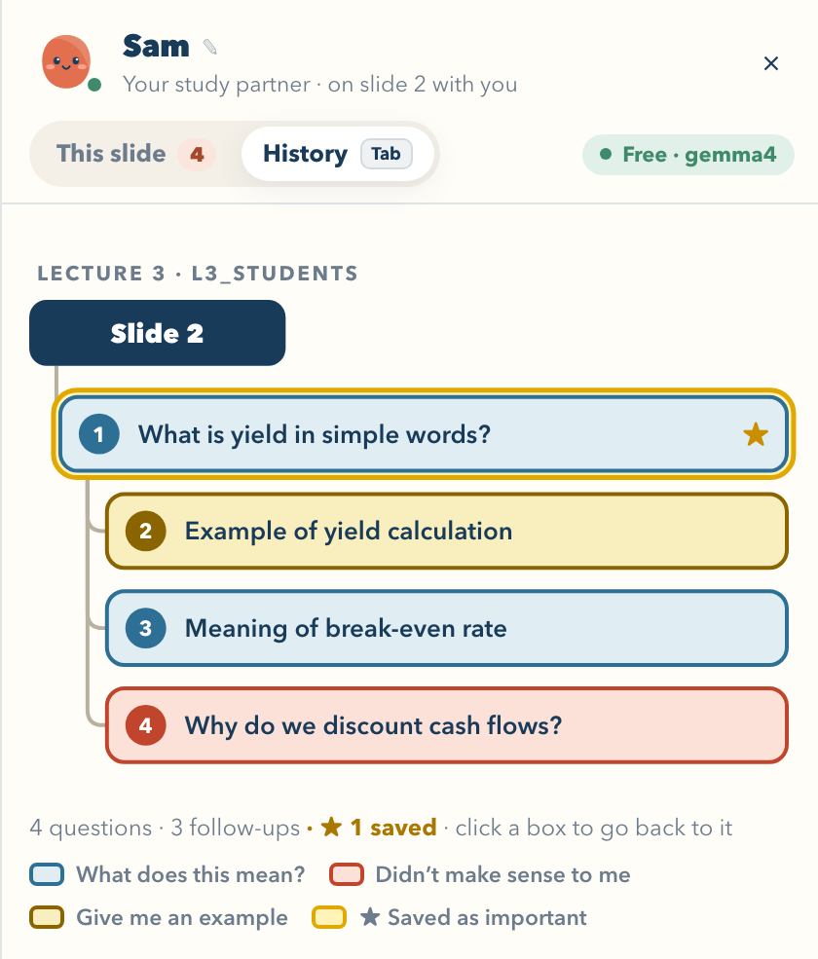






Rewind your learning, not another chat
FEATURE 3 · ORGANIZED CONVERSATION PANEL
Chats pinned to slides
Follow-ups as branches
Built
Built
Each slide keeps its own conversation. Come back and it’s there.
The AI spots follow-up questions and files them under the answer they build on.
History tree
Save what matters
Built
Built
One picture per slide, coloured by the kind of question. Click a box to go back.
Star an answer and it stands out in the tree.
“Still confused” flags
Auto study notes
Partly built
Planned
Questions that didn’t make sense show in red. A review list is next.
A short summary for each slide or lecture.
Notes:
SPEAKER 4
Feature three is the organized conversation panel: a rewind, not another chat. Every conversation stays with the slide it happened on. The AI works out which questions are follow-ups and draws the slide’s history as a tree, coloured by the kind of question. You can star the answers that mattered, and one click takes you back. Most of this is built; the review list and automatic notes are still to come.

Slide 9

What we built in a short hackathon
THE DEMO
Upload a folder; files sort into Learn and Course Info
First lecture found and opened, tested on 5 real courses
PDF, PowerPoint and Excel files open inside Smazy
A Study Partner you can name and customize
Quick or Deep answers, voice, and a history tree
Markup like Preview, with a PDF download of your notes
Linked slides, a built-in web browser, and shortcuts
Notes:
SPEAKER 4
Here’s what we built. Drop in a real course folder, and Smazy sorts it and opens the first lecture. We tested it on five of our own courses, with PDF, PowerPoint and Excel files. On the slide you can highlight, draw and add text boxes like in Preview, download your notes as a PDF, search the web, and talk to your Study Partner about the exact slide you’re on.

Slide 10


Built spec-first in Kiro
02 TECHNICAL IMPLEMENTATION
requirements.md
design.md
tasks.md
What Smazy must do
How it’s built
Step-by-step build plan
When a student uploads a course folder, Smazy shall automatically group files into Learn and Course Info.
Study Partner chat + conversation logs
Build upload screen
Build auto-grouping
Build personality questions
Spec in Kiro: requirements → design → tasks, so every feature we built traces back to a requirement.
Notes:
SPEAKER 5: Technical implementation (spec in Kiro)
Suggested: We built Smazy spec-first in Kiro. requirements.md states what it must do, for example: when a student uploads a course folder, Smazy shall automatically group files into Learn and Course Info. design.md describes how, such as the Study Partner chat and its conversation logs. And tasks.md breaks it into buildable steps: the upload screen, the auto-grouping, and the personality questions.

Slide 11


Built in a short time, so some things aren’t there yet
DEMO LIMITATIONS
Not built yet (out of time)
Prototype shortcuts
A personality-matched partner: today every student gets the same Study Partner. Only its name and look are theirs.
The rest of Feature 3: the “still confused” review list, auto study notes, and one-key recall of saved answers.
Proactive margin hints on tricky slides.
Runs on one laptop: no accounts, cloud storage or encryption; chats and notes stay in the browser.
The demo’s AI model is small (free, local Gemma): too small to adapt to each student’s personality, and sometimes wrong. We expect a larger model such as Claude Opus to do far better; Bedrock is wired in, awaiting credits.
Sorting and praise follow written rules, not the AI model.
Not yet tested with students, only on 5 of our own courses.
Why: we spent our limited time on the core flow and the on-slide experience: sorting, chat, the history tree and markup.
Notes:
SPEAKER 5
We built this in a short time, so we want to be upfront about its limits. The biggest one is the Study Partner’s personality. Our demo runs on a free AI model on this laptop. It is too small to adapt to each student’s personality, and it sometimes gets things wrong. So today every student gets the same partner; only its name and look are theirs. We expect a larger model, such as Claude Opus on Amazon Bedrock, to do this far better. It is already wired in; we just didn’t have credits to test it. The review list and automatic notes from Feature three are also still missing, and everything runs on one laptop, with no accounts or cloud storage.

Slide 12


NEXT STEPS
From hackathon demo to every student’s study desk
Finish the panel
Personality + Claude
Private cloud storage
Test with real students
Review list, auto study notes and one-key recall
Personality questions, with Claude on Bedrock as the partner’s brain
Everything synced, with user-side encryption
A real course folder, a real semester
Smazy. Smart about being lazy.
Thank you! Questions?
Notes:
SPEAKER 5
Next, we’ll finish the conversation panel, add the personality questions, connect Claude on Bedrock and test whether it really is a better study partner, move to encrypted cloud storage, and test with real students. Smazy: smart about being lazy. Thank you! We’re happy to take your questions.

