Slide 1
Total ARR
NRR (Dec)
MONTHLY
ARR REPORT
$21.1M
98.0%
as of Dec 2024
vs 100.4% Dec 2023
December 2024 | FY2024 Full Year
Gross Margin
Rule of 40
B2B SaaS | Internal Board Package
81.0%
29.2
DDOG-benchmarked
ARR Growth + EBITDA
Prepared by Minh-Duc, Théo HO | FP&A Analytics

Slide 2
Executive Summary
December 2024
ARR
MRR Growth
NRR
$21.1M
+$102K
98.0%
vs $13.1M Dec'23 (+61%)
vs Dec 2023: +$102K
Churn spike resolved
GRR
EBITDA Margin
Rule of 40
96.7%
23.0%
29.2
Gross retention floor
Improving trend
Growth + profitability
KEY NARRATIVE
FY2024 closed with ARR of $21.1M, representing 61% growth vs FY2023. August 2024 churn spike ($105K, NRR 94.4%) was the key risk event of the year, driven by SMB segment pressure. Recovery was swift — NRR rebounded to 97.5% by September. Q4 2024 delivered strongest expansion MRR of the year (+$77K), validating the Enterprise upsell motion. EBITDA margin expanded to 23%, and Rule of 40 reached 29.2 in December.
CONFIDENTIAL | INTERNAL USE ONLY

Slide 3
ARR Growth Trajectory
Jan 2023 – Dec 2024
Jan 2023
ARR
$1.2M
Dec 2024
ARR
$21.1M
2-Year
Growth
17x
Peak Month
Addition
+$143K
CONFIDENTIAL | INTERNAL USE ONLY

Slide 4
Monthly MRR
All movements Jan 2023 – Dec 2024
⚠ Aug 2024: Churn spike of $105K (largest single-month churn event). SMB segment primary driver. NRR hit 24-month low of 94.4%.
CONFIDENTIAL | INTERNAL USE ONLY

Slide 5
Retention Analysis — NRR & GRR
Net & Gross Revenue Retention
NRR > 100%
Months with NRR above 100% signal net expansion — existing base grows without new logos.
Aug 2024 Trough
NRR fell to 94.4% — worst month. GRR hit 93.0%. Primary trigger: SMB churn cluster.
Spread NRR-GRR
Average 2.1pp spread reflects healthy upsell motion offsetting contraction.
Recovery
Post-August recovery to 98-99% NRR by Q4 confirms churn was non-structural.
CONFIDENTIAL | INTERNAL USE ONLY

Slide 6
P&L Summary — Benchmarked Ratios
Industry-benchmarked ratios — see Data Sources & Methodology
FY2024 Gross
Margin Avg
81.9%
FY2024 S&M
Ratio Avg
23.1%
FY2024 EBITDA
Margin Avg
18.6%
S&M Compression
2023→2024
-1.7pp
CONFIDENTIAL | INTERNAL USE ONLY

Slide 7
Rule of 40 & Unit Economics
Quarterly view
Rule of 40
Dec 2024
Benchmark: 40
29.2
Below 40 benchmark
but improving
CAC Payback
Avg FY2024
3.7mo
Strong — top quartile
< 12mo benchmark
Gross Margin
FY2024 Avg
81.9%
Consistent with
DDOG comps
CONFIDENTIAL | INTERNAL USE ONLY

Slide 8
Segment Analysis
Enterprise · Mid-Market · SMB
Enterprise
ARR Mix: 42% NRR: 103% Churn Risk: Low Gross Margin: 84%
Primary upsell engine. NRR >100% driven by seat expansion.
Mid-Market
ARR Mix: 35% NRR: 99% Churn Risk: Med Gross Margin: 82%
Stable retention. Contraction risk in H2 2024 partially offset by Q4 expansion.
SMB
ARR Mix: 23% NRR: 91% Churn Risk: High Gross Margin: 79%
Primary driver of Aug 2024 churn spike. Highest CAC payback pressure.
CONFIDENTIAL | INTERNAL USE ONLY

Slide 9
Forward Outlook — H1 2025 Forecast
Base case assumptions
Bear Case
$2.0M MRR
NRR 95%, churn persists at H2'24 level
Base Case
$2.2M MRR
NRR 98%, churn normalizes, Q4-like expansion
Bull Case
$2.3M MRR
NRR 102%, Enterprise expansion accelerates
CONFIDENTIAL | INTERNAL USE ONLY

Slide 10
AI-Generated
Executive Commentary
BOARD COMMENTARY — DEC 2024
FY2024 represents a year of strong ARR momentum, with the portfolio growing from $13.1M to $21.1M, a 61% annual expansion.
The August churn event ($105K, NRR 94.4%) was the primary risk crystallization of the year, concentrated in the SMB segment, but proved transient as NRR recovered to 98% by Q4.
Enterprise NRR consistently exceeded 100%, validating the upsell thesis. EBITDA margin expanded from 16% to 23% through S&M efficiency gains benchmarked against Datadog's FY2024 10-K ratios.
Rule of 40 reached 29.2 in December, approaching but not yet at the 40-point benchmark.
H1 2025 base case targets $2.2M MRR, contingent on sustaining Enterprise expansion and resolving SMB churn risk.
Generated by Claude API — VBA macro reads live metrics and produces board-ready analysis in < 5 seconds.
Powered by Claude API · Anthropic · FP&A Analytics Suite

Slide 11
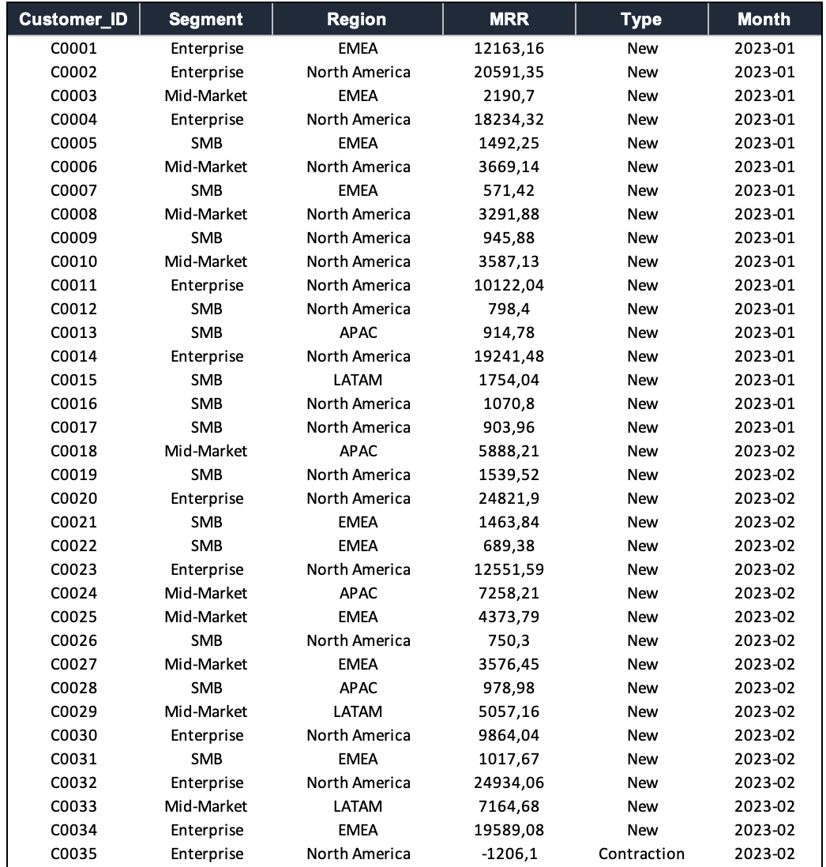
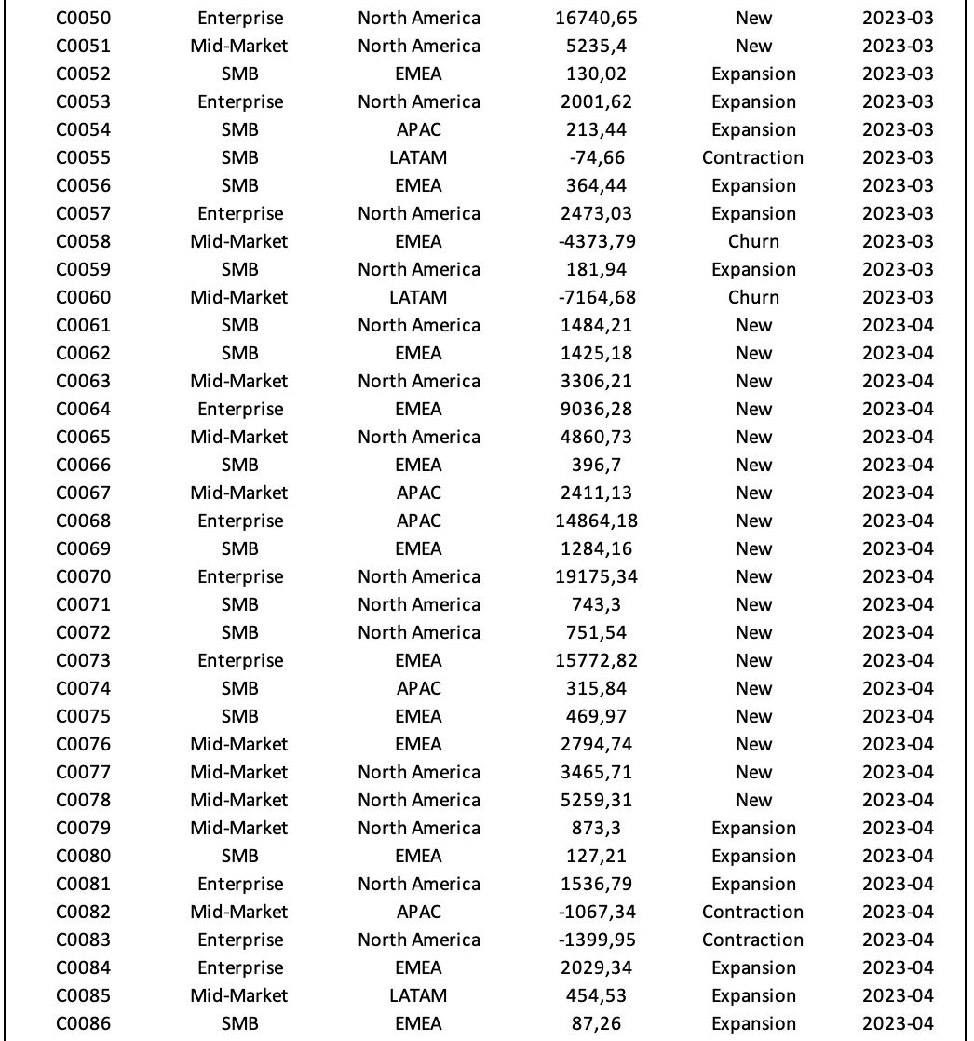
Appendix 1 – Excel Sheet – Raw Data (one fraction)

Slide 12
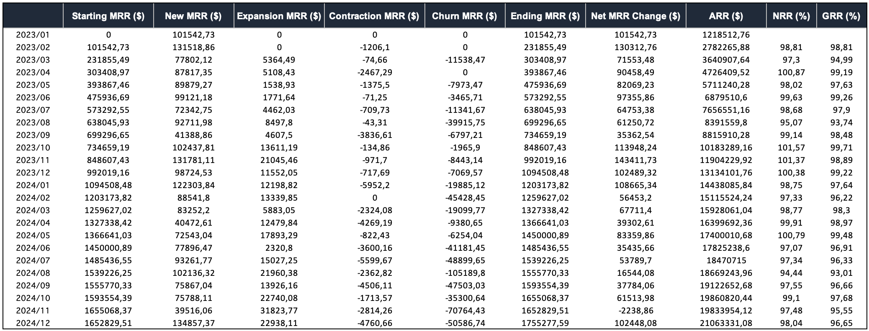
Appendix 2 – Excel Sheet – Metrics obtained via SQL

Slide 13
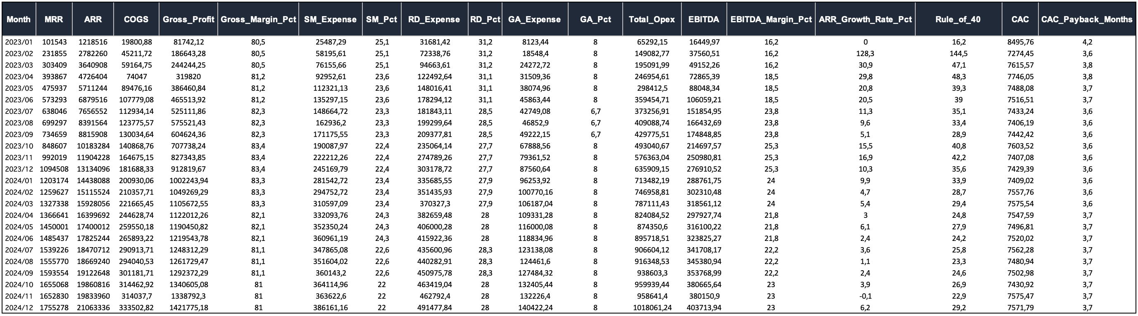
Appendix 3 – Excel Sheet – P&L Monthly

Slide 14
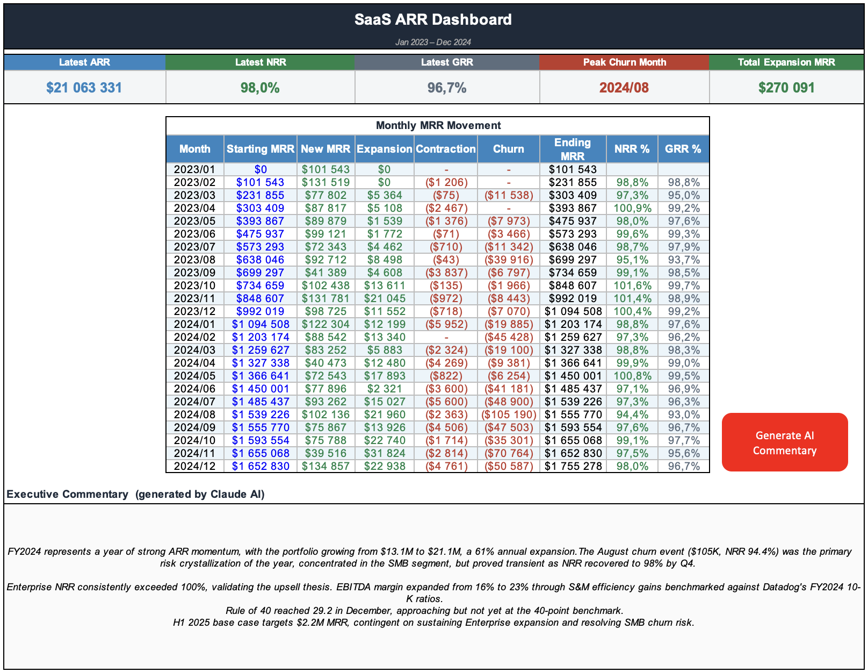
Appendix 4 – Excel Sheet – Dashboard + AI Commentary via Claude and VBA

Slide 15
Data Sources & Methodology
The customer and revenue dataset used throughout this report is entirely synthetic, generated programmatically to simulate a realistic B2B SaaS operating environment over a 24-month period (January 2023 – December 2024). No real customer, revenue, or commercial data has been used.
P&L ratios applied in the financial analysis include Gross Margin, Sales & Marketing expense, Research & Development expense, General & Administrative expense, and derived EBITDA margin are benchmarked against Datadog, Inc. (NASDAQ: DDOG) quarterly financial disclosures for FY2023 and FY2024, sourced from the company's Annual Report on Form 10-K and quarterly earnings releases.
These ratios were rescaled proportionally to the synthetic revenue base and are used solely for illustrative benchmarking purposes.
The forward outlook scenarios presented in Slide 9 are hypothetical projections based on observed trends in the synthetic dataset and do not constitute financial forecasts or investment advice.
This report was produced as an independent analytical project to demonstrate applied FP&A capabilities, including SQL-based data aggregation, Excel financial modeling, and AI-assisted executive commentary generation via the Anthropic Claude API.

