Slide 1
PROJECT 3 DOCUMENTATION
NAME: THEOPHILUS ADDO
ID: 10828947
INTRO TO SOFTWARE ENGINEERING

Slide 2
PROBLEM STATEMENT
A problem is created whenever people want to buy products or items but do not know where and how to get it. People tend to move from one vendor to another in search for the products and this results in the loss of time and energy. A database driven web and mobile application is developed to solve this problem. It allows people to search and order for products they need, which would be delivered right to their door step.

Slide 3
REQUIREMENTS
Users of the system will be authenticated using email and password.
The system should be able support multiple sellers on the same platform.
Users of the software should be able to post or uploads products for sale.
The system should allow sellers of the platform to edit or delete their products after uploading.
Users should be able to view available products ready for purchase.
The system should be able convey the location of the customer or buyer to the seller.

Slide 4
SOFTWARE PROCESS
The software would be developed using agile methods. This is because, the requirements of the website may change from time to time. Agile methods allow iterative development which would account for the changing requirements of the customer.

Slide 5
SOFTWARE MODELLING
The incremental model will be used to develop the application. The software will be broken down into smaller chunks or increments, with each chunk specifying a certain functionality of the system.

Slide 6
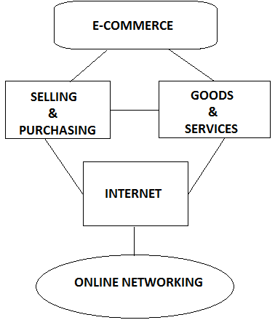
SOFTWARE SYSTEM ARCHITECTURE

Slide 7
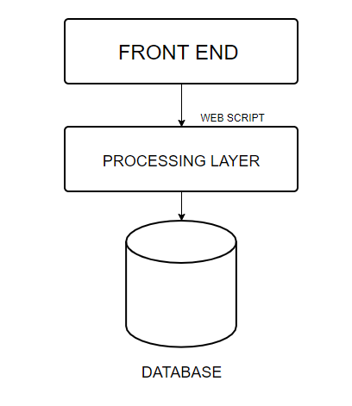
DESIGN AND IMPLEMENTATION

Slide 8
TESTING
The system would be tested to make sure it meets the required specifications. The individual units or components of the software would be tested differently to ensure that each part of the system is functional. Tests would also be run on the entire system to ensure that the different parts of the system, when integrated, produce the required functionalities. The application would also undergo acceptance testing. The application would be tested with real-world customer data to check that it meets the customer requirements.

Slide 9
SOFTWARE PROJECT MANAGEMENT
The software would be developed incrementally. It would be divided into small increments, with each increment specifying a specific functionality of the system. The increments would be developed according to priority. At least one increment shall be developed every week. Activities and measures will be put in place to ensure that each increment is delivered on time. The risks that may affect the project will be accessed and monitored. Actions will be taken when problems arise. The progress of the application will be communicated regulary to the customer or the company manufacturing the software.

