Slide 1

STABLESAVE · DEMO DAY
STABLE
SAVE
STABLECOIN YIELD · SOLANA VAULT PROTOTYPE
Know the risk before you chase the yield.
Theo stablesaver-web.vercel.app
Notes:
TIME: 10 seconds. (Clock: 0:00 to 0:10.)
SAY: "Hi, I'm Theo. This is StableSave: know the risk before you chase the yield. It has two parts: a comparison app that's live today, and a Solana vault that's a devnet prototype."
Transition: straight to the next slide.

Slide 2



YIELD IS EASY TO FIND
Knowing what you're taking on is the hard part.
WHAT YOU TAKE ON
WHAT YOU SEE
A BIG APY
One number on a dashboard, usually the highest one.
CONCEPTUAL ILLUSTRATION
Scattered: options sit across many protocols and networks
Higher isn't better: a higher APY often just means more risk
Fees bite: network fees can wipe out the return on a small deposit
02 / 6
Notes:
TIME: 25 seconds. (Clock: 0:10 to 0:35.)
SAY: "If you hold USDC or USDT, finding a yield is easy: every app shows you one big number. What's hard is everything behind it. The options are scattered across protocols and networks. A higher APY often just means more risk. And on a small deposit, network fees can eat the whole return."
Note: the left card is a concept, not a real pool. No market statistics here on purpose.

Slide 3

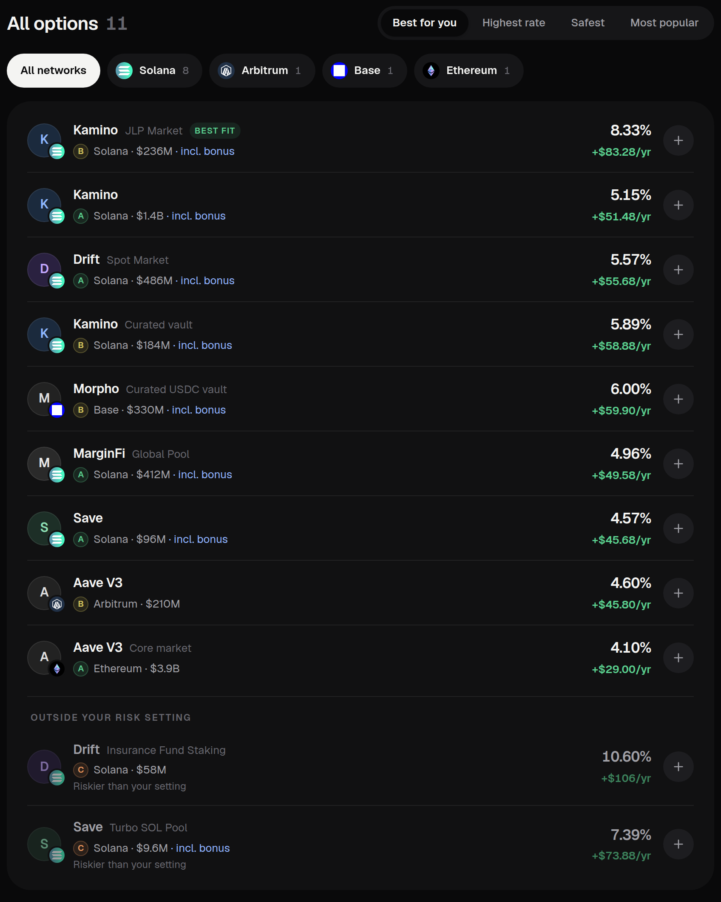
RATE, RISK, REAL RETURN
Every option shows the rate, an A–D risk grade and what you keep after fees.
A–D
RISK GRADE
Nine factors, and the weakest one always counts.
−$7.90
AFTER FEES · $100 ON ETHEREUM
Fees cost more than you'd earn, and the app says so.
$0
HELD BY STABLESAVE
No sign-up to compare. You deposit on the protocol's own app.
REAL INTERFACE · LOCAL BUILD, DEMO DATA
03 / 6
Notes:
TIME: 35 seconds. (Clock: 0:35 to 1:10.)
SAY: "StableSave puts it on one screen. You type an amount, pick how much risk you want, and every option shows three things. The rate. An A to D risk grade from nine factors, where the weakest factor always counts, so a high APY can't hide a weak spot. And what you keep after fees: a hundred dollars on Ethereum earns about four dollars a year but costs about twelve to get in and out, and the app tells you. You don't need a wallet to compare, and you deposit on the protocol's own app."
Honesty: the screenshot and the -$7.90 are from demo data. The live site uses live DefiLlama data.

Slide 4

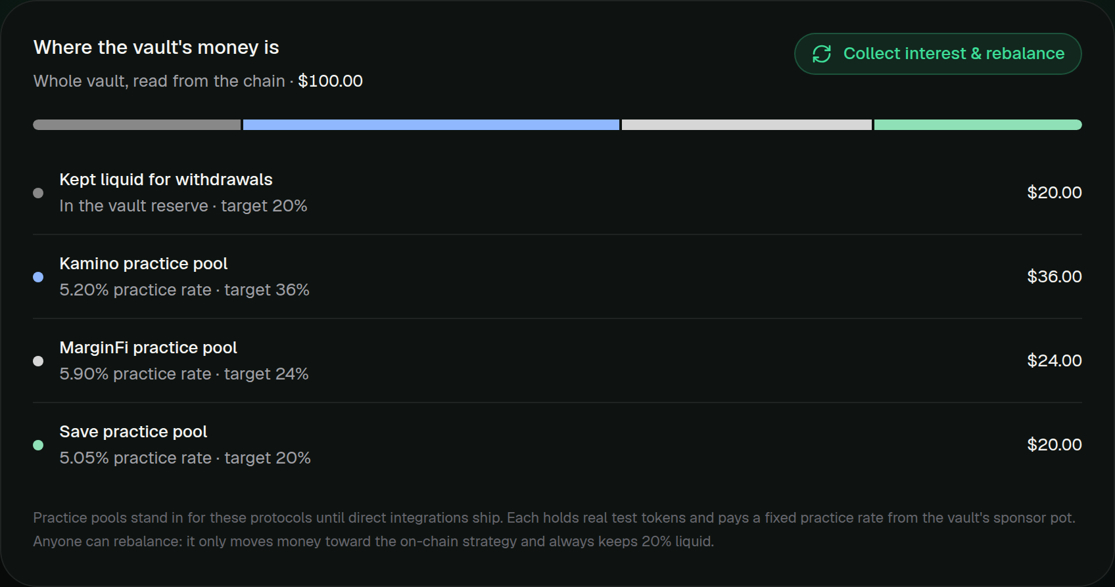
THE SOLANA VAULT
A separate devnet prototype: the program itself enforces the rules.
DEVNET · TEST TOKENS
ENFORCED ON-CHAIN
Split on deposit: 20% kept liquid, the rest across practice pools by strategy
Withdrawal limits: 2,000 a wallet a day at once; bigger exits wait 30 minutes
Safety switch: a guardian can pause; only the authority unpauses
Deposit from a link: the same deposit as a Solana Blink
REAL INTERFACE · THE SPLIT FROM THE CI REHEARSAL
Not yet: market yield (practice pools pay fixed practice rates) · an audit · a multisig
04 / 6
Notes:
TIME: 25 seconds. (Clock: 1:10 to 1:35.)
SAY: "The second part is separate: a vault program on Solana devnet, where the program enforces the rules, not the website. Every deposit is split: twenty percent stays liquid for withdrawals, the rest goes into practice pools by strategy. Withdrawals have daily limits, big exits wait thirty minutes, and a guardian can pause it. To be clear: devnet, test tokens, practice rates, not audited."
Do NOT claim market yield, real Kamino/MarginFi/Save deposits, or an audit.

Slide 5

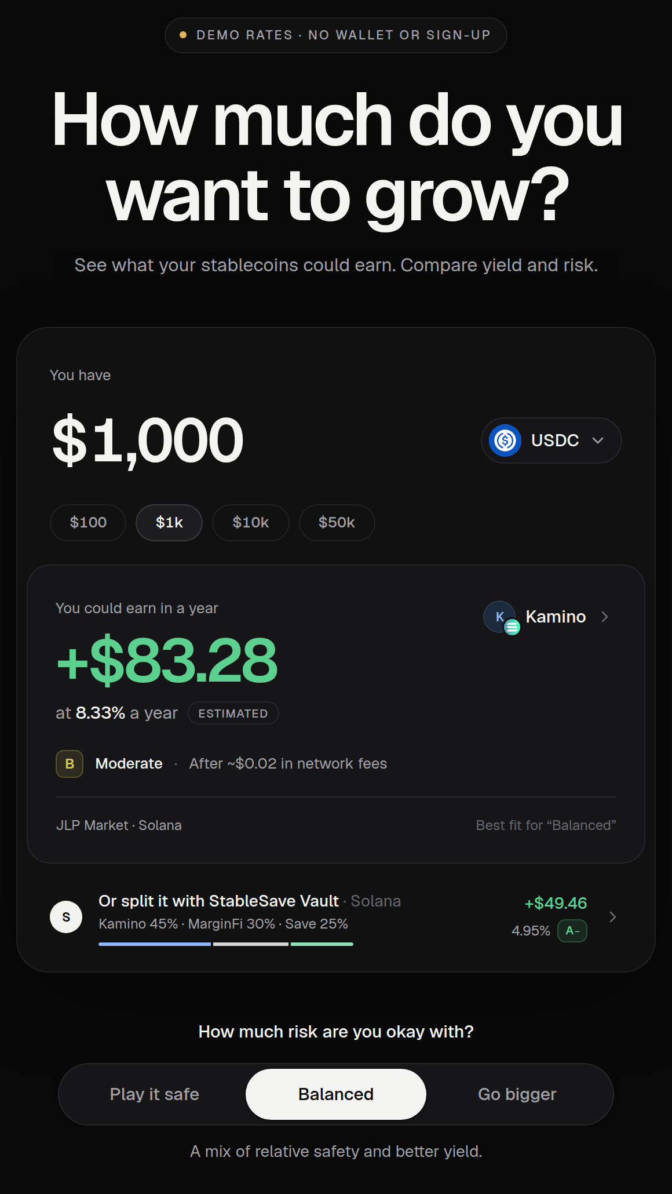
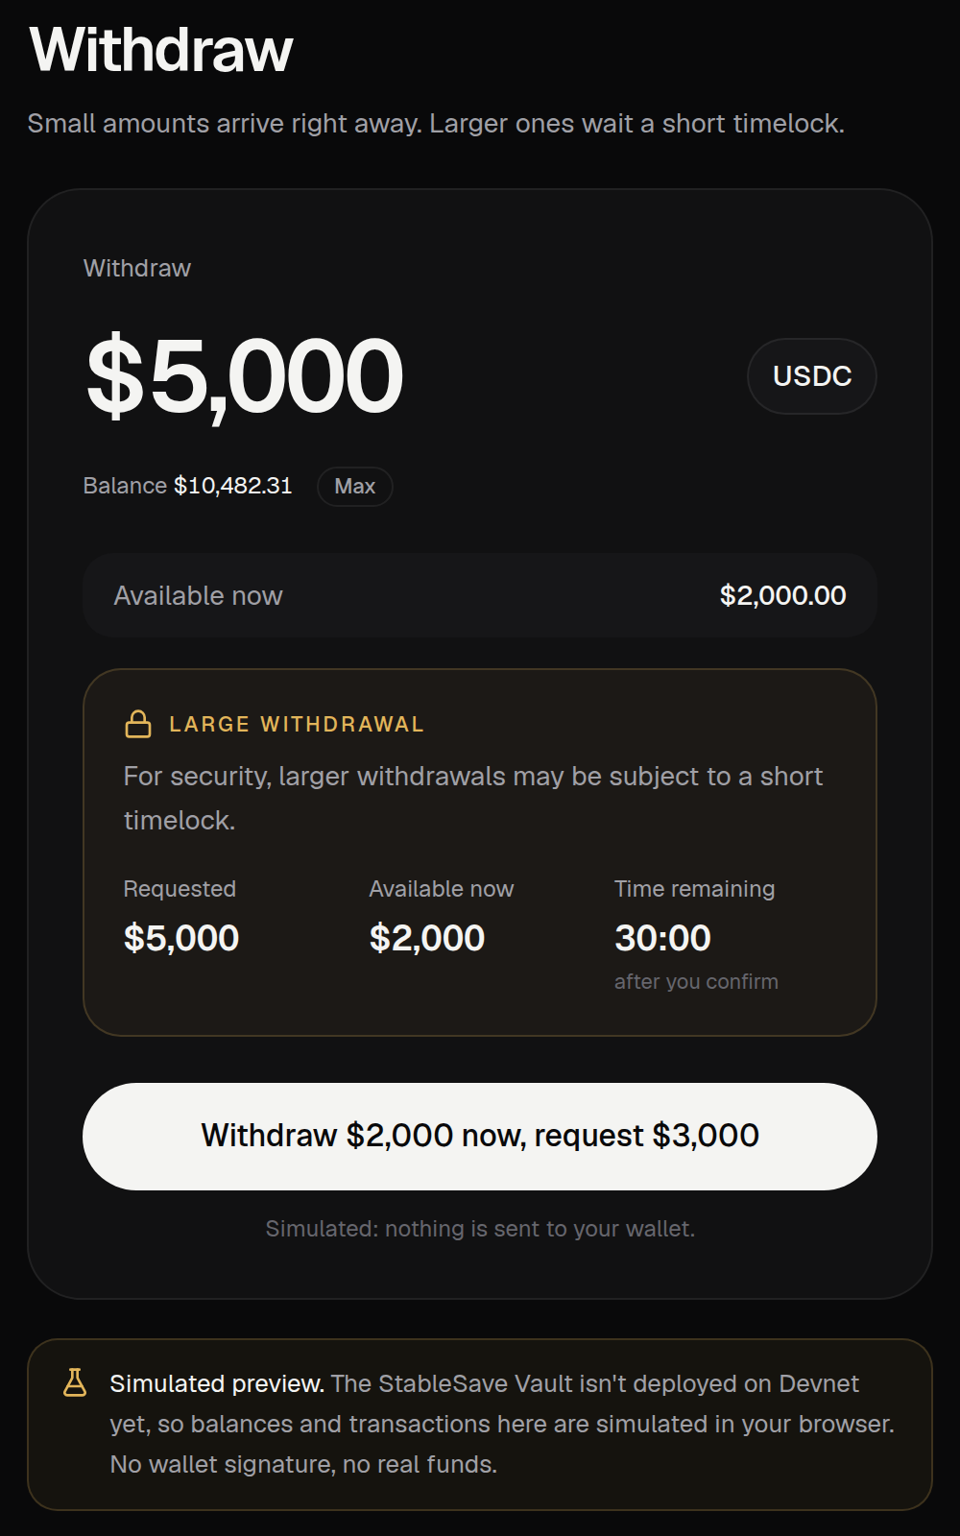
LET'S SEE IT WORK
Part A is live. Part B is a devnet prototype. Keep them separate.
A · LIVE · 1½ MIN
B · DEVNET · 1½ MIN
Comparison app
Vault
stablesaver-web.vercel.app
Wallet on Solana devnet
01
Type 1,000, then switch risk levels
01
Deposit 100 test USDC
02
Open the top option: its grade, and can I withdraw today?
02
See the split: 20% liquid, the rest in pools
03
Find idle money in a pasted wallet
03
If there's time: deposit again from the Blink
Devnet tokens have no value. Practice pools pay fixed practice rates, not market yield. Thumbnails: local build (demo data; vault in simulated preview).
05 / 6
Notes:
TIME: 3 minutes in total. (Clock: 1:35 to 4:35.) Then go to the last slide.
SAY: "Let me show you." Switch to the browser.
BEFORE THE TALK
- Tab 1: stablesaver-web.vercel.app, the calculator showing.
- Tab 2: stablesaver-web.vercel.app/vault with the wallet connected. Wallet on Devnet, holding test USDC and a little devnet SOL. Do one deposit beforehand so the pools card already has money in it.
- Copy a mainnet wallet address that holds USDC (for Find idle money).
PART A: live app (1:30)
1. (0:00) Type 1000. Click Play it safe, then Go bigger. SAY: "The list re-ranks by how much risk you're comfortable with."
2. (0:30) Open the top option. SAY: "Here's its grade and why. And can I withdraw today? Yes: this much is free in the pool right now."
3. (1:00) Close it, click Find idle money, paste the address. SAY: "It reads a real wallet, read-only, and fills the calculator."
PART B: devnet vault (1:30)
4. (1:30) Tab 2. SAY: "This is devnet, test tokens." Deposit 100, approve in the wallet.
5. (1:45) While it confirms, point at "Where the vault's money is". SAY: "One transaction deposits and splits it: twenty percent liquid, the rest across three pools, read from the chain."
6. (2:20) Only if you're under 2:30: press Try it on the "Deposit from a link" card, then Deposit 10. SAY: "The same deposit from a link you can post anywhere."
If a transaction is slow, keep talking over the pools card and move on; never wait in silence. If the network fails, show slide 4 instead.

Slide 6







THANK YOU!
Make stablecoin yield easier to understand before making it easier to chase.
SCAN TO TRY IT · STABLESAVER-WEB.VERCEL.APP
Next: a real Kamino strategy in the vault, then an audit and a multisig.
06 / 6
Notes:
TIME: 20 seconds. (Clock: 4:35 to 4:55.)
SAY: "That's StableSave: know the risk before you chase the yield. Next, I'll swap a practice pool for a real Kamino strategy, then get an audit and a multisig. Scan the code to try it, no wallet needed. Thank you!"
LIKELY QUESTIONS (the full deck, StableSave-Demo-Day.pptx, has a slide for each)
- Does the vault earn yield? Not market yield yet. The practice pools pay fixed practice rates from a sponsor pot of test tokens. A real Kamino strategy is the next build.
- Is it audited? No. It's a devnet prototype.
- Who controls the vault? One authority key today, plus a guardian that can only pause. A multisig and a delay on strategy changes are planned.
- Why trust the grades? Every factor and its reason is shown, and unknowns lower the grade. The weights are my judgement and not back-tested yet.
- Why only DefiLlama? It covers every network without an API key. The trade-off is a single point of failure.

