Slide 1

STABLECOIN YIELD INTELLIGENCE + SOLANA VAULT PROTOTYPE
Know the risk before you chase the yield.
A simpler way to compare stablecoin yield opportunities, understand risk, and see what remains after fees.
Theo
Demo Day · stablesaver-web.vercel.app
Notes:
TIME: about 20 seconds.
Key message: StableSave helps people see the risk and the real return before they chase a headline rate.
Talking points:
- Hi, I'm Theo. This is StableSave.
- It has two parts, and I'll keep them separate all the way through: a comparison app that is live today, and a Solana vault that is a devnet prototype.
- One line to remember: know the risk before you chase the yield.
Transition: Let's start with why this matters.

Slide 2





Finding yield is easy.
Knowing what you're taking on is harder
WHAT YOU TAKE ON
WHAT YOU SEE
Scattered
Options sit across many protocols and networks.
A big APY
One number on a dashboard, usually the highest one.
Higher isn't better
A higher APY can mean more risk, not a better deal.
Fees bite
Network fees can wipe out the return on a small deposit.
Hard to compare
Security, liquidity, maturity and strategy complexity hide in docs.
Conceptual illustration
No framework
Beginners have no clear way to weigh any of it.
Notes:
TIME: about 40 seconds.
Key message: the headline rate is the easy part. The risk and the costs behind it are the hard part.
Talking points:
- If you hold USDC or USDT, finding a rate is easy. Every app shows you one big number.
- What's hard is everything behind it: options are spread across many protocols and networks.
- A higher APY can simply mean more risk.
- Network fees can wipe out the return on a small deposit. I'll show a real example in a minute.
- Security, liquidity, how long a protocol has been live, and how complex its strategy is are all hard to compare.
- Beginners don't have a framework for any of it.
Note: no market statistics on this slide on purpose. The left card is a concept, not a real pool.
Transition: So here's what StableSave does about it.

Slide 3
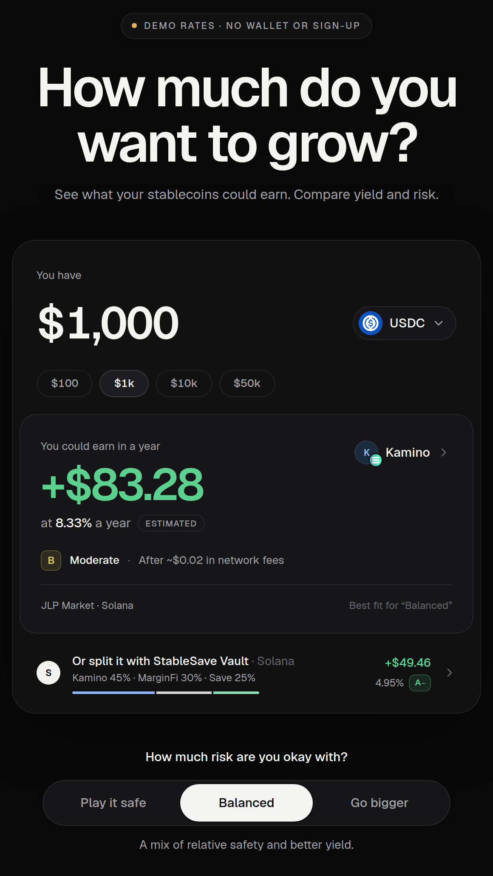


One place to compare yield, risk,
and estimated net earnings
1
Enter a stablecoin amount
4
Check the grade and its reasons
2
Pick a risk preference
5
See earnings after fees
3
Compare the options
6
Continue to the official app
No wallet or sign-up
Never holds your funds
Comparing needs nothing but an amount.
You deposit from your own wallet, on the protocol's own app.
Real interface · local build, demo data
Notes:
TIME: about 35 seconds.
Key message: one screen shows the rate, the risk grade, and what you'd actually keep after fees.
Talking points:
- You type an amount and choose a stablecoin. You pick how much risk you're comfortable with: Play it safe, Balanced, or Go bigger.
- StableSave ranks the options, gives each one an A to D grade with its reasons, and shows estimated earnings after network fees.
- When you're ready, it sends you to the protocol's official app. You deposit from your own wallet.
- Two promises: no wallet or sign-up just to compare, and StableSave never holds anyone's money in this flow.
Honesty note: this screenshot is the real interface running locally with demo data, so the numbers are illustrative. The live site shows live DefiLlama data.
Transition: Let me walk through the screens.

Slide 4
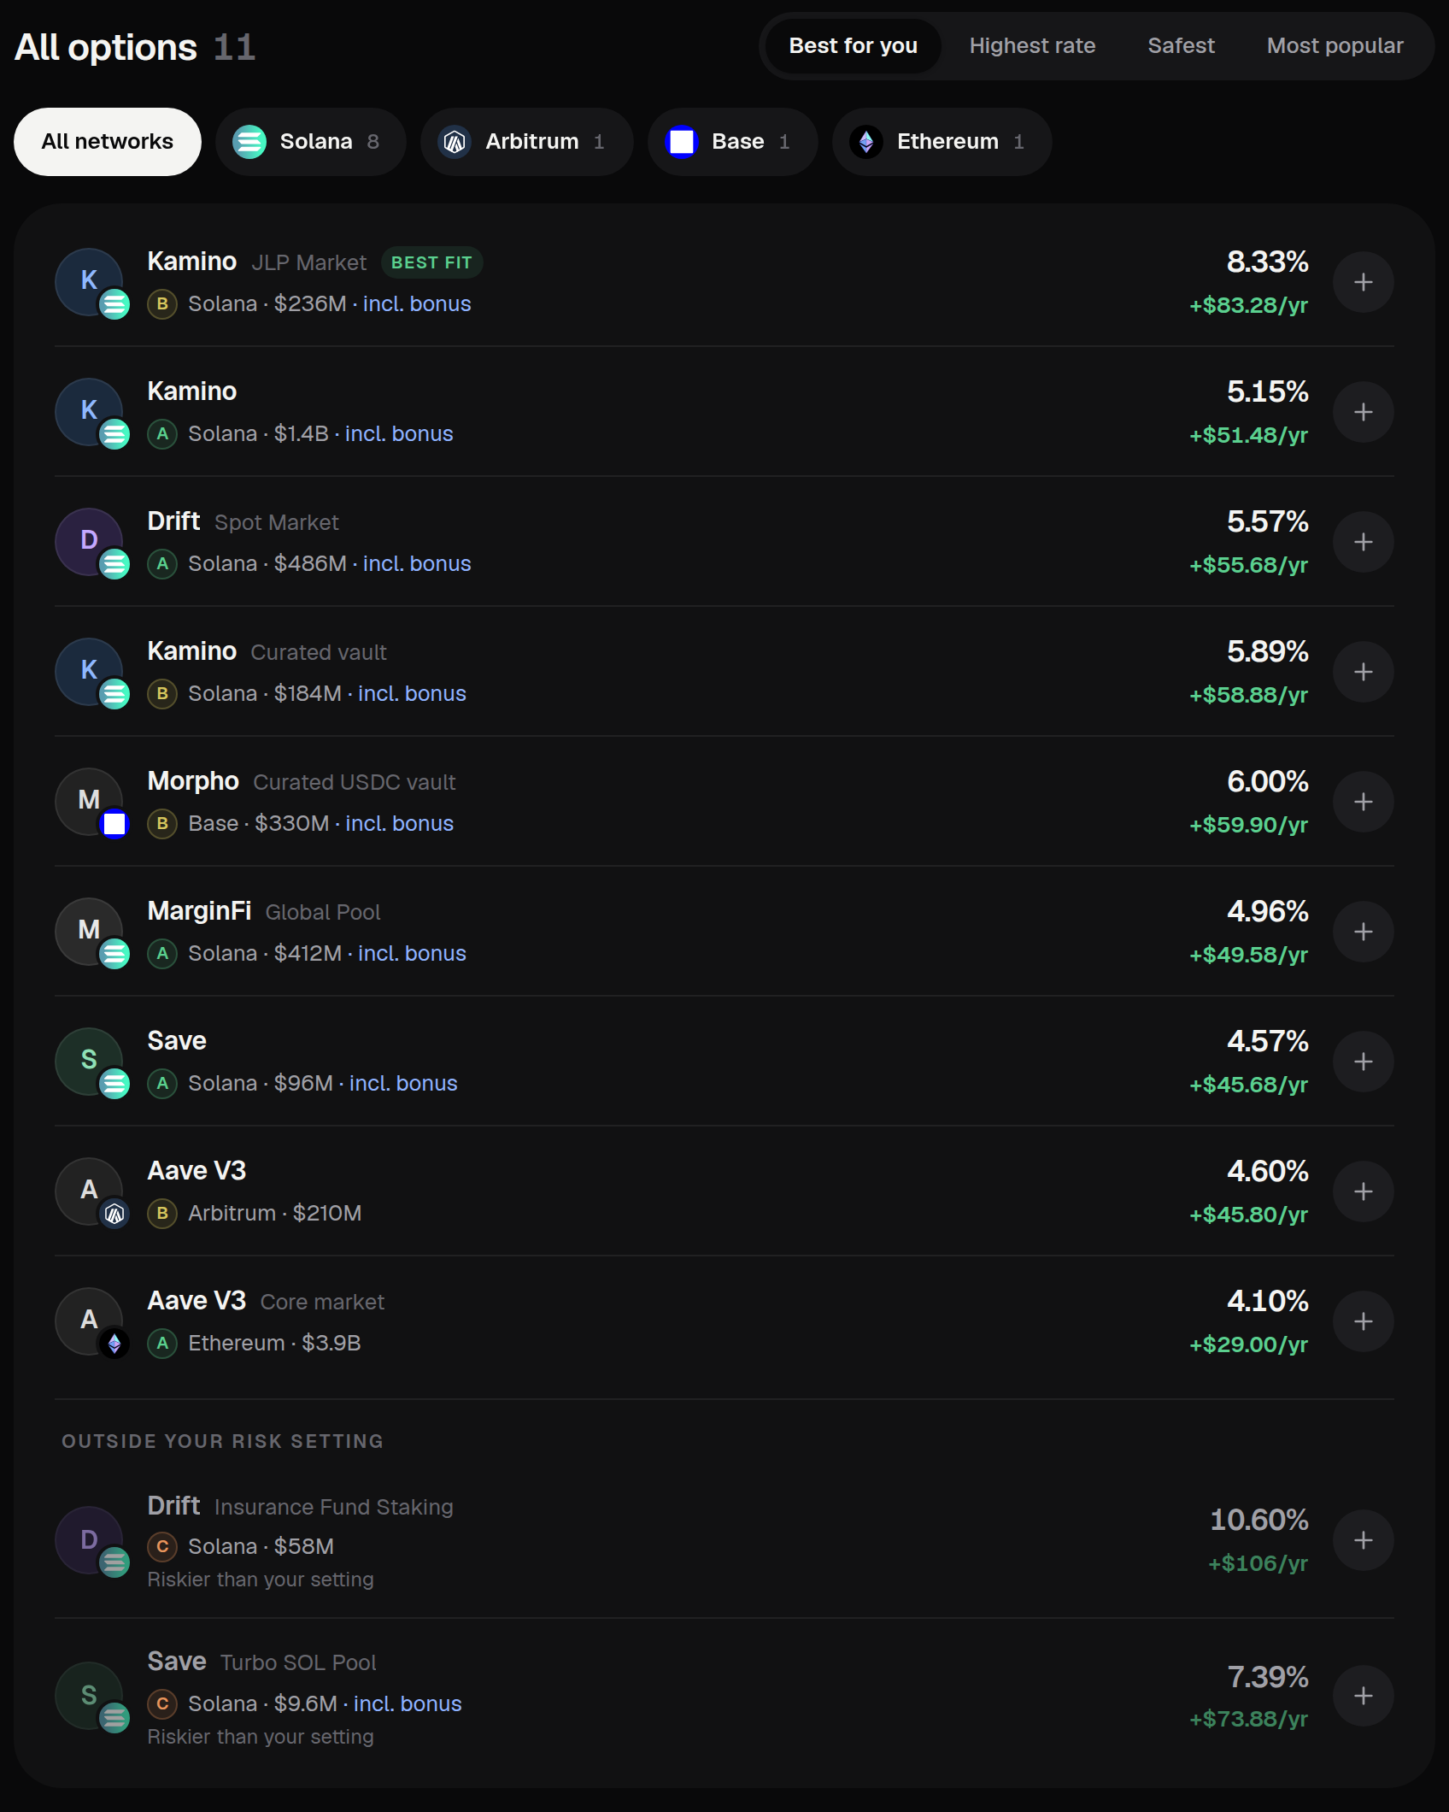
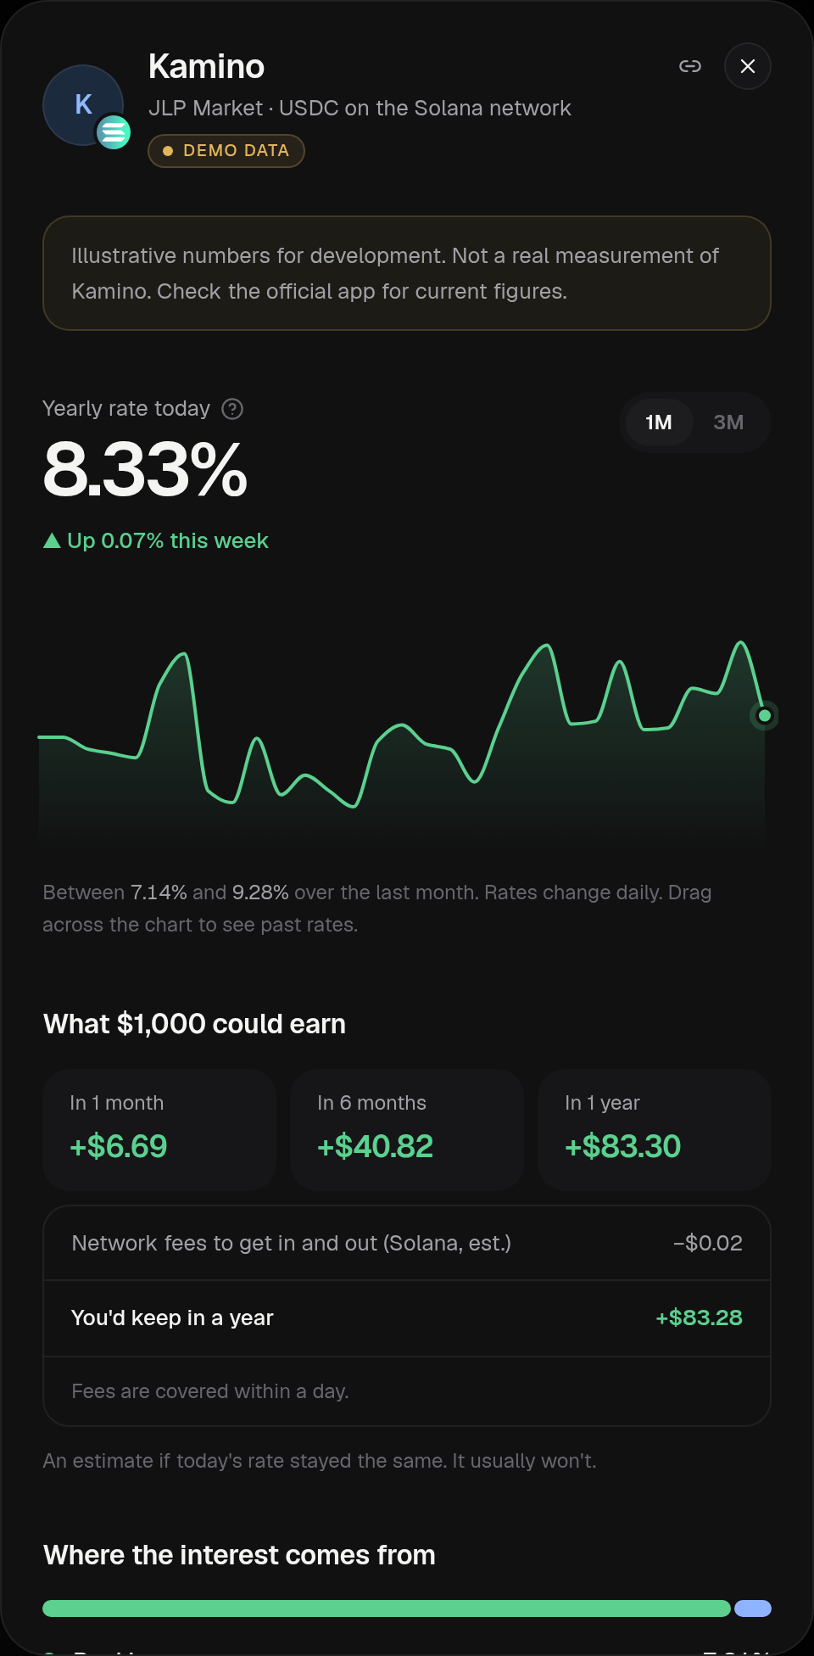
From a balance to a more informed decision
3
1
Amount
$1,000 of USDC here
4
2
Risk preference
Safe, Balanced or Bigger
1
3
Ranked options
5
Sort: best fit, rate, safety
4
A–D grade
Next to network, deposits
6
5
Rate history
30 or 90 days, daily
2
6
After fees
What you'd keep a year
Worked example (demo data): $1,000 USDC, Balanced → 8.33% → about +$83 a year after fees. Estimated, not promised.
Notes:
TIME: about 45 seconds.
Key message: in a few clicks you go from a balance to a ranked, graded, fee-adjusted choice.
Walk the numbers on the slide:
1. Enter the amount and stablecoin. Here, $1,000 of USDC.
2. Pick a risk preference. Balanced is selected.
3. Options are ranked for that preference.
4. Every row shows its A to D grade, network and deposits, plus the rate and a yearly estimate.
5. Open any option: you get 30 or 90 days of daily rate history, so you can see whether today's rate is normal.
6. And what $1,000 could earn after the network fees to get in and out.
The detail panel then explains the grade factor by factor ("How risky is it?"), adds a plain risk warning, steps to deposit safely, and quick facts. Note: the review guide calls these "Why this grade?" and "What could go wrong?". The current interface uses the new headings.
Honesty: the worked example uses demo data. Say "estimated" every time. Rates change.
Transition: The grade is the core of this, so here's how it works.

Slide 5
A high APY should never tell the whole story
Nine factors, weighted (% of the score)
HOW THE SCORE IS BUILT
Score = 75% weighted average
+ 25% weakest factor
So one bad area pulls the grade down.
A
B
C
D
80+
65–79
50–64
<50
ONE WEAK FACTOR (DEMO DATA)
Kamino JLP Market: weighted average 81 (an A on its own). Concentration scores 37, so the final score is 70: grade B.
Hard caps can override the score (e.g. no public audits: at most C). Inputs the data doesn't cover are marked "Not verified" and scored cautiously, never guessed.
Notes:
TIME: about 50 seconds.
Key message: the grade can't be gamed by one shiny number, because the weakest factor always counts.
Talking points:
- Every option gets a score from 0 to 100 across nine factors. The biggest weights are protocol maturity and smart contract security at 14% each. Yield stability is the smallest at 8%.
- 75% of the score is the weighted average. The other 25% is the single weakest factor. That's deliberate: one bad area should pull the grade down.
- Scores map to grades: A is 80 and above, B 65 to 79, C 50 to 64, D below 50.
- Hard caps override the number. No public audits, unrepaid losses or a first-loss insurance fund: at most C. Live under six months, or one key can change the code: at most C+. 98% or more lent out: at most B minus. Three or more unverified inputs: at most B.
- If the data doesn't cover an input, it's labelled Not verified and scored cautiously. Never guessed.
The example is from the demo data on screen: an average of 81 would be an A, but concentration scores 37, so the final score is 70, a B. (0.75 x 81 + 0.25 x 37 = 70.)
Be honest if asked: the weights are my judgement. I haven't back-tested them against past exploits yet. That's on the roadmap.
Transition: The other half of a good decision is cost.

Slide 6
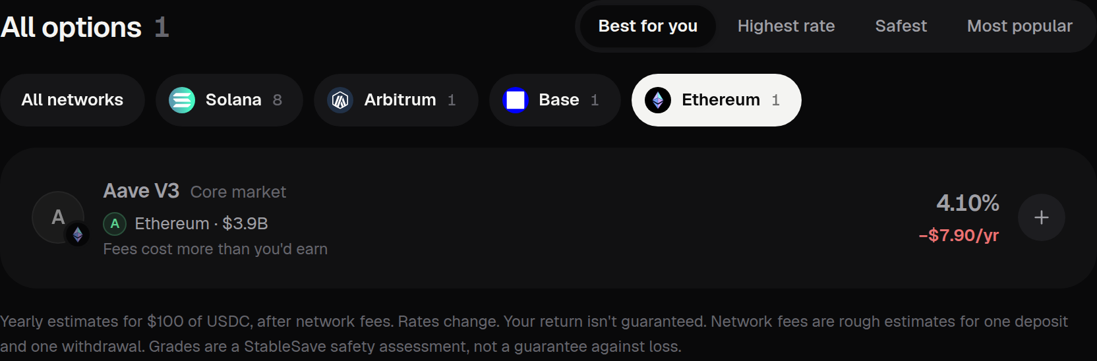
The return that matters is the return after costs
MARKED, NOT HIDDEN
$100 at 4.10% earns about $4.10 a year. Getting in and out of Ethereum is estimated at $12. So the app says: "Fees cost more than you'd earn."
Real interface · local build, demo data · $100 of USDC, Ethereum
Headline rate
A year's interest
Network fees (est.)
What you keep
Ethereum
4.10%
$4.10
−$12.00
−$7.90
Solana
4.10%
$4.10
−$0.02
+$4.08
Illustrative: $100 at the same 4.10% rate, using StableSave's per-network fee estimates for one deposit and one withdrawal. Estimates, not live gas prices.
Notes:
TIME: about 35 seconds.
Key message: a good rate on an expensive network can lose you money on a small deposit.
Talking points:
- This is the example from my review guide: enter $100 and filter to Ethereum.
- At 4.10%, $100 earns about $4.10 in a year. StableSave's estimate for getting in and out on Ethereum is about $12. So you'd be $7.90 down, and the app marks the option: "Fees cost more than you'd earn".
- The same rate on Solana, where the estimate is about two cents, keeps about $4.08.
- That's why ranking uses yield after fees, so small deposits aren't sent to expensive networks.
Be precise: the screenshot uses demo data, and the Solana row is an illustration at the same rate. Network fees are fixed per-network estimates for one deposit and one withdrawal, not live gas prices. Bridging costs aren't counted yet.
Transition: That's the comparison app, which is live. Now the second, separate part: the Solana vault.

Slide 7

A separate Anchor vault prototype
brings the project on-chain
StableSave Vault program
Vault PDA
Anchor · Solana devnet · 16 instructions
["vault", mint, risk_profile]
Roles, limits, strategy, share totals
PROGRAM-ENFORCED CHECKS
deposit
Not paused
User wallet
Deposit ≥ minimum, under the vault cap
Reserve + practice pools
Signs every user action
withdraw
["reserve"] · ["pool", protocol]
Instant: 2,000 per wallet, 50,000 per vault / 24 h
20% kept liquid; the rest split by strategy weight. Only the vault signs transfers out
Devnet prototype
Unaudited
Practice pools
Bigger: request, wait 30 min, then execute
UserPosition PDA
Shares priced with a virtual offset
["position", vault, owner]
Admin: authority (settings, unpause, two-step handover) · guardian (pause only)
One depositor's shares and pending withdrawal
Notes:
TIME: about 50 seconds.
SAY THIS CLEARLY: this is a separate component, and it's a devnet prototype. It splits deposits into practice pools, not real protocols, and it is not audited.
Key message: the rules of the vault are enforced on-chain by the program, not by the website.
Talking points:
- The vault is one Anchor program on Solana devnet with 16 instructions.
- It uses three kinds of account. These are PDAs: program-derived addresses, which only the program can sign for.
- Vault: the settings. Who the admins are, the limits, the strategy weights, the share totals. One per token and risk level.
- Reserve and practice pools: rebalance keeps 20% of the vault in the reserve for withdrawals and splits the rest into one practice pool per protocol, by the on-chain strategy weights. Anyone can call rebalance, but it can only move money toward the strategy. Only the vault can sign a transfer out.
- UserPosition: one depositor's shares and any pending withdrawal.
- The user signs a deposit or a withdrawal from their wallet. The program checks it's not paused, the deposit is at least the minimum and under the cap, and the withdrawal fits the instant limits. Anything larger goes through a 30-minute timelock.
- Two admin roles: the authority changes settings and is the only one who can unpause. The guardian can only pause.
Do NOT claim: that deposits earn market yield, that funds go to Kamino, MarginFi, Drift or Save yet, or that it's audited. The practice pools pay fixed practice rates from a sponsor pot of test tokens; real protocol integration is next.
Transition: Each of those controls is a trade-off, so let me be explicit about them.

Slide 8




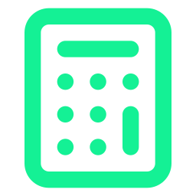

Security is not a badge. It is a set of explicit trade-offs
On-chain checks
2,000 per wallet / 24 h
50,000 per vault / 24 h
30-minute timelock
Pause, minimum and cap
Instant withdrawal limit
Instant limit, all users
Above the instant limits
Rejects bad deposits and exits
Limits a stolen wallet
Slows a bank run
Time to react; big exits wait
Guardian pause
Role-based admin
Virtual share offset
Automated tests
Only the authority unpauses
Two-step authority handover
1,000 shares, 1 asset
10 unit + 5 integration
Fast stop; no escape hatch yet
One powerful key today
Stops share-price inflation
Plus a local deploy rehearsal
Not yet: audit · multisig authority · strategy-change delay · pause escape hatch · fuzz testing (everything above runs on devnet only)
Notes:
TIME: about 40 seconds.
Key message: every control buys safety with something else, and I can name the cost of each one.
Talking points (pick three, don't read all eight):
- Two instant-withdrawal limits: 2,000 per wallet and 50,000 per vault every 24 hours. They limit the damage from a stolen wallet and slow a bank run. The cost: large withdrawals are slower.
- Above the limits there's a 30-minute timelock: time to react before a big outflow. The cost: users wait.
- The guardian can pause; only the authority can unpause. A fast emergency stop that one key can't abuse. The cost: today there's no escape hatch if the vault stays paused.
- Shares use 1,000 virtual shares and 1 virtual asset, so the first depositor can't inflate the share price. The cost: tiny rounding losses.
- Only the program's upgrade authority can create vaults, so nobody can front-run vault creation. The cost: that's a single powerful key.
- Tests: 14 unit and 10 integration tests run against the compiled program on every change, and an automated job deploys it to a local test network, makes a real deposit, checks the split into practice pools and withdraws.
Do NOT call it audited or production-ready. Bottom line on the slide: devnet only.
Transition: Enough slides. Let's look at it working.

Slide 9
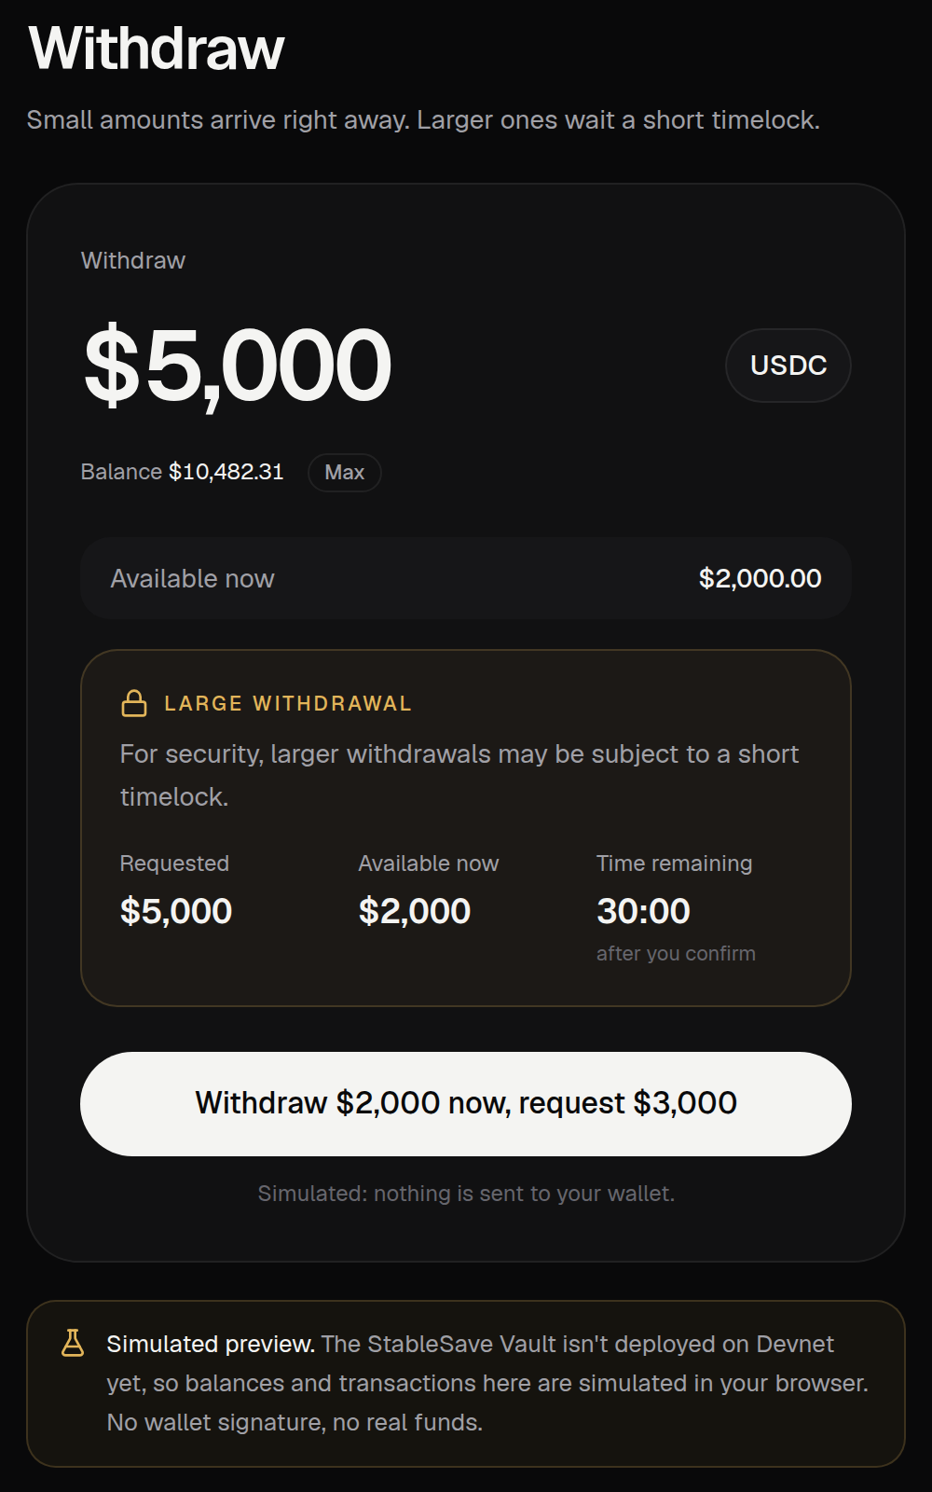
Let's see what works today
A · LIVE
B · DEVNET PROTOTYPE
Comparison app
Vault
stablesaver-web.vercel.app
Wallet on Solana devnet
1
Find idle money in a wallet
1
Connect a devnet wallet
2
Switch Safe / Balanced / Bigger
2
Deposit: split into pools
3
Open an option: grade, withdraw
3
Where the money is
4
Compare with US T-bills
4
Collect interest, rebalance
5
$100 + Ethereum: fees win
5
Withdraw: pools top up
6
Share my estimate
6
Deposit from a Blink
Devnet tokens have no value. Practice pools pay fixed practice rates, not market yield. Thumbnails: local build (demo data; vault in simulated preview).
Notes:
TIME: 15 seconds for the slide; the live demo itself takes 3 to 4 minutes if there's time. If time is short, skip Part B and show this slide only.
SAY: Part A is live. Part B is a devnet prototype. Keep them separate.
PART A — live comparison app (stablesaver-web.vercel.app)
1. Open the site (no wallet or sign-up). Click "Find idle money in my wallet" and paste a wallet address: it reads the USDC and USDT on Solana, read-only, and fills the calculator.
2. Click Play it safe, then Balanced, then Go bigger. The recommendation and the list change.
3. Open the top option. Show the rate chart (drag across it), "Can I withdraw today?" and "How risky is it?": the grade and each factor.
4. Point at the "For comparison" row: US Treasury bills, from the US Treasury's own data, with no crypto risk.
5. Type $100 and pick the Ethereum chip. If the live data still shows it, an option is marked "Fees cost more than you'd earn". If it doesn't, say so and move on.
6. Click "Share my estimate": the link previews as a card with the estimate. The QR code on the last slide opens the same site.
PART B — devnet vault
Before the talk: Vercel has the three devnet variables set and redeployed; Solflare is on devnet with test tokens and a little devnet SOL; do one dry run.
1. Show the wallet is on devnet (Solflare: Settings, Network, Devnet), open Vault (the badge says Devnet, not Preview) and connect.
2. Deposit some test tokens; approve in the wallet. The same transaction splits the deposit into the practice pools.
3. "Where the vault's money is": 20% kept liquid, the rest in a pool per protocol, read from the chain.
4. Click "Collect interest & rebalance": anyone can press it, and it can only move money toward the on-chain strategy.
5. Withdraw more than the reserve holds: the program pulls the difference back from the pools. Above 2,000 the rest waits 30 minutes; don't wait live.
6. Open the Blink from the Vault page: the same deposit, from a link or QR code.
Say out loud: devnet tokens have no value; the pools pay fixed practice rates, not market yield.
Backup if the network fails: use these screenshots and the recorded run if you made one.

Slide 10
What is live, what is experimental, and what comes next
Live
Devnet prototype
Not yet implemented
Stablecoin opportunity comparison
Risk grades and explanations
Fee-adjusted earnings estimates
Withdraw-today check, T-bill comparison
Idle-money scan and share cards
Anchor vault program
Deposits, shares, limits, timelock
Split into practice pools on-chain
Deposit Blink (Solana Action)
Pause and authority controls
CPI into Kamino, MarginFi, Drift and Save
Market yield through the vault
Production security assurances
ALSO WORTH KNOWING
One data source
Fixed network-fee estimates
Weights not back-tested
Ranks on today's APY, not the 30-day average
Bridge costs and risk not modelled
Admin and upgrade-key risk
Notes:
TIME: about 35 seconds.
Key message: I know exactly what's real, what's experimental and what's missing. That's a strength, not an apology.
Talking points:
- Live today: the comparison on DefiLlama data, the grades with their reasons, fee-adjusted estimates, "Can I withdraw today?", the US Treasury bill comparison, the idle-money wallet scan, shareable estimate cards, and an optional API.
- Devnet prototype: the Anchor vault with deposits, shares, withdrawal limits, the timelock, pause and authority controls; a permissionless rebalance that splits deposits into practice pools by the on-chain strategy; and a deposit Blink.
- Not yet: CPI into the real protocols, so no market yield through the vault. Every balance the vault counts is already a real token in an account it owns, read on-chain, never reported by an admin. And no production security assurances: no audit.
- Other limits: one data source, fixed fee estimates, weights that are my judgement and not back-tested, ranking on today's APY rather than the 30-day average, bridging not modelled, and admin and upgrade-key risk.
Transition: Here's the order I'll fix them in.

Slide 11
From useful comparison tool
to a more complete on-chain system
PHASE 1
PHASE 2
PHASE 3
PHASE 4
Safety and correctness
Better recommendations
Vault integration
Admin and expansion
Escape hatch if a vault stays paused
Rank on the 30-day average APY
Swap a practice pool for one real Kamino strategy
Multisig authority
close_position to refund rent
Flag options that need funds moved between networks
Tested against the real Kamino program on a local validator
Delay on strategy changes
Fuzz the share math and limits
Back-test grades against past exploits
Same rebalance and on-chain balances
Alerts, read-only portfolio, more tokens
PLANNED WORK
None of this is built yet. Safety first, then the feature that makes the vault real.
Notes:
TIME: about 30 seconds.
Key message: the roadmap goes straight at the weaknesses I just listed. Safety first, then the feature that makes the vault real.
Talking points:
- Phase 1, safety: an escape hatch so withdrawals reopen if a vault stays paused too long; close_position to refund account rent; fuzz testing the share math and withdrawal limits.
- Phase 2, recommendations: rank on the 30-day average instead of today's rate; flag options that need funds moved between networks; back-test the grades against past exploits.
- Phase 3, the vault: replace a practice pool with one real Kamino lending integration, tested against the real Kamino program on a local validator. The rebalance and the on-chain accounting stay the same.
- Phase 4: a multisig authority and a delay on strategy changes, then rate and grade alerts, a read-only portfolio view, and more tokens such as USDT and Token-2022.
All of this is planned, none of it is built yet. Don't give dates you can't commit to.
Transition: To wrap up.

Slide 12




Make stablecoin yield easier to understand before making it easier to chase.
Simpler comparison
Yield options in one place, ranked for your risk.
Risk grades that show trade-offs
Try it now
A–D, with the reasons, and unknowns never guessed.
stablesaver-web.vercel.app
A separate Solana vault prototype
Feedback welcome on risk scoring, vault security, and which integration to build next.
Controlled deposits and withdrawals on devnet.
Theo · StableSave — Know the risk before you chase the yield.
Notes:
TIME: about 25 seconds, then questions.
Key message: StableSave makes yield easier to understand before it makes yield easier to chase.
Talking points:
- Three things: simpler comparison across yield options; risk grades that show the trade-offs; and a separate Solana vault prototype that explores controlled deposits and withdrawals.
- Scan the code to try it. No wallet needed.
- I'd love feedback on three things: the risk scoring, the vault's security model, and which integration I should build next.
- Close: StableSave. Know the risk before you chase the yield. Thank you.
Likely questions and honest answers:
- Does the vault earn yield? Not market yield yet. On devnet it splits deposits into practice pools that pay fixed practice rates from a sponsor pot of test tokens; swapping one for a real Kamino strategy is the next build.
- Is it audited? No. It's a devnet prototype.
- Who controls the vault? One authority key today, plus a guardian that can only pause. A multisig and a delay on strategy changes are planned.
- Why trust the grades? They're transparent: every factor and its reason is shown, and unknowns lower the grade. The weights are my judgement and not back-tested yet.
- Why only DefiLlama? It covers every network without an API key. The trade-off is a single point of failure.

