Slide 1


Multi-cell Outdoor Channel State Information Dataset (MOCSID)
Mohamed El Mehdi MAKHLOUF
MARACAS Team, Lyon
28/02/2025

Slide 2
Table of Contents
1
Introduction
2
Scenario description
3
Data set structure
4
Channel Charting using MOCSID
5
Conclusion

Slide 3
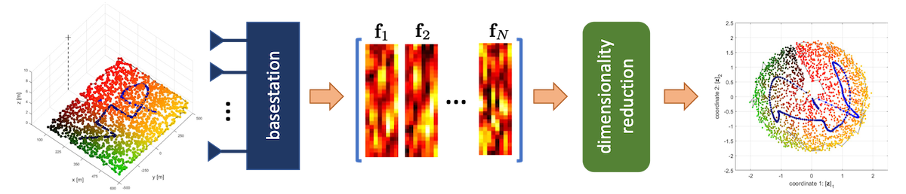
Introduction
What is Channel Charting?
A self-supervised learning approach that maps high-dimensional Channel State Information (CSI) to a low-dimensional spatial representation
Enables location-based applications without Global Navigation Satellite Systems GNSS
No need for ground truth or costly measurement campaigns
Challenges in Real-World Data Collection
Expensive and difficult to obtain large-scale datasets
Existing datasets (e.g., DICHASUS [1], MaMIMO-UAV [1]) lack wide coverage or multi-cell mobility
Illustration of channel charting on a toy example, figure from the project web page
[1] F. Euchner et al “A Distributed Massive MIMO Channel Sounder for ”Big CSI Data”-driven Machine Learning,” in International Workshop on Smart Antennas (WSA), 2021.
[2] A. Colpaert et al MaMIMO-UAV 3D Channel State Information Dataset, KU Leuven RDR, V1, 2023
CHASER web page : https://chaser-project.github.io

Slide 4

Introduction
Why Use Synthetic Data?
Ray-tracing simulations (e.g., NVIDIA Sionna) provide controlled, reproducible environments
More flexibility to model user mobility and base stations density
Important aspect to consider
The spatial and temporal consistency of the simulated data
Simulated environment with overlapping coverage maps

Slide 5
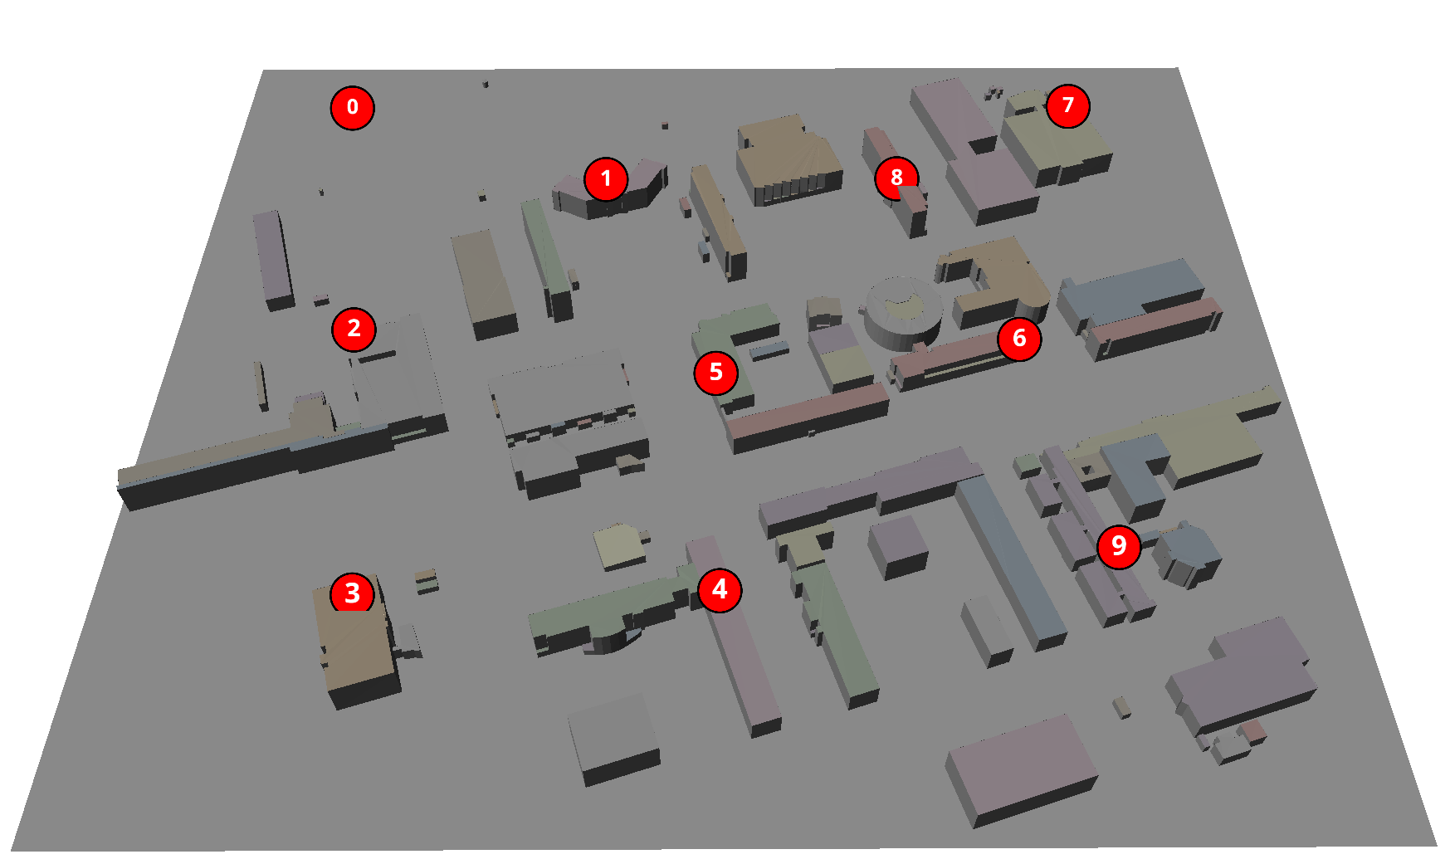
Scenario description
Scattering environment
Blosm to import Openstreetmap data into Blender
Assign radio materials to different objects in the scene
Walls : concrete,
Roofs: metal
Ground plan: medium_dry_ground
Mitsuba to export the environment files
Scene Size: 625x535 m

Slide 6
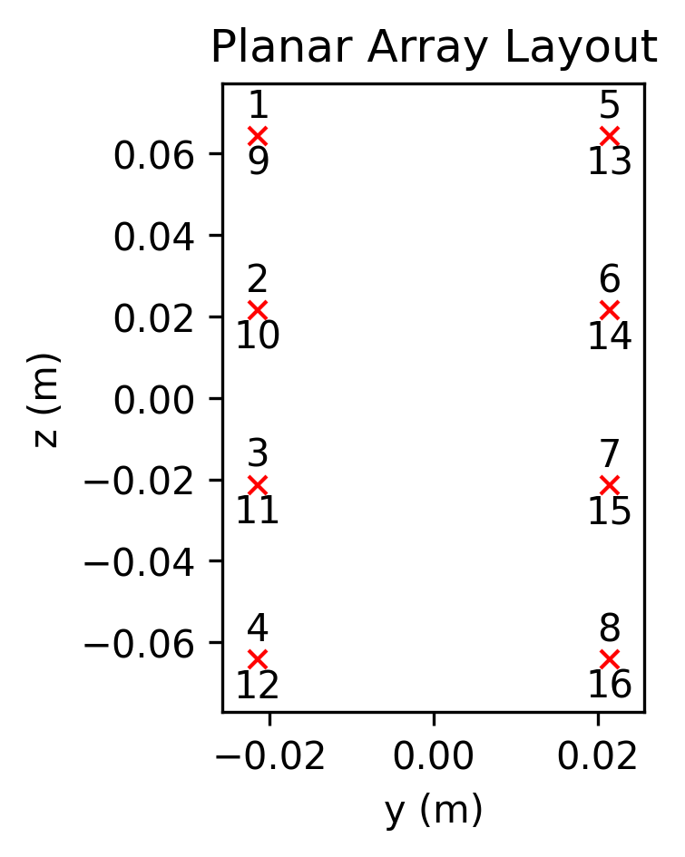
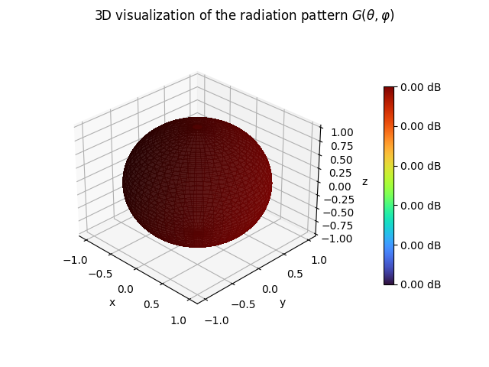
Scenario description
Base stations
Located at 25m height
MIMO array of 4 rows and 2 columns half wavelength spacing
Cross polarized antenna elements with isotropic pattern

Slide 7
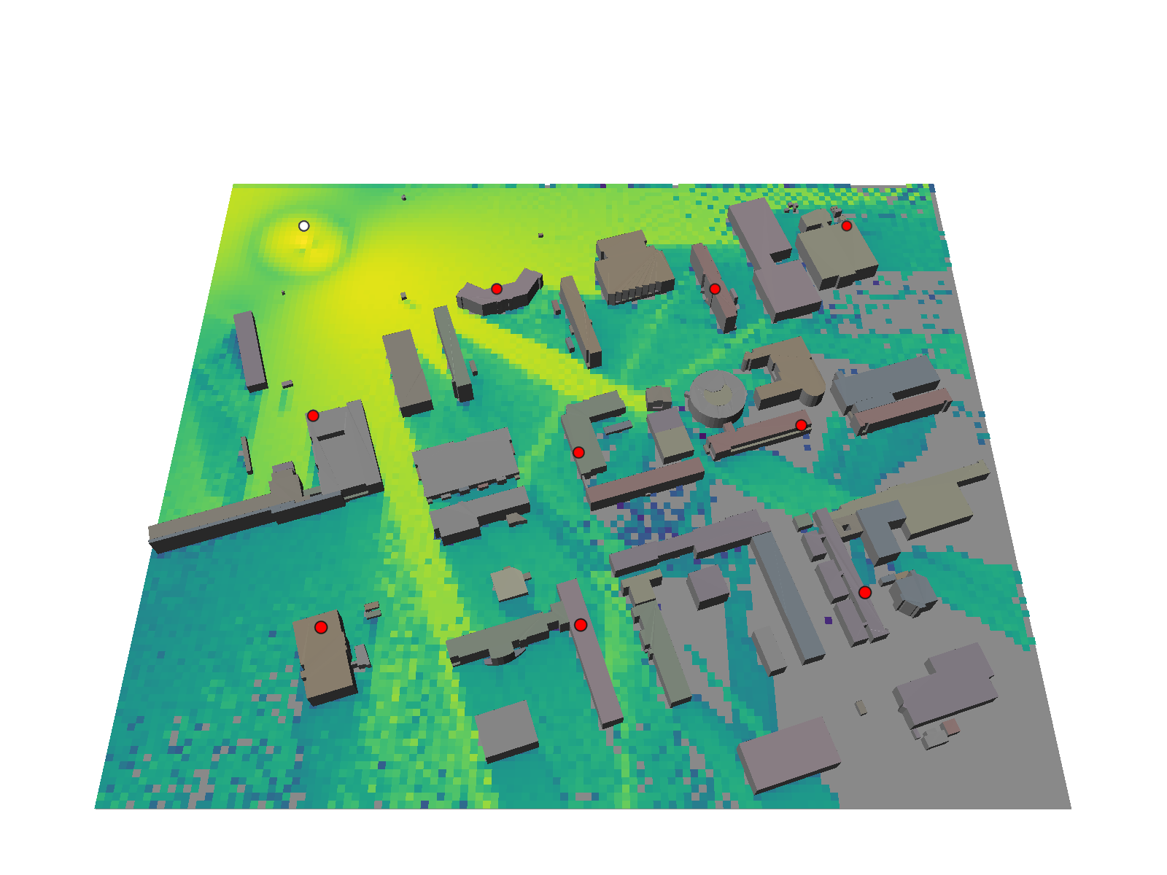
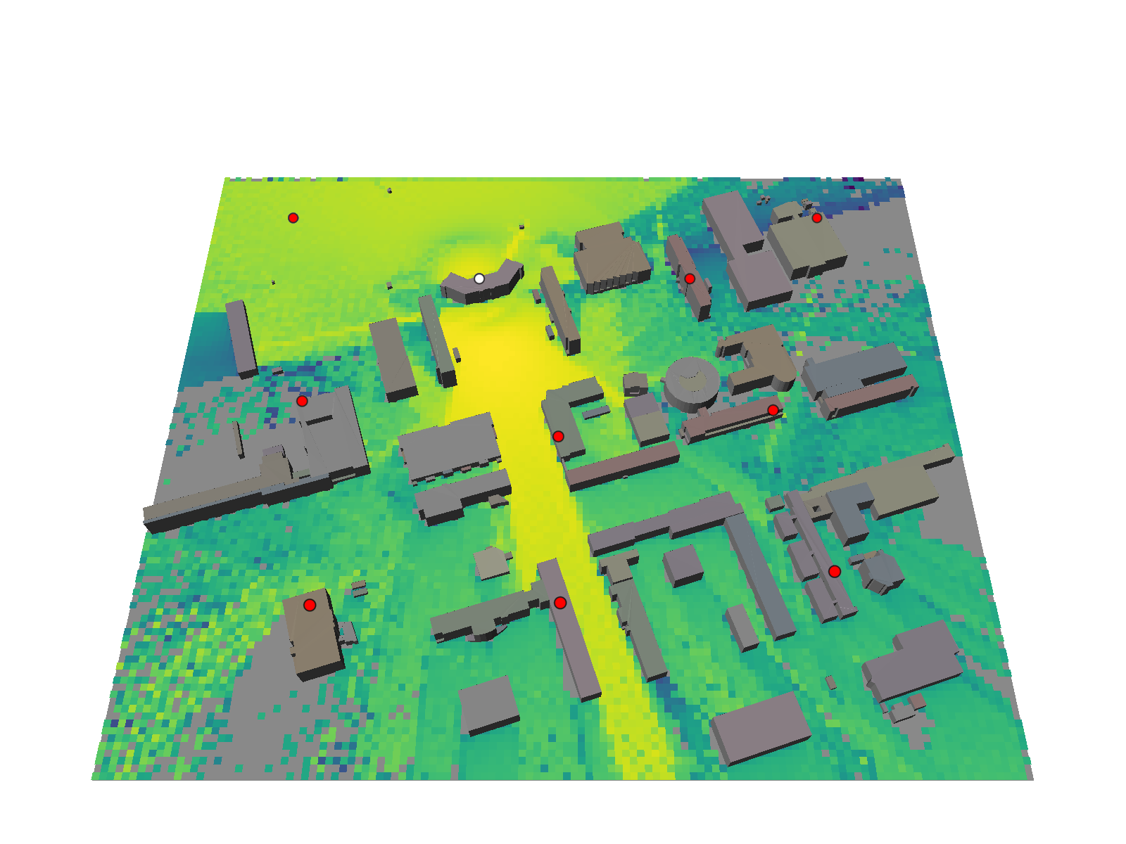
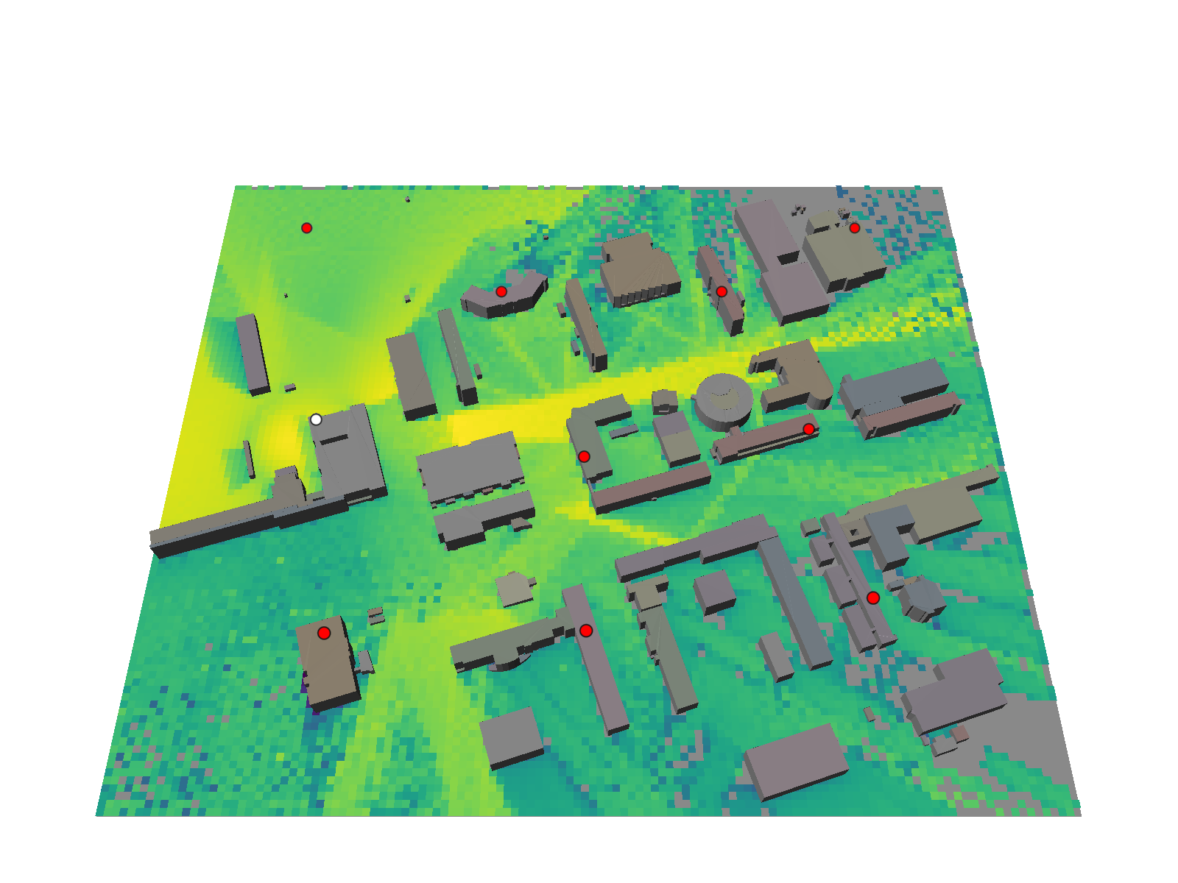
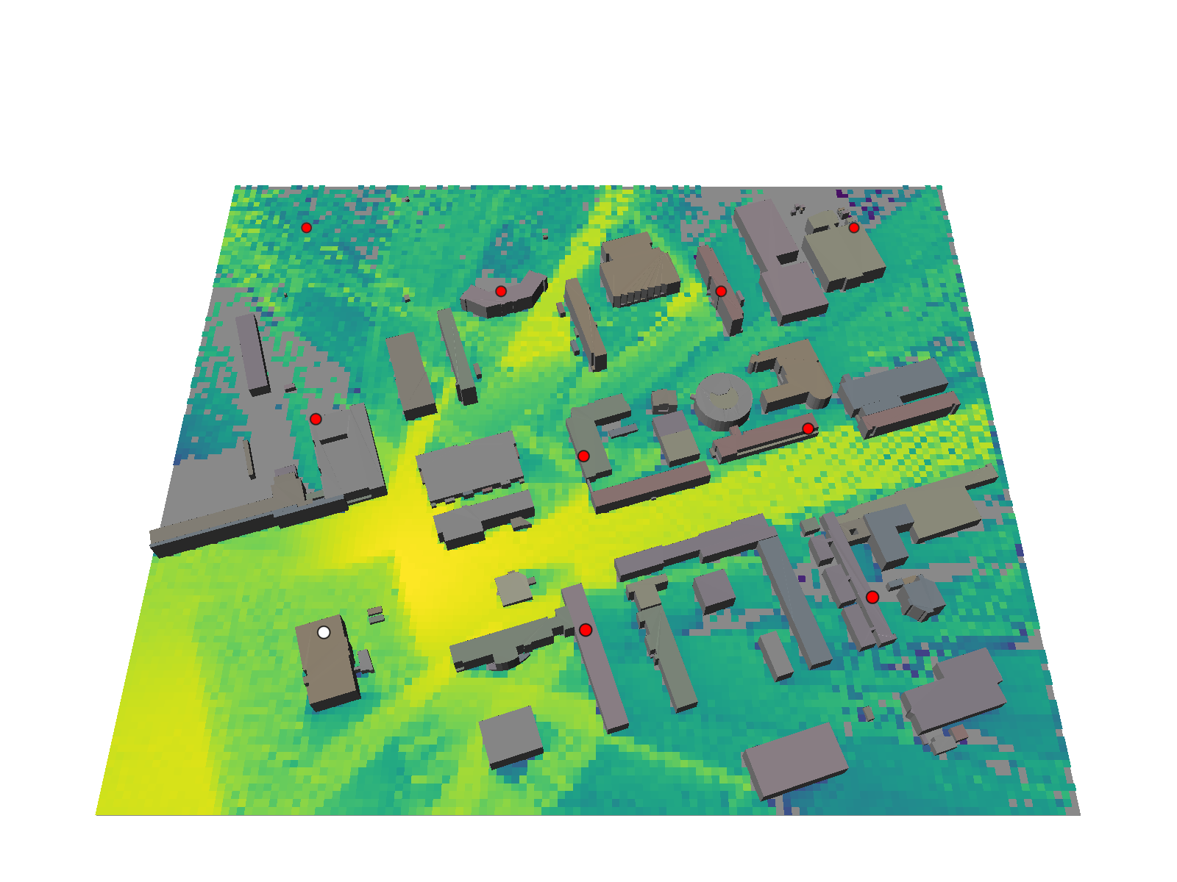
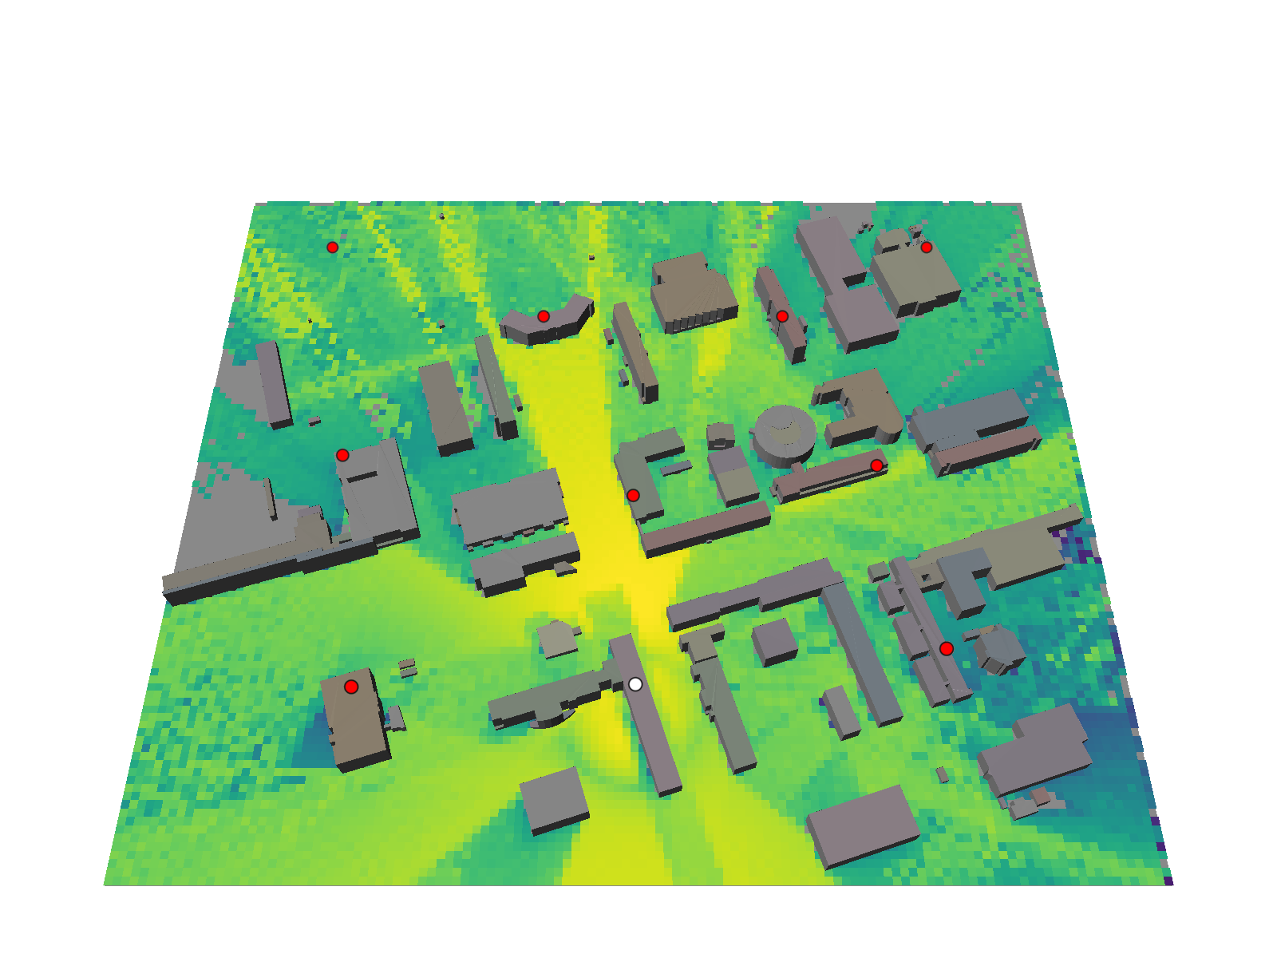
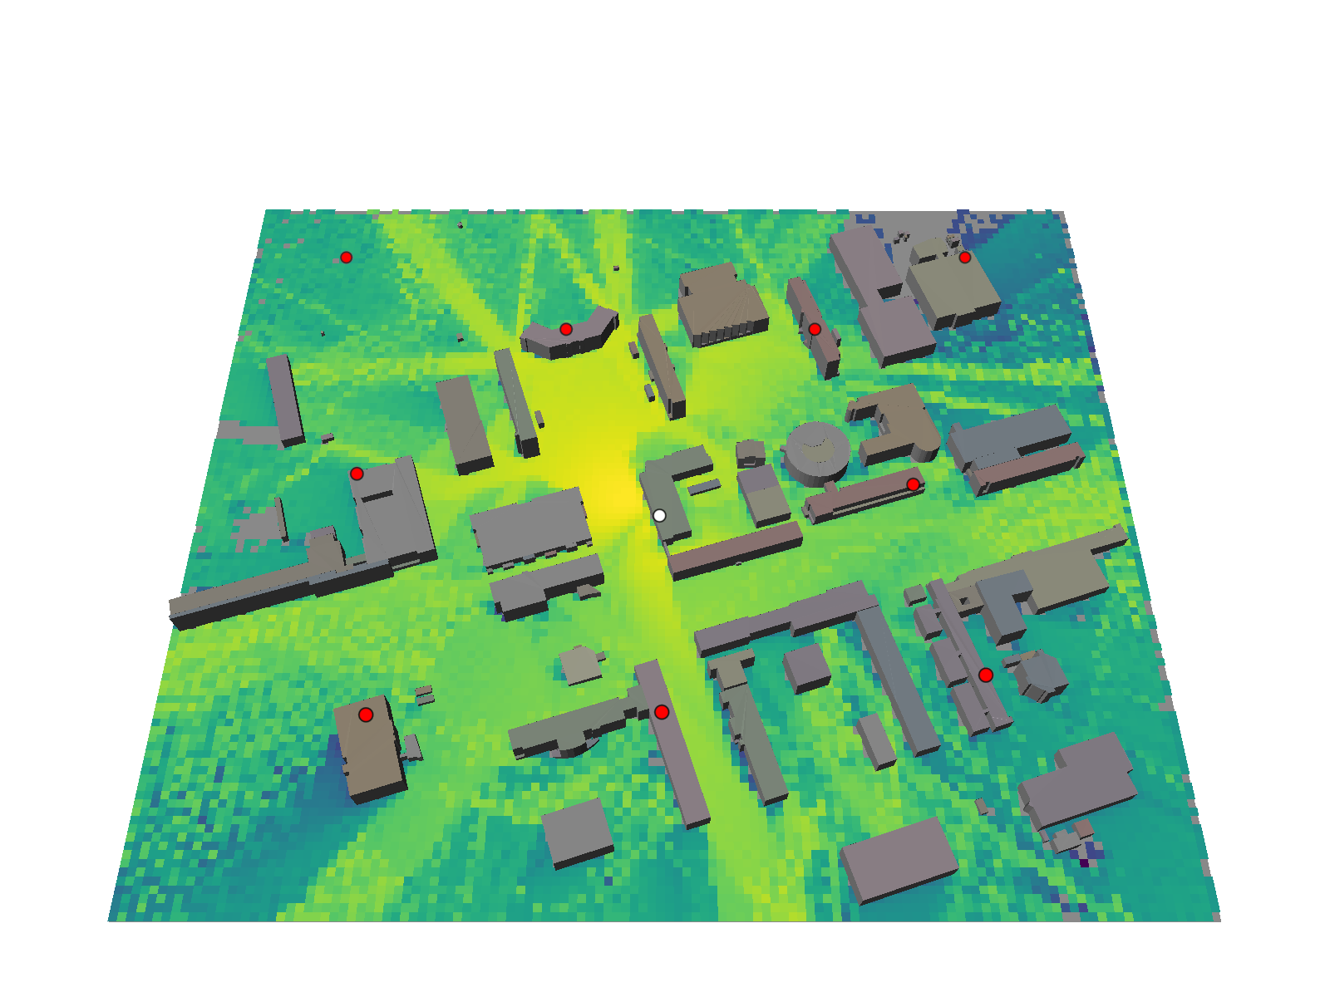
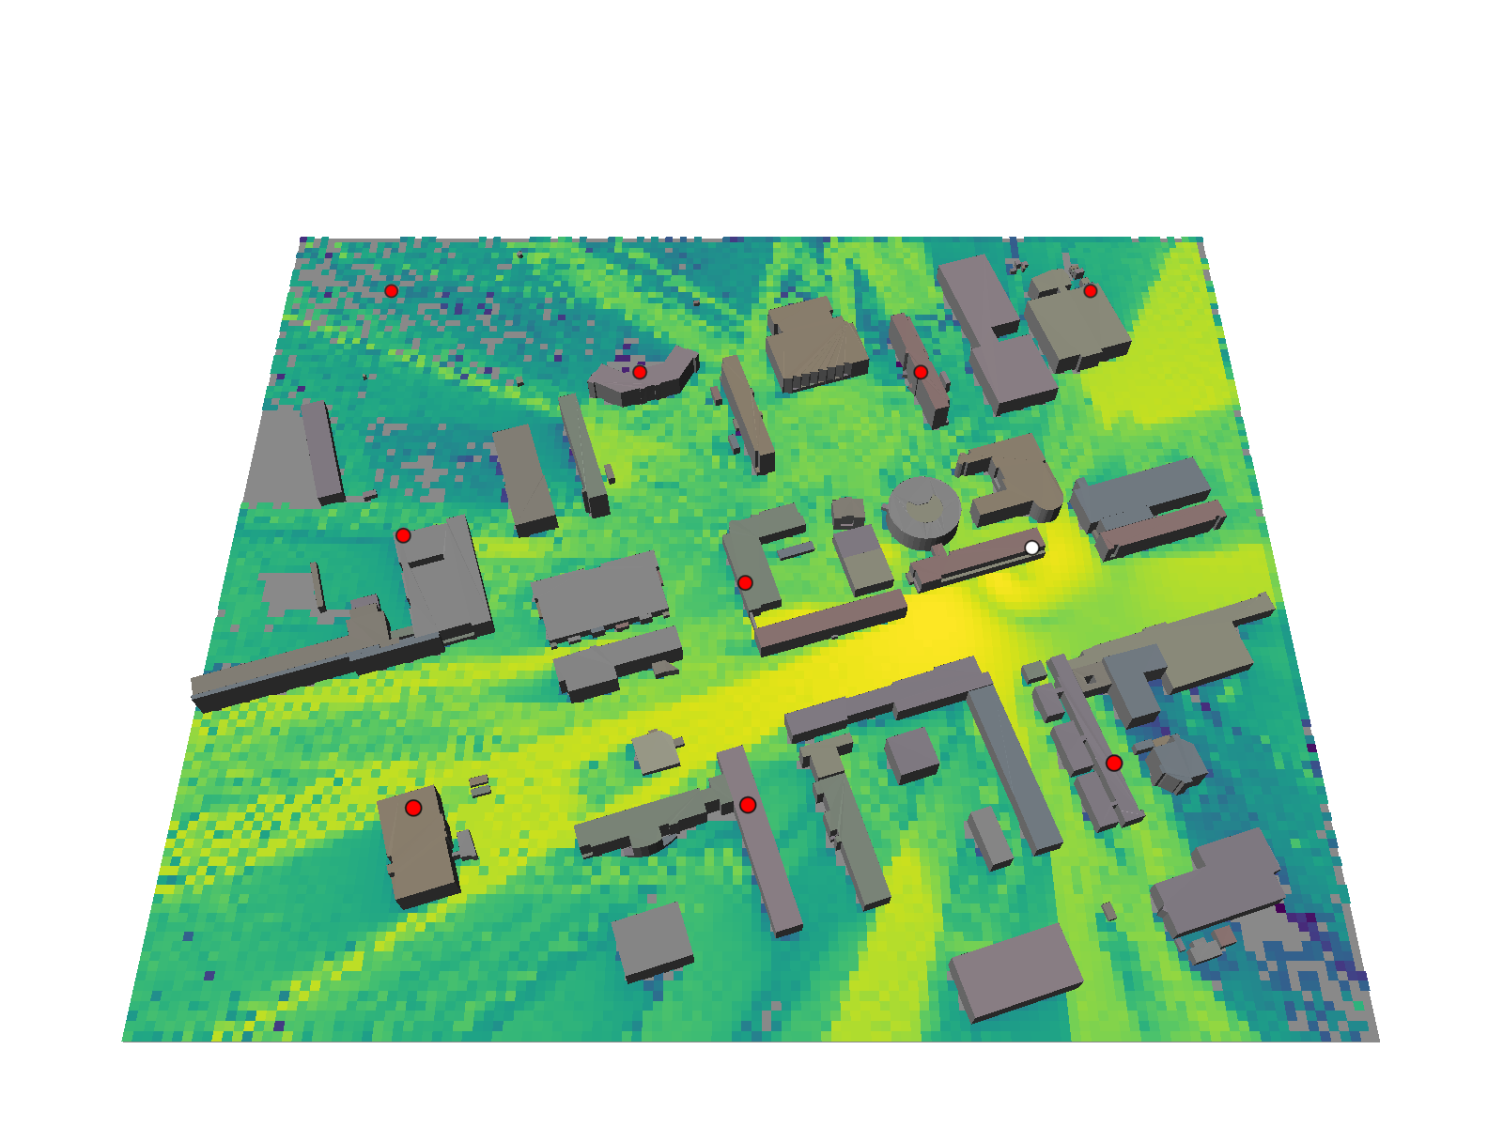
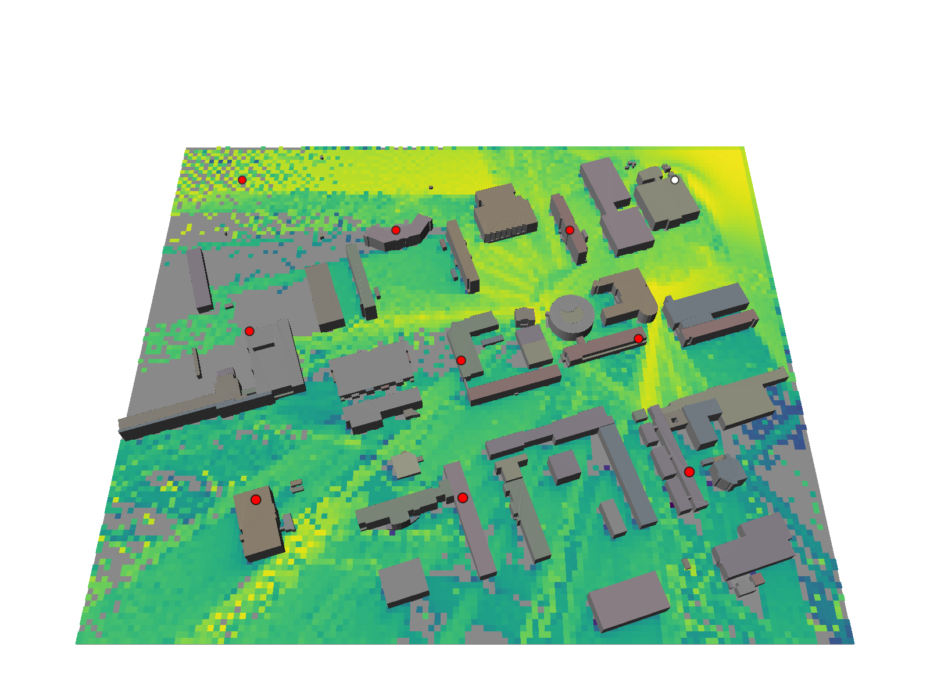
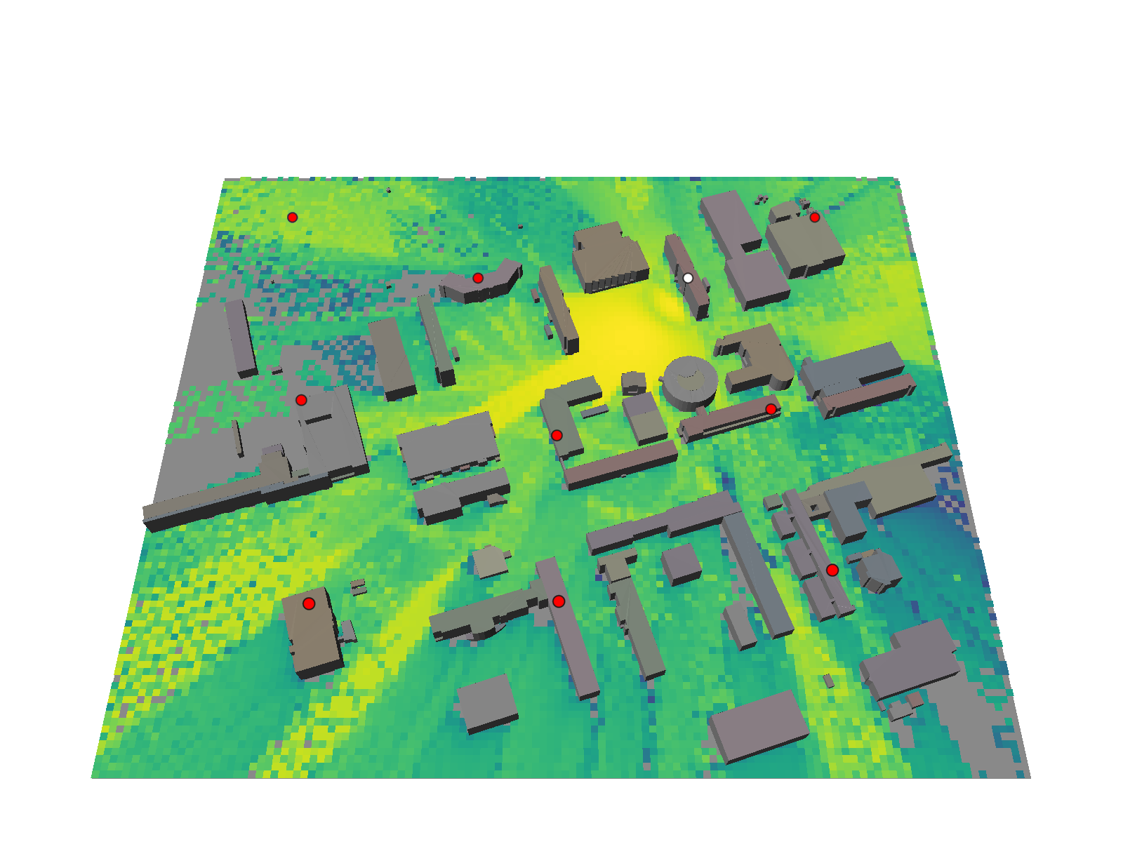
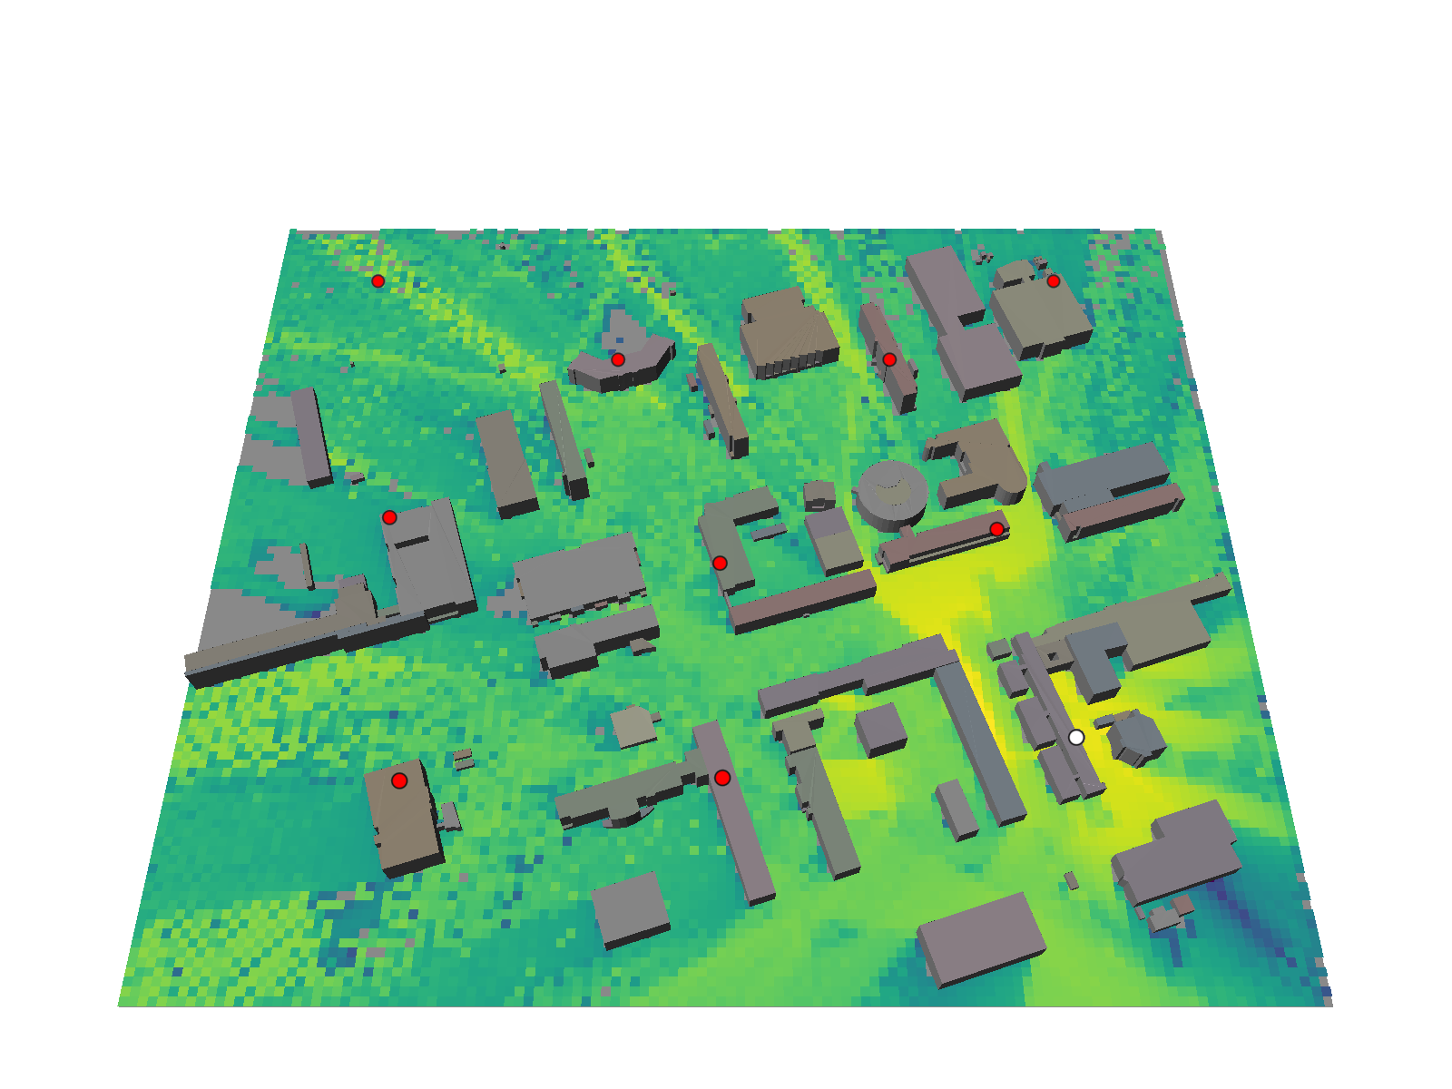
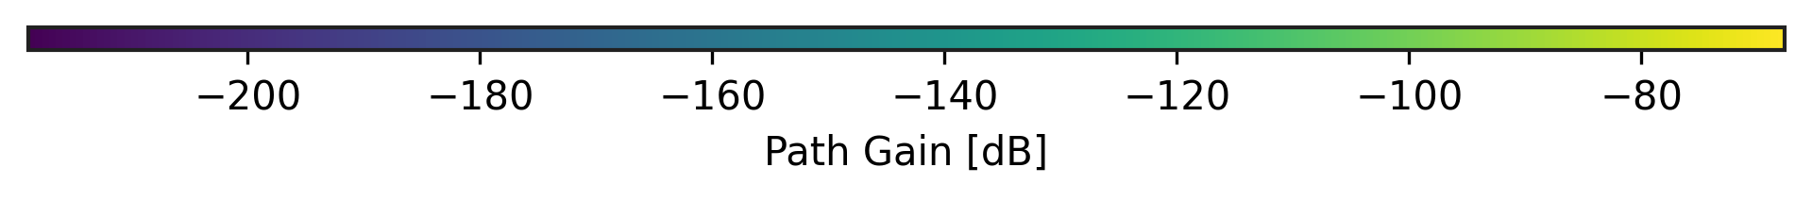
Scenario description
Path loss maps

Slide 8
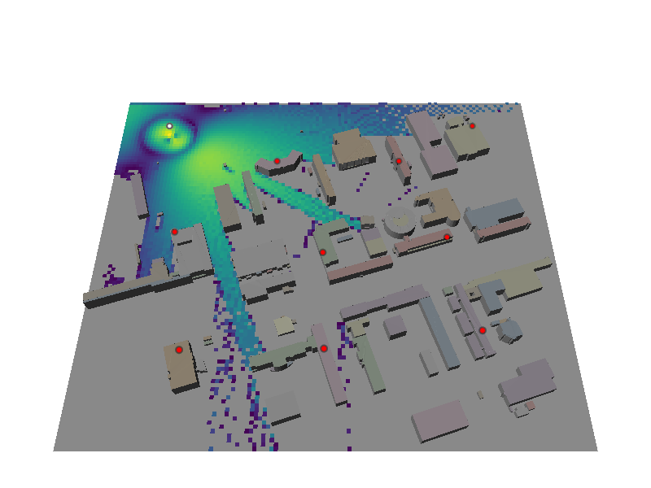
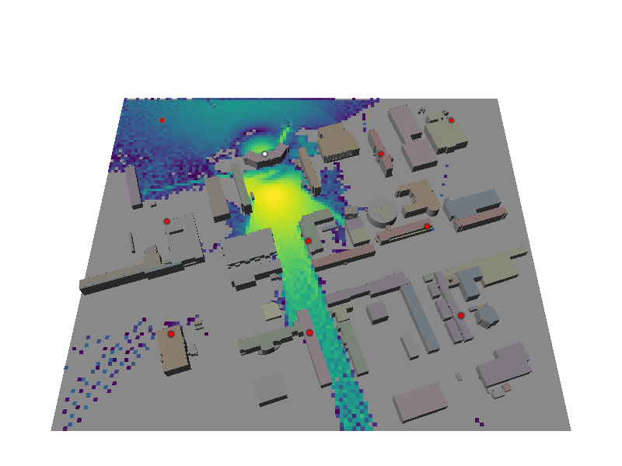
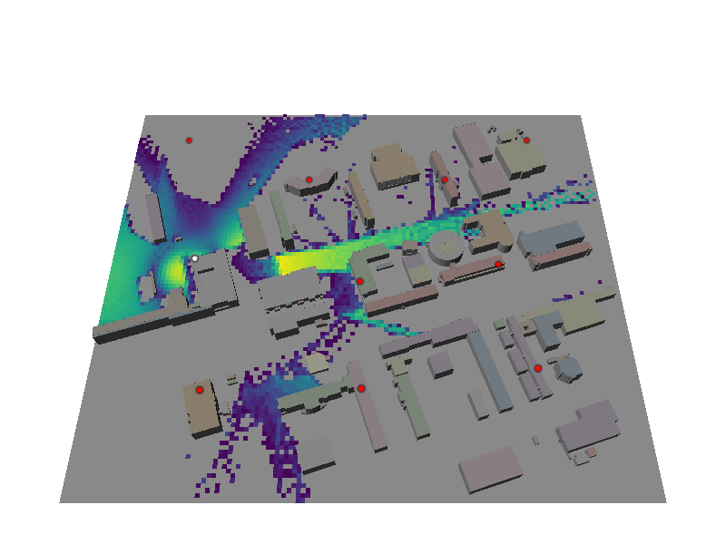
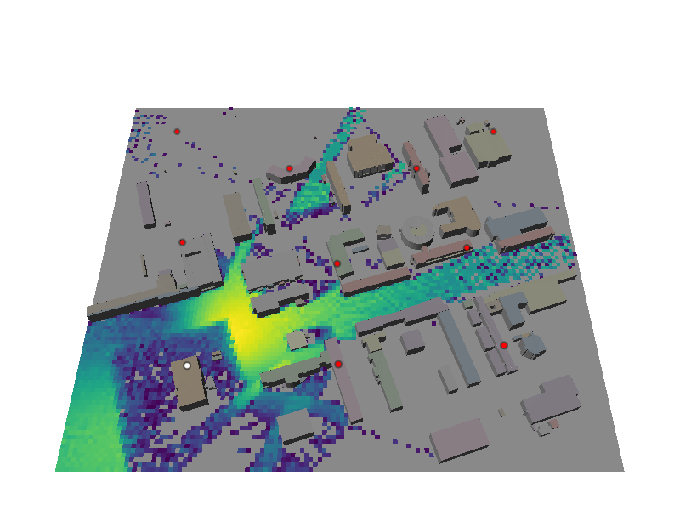
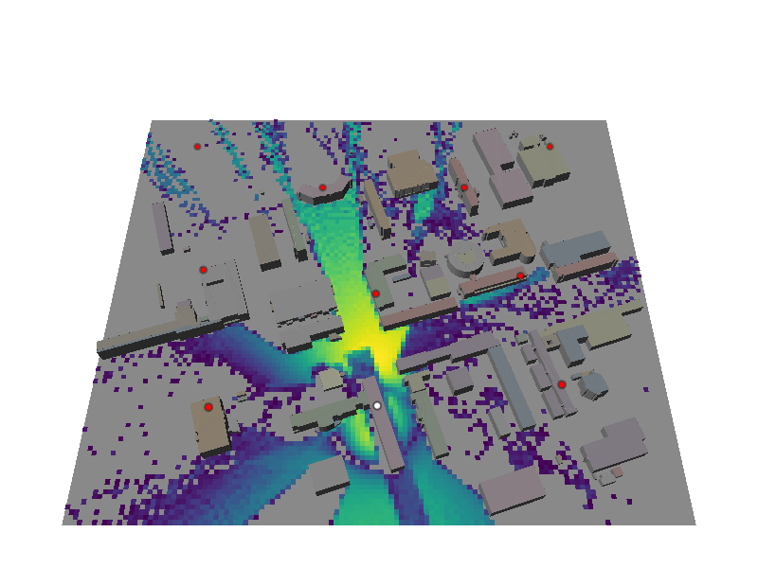
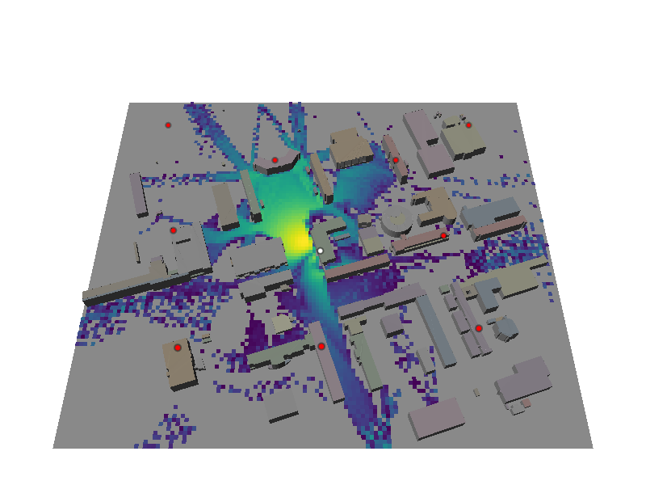
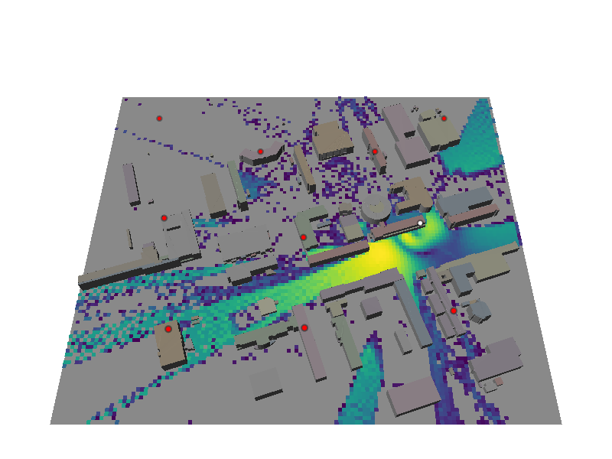
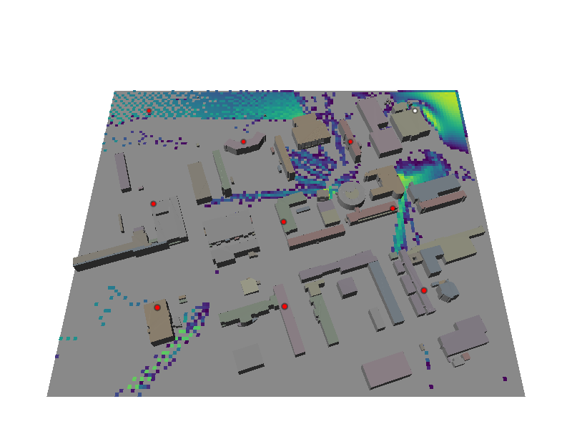
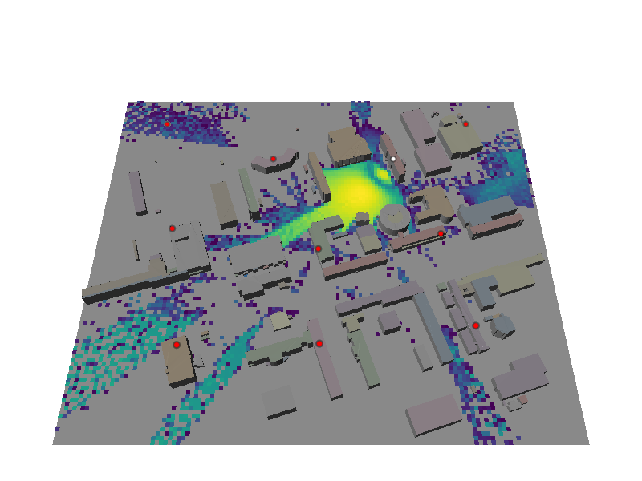
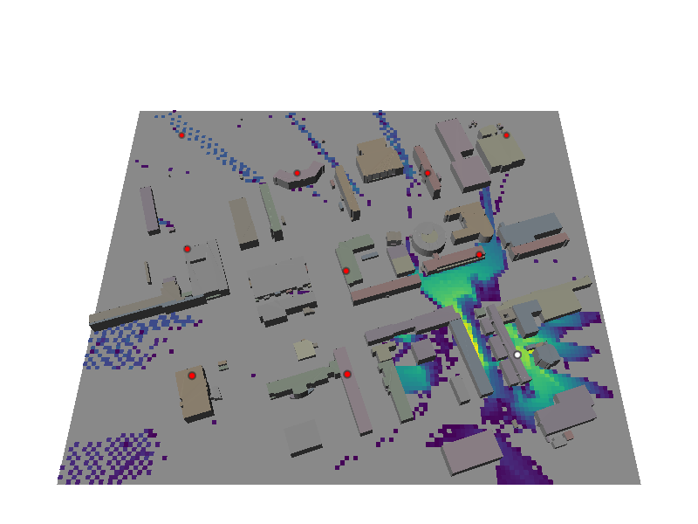
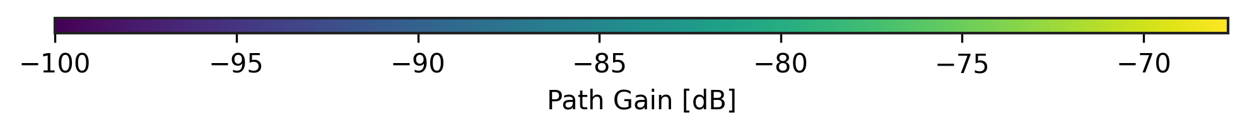
Scenario description
Path loss maps , truncated to control the overlap between different cells

Slide 9
Scenario description
User equipment and mobility pattern
Located at 1.5m height
Single Antenna UE
Vertical polarization antenna element with isotropic radiation pattern
Probabilistic Road Map (PRM) path finder to generate random feasible piecewise linear trajectories
Cubic splines to smooth and sample the resulting trajectories (1 m/s nominal speed and 10 Hz sampling frequency)

Slide 10
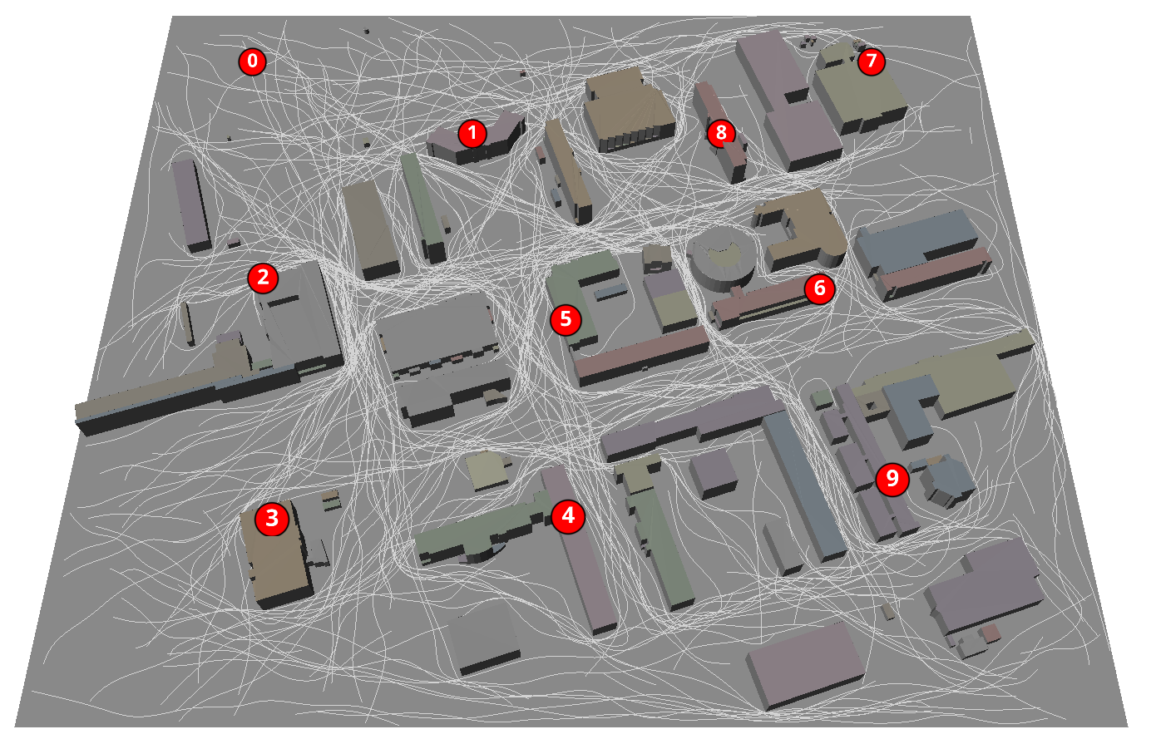
Scenario description
Resulting 241 trajectories & PRM Demonstration

Slide 11
Scenario description
Radio and Ray Tracing Parameters
Central frequency | Bandwidth | Sub carrier spacing | FFT size
3.5 GHz | 15.36 MHz | 60 KHz | 256
 | Array Configuration | Antenna pattern | Antenna polarization
User Equipment | Single Antenna element | Isotropic | Vertical
Base stations | 4x2 Antenna array | Isotropic | Cross polarization
Synthetic array | Max Depth | Los, Reflection, Diffraction, | Scattering | Normalize Delays | Normalize - CIR to OFDM CSI
True | 5 | True | False | False | False

Slide 12
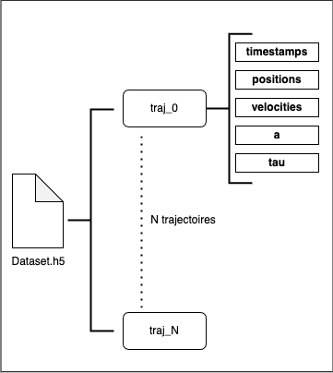
Data set structure
Hierarchical Data Format
Trajectory N:
Timestamps: Time of the measure
Positions: User position
Velocities: User velocity
Paths Coeffs: The baseband paths coefficients
Paths Delays: Paths delays
The size of one compressed sample is 0.02 MB
On an NVIDIA Tesla V100 16GB, generating one sample takes about 34 ms

Slide 13
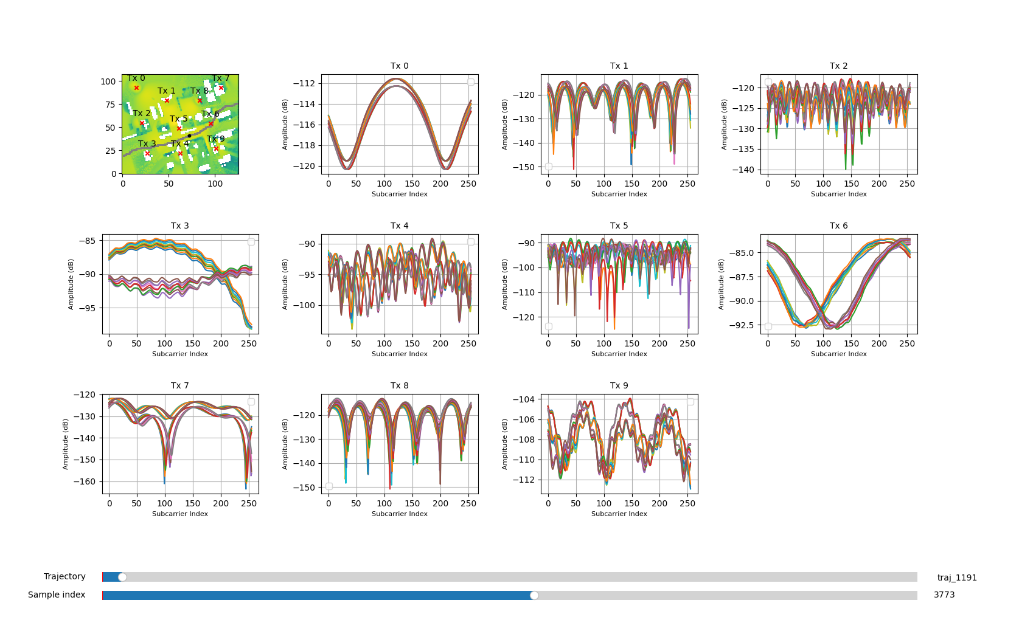
Data set structure
Frequency Domain CSI visualization

Slide 14
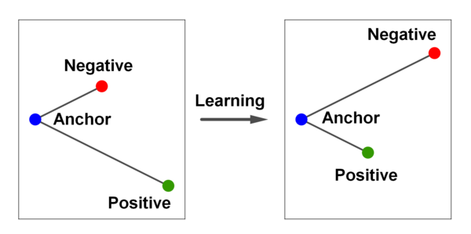

Channel Charting using MOCSID
Triplet loss
CSI data
Anchor
(A)
Positive
(P)
Negative
(N)
𝒇
𝒇
𝒇
source: F. Schroff et al , FaceNet: A Unified Embedding for Face Recognition and Clustering
Triplet loss
Triplet selection based on the timestamp
We select a triplet (Anchor, Positive, Negative) such that :
|t_{positive} − t_{anchor}| ≤ Tc and |t_{negative} − t_{anchor}| > Tc
Tc: Coherence Time and t_{i}: measurement time of the ith sample
A^{(i)}, P^{(i)} and N^{(i)}: Anchor, positive and negative samples for triplet i
𝒇: A Deep Neural Network , shared weights
m: Batch size
𝜶: The margin

Slide 15
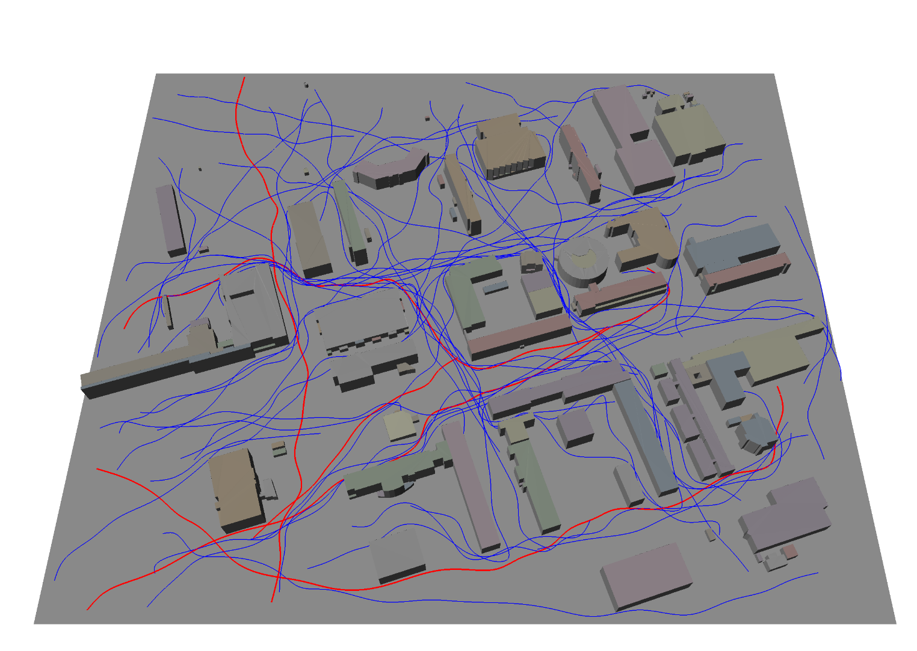
Channel Charting using MOCSID
Training parameters :
Triplet selection: timestamp based with Tc = 2 seconds
Triplet loss Margin 𝞪 = 1
ADAM optimizer
  Learning rate 10⁻²
  Weight decay 10⁻⁷
20 epochs with batch size equal to 1024
Model architecture Multi Layer Perceptron [3]
(1280,512)(BN)(512,256)(BN)(256,128)(BN)(64,32)(BN)(32,2)
[3] P. Ferrand et al “Triplet-based wireless channel charting: Architecture and experiments,”IEEEJourn. Sel. Areas in Comm., vol. 39, no. 8, pp. 2361–2373, 2021

Slide 16
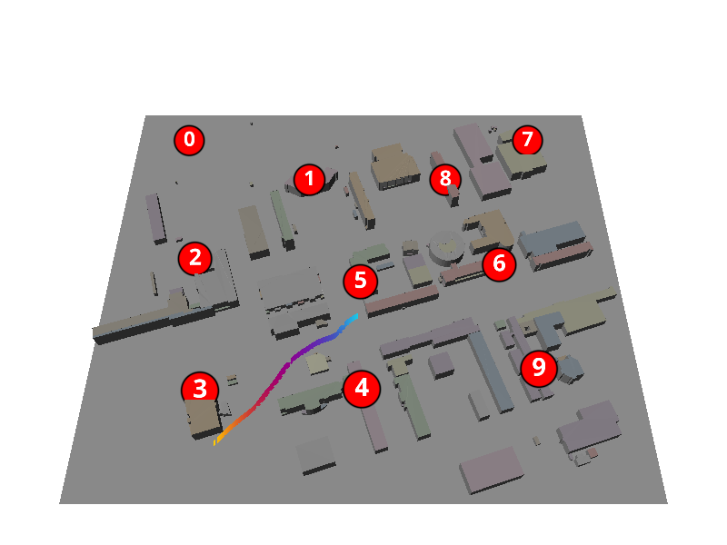
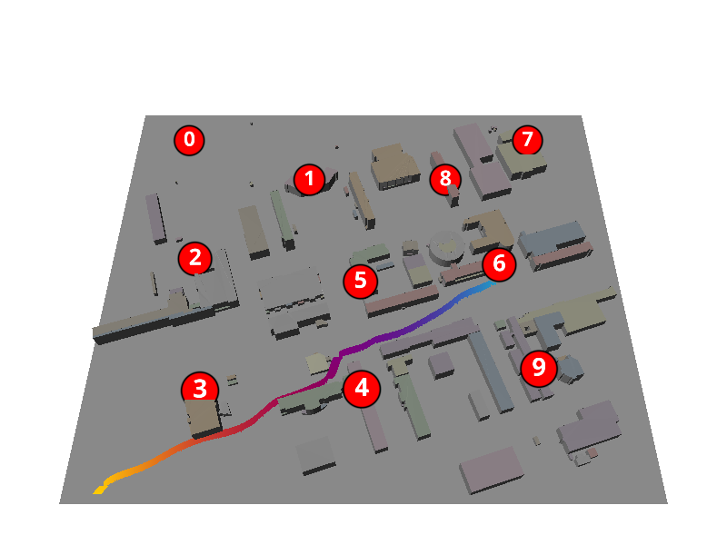
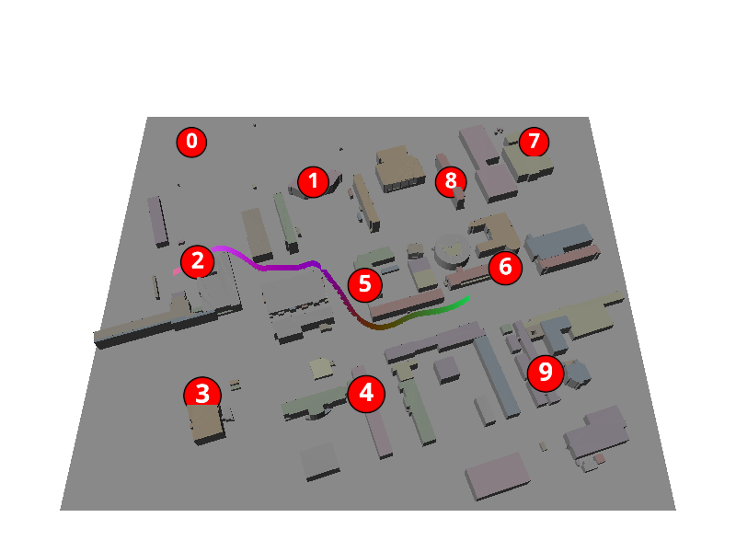
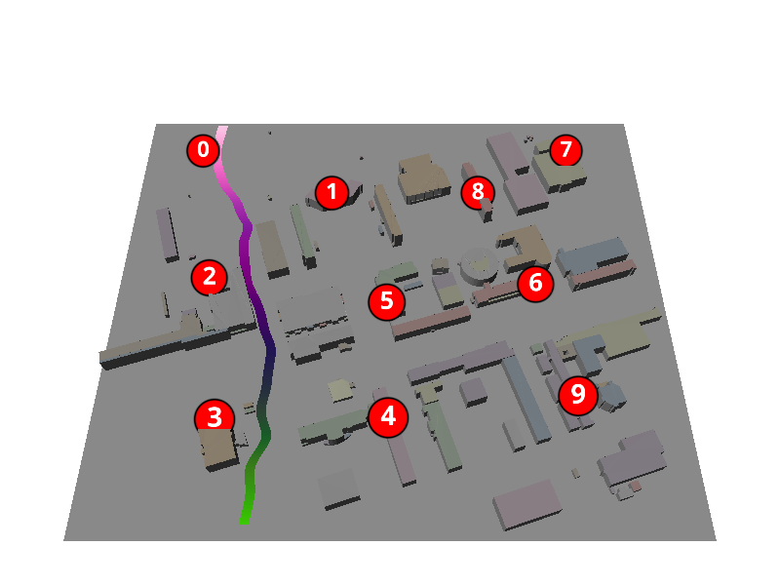
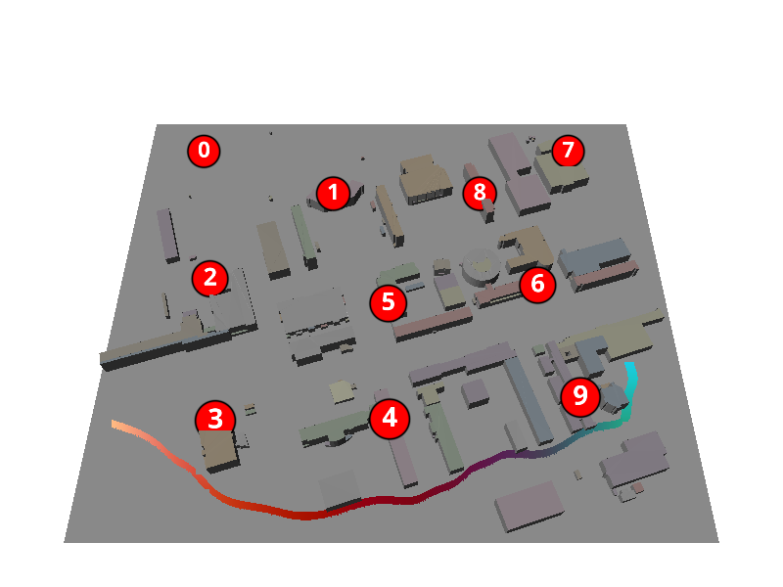
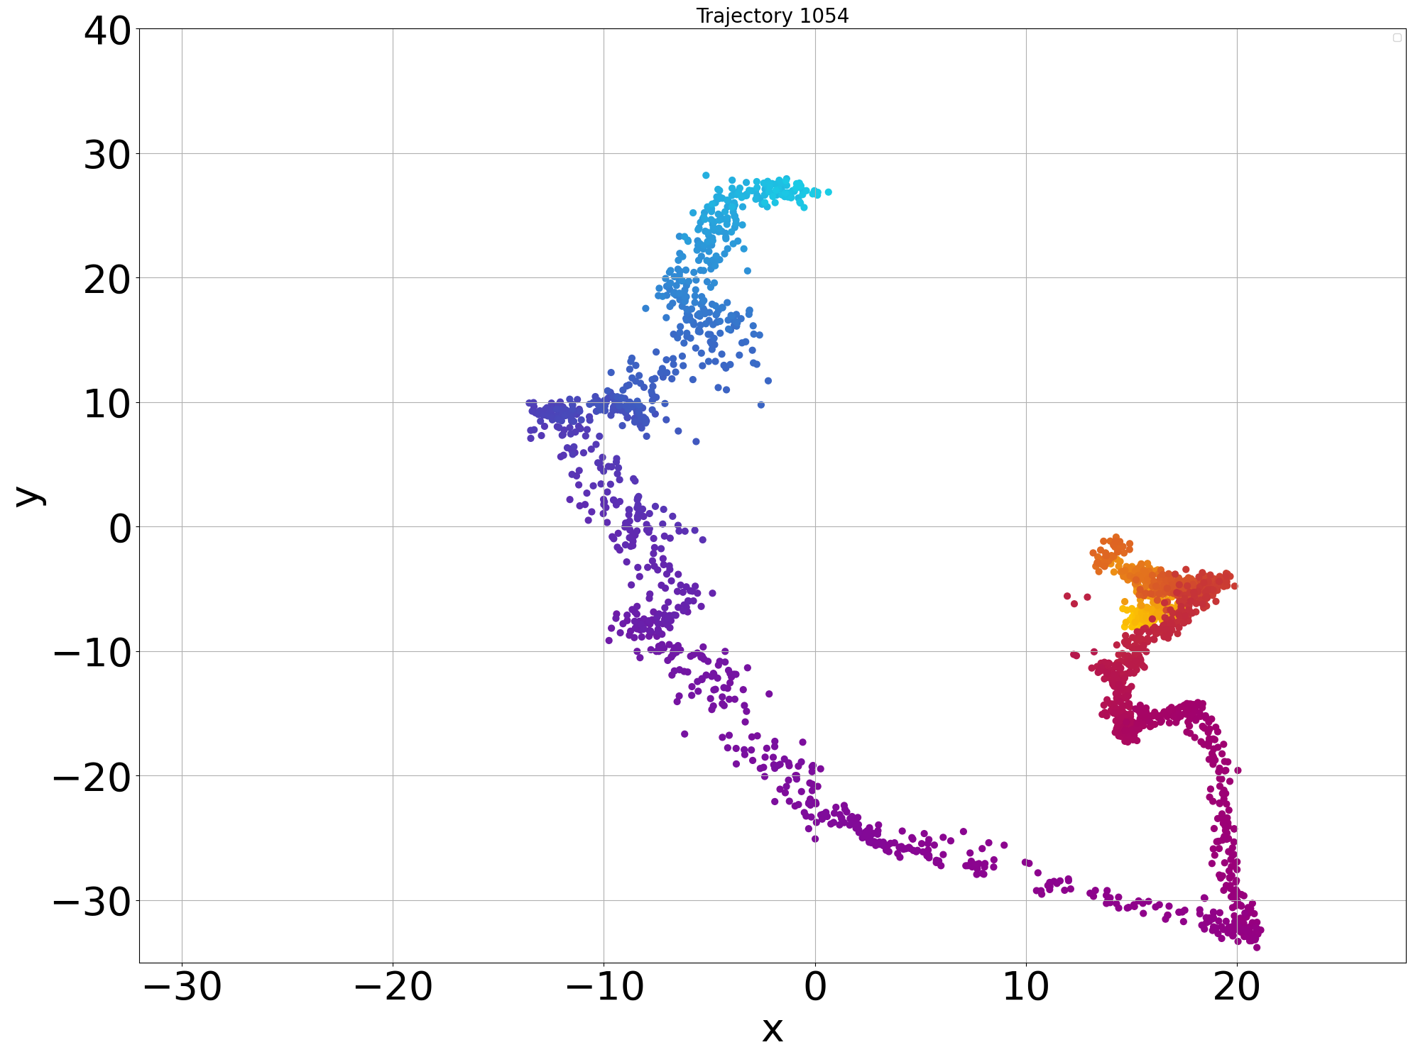
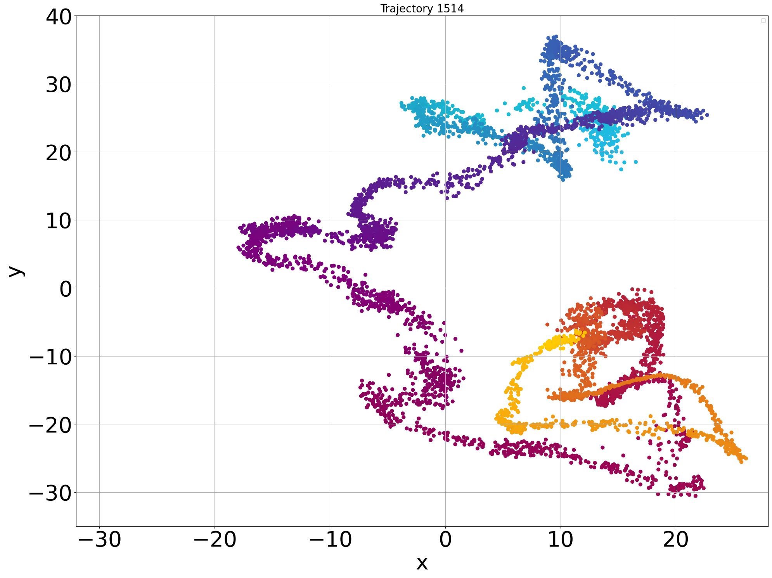
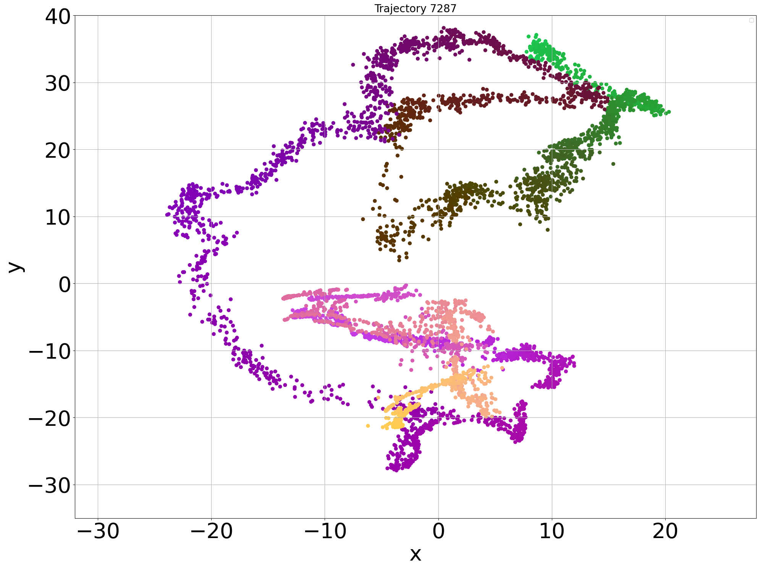
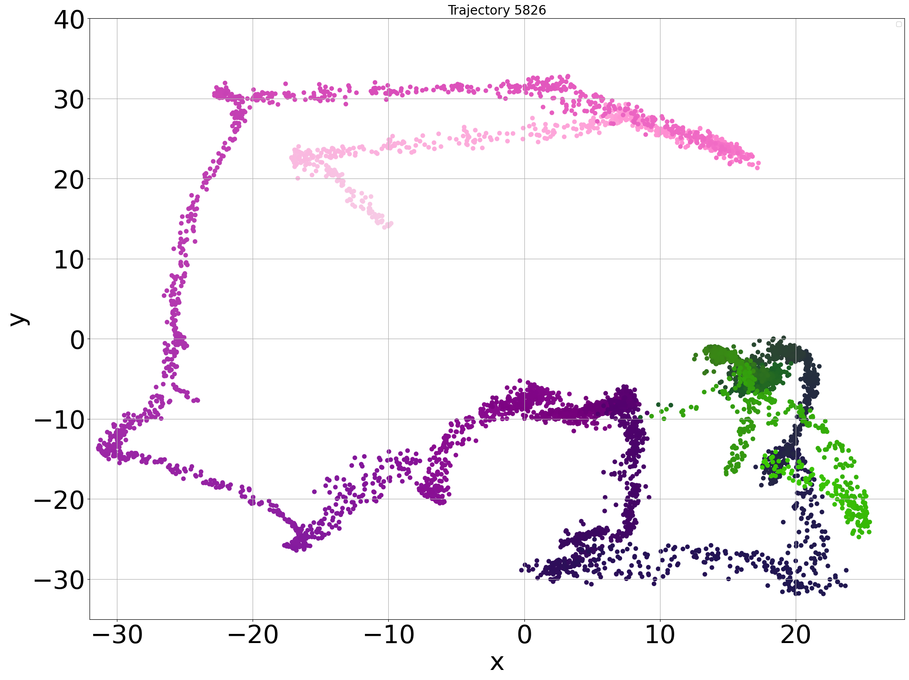
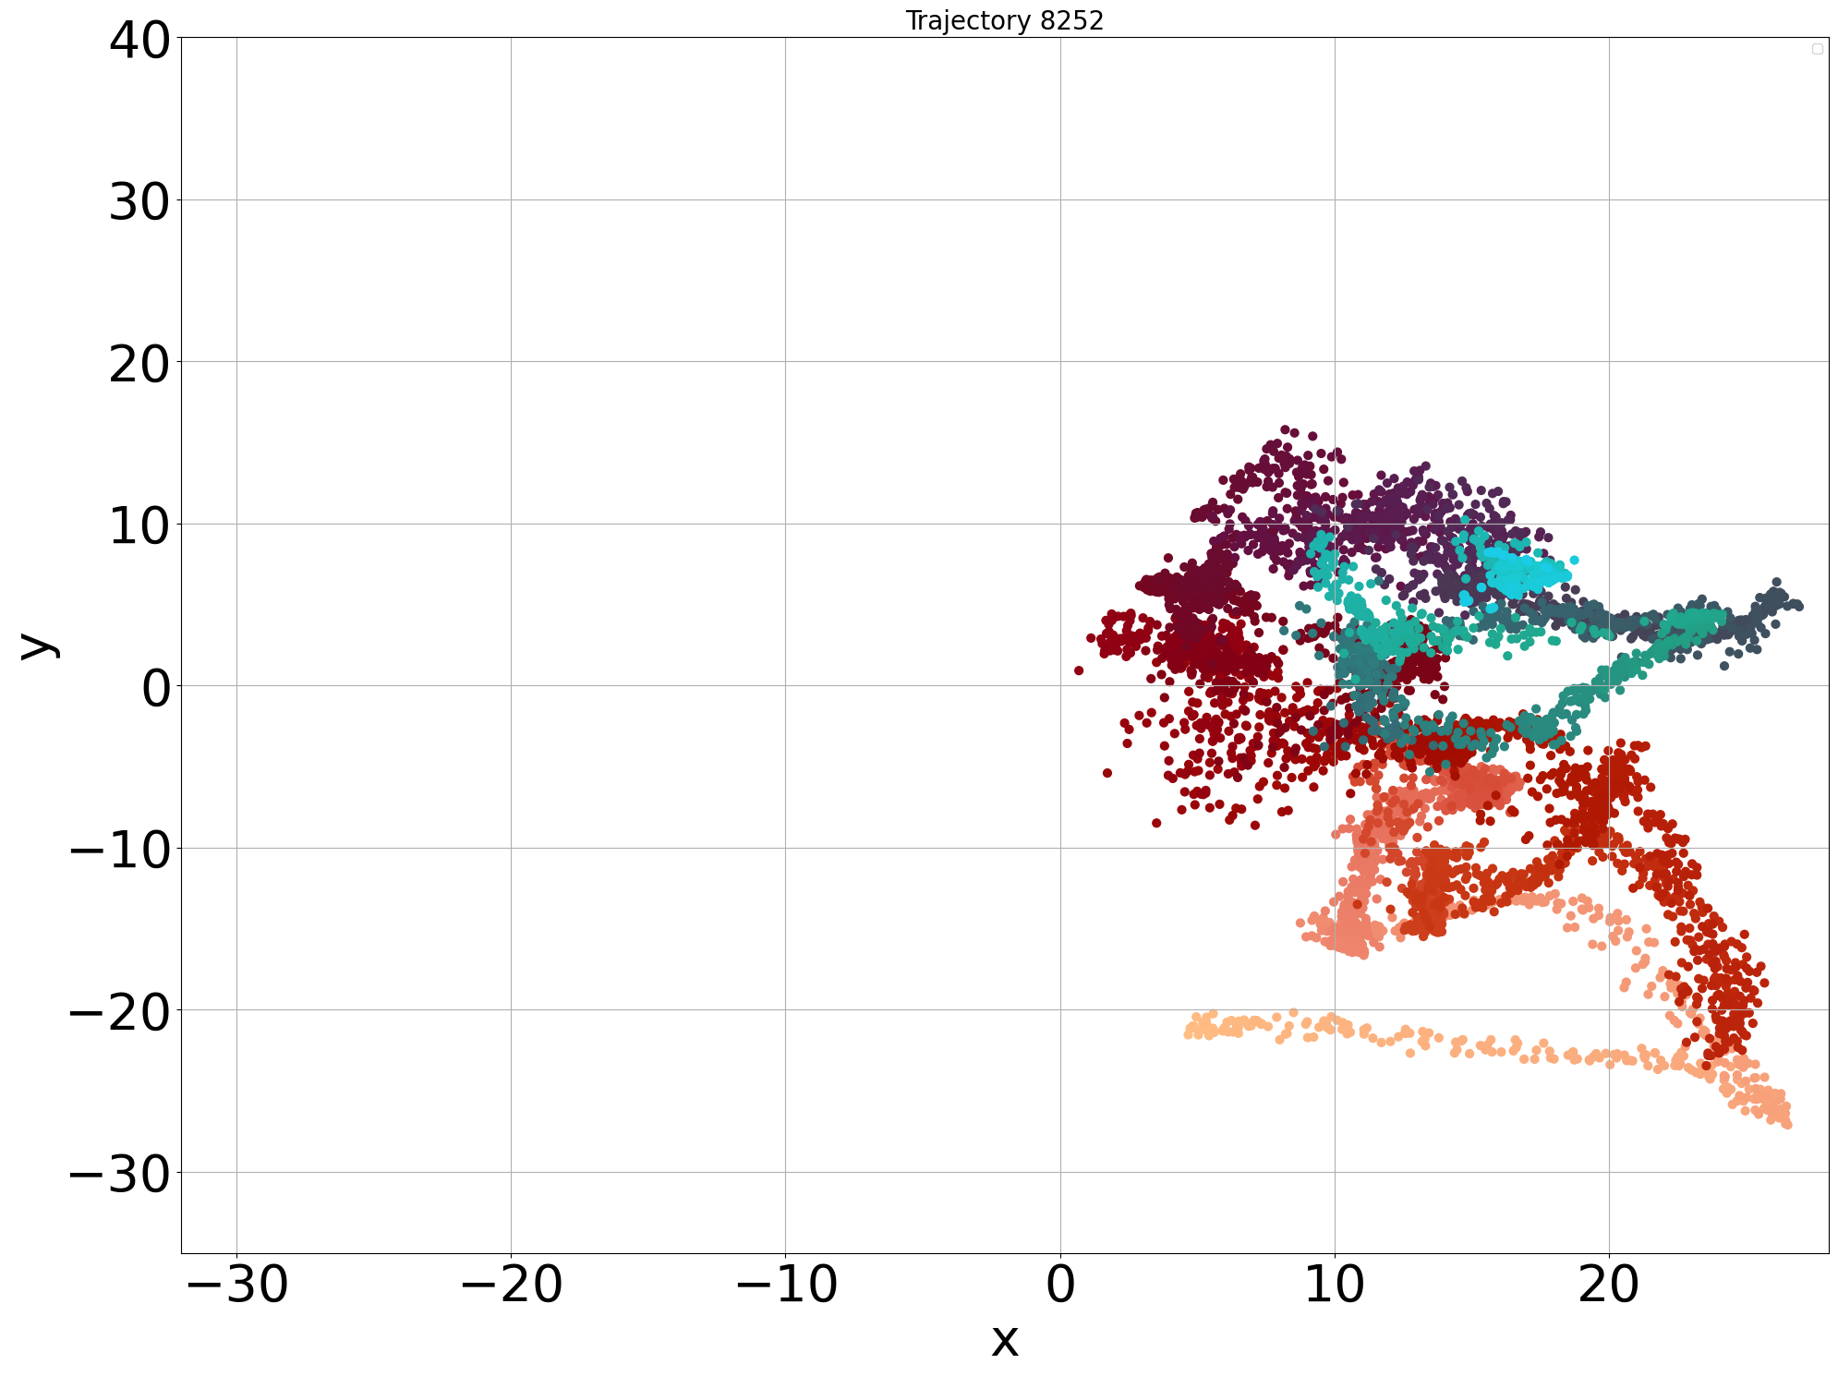
Channel Charting using MOCSID
Results
Trajectory 1054
Trajectory 1514
Trajectory 7287
Trajectory 5826
Trajectory 8252

Slide 17
Channel Charting using MOCSID
Trajectory ID | Trustworthiness (%) ↑ | Continuity (%) ↑ | Kruskal Stress ↓
1054 | 98.00 | 98.60 | 0.47
1514 | 97.47 | 99.17 | 0.43
7287 | 96.94 | 99.28 | 0.47
5826 | 98.27 | 99.10 | 0.49
8252 | 95.32 | 98.46 | 0.42
All | 92.00 | 98.96 | 0.46
Trustworthiness and Continuity gives an idea about the neighborhood conservation (from the real space to the chart space for the Trustworthiness and the inverse for the Continuity)
Kruskal Stress measure of how well the chart preserves the pairwise distances from the real space
Notes:
where:
- $D_X^{(i,j)}$ is the pairwise distance between points $i$ and $j$ in the original space.
- $D_{X'}^{(i,j)}$ is the pairwise distance between points $i$ and $j$ in the embedded space.
- $\beta$ is a scaling factor.

Slide 18
Conclusion
Introduced MOCSID, a synthetic outdoor dataset representing a real-world campus scenario
We made the code and the dataset publicly available
Future improvements could include dynamic elements in the environment
Validating synthetic datasets is crucial to ensure their relevance for the desired task
Sionna enables advanced simulations of wireless networks with ray tracing and other modules with a support for machine learning integration
Contact information : mohamed-el-mehdi.makhlouf@inria.fr
Code availbal at : https://gitlab.inria.fr/channelcharting/outdoor_dataset
Dataset availbal at : https://zenodo.org/records/14535165 ; DOI : 10.5281/zenodo.14535165.

