Slide 1


An Open source machine learning and data visualization Software
Name: Apurv Vidhate
Roll Number: 2183046
Enrollment Number: MITU18BTCS0267
Class: CSE Core

Slide 2
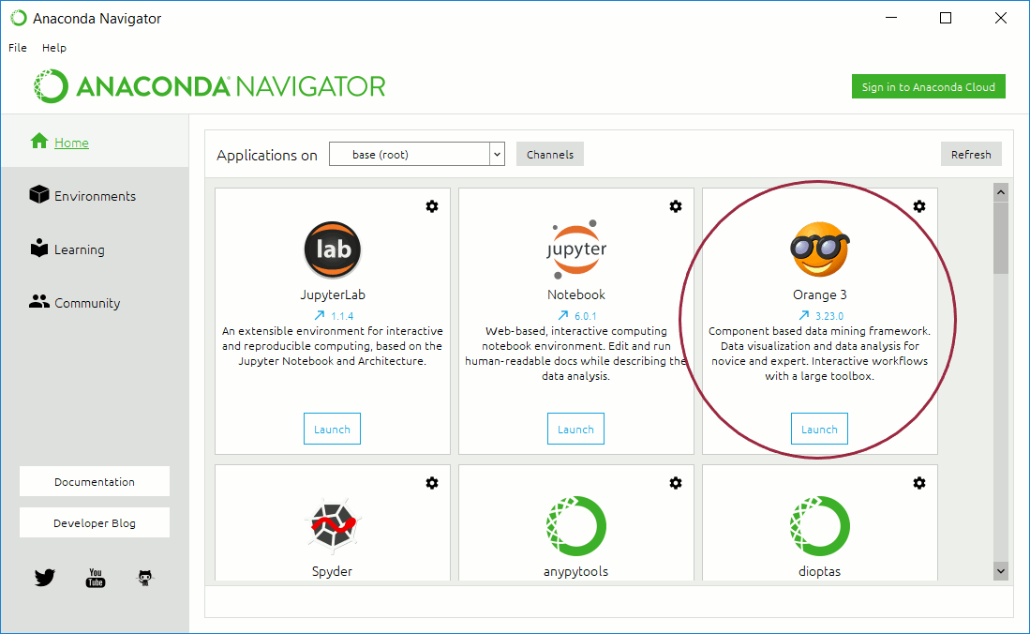
Introduction
Orange is a platform built for creating machine learning pipelines on a GUI workflow. People with no coding skills can operate Orange with ease. One can perform every task right from data preparation to model evaluation without writing a single line of code.
Name: Apurv Vidhate
Roll Number: 2183046

Slide 3
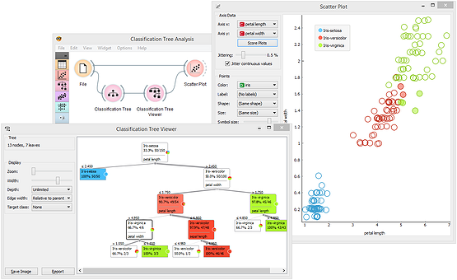
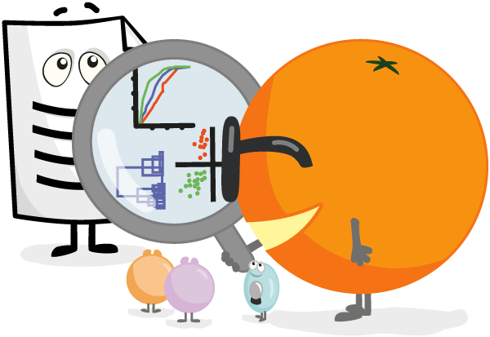
Why do we need it?
With growing need of data science managers, we need tools which take out difficulty from doing data science and make it fun. Not everyone is willing to learn coding, even though they would want to learn / apply data science. This is where GUI based tools can come in handy.
Name: Apurv Vidhate
Roll Number: 2183046

Slide 4
Features
Interactive Data Visualization
Orange is all about data visualizations that help to uncover hidden data patterns, provide intuition behind data analysis procedures or support communication between data scientists and domain experts.
Visualization widgets include scatter plot, box plot and histogram, and model-specific visualizations like dendrogram, silhouette plot, and tree visualizations, just to mention a few. Many other visualizations are available in add-ons and include visualizations of networks, word clouds, geographical maps, and more.
Name: Apurv Vidhate
Roll Number: 2183046

Slide 5
Features
Visual Programming
Orange is a great data mining tool for beginners as well as for expert data scientists. Thanks to its user interface users can focus on data analysis instead on laborious coding, making a construction of complex data analytics pipelines simple. Orange has a few widgets which help in data mining.
Component based Data Mining
Interactive based Data Mining
Clever Workflow Design Interface
Name: Apurv Vidhate
Roll Number: 2183046

Slide 6
Features
Add On Functionality
You can use various add-ons available within Orange to mine data from external data sources, perform natural language processing and text mining, conduct network analysis, infer frequent itemset and do association rules mining.
Additionally, bioinformaticians and molecular biologists can use Orange to rank genes by their differential expression and perform enrichment analysis.
Name: Apurv Vidhate
Roll Number: 2183046

Slide 7
Teachers and Students love it
Orange is the perfect tool for hands-on training. Teachers enjoy the clear program design and the visual explorations of data and models. Students benefit from the flexibility of the tool and the power to invent new combinations of data mining methods.
The educational strength of Orange comes from the combination of visual programming and interactive visualizations. Moreover, they have also designed some educational widgets that have been explicitly created to support teaching.
Name: Apurv Vidhate
Roll Number: 2183046

Slide 8
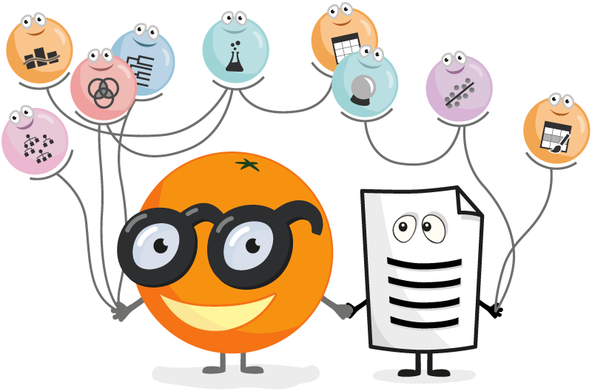
Applications
Orange can we used in a wide range of applications:
Data Visualization
Machine Learning
Data Mining
It is quite useful for beginners to start their Machine Learning path, and with the help of add ons you can extend the scope of what you can do.
Name: Apurv Vidhate
Roll Number: 2183046

Slide 9

Thank you!
Name: Apurv Vidhate
Roll Number: 2183046
Enrollment Number: MITU18BTCS0267
Class: CSE Core

