Slide 1
Constraint Propagation
III. Constraint Satisfaction Problems and planning

Slide 2
State-space Search = only search
CSPs = search or do a specific type of inference called constraint propagation
Using constraints to reduce number of legal values for a variable, can reduce legal values for another variable and so on.
It may be preprocessing step before search, can solve whole problem
Key idea: Local consistency
Each binary constraint as an arc, then enforcing local consistency in each part of graph causes inconsistent values to be eliminated throughout the graph.

Slide 3
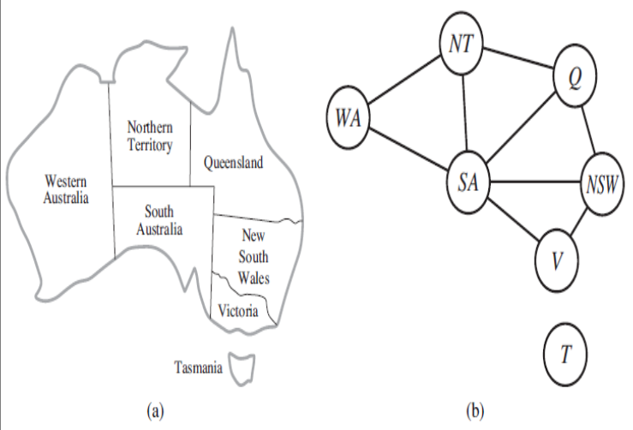
Types of local consistency
Node Consistency:
A single variable is node-consistent, if all values in domain satisfy the variable’s unary constraint.
E.g. in map colouring problem from { red, green, blue} if any colour is removed due to a constraint for all nodes in graph.
Always possible to eliminate all unary constraints in a CSP by running node consistency.
Possible to transform all n-ary constraints into binary ones.

Slide 4
Arc consistency:
If every value in domain satisfies the variable’s binary constraint then that variable is arc-consistent.
Xi is arc consistent w.r.t. Xj if for every value in Di there is some value in Dj that satisfies binary constraint on arc (Xi, Xj)
A network is arc-constraint if every variable is arc sonstent with every other variable.
E.g. Y=X² then constraint is <(X,Y),{(0,0),(1,1),(2,4),(3,9)}>
To make X arc consistent w.r.t. Y, reduced X’s domain to {0,1,2,3}
Also, to make Y arc-consistent, Y’s domain reduced to {0,1,4,9} and whole CSP is arc-consistent.
Arc-consistency don’t work for map coloring problem-
Consider constraint (SA,WA): {(R,G),(R,B),(G,R),(G,B),(B,R),(B,G)}
No matter what value for first variable, but second assignment is concious.

Slide 5
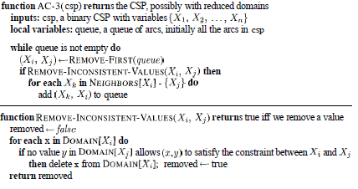
AC-3: most popular arc-consistent algorithm
Maintains queue of arcs to consider
Initiallt queue contains all arcs in CSP
Pops off an arbitrary arc (Xi, Xj) from queue and makes Xi arc-consistent w.r.p. Xj
If Di unchanged, then algorithm moves on to the next arc
If Di revises, then add to queue all arcs (Xk,Xi) where Xk is neighbor of Xi
Because change in Di might enable further reductions in the Dk, even if previously considered Xk.
If Di is revised down to nothing, then whole CSP has no consistent solution and AC-3 can return failure.
Otherwise keep checking, trying to remove values from domains of variables until no more arcs are in the queue
We left with CSP, equivalent to original CSP (as having same solution) but they are arc-consistent CSP, faster to search as having smaller domains.
Complexity:
Assume n variables, each with domain size at most d, with c binary constraints (arcs)
Each arc (Xk, Xi) can be inserted in queue only d times as Xi has at most d values to delete.
Checking consistency of arc can be done in O(d²) time, so we get O(cd³) total worst case time.

Slide 6
Generalized Arc-consistency (hyperarc consistency):
Extension of arc consistency to handle n-ary rather than just binary constraints
If for every value v in domain of Xi there exists a tuple of values that is a member of constraint, has all its values taken from domains of corresponding variables, and has its Xi component equal to v
E.g. if all variables have the domain {0,1,2,3}, then to make variable X consistent with constraint X < Y < Z, we would have to eliminate 2 and 3 from domain of X because constraint can’t be satisfied when X is 2 or 3

Slide 7
Path consistency
For some CSP networks arc consistency fails to make enough inferences
For Australia map coloring with two colors not possible, need at least three colors
Arc consistency tightens down domains (unary constraints) using arcs (binary constraints).
Path consistency tightens binary constraints by using implicit constraints that are inferred by looking at triples of variables.
Two variable set (Xi, Xj) is path-consistent w.r.t. third Xm if, for every assignment {Xi=a, Xj=b} consistent with constraints on {Xi,Xj}, there is an assignment to Xm that satisfies constriants on {Xi, Xm} and {Xm, Xj}.
Path consistency as path from Xi to Xj with Xm in middle
E.g. Australia Map coloring problem with two colors
Make {WA, SA} path consistent w.r.t NT.
{WA=red, SA=blue} or {WA=blue, SA=red}, NT can be neither red nor blue
So as no valid choice for NT, eliminate both assignments and end up with no valid assignments for {WA, SA}. No solution to this problem.

Slide 8
K-consistency
Stronger form of propagation with notion of K-consistency
A CSP is k-consistent, if for set oof k-1 variable and or any constraint assignment to those variables, a consistent value can always be assigned to any kth variable.
1-consistency: empty set given
2-consisitency: any set of one variable , like wise
A CSP is strongly k-consistent if it is k-consistent and is also (k-1) consistent, (k-2) consistent,….,,,1-consistent

