Slide 1
Planning
III. Constraint Satisfaction Problems and Planning

Slide 2
Learnings
Planning components
Blocks world
Goal Stack Planning
Planning as a state space search
Partial Order Planning
Multi-agent Planning
Job shop scheduling problem
How an agent can take advantage of the structure of a problem to construct complex plans of action.
The task of coming up with a sequence of actions that will achieve a goal is called planning.
Environments that are fully observable, deterministic, finite, static, and discrete (in time, action, objects, and effects) are called classical planning environments

Slide 3
Introduction
If Problem Solving Agent trying to solve Irrelevant action then needs
Knowledge and the goal, the planner can decide in a single unification step that is the right action. E.g. Book selling online. Buy(ISBN) Have (ISBN)
The problem solving agent requires a human to supply a heuristic function for each new problem.
On the other hand, if a planning agent has access to an explicit representation of the goal as a conjunction of subgoals, then it can use a single domain-independent heuristic: the number of unsatisfied conjuncts.
The problem solver might be inefficient because it cannot take advantage of problem decomposition.
The design of many planning systems-particularly the partial-order planners described is based on the assumption that most real-world problems are nearly decomposable.
additional work to combine the resulting subplans

Slide 4
Language of Planning Probelms

Slide 5
Syntax of representation of planning problem
Representation of planning problems-states, actions, and goals-should make it possible for planning algorithms to take advantage of the logical structure of the problem.
The key is to find a language that is expressive enough to describe a wide variety of problems, but restrictive enough to allow efficient algorithms to operate over it.
Representation of states.
Planners decompose the world into logical conditions and represent a state as a conjunction of positive literals.
Consider propositional literals; for example, Poor ᴧ (the state of a hapless agent).
Use first-order literals; for example, At(Plane1, Melbourne) A At(Plane2, Sydney) might represent a state in the package delivery problem.
Literals in first-order state descriptions must be ground and function-free.
The closed-world assumption is used, any conditions that are not mentioned in a state are assumed false.

Slide 6
Components
Representation of goals.
A goal is a partially specified state, represented as a conjunction of positive ground literals, such as Rich A Famous or At(P2, Tahiti).
A propositional state s satisfies a goal g if s contains all the atoms in g (and possibly others).
For example, the state Rich A Famous A Miserable satisfies the goal Rich A Famous
Representation of actions.
An action is specified in terms of the preconditions that must hold before it can be executed and the effects that ensue when it is executed.
For example, an action for flying a plane from one location to another is:
Action(Fly(p, from, to),
PRECOND: At(p, from) A Plane(p) A Airport(from) A Airport(to)
EFFECT: ~At(p, from) A At (p, to)
This is more properly callled an action schema, meaning that it: represents a number of different actions that can be derived by instantiating the variables p, from, and to to different constants.

Slide 7
Action Schema
The action name and parameter list-for example, Fly(p, from, to)-serves to identify the action.
The precondition is a conjunction of function-free positive literals stating what must be true in a state before the action can be executed. Any variables in the precondition must also appear in the action's parameter list.
The effect is a conjunction of function-free literals describing how the state changes when the action is executed. A positive literal P in the effect is asserted to be true in the state resulting from the action, whereas a negative literal ~P is asserted to be false. Variables in the effect must also appear in the action's parameter list.
To improve readability, some planning systems divide the effect into the add list for positiveliterals and the delete list for negative literals.

Slide 8
Planning With State Space Search
Planning algorithms: The most straightforward approach is to use state-space search. Because the descriptions of actions in a planning problem specify both preconditions and effects, it is possible to search in either direction: either forward from the initial state or backward from the goal.

Slide 9
Forward state-space search
It is sometimes called progression planning, because it moves in the forward direction.
The formulation of planning problems as state-space search problems is as follows:
The initial state of the search is the initial state from the planning problem. In general, each state will be a set of positive ground literals; literals not appearing are false.
The actions that are applicable to a state are all those whose preconditions are satisfied. The successor state resulting from an action is generated by adding the positive effect literals and deleting the negative effect literals. Note that a single successor function works for all planning problems-a consequence of using an explicit action representation.
The goal test checks whether the state satisfies the goal of the planning problem.
The step cost of each action is typically 1. Although it would be easy to allow different costs for different actions, this is seldom done by STRIPS planners.

Slide 10
A planning problem in the blocks world: building a three-block tower. One
solution is the sequence [Move(B, Table, C ) ,
Move(A, Table, B)]
(a) Forward (progression) state-space search, starting in the initial state and using the problem's actions to search forward for the
goal state.

Slide 11
Backward Space-Search
Note that backward search can be difficult to implement when the goal states are described by a set of constraints rather than being listed explicitly.
It is not always obvious how to generate a description of the possible predecessors of the set of goal states.
The STRIPS representation makes this quite easy because sets of states can be described by the literals that must be true in those states.
The main advantage is that it allows to consider only relevant actions. An action is relevant to a conjunctive goal if it achieves one of the conjuncts of the goal.
For example, the goal in our 10-airport air cargo problem is to have 20 pieces of cargo at airport B, or more precisely
At(C1,B ) A At(C2,B)A . . . A At(C2o,B )
The conjunct At (C₁,B).Working backwards, There is only one: Unload (C1,p,B) where plane p is unspecified.
There are many irrelevant actions that can also lead to a goal state- fly an empty plane from JFK to SFO
A backward search that allows irrelevant actions will still be complete, but it will be much less efficient.
The restriction to relevant actions means that backward search often has a much lower branching factor than forward search.

Slide 12
Called also regression planning
What are the states from which applying a given action leads to the goal? Computing the description of these states is called regressing the goal through the action.
At(C1,B) A At(C2,B) A ….. A At(C20,B) Here Irrelevant is relevant action Unload(C1,p,B)
Therefore, any predecessor state must include these preconditions: In(C1,p ) A At (p, B ). Thus, the predecessor description is
In(Cl, p) A At (p, B) A At (C2, B) A . . . A At (C20, B) .

Slide 13
Partial Order Planning
Forward and backward state-space search are particular forms of totally ordered plan search.
They explore only strictly linear sequences of actions directly connected to the start or goal.
An approach that works on several subgoals independently, solves them with several subplans, and then combines the subplans.
Advantage of flexibility in the order in which it construct the plan.
The general strategy of delaying a choice during search is called a least commitment strategy. Some degree of commitment is necessary, lest the search would make no progress.
Despite the informality, least commitment is a useful concept for analyzing when decisions should be made in any search problem.

Slide 14
Partial Order Planning Example-problem of putting on a pair of shoes
Goal (RightShoeOn A LeftShoeOn)
Init ()
Action(RightShoe, PRECONDR:RightSockOn, EFFECT: RightShoeOn)
Action(RightSock, EFFECT:RightSockOn)
Action(LeftShoe; PRECOND:LeftSockOn, EFFECCT: LeftShoeOn)
Action (LeftSock, EFFECT:LeftsocOn)
A planner should be able to come up with the two-action sequence Rightsock followed by Rightshoe to achieve the first conjunct of the goal and the sequence Leftsock followed by LeftShoe for the second conjunct. Then the two sequences can be combined to yield the final plan.
Any planning algorithm that can place two actions into a plan without specifying which comes first is called a partial-order planner.
The partial-order solution corresponds to six possible total-order plans; each of these is called a linearization of the partial-order plan.
formulate partial-order planning as an instance of a search problem. States of search problem will be (mostly unfinished) plans.

Slide 15
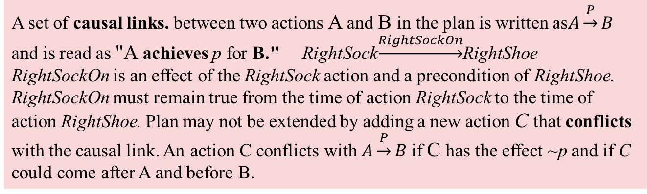
Partial Order Planning Components of the Plan
A set of actions that make up the steps of the plan. Taken from the set of actions in the planning problem. The "empty" plan contains just the Start and Finish actions. Start has no preconditions and has as its effect all the literals in the initial state of the planning problem. Finish has no effects and has as its preconditions the goal literals of the planning problem.
A set of ordering constraints. Each ordering constraint is of the form AαB, read as "A before B“ & action A must be executed sometime before action B. The ordering constraints must describe a proper partial order. Any cycle-such as A α B and B α A-represents a contradiction,
so an ordering constraint cannot be added to the plan if it creates a cycle.
A set of causal links. between two actions A and B in the plan is written as$A\underset{→}{P}B$ and is read as "A achieves p for B." RightSock$\underset{→}{RightSockOn}$RightShoe
RightSockOn is an effect of the RightSock action and a precondition of RightShoe.
RightSockOn must remain true from the time of action RightSock to the time of action RightShoe. Plan may not be extended by adding a new action C that conflicts with the causal link. An action C conflicts with $A\underset{→}{P}B$if C has the effect ~p and if C could come after A and before B.
Each plan has the four components, first two define the steps of the plan and the last two serve a bookkeeping function to determine how plans can be extended:
A set of open preconditions. A precondition is open if it is not achieved by some action in the plan. Planners will work to reduce the set of open preconditions to the empty set, without introducing a contradiction.

Slide 17
A consistent plan as a plan in which there are no cycles in the ordering constraints and no conflicts with the causal links.
A consistent plan with no open preconditions is a solution.
Every linearization of a partial-order solution is a total-order solution whose execution from the initial state will reach a goal state.
Can extend the notion of "executing a plan" from total-order to partial-order plans.
The flexibility available to the agent as it executes the plan can be very useful when the world fails to cooperate.
The flexible ordering also makes it easier to combine smaller plans into larger ones, because each of the small plans can reorder its actions to avoid conflict with the other plans.

Slide 18
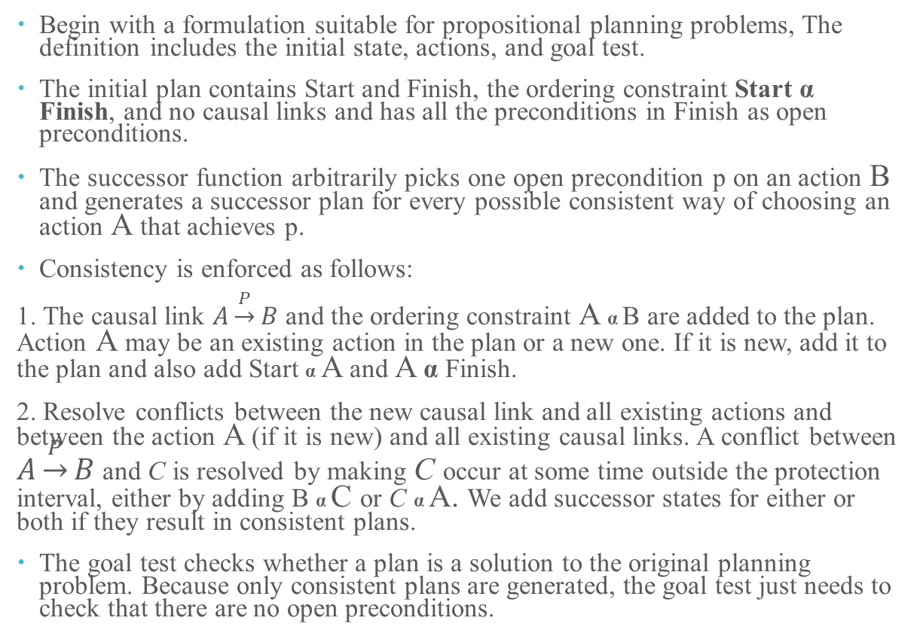
POP Algorithm
Begin with a formulation suitable for propositional planning problems, The definition includes the initial state, actions, and goal test.
The initial plan contains Start and Finish, the ordering constraint Start α Finish, and no causal links and has all the preconditions in Finish as open preconditions.
The successor function arbitrarily picks one open precondition p on an action B and generates a successor plan for every possible consistent way of choosing an action A that achieves p.
Consistency is enforced as follows:
1. The causal link $A\underset{→}{P}B$ and the ordering constraint A α B are added to the plan. Action A may be an existing action in the plan or a new one. If it is new, add it to the plan and also add Start α A and A α Finish.
2. Resolve conflicts between the new causal link and all existing actions and between the action A (if it is new) and all existing causal links. A conflict between $A\underset{→}{P}B$ and C is resolved by making C occur at some time outside the protection interval, either by adding B α C or C α A. We add successor states for either or both if they result in consistent plans.
The goal test checks whether a plan is a solution to the original planning problem. Because only consistent plans are generated, the goal test just needs to check that there are no open preconditions.

Slide 19
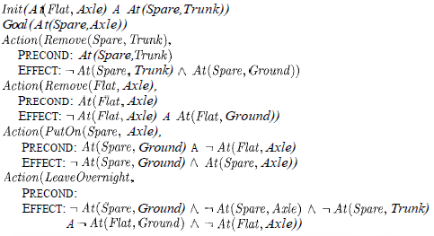

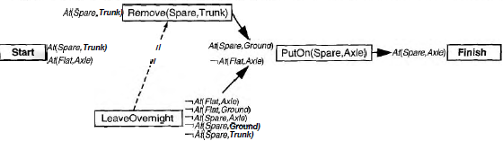
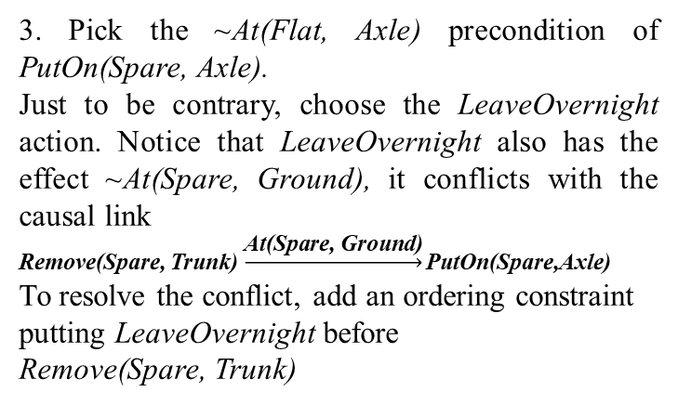
Example: The spare tire problem of changing a flat tire. More precisely, the goal is to have a good spare tire properly mounted onto the car's axle, where the initial state has a flat tire on the axle and a good spare tire In the trunk. There are just four actions: * *removing the spare from the trunk, *removing the flat tire from the axle, *putting the spare on the axle, *leaving the car unattended overnight.
The sequence of events is as follows:
1. Pick the only open precondition, At(Spare, Axle) of Finish. Choose the only applicable action, Put On (Spare, Axle).
2. Pick the At (Spare, Ground) precondition of PutOn(Spare, Axle). Choose the only applicable action, Remove(Spare, Trunk) to achieve it.
3. Pick the ~At(Flat, Axle) precondition of PutOn(Spare, Axle).
Just to be contrary, choose the LeaveOvernight action. Notice that LeaveOvernight also has the effect ~At(Spare, Ground), it conflicts with the causal link
Remove(Spare, Trunk) $\underset{→}{\text{At}\text{(}\text{Spare}\text{, }\text{Ground}\text{)}}\text{PutOn}\text{(}\text{Spare}\text{,}\text{Axle}\text{)}$
To resolve the conflict, add an ordering constraint putting LeaveOvernight before
Remove(Spare, Trunk)

Slide 20
4. The only remaining open precondition is At (Spare, Punk) of action Remove(Spare, Trunk). The only action can achieve it is existing Start action, but the causal link from Start to Remove(Spare, Trunk) is in conflict with the ~At(Spare,Trunk) effect of LeaveOvernight. No way to resolve the conflict with LeaveOvernight: can’t order it before Start, and cannot order it after Remove(Spare, Trunk)(because there is already a constraint ordering it before Remove(Spare, Trunk)). So forced to back up, remove the LeaveOvernzght action and the last two causal links, and return to the state. In essence, the planner has proved that LeaveOvernight doesn't work as a way to change a tire.
5. Consider again the ~At(Flat, Axle) precondition of PutOn(Spare, Axle). This time, choose Remove(Flat, Axle).
6. Once again, pick the At(Spare, Trunk) precondition of Remove(Spare, Trunk) and choose Start to achieve it. This time there are no conflicts.
7. Pick the At(Flat, Axle) precondition of Remove(Flat, Axle), and choose Start to achieve it. This gives us a complete, consistent plan i.e. Solution.

Slide 21
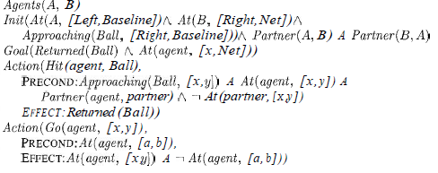
Multi Agent Planning When there are other agents in the environment, our agent could simply include them in its model of the environment, without changing its basic algorithms. In many cases, however, that would lead to poor performance because of indifferent to the agent's intentions.
Multiagent environments can be cooperative or competitive.
Efficient plan construction is useful, but does not guarantee success; the agents have to agree to use the same plan! This requires some form of coordination, possibly achieved by communication
Cooperation: Joint goals and plans
Two agents playing on a doubles tennis team have the joint goal of winning the match, which gives rise to various subgoals. Let's suppose that at one point in the game, they have the joint goal of returning the ball that has been hit to them and ensuring that at least one of them is covering the net. We can represent this notion as a multiagent planning problem,

