Slide 1

System Programming and Operating System
18BTIS502/18BTCS502
Compiled by –
Dr. Jyoti Malhotra & Prof. Pranav More
SPOS faculty
Department of CSE
MIT School of Engineering, MIT ADT University
Pre-requisite : Maturity on Programming Languages and Data Structures

Slide 2

Course Objectives
To understand basics of System Programming.
To learn and understand data structures used in design of system software.
To understand functions of operating system.
To learn and understand process, resource and memory management.

Slide 3
Course Outcomes
Analyze and synthesize system software
Understand the working of Assemblers and Macroprocessors
Understand the functions of operating system.
Do the programming for process and thread management in OS

Slide 4
System Programming and Operating System 18BTIS502
Introduction to Systems Programming
Introduction to Macro Processors
Introduction to Operating System & Process Management
Memory Management
I/O and File Management
References- Systems Programming and Operating Systems, D.M. Dhamdhere and Internet resources)

Slide 5

Let’s think:
Software ?
Role of Rules/Structure
Role of Intelligence
How user and machine Interact?
Programming; Compiling; Executing (Loading from HD to RAM)
gcc, tasm, javac, cpython, pypy
Operating System

Slide 6
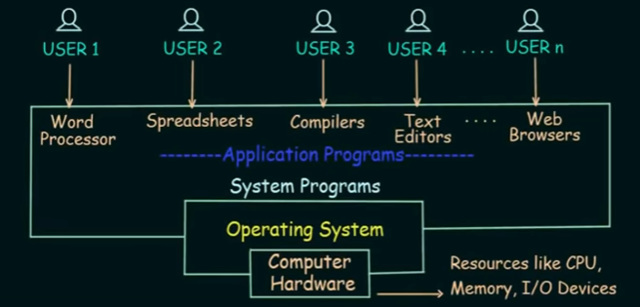
Software – System software and Application software
Back

Slide 7

1. Introduction to Systems Programming
System Software
Language Processing
Introduction to Assemblers
Design of two-pass assemblers

Slide 8
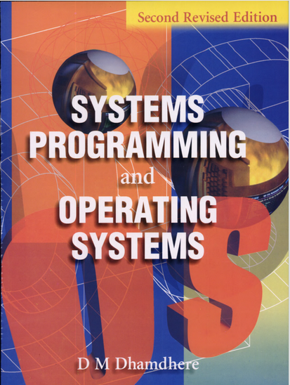
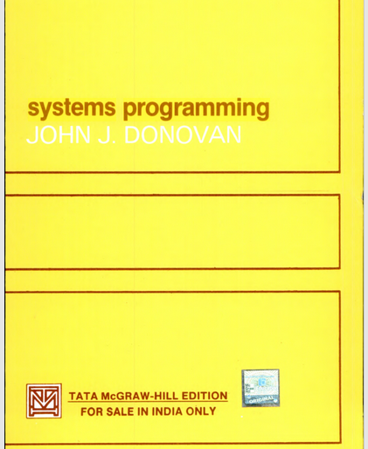

Slide 9
Introduction
Fast CPU
Large Memory
Sophisticated Input and Output devices
Good networking support
Capabilities of modern computer(s)
Who bridges this gap?
Instructed through machine language; where the instructions are converted into 0s & 1s
System Software : A collection of programs to BRIDGE the gap between user and computer level interaction

Slide 10
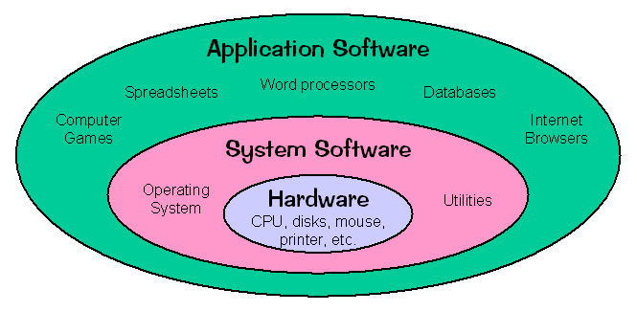
Introduction to System Software
System Software = Operating System + Utilities enabling computer to function
System software is a computer software which MANAGES and CONTROLS the hardware and PROVIDES a platform for running application software.
Examples :
Compilers
Loaders
Linkers
Interpreters
Debuggers
Drivers
Image Courtesy: https://courses.cs.vt.edu/

Slide 11
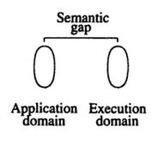
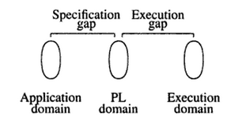
Language Processing
Software
Customer expresses the ideas
Designer describes the ideas
Programmer implements the ideas
Systems behaves
Application domain
Execution domain
PL – Programming Languages
Image Courtesy: Systems Programming and Operating Systems, D.M. Dhamdhere

Slide 12
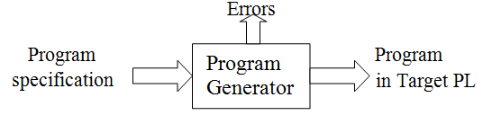
Language Processing + Activities
Language processors – A System Program that bridges the specification and execution gap of the computation.
#define MAX 50 → int arr[MAX]; → int arr[50];
test.c → gcc –o t test.c → t
Language Processing activities -
Program Generation
Program Execution
Program Translation
Program Interpretation
Image Courtesy: Systems Programming and Operating Systems, D.M. Dhamdhere

Slide 13
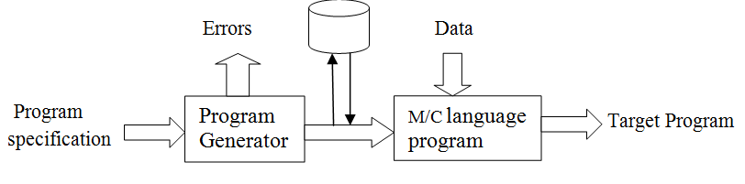
Program Translator
.cpp
.i
.s
a.out
Characteristics of program translation-
A program must be translated before its execution.
Translated program is saved in a file, which may be executed repeatedly.
A program may be retranslated with modifications.
Image Courtesy: Systems Programming and Operating Systems, D.M. Dhamdhere

Slide 14
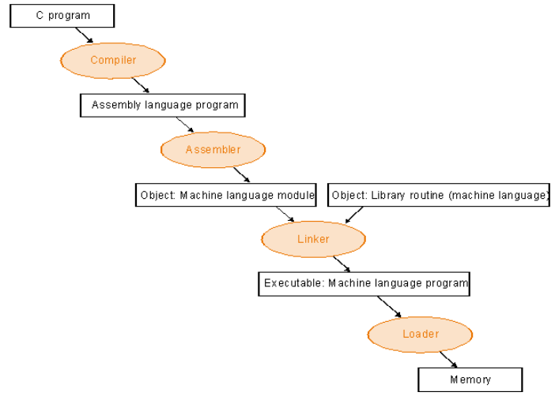
c/cpp program Translation hierarchy

Slide 15
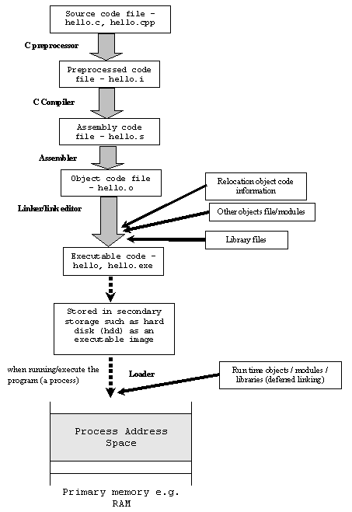
Build Process in C (5 phases)
Preprocessing – #symbol
Directives like #define, #include, #ifdef
#include” causes the preprocessor to paste the contents of “stdio.h” into the source code file at the location of the #include statement
Compiler– Identification of syntax errors in hello.i
If found; the syntax errors are listed on the terminal with warnings.
If NOT found; error free code is translated by the Compiler into an equivalent assembly language program – hello.s
gcc -c -save-temps hello.c

Slide 16
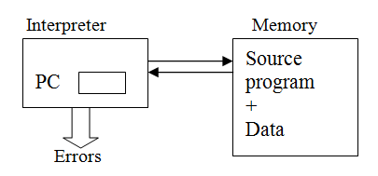
Program Interpretation (Fetch, Analyze and execute)
The interpreter reads the source program and stores it in its memory.
Interpretation cycle which consists of the following steps:
Fetch the statement
Analyze the statement and determine its meaning, viz. The computation to be performed and its operands.
Execute the meaning of the statement.
Image Courtesy: Systems Programming and Operating Systems, D.M. Dhamdhere

Slide 17

Fundamentals of
Language Processing:
Language processing =
Analysis of Source Program + Synthesis of Target Program
Analysis
Lexical rules (vocabulary of a language)
Syntax rules eg. Per_profit=(profit*100)/costprice;
Semantic rules (Meaning of an instruction)
Synthesis (construction of data structures in target program)
Creation of data structure i.e. Memory Allocation
Generation of target code

Slide 18



Components of System Software
Assemblers
Macro Processors

Slide 19
Assemblers
Converts assembly language programs into object files.
Object files contain a combination of -
Machine instructions
Data and information needed to place instructions properly in memory.

Slide 20
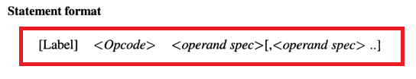
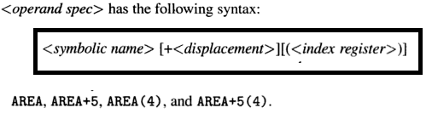
Elements of Assembly Language
Basic features of Assembly language –
Mnemonic operation codes (mnemonic opcode) - ADD, DIV, SUB
Symbolic name – Operands (Data / Instruction) – a, b, c
Data Declaration – int, float

Slide 21
Symbolic names
AREA – Refers to memory word with which name AREA is associated.
AREA + 5 – Refers to the Memory word 5 words away from AREA (offset from AREA)
AREA (4) – Indexing with index register 4 i.e. Address of AREA + Contents of Index register* 4
AREA + 5(4)
Index Register – A processor register for modifying operand addresses during the run of a program. (typically for array operations)

Slide 22
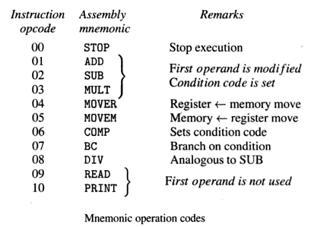
Mnemonic Opcodes (Machine Instructions):
STOP – No Operands
ADD to DIV – 2 operands (1st is Register operand and 2nd is Memory operand)
READ & PRINT – only Memory operand

Slide 23
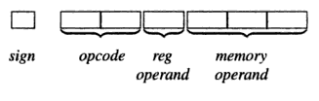
Branch on Condition:
Machine Instruction format:
Condition Code – is encoded in first operand position using the codes for – LT, LE, EQ, GT, GE, ANY
CODEs for CONDITIONS
LT - 0
LE - 1
EQ - 2
GT - 3
GE - 4
ANY - 5
REGISTER OPERAND can be either a Condition code or Register
CODEs for REGISTER OPERAND
AREG - 0
BREG - 1
CREG - 2
DREG – 3

Slide 24
Today’s discussion
System software
Language processing
2 activities
Analysis
Synthesis
Introduction to Assemblers

Slide 25

Last class
System software
Language processing =
Program Generation + Program Execution( Translation + Interpretation )
Language Processing activities = Analysis + Synthesis
Assemblers:
Mnenomic Opcodes (STOP, ADD, SUB, MULT, MOVER, MOVEM, COMP, BC, DIV, READ, PRINT)
Register Operand (AREG, BREG, CREG, DREG, …)
Condition Codes (LT, LE, EQ, GT, GE, ANY)
STOP – No Operands
ADD to DIV – 2 operands (1st is Register operand; 2nd is Memory operand)
READ & PRINT – only Memory operand

Slide 26
Learning outcome of this session
Assembly language 3 statement types for the given hypothetical set
Literals – Constants
Literal Pool – Repository of literals
Advanced Assembler directives

Slide 27
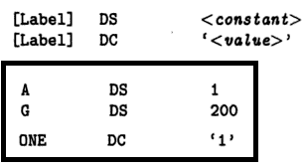

Assembly Language Statements
Assembler Directives- Instructs assemblers to perform certain actions – START, END
Imperative Statements – Indicates an action to be performed (Mnemonic opcodes)
Declaration Statements - DS (Declare Storage) & DC (Declare Constant)
DS reserve areas of memory and associate names with them.
DC constructs memory words containing constants.
Immediate Operands and Literals ( ADDI AREG, ‘5’ )
char A;
int G[200];
int ONE = 1;
ONE = BREG;

Slide 28
Assembly Directives
START <constant>
1
First word of target program should be placed in the memory word with address <constant>
END [<operand>]
2
Address where execution of program should begin.
(By default execution begins with the first instruction of assembled program)
START 200
Source Program
Assembler
Target Program
Loader
Execution

Slide 29
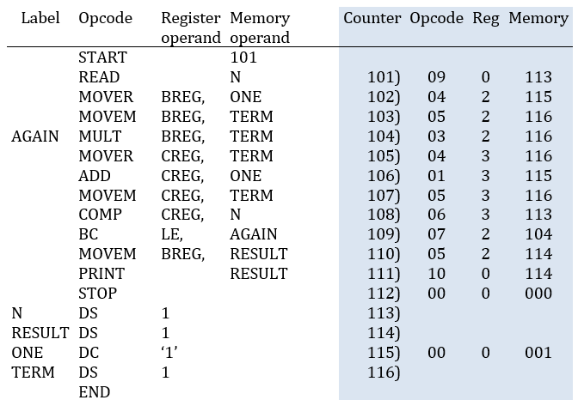
Sample ALP with its machine language program(target program) :
Source Program
Assembler
Target Program

Slide 30
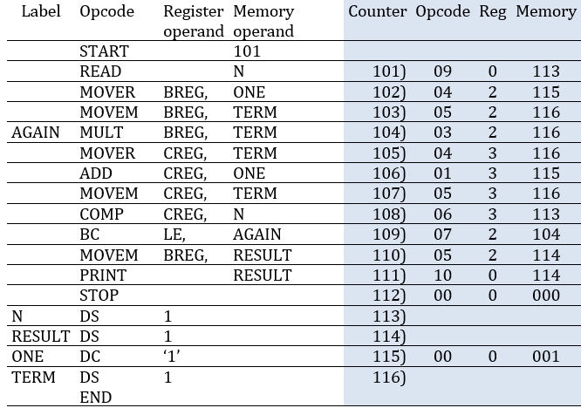
ALP
101 is Location Counter/ Program Counter – LC/PC
101 to 116 :
LC/PC is incrementing by 1 assuming every instruction takes 1 byte or 1 word
N, RESULT, ONE, TERM, AGAIN are the SYMBOLS
N, RESULT, ONE, & TERM are used before they are declared – FORWARD REFERENCE

Slide 31
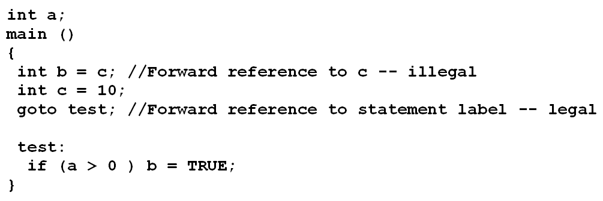
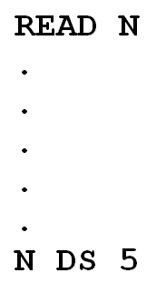
Forward References
Using an identifier before its declaration is called a forward reference, and results in an error.
ALP -

Slide 32

Literals
&
Advanced Assembler Directives

Slide 33
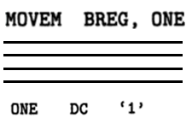
Literals
A literal is a Memory operand with the syntax =‘<value>’
Value of a constant operand is written as a part of the instruction that uses it.
This avoids having to define the constant elsewhere in the program and make up a label for it.
Example – ADD AREG, =‘5’
This is treated internally as
ADD AREG, @FIVE
@FIVE DC, ‘5’
MOVEM BREG, =‘1’

Slide 34
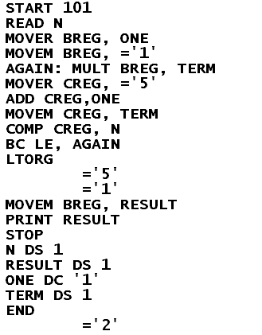
Literals – Example ALP
= is used to represent a literal

Slide 35
Immediate Addressing
The operand value is assembled as part of the machine instruction.
E.g. ADDI AREG, 5
ADD AREG, =‘5’
Need special addressing mode called as Immediate Addressing.
Literals:
The assembler generates the specified value as a constant at some other memory location.
The address of this generated constant is used as the target address for the machine instruction.

Slide 36
Literal POOL
All the literal operands used in the program are gathered into one or more literal pools.
Normally literals are placed into a pool at the end of the program IF LTORG IS NOT MENTIONED.
Sometimes, it is DESIRABLE to place literals into a pool at some other location in the object program.
LTORG directive is introduced for this purpose.
LTORG separates different pools.
When the assembler encounters a LTORG, it creates a pool that contains all the literals used since the previous LTORG.

Slide 37
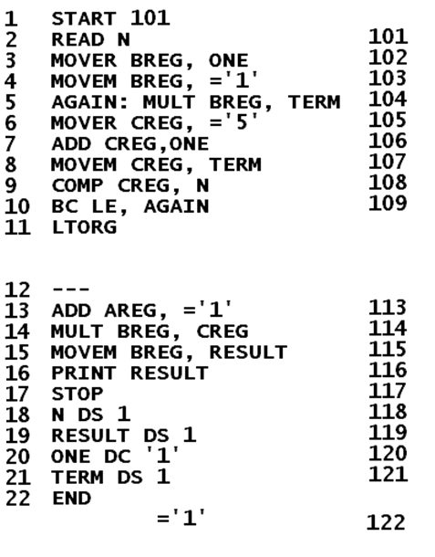

LTORG Example
If we do not use a LTORG on line 11, the literals =’1’ & =‘5’ will be placed at the end of the program.
This operand will then begin at address 120 and be too far away from the instruction that uses it.
LTORG thus is used when we want to keep the literal operands close to the instruction that uses it.

Slide 38
Duplicate Literals
Duplicate literals – the same literal used in more than one place in the program
In a single pool; for duplicate literals, we should store only one copy of the specified data value to save space.
Most assembler can recognize duplicate literals.
E.g., There are two uses of =’1’ on lines 4 and 13, respectively.
Multiple copies are generated.

Slide 39
EQU Directive- for symbols
Use the EQU directive to define a symbol’s value.
<symbol> EQU <address_spec>
The value assigned to a symbol may be a constant, or any expression involving constants and previously defined symbols.

Slide 40
Last class
System software → Language processing → Analysis + Synthesis → Assemblers (Mnenomic Opcodes, Register Operand, Condition codes)
Sample source program and target program
Source program – Line of code parts = Label, Opcode, First operand, Second Operand
Target Program – LC, opcode(2 bits), Register/Condition code(1 bit), Memory operand(3 or 4 bits)
Memory Operand can be either a Symbol or a Literal
LTORG – (Literal Origin)
Literal Pool – (Directive END also signifies end of the pool)
Duplicate Literals – (Only 1 copy of literal is saved for 1 pool)
EQU
Examples: A EQU B or A EQU 3000 or A EQU B+5
Assembler Directives(4):
START
END
LTORG
EQU

Slide 41
Symbols (EQU Directive)
EQU statement defines the symbol to represent <address_spec>.
This differs from DC/DS as NO LC processing is IMPLIED ?.
EQU associates the name <symbol> with <address_spec>
E.g. BACK EQU LOOP (Introduces the symbol BACK to represent the operand LOOP).
When the assembler encounters the EQU statement, it enters “BACK” into Symbol Table (with the address of “LOOP”).
Symbol Table is the data structure used in the processing of assembler.

Slide 42
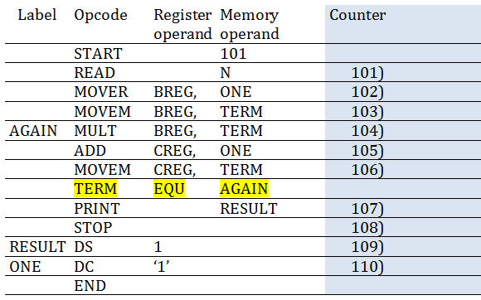
EQU – No LC processing
Back

Slide 43
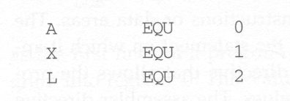
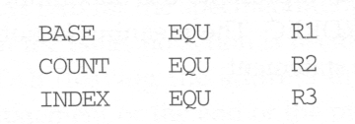
Usage of Symbols
Define mnemonic names for registers:

Slide 44

ORG / ORIGIN Directive
This can be used to indirectly assign values to symbols.
ORIGIN <address spec>
When this statement is encountered during assembly of a program, the assembler RESETS its location counter to the specified value.
The ORG statement will thus affect the values of all labels defined until the next ORG.
Normally when an ORG without specified value is encounter, the previously saved location counter value is restored.

Slide 45
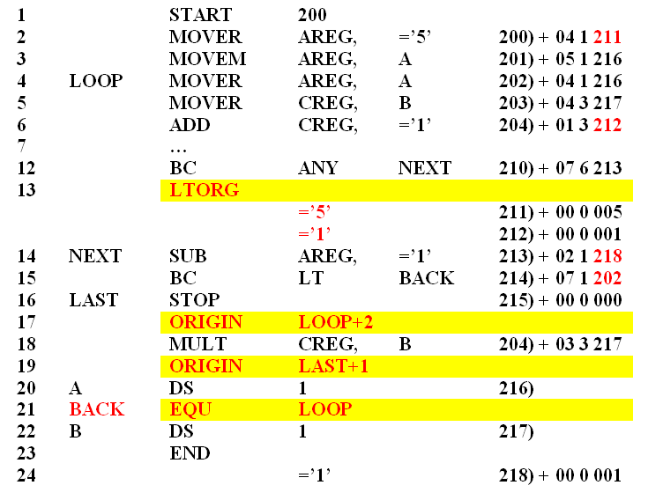
EQU and ORIGIN example
Symbol Name | Address

Slide 46
No Forward Reference Allowed
For EQU and ORG, all symbols used on the right-hand side of the statement must have been defined previously in the program.
This is because in the two-pass assembler, we require that all symbols must be defined in pass 1.
ALPHA DS 1
BETA EQU ALPHA
Allowed
BETA EQU ALPHA
ALPHA DS 1
Not allowed

Slide 47
ORG and EQU Restriction
ORG ALPHA
A DS 1
B DS 1
C DS 1
ORG
ALPHA DS 1
Not allowed
ALPHA is used before its declaration i.e. FORWARD REFERENCE
Symbols are said to be declared if they occur in the label field (i.e. leftmost entity in the instruction)
Forward references are not allowed with EQU and ORG
ALPHA EQU BETA
BETA EQU DELTA
DELTA DS 1
Not allowed

Slide 48
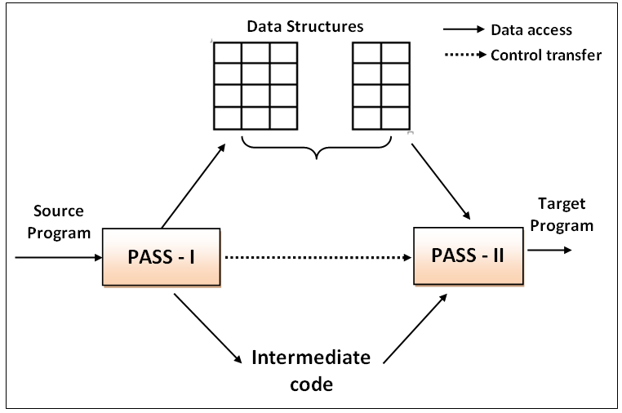
Overview of 2 pass assembler
Mnemonic Table
Symbol Table
Literal Table
Pool Table
Analysis
Phase
Synthesis
Phase
LEARNING OUTCOME:
Illustrate the design steps of two – pass assembler.
Organize the data structures for the design.
It requires TWO scans of the source program.
Handles forward references very conveniently.
LC processing is performed in the first pass and the symbols, literals are placed in the respective tables.
The second pass Synthesize the target program.

Slide 49
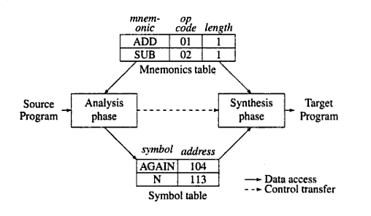
TWO PASS ASSEMBLER:
Pass I (Analysis Phase)
Separate the symbols, mnemonic opcode, and operand fields.
Build the symbol Table (REPOSITORY of all symbols)
Build the Literal and Pool Table
Perform LC processing
Construct Intermediate code (IC)
Pass II (Synthesis Phase)
Synthesize the intermediate code and generate target code
Generate data for literals and look for values of symbols
TWO PASS ASSEMBLER

Slide 50
Today’s discussion
EQU
ORIGIN
2-pass assembler structure
Data Structures

Slide 51
Assembler Pass – I Data Structures
Machine Opcode table – OPTAB :
Opcode, &
Mnemonic name
Register table – REGTAB :
Register Name &
ordinal value
Condition code table – CCTAB :
Condition code, & ordinal value
Symbol table – SYMTAB:
Symbol name, &
its address
Literal table – LITTAB:
Literal name, &
its address
Pool table – POOLTAB: contains starting offset of each pool

Slide 52
OPTAB
REGTAB
CCTAB
Opcode | Mnemonic Name
00 | STOP
01 | ADD
02 | SUB
03 | MULT
04 | MOVER
05 | MOVEM
06 | COMP
07 | BC
08 | DIV
09 | READ
10 | PRINT
Code | Register Name
00 | AREG
01 | BREG
02 | CREG
03 | DREG
04 | EREG
Code | Condition Codes
00 | LT
01 | LE
02 | EQ
03 | GT
04 | GE
05 | ANY
PROVIDED
GENERATED
SYMTAB
LITTAB
POOLTAB
Symbol Name | Address
A | 500
NEXT | 525
TERM | 526
BACK | 500
Literal Name | Literal value | Address
=‘1’ | 1 | 511
=‘5’ | 5 | 512
=‘8’ | 8 | 527
=‘1’ | 1 | 528
Literal Number
#1
#2

Slide 53
DECLARATIVE STATEMENTS (DL)
DC | 00
DS | 01
ASSEMBLER DIRECTIVES (AD)
START | 00
END | 01
ORIGIN | 02
EQU | 03
LTORG | 04

Slide 54
Symbol Processing
Need a symbol table SYMTAB. For each symbol used, the table contains:
Symbol name
The address assigned to the symbol when it is declared using either DS, DC, EQU, or is used as a label.
Pass 1: When encountering a symbol; if not found in SYMTAB, it is added to the SYMTAB
Symbol name can be entered now
The address field is left blank if instruction neither contains a label, EQU, DS, or DC
When encountering a label, EQU, DS, or DC instruction with the same symbol name, its location counter should be entered into SYMTAB as the address of the respective symbol.

Slide 55
Literal Processing
Need a literal table LITTAB. For each literal used, the table contains:
Literal name; operand value; and address assigned to the operand when it is placed in a literal pool.
Pass 1: When encountering a literal; if not found in LITTAB, it is added to the LITTAB
Literal name and operand value can be entered now
Only the address field is left blank.
When encountering a LTORG or END of the program,
the assembler scans LITTAB.
Each literal currently in this table is assigned an address.
The location counter then should be updated to reflect the number of bytes occupied by each literal.

Slide 56
Intermediate code forms
Variant I & Variant II

Slide 57
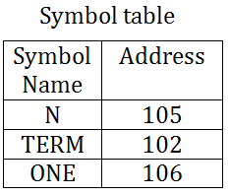
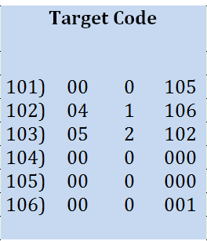
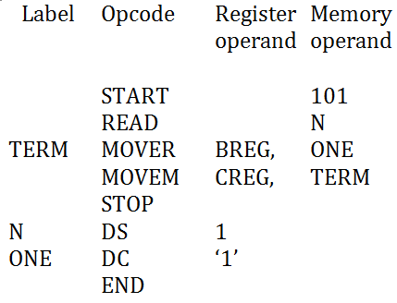
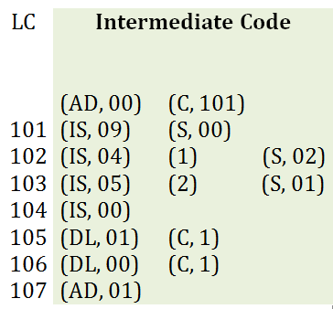
PASS – 2
Synthesis Phase
PASS – 1
Analysis Phase

Slide 58

Intermediate Code (IC) Units
An intermediate representation (IR) is the data structure or code used internally by a translator to represent source code.
Assembly language program instruction contains:
Label Opcode Register Operand Memory Operand
(Statement_class, Code)
AD – Assembler directive
IS – Imperative statement
DL – Declarative statement
(Register code) OR
(Condition code)
(Operand_class, Code)
S – Symbol
L – Literal
C – Constant
No IC

Slide 59
Intermediate Code (IC) Units
Address i.e. Location Counter
Representation of the mnemonic opcode
Representation of operands
Variants 1 & II differs in processing & memory efficiency
For Mnemonic (opcode) field; IC is written as -
(statement class, code)
Where Statement class can be (IS, AD, DL)
For IS; code is the instruction opcode
For DL & AD; code is an ordinal number within the class

Slide 60
IC units – Operand field
First Operand - single digit number (code) for register (0-3 for AREG-DREG) or the condition code (0-5).
Second Operand - (operand class, code)
Operand class – C, S & L
For C, code is internal representation of the const
For S & L, code is ordinal no. of the operand's entry in SYMTAB or LITTAB.

Slide 61
Source Program
Intermediate Code
 | START |  | 101
 | READ |  | N
TERM | MOVER | BREG, | ONE
 | MOVEM | CREG, | TERM
 | STOP
N | DS | 5
ONE | DC | ‘1’
 | END
 | (AD, 00) | (C, 101)
101 | (IS, 09) | (S, 00)
102 | (IS, 04) | (1) | (S, 02)
103 | (IS, 05) | (2) | (S, 01)
104 | (IS, 00)
105 | (DL, 01) | (C, 5)
110 | (DL, 00) | (C, 1)
111 | (AD, 01)
 | Symbol Name | Address
0 | N | 105
1 | TERM | 102
2 | ONE | 110

Slide 62
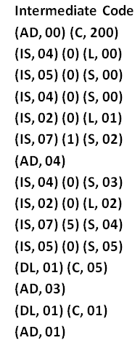
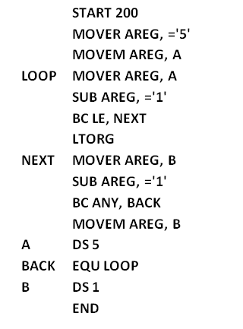
Assembler First Pass
 | Symbol Name | Address
0 | A | 211
1 | LOOP | 202
2 | NEXT | 207
3 | B | 216
4 | BACK | 202
 | Literal | Address
0 | =‘5’ | 205
1 | =‘1’ | 206
2 | =‘1’ | 217
 | Pool#
0 | 0
1 | 2

Slide 63

Assembler First Pass
 | Symbol Name | Address
0 | A | 211
1 | LOOP | 202
2 | NEXT | 207
3 | B | 216
4 | BACK | 202
 | Literal | Address
0 | =‘5’ | 205
1 | =‘1’ | 206
2 | =‘1’ | 217
 | Pool#
0 | 0
1 | 2

Slide 64
Recap
https://www.menti.com/923gv4nz2e

Slide 65
Learning outcome of this session
Assembler Pass1 (Algorithm)
IC – Variant – II
Assembler Pass2
Example(s)

Slide 66
IC: Example of Variant I
 | START | 200 |  |  | (AD, 00) | (C, 200)
 | READ | A |  |  | (IS, 09) | (S, 00)
Z | MOVER | AREG, | A |  | (IS, 04) | (0) | (S, 00) | (S, 00)
 | MOVER | CREG, | B |  | (IS, 04) | (2) | (S, 02) | (S, 02)
 | SUB | AREG, | =’1’ |  | (IS, 02) | (0) | (L, 00) | (L, 00)
 | BC | GT | Z |  | (IS, 07) | (0) | (S, 01)
 | STOP |  |  |  | (IS, 00)
A | DS | 1 |  |  | (DL, 01) | (C, 1)
B | DS | 5 |  |  | (DL, 01) | (C, 5)
 | LTORG |  |  |  | (AD, 04)
 | Symbol Name | Address
0 | A | 206
1 | Z | 201
2 | B | 207
 | Literal | Address
0 | =‘1’ | 212
 | Pool#
0 | 0

Slide 67
Operand fields are selectively replaced by their processed forms.
Operand processing is done for DL and AD for LC
For IS, operand fields are processed only to identify literal references.
Symbolic references are NOT processed during pass – I.
Intermediate code
variant II

Slide 68
IC: Example of Variant II
 | START | 200 |  |  | (AD, 00) | (C, 200)
 | READ | A |  |  | (IS, 09) | A
Z | MOVER | AREG, | A |  | (IS, 04) | AREG, | A
 | MOVER | CREG, | B |  | (IS, 04) | CREG, | B
 | SUB | AREG, | =’1’ |  | (IS, 02) | AREG, | (L, 00)
 | BC | GT | Z |  | (IS, 07) | GT, | Z
 | STOP |  |  |  | (IS, 00)
A | DS | 1 |  |  | (DL, 01) | (C, 1)
B | DS | 5 |  |  | (DL, 01) | (C, 5)
 | LTORG |  |  |  | (AD, 04)

Slide 69
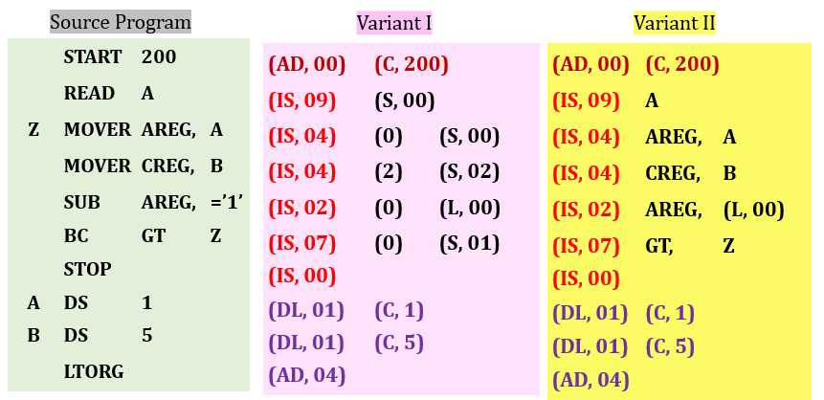
Difference between IC Variant I & II
Variant I – Extra work in Pass I and simplifies the tasks of Pass II
Variant II transfers the burden of operand processing to pass II
Variant II is well suited if expressions are permitted in the operand field
Variant I of IC for MOVER AREG, A+5 would be
(IS, 05) (0) (S, 00) + 5
Functions and memory requirements of two passes get better balanced

Slide 70
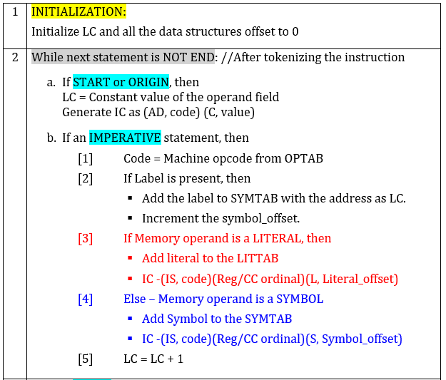
Algorithm : Pass - I

Slide 71
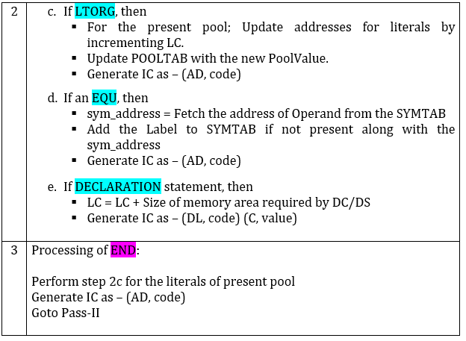
Algorithm : Pass – I contd..

Slide 72
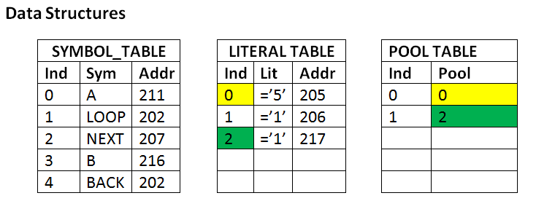

Slide 73
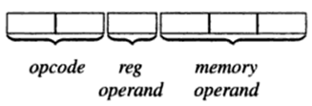
PASS-II
LC = 0; pooltab_ptr = 0;
If START/ORIGIN (NO machine code)
LC = value specified in operand field (i.e. 4th token)
If IMPERATIVE statement
a. Get operand address from SYMTAB or LITTAB
b. Assemble instruction in machine code
If DECLARATION statement (NO machine code for DS)
a. For DC; Assemble the constant in machine code
b. LC= LC + size required by DC/DS
If LTORG/END
a. Process literals from LITTAB [POOLTAB [pooltab_ptr]] to LITTAB [POOLTAB [ pooltab_ptr+1] ] and process the instruction as in a DC statements in machine code
b. pooltab_ptr ++;
L[0].address
S[0].address
NO machine code for START, ORIGIN, EQU, DS

Slide 74
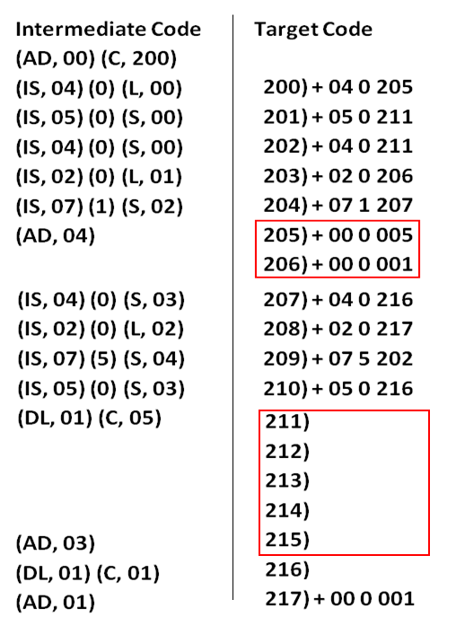
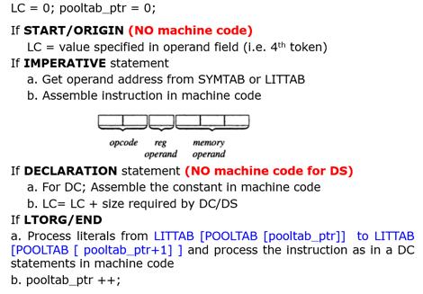

Slide 75
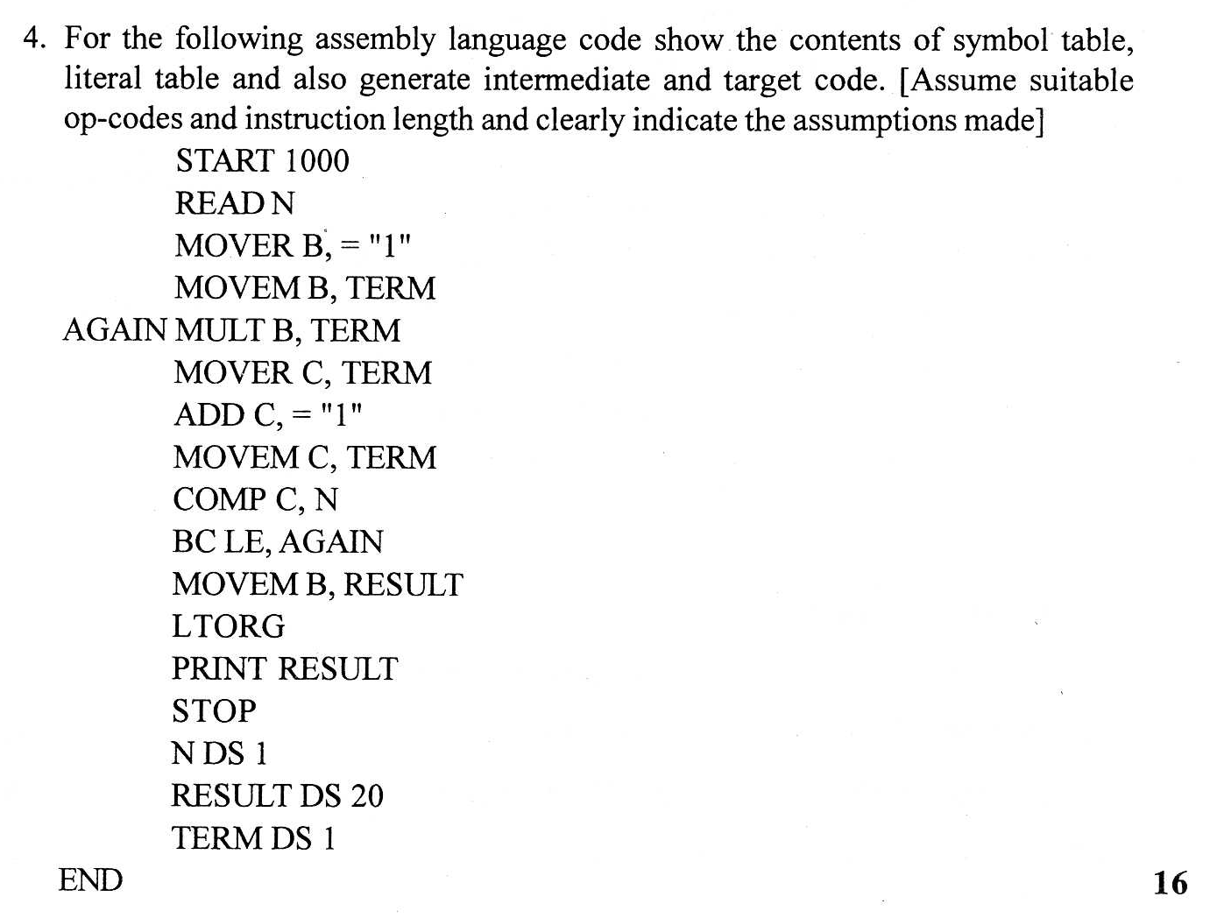
B is Register Operand
REGISTERS
0 | A
1 | B
2 | C
3 | D

Slide 76
(AD, 00) (C, 1000)
(IS, 09) (S, 00)
(IS, 04) (1) (L, 00)
(IS, 05) (1) (S, 01)
(IS, 03) (1) (S, 01)
(IS, 04) (2) (S, 01)
(AD, 00) (C, 1000)
(IS, 09) (S, 00)
(IS, 04) (1) (L, 00)
(IS, 05) (1) (S, 01)
(AD, 00) (C, 1000)
(IS, 09) (S, 00)
(IS, 04) (1) (L, 00)
(IS, 05) (1) (S, 01)
(IS, 03) (1) (S, 01)
(AD, 00) (C, 1000)
(AD, 00) (C, 1000)
(IS, 09) (S, 00)
(AD, 00) (C, 1000)
(IS, 09) (S, 00)
(IS, 04) (1) (L, 00)
B is Register Operand
(AD, 00) (C, 1000)
(IS, 09) (S, 00)
(IS, 04) (1) (L, 00)
(IS, 05) (1) (S, 01)
(IS, 03) (1) (S, 01)
(IS, 04) (2) (S, 01)
(IS, 01) (2) (L, 00)
Index | Symbol Name | Address
0 | N | 1013
1 | TERM | 1034
2 | AGAIN | 1003
3 | RESULT | 1014
PoolTAB
0 | 0
1 | 1
Index | Literal Name | Address
0 | =“1” | 1010
1

Slide 77
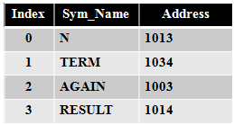
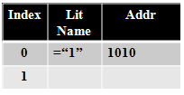
START 1000
READ N
MOVER B, =‘1’
MOVEM B, TERM
AGAIN MULT B, TERM
MOVER C, TERM
ADD C, =‘1’
MOVEM C, TERM
COMP C, N
BC LE, AGAIN
MOVEM B, RESULT
LTORG
PRINT RESULT
STOP
N DS 1
RESULT DS 20
TERM DS 1
END
(AD, 00) (C, 1000)
(IS, 09) (S, 00)
(IS, 04) (1) (L, 00)
(IS, 05) (1) (S, 01)
(IS, 03) (1) (S, 01)
(IS, 04) (2) (S, 01)
(IS, 01) (2) (L, 00)
(IS, 05) (2) (S, 01)
(IS, 06) (2) (S, 00)
(IS, 07) (1) (S, 02)
(IS, 05) (1) (S, 03)
(AD, 04)
(IS, 10) (S, 03)
(IS, 00)
(DL, 01) (C, 1)
(DL, 01) (C, 20)
(DL, 01) (C, 1)
(AD, 01)
TARGET CODE -
1000) 09 0 1013
1001) 04 1 1010
1002) 05 1 1034
1003) 03 1 1034
1004) 04 2 1034
1005) 01 2 1010
1006) 05 2 1034
1007) 06 2 1013
1008) 07 1 1003
1009) 05 1 1014
1010) 00 0 0001
1011) 10 0 1014
1012) 00 0 0000
1013)
1014)
1034)
1035)
No register operand present
From (S, 00) I.e.
S[0].Address i.e. 1013
Internal representation of =‘1’ (no opcode and register code)

Slide 78
Assembler Phases
Pass 1
Analysis Phase
Pass 2
Synthesis Phase
Obtain address of a memory operand from Symbol or Literal Table.
Synthesize a machine instruction or the machine form of a constant.
If a label is present; enter the pair (symbol, <LC contents> in a new entry of symbol.
Get the mnemonic opcode from mnemonic table.
Perform LC processing and symbols and literals present in the instruction.
Obtain the machine code corresponding to the mnemonic from the IC.
Tokenize the label, mnemonic opcode and operand fields.
Create Intermediate Code

Slide 79
Single Pass Assembler / One pass assembler (Translation)
Single pass does:
1. LC processing
2. Construction of symbol table, Literal table, target program.
How to handle forward references?
Forward references are handled by backpatching.
If instruction contains a forward reference to a symbol; assembler leaves the operand field of an instruction blank.
The address of symbol is processed after the definition of symbol is encountered in the program.

Slide 80
Single Pass Translation – Backpatching Implementation
Assembler builds a Table of Incomplete Instruction (TII); which records the information about instructions whose operand fields were left blank.
Each entry in TII contains a pair of the form - (instruction address, symbol)
This indicates that the address of symbol should be put in the operand field of the instruction with the specified address.
At the END statement, symbol table contains the addresses of all defined symbols and TII contains information describing all forward references.
Now the assembler can process each entry in TII to complete the concerned instruction.

Slide 81
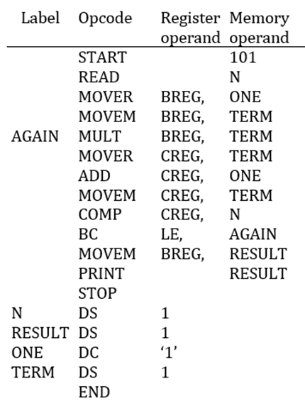
Single Pass Translation – Backpatching Implementation
READ N
Assembler leaves the memory operand field blank in the instruction at location 101 and makes an entry (101, N) in TII.
While processing the statement N DS 1
The address of N i.e. 113 is entered in SYM_TAB
After END, the entry (101, N) would be processed by obtaining the address of N from SYM_TAB and updating operand field of instruction with address 113.

Slide 82
Single Pass Translation – Backpatching Implementation
MOVER BREG, ONE
Assembler leaves the second operand field blank in the instruction at location 102 and makes an entry (102, ONE) in TII.
While processing the statement ONE DC ‘1’
The address of ONE ie. 115 is entered in SYM_TAB
After END, the entry (102, ONE) would be processed by obtaining the address of ONE from SYM_TAB and updating second operand field of instruction with address 115.

Slide 83
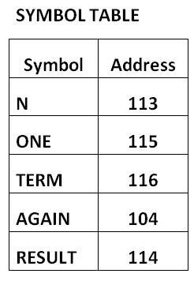
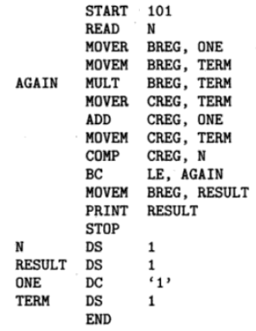
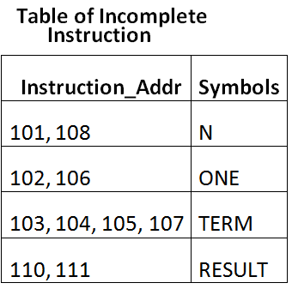
Single Pass Translation – (EXAMPLE)
TARGET
101) 09 0 ….
102) 04 1 ….
103) 05 1 ….
104) 03 1 ….
105) 04 2 ….
106) 01 2 ….
107) 05 2 ….
108) 06 2 ….
109) 07 1 104
110) 04 1 ….
111) 10 0 ….
112) 00 0 000
113)
00 0 001

Slide 84
Single Pass Translation – (example)
On END instruction;
Scan TII
Select the symbol and update its address for respective instruction addresses in the target code.
TARGET
101) 09 0 ….
102) 04 1 ….
103) 05 1 ….
104) 03 1 ….
105) 04 2 ….
106) 01 2 ….
107) 05 2 ….
108) 06 2 ….
109) 07 1 104
110) 04 1 ….
111) 10 0 ….
112) 00 0 000
113)
00 0 001
113
115
116
116
116
115
116
113
114
114

Slide 85

Listing & Error reporting
Report errors in Pass I or Pass II ?
If done in pass 1 then; Source program need not be preserved.
Conserve Memory & Avoids duplicate processing
Errors
Syntax errors – missing commas, parenthesis
Semantic errors – duplicate definitions of symbols
Invalid opcode, etc
References to undefined variables
Effective error reporting is to report all errors against the erroneous statement itself.

Slide 86
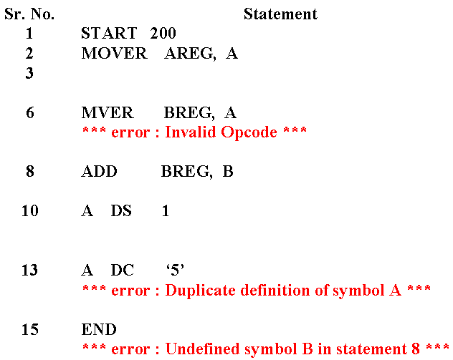
Error reporting in Pass-I

Slide 87

Error reporting in pass II

Slide 88

Pass-I Flowchart

Slide 89

Pass-I Flowchart

Slide 90
Assemblers in nutshell
System software
Language Processing
Program Translation
Elements of assembly language processing
Design of II Pass assembler:
Processing of IS, DL, AD
Data structures( OPTAB, SYMTAB, LITTAB, POOLTAB )
Intermediate code (class, code)
Pass II –NO Target code for START, ORIGIN, EQU, DS
Design of one pass assembler : Backpatching and TII
Effective error reporting
https://www.bookwidgets.com/play/LBB88LP?teacher_id=6651506576064512

Slide 91

Practice Questions on Assemblers
Define the terms - System Software and Assemblers
What is a language processor; explain the activities for developing some project/module?
Say True or false and justify your answer:
Single pass assembler can handle forward references.
Error “Symbol used but not defined” can be detected during Pass I of 2 pass assembler.
Assembler directives get translated into object/target code.
The literals used in assembly language get memory allocated only after END.
Literals are processed in PASS-2
Incorrect op-codes are identified in PASS -1
Represent various 2 pass assembler activities as a flowchart/Algorithm.

Slide 92
Practice Questions on Assemblers
What are the tasks of analysis and synthesis phase of language translator?
What are the features of assembly language?
Differentiate between literal and immediate operand.
Distinguish between Variant-I and Variant-II representations used for Intermediate code of two pass assembler.
Give the difference between Literal and Symbol. How these are treated by assembler?
Can single pass assembler resolve forward references? Justify your answer with appropriate example and data structure needed.
Explain the term back-patching and forward reference for single pass assembler?
Explain what is a pass of an assembler?
What activities are conducted during analysis and synthesis phase of a 2-pass assembler?
What are assembler directives? Explain how LTORG, ORIGIN, and EQU are processed in first pass.
What types of errors are handled by the assembler? Mention error reporting in Pass I and Pass II of 2 pass assembler.
Enlist various data structures created during Pass 1 assembler activities.
Write an algorithm for Pass-1 of 2 pass assembler.

Slide 93
Problem Solving
Pass 1
Pass 1 & 2
Only Pass 2
Single pass assembler

Slide 94



2-pass assembler practice example 1
For the following assembly code generate Literal table, Symbol table, Pool table, intermediate code( using variant-I). Assume size of instruction is equal to one byte.
 | START | 200
 | MOVER | AREG, A
L: | MOVEM | BREG, =‘2’
 | ADD | BREG, =‘2’
 | ADD | CREG, =‘3’
 | ORIGIN | L+20
 | LTORG
 | MOVER | AREG, C
C | EQU | L+15
 | ADD | AREG, =‘2’
 | ADD | BREG, =‘5’
A | DS | 5
 | END
(AD, 00) (C, 200)
(IS, 04) (0) (S, 00)
(IS, 05) (1) (L, 00)
(IS, 01) (1) (L, 00)
(IS, 01) (2) (L, 01)
(AD, 02) (S,01) + 20
(AD, 04)
(IS, 04) (0) (S, 02)
(AD, 03)
(IS, 01) (0) (L, 02)
(IS, 01) (1) (L, 03)
(DL, 01) (C, 05)
(AD, 01)

Slide 95
2-pass assembler practice example 2
For the following assembly code generate Literal table, Symbol table, Pool table, intermediate code( using variant-II). Assume size of instruction is equal to one byte.
 | START | 200
 | MOVER | AREG, A
L: | MOVEM | BREG, =‘2’
 | ADD | BREG, =‘2’
 | ADD | CREG, =‘3’
 | ORIGIN | L+20
 | LTORG
 | MOVER | AREG, C
C | EQU | L+15
 | ADD | AREG, =‘2’
 | ADD | BREG, =‘5’
A | DS | 5
 | END
(AD, 00) (C, 200)
(IS, 04) AREG, A
(IS, 05) BREG, (L, 00)
(IS, 01) BREG, (L, 00)
(IS, 01) CREG, (L, 01)
(AD, 02) L+20
(AD, 04)
(IS, 04) AREG, C
(AD, 03)
(IS, 01) AREG, (L, 02)
(IS, 01) BREG, (L, 03)
(DL, 01) (C, 05)
(AD, 01)

Slide 96
2-pass assembler practice example 3
 | START | 200
 | MOVER | AREG, =‘5’
 | MOVEM | AREG, A
LOOP | MOVER | AREG, A
 | MOVER | CREG, B
 | ADD | CREG, =1’
 | BC | ANY, NEXT
 | LTORG
NEXT | SUB | AREG, =‘1
 | BC | LT, BACK
LAST | STOP
 | ORIGIN | LOOP + 2
 | MULT | CREG, B
A | DS | 1
BACK | EQU | LOOP
B | DS | 1
 | END
Generate Literal table, Symbol table, intermediate code( using variant-I) and target code, for the assembly language code given below:
Assume the instruction opcodes for assembly as follows:
Instruction opcode | Mnemonic | Length
00 | STOP | 2
01 | ADD | 1
02 | SUB | 1
03 | MULT | 1
04 | MOVER | 1
05 | MOVEM | 1
06 | BC | 2

Slide 97
2-pass assembler practice example 4
Write Target code for following IC of TWO Pass assembler with hypothetical Instruction set. (Assume symbols, literal, symbol table and literal table)
(AD, 00) (C, 200)
(IS, 09) (S, 00)
(IS, 09) (S, 01)
(IS, 04) (0) (L, 00)
(IS, 04) (0) (S, 00)
(IS, 01) (0) (S, 01)
(IS, 02) (0) (L, 01)
(IS, 05) (0) (S, 02)
(IS, 10) (S, 02)
(AD, 04)
(IS, 04) (0) (L, 02)
(IS, 04) (0) (S, 00)
(IS, 01) (0) (S, 01)
(IS, 02) (0) (L, 03)
(IS, 08) (0) (L, 04)
(IS, 05) (0) (S, 02)
(DL, 01) (C, 01)
(DL, 01) (C, 01)
(DL, 01) (C, 01)
(IS, 00)
(AD, 01)
Assumption – 3 symbols are A,B, C and 5 literals are 1,2,3,4,5
Based on this assumption; following are the required data structures:
(AD, 04) signifies IC for LTORG i.e. End of the previous pool
(AD, 01) signifies IC for END i.e. end of the program and existing pool
Tasks:
Create constant representation for literals of previous pool by incrementing LC value.
(S, 00) and (L,00) meaning S[0].address and L[0].address-
Create suitable data structures and write target code.

Slide 98



2-pass assembler practice example 4
Write Target code for following IC of TWO Pass assembler with hypothetical Instruction set. (Assume symbols, literal, symbol table and literal table)
(AD, 00) (C, 200)
(IS, 09) (S, 00)
(IS, 09) (S, 01)
(IS, 04) (0) (L, 00)
(IS, 04) (0) (S, 00)
(IS, 01) (0) (S, 01)
(IS, 02) (0) (L, 01)
(IS, 05) (0) (S, 02)
(IS, 10) (S, 02)
(AD, 04)
(IS, 04) (0) (L, 02)
(IS, 04) (0) (S, 00)
(IS, 01) (0) (S, 01)
(IS, 02) (0) (L, 03)
(IS, 08) (0) (L, 04)
(IS, 05) (0) (S, 02)
(DL, 01) (C, 01)
(DL, 01) (C, 01)
(DL, 01) (C, 01)
(IS, 00)
(AD, 01)
Assumption – 3 symbols are A,B, C and 5 literals are 1,2,3,4,5
Based on this assumption; following are the required data structures:

Slide 99
Solution - example 4
(AD, 00) (C, 200)
(IS, 09) (S, 00)
(IS, 09) (S, 01)
(IS, 04) (0) (L, 00)
(IS, 04) (0) (S, 00)
(IS, 01) (0) (S, 01)
(IS, 02) (0) (L, 01)
(IS, 05) (0) (S, 02)
(IS, 10) (S, 02)
(AD, 04)
(IS, 04) (0) (L, 02)
(IS, 04) (0) (S, 00)
(IS, 01) (0) (S, 01)
(IS, 02) (0) (L, 03)
(IS, 08) (0) (L, 04)
(IS, 05) (0) (S, 02)
(DL, 01) (C, 01)
(DL, 01) (C, 01)
(DL, 01) (C, 01)
(IS, 00)
(AD, 01)
----------------------
200 – 09 0 216
201 – 09 0 217
202 – 04 0 208
203 – 04 0 216
204 – 01 0 217
205 – 02 0 209
206 – 05 0 218
207 – 10 0 218
208 – 00 0 001
209 – 00 0 002
210 – 04 0 220
211 – 04 0 216
212 – 01 0 207
213 – 02 0 221
214 – 08 0 222
215 – 05 0 218
216 –
217 –
218 -
219 – 00 0 000
220 – 00 0 003
221 – 00 0 004
222 – 00 0 005
Target code

Slide 100


2-pass assembler practice example 5
Write Target code for following IC of TWO Pass assembler with hypothetical Instruction set. (Assume symbols, literal, symbol table and literal table)
TARGET CODE
500 + 09 0 3501
501 + 10 0 3526
502 + 01 0 3528
503 + 04 1 3501
504 + 01 2 3526
1500 + 02 0 3529
1501 + 05 0 3527
1502 + 10 0 3527
1503 + 01 0 3526
1504 + 02 0 3530
3500 + 05 0 ……
(Undefined symbol at 3500)
3501 +
3526 + 00 0 010
3527 +
3528 + 00 0 006
3529 + 00 0 007
3530 + 00 0 008
(AD, 00) (C, 500)
(IS, 09) (S, 00)
(IS, 10) (S, 01)
(IS, 01) (0) (L, 00)
(IS, 04) (1) (S, 00)
(IS, 01) (2) (S, 01)
(AD, 02) (C, 1500)
(IS, 02) (0) (L, 01)
(IS, 05) (0) (S, 02)
(IS, 10) (S, 02)
(IS, 01) (0) (S, 01)
(IS, 02) (0) (L, 02)
(AD, 02) (C, 3500)
(IS, 05) (0) (S, 03)
(DL, 01) (C, 25)
(DL, 00) (C, 10)
(DL, 01) (C, 01)
(AD, 01)
SYMBOL TABLE
0 | A | 3501
1 | B | 3526
2 | C | 3527
3 | D
F O R -
R E F E R E N C E
LITERAL TABLE
0 | =6 | 3528
1 | =7 | 3529
2 | =8 | 3530
POOL TABLE
0 | 0
1

Slide 101
2-pass assembler practice example 6
 | START | 5000
 | MULT | BREG, A
A | DS | 30
L1 | LOAD | B
 | ADD | CREG, =’5’
 | STORE | B
D | EQU | A+1
L2 | PRINT | D
 | MOVEM | AREG, =’15’
 | ORIGIN | L1+2
 | LTORG
B | DC | 5
 | MULT | AREG, =’10’
 | MOVEM | AREG, D
 | STOP
 | ORIGIN | 7000
D | DS | 25
 | END
For the following piece of assembly language code; show the contents of the symbol table, literal table, & pool table by generating the Intermediate Code. Assume the size of instruction as 2 for DC and 1 for IS, AD.

Slide 102
2-pass assembler practice example 6 - SOLUTION
 | START | 5000
 | MULT | BREG, A
A | DS | 30
L1 | LOAD | B
 | ADD | CREG, =’5’
 | STORE | B
D | EQU | A+1
L2 | PRINT | D
 | MOVEM | AREG, =’15’
 | ORIGIN | L1+2
 | LTORG
B | DC | 5
 | MULT | AREG, =’10’
 | MOVEM | AREG, D
 | STOP
 | ORIGIN | 7000
D | DS | 25
 | END
LC | (AD, 00) | (C, 5000)
5000 | (AD, 01) | (1) (S, 00)
5001 | (DL, 01) | (C, 30)
5031 | (IS, 15) | (S, 02)
5032 | (AD, 01) | (2) (L, 00)
5033 | (IS, 16) | (S, 02)
 | (AD, 03) | (S, 00) + 1
5034 | (IS, 10) | (S, 03)
5035 | (IS, 05) | (0) (L, 01)
 | (AD, 02) | (S, 01) + 2
5033 | (AD, 05)
5035 | (DL, 00) | (C ,05)
5037 | (IS, 03) | (0) (L, 02)
5038 | (IS, 05) | (0) (S, 03)
5039 | (IS, 00)
 | (AD, 02) | (C, 7000)
7000 | (DL,01) | (C, 25)
7025 | (AD, 01)
Size of DC= 2
SYMBOL TABLE
0 | A | 5001
1 | L1 | 5031
2 | B | 5035
3 | D | 7000
4 | L2 | 5034
LITERAL TABLE
0 | =5 | 5033
1 | =15 | 5034
2 | =10 | 7025
POOL TABLE
0 | 0
1 | 2

Slide 103
2-pass assembler practice example 7
 | START | 5000
 | MULT | BREG, A
A | DS | 5
 | ADD | CREG, B
 | STORE | B
D | EQU | A-5
 | PRINT | D
 | MOVEM | AREG, =’15’
 | LTORG
B | DC | 5
 | MULT | AREG, B
 | MOVEM | AREG, D
 | STOP
 | ORIGIN | 7000
Z | DS | 25
 | END
For the following piece of assembly language code; generate Target code using single pass assembler features. Assume the size of instruction 1

Slide 104
2-pass assembler practice example 7 - SOLUTION
SYMBOL TABLE
0 | A | 5001
1 | B | 5011
2 | D | 4996
3 | Z | 7000
TARGET CODE
5000+ | 03 | 1 …….
5001+
5006+ | 01 | 2 …….
5007+ | 15 | 0 …….
5008+ | 10 | 0 4996
5009+ | 05 | 0 …….
5010 | 00 | 0 0015
5011 | 00 | 0 0005
5012 | 03 | 0 5011
5013 | 08 | 0 4996
5014 | 00 | 0 0000
7000
7025
 | START | 5000
 | MULT | BREG, A
A | DS | 5
 | ADD | CREG, B
 | STORE | B
D | EQU | A-5
 | PRINT | D
 | MOVEM | AREG, =’15’
 | LTORG
B | DC | 5
 | MULT | AREG, B
 | MOVEM | AREG, D
 | STOP
 | ORIGIN | 7000
Z | DS | 25
 | END
5001
5011
5011
LITERAL TABLE
0 | =15 | 5010
1
5010
TABLE OF INCOMPLETE INSTRUCTION
Instruction Address (LC) | Symbols/Literals
5000 | A
5006, 5007 | B
5009 | =‘15’

