Slide 1

System Programming and Operating System
18BTIS502/18BTCS502
Compiled by –
Dr. Jyoti Malhotra & Prof. Pranav More
SPOS – subject incharge
Department of CSE
MIT School of Engineering, MIT ADT University
Pre-requisite : Maturity on Programming Languages and Data Structures

Slide 2

Course Objectives
To understand basics of System Programming.
To learn and understand data structures used in design of system software.
To understand functions of operating system.
To learn and understand process, resource and memory management.

Slide 3
Course Outcomes
Analyze and synthesize system software
Understand the working of Assemblers and Macroprocessors
Understand the functions of operating system.
Do the programming for process and thread management in OS

Slide 4
System Programming and Operating System 18BTIS502
Introduction to Systems Programming
Introduction to Macro Processors
Introduction to Operating System & Process Management
Memory Management
I/O and File Management
References- Systems Programming and Operating Systems, D.M. Dhamdhere and Internet resources)

Slide 5

Let’s think:
Pre-processing statements
#def, #include
Subroutine
Macro
Is a rule or pattern that specifies how a certain input sequence should be mapped to a replacement output sequence according to a defined procedure.
One can automate frequently used tasks by creating and running macros.

Slide 6
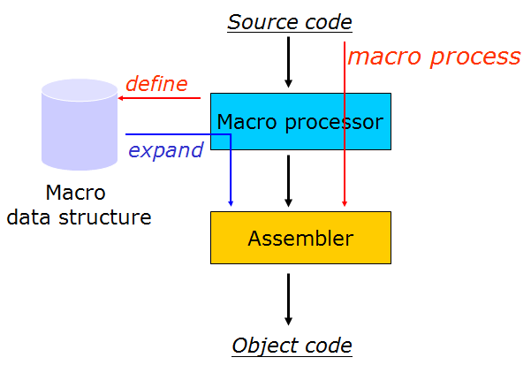
2. Introduction to Macro Processors
Macro Processors
Macro definition; call; expansion
Advanced Macro facilities
Loaders
Linkers

Slide 7
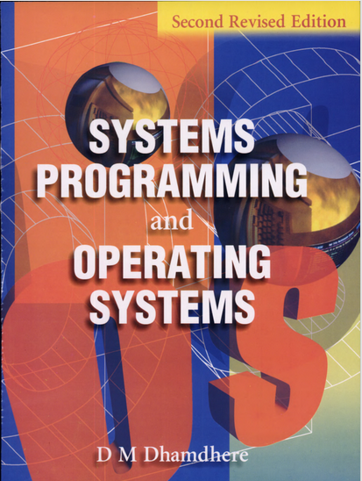
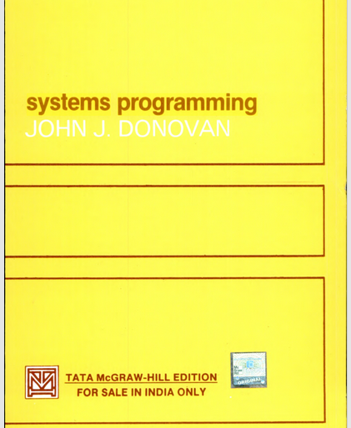
Loaders and Linkers
Macros

Slide 8
Macros (Macro instructions)
A macro is a sequence of instructions, assigned by a name and could be used anywhere in the program.
Macros are defined with MACRO and MEND directives.
It allows the programmer to write shorthand version of a program (module programming)
The macro processor replaces each macro call/invocation with the corresponding sequence of statements (Macro expansion)
Many languages provide built-in facilities for writing macros – C, C++
MACRO
----------------------
----------------------
MEND

Slide 9
Macro Definition
Macro definition is enclosed between MACRO header and MEND statement
Located at start of the program.
Definition consists of :
A macro prototype statement
Declares macro name with name & kinds of its formal parameters
One or more modal statements
Generates assembly language during macro expansion
Macro preprocessor statements
Conditional functions during macro expansion

Slide 10
function INCR( MEM_VAL, INCR_VAL, REG) {
REG = MEM_VAL
REG = REG + INCR_VAL
MEM_VAL = REG
}
Definition of macro INCR.
MACRO
INCR &MEM_VAL, &INCR_VAL, &REG
MOVER &REG, &MEM_VAL
ADD &REG, &INCR_VAL
MOVEM &REG, &MEM_VAL
MEND
CALL - INCR A, B, AREG
Macro Name
Formal parameters
Model statements
Actual parameters
INCR &MEM_VAL, &INCR_VAL, &REG - MACRO PROTOTYPE

Slide 11
Syntax of MACRO PROTOTYPE
< macro name> [ < formal parameters specification>]
Where;
<macro name> is the mnemonic field of an assembly statement
< formal parameters specification > is in the form &<parameter name> [< parameter kind >]
Formal parameters are either Positional, default Parameter or Keyword Parameters
Syntax of MACRO CALL - By writing the macro name in mnemonic field of an assembly statement.
< macro name> [ < actual parameters specification>]
<actual parameter spec> is simply an <ordinary string>

Slide 12
Macro Expansion
Macro calls leads to macro expansion.
During macro expansion, the macro call is replaced by a sequence of assembly statements.
MACRO
INCR &MEM_VAL, &INCR_VAL, &REG
MOVER &REG, &MEM_VAL
ADD &REG, &INCR_VAL
MOVEM &REG, &MEM_VAL
MEND
+ MOVER AREG, A
+ ADD AREG, B
+ MOVEM AREG, A
INCR A, B, AREG
Macro definition
Macro call
Expanded code

Slide 13

Macro expansion
Macro Expansion
Lexical Expansion
Semantic Expansion
Macro expansion : Macro name with a set of actual parameters is replaced by some code.
Lexical expansion is used to generate an assembly statement from a model statement i.e. Replace formal parameters by actual parameters (last slide example)
Semantic expansion / Expansion time control flow is generation of statements of a specific macro call.
Determines the order in which model statements are visited during macro expansion (IF-ELSE)

Slide 14
Macro Vs subroutines
Macros | Subroutines
A macro call leads to macro expansion during which formal parameters are substituted by actual parameters. | A subroutine call also leads to formal parameters substitution; but substitution takes place during execution.
Completely handled by the assembler during assembly time. | Completely handled by the hardware at runtime.
The macro processor generates a new copy of the macro and places it in the program. | Stored in memory once (just one copy)
Duplicated as many times as necessary. (this increases program size and the execution time)

Slide 15
Macro Processor
Recognize macro definitions
Save the macro definition
Recognize macro calls
Expand macro calls
Source Code
(with macro)
Macro Processor
Expanded Code
Compiler or Assembler
obj

Slide 16

MACRO EXPANSION
Macro Assembler
Macro Preprocessor

Slide 17
Features of Macro expansion
Lexical substitution
(Generates ALP)
String types:
1. Ordinary string
2. Formal parameters(&)
Semantic substitution
(Expansion time control flow)
1. Default flow (sequential)
2. Preprocessor statement alters the control flow during expansion
Conditional expansion
(statements are never visited)
Expansion time loops
(Repeatedly visited)
Notes:
ALP – Assembly Language Programming

Slide 18
Ordinary strings - Example
Source
MACRO
STRG
STA DATA1
STB DATA2
STX DATA3
MEND
.
STRG
.
STRG
.
.
Expanded source
.
.
.
STA DATA1
STB DATA2
STX DATA3
.
STA DATA1
STB DATA2
STX DATA3
.
{
{
Values of formal parameters depend on the kind of parameter.

Slide 19
Formal Parameters: Positional Parameters
Example of macro definition:
MACRO
INCR &MEM_VAL, &INCR_VAL, &REG
MOVER &REG, &MEM_VAL
ADD &REG, &INCR_VAL
MOVEM &REG, &MEM_VAL
MEND
Positional parameter is written as :
<parameter kind> is absent
Value of a positional formal parameter is determined by the rule of positional association.
Ordinal positions of formal and actual parameters should be same.
& <parameter name> i.e. &TEST
Consider the macro CALL - INCR A, B, AREG
Values of formal parameters are :
Formal parameter Value
MEM_VAL A
INCR_VAL B
REG AREG

Slide 20
Formal Parameters: Keyword Parameters
Keyword parameter is written as :
<parameter name> is an ordinary string
<parameter kind> is the string ‘=‘
Value of a keyword formal parameter is determined by the rule of keyword association.
<actual parameter spec> is –
<formal parameter name> = <ordinary string>
Ordinal positions of formal and actual parameters may be different.
Example of macro definition:
MACRO
INCR &MEM_VAL=, &INCR_VAL=, &REG=
MOVER &REG, &MEM_VAL
ADD &REG, &INCR_VAL
MOVEM &REG, &MEM_VAL
MEND
& <parameter name=> i.e. &TEST=
Consider the macro CALLs –
INCR MEM_VAL=A, INCR_VAL=B, REG=AREG
INCR INCR_VAL=B, REG=AREG, MEM_VAL=A

Slide 21
Default specifications of parameters
Default is used in the absence of an explicit specification.
Syntax :
&<parameter name> [ =[<default value>]]
Example of macro definition:
MACRO
INCR_D &MEM_VAL=, &INCR_VAL=, &REG=AREG
MOVER &REG, &MEM_VAL
ADD &REG, &INCR_VAL
MOVEM &REG, &MEM_VAL
MEND

Slide 22
Macro definition with POSITIONAL paramater
MACRO
INCR &MEM_VAL, &INCR_VAL, &REG
MOVER &REG, &MEM_VAL
ADD &REG, &INCR_VAL
MOVEM &REG, &MEM_VAL
MEND
Macro CALL - INCR A, B, AREG
Macro definition with KEYWORD parameter
MACRO
INCR &MEM_VAL=, &INCR_VAL=, &REG=
MOVER &REG, &MEM_VAL
ADD &REG, &INCR_VAL
MOVEM &REG, &MEM_VAL
MEND
Macro CALLs –
INCR MEM_VAL=A, INCR_VAL=B, REG=AREG
INCR INCR_VAL=B, REG=AREG, MEM_VAL=A
Macro definition with KEYWORD-DEFAULT parameter
MACRO
INCR_D &MEM_VAL=, &INCR_VAL=, &REG=AREG
MOVER &REG, &MEM_VAL
ADD &REG, &INCR_VAL
MOVEM &REG, &MEM_VAL
MEND
Macro CALLs –
INCR_D MEM_VAL=A, INCR_VAL=B
INCR_D INCR_VAL=B, MEM_VAL=A
INCR_D INCR_VAL=B, MEM_VAL=A, REG=BREG

Slide 23
Default specifications of parameters
MACRO
INCR_D &MEM_VAL=, &INCR_VAL=, &REG=AREG
MOVER &REG, &MEM_VAL
ADD &REG, &INCR_VAL
MOVEM &REG, &MEM_VAL
MEND
MACRO CALL (possibility 2) :
INCR_D INCR_VAL=B, MEM_VAL=A
Output:
+ MOVER AREG, A
+ ADD AREG, B
+ MOVEM AREG, A
MACRO CALL (possibility 1) :
INCR_D MEM_VAL=A, INCR_VAL=B
Output:
+ MOVER AREG, A
+ ADD AREG, B
+ MOVEM AREG, A
MACRO CALL (possibility 3) :
INCR_D INCR_VAL=B, MEM_VAL=A, REG=BREG
Output:
+ MOVER BREG, A
+ ADD BREG, B
+ MOVEM BREG, A
The third call overrides the default value for REG with BREG.

Slide 24
MACROs with mixed parameter lists (Positional parameters followed by default or keyword parameters)
Example macro call: SUM A, B, C=50, D=E
Other uses of parameters:
MACRO
CALC &X, &Y, &OP=MULT, &LAB=
&LAB MOVER AREG, &X
&OP AREG, &Y
MOVEM AREG, &X
MEND
Consider Macro call as : CALC A, B, LAB=LOOP
Macro expansion output:
LOOP MOVER AREG, A
MULT AREG, B
MOVEM AREG, A

Slide 25

ALP with Macros
MEM_VAL = A
INCR_VAL = B
REG = DREG
MACRO
INCR &MEM_VAL, &INCR_VAL, &REG=AREG
MOVER &REG, &MEM_VAL
ADD &REG, &INCR_VAL
MOVEM &REG, &MEM_VAL
MEND
START 400
ADD BREG, =‘4’
MOVEM BREG, X
SUB CREG, = ‘5’
MOVEM CREG, Y
INCR A, B, REG=DREG
END
MACRO EXPANSION - OUTPUT
START 400
ADD BREG, =‘1’
MOVEM BREG, X
SUB CREG, = ‘5’
MOVEM CREG, Y
+ MOVER DREG, A
+ ADD DREG, B
+ MOVEM DREG, A
END
Output of INCR

Slide 26
Recap of the discussion
Macros
Macro definition; Macro call
Macro expansion
Lexical substitution
Semantic substitution
Formal parameter types (prefixed with &)
Positional parameters
Keyword parameters
Default parameters

Slide 27
NESTED macro calls
Model statement in a macro calls another macro.
Expansion of nested macro calls follows LIFO rule.
Example macro definition:
MACRO
COMPUTE &FIRST, &SEC
MOVEM BREG, TMP
INCR &FIRST, &SEC, &REG=BREG
MOVER BREG, TMP
MEND
Consider Macro call as : COMPUTE X, Y

Slide 28
NESTED macro calls
MACRO
INCR &MEM_VAL, &INCR_VAL, &REG=AREG
MOVER &REG, &MEM_VAL
ADD &REG, &INCR_VAL
MOVEM &REG, &MEM_VAL
MEND
MACRO
COMPUTE &FIRST, &SEC
MOVEM BREG, TMP
INCR &FIRST, &SEC, &REG=BREG
MOVER BREG, TMP
MEND
START 400
ADD BREG, =‘4’
MOVEM BREG, X
SUB CREG, = ‘5’
MOVEM CREG, Y
COMPUTE X, Y
END
MEM_VAL = FIRST i.e. X
INCR_VAL = SEC i.e. Y
REG = BREG
MACRO EXPANSION - OUTPUT
START 400
ADD BREG, =‘1’
MOVEM BREG, X
SUB CREG, = ‘5’
MOVEM CREG, Y
+ MOVEM BREG, TMP
+ MOVER BREG, X
+ ADD BREG, Y
+ MOVEM BREG, X
+ MOVER BREG, TMP
END
FIRST = X
SEC = Y
Output of INCR

Slide 29
Advanced Macro Facilities [Supports semantic expansions]
Synchronizes the Flow of control during Macro expansion
The default flow of control during macro expansion is sequential.
A preprocessor statement can alter the flow of control during the expansion such that :
Some model statement are NEVER VISITED– Conditional Expansion
Some model statements are REPEATEDLY VISITED– Expansion Time Loop

Slide 30
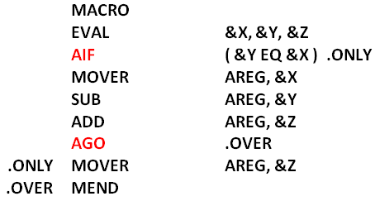
Advanced Macro facilities
Preprocessor statement and various methods such as:
Alteration of flow control
Sequencing Symbols(SS) (prefixed with a dot .)
Assembler IF(AIF) – Conditional jump
Assembler GO(AGO) – Unconditional jump
ANOP – Assembler No operation
Expansion time variables – Local and Global (LCL, GBL)
Attributes of parameters – Instruction length, type and size
Sequencing Symbol

Slide 31
Adv. Macros – ALTERATION OF FLOW CONTROL
Expansion time Sequencing Symbols
Sequencing Symbols (SS) : . <ordinary string>
SS appears in label field in macro body
It is used as an operand field of AIF or AGO stmt.
It never appears in the expanded form of a model statement.
Expansion time statements AIF, AGO & ANOP
AIF (<expression>) <sequencing symbol> (relational expression involving ordinary strings, formal parameters & expansion time variables)
AGO < sequencing symbol > -- unconditional transfer
< sequencing symbol > ANOP – defines the SS .TEST ANOP

Slide 32
Adv. Macros – EXPANSION TIME VARIABLES(EV) LCL, GBL
Used during macro expansion.
A local EV is for a particular macro call.
A global EV exists across all macro calls situated in a program.
Syntax :
LCL &< EV name>
GBL &< EV name>
Values of EV’s are manipulated using SET i.e. <EV name> SET <SET-expression>
Value of EV is used in any field of model statement and in the expression of an AIF stmt.

Slide 33
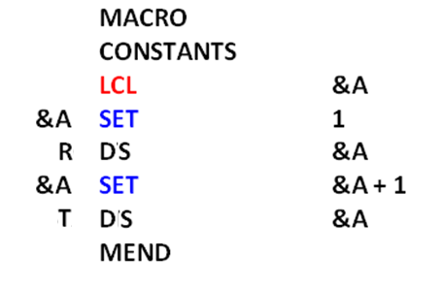
Expansion time variables - Example
int A
A =1
The local EV – A is created.
First SET assigns the value ‘1’ to it.
Define 1 byte to symbol R
Second SET assigns 2 bytes for symbol T

Slide 34
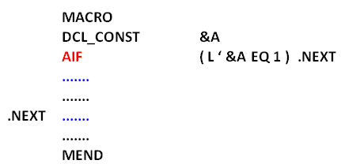
Adv. Macros – Attributes of formal parameters
<attribute name> ‘ <formal parameter spec>
Represents information about the value of the formal parameter (i.e. actual parameter).
Type, length and size attributes – T, L & S
Control is transferred to .NEXT only if the actual parameter corresponding to the formal parameter A has the length of ‘1’

Slide 35
Example – Conditional Expansion
X =A
Y =B
Z = C
MACRO EXPANSION
MOVER AREG, A
SUB AREG, B
ADD AREG, C
Macro call - EVAL A, B, C
Macro evaluates : A – B + C
If names of first 2 parameters are same, control is transferred to MOVER AREG, &Z

Slide 36
Example – Conditional Expansion
X = A
Y = A
Z = C
MACRO EXPANSION
MOVER AREG, C
Macro call - EVAL A, A, C
Macro evaluates : A – A + C
If names of first 2 parameters are same, control is transferred to MOVER AREG, &Z

Slide 37
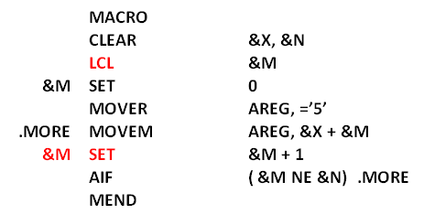
Example – Expansion time loops
X = B and N = 3
Local variable M is created
M = 0
&X + &M i.e. B + 0 i.e. B ; ignore SS as it appears in the label field
M =M+1
If ( M != 3) then goto statement with label .MORE
MACRO_CALL : CLEAR B, 3
EXPANSION :
MOVER AREG, =‘5’
MOVEM AREG, B
MOVEM AREG, B + 1
MOVEM AREG, B + 2
MOVER puts ‘5’ in AREG, while 3 MOVEM store this value in 3 consecutive bytes with the addresses B, B + 1 and B + 2.

Slide 38

Macro Journey so far
Macros
Macro Definition; Macro Call; Macro expansion
Formal parameters: Positional, Keyword, Default Kw
Lexical expansion and sentiment expansion
Altered change of flow control
AIF, AGO, ANOP
Sequencing Symbol ( appears in label and OPERANDS with AIF and AGO)
LCL and GBL
Attribute parameters
SS, AIF, AGO, ANOP, LCL, and GBL instructions NEVER appear in the macro expanded source code.
Macro Preprocessor : Process Macro Definition + Process Macro Call

Slide 39
Practice Questions on Macros
In an assembly language program certain action is required at ten different places. Under what conditions would you code this as Macro or subroutine? Justify your answer.
Explain with example following macro facilities
Expansion time loops
Change of flow during macro facilities.
Keyword and positional parameters
Sample asm program DEFINE a macro with some parameter values; what can be possible ways to specify these arguments?
Justify your comments on following statements-
A unit of specification for a program generation through expansion is called as compiler.
An AGO <Sequencing Symbol> statement unconditionally transfers control flow.

Slide 40
Macros: Practice Examples
Show the expanded assembly language program.
MACRO
MAC_1 &A, &REG=ZREG
ADD REG, &A
MOVEM REG, &A
MEND
START 400
ADD AREG, C
MAC_1 P, DREG
MOVER CREG, =‘5’
MAC_1 B
END
MACRO
MAC_1 &A, &REG=ZREG
ADD &REG, &A
MOVEM &REG, &A
MEND
MACRO
MAC_2 &A, &B
MOVER &AREG, &A
MAC_1 &B, &REG = DREG
PRINT &A
MEND
START 600
MAC_1 A
MOVER CREG, =‘5’
MAC_2 P, Q
END
MACRO
MAC_3 &A, &B, &C
AIF (&A’ L 20) .TEST
MOVER AREG, &A
MULT AREG, &B
AGO .STP
.TEST MOVER AREG, &B
MULT AREG, &C
.STP MEND
START 400
MOVEM AREG, P
MOVEM BREG, Q
MOVEM CREG, R
P DS 20
MAC_3 P, Q, R
END
Examples – without Data structures

Slide 41
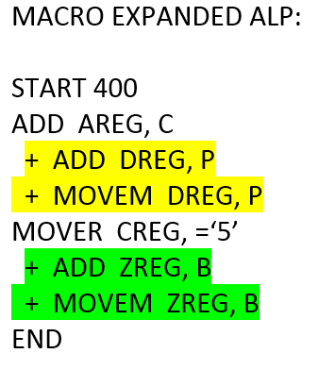
Macros: Practice Example 1 solution
Show the expanded assembly language program.
MACRO
MAC_1 &A, &REG=ZREG
ADD REG, &A
MOVEM REG, &A
MEND
START 400
ADD AREG, C
MAC_1 P, DREG
MOVER CREG, =‘5’
MAC_1 B
END

Slide 42
Macros: Practice Example 2 solution
Show the expanded assembly language program.
MACRO
MAC_1 &A, &REG=ZREG
ADD &REG, &A
MOVEM &REG, &A
MEND
MACRO
MAC_2 &A, &B
MOVER &AREG, &A
MAC_1 &B, &REG = DREG
PRINT &A
MEND
START 600
MAC_1 A
MOVER CREG, =‘5’
MAC_2 P, Q
END
OUTPUT:
START 600
+ ADD ZREG, A
+ MOVEM ZREG, A
MOVER CREG, =‘5’
+ MOVER AREG, P
+ ADD DREG, Q
+ MOVEM DREG, Q
+ PRINT P
END

Slide 43
Macros: Practice Example 3 solution
Show the expanded assembly language program.
OUTPUT:
START 400
MOVEM AREG, P
MOVEM BREG, Q
MOVEM CREG, R
P DS 20
+ MOVER AREG, Q
+ MULT AREG, R
END
MACRO
MAC_3 &A, &B, &C
AIF (&A’ L 20) .TEST
MOVER AREG, &A
MULT AREG, &B
AGO .STP
.TEST MOVER AREG, &B
MULT AREG, &C
.STP MEND
START 400
MOVEM AREG, P
MOVEM BREG, Q
MOVEM CREG, R
P DS 20
MAC_3 P, Q, R
END
MACRO
MAC_3 &A, &B, &C
AIF (&A’ L 20) .TEST
MOVER AREG, &A
MULT AREG, &B
AGO .STP
.TEST MOVER AREG, &B
MULT AREG, &C
.STP MEND
START 400
MOVEM AREG, P
MOVEM BREG, Q
MOVEM CREG, R
P DS 40
MAC_3 P, Q, R
END
OUTPUT:
START 400
MOVEM AREG, P
MOVEM BREG, Q
MOVEM CREG, R
P DS 40
+ MOVER AREG, P
+ MULT AREG, Q
END

Slide 44

Macro Preprocessor
1. Process Macro definition
2. Process Macro call

Slide 45
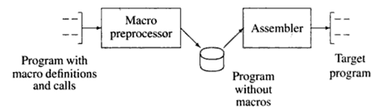
Macro Preprocessor
Macro preprocessor separates macro expansion from the process of program assembly.
Macro – Assembler performs macro expansion as well as assembly.

Slide 46
Macro preprocessor design overview & data structure taxonomy for Macro definition processing
Recognize Macro Definition – Macro Name Table (MNT)
Identify formal parameters - Parameter Name table, Keyword parameter default table (PNTAB, KPDTAB)
Maintain the expansion time variables declared in a macro – Expansion time variable name table (EVNTAB)
Process model statements except MEND
Find the statement that defines a sequencing symbols. (SSNTAB, SSTAB)
Record the intermediate representation in Macro definition table (MDT)
( SSTAB holds MDT entry #)

Slide 47
Macro preprocessor design overview & data structure taxonomy for Macro call processing
MACRO_CALL : CLEAR B, 3
Recognize a Macro Call– Macro Name Table (MNT)
Determine actual parameters - Actual Parameter Table
(APTAB)
<formal parameter name>, <value>
Organize expansion time control flow.
Macro Expansion Counter (MEC)
Maintain the values of expansion time variables– Expansion time variable table (EVTAB)
MEC points to the MDT entry containing the model statement.
Values of formal parameters and EV's are available in APT and EVT.
The Model statements defining SS is identified from SSTAB
Perform expansion of a model statement
(by lexical substitution for the parameters and EV’s)

Slide 48
Macro preprocessor Data Structures
Tables | Fields in each entry
Macro Name Table (MNT) | Macro name No. of positional parameters(#PP) No. of keyword parameters (#KP) No. of expansion time variables (#EV) MDT pointer (MDTP) KPDTAB pointer (KPDTP) SSTAB pointer (SSTP)
Parameter name table(PNTAB) | Parameter names
EV name table (EVNTAB) | Expansion time variable name
Sequencing symbol name table (SSNTAB) | Sequencing symbol name
Keyword parameter default table (KPDTAB) | Keyword parameter name, default value
Macro Definition table (MDT) | Label, Opcode, operands
Sequencing Symbol tab(SSTAB) | MDT entry # of the Sequencing symbol
Tables | Fields in each entry
Actual parameter table (APTAB) | Macro call - Parameter values
EV table (EVTAB) | Value of expansion variables during macro expansion
 | Processing macro definition
 | Processing macro call

Slide 49
Macro preprocessor 9 Data Structures
Tables
Macro Name Table (MNT)
Parameter name table(PNTAB)
EV name table (EVNTAB)
Sequencing symbol name table (SSNTAB)
Keyword parameter default table (KPDTAB)
Macro Definition table (MDT)
Sequencing Symbol tab(SSTAB)
Actual Parameter table (APTAB)
EV Table (EVTAB)
Constructed while
 | Processing macro prototype statement
 | Processing the prototype statement
 | Expansion time variable declarations
 | Sequencing symbol definitions and its usage
 | Processing macro body (model statements)
 | Processing definition of a SS
 | Processing macro call statement
 | Start of macro expansion

Slide 50
Macro Preprocessor (2 Phases)
MACRO
TEST &A, &B
ADD AREG, &A
SUB AREG, &B
MULT BREG, &A
MEND
START 600
READ P
READ Q
TEST P, Q
P DS 1
Q DS 2
END
MNT
KPDTAB
SSTAB
MDT
MACRO PASS-2
Process Macro
Call
(SYNTHESIS PHASE)
Data structures
MNT
PNTAB
KPDTAB
EVNTAB
SSNTAB
SSTAB
MDT
MACRO PASS-1
Process Macro Definition
(ANALYSIS PHASE)
APTAB
EVTAB
START 600
READ P
READ Q
+ ADD AREG, P
+ SUB AREG, Q
+ MULT BREG, P
P DS 1
Q DS 2
END
2 Pass or Single Pass Assembler

Slide 51
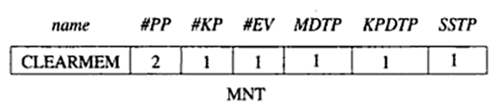

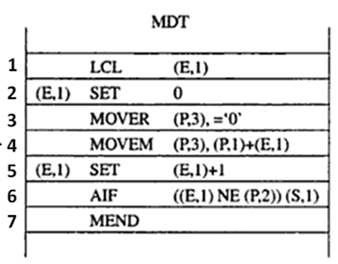
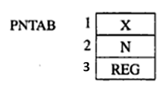
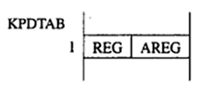


MACRO
CLEARMEM &X, &N, &REG = AREG
LCL &M
&M SET 0
MOVER &REG, =‘ 0 ’
.MORE MOVEM &REG, &X+ &M
&M SET &M + 1
AIF (&M NE &N) .MORE
MEND
Example :

Slide 52
MACRO
CLEARMEM &X, &N, &REG = AREG
LCL &M
&M SET 0
MOVER &REG, =‘ 0 ’
.MORE MOVEM &REG, &X+ &M
&M SET &M + 1
AIF (&M NE &N) .MORE
MEND
Example :

Slide 53
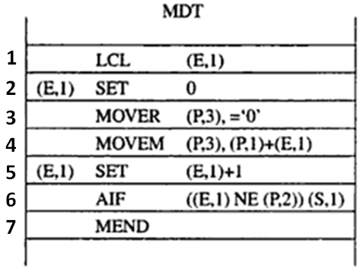
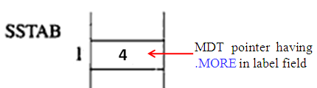
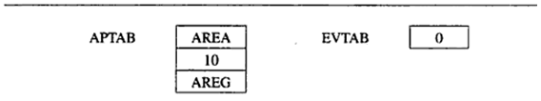
Macro Call
(later)

Slide 54
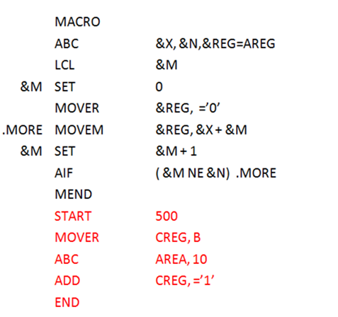
Practice Example # 1
Show the contents of different tables with Intermediate Representation after processing macro definition.
Note on SS:
Sequencing symbols are added to SSNTAB when they appear either as a label OR in the operand field.
SSTAB is updated with the MDT entry ONLY when SS appears in the label field.

Slide 55
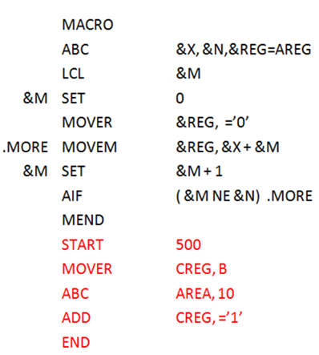
Processing Macro definition
MNT
Name | #PP | #KP | #EV | MDTP | KPDTP | SSTP
ABC | 2 | 1 | 0 | 1 | 1 | 1
1
MDT
1 | LCL (E, 1)
2 | (E, 1) SET 0
3 | MOVER (P,3), =‘0’
4 | MOVEM (P,3), (P,1) + (E,1)
5 | (E, 1) SET (E,1) + 1
6 | AIF ( (E,1) NE (P,2) ) (S,1)
7 | MEND
PNTAB
1 | X
2 | N
3 | REG
KPDTAB
1 | REG | AREG
EVNTAB
1 | M
SSNTAB
1 | MORE
SSTAB
1 | 4

Slide 56
Processing Macro definition - SOLUTION
MNT
Name | #PP | #KP | #EV | MDTP | KPDTP | SSTP
ABC | 2 | 1 | 0 | 1 | 1 | 1
1
MDT
1 | LCL (E, 1)
2 | (E, 1) SET 0
3 | MOVER (P,3), =‘0’
4 | MOVEM (P,3), (P,1) + (E,1)
5 | (E, 1) SET (E,1) + 1
6 | AIF ( (E,1) NE (P,2) ) (S,1)
7 | MEND
PNTAB
1 | X
2 | N
3 | REG
KPDTAB
1 | REG | AREG
EVNTAB
1 | M
SSNTAB
1 | MORE
SSTAB
1 | 4

Slide 57
Practice Example # 2
MACRO
TEST &A, &B, &C=DREG
AIF (&A’ L 20) .TEST
MOVER AREG, &A
MULT AREG, &B
AGO .STP
.TEST MOVER AREG, &B
MULT AREG, &C
.STP MEND
Show the contents of different tables with Intermediate Representation after processing macro definition.

Slide 58
MACRO
TEST &A, &B, &C=DREG
AIF (&A’ L 20) .JMP
MOVER AREG, &A
MULT AREG, &B
AGO .STP
.JMP MOVER AREG, &B
MULT AREG, &C
.STP MEND
Processing Macro definition
MNT
Name | #PP | #KP | MDTP | KPDTP | SSTP
TEST | 2 | 1 | 1 | 1 | 1
MDT
1 | AIF ((P,1) L’ 20) (S, 1)
2 | MOVER AREG, (P, 1)
3 | MULT AREG, (P, 2)
4 | AGO (S, 2)
5 | MOVER AREG, (P, 2)
6 | MULT AREG, (P, 3)
7 | MEND
PNTAB
1 | A
2 | B
3 | C
KPDTAB
1 | C | DREG
SSNTAB
1 | JMP
2 | STP
SSTAB
1 | 5
2 | 7
No Evs are present; hence EVNTAB and #EV from MDT are omitted.

Slide 59
Processing Macro definition - SOLUTION
MACRO
TEST &A, &B, &C=DREG
AIF (&A’ L 20) .JMP
MOVER AREG, &A
MULT AREG, &B
AGO .STP
.JMP MOVER AREG, &B
MULT AREG, &C
.STP MEND
MNT
Name | #PP | #KP | MDTP | KPDTP | SSTP
TEST | 2 | 1 | 1 | 1 | 1
MDT
1 | AIF ((P,1) L’ 20) (S, 1)
2 | MOVER AREG, (P, 1)
3 | MULT AREG, (P, 2)
4 | AGO (S, 2)
5 | MOVER AREG, (P, 2)
6 | MULT AREG, (P, 3)
7 | MEND
PNTAB
1 | A
2 | B
3 | C
KPDTAB
1 | C | DREG
SSNTAB
1 | JMP
2 | STP
SSTAB
1 | 5
2 | 7
No EVs are present; hence EVNTAB and #EV from MDT are omitted.

Slide 60
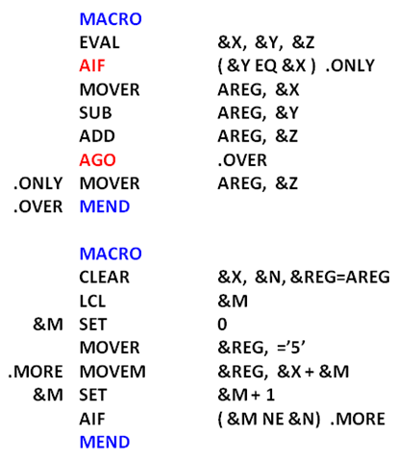
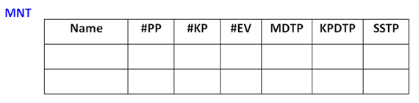
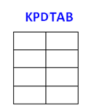
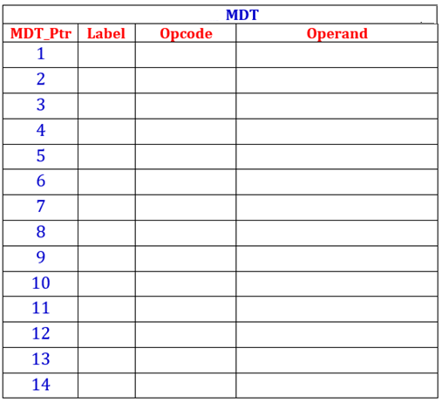
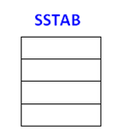
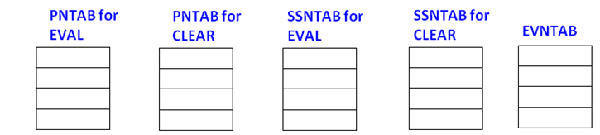
EVAL
3
0
0
1
1
1
2
1
0
8
1
3
CLEAR
1
1
REG AREG
AIF
((P, 2) EQ (P, 1) ) (S, 1)
MOVER
AREG, (P, 1)
SUB
AREG, (P, 2)
ADD
AREG, (P, 3)
AGO
(S, 2)
6
MOVER
AREG, (P, 3)
1
2
7
MEND
3
LCL
(E, 1)
11
(E, 1)
SET
0
MOVER
(P, 3), =‘5’
MOVEM
(P, 3), (P, 1) + (E, 1)
(E, 1)
SET
(E,1) + 1
AIF
((E, 1) NE (P, 2) ) (S, 3)
1
X
1
X
1
ONLY
1
MORE
1
M
MEND
2
Y
2
N
2
OVER
3
Z
3
REG
SSTP + q - 1 [ q is the index of SS in the SSNTAB)

Slide 61
(S, #)- SSTAB
(P, #) - PNTAB
(E,#)- EVNTAB
EVAL
3
0
0
1
1
1
CLEAR
2
1
1
8
1
3
1
REG AREG
AIF
((P, 2) EQ (P, 1) ) (S, 1)
MOVER
AREG, (P, 1)
SUB
AREG, (P, 2)
ADD
AREG, (P, 3)
AGO
(S, 2)
6
MOVER
AREG, (P, 3)
1
2
7
MEND
3
LCL
(E, 1)
11
(E, 1)
SET
0
MOVER
(P, 3), =‘5’
MOVEM
(P, 3), (P, 1) + (E, 1)
(E, 1)
SET
(E,1) + 1
AIF
((E, 1) NE (P, 2) ) (S, 3)
1
X
1
X
1
ONLY
1
MORE
1
M
MEND
2
Y
2
N
2
OVER
3
Z
3
REG
SSTP + q - 1 [ q is the index of SS in the SSNTAB)

Slide 62
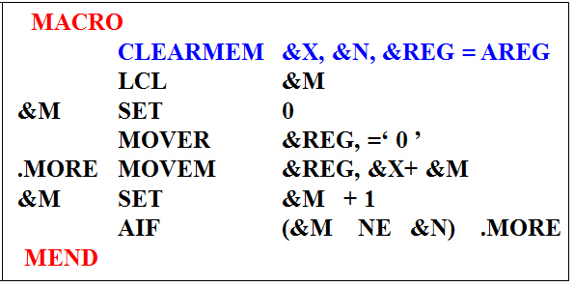
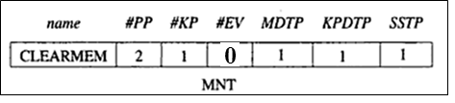
Algorithm - Processing of Macro Definitions
KPDTAB, SSTAB & MDT are shared
Initializations : KPDTAB_pointer := SSTAB_ptr := MDT_ptr := 1;
Algorithm –
SSNTAB_ptr := PNTAB_ptr := 1;
Process the MACRO PROTOTYPE statement and form the MNT entry.
name := Macro name;
For each positional parameter,
Enter parameter names in PNTAB
#PP := #PP + 1;
KPDTP := KPDTAB_ptr;
For each keyword parameter,
Enter parameter name & default value (if any) in KPDTAB
Enter parameter name in PNTAB[PNTAB_ptr]
#KP := #KP + 1;
MDTP := MDT_ptr;
#EV := 0;
SSTP := SSTAB_ptr;

Slide 63
3. While not a MEND statement
If LCL statement, then
Enter expansion time variable name in EVNTAB
#EV := #EV + 1;
If model statement, then
If label contains a Sequencing symbol, then
if symbol is NOT present in SSNTAB then
Enter symbol in SSNTAB
Store the index of new SS in variable say q
end if
SSTAB [ SSTP + q – 1 ] := MDT_ptr;
End if
For a parameter and expansion variable, generate the specification (P, #n) and (E, #n);
Record IC in MDT[MDT_ptr];

Slide 64
If PRE-PROCESSOR statement, then
If SET statement, then
Search each expansion time variable name used in the statement in EVNTAB and generate the spec ( E, #m )
If AIF or AGO, then
if sequencing symbol is NOT present in SSNTAB then
Enter symbol in SSNTAB
Store the index of new SS in variable say q
end if
Replace the symbol by (S, SSTP + q – 1 ); //q is the index of SS in SSNTAB
Record IC in MDT[MDT_ptr]; and MDT_ptr := MDT_ptr + 1;
4. MEND statement
If SSNTAB_ptr = 1 (i.e. SSNTAB is empty) then SSTP := 0;
Else set SSTP for the next macro
if #KP = 0 then KPDTP =1;

Slide 65
Macro Call processing

Slide 66
Algorithm - Macro Expansion
Data Structures -
Additional Data structures
APTAB | Actual Parameter table
EVTAB | Expansion Time / Expression variables tables
Pointers
MEC | Macro Expansion Counter for accessing MDT
APTAB_ptr | APTAB pointer
EVTAB_ptr | EVTAB pointer

Slide 67
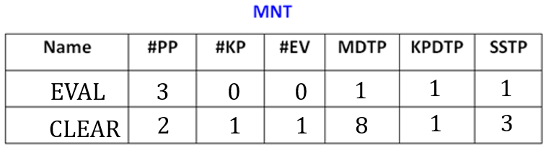
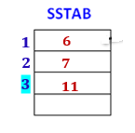

Macro Expansion Counter
The flow of control during macro expansion is implemented using a Macro Expansion Counter (MEC).
Algorithm-
MEC := MDT pointer value for the called macro
While not a MEND
a. If a model statement, then
i. Process the statement
ii. MEC := MEC + 1
b. Else (preprocessor statement i.e. AIF and AGO)
MEC := new value specified in (S, #) [i.e. MDT entry]
3. Exit from macro expansion

Slide 68
Process Macro Call
Algorithm
MEC = MDT pointer of the called macro
Initialization –
Copy the default keyword values in APTAB
Copy positional parameters values from macro call in APTAB
Copy Keyword parameters values(if present) from macro call in APTAB
Process MDT with MEC
For Model statement:
Replace (P, #m) by the values of APTAB[m]
Process (E, #n) by the values of EVTAB[n]
Generate the output statement
Set MEC = MEC + 1
For AIF:
if condition is true – Set MEC = SSTP[#m] As (S,#m)
else Set MEC = MEC + 1
For AGO:
Set MEC = SSTP[#m] As (S,#m)
Exit from macro expansion on MEND

Slide 69
MACRO
ONE &A, &Y, &OP=MULT
MOVER AREG, &A
&OP AREG, &Y
MOVEM AREG, &A
MEND
MACRO
TWO &F, &S, &K=DREG
MOVEM BREG, &F
MOVER &K, &S
ADD &F, &S
MEND
START 100
TWO W, Z, K=EREG
ONE X, Y
END
Processing Macro definition – Another example
MNT
Name | #PP | #KP | MDTP | KPDTP
ONE | 2 | 1 | 1 | 1
TWO | 2 | 1 | 5 | 2
MDT
1 | MOVER AREG, (P_{ONE}, 1)
2 | (P, 3) AREG, (P_{ONE}, 2)
3 | MOVEM AREG, (P_{ONE}, 1)
4 | MEND
5 | MOVEM BREG, (P_{TWO}, 1)
6 | MOVER (P_{TWO}, 3), (P_{TWO}, 2)
7 | ADD (P_{TWO}, 1), (P, _{TWO} 2)
8 | MEND
PNTAB_ONE
1 | A
2 | Y
3 | OP
PNTAB_TWO
1 | F
2 | S
3 | K
KPDTAB
1 | OP | MULT
2 | K | DREG
No EVs & SS are present; hence SSNTAB, SSTAB, EVNTAB, SSTP and #EV from MDT are omitted.

Slide 70
MACRO
ONE &A, &Y, &OP=MULT
MOVER AREG, &A
&OP AREG, &Y
MOVEM AREG, &A
MEND
MACRO
TWO &F, &S, &K=DREG
MOVEM BREG, &F
MOVER &K, &S
ADD &F, &S
MEND
START 100
TWO W, Z, K=AREG
ONE X, Y, OP=ADD
END
Processing Macro definition – Another example
MNT
Name | #PP | #KP | MDTP | KPDTP
ONE | 2 | 1 | 1 | 1
TWO | 2 | 1 | 5 | 2
KPDTAB
1 | OP | MULT
2 | K | DREG
MDT
1 | MOVER AREG, (P_{ONE}, 1)
2 | (P_{ONE}, 3) AREG, (P_{ONE}, 2)
3 | MOVEM AREG, (P_{ONE}, 1)
4 | MEND
5 | MOVEM BREG, (P_{TWO}, 1)
6 | MOVER (P_{TWO}, 3), (P_{TWO}, 2)
7 | ADD (P_{TWO}, 1), (P, _{TWO} 2)
8 | MEND
For Macro Expansion
APTAB
1
2
3

Slide 71
Processing Macro Call – Previous example
MNT
Name | #PP | #KP | MDTP | KPDTP
ONE | 2 | 1 | 1 | 1
TWO | 2 | 1 | 5 | 2
START 100
TWO W, Z, K=AREG
ONE X, Y
END
MEC = 5
6
7
8
MEC = 1
3
2
4
KPDTAB
1 | OP | MULT
2 | K | DREG
OUTPUT
START 100
MOVEM BREG, W
MOVER AREG, Z
ADD W, Z
MOVER AREG, X
MULT AREG, Y
MOVEM AREG, X
END
APTAB for TWO
1 | W
2 | Z
3 | DREG
MDT
1 | MOVER AREG, (P_{ONE}, 1)
2 | (P_{ONE}, 3) AREG, (P_{ONE}, 2)
3 | MOVEM AREG, (P_{ONE}, 1)
4 | MEND
5 | MOVEM BREG, (P_{TWO}, 1)
6 | MOVER (P_{TWO}, 3), (P_{TWO}, 2)
7 | ADD (P_{TWO}, 1), (P_{TWO}, 2)
8 | MEND
AREG
APTAB for ONE
1 | X
2 | Y
3 | MULT

Slide 72
Macro Call Steps –
Initialization
Process MDT with MEC
Exit from macro expansion
1. Perform Initializations for a macro expansion
MEC = MDTP field of MNT entry
Copy Keyword parameter default values (if any) from KPDTAB to APTAB
KPDTAB[KPDTP] to KPDTAB[KPDTP + #KP - 1] in the APTAB [#PP + 1] to APTAB[#PP + #KP]
Process the Positional parameters in macro call and copy them into APTAB
Indices : APTAB[1] to APTAB[#PP ]
For each keyword parameter in the Macro Call (i.e. actual parameter list-) copy the values
Search name of parameter in KPDTAB[KPDTP].
Say q is the index of matching entry.
Enter the (new) value of keyword parameter in the call(if any) in APTAB [ #PP + q – KPDTP + 1]

Slide 73
2. While statement pointed by MEC is not MEND
(Model, SET, AGO, AIF)
If a model statement, then
1. Replace operands of the form (P, #m) and (E, #n) by the values in APTAB[m] and EVTAB[n] respectively. [ P is APTAB and E is EVTAB ]
2. Output the generated statement.
3. MEC = MEC + 1
If a SET statement with the specification (E, #m) in label field then
1. Evaluate the expression in the operand field using values from APTAB and EVTAB where appropriate and set the resulting value in EVTAB[m].
2. MEC = MEC+ 1

Slide 74
2. While statement pointed by MEC is not MEND
(Model, SET, AGO, AIF)
c. If an AGO statement with (S, #q) in operand field then
MEC = SSTAB[ SSTP + q – 1]
d. If an AIF statement with (S, #q) in operand field then
Evaluate the condition; If condition is true then,
MEC = SSTAB[ SSTP + q – 1]
Else
MEC = MEC + 1;
3. Exit from macro expansion

Slide 75
Practice Example 1
Show the contents of different tables with output after processing macro definition. (Refer this slide)
Show the expanded assembly language program.
Step 1 OUTPUT
MNT
Name | #PP | #KP | #EV | MDTP | KPDTP | SSTP
ABC | 2 | 1 | 1 | 1 | 1 | 1
MDT
1 | LCL (E, 1)
2 | (E, 1) SET 0
3 | MOVER (P,3), =‘0’
4 | MOVEM (P,3), (P,1) + (E,1)
5 | (E, 1) SET (E,1) + 1
6 | AIF ( (E,1) NE (P,2) ) (S,1)
7 | MEND
SSTAB
1 | 4
KPDTAB
1 | REG | AREG

Slide 76

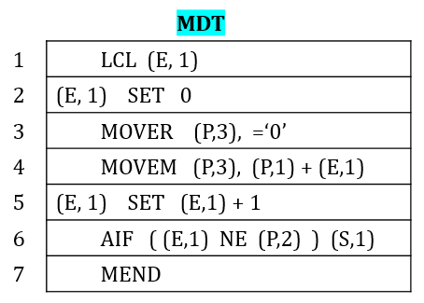
2. Show the expanded assembly language program.
KPDTAB
1 | REG | AREG
SSTAB
1 | 4
OUTPUT
MEC
1
2
3
4
5
6
4
5
6
4
5
6
4
.
.
.
.
.
MACRO EXPANSION
START 500
MOVER CREG, B
+ MOVER AREG, =‘0’
+ MOVEM AREG, AREA + 0
+ MOVEM AREG, AREA + 1
+ MOVEM AREG, AREA + 2
+ MOVEM AREG, AREA + 3
+ MOVEM AREG, AREA + 4
+ MOVEM AREG, AREA + 5
+ MOVEM AREG, AREA + 6
+ MOVEM AREG, AREA + 7
+ MOVEM AREG, AREA + 8
+ MOVEM AREG, AREA + 9
+ MOVEM AREG, AREA + 10
ADD CREG, =‘1’
END
APTAB
1 | AREA
2 | 10
3 | AREG
EVTAB
0
1
2
3
.
.
10

Slide 77
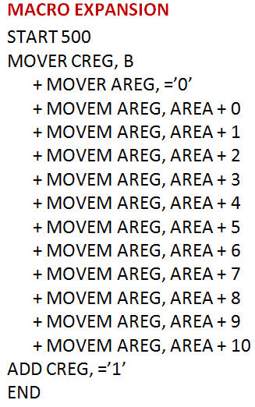
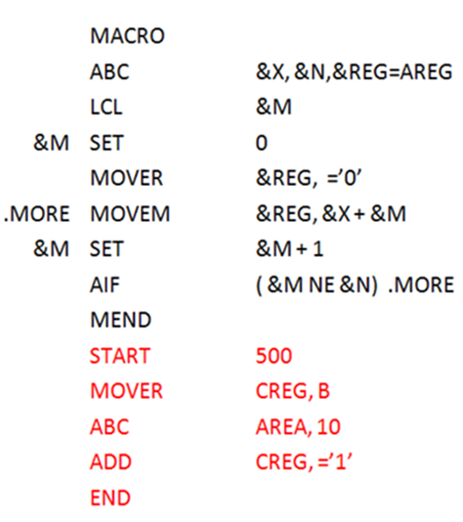
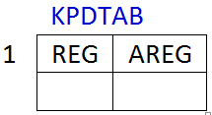
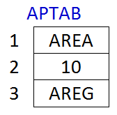

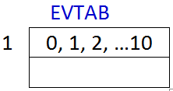
Practice Example 1 - SOLUTION
Show the contents of different tables with output after processing macro definition.
Show the expanded assembly language program.

Slide 78

Practice Questions on Assemblers
Design an algorithm for PASS-2 of a two pass macro processor.
Can macro processing be incorporated in an assembler? Elaborate.
Macro enabled asm program is given as an input to macro processor; what are different data structures involved in its processing before calling a macro. Explain in brief.
Justify the given statement: Data structures constructed during pass II deals with actual parameters and expansion time variables.

Slide 79
Macro preprocessor Phases
Pass 1
Process Macro definition
Analysis Phase
Pass 2
Process Macro call
Synthesis Phase
Process Macro Call
Process Macro definition
Create MDT for model statements
Create PNTAB for all the parameters
Create KPDTAB for keywords parameters
Create SSNTAB for SS
Create SSTAB for SS appearing in the label field
Create EVNTAB when EVs are declared
Create APTAB for actual parameters
Create EVTAB for processing EVs
Set MEC
Process Model statements from MDT
Record the output.

Slide 80
Problem Solving
Nested macros
Macro processing without data structures
Macro definition processing with data structures
Macro call processing with data structures

Slide 81
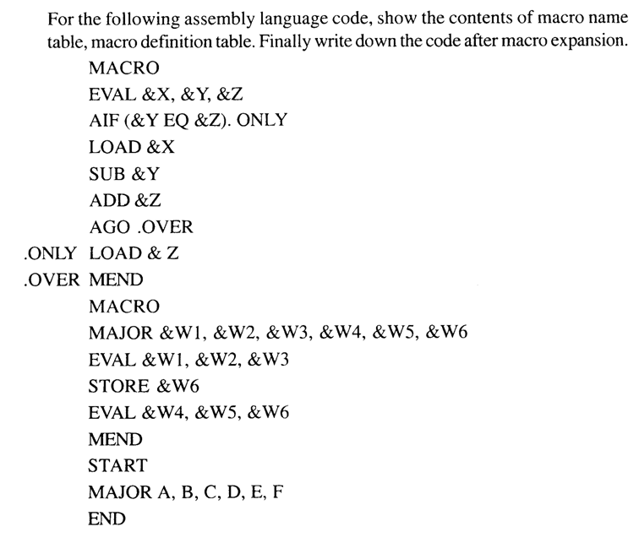
Practice Example # 2
Macro Call within Macro definition

Slide 82
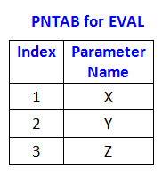
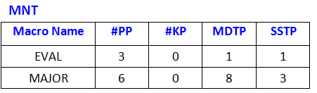
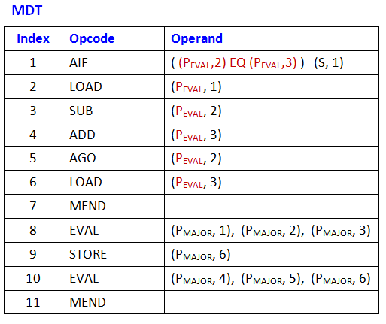
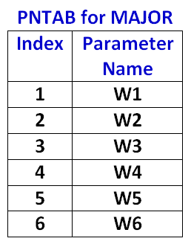
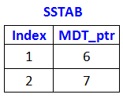
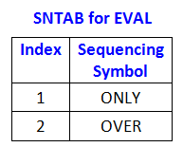

Slide 83
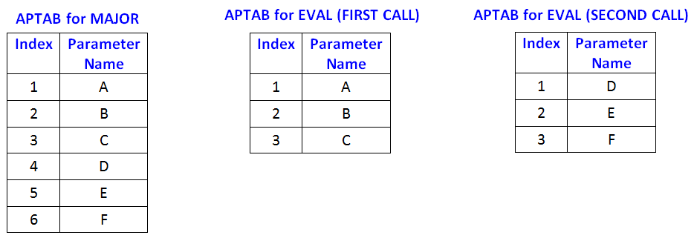
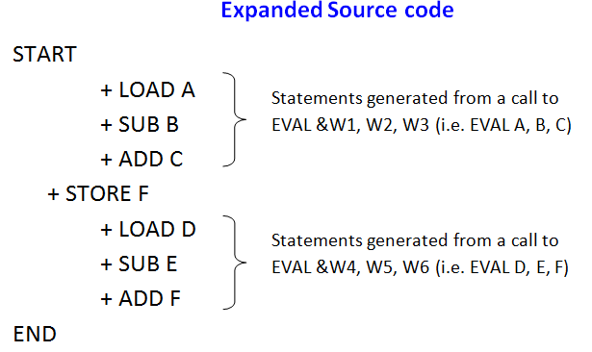

Expanded Source code

Slide 84
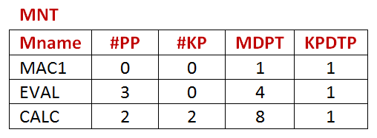
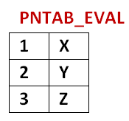
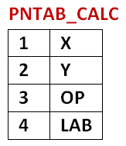
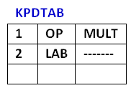
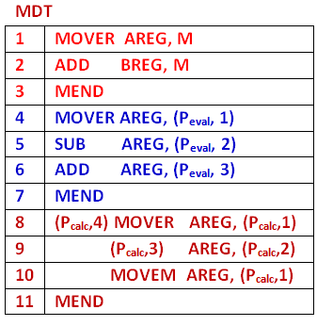
MACRO
MAC1
MOVER AREG, M
ADD BREG, M
MEND
MACRO
EVAL &X, &Y, &Z
MOVER AREG, &X
SUB AREG, &Y
ADD AREG, &Z
MEND
MACRO
CALC &X, &Y, &OP=MULT, &LAB=
&LAB MOVER AREG, &X
&OP AREG, &Y
MOVEM AREG, &X
MEND
START
MOVEM AREG, B
EVAL A, B, C
MOVEM AREG, N
CALC P, Q, LAB=LOOP:
MOVEM AREG, N
MAC1
CALC P,Q,OP=DIV, LAB=NEXT
M, N DS 1
A, B DS 5
P, Q DS 1
END
Practice Example # 3

Slide 85
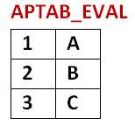
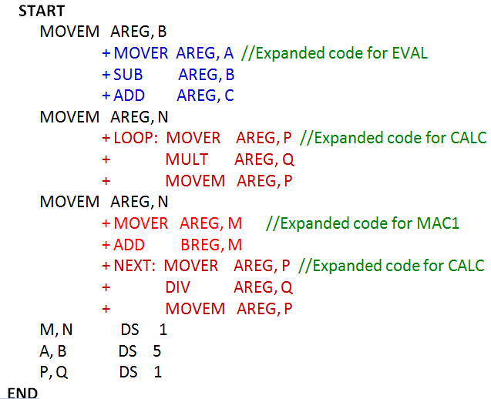

Practice Example # 3
Expanded source code

Slide 86
Macros in nutshell
Macros
Positional and actual parameters
Macro preprocessor
Sequencing Symbols
Assembler preprocessors (AIF, AGO, ANOP)
Processing Macro definition
Processing Macro Call

Slide 87

Components of System Software
Loaders
Linkers

Slide 88
Loaders
Definition of Loader
Different Loader schemes
General loader Scheme
Absolute loaders
Subroutine linkages
Relocating loaders
Direct linking loaders
Overlay structure
Static and dynamic linked libraries

Slide 89

Program Translation hierarchy

Slide 90



Loaders
A loader is a system program, which takes the –
Object code(s) of a program as input and prepares it for execution
It is a part of an Operating System that is responsible for –
Loading Programs and Libraries
Initiating the Execution Process
test.c
gcc –o t test.c
./t
./a.out
Object program
Contains translated instructions and data from the source program.
Specifies addresses in memory where these items are to be loaded.
./ calls the system loader

Slide 91

Loader Functions
Allocation
The loader determines and allocates the required memory space for the program to execute properly.
Linking
Resolve symbolic references between object files.
Combines two or more separate object programs.
Supplies information needed to allow cross-references.
The loader loads the machine instructions and data into the allocated memory space and makes the program ready to execute.
Loading
Adjust all address dependent locations, such as address constants, to correspond to the allocated space.
Relocation
Modifies the object program so that it can be loaded at an address different from the location originally specified.

Slide 92
Loader contd..
“Loader and Linker” may be a single system program
Loader : loading and relocation
Linker : linking
Linking loader
How does Loader gets loaded ?
A bootstrap loader is a computer program residing in EPROM/ROM that loads the main operating system or runtime environment for the computer after completion of self-tests.

Slide 93


Bootstrap loader
The bootstrap begins at address 0.
It loads the OS at address 0x80.
The control is transferred to the instruction at address 80.
Power ON
Load bootstrap loader from ROM to Memory.
Bootstrap loader loads loader from Disk.
Loader loads OS from Disk.
Transfer control from loader to OS.

Slide 94
Loader Example
In Unix, the loader is the handler for the system call exec().
The Unix loader's tasks include:
Validation (permissions, memory requirements etc.)
Copying
Program image from the disk into main memory;
Command-line arguments on the stack
Initializing registers
(e.g., the stack pointer)
Switching to the program entry point (_start).

Slide 95

Loader schemes/types
General Loader Scheme
Absolute Loader
Subroutine Linkage
Relocating Loader
Direct Linking Loader

Slide 96

General Loader Scheme
The source program is converted to object program by some translator.
The loader accepts these assembled machine instructions, data and other information present in the object format and places machine instructions and data in the memory in an executable form.
The reassembly is not necessary to run the program later.

Slide 97

Advantages of General loader scheme
The program need not be retranslated each time while running it.
There is no wastage of memory, as assembler is not placed in the memory.
Instead of assembler, loader occupies some portion of the memory.
Size of loader is smaller than assembler, so more memory is available to the user.
It is possible to write source program / subroutines in several different languages as –
source programs → object programs → loader accepts these object modules to convert it to executable form.

Slide 98

Absolute Loader
Its Operation is very simple – Only Loading; No relocation or linking.
Places absolute code into main memory at the location prescribed by assembler.
The starting address of every module is known, this corresponding starting address is stored in the object file.
Loader places the executable form of the machine instructions at the locations mentioned in the object file.

Slide 99

Absolute Loader
Easy to design and implement as No address manipulation is performed. i.e. No Linking and relocation needed.
Load Module format of object file:
Single pass operation
check H (Header) record to verify that correct program has been presented for loading
read each T (Text) record, and move object code into the indicated address in memory
at E (Execution) record, switch to the specified address to begin execution of the loaded program.

Slide 100



Absolute Loader

Slide 101
Absolute Loader - Disadvantages
Allocation - by programmer
Linking - by programmer
Relocation – by Assembler (loaded where assembler assigned)
Loading - by loader
The programmer must specify to the assembler the address where the program is to be loaded.
If there are multiple subroutines, the programmer must remember the address of each.
The programmer must be careful not to assign two subroutines to the same or overlapping locations.
The MAIN program is assigned to locations 100-247 and the SQRT subroutine 400-477.
If changes were made to MAIN that increased its length to more than 300 bytes
End of the MAIN (100+300 = 400) would overlap the start of SQRT at 400.
Assign SQRT to a new location i.e. changing its START and re-assembling it
Furthermore, it would also be necessary to modify all other subroutines that referred to the address of SQRT.

Slide 102

Subroutines
Easy to design and implement
A subroutine call is when a main routine (or other routine) passes control to another subroutine.
The main routine is the CALLER, and the subroutine is the CALLEE.
A return from a subroutine is when a subroutine passes control back to its CALLER.
When a CALLEE finishes execution it nearly always returns control to its CALLER.

Slide 103
SUBROUTINE LINKAGES
Program A
START 900
_________
_________
_________
CALL B
_________
_________
END
EXTERN B
Subroutine Linkage: Program “A” calls subroutine “B” and subroutine B is NOT written in the program segment of A, rather B is defined in some another program.
While generating the code for B, as B is not defined in the segment A, the assembler cannot find the value of this symbolic reference and hence it will declare it as an error.
B must -be declared as an external routine in A.
EXTERN or EXT Directive.
Subroutine B
START 500
_________
_________
RET
END

Slide 104
SUBROUTINE LINKAGES
Program A
START 900
_________
_________
_________
CALL B
_________
_________
END
EXTERN B
At the beginning of the Program-A the subroutine B is declared as external.
Call to subroutine B → the current content of the program counter is stored in the system stack.
While returning from the subroutine B (at RET) the pop is performed to restore the program counter of caller routine with the address of next instruction to be executed.
Assembler symbols are either internal or external.
External means that their value is not known to the assembler but will be provided by the loader.
Program B
START 500
_________
_________
RET
END

Slide 105
EXTERN & ENTRY
If a symbol is defined in one program and referenced in others;
insert it into a symbol list following the pseudo-opcode ENTRY.
The assembler pseudo-opcode EXTERN followed by a list of symbols indicates that the symbols are defined in other programs but referenced in the present program.
A START
ENTRY B1, B2, B3
EXTERN SQRT
______________
______________
SQRT
B1 ______________
B2 ______________
B3 ______________
END
Defines subroutine A
B1, B2, B3 can be used in other prg.
SQRT is defined in other program

Slide 106

Relocating Loaders
A loader able to load a program into memory wherever there is room for it is called a relocating loader.
Sequence of segments
Segments are loaded into memory one after the other, to use as little space as possible.
Subroutine,
Function,
Main program, Block of global data
The relocatable load format helps to assemble/ compile separate segments at load time.
Global data means only 1 data segment

Slide 107
Relocatable loaders
A relocatable loader
Accepts as input a sequence of segments, each in a special relocatable load format, and
Loads these segments into memory.
The addresses into which segments are loaded are determined by the relocatable loader, not by the assembler or the programmer.
Prevent reassembling of the code every time a subroutine is changed
If any of the segments which are loaded into memory change in size due to recoding and reassembly between the two loads, then the addresses in memory into which the segment is loaded will change by the same amount.
The loader does not facilitate access to data segments that can be shared; Not well suited for loading or storing external data (data located in another procedure segment).

Slide 108
Relocatable loaders
A relocatable loader
Accepts as input a sequence of segments, each in a special relocatable load format, and
Loads these segments into memory.
The addresses into which segments are loaded are determined by the relocatable loader, not by the assembler or the programmer.
Prevent reassembling of the code every time a subroutine is changed
If any of the segments which are loaded into memory change in size due to recoding and reassembly between the two loads, then the addresses in memory into which the segment is loaded will change by the same amount.
The loader does not facilitate access to data segments that can be shared; Not well suited for loading or storing external data (data located in another procedure segment).

Slide 109
Direct Linking Loader - Relocatable Loader
Allows MULTIPLE text segments and MULTIPLE data segments.
The length of object code segment.
Assembler
Loader
A list of external symbols *
A list of Entry symbols **
Information about address constants ***
The machine code translation of the source program
* Symbols not defined in current segment but can be used in the current segment.
** Symbols defined in current segment; can be referred by other segments.
*** Where they are loaded?
How to revise their values.

Slide 110
Disadvantages of Direct Linking
It is necessary to allocate, relocate, link, and load ALL the subroutines each time in order to execute a program
Loading process can be extremely time consuming.
Though smaller than the assembler, the loader absorbs a considerable amount of space
Solution :
Memory overlay or Dynamic loading.

Slide 111
Dynamic Loading
If the total amount of memory required by all subroutines exceeds the available memory.
The module loader loads the procedures as they are needed → Allocating an overlay structure
The Flipper or overlay supervisor is the portion of the loader that intercepts the "calls" and loads the necessary procedure.

Slide 112


After execution, the control is returned
to the loader and to
the user program
Control is passed
to the loaded
Subroutine for execution
User program issues a load-and-call
service request
Loads the called
subroutine into
memory
Next time, if the subroutine is called; it is already loaded.

Slide 113



Overlay Structure - Example
Program consists of 5 modules (A{20k}, B{20k}, C{30k}, D{10k}, and E{20k}) that require 100K bytes of core memory.
Module A only calls B, D and E;
Module B only calls C and E;
Module D only calls E
Module C and E do not call any other routines
Note that modules B and D are never in used the same time; neither are C and E.
100k vs 70k needed
Without Overlay; sequential memory allocation
With Overlay; Load as per need
A
20K
B
20K
C
30K
D
10K
E
20K

Slide 114
Overlay Structure – Example 2 (Assembler program)
Pass 1 – 60 K
Pass 2 – 75 K
Data structures – 20 K
Common routines(display, search) – 35 K
Drivers 10 K
Total - 200 K
200 K vs 125 K OR 140 K
Data Structures | 20 K
Common routines | 35 K
Overlay Drivers (to decide whether to load Pass 1 or 2?) | 10 K
Pass 1 OR Pass 2 | 60 K
 | 75 K
Total (20 + 35 + 10 + 60 = 125 K) OR (20 + 35 + 10 + 75 = 140 K)
Overlay Structure

Slide 115
Linkers (Performs the process of linking)
Linker is a program in a system which helps to link object modules of program into a single object file.
Linkers are also called link editors.
Linking is process of collecting and maintaining piece of code and data into a single file.
for loader
Object Modules
takes
Executables
Assembler
Linker
Linker requires more memory space as it copy all library routines.

Slide 116
LINKING TYPES
STATIC LINKING
It is performed during the compilation of source program. gcc -l
It takes collection of relocatable object file and command-line argument and generate fully linked object file that can be loaded and run.
Static linker perform 2 major tasks:
Symbol Resolution
Relocation
Associates each symbol reference with its definition.
Relocates code and data section and modify symbol references to the relocated memory location.
It is faster; as it does not require the presence of library when it is run.

Slide 117
Linking Types
DYNAMIC LINKING
The loading and linking of external references are POSTPONED until execution OR run time.
The loader loads only the main program.
It requires less memory space as multiple program can share a single copy of the library.
The shared library needed in the linking is stored in virtual memory to save RAM.
In this linking we can also relocate the code for the smooth running of code, but all the code is not relocatable. It fixes the address at run time.
A dynamic link library (DLL) is a collection of small programs that can be loaded when needed by larger programs and used at the same time.

Slide 118
Self Relocating Programs (Capable of being loaded into memory at any address)
A program that relocates its own address-dependent instructions and data when run.
Self-relocation is like the relocation process; the difference is that it is loaded itself rather than the loader in the operating system or shell that performs the relocation.
Examples: Bootloaders, Drivers, Garbage collectors, etc
The self-relocation process may be either static or dynamic.
Static relocation is performed before the program is executed, whereas dynamic relocation is performed during program execution.
Dynamic relocation may first suspend the program execution and perform the relocation or use a relocation register.

Slide 119

Unit 2 – Introduction to Macro Processors
Macro Processors
Processing Macro definition
Processing Macro call
Loaders
General loader
Absolute loader
Relocatable loader
Dynamic loader
Overlay structure
Linkers
Self Relocating Programs

