Slide 1
System Programming and Operating System 17BTIS503
Introduction to Systems Programming
Introduction to Compiler Design
Introduction to Operating System & Process Management
Memory Management
I/O and File Management
Pre-requisite : A very good and strong understanding of the C Programming language (esp. pointers) & Computer Organization
(Prepared By – Jyoti Malhotra; Pranav More; MITSOE,
References- Operating Systems: Internals and Design Principles, Seventh Edition, by William Stallings and Internet resources)

Slide 2

Topics Covered Unit 3 – Kernel, Process, Threads, CPU scheduling
Operating Systems
Kernel
System calls
Process
States
PCB
System calls – fork(), sleep(), wait(), getpid() and getppid()
Threads
ULT and KLT
CPU Scheduling
FCFS
SJF (Non-preemptive and Preemptive)
Round Robin

Slide 3

Introduction to Operating Systems and Process Management
Concurrency
Mutual Exclusion
Deadlock & Starvation
Image courtesy: www.howtogeek.com; windows; Macintosh ; Android; Linux

Slide 4
Concurrency
Concurrency - two or more processes or threads executing at the same time.
Operating systems design is concerned with the management of processes and threads:
Multiprogramming
Multiprocessing
Distributed Processing
Concurrency encompasses a host of design issues
Communication among processes - Semaphores
Sharing of resources (memory, files, and I/O access) – Mutual Exclusion
Synchronization of the activities of multiple processes - Semaphores
Allocation of processor time to processes
Notes:
The central themes of operating system design are all concerned with the management of processes and threads:
• Multiprogramming: The management of multiple processes within a uniprocessor system
• Multiprocessing : The management of multiple processes within a multiprocessor
• Distributed processing: The management of multiple processes executing on multiple, distributed computer systems. The recent proliferation of clusters is a prime example of this type of system.

Slide 5
Concurrency Arises in Three Different Contexts:
Multiple Applications
invented to allow processing time to be shared among active applications
Structured Applications
Applications can be effectively programmed as a concurrent processes
Operating System Structure
OS themselves implemented as a set of processes or threads
Notes:
Concurrency arises in three different contexts:
• Multiple applications: Multiprogramming was invented to allow processing time to be dynamically shared among a number of active applications.
• Structured applications: As an extension of the principles of modular design and structured programming, some applications can be effectively programmed as a set of concurrent processes.
Operating system structure: The same structuring advantages apply to systems programs, and we have seen that operating systems are themselves often implemented as a set of processes or threads.

Slide 6
Concurrency & Shared Data
Concurrent processes may share data to support communication, information exchange, etc.
Threads in the same process can share global address space
Concurrent sharing may cause problems
For example: lost updates
Concurrency is the interleaving of processes in time to give the appearance of simultaneous execution.

Slide 7
Concurrency – Key terms
Atomic Operations | Atomic operation are those operations that finish their tasks i.e. no other interruption is allowed before its completion Isolated from other operations that may be happening at the same time. Atomic operations are critically important when dealing with shared resources.
Critical Section | A code segment that accesses shared variables and must be executed as an atomic action. At any given time; only one process must be executing the critical section Example: printer
Notes:
Atomic operations in concurrent programming are program operations that run completely independently of any other processes. No other interruption is allowed.
Printer, can only be accessed by one process at a time.

Slide 8
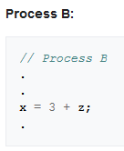
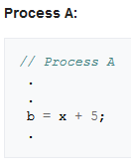
Critical section
Railway Systems; Joint bank accounts
Notes:
If A needs to read the updated value of x, executing Process A and Process B at the same time may not give required results. To prevent this, variable x is protected by a critical section.

Slide 9
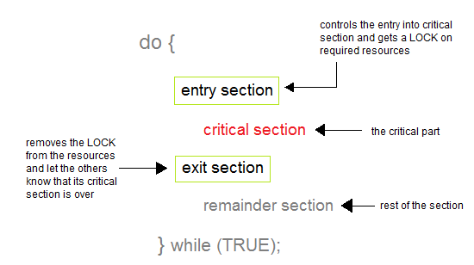
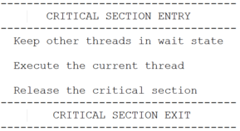
Critical section

Slide 10
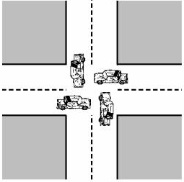
Concurrency – Key terms
Deadlock | A deadlock is a situation in which two processes sharing the same resource are effectively preventing each other from accessing the resource, resulting in both processes ceasing to function.
2 processes - P1 and P2
2 resources - R1 and R2.
Each process needs access to both resources to perform part of its function.
OS assigns R1 to P2, and R2 to P1
i.e. P1 and P2 wait for each other to release the resources

Slide 11
Concurrency – Key terms
Mutual Exclusion | Only one process can be in its critical section at a given point of time. No two process can be in the same CS at the same time.
Race condition | Multiple threads/processes read and write a shared data item and the final result depends on the relative timing of their execution. [TICKET BOOKING]
Starvation | A runnable process is overlooked indefinitely by the scheduler; it is able to proceed; but it is never chosen.

Slide 12
Race condition
The “loser” of the race is the process that updates last and will determine the final value of the variable.
Process P1
A = 1
Process P2
A = 2
B =1
C = 2
If P3 executes first; final values are : b = 3 and c = 5
If P4 executes first; final values are: b = 4 and c = 3
Process P3
B = b + c
Process P4
C = b + c

Slide 13
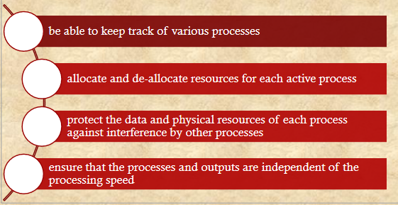
Operating System Concerns
Design & management issues raised by existence of concurrency:
Notes:
What design and management issues are raised by the existence of concurrency?
We can list the following concerns:
1. The OS must be able to keep track of the various processes. This is done with the use of process control blocks and was described in Chapter 4 .
2. The OS must allocate and de-allocate various resources for each active process.
At times, multiple processes want access to the same resource. These resources include
• Processor time: This is the scheduling function, discussed in Part Four.
• Memory: Most operating systems use a virtual memory scheme. The topic is addressed in Part Three.
• Files: Discussed in Chapter 12 .
• I/O devices: Discussed in Chapter 11 .
3. The OS must protect the data and physical resources of each process against
unintended interference by other processes. This involves techniques that relate to memory, files, and I/O devices. A general treatment of protection is found in Chapter 14 .
4. The functioning of a process, and the output it produces, must be independent
of the speed at which its execution is carried out relative to the speed of other
concurrent processes. This is the subject of this chapter.

Slide 14
Resource Competition
Concurrent processes come into conflict when they use the same resource (competitively or shared)
for example: I/O devices, memory, processor time, clock
Three control problems must be faced
Need for mutual exclusion
Mutual exclusion creates additional control problems – Deadlock & Starvation
Notes:
There is no exchange of information between the competing processes. However, the execution of one process may affect the behavior of competing processes. In particular, if two processes both wish access to a single resource, then one process will be allocated that resource by the OS, and the other will have to wait. Therefore, the process that is denied access will be slowed down. In an extreme case, the blocked process may never get access to the resource and hence will never terminate successfully.
In the case of competing processes three control problems must be faced. First is the need for mutual exclusion . Suppose two or more processes require access to a single non-sharable resource, such as a printer. Each process will be sending commands to the I/O device, receiving status information, sending data, and/or receiving data.
We will refer to such a resource as a critical resource , and the portion of the program that uses it as a critical section of the program. It is important that only one program at a time be allowed in its critical section. In the case of the printer, for example, we want any individual process to have control of the printer while it prints an entire file. Otherwise, lines from competing processes will be interleaved.
The enforcement of mutual exclusion creates two additional control problems. Deadlock .
For example, consider two processes, P1 and P2, and two resources, R1 and R2. Suppose that each process needs access to both resources to perform part of its function. Then it is possible to have the following situation: the OS assigns R1 to P2, and R2 to P1. Each process is waiting for one of the two resources. Neither will release the resource that it already owns until it has acquired the other resource and performed the function requiring both resources. The two processes are deadlocked.
A final control problem is starvation . Suppose that three processes (P1, P2, P3) each require periodic access to resource R. Consider the situation in which P1 is in possession of the resource, and both P2 and P3 are delayed, waiting for that resource. When P1 exits its critical section, either P2 or P3 should be allowed access to R. Assume that the OS grants access to P3 and that P1 again requires access before P3 completes its critical section. If the OS grants access to P1 after P3 has finished, and subsequently alternately grants access to P1 and P3, then P2 may indefinitely be denied access to the resource, even though there is no deadlock situation.

Slide 15
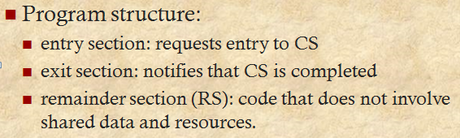
Mutual Exclusion
Mutual Exclusion prevents concurrent execution by processes when they are accessing the shared data/resources i.e. Critical Section (CS).
Enforcing mutual exclusion guarantees that related CS’s will be executed serially instead of concurrently.
Processes/threads must request permission to enter a CS, and signal when they leave CS.
Notes:
The CS problem exists on multiprocessors as well as on uniprocessors.

Slide 16
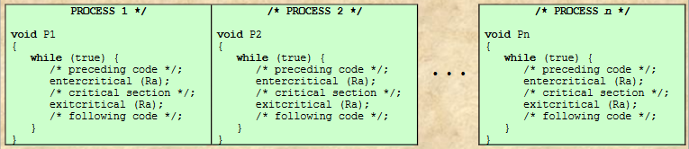
Illustration of Mutual Exclusion
Locking a resource prior to its use.
There are n processes to be executed concurrently.
CS operating on some resource Ra.
2 functions : entercritical (Ra) and exitcritical(Ra)
A process has to wait while another process is its CS
Notes:
Figure illustrates the mutual exclusion mechanism-
There are n processes to be executed concurrently.
Each process includes
(1) a critical section that operates on some resource Ra, and
(2) additional code preceding and following the critical section that does not involve access to Ra.
As all processes access the same resource Ra, it is desired that only one process at a time be in its critical section.
To enforce mutual exclusion, two functions are provided: entercritical and exitcritical.
Each function takes as an argument the name of the resource that is the subject of competition.
Any process that attempts to enter its critical section while another process is in its critical section, for the same resource, is made to wait.

Slide 17
Requirements for Mutual Exclusion
Mutual Exclusion: must be enforced
Non interference: A process that halts must not interfere with other processes.
No deadlock or starvation
Progress: A process must not be denied access to a critical section when there is no other process using it
A process remains inside its critical section for a finite time only.
Notes:
Any facility or capability that is to provide support for mutual exclusion should
meet the following requirements:
1. Mutual exclusion must be enforced: Only one process at a time is allowed into
its critical section, among all processes that have critical sections for the same resource or shared object.
2. A process that halts in its noncritical section must do so without interfering
with other processes.
3. It must not be possible for a process requiring access to a critical section to be
delayed indefinitely: no deadlock or starvation.
4. When no process is in a critical section, any process that requests entry to its
critical section must be permitted to enter without delay.
5. No assumptions are made about relative process speeds or number of processors.
6. A process remains inside its critical section for a finite time only.
There are several ways in which the requirements for mutual exclusion can be satisfied. One approach is to leave the responsibility with the processes that wish to execute concurrently. Processes, whether they are system programs or application programs, would be required to coordinate with one another to enforce mutual exclusion, with no support from the programming language or the OS. We can refer to these as software approaches. Although this approach is prone to high processing overhead and bugs, it is nevertheless useful to examine such approaches to gain a better understanding of the complexity of concurrent processing. This topic is covered in Appendix A . A second approach involves the use of special purpose machine instructions. These have the advantage of reducing overhead but nevertheless will be shown to be unattractive as a general-purpose solution; they are covered in Section 5.2 . A third approach is to provide some level of support within the OS or a programming language. Three of the most important such approaches are examined in Sections 5.3 through 5.5 .

Slide 18
OS & Programming mechanisms for Concurrency
SEMAPHORES
Process synchronization; signaling mechanism proposed by Dijkstra.
Restrict the number of threads that can access a resource.
Example, max 10 connections to access a file simultaneously.
Limit max n connections to the server and kill unwanted entries to free up the memory allocated to the server.
MUTEX
Mutex is a mutual exclusion object that synchronizes access to a resource.
Only one thread to access a resource at once.
Special case of semaphores.
Example, when a client is accessing a file, no one else should have access the same file at the same time.
Semaphores are typically used to coordinate access to resources

Slide 19
Semaphores
An integer value used for signaling among processes.
3 atomic operations (full execution; no partial exit)
Initialize - to a nonnegative integer value
Decrement – Blocking of a process
Increment – Unblocking of a process
2 queues – Ready queue and wait queue
Ready Q – holds the processes scheduled by CPU
Wait Q – holds the blocked processes
Primitive Operations on s
s – Available units of resources
semWait(s) – Decrements the value
semSignal(s) – Increments the value
19
Notes:
19
For signaling, special variables called semaphores are used. To transmit a signal via semaphore s , a process executes the primitive semSignal(s) . To receive a signal via semaphore s , a process executes the primitive semWait(s) ; if the corresponding signal has not yet been transmitted, the process is suspended until the transmission takes place.
To achieve the desired effect, we can view the semaphore as a variable that has an integer value upon which only three operations are defined:
1. A semaphore may be initialized to a nonnegative integer value.
2. The semWait operation decrements the semaphore value. If the value becomes negative, then the process executing the semWait is blocked. Otherwise, the process continues execution.
3. The semSignal operation increments the semaphore value. If the resulting value is less than or equal to zero, then a process blocked by a semWait operation, if any, is unblocked. Other than these three operations, there is no way to inspect or manipulate semaphores.

Slide 20
Program template for n processes & s resources
Process(int id) {
while(True){
semWait(s); //ENTRY
//Critical Section
semSignal(s); //EXIT
}
}
main(){
Process(1);
Process(2);
Process(3);
Process(n);
}
semWait(s) – Wait if resource is not available
semSignal(s) – Signals the finish of existing process and make resource available
20
Notes:
20

Slide 21
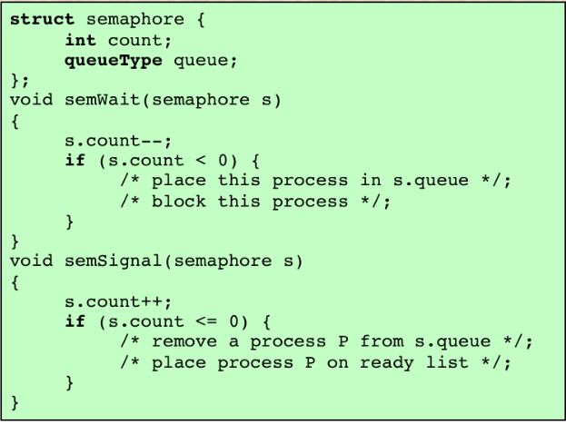
Semaphore Primitives
Notes:
The semWait and semSignal primitives are assumed to be atomic.

Slide 22
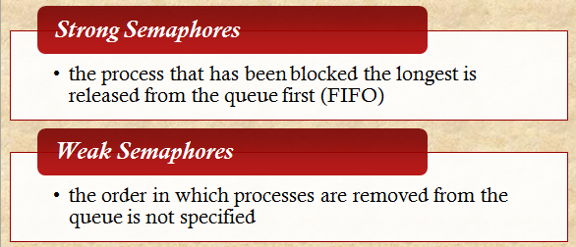
4 Semaphore types
Counting semaphores/General semaphores – s is a nonnegative integer
Binary semaphores – s is either {0,1}
Strong semaphores
Weak semaphores
22
Notes:
22
A queue is used to hold processes waiting on the semaphore.

Slide 23
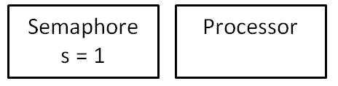
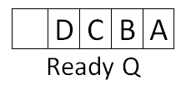
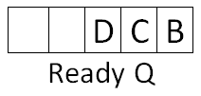
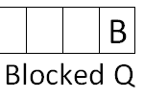

Example of semaphore mechanism
4 Processes and 1 resource i.e. n = 4 and s = 1
semWait(s)
//CS
semSignal(s)
Processor
A
Semaphore
s = s -1 = 0
Processor
B
Semaphore
s = s -1 = -1
23
Notes:
23
Semaphore values:
+ve means Critical Section is empty and Blocked Q is also empty
0 means Critical Section is occupied and Blocked Q is empty
-ve means Critical Section is occupied and Blocked Q has the processes; -3 means 3 processes are blocked in the Q

Slide 24

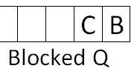


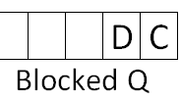
Example of semaphore mechanism
Processor
B
Semaphore
s = s -1 = -1
Processor
C
Semaphore
s = s -1 = -2
Processor
D
Semaphore
s = s -1 = -3
Schedule B
Process A exits CS and give signal on s
Semaphore
s = s +1
= -3+1 = -2
24
Notes:
24

Slide 25
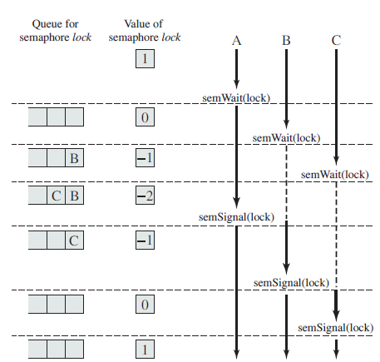
3 Processes
1 resource
i.e. n = 3
s = 1
Notes:
Figure shows a possible sequence for three processes.
In this example three processes (A, B, C) access a shared resource protected by the semaphore lock . Process A executes semWait( lock ) ; because the semaphore has a value of 1 at the time of the semWait operation, A can immediately enter its critical section and the semaphore takes on the value 0. While A is in its critical section, both B and C perform a semWait operation and are blocked pending the availability of the semaphore. When A exits its critical section and performs semSignal( lock ) , B, which was the first process in the queue, can now enter its critical section.

Slide 26
Counting Semaphore
5 processes and 2 available Resources
N = 5
S = 2

Slide 27
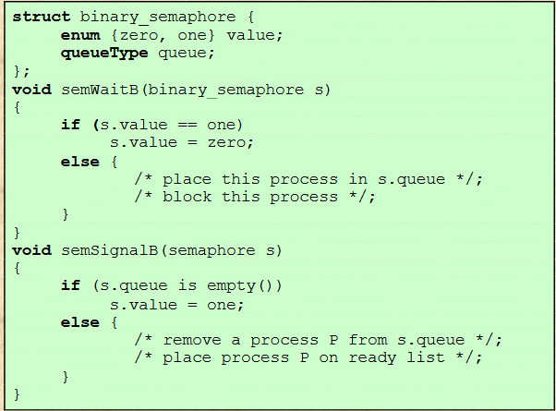
Binary Semaphore - Definition A semaphore that takes only the values 0 & 1
Initialization
s = 1
27
Notes:
27
Semaphore values
1 – Critical section is empty
0 – Critical section is occupied

Slide 28
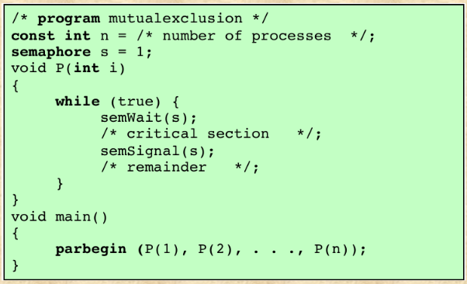
Mutex Similar to Binary semaphore
Key Difference : The process that locks the mutex, must be the once to unlock it.
First process decrements s
i.e. value of s = 0;
Any other process gets blocked setting
the value of s = -1
First process departs Critical section- s is incremented
and one of the blocked process is removed from the Q
28
Notes:
28
The semaphore is initialized to 1.
Thus, the first process that executes a semWait will be able to enter the critical section immediately, setting the value of s to 0. Any other process attempting to enter the critical section will find it busy and will be blocked, setting the value of s to –1.
Any number of processes may attempt entry; each such unsuccessful attempt results in a further decrement of the value of s .
When the process that initially entered its critical section departs, s is incremented and one of the blocked processes (if any) is removed from the queue of blocked processes associated with the semaphore and put in a Ready state.
When it is next scheduled by the OS, it may enter the critical section.

Slide 29
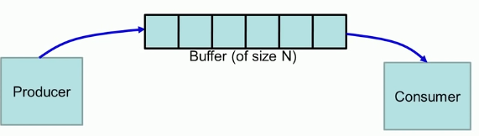
Producer-Consumer Problems
Interprocess communication
Classic example of multi-process synchronization.
Also known as Bounded buffer Problem.
Producer produces and stores in buffer; Consumer consumes from buffer.
Challenges:
Producer produces; but buffer is full
Consumer consumes; but buffer is empty

Slide 30
Producer/Consumer Problem
General Situation:
one or more producers are generating data and placing these in a buffer.
a single consumer is taking items out of the buffer one at time.
only one producer or consumer may access the buffer at any one time.
The Problem:
ensure that the producer can’t add data into full buffer and consumer can’t remove data from an empty buffer.
Notes:
To begin, let us assume that the buffer is infinite and consists of a linear array of elements.
We now examine one of the most common problems faced in concurrent processing: the producer/consumer problem. The general statement is this: There are one or more producers generating some type of data (records, characters) and placing these in a buffer. There is a single consumer that is taking items out of the buffer one at a time. The system is to be constrained to prevent the overlap of buffer operations. That is, only one agent (producer or consumer) may access the buffer at any one time. The problem is to make sure that the producer won’t try to add data into the buffer if it’s full and that the consumer won’t try to remove data from an empty buffer. We will look at a number of solutions to this problem to illustrate both the power and the pitfalls of semaphores.

Slide 31
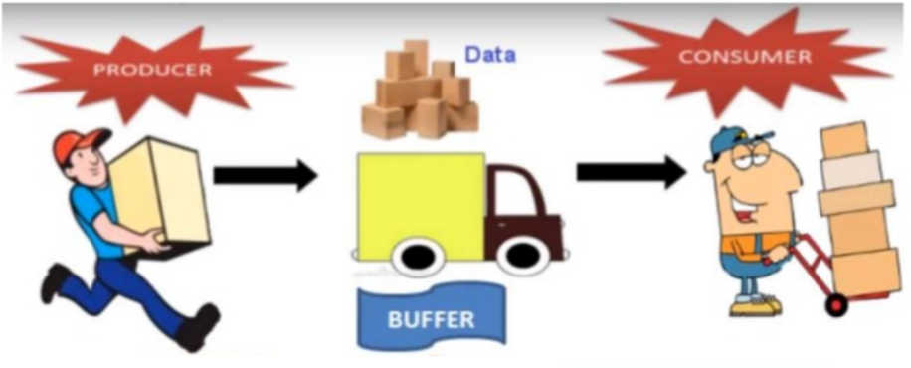
Analogy –semi truck; loading and unloading of items
Producer needs to WAIT if buffer is FULL
Consumer needs to WAIT if buffer is EMPTY

Slide 32
Solution for the Producer-Consumer
Producer wants to load the data; but the buffer is FULL
Go to sleep and wake up when the consumer takes one or more item
Consumer wants to unload the data; but the buffer is EMPTY
Go to sleep and wake up when the producer puts one or more item

Slide 33
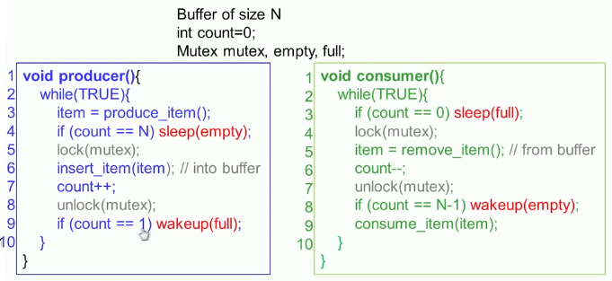
Producer-Consumer Problems (program essence)
Producer sleeps if the buffer is full (i.e. count == N)
Consumer sleeps if the buffer is empty (i.e. count == 0)
Producer wakes if the consumer consumes atleast 1 item
Consumer wakes if the producer produces atleast 1 item

Slide 34


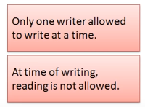

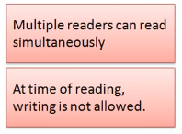
Readers Writers Problem
Classic example of Process Synchronization
Writer will read and modify the data
Reader will only read the data
Notes:
The readers/writers problem is defined as follows:
There is a data shared among a number of process.
The data could be a file, a block of main memory, or a bank of processor registers.
There are a number of processes that only read the data (readers) and a process that only write to the data area(writer).
Conditions:
Any number of readers may simultaneously read the file.
Only one writer at a time writes to the file.
If a writer is writing to the file. No reader may read it.

Slide 35
Readers Writers Problem
A real-world example of the readers-writers problem is an airline reservation system.
Readers: want to read flight information
Writers: want to make flight reservations
Potential problem: if readers and writers can access the shared data simultaneously then readers/writers may view flights as being available when they’ve just been booked
Solution: enforce mutual exclusion
Notes:
The readers/writers problem is defined as follows:
There is a data shared among a number of process.
The data could be a file, a block of main memory, or a bank of processor registers.
There are a number of processes that only read the data (readers) and a process that only write to the data area(writer).
Conditions:
Any number of readers may simultaneously read the file.
Only one writer at a time writes to the file.
If a writer is writing to the file. No reader may read it.

Slide 36

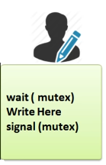
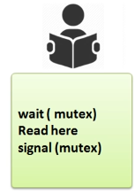
Readers Writers Problem – Solution Give priority to reader and writer
Acquire lock to stop reader from reading;
Acquire lock to stop writer from writing;
WAIT is activated when the process enters the critical region - LOCK
SIGNAL is activated when the process exits the critical region - UNLOCK
This solution allow only one reader or one writer to access the shared resources.
Notes:
At the time of writing; no reading is allowed
If a reader is reading the file; other readers are allowed to read

Slide 37
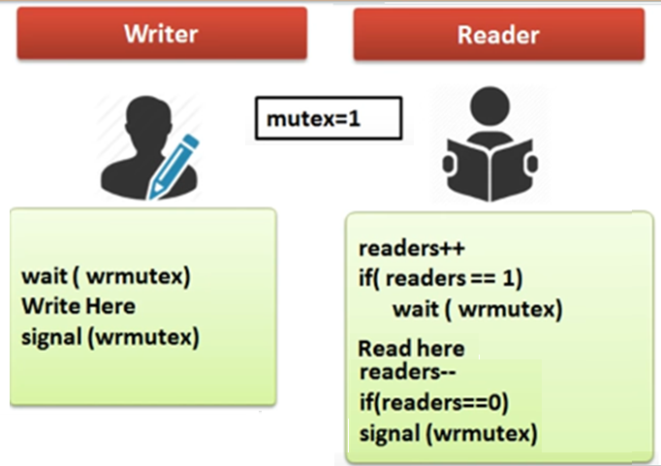
Readers/Writers – Solution 2 give priority to readers over writers
Acquire lock to stop writer from writing;
If a writer wants to write to the resource, it must wait until there are no readers currently accessing that resource.
Problem - Multiple readers may try to access the value of variable (readers) at same time – race condition
Notes:
If reader is the first reader; acquire the lock
Last reader; release the lock
From the above problem statement, it is evident that readers have higher priority than writer. If a writer wants to write to the resource, it must wait until there are no readers currently accessing that resource.

Slide 38
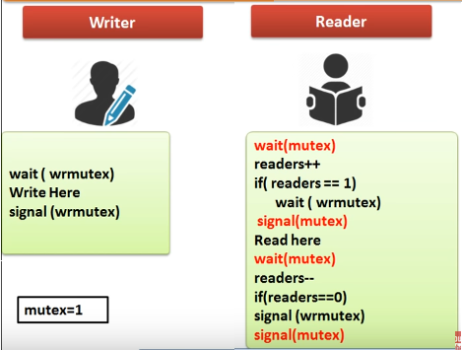
Readers/Writers – Solution 2b
Acquire lock for increase or decrease the variable readers.
Another lock to stop writer from writing;
Release the lock on readers variable for other readers.
Notes:
One more semaphore variable

Slide 39
Readers-Writers Problem (Cont.)
The structure of a writer process
do { wait(wr_mutex);
... /* writing is performed */
...
signal(wr_mutex);
} while (true);

Slide 40
Readers-Writers Problem (Cont.)
The structure of a reader process
do { wait(mutex); readers++; if (readers == 1)
wait(wr_mutex);
signal(mutex);
... /* reading is performed */
...
wait(mutex); readers --; if (readers == 0)
signal(wr_mutex);
signal(mutex);
} while (true);

Slide 41
Solution 3: Give priority to writers over readers
As soon as a writer arrives, any readers that are reading, can finish their task, but all additional readers are put on hold until the writer has finished its task –
Problem: results in starvation of readers if there is a continuous stream of writers

Slide 42
Combination priority policy
An attempt to avoid starvation problems.
Solution:
When a writer has finished writing, all readers who are waiting can read
When this group of readers have finished reading, a writer on hold can begin to write
Any new readers that arrive in the meantime are not allowed to start reading until the writer has finished

Slide 43
Deadlock & Starvation
Permanent blocking of a set of processes
Deadlock Prevention
Deadlock Avoidance
Deadlock Detection
Dining Philosophers problem

Slide 44
System Model
System consists of resources
Resource types R₁, R₂, . . ., R_{m}
CPU cycles, memory space, I/O devices
Each resource type R_{i} has W_{i} instances.
Each process utilizes a resource as follows:
Request a resource
Use the resource
Release the resource
Each process needing what another process has.

Slide 45
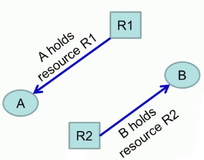
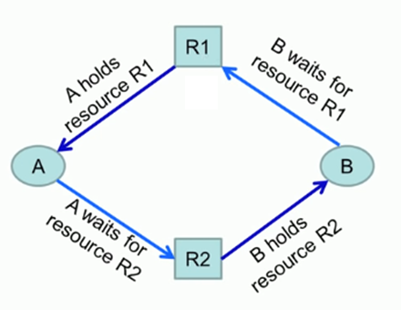
Deadlock
R₁ is a file
R₂ is a printer
DEADLOCK - State in the system; where each process is waiting for an event that only another process in the set can cause/release.
Notes:
Infinite waiting time

Slide 46
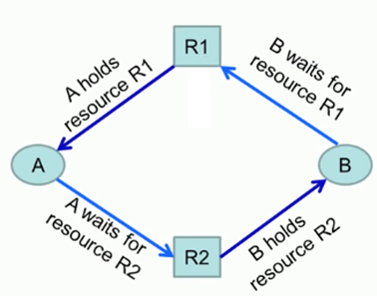
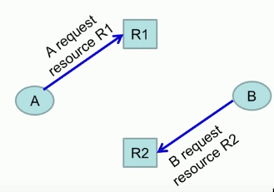
Resource allocation graph(s)
It is a Directed graph.
Used to model resource allocations.
request edge – directed edge P_{i} → R_{j}
assignment edge – directed edge R_{j} → P_{i}
Types of resources – Reusable resources & Consumable resources.
Notes:
A reusable resource is one that can be safely used by one process at a time and is not depleted by that use.
A Consumable resource is one that can be created and destroyed – (Producer-Consumer) Example- interrupts, messages, signals, and messages in the I/O buffer

Slide 47
Resource-Allocation Graph (Cont.)
Process
Resource Type with 4 instances
P_{i} requests instance of R_{j}
P_{i} is holding an instance of R_{j}
P_{i}
R_{j}
P_{i}
R_{j}

Slide 48
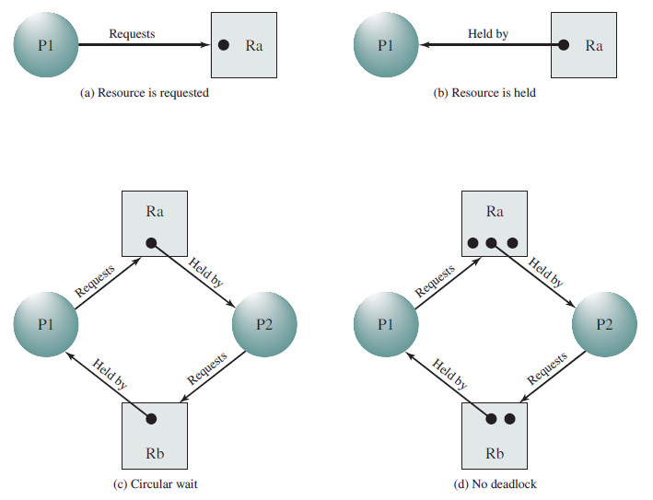
Resource allocation graphs-examples

Slide 49
Basic Facts
If graph contains no cycles ⇒ no deadlock
If graph contains a cycle ⇒
if only one instance per resource type, then DEADLOCK
if several instances per resource type, possibility of deadlock

Slide 50
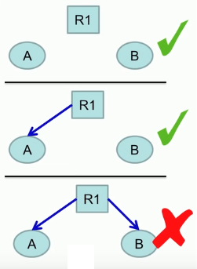

Conditions for deadlock
Deadlock can arise if ALL four conditions happen simultaneously.
Mutual Exclusion, Hold and wait, No preemption, circular wait
1. Mutual Exclusion
Each resource is either available or currently assigned to exactly one process.
i.e. only one process may use a resource at a time.
Needed to ensure consistency of results and integrity of data.

Slide 51

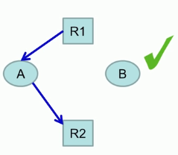
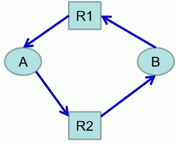
Conditions for deadlock
2. Hold and wait
A process holding at least one resource; is waiting to acquire additional resources held by other processes.
3. No Preemption
The process voluntarily release a resource, after completing its task.
4. Circular Wait
In a set {P₀, P₁, …, P_{n}} of processes; P₀ is waiting for a resource held by P₁, P₁ is waiting for a resource held by P₂, …, P_{n-1} is waiting for P_{n}, and P_{n} is waiting for a resource held by P₀.
Notes:
There is a probability that Deadlock can occur;
Deadlock is a chanced event based on ordering of requests and OS parameters

Slide 52
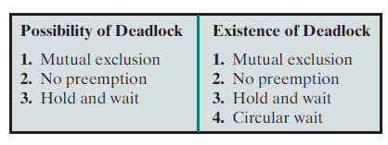
Deadlock conditions
4 conditions
Mutual exclusion
Hold and wait
No preemption
Circular wait

Slide 53
Methods for Handling Deadlocks
3 methods:
Ignore deadlocks
Ensure that the system will never enter a deadlock state
Deadlock prevention - Prevent any one of the 4 conditions from happening
Deadlock avoidance
Allow deadlock to happen
Detection - Know a deadlock has occurred
Recovery - Regain the resources

Slide 54
Methods for handling deadlocks
Deadlock prevention
DISALLOW 1 of the 4 necessary conditions of deadlock occurrence
Deadlock avoidance
DO NOT GRANT a resource request if this allocation might lead to deadlock
Deadlock detection
ALWAYS GRANT RESOURCE request when possible. But periodically check for the presence of deadlock and then recover from it

Slide 55
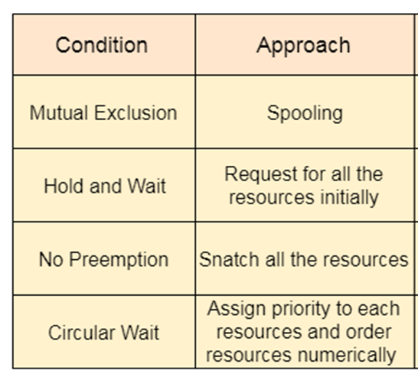
Deadlock Prevention

Slide 56
Deadlock Prevention
Do not allow one of the four conditions to occur.
2 Classes –
Indirect method – (ME, HW, NP)
Direct method – CW (Circular wait)
1. Mutual Exclusion
Not required for sharable resources (e.g., read-only files);
Required for non-sharable resources.
Automatically holds for printers and other non-sharables.
Notes:
Aim – To design a system in such a way that the possibility of deadlock is excluded.

Slide 57
Deadlock Prevention
No preemption
P1
2. Hold and Wait
Collect all resources before execution.
Must guarantee that whenever a process requests a resource, it does not hold any other resources
Low resource utilization; starvation possible
R₄
R₁
R₂
R₄ cannot be immediately allocated; then RELEASE R₁, R₂, R₃
R₃
3. No Preemption
If a process that is holding some resources requests another resource that cannot be immediately allocated to it, then all resources currently being held are released.
The state of this resource must be saved for later resumption.
Practical only when the state of a resource can be easily saved and restored later, such as the processor.
Notes:
Hold and Wait – must guarantee that whenever a process requests a resource, it does not hold any other resources
Require process to request and be allocated all its resources before it begins execution, or allow process to request resources only when the process has none allocated to it.
Low resource utilization; starvation possible

Slide 58
Deadlock Prevention
2. Hold and Wait
Collect all resources before execution.
Must guarantee that whenever a process requests a resource, it does not hold any other resources
Low resource utilization; starvation possible
3. No Preemption
If a process that is holding some resources requests another resource that cannot be immediately allocated to it, then all resources currently being held are released.
The state of this resource must be saved for later resumption.
Practical only when the state of a resource can be easily saved and restored later, such as the processor.
Notes:
Hold and Wait – must guarantee that whenever a process requests a resource, it does not hold any other resources
Require process to request and be allocated all its resources before it begins execution, or allow process to request resources only when the process has none allocated to it.
Low resource utilization; starvation possible

Slide 59
Deadlock Prevention
4. Circular Wait – Direct Method
Avoid circular wait
Number all resources in the linear ordering
To require them; processes request resources only in strictly increasing ( or decreasing ) order.
In other words, in order to request resource Rj, a process must first release all Ri such that i >= j.
One big challenge in this scheme is determining the relative ordering of the different resources.

Slide 60
Deadlock Avoidance
The request for any resource will be granted if the resulting state of the system doesn't cause deadlock.
Each process declare the maximum number of resources of each type that it may need.
Dynamically examines the resource-allocation state to ensure that there can never be a circular-wait condition.
When a process requests an available resource, system must decide if immediate allocation leaves the system in a safe state?
A state is safe if the system can allocate all resources requested by all processes without entering a deadlock state.
Notes:
Approach - Do not start a process if it’s demand might lead to deadlock
Resource-allocation state is defined by the number of available and allocated resources, and the maximum demands of the processes.
SAFE STATE:
A state is safe if the system can allocate all resources requested by all processes without entering a deadlock state.
More formally, a state is safe if there exists a safe sequence of processes { P0, P1, P2, ..., PN } such that all of the resource requests for P3 can be granted using the resources currently allocated to P3 and all processes Pj where j < 3. ( I.e. if all the processes prior to P3 finish and free up their resources, then P3 will be able to finish also)

Slide 61
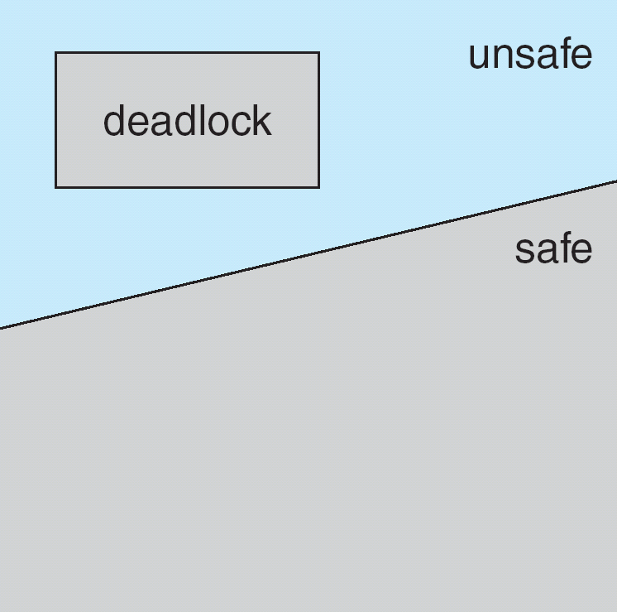
Deadlock Avoidance
If a system is in SAFE state ⇒ no deadlocks
If a system is in UNSAFE state ⇒ possibility of deadlock
AVOIDANCE ⇒ ensure that a system will never enter an unsafe state.
safe sequence of processes { P₀, P₁, P₂, ..., P_{N} }
Resource requests of P3 can be granted using - the resources allocated to P3 and all Pj (j<3)

Slide 62
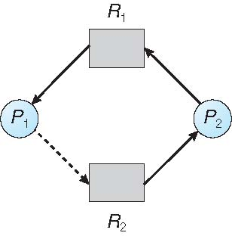
Avoidance Algorithms
Single instance of a resource type
Use a resource-allocation graph
Now if P2 request need resource R1 ,even if it is available will not be allocated to P2 as it allocated to P1.
P1 should release R1 then only will be allocated to P2
Multiple instances of a resource type
Use the banker’s algorithm

Slide 63
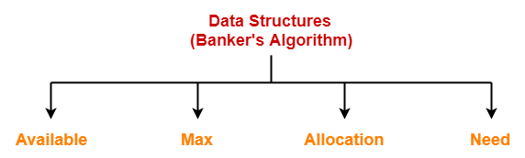
Banker’s Deadlock avoidance algorithm
A resource-request algorithm used to determine if a particular state is safe - If there exists a sequence of processes without deadlock:
Multiple instances of the resources are available.
Each process must a priori claim maximum use.
When a process requests a resource it may have to WAIT.
When a process gets all its resources it must RETURN them in a finite amount of time.

Slide 64
Banker’s Algorithm - Data Structures
Let n = number of processes, and m = number of resources types.
Available: A vector of length m indicates the number of available resources of each type.
available [j] = k, there are k instances of resource type R_{j} available
Max: n x m matrix. If Max [i,j] = k, then process P_{i} may request at most k instances of resource type R_{j}
Allocation: n x m matrix defines the number of resources of each type currently allocated to each process.
Allocation[i,j] = k then P_{i} is currently allocated k instances of R_{j}
Need/Request: n x m matrix. If Need[i,j] = k, then P_{i} may need/request k more instances of R_{j} to complete its task.
Need [i,j] = Max[i,j] – Allocation [i,j]

Slide 65
Safety Algorithm
1. Let Finish be vectors of length n. Initialize:
Finish [i] = false for i = 0, 1, …, n- 1
2. Find an i such that both:
(a) Finish [i] = false
(b) Need_{i} ≤ Available
If no such i exists, go to step 4
3. Available = Available + Allocation_{i} Finish[i] = true go to step 2
4. If Finish [i] == true for all i, then the system is in a safe state

Slide 66
Resource-Request Algorithm for Process P_{i}
If Need_{i} ≤ Available, go to step 2. Otherwise P_{i} must wait, since resources are not available
Allocate requested resources to P_{i}
Once P_{i} terminates update Available matrix by adding the resource instances released by P_{i}
Available = Available + Allocation_{i};
If P_{i} is still in the execution then
Available = Available - Need_{i};

Slide 67
Example of Banker’s Algorithm
5 processes P₁ through P₅;
3 resources: A (10 instances), B (5instances), and C (7 instances)
Snapshot at time T₀:
Process | Allocation |  |  | Max
 | A | B | C | A | B | C
p₁ | 0 | 1 | 0 | 7 | 5 | 3
P₂ | 2 | 0 | 0 | 3 | 2 | 2
P₃ | 3 | 0 | 2 | 9 | 0 | 2
P₄ | 2 | 1 | 1 | 4 | 2 | 2
P₅ | 0 | 0 | 2 | 5 | 3 | 3
Total - Allocation
Σ=7
Available
A | B | C
3 | 3 | 2
10-7

Slide 68
Step 2: Calculate Need matrix
Available
A | B | C
3 | 3 | 2
Need = Max – Allocation
Process | Allocation |  |  | Max |  |  | Need
 | A | B | C | A | B | C | A | B | C
p₁ | 0 | 1 | 0 | 7 | 5 | 3 | 7 | 4 | 3
P₂ | 2 | 0 | 0 | 3 | 2 | 2 | 1 | 2 | 2
P₃ | 3 | 0 | 2 | 9 | 0 | 2 | 6 | 0 | 0
P₄ | 2 | 1 | 1 | 4 | 2 | 2 | 2 | 1 | 1
P₅ | 0 | 0 | 2 | 5 | 3 | 3 | 5 | 3 | 1
Need (P₁) ≤ (3,3,2)? (i.e. (7,4,3) ≤ (3,3,2) ⇒ false – WAIT (add P1 to Q)
Need (P₂) ≤ (3,3,2)? (i.e. (1,2,2) ≤ (3,3,2)⇒ true – ADD <P2> to safe seq
Update Allocation matrix for P2 and Available matrix
Safe sequence - <P2>

Slide 69
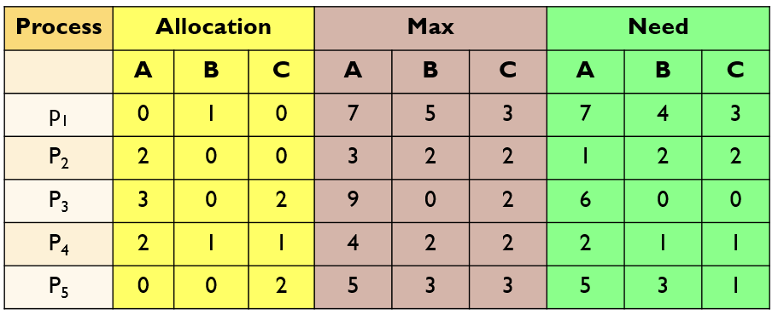
Available
A | B | C
3 | 3 | 2
Safe sequence-
<P2>
Need (P₁) ≤ (3,3,2)? (i.e. (7,4,3) ≤ (3,3,2) ⇒ false – WAIT (add P1 to Q)
Need (P₂) ≤ (3,3,2)? (i.e. (1,2,2) ≤ (3,3,2)⇒ true – ADD <P2> to safe seq
Allocate the required resources to P₂ i.e.
[Current Allocation + Need]
Available
A | B | C
2 | 1 | 0
 | Allocation
P2 | 3 | 2 | 2
Update Available matrix:
[Current avl – need]

Slide 70
Available
A | B | C
3 | 3 | 2
Safe sequence-
<P2>
Need (P₁) ≤ (3,3,2)? (i.e. (7,4,3) ≤ (3,3,2) ⇒ false – WAIT (add P1 to Q)
Need (P₂) ≤ (3,3,2)? (i.e. (1,2,2) ≤ (3,3,2)⇒ true – ADD <P2> to safe seq
Allocate the required resources to P2 i.e.
Assume that process P2 is over and releases the resources.
Update available matrix:
[Current avl + released resources]
 | Allocation
P2 | 3 | 2 | 2
Available
A | B | C
2 | 1 | 0
5 | 3 | 2
Now, Available = (3,3,2) + (2,0,0) = (5,3,2)

Slide 71
Q
Available
A | B | C
3 | 3 | 2
Available
A | B | C
5 | 3 | 2
P₁
Process | Allocation |  |  | Max |  |  | Need
 | A | B | C | A | B | C | A | B | C
p₁ | 0 | 1 | 0 | 7 | 5 | 3 | 7 | 4 | 3
P₂ | 2 | 0 | 0 | 3 | 2 | 2 | 1 | 2 | 2
P₃ | 3 | 0 | 2 | 9 | 0 | 2 | 6 | 0 | 0
P₄ | 2 | 1 | 1 | 4 | 2 | 2 | 2 | 1 | 1
P₅ | 0 | 0 | 2 | 5 | 3 | 3 | 5 | 3 | 1
Need (P₁) ≤ (3,3,2)? (i.e. (7,4,3) ≤ (3,3,2) ⇒ false – WAIT (add P1 to Q)
Need (P₂) ≤ (3,3,2)? (i.e. (1,2,2) ≤ (3,3,2)⇒ true – ADD <P2> to safe seq
Now, Available = (3,3,2) + (2,0,0) = (5,3,2)
Next, check for P3, P4, P5, P1, and so on
Safe sequence-
<P2, P4, P5, P1, P3>

Slide 72
Deadlock Detection
If a system does not employ either a deadlock-prevention or a deadlock-avoidance algorithm, then a deadlock situation may occur.
An algorithm that examines the state of the system to determine whether a deadlock has occurred?
Single instance
Multiple instance
An algorithm to recover from the deadlock

Slide 73
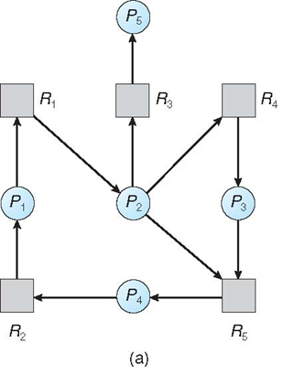
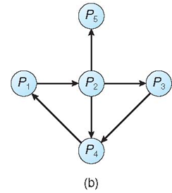
Single Instance of Each Resource Type
Maintain wait-for graph
Nodes are processes
P_{i} → P_{j} if P_{i} is waiting for P_{j}
Periodically invoke an algorithm that searches for a cycle in the graph. If there is a cycle, there exists a deadlock
Resource allocation
graph
wait-for graph
Notes:
An algorithm to detect a cycle in a graph requires an order of n² operations, where n is the number of vertices in the graph

Slide 74
Example of Detection Algorithm
5 processes P₀ through P₄;
3 resources: A (7 instances), B (2 instances), and C (6 instances)
Snapshot at time T₀:
Process | Allocation |  |  | Need
 | A | B | C | A | B | C
p₁ | 0 | 1 | 0 | 0 | 0 | 0
P₂ | 2 | 0 | 0 | 2 | 0 | 2
P₃ | 3 | 0 | 3 | 0 | 0 | 0
P₄ | 2 | 1 | 1 | 1 | 0 | 0
P₅ | 0 | 0 | 2 | 0 | 0 | 2
Available
A | B | C
0 | 0 | 0
Sequence <P₁, P₃, P₄, P₂, P₅> will result in Finish[i] = true for all i

Slide 75
Example (Cont.)
P₃ requests an additional instance of type C
Request
A B C
P₁ 0 0 0
P₂ 2 0 2
P₃ 0 0 1
P₄ 1 0 0
P₅ 0 0 2
State of system?
UNSAFE

Slide 76
Recovery from Deadlock: Process Termination
Abort all deadlocked processes.
Abort one process at a time until the deadlock cycle is eliminated.
In which order should we choose to kill the process?
Priority of the process
How long process has computed, and how much longer to completion
Resources the process has used
Resources process needs to complete
How many processes will need to be terminated-dependency
Is process interactive or batch?

Slide 77
Recovery from Deadlock: Resource Preemption
Selecting a victim – minimize cost
Rollback – return to some safe state, restart process for that state
Starvation – same process may always be picked as victim, include number of rollback in cost factor.
Notes:
Starvation. How do we ensure that starvation will not occur? That is,how can we guarantee that resources will not always be preempted fromthe same process?In a system where victim selection is based primarily on cost factors,it may happen that the same process is always picked as a victim. Asa result, this process never completes its designated task, a starvationsituation any practical system must address. Clearly, we must ensurethat a process can be picked as a victim only a (small) finite number oftimes. The most common solution is to include the number of rollbacksin the cost factor.

Slide 78
Dining Philosopher Problem
The dining-philosophers problem is considered a classic synchronization problem.
Large class of concurrency control problem.
It is a simple representation of the need to allocate several resources among several processes in a deadlock-free and starvation-free manner.

Slide 79
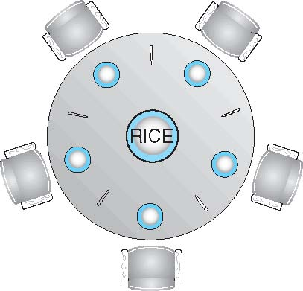
Dining-Philosophers Problem
Philosophers alternatively think & eat.
They do not interact with their neighbors, occasionally try to pick up 2 chopsticks (one at a time) to eat from bowl.
Need both to eat, then release both when done
In the case of 5 philosophers, the shared data:
Bowl of rice (data set)
Semaphore chopstick [5] initialized to 1

Slide 80
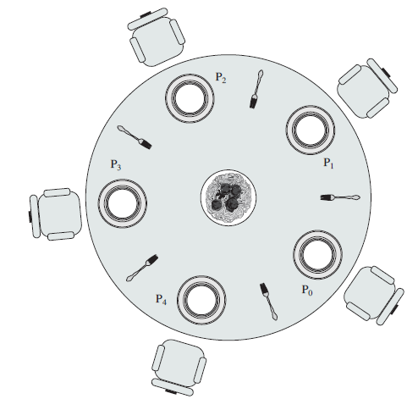
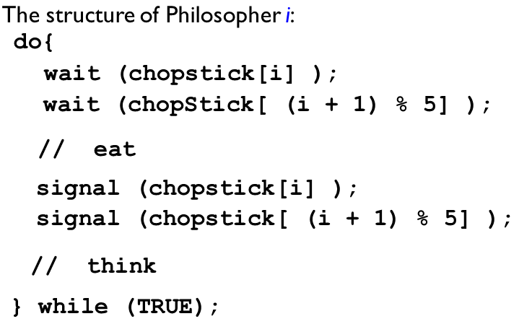
DP using semaphores
5 plates for 5 users/process
5 forks

Slide 81
Dining-Philosophers Problem Algorithm (Cont.)
This solution guarantees that no two neighbors are eating simultaneously.
Possibility of a deadlock. Suppose that all five philosophers become hungry at the same time and each grabs the left chopstick.
Solution:
Allow at most 4 philosophers to be sitting simultaneously at the table.
Allow a philosopher to pick up the forks only if both are available (picking must be done in a critical section.
Use an asymmetric solution -- an odd-numbered philosopher picks up first the left chopstick and then the right chopstick. Even-numbered philosopher picks up first the right chopstick and then the left chopstick.

Slide 82

Unit 3 – Introduction to Operating System & Process Management
Concurrency
Mutual exclusion, critical section, race condition, deadlock
Process synchronization
Semaphores – Counting semaphores, Binary Semaphores
Mutex
Producer consumer problem
Reader writer problem and the solutions
Readers can access database when no writers
Writers can access database when no readers
Deadlock prevention; avoidance; detection; recovery

