Slide 1
Discrete and Continuous Random Variables

Slide 2
Random Variables
Random variable is a real valued function which assign a real number to each sample point in the sample space..
Ex- Suppose we toss two coin together then a sample space for this event will be (HH,HT,TH,TT). Here the random variable in the no. of heads(0,1,2)
OUTCOME | HH | HT | TH
VALUE | 2 | 1 | 1
TT
0

Slide 3
Distribution function Distribution function, mathematical expression that describes the probability that a system will take on a specific value or set of values.
X | 0 | 1 | 2
P(X) | 1/4 | 1/2 | 1/4

Slide 4
Discrete Random Variable
A variable which can assume only a countable number of real values and for which the value for which variable takes depends on a chance, is called a discrete random variable.
Example-
no. of accidents
No. of phone calls in a day
No. of defects

Slide 5
Probability Mass Function
A probability function relating to a discrete random variable is called probability mass function.
PMF is a function that provides probabilities for the value in the range of a discrete random variable.

Slide 6
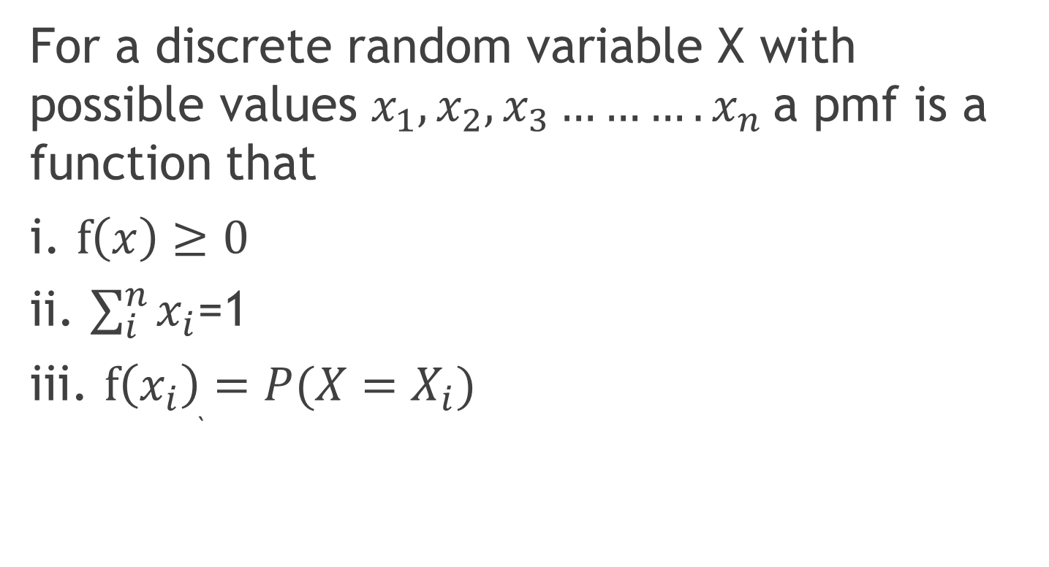
Cont…
For a discrete random variable X with possible values $x_{1},x_{2},x_{3}……….x_{n}$a pmf is a function that
i. $f\left(x\right)≥0$
ii. $\sum_{i}^{n}{x_{i}}$=1
iii. $f\left(x_{i}\right)=P(X=X_{i})$ `

Slide 7
Cont…
Example- A coin is tossed twice of random variable X is no. of heads.
Tabulate PMF
What is the probability of getting two heads?
Solution-

Slide 8
Continuous Random Variable
A random variable which can take no. of values in an interval is known as continuous random variable.
Example-
Height/weight of an individual
financial ratios
Income levels
Interest rates

Slide 9
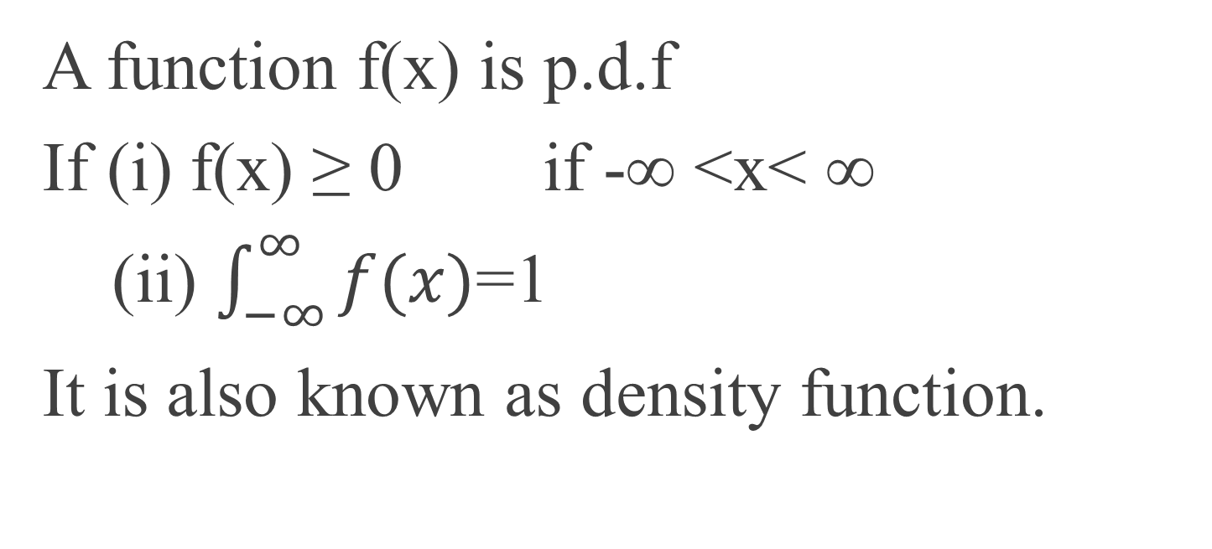
Probability Density function
A function f(x) is p.d.f
If (i) f(x) ≥ 0 if -∞ <x< ∞
(ii) $\int_{−∞}^{∞}{f(x)}$=1
It is also known as density function.

Slide 10

Example-
If X is a continuous random variable with following p.d.f
$$f\left(x\right)=\left\{\begin{aligned}α\left(2x−x^{2}\right) 0<x<2 \\ 0 otherwise\end{aligned}\right.$$
Find α
P(X>1)

Slide 12


