Slide 1

Probability and Queueing Theory
Prof. Akshika Rastogi

Slide 2
Syllabus

Slide 4

Books

Slide 5
Probability
introduction

Slide 6
Conti..
.

Slide 7
.
.

Slide 8
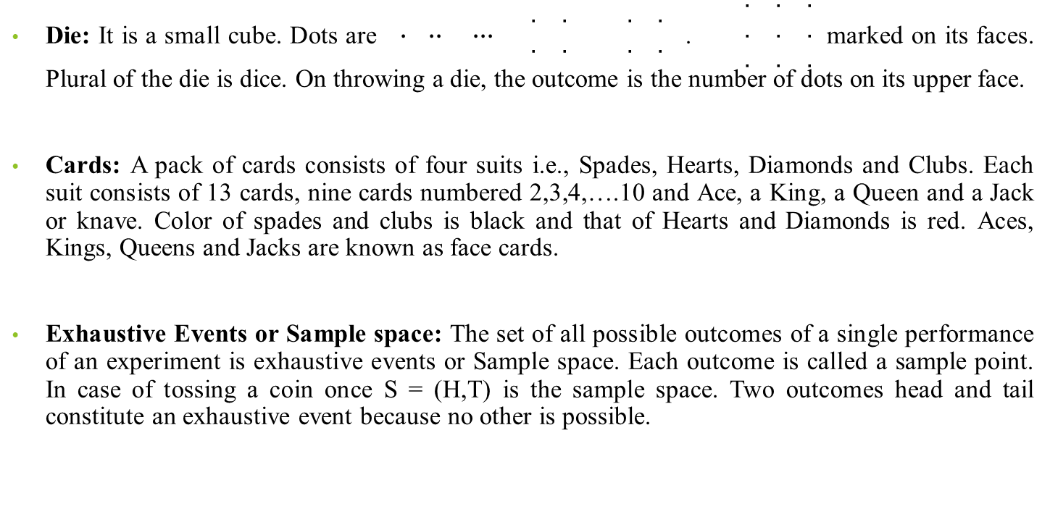
Terminology
Die: It is a small cube. Dots are $∙$ $∙∙$ $∙∙∙$ $\begin{matrix}. & . \\ . & .\end{matrix}$ $\begin{matrix}. & . \\ . & .\end{matrix}$ . $\begin{matrix}. & . & . \\ . & . & . \\ . & . & .\end{matrix}$ marked on its faces. Plural of the die is dice. On throwing a die, the outcome is the number of dots on its upper face.
Cards: A pack of cards consists of four suits i.e., Spades, Hearts, Diamonds and Clubs. Each suit consists of 13 cards, nine cards numbered 2,3,4,….10 and Ace, a King, a Queen and a Jack or knave. Color of spades and clubs is black and that of Hearts and Diamonds is red. Aces, Kings, Queens and Jacks are known as face cards.
Exhaustive Events or Sample space: The set of all possible outcomes of a single performance of an experiment is exhaustive events or Sample space. Each outcome is called a sample point. In case of tossing a coin once S = (H,T) is the sample space. Two outcomes head and tail constitute an exhaustive event because no other is possible.

Slide 9
Experiments: Students of science and engineering are familiar with experiments which when performed repeatedly under the same conditions given identical results. In theory of probability, our interest is centered around the kind of experiment, which though repeated under essentially identical conditions, does not give unique results but may result in any one of the several possible outcomes, such an experiment is also called a trial and the outcome an event or a case. For example, the throw of a coin is an experiment or a trial which can result in one of the two outcomes a Head or Tail. Drawing a card from a well shuffled pack is a trial which may result in any one of 52 outcomes.
Random Experiment: There are experiments, in which results may be altogether different, even though they are performed under identical conditions. They are known as random experiments. Tossing a coin or throwing a die is random experiment.
Trial and Events: Performing a random experiment is called a trial and outcome is termed as event. Tossing of a coin is a trial and the turning up of head or tail is an event.

Slide 10
Equally Likely Events: Two events are said to be ‘equally likely’ if one of them cannot be expected in preference to the other. For instance, if we draw a card from well shuffled pack, we may get any card, then the 52 different cases are equally likely.
Independent Events: Two, Events may be independent when the actual happening of one does not influence in any way the probability of the happening of the other.
Example: The Event of getting head on first coin and the event of getting tail on the second coin in a simultaneous throw of two coins are independent.
Mutually Exclusive Events: Two Events are known as mutually exclusive, when the occurrence of one of them excludes the occurrence of the other. For example, on tossing of a coin, either we get head or tail, but not both.
Compound Events: When two or more events occur in composition with each other the simultaneous occurrence is called a compound event. When two dice are thrown, getting a 5 or 6 is a compound event.

Slide 11
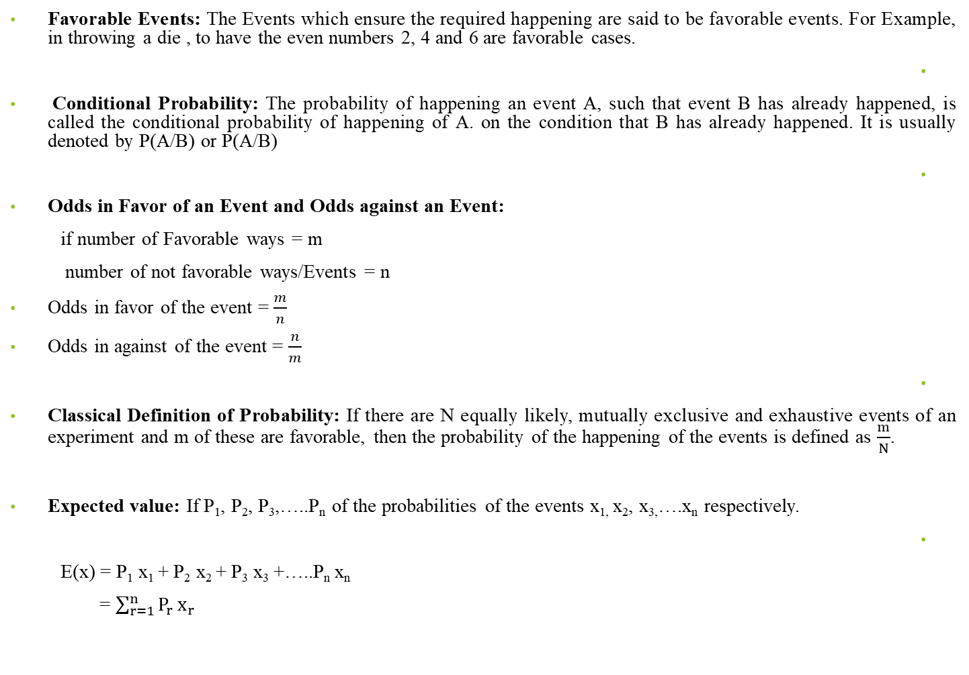
Favorable Events: The Events which ensure the required happening are said to be favorable events. For Example, in throwing a die , to have the even numbers 2, 4 and 6 are favorable cases.
Conditional Probability: The probability of happening an event A, such that event B has already happened, is called the conditional probability of happening of A. on the condition that B has already happened. It is usually denoted by P(A/B) or P(A/B)
Odds in Favor of an Event and Odds against an Event:
if number of Favorable ways = m
number of not favorable ways/Events = n
Odds in favor of the event = $\frac{m}{n}$
Odds in against of the event = $\frac{n}{m}$
Classical Definition of Probability: If there are N equally likely, mutually exclusive and exhaustive events of an experiment and m of these are favorable, then the probability of the happening of the events is defined as $\frac{m}{N}$.
Expected value: If P₁, P₂, P₃,…..P_{n} of the probabilities of the events x_{1,} x₂, x_{3,}….x_{n} respectively.
E(x) = P₁ x₁ + P₂ x₂ + P₃ x₃ +…..P_{n} x_{n}
= $\sum_{r=1}^{n}{P_{r}}x_{r}$

Slide 12
Q1. Find the probability of throwing
(a) 5 (b) An even number with an ordinary six faced die

Slide 13
Q.2. Find the probability of throwing 9 with two dice.

Slide 14
Q.3. From a pack of 52 cards, one is drawn at random. Find the probability of getting a king.

Slide 15
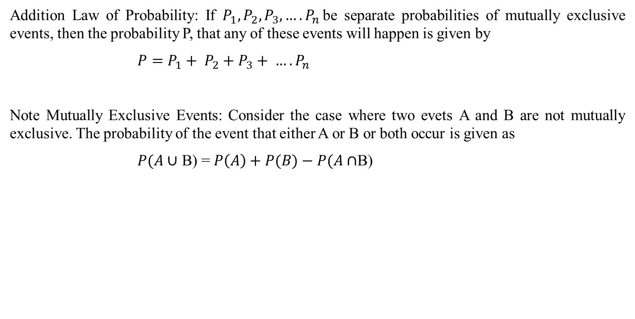
Addition Law of Probability: If $P_{1}, P_{2},P_{3}, ….P_{n}$be separate probabilities of mutually exclusive events, then the probability P, that any of these events will happen is given by
${P=P}_{1}+ P_{2}+P_{3}+ ….P_{n}$
Note Mutually Exclusive Events: Consider the case where two evets A and B are not mutually exclusive. The probability of the event that either A or B or both occur is given as
$P(A∪$ B) = $P\left(A\right)+P(B)−P(A∩$B)

Slide 16
Q.4. An bag contains 10 black and 10 white balls. Find the probability of drawing two balls of the same color.

Slide 17
Q.5. A bag contains four white and two black balls and a second bag contains three of each color. A bag is selected at random, and a ball is then drawn at random from the bag chosen. What is the probability that the ball drawn is white?

Slide 18


