Slide 1
Formulating Problem Structure
III. Constraint Satisfaction Problems and Plannings

Slide 2
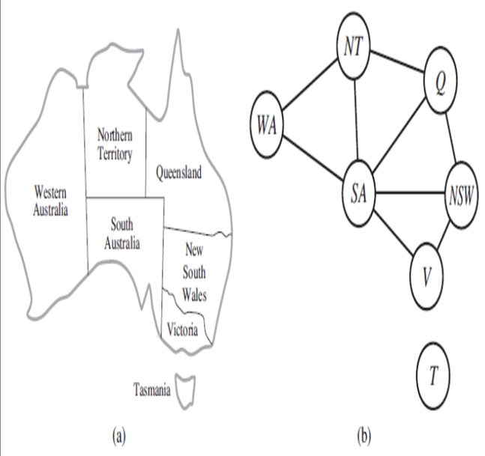
the structure of the problem, as represented by the constraint graph, can be used to find solutions quickly.
The only way we can possibly hope to deal with the real world is to decompose it into many subproblems.
Eg. Australia map coloring problem
one fact stands out: Tasmania is not connected to the mainland. => coloring Tasmania and coloring the mainland are independent subproblems
any solution for the mainland combined with any solution for Tasmania yields a solution for the whole map
Independence can be ascertained simply by finding connected components of the constraint graph
Each component corresponds to a subproblem CSPi.
If assignment Si is a solution of CSPi, then Si is a solution of i CSPi.

Slide 3
Why is this important?
suppose each CSP_{i} has c variables from the total of n variables, where c is a constant. Then there are n/c subproblems, each of which takes at most d^{c} work to solve, Hence, the total work is O(d^{c}n/c), which is linear in n; without the decomposition, the total work is O(d^{n}), which is exponential in n.
Let's make this more concrete:
dividing a Boolean CSP with n = 80 into four subproblems with c = 20 reduces the worst-case solution time from the lifetime of the universe down to less than a second.
Completely independent subproblems are delicious
the subproblems of a CSP are connected.
any tree-structured CSP can be solved in time linear in the number of variables.

Slide 4
The algorithm has the following steps:
Choose any variable as the root of the tree, and order the variables from the root to the leaves in such a way that every node's parent in the tree precedes it in the ordering.
Label the variables X₁, . . . , X_{n} in order.
Now, every variable except the root has exactly one parent variable.
For j from n down to 2, apply arc consistency to the arc (X_{i}, X_{j}), where X_{i} is the parent of X_{j}, removing values from DOMAIN[X_{i}] as necessary.
For j from 1 to n, assign any value for Xj consistent with the value assigned for Xi, where Xi is the parent of Xj.
Key Points:
after step 2 the CSP is directionally arc-consistent, so the assignment of values in step 3 requires no backtracking.
by applying the arc-consistency checks in reverse order in step 2, the algorithm ensures that any deleted values cannot endanger the consistency of arcs that have been processed already.
The complete algorithm runs in time O(nd²).
Now that we have an efficient algorithm for trees, constraint graphs can be reduced to trees somehow. By,
based on removing nodes -> assigning values to some variables so that the remaining variables form a tree.
based on collapsing nodes together

Slide 5
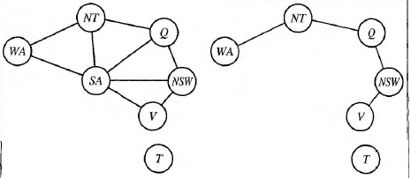
based on removing nodes -> assigning values to some variables so that the remaining variables form a tree.
delete South Australia, the graph would become a tree
by fixing a value for SA and deleting from the domains of the other variables any values that are inconsistent with the value chosen for SA.
any solution after SA and its constraints are removed will be consistent with the value chosen for SA.
complicated with higher-order constraints.) Therefore, we can solve the remaining tree with
the algorithm given above and thus solve the whole problem.
the value chosen for SA could be the wrong one, so we would need to try each of them. The general algorithm is as follows:
Choose a subset S from VARIABLES[CSp] such that the constraint graph becomes a tree after removal of S. S is called a cycle cutset.
For each possible assignment to the variables in S that satisfies all constraints on S,
(a) remove from the domains of the remaining variables any values that are inconsistent with the assignment for S, and
(b) If the remaining CSP has a solution, return it together with the assignment for S.
If the cycle cutset has size c, then the total runtime is O(d^{C} . (n - c)d²)

Slide 6
Based on constructing a tree decomposition of the constraint graph into a set of connected subproblems.
Each subproblem is solved independently, and the resulting solutions are then combined.
A tree decomposition must satisfy the following three requirements:
Every variable in the original problem appears in at least one of the subproblems.
If two variables are connected by a constraint in the original problem, they must appear together (along with the constraint) in at least one of the subproblems.
If a variable appears in two subproblems in the tree, it must appear in every subproblem along the path connecting those subproblems.
First, each subproblem as a "mega-variable" whose domain is the set of all solutions
a map-coloring problem with three variables and hence has six solutions-one is { WA = red, SA = blue, NT = green).
Then, we solve the constraints connecting the subproblems using the efficient algorithm for trees given earlier.
The constraints between subproblems simply insist that the subproblem solutions agree on their shared variables. For example, given the solution { WA = red, SA = blue, NT = greeen) for the first subproblem, the only consistent solution for the next subproblem is {SA I= blue, NT = green, Q = red).
A given constraint graph admits many tree decompositions; in choosing a decomposition, the aim is to make the subproblems as small as possible.
The tree width is one less than the size of the largest subproblem; the tree width of the graph itself is defined to be the minimum tree width among all its tree decompositions.
If a graph has tree width w, and we are given the corresponding tree decomposition, then the
problem can be solved in O(nd^{W+1})time.
Hence, CSPs with constraint graphs of bounded tree width are solvable in polynomial time. Unfortunately, finding the decomposition with minimal tree width is NP-hard, but there are heuristic methods that work well in practice.

