Slide 1
KNOWLEDGE AND REASONING
UNIT IV
Artificial Intelligence

Slide 2
Learnt:
The technology for knowledge-based agents: Syntax, Semantics and proof theory of propositional and first-order logic, implementation of agents that use these logics
Human beings are good at understanding, reasoning and interpreting knowledge. And using this knowledge, they are able to perform various actions in the real world. But how do machines perform the same? We will learn about Knowledge Representation in AI and how it helps the machines perform reasoning and interpretation using Artificial Intelligence in the following sequence:
What is Knowledge Representation?
Different Types of Knowledge
Cycle of Knowledge Representation
What is the relation between Knowledge & Intelligence?
Techniques of Knowledge Representation
Representation Requirements
Approaches to Knowledge Representation with Example
Knowledge Representation

Slide 3
Knowledge Representation in AI describes the representation of knowledge.
It is a study of how the beliefs, intentions, and judgments of an intelligent agent can be expressed suitably for automated reasoning.
One of the primary purposes of Knowledge Representation includes modeling intelligent behavior for an agent.
Knowledge Representation and Reasoning (KR, KRR) represents information from the real world for a computer to understand and then utilize this knowledge to solve complex real-life problems like communicating with human beings in natural language.
Knowledge representation in AI is not just about storing data in a database, it allows a machine to learn from that knowledge and behave intelligently like a human being.
The different kinds of knowledge that need to be represented in AI include:
Objects
Events
Performance
Facts
Meta-Knowledge
Knowledge-base
Knowledge Representation
Definition

Slide 4
Declarative Knowledge – It includes concepts, facts, and objects and expressed in a declarative sentence.
Structural Knowledge – It is a basic problem-solving knowledge that describes the relationship between concepts and objects.
Procedural Knowledge – This is responsible for knowing how to do something and includes rules, strategies, procedures, etc.
Meta Knowledge – Meta Knowledge defines knowledge about other types of Knowledge.
Heuristic Knowledge – This represents some expert knowledge in the field or subject.
Types Knowledge

Slide 5
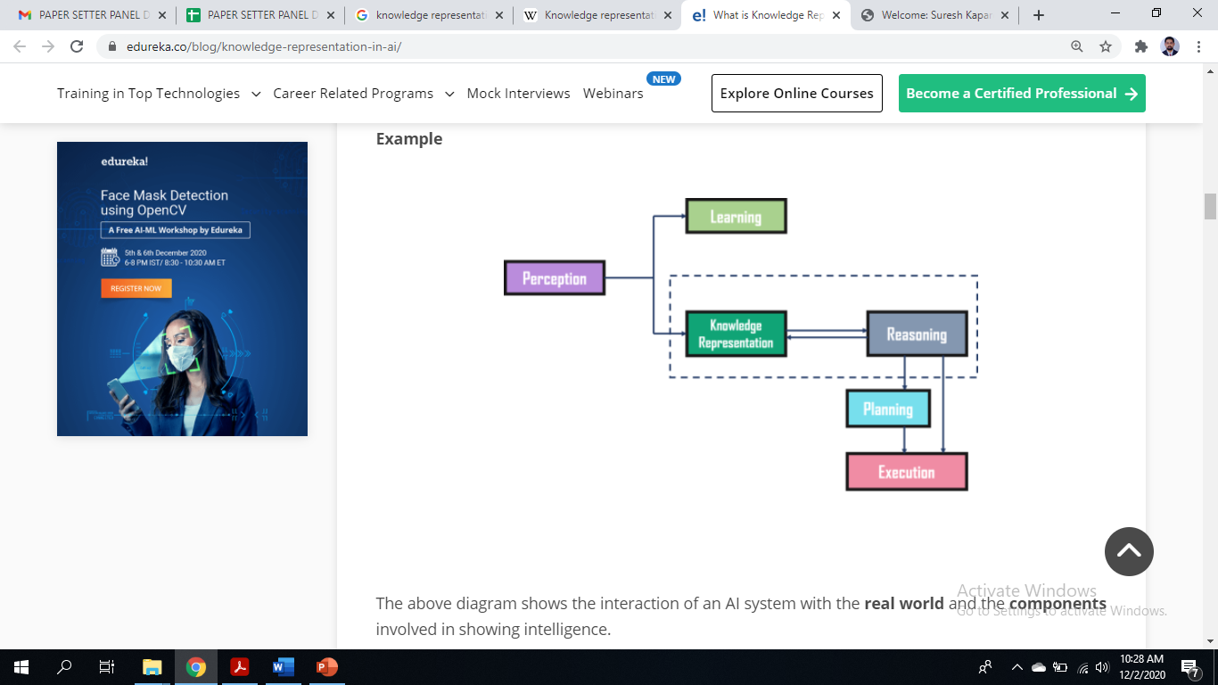
Perception
Learning
Knowledge Representation & Reasoning
Planning
Execution
Cycle of Knowledge Representation in AI
interaction of an AI system with the real world and the components involved in showing intelligence

Slide 6
The Perception component retrieves data or information from the environment. with the help of this component, you can retrieve data from the environment, find out the source of noises and check if the AI was damaged by anything. Also, it defines how to respond when any sense has been detected.
Learning Component that learns from the captured data by the perception component. The goal is to build computers that can be taught instead of programming them. Learning focuses on the process of self-improvement. In order to learn new things, the system requires knowledge acquisition, inference, acquisition of heuristics, faster searches, etc.
Components of Cycle of Knowledge Representation
Knowledge Representation and Reasoning which shows the human-like intelligence in the machines. Knowledge representation is all about understanding intelligence. Instead of trying to understand or build brains from the bottom up, its goal is to understand and build intelligent behavior from the top-down and focus on what an agent needs to know in order to behave intelligently. Also, it defines how automated reasoning procedures can make this knowledge available as needed.
Planning and Execution components depend on the analysis of knowledge representation and reasoning. Here, planning includes giving an initial state, finding their preconditions and effects, and a sequence of actions to achieve a state in which a particular goal holds. Now once the planning is completed, the final stage is the execution of the entire process.

Slide 7
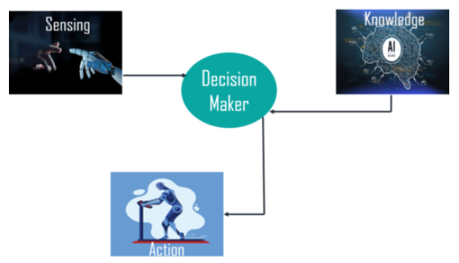
In the real world, knowledge plays a vital role in intelligence as well as creating artificial intelligence. It demonstrates the intelligent behavior in AI agents or systems. It is possible for an agent or system to act accurately on some input only when it has the knowledge or experience about the input.
Relation between Knowledge & Intelligence
Decision-maker whose actions are justified by sensing the environment and using knowledge. But, if we remove the knowledge part here, it will not be able to display any intelligent behavior.

Slide 8
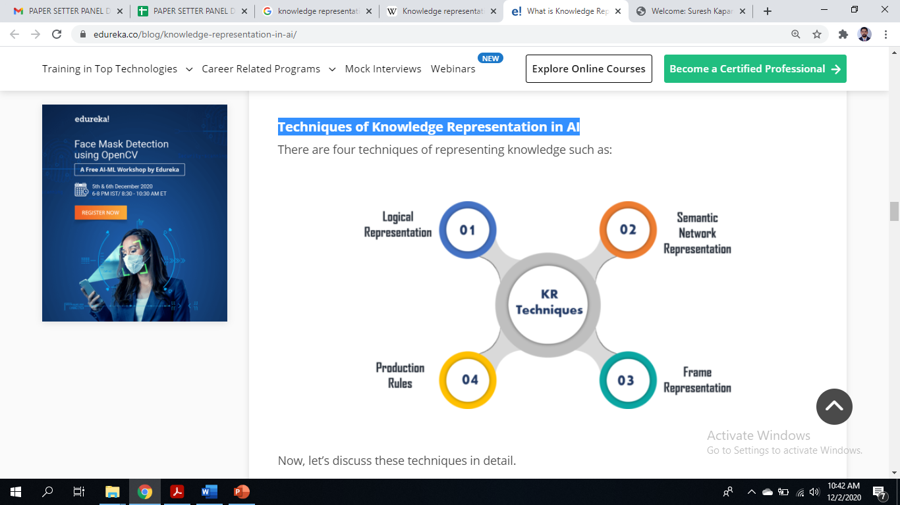
Techniques of Knowledge Representation in AI

Slide 9
Logical Representation
A language with some definite rules which deal with propositions and has no ambiguity in representation. It represents a conclusion based on various conditions and lays down some important communication rules. Consists of precisely defined syntax and semantics. Each sentence can be translated into logics using syntax and semantics.
Techniques of Knowledge Representation in AI
Advantages:
Logical representation helps to perform logical reasoning.
This representation is the basis for the programming languages.
Disadvantages:
Logical representations have some restrictions and are challenging to work with.
This technique may not be very natural, and inference may not be very efficient.

Slide 10
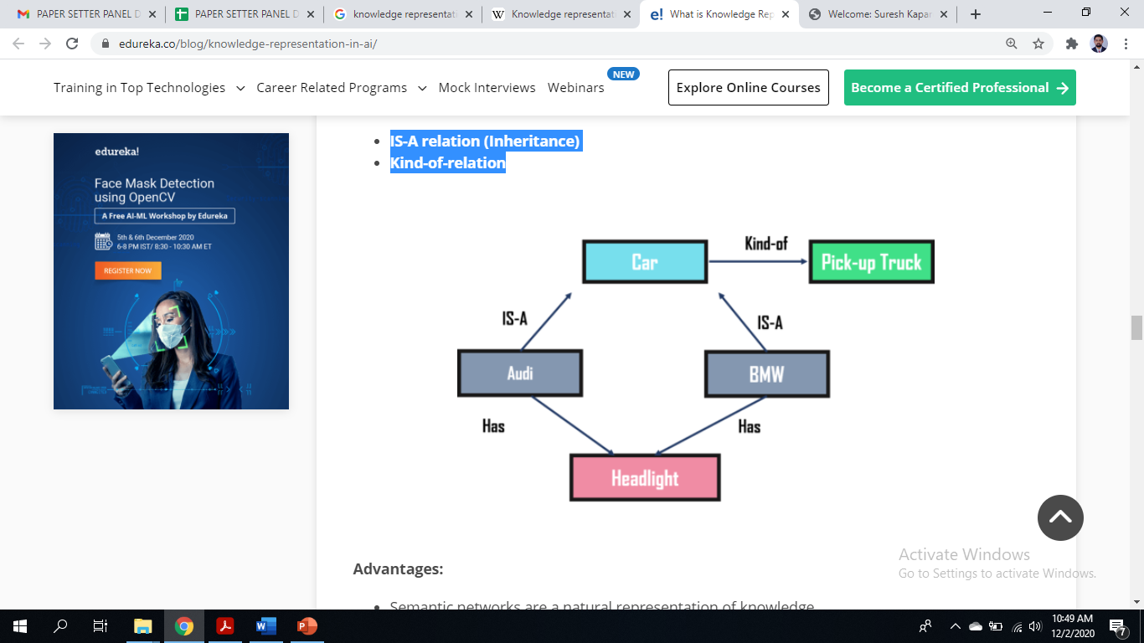
Semantic Network Representation
Semantic networks work as an alternative of predicate logic for knowledge representation. In Semantic networks, you can represent your knowledge in the form of graphical networks. This network consists of nodes representing objects and arcs which describe the relationship between those objects. Also, it categorizes the object in different forms and links those objects.
This representation consist of two types of relations:
IS-A relation (Inheritance)
Kind-of-relation
Techniques of Knowledge Representation in AI
Advantages:
Semantic networks are a natural representation of knowledge.
Also, it conveys meaning in a transparent manner.
These networks are simple and easy to understand.
Disadvantages:
Semantic networks take more computational time at runtime.
Also, these are inadequate as they do not have any equivalent quantifiers.
These networks are not intelligent and depend on the creator of the system.

Slide 11
Frame Representation
A frame is a record like structure that consists of a collection of attributes and values to describe an entity in the world. These are the AI data structure that divides knowledge into substructures by representing stereotypes situations. Basically, it consists of a collection of slots and slot values of any type and size. Slots have names and values which are called facets.
Advantages:
It makes the programming easier by grouping the related data.
Frame representation is easy to understand and visualize.
It is very easy to add slots for new attributes and relations.
Also, it is easy to include default data and search for missing values.
Disadvantages:
In frame system inference, the mechanism cannot be easily processed.
The inference mechanism cannot be smoothly proceeded by frame representation.
It has a very generalized approach.
Techniques of Knowledge Representation in AI

Slide 12
Production Rules
In production rules, agent checks for the condition and if the condition exists then production rule fires and corresponding action is carried out. The condition part of the rule determines which rule may be applied to a problem. Whereas, the action part carries out the associated problem-solving steps. This complete process is called a recognize-act cycle.
The production rules system consists of three main parts:
The set of production rules
Working Memory
The recognize-act-cycle
Advantages:
The production rules are expressed in natural language.
The production rules are highly modular and can be easily removed or modified.
Disadvantages:
It does not exhibit any learning capabilities and does not store the result of the problem for future uses.
During the execution of the program, many rules may be active. Thus, rule-based production systems are inefficient.
So, these were the important techniques for Knowledge Representation in AI. Now, let’s have a look at the requirements for these representations.
Techniques of Knowledge Representation in AI

Slide 13
Representational Accuracy: It should represent all kinds of required knowledge
Inferential Adequacy: It should be able to manipulate the representational structures to produce new knowledge corresponding to the existing structure.
Inferential Efficiency: The ability to direct the inferential knowledge mechanism into the most productive directions by storing appropriate guides.
Acquisitional efficiency: The ability to acquire new knowledge easily using automatic methods
Representation Requirements
A good knowledge representation system must have above properties

Slide 14
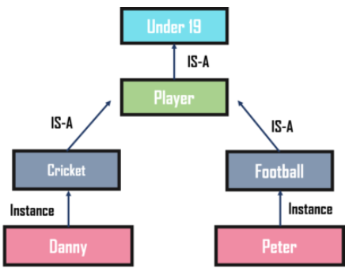
Simple Relational Knowledge
It is the simplest way of storing facts which uses the relational method. Here, all the facts about a set of the object are set out systematically in columns. Also, this approach of knowledge representation is famous in database systems where the relationship between different entities is represented. Thus, there is little opportunity for inference.
Example:
Name Age Emp ID
John 25 100071
Amanda 23 100056
Sam 27 100042
Approaches to Knowledge Representation in AI
Inheritable Knowledge
In the inheritable knowledge approach, all data must be stored into a hierarchy of classes and should be arranged in a generalized form or a hierarchal manner. Also, this approach contains inheritable knowledge which shows a relation between instance and class, and it is called instance relation. In this approach, objects and values are represented in Boxed nodes.

Slide 15
Inferential Knowledge
The inferential knowledge approach represents knowledge in the form of formal logic. Thus, it can be used to derive more facts. Also, it guarantees correctness.
Approaches to Knowledge Representation in AI
Example:
Statement 1: John is a cricketer.
Statement 2: All cricketers are athletes.
Then it can be represented as;
Cricketer(John) ∀x = Cricketer (x) ———-> Athelete (x)s

