Slide 1
KNOWLEDGE AND REASONING
UNIT IV
Artificial Intelligence

Slide 2
THE WUMPUS WORLD

Slide 3
A simple world example to illustrate the worth of a knowledge-based agent and to represent knowledge representation. It was inspired by a video game Hunt the Wumpus by Gregory Yob in 1973.
The Wumpus world is a cave which has 4/4 rooms connected with passageways. So there are total 16 rooms which are connected with each other. We have a knowledge-based agent who will go forward in this world. The cave has a room with a beast which is called Wumpus, who eats anyone who enters the room.
The Wumpus can be shot by the agent, but the agent has a single arrow.
There are some Pits rooms which are bottomless, and if agent falls in Pits, then he will be stuck there forever.
*

Slide 4
The exciting thing with this cave is that in one room there is a possibility of finding a heap of gold. So the agent goal is to find the gold and climb out the cave without fallen into Pits or eaten by Wumpus. The agent will get a reward if he comes out with gold, and he will get a penalty if eaten by Wumpus or falls in the pit.
Navigating Components
There are also some components which can help the agent to navigate the cave. These components are given as follows:
The rooms adjacent to the Wumpus room are smelly, so that it would have some stench.
The room adjacent to PITs has a breeze, so if the agent reaches near to PIT, then he will perceive the breeze.
There will be glitter in the room if and only if the room has gold.
The Wumpus can be killed by the agent if the agent is facing to it, and Wumpus will emit a horrible scream which can be heard anywhere in the cave.

Slide 5
Performance measure:
+1000 reward points if the agent comes out of the cave with the gold.
-1000 points penalty for being eaten by the Wumpus or falling into the pit.
-1 for each action, and -10 for using an arrow.
The game ends if either agent dies or came out of the cave.
Environment:
A 4*4 grid of rooms.
The agent initially in room square [1, 1], facing toward the right.
Location of Wumpus and gold are chosen randomly except the first square [1,1].
Each square of the cave can be a pit with probability 0.2 except the first square.
PEAS description of Wumpus world:
Sensors:
The agent will perceive the stench if he is in the room adjacent to the Wumpus. (Not diagonally).
The agent will perceive breeze if he is in the room directly adjacent to the Pit.
The agent will perceive the glitter in the room where the gold is present.
The agent will perceive the bump if he walks into a wall.
When the Wumpus is shot, it emits a horrible scream which can be perceived anywhere in the cave.
These percepts can be represented as five element list, in which we will have different indicators for each sensor.
Example if agent perceives stench, breeze, but no glitter, no bump, and no scream then it can be represented as: [Stench, Breeze, None, None, None].
Actuators:
Left turn,
Right turn
Move forward
Grab
Release
Shoot

Slide 6
Partially observable: The Wumpus world is partially observable because the agent can only perceive the close environment such as an adjacent room.
Deterministic: It is deterministic, as the result and outcome of the world are already known.
Sequential: The order is important, so it is sequential.
Static: It is static as Wumpus and Pits are not moving.
Discrete: The environment is discrete.
One agent: The environment is a single agent as we have one agent only and Wumpus is not considered as an agent.
The Wumpus world Properties

Slide 7
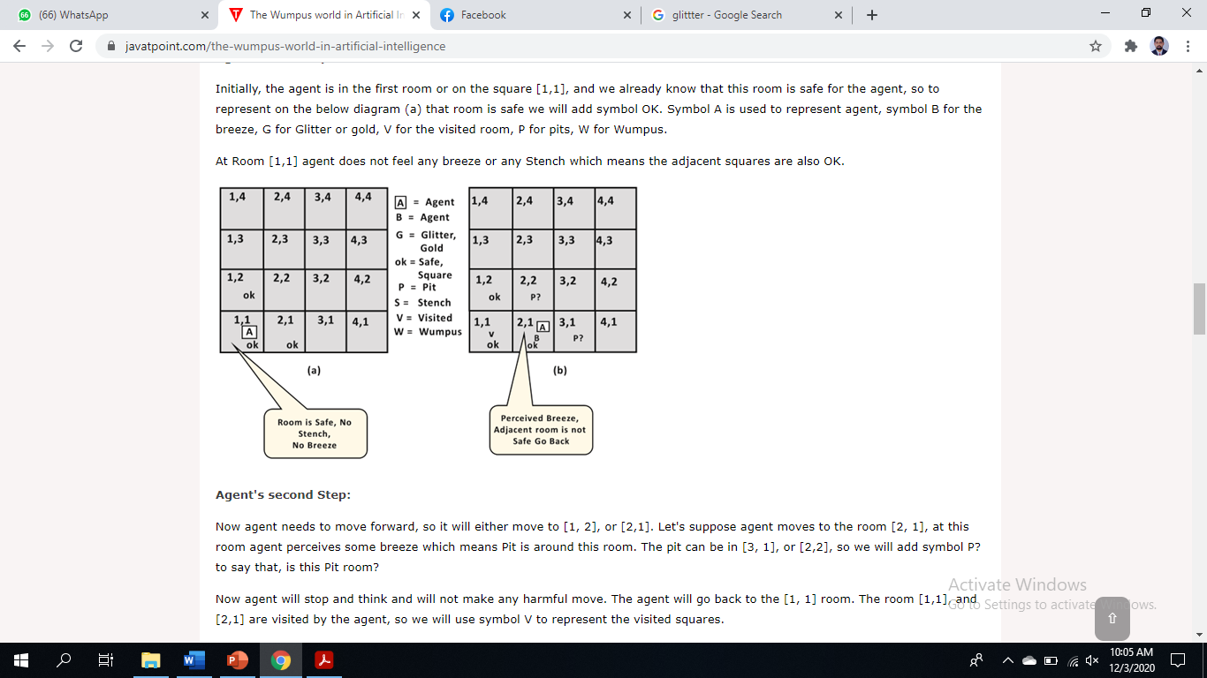
Exploring the Wumpus world
The percepts will be given to the agent program in the form of a list of five symbols;
for example, if there is a stench and a breeze, but no glitter, bump, or scream, the agent program will get [Stench, Breeze, None, None, None]

Slide 8
The wumpus environment is discrete, static, and single-agent.
It is sequential, because rewards may come only after many actions are taken.
It is partially observable, because some aspects of the state are not directly perceivable: the agent’s location, the wumpus’s state of health, and the availability of an arrow.
As for the locations of the pits and the wumpus: we could treat them as unobserved parts of the state that happen to be immutable—in which case, the transition model for the environment is completely known; or we could say that the transition model itself is unknown because the agent doesn’t know which Forward actions are fatal—in which case, discovering the locations of pits and wumpus completes the agent’s knowledge of the transition model.
Exploring the Wumpus world
Challenge to Agent: initial ignorance of the configuration of the environment; which require logical reasoning.
Occasionally, the agent must choose between going home empty-handed and risking death to find the gold.
About 21% of the environments are utterly unfair, because the gold is in a pit or surrounded by pits.

Slide 9
informal knowledge representation language
A knowledge-based wumpus agent exploring

Slide 10
The agent’s initial knowledge: it knows that it is in [1,1] and that [1,1] is a safe square; we denote that with an “A” and “OK,” respectively, in square [1,1].
The first percept: [None, None, None, None, None], its neighboring squares, [1,2] and [2,1], are free of dangers—they are OK.
A cautious agent will move only into a square that it knows to be OK.
Suppose next move forward to [2,1]: The agent perceives a breeze (denoted by “B”) in [2,1], so there must be a pit in a neighboring square. The pit cannot be in [1,1], by the rules of the game, so there must be a pit in [2,2] or [3,1] or both.
The notation “P?” indicates a possible pit in those squares.
At this point, only one known square that is OK and that has not yet been visited. So the prudent agent will turn around, go back to [1,1], and then proceed to [1,2].
The agent perceives a stench in [1,2], resulting in the state of knowledge that there must be a wumpus nearby.
But wumpus cannot be in [1,1], by the rules of the game, and it cannot be in [2,2] (or the agent would have detected a stench when it was in [2,1]). Therefore, the agent can infer that the wumpus is in [1,3]. The notation W! indicates this inference.
The lack of a breeze in [1,2] implies that there is no pit in [2,2]. Yet the agent has already inferred that there must be a pit in either [2,2] or [3,1], so this means it must be in [3,1].
This is a fairly difficult inference, because it combines knowledge gained at different times in different places and relies on the lack of a percept to make one crucial step.
A knowledge-based wumpus agent exploring

Slide 11
knowledge bases consist of sentences. Which are expressed according to the syntax, specifies all the sentences that are well formed.
A logic define the semantics or meaning of sentences.
The semantics defines the truth of each sentence with respect to each possible world (model).
For example, the semantics for arithmetic “x + y =4” is true if x is 2 and y is 2.
Every sentence must be either true or false in each possible world.
Models are mathematical abstractions, each of which simply fixes the truth or falsehood of every relevant sentence.
If a sentence α is true in model m, say that m satisfies α or sometimes m is a model of α.
Use the notation M(α) to mean the set of all models of α.
LOGIC
Logical reasoning involves the relation of logical entailment between sentences—the idea that a sentence follows logically from another sentence.
In mathematical notation, α |= β: sentence α entails the sentence β
α |= β if and only if, in every model in which α is true, β is also true
Can describe like: α |= β if and only if M(α) ⊆ M(β)
NOTE: Here ⊆ means α is a stronger assertion than β

Slide 12
Syntax:
Defines the allowable sentences.
The atomic sentences consist of a single proposition symbol. stands for a proposition that can be true or false.
Symbols start with an uppercase letter for example: P, Q, R, W1,3 and North.
Two proposition symbols with fixed meanings: True is the always-true proposition and False is the always-false proposition.
Complex sentences are constructed from simpler sentences, using parentheses and logical connectives.
There are five connectives in common use:
￢ (not) called the negation. A literal is either anatomic sentence (a positive literal) or a negated atomic sentence (a negative literal).
∧ (and). is called a conjunction; its parts are the conjuncts.
∨ (or). is a disjunction of the disjuncts which means “or.”
⇒ (implies). is called an implication (or conditional). Its premise or antecedent and its conclusion or consequent. Implications are also known as rules or if–then statements. The implication symbol is sometimes written in other books as ⊃ or →.
⇔ (if and only if). is a biconditional. Some write this as ≡.
Propositional Logic: A very simple Logic

Slide 13
Semantics
Semantics defines the rules for determining the truth of a sentence with respect to a particular model.
In propositional logic, a model simply fixes the TRUTH VALUE truth value—true or false—for every proposition symbol.
The semantics for propositional logic must specify how to compute the truth value of
any sentence, given a model. This is done recursively.
All sentences are constructed from atomic sentences and the five connectives;
Propositional Logic
• ¬P is true iff P is false in m.
• P ∧ Q is true iff both P and Q are true in m.
• P ∨ Q is true iff either P or Q is true in m.
• P ⇒ Q is true unless P is true and Q is false in m.
• P ⇔ Q is true iff P and Q are both true or both false in m.
Expressed by Truth Table

Slide 14
Some additional concepts related to entailment.
logical equivalence: two sentences α and β are logically equivalent if they are true in the same set of models. α ≡ β. For example, P ∧ Q and Q ∧ P are logically equivalent;
Other way, any two sentences α and β are equivalent only if each of them entails the other:
α ≡ β if and only if α |= β and β |= α .
validity. A sentence is valid if it is true in all models. For example, the sentence P ∨ ¬P is valid. Valid sentences are also known as tautologies.
the deduction theorem, For any sentences α and β, α |= β if and only if the sentence (α ⇒ β) is valid.
Satisfiability. A sentence is satisfiable if it is true in, or satisfied by, some model. For example, the knowledge base given earlier, (R1 ∧ R2 ∧R3 ∧ R4 ∧ R5), is satisfiable because there are three models in which it is true.
Satisfiability can be checked by enumerating the possible models until one is found that satisfies the sentence.
The problem of determining the satisfiability of sentences in propositional logic—the SAT problem—was the first problem proved to be NP-complete.
Many problems in computer science are really satisfiability problems. For example, all the
constraint satisfaction problems whether the constraints are satisfiable by some assignment.
Validity and satisfiability are of course connected: α is valid iff ￢α is unsatisfiable;
contrapositively, α is satisfiable iff ￢α is not valid. We also have the following useful result:
α |= β if and only if the sentence (α ∧ ￢β) is unsatisfiable.
PROPOSITIONAL THEOREM PROVING

Slide 15
inference rules that can be applied to derive a proof—a chain of conclusions that leads to the desired goal
Inference and proofs

Slide 16
If we removed the biconditional elimination rule, the proof in the preceding section would not go through.
The current section introduces a single inference rule, resolution, that yields a complete
inference algorithm when coupled with any complete search algorithm.
We begin by using a simple version of the resolution rule in the wumpus world. Let us
consider the steps leading up to Figure 7.4(a): the agent returns from [2,1] to [1,1] and then
goes to [1,2], where it perceives a stench, but no breeze. We add the following facts to the
knowledge base:
R11 : ￢B1,2 .
R12 : B1,2 ⇔ (P1,1 ∨ P2,2 ∨ P1,3)
Proof by resolution

