Slide 1
Select an advertising page below:
Impressions in Czechia
Impressions = The number of times ads were displayed on screen.
Spending = The amount of money spent running the ad
MAX
MIN
Impressions
Spending
Impressions distribution among genders
Female
Male

Slide 2
Select an advertising page below:
Regional distribution in Czechia
Impressions = The number of times ads were displayed on screen.
Spending = The amount of money spent running the ad
MAX
MIN
MAX
MIN
No. of ads
What is trending
Year over Year comparison
Comparison between age groups
Distribution among genders
% Growth
Impressions
Spending
Female
Male

Slide 3
Political Advertisement in the Czech Republic
Regional distribution in Czechia
When ads about social issues, elections or politics appear across Meta technologies, they're required to include information about who paid for them. Additional transparency about spend, reach and funding entities
Impressions = The number of times ads were displayed on screen.
Spending = The amount of money spent running the ad.
Reach = The number of unique users who see the ad.
Audience = The number of potential users the advertiser target.
MAX
MIN
MAX
MIN
Evolution vs previous year
Age base Pareto principle and top advertisers
80/20 line
Change of advertisement over time
Who are the top 10 performers in each domain
Overall statistics of individual advertisers
Reach Ratio = The average number of times an ad is shown to an individual
📈= The value is above average 📉 = The value is below average

Slide 4
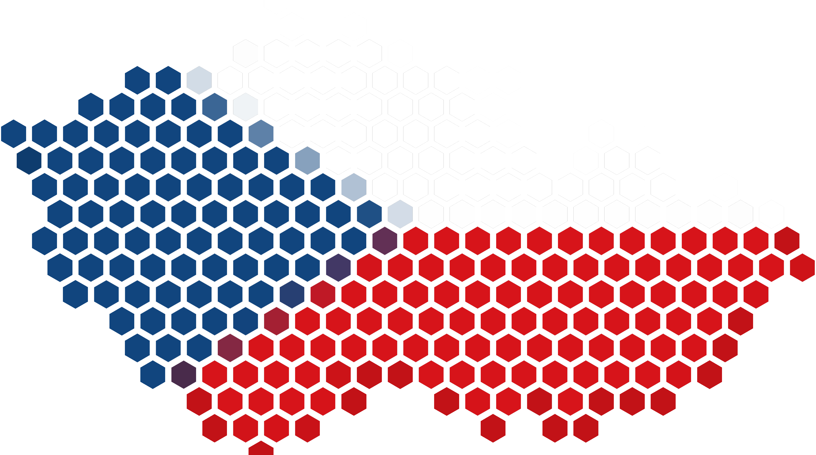
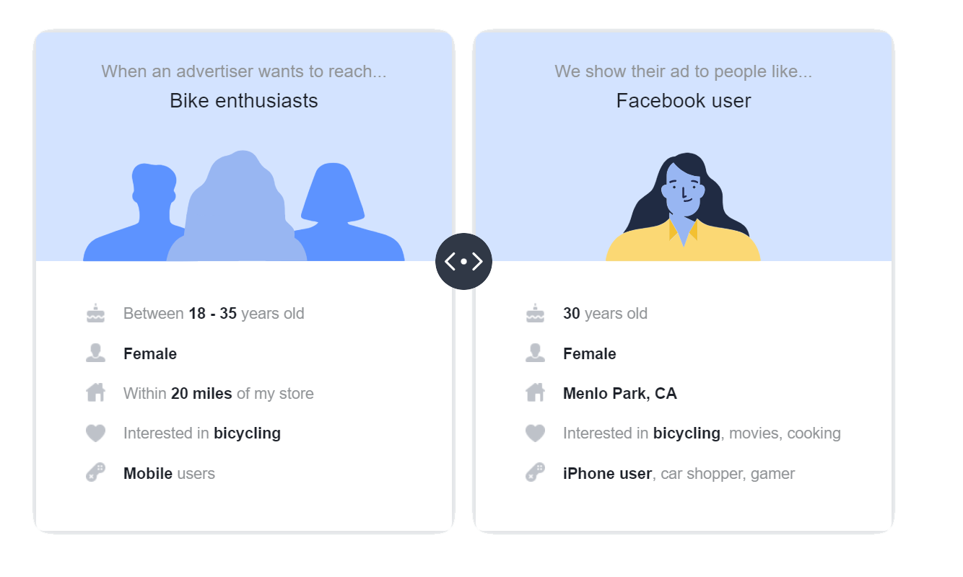
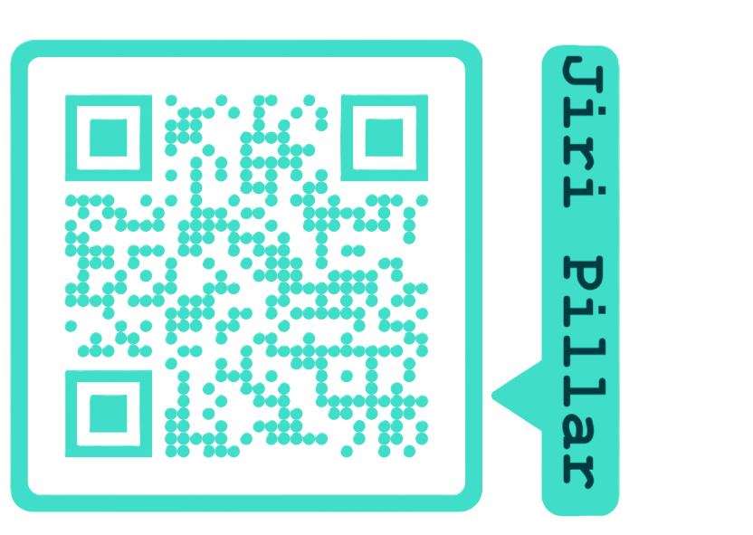
Political Advertisement in the Czech Republic
Metrics and data fields :
About:
This Project aims to provide a searchable and complete copy of the ads about social issues, elections or politics that have run in the past 4 years on Facebook Ad Library
Page name = Name of the Facebook Page which ran the ad
Content of the ad creative = A list of the text which displays in each unique ad card of the ad
Ad delivery dates = Date and time when an advertiser wants to start and stop delivery of the ad
Demographic information, such as age, gender and location (%) = aggregated demographic data based on a number of factors, including information users provide in their Facebook profile
Beneficiary and payer information = the name of the person, company, or entity that provided funding for the ad
Currency = The currency used to pay for the ad,
Impressions = The number of times ads were displayed on screen.
Spending = The amount of money spent running the ad
Reach Ratio = The average number of times an ad is shown to an individual
📈= The value is above average 📉 = The value is below average
Selected Advertisers:
Advertisers who spend over 300 CZK in the past 90 days. For such advertisers, 4 years history from Facebook Ad Library is included.
Ads about social issues, elections or politics:
To increase transparency around the ads about social issues, elections or politics, Meta has measures to help ensure the authenticity of these types of ads on Facebook and all Meta Products. A social issue, electoral or political ad in feed or stories can be identified on Facebook by the Paid for by disclaimer.
When ads about social issues, elections or politics appear across Meta technologies, they're required to include information about who paid for them. An issue, electoral or political ad can be identified on Facebook by the Paid for by disclaimer. This disclaimer is followed by information about who paid for the ad.
Let's talk about ads, together:
Why you see a particular ad:
Understand what data is used to show you ads and how it is used to show you ads without advertisers knowing who you are.
Meta prioritizes what ad to show you based on what advertisers' specification of their desired audience is, and Meta then match it to people who might be interested in that ad.
Created by:
Sources/References:
Meta Business help documentation,
Meta ads transparency tools documentation

