Slide 1
Select an advertising page below:
Impressions in Czechia
Impressions = The number of times ads were displayed on screen.
Spending = The amount of money spent running the ad
MAX
MIN
Impressions
Spending
Impressions distribution among genders
Female
Male

Slide 2

Regional distribution in Czechia
Political Advertisement in the Czech Republic
Impressions = The number of times ads were displayed on screen.
Spending = The amount of money spent running the ad.
Reach = The number of unique users who see the ad.
Audience = The number of potential users the advertiser target.
MAX
MIN
MAX
MIN
When ads about social issues, elections or politics appear across Meta technologies, they're required to include information about who paid for them. Additional transparency about spend, reach and funding entities
Evolution vs previous year
Age base Pareto principle and top advertisers
80/20 line
Change of advertisement over time
Who are the top 10 performers in each domain
Overall statistics of individual advertisers
Conversion = Accuracy of meeting the targeted audience
= The value is above market average
Reach Ratio = The average number of times an ad is shown to an individual
= The value is below market average

Slide 3
The last 12 months of:
Regional distribution in Czechia
Select an advertising page below:
MAX
MIN
MAX
MIN
Who is paying for it:
Target:
What is trending
Comparison between age groups
Distribution among genders
Female
Male

Slide 4
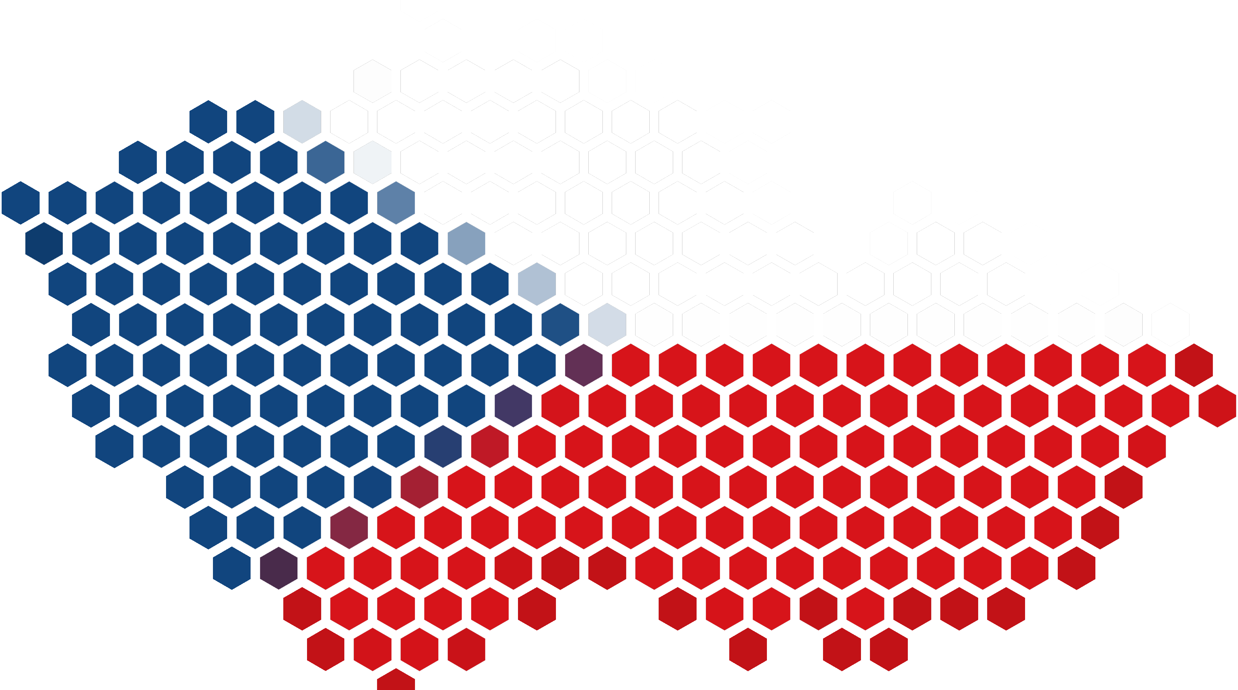
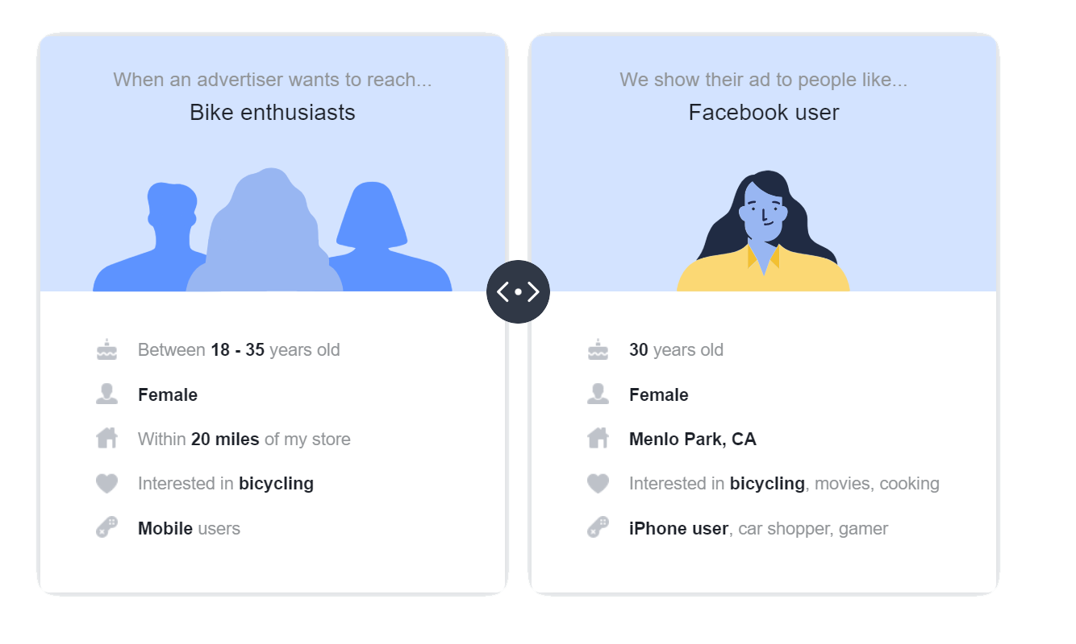
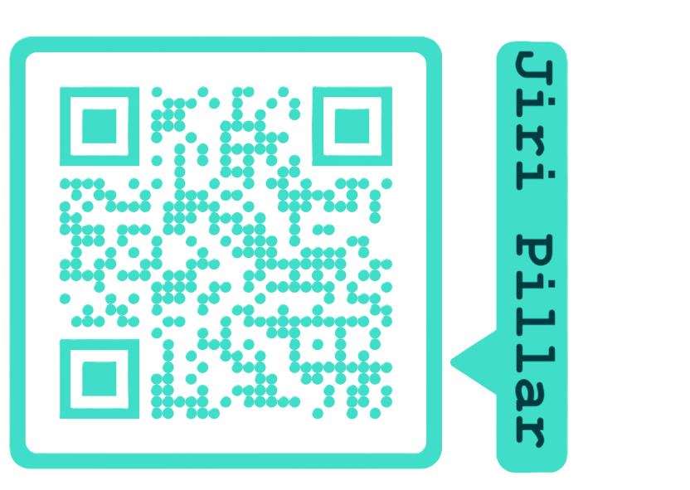
Political Advertisement in the Czech Republic
Metrics and data fields :
About:
Page name = Name of the Facebook Page which ran the ad
Byline = the name of the person, company, or entity that provided funding for the ad
Content of the ad creative = A list of the text which displays in each unique ad card of the ad
Ad delivery dates = Date and time when an advertiser wants to start and stop delivery of the ad
Demographic information, such as age, gender and location (%) = aggregated demographic data based on a number of factors, including information users provide in their Facebook profile
Currency = The currency used to pay for the ad,
Impressions = The number of times ads were displayed on screen.
Spending = The amount of money spent running the ad
Reach Ratio = The average number of times an ad is shown to an individual
This Project aims to provide a searchable and complete copy of the ads about social issues, elections or politics that have run in the past 4 years on Facebook Ad Library
Selected Advertisers:
Advertisers who spend over 300 CZK in the past 90 days. For such advertisers, 4 years history from Facebook Ad Library is included.
Ads about social issues, elections or politics:
To increase transparency around the ads about social issues, elections or politics, Meta has measures to help ensure the authenticity of these types of ads on Facebook and all Meta Products. A social issue, electoral or political ad in feed or stories can be identified on Facebook by the Paid for by disclaimer.
When ads about social issues, elections or politics appear across Meta technologies, they're required to include information about who paid for them. An issue, electoral or political ad can be identified on Facebook by the Paid for by disclaimer. This disclaimer is followed by information about who paid for the ad.
= The value is above market average
= The value is below market average
Let's talk about ads, together:
Why you see a particular ad:
Understand what data is used to show you ads and how it is used to show you ads without advertisers knowing who you are.
Meta prioritizes what ad to show you based on what advertisers' specification of their desired audience is, and Meta then match it to people who might be interested in that ad.
Created by:
Sources/References:
Meta Business help documentation,
Meta ads transparency tools documentation

Slide 5

Regional distribution in Czechia
Political Advertisement in the Czech Republic
Impressions = The number of times ads were displayed on screen.
Spending = The amount of money spent running the ad.
Reach = The number of unique users who see the ad.
Audience = The number of potential users the advertiser target.
MAX
MIN
MAX
MIN
When ads about social issues, elections or politics appear across Meta technologies, they're required to include information about who paid for them. Additional transparency about spend, reach and funding entities
Evolution vs previous year
Age base Pareto principle and top advertisers
80/20 line
Change of advertisement over time
Who are the top 10 performers in each domain
Overall statistics of individual advertisers
Conversion = Accuracy of meeting the targeted audience
= The value is above market average
Reach Ratio = The average number of times an ad is shown to an individual
= The value is below market average

Slide 6
Poslednich 12 mesicu:
Regionalni rozlozeni v Cesku:
Vyberte verejnou stranku:
MAX
MIN
MAX
MIN
Kdo za to plati:
Zacileni:
O cem se pise nejvice:
Porovnani napric vekovymi skupinami
Rozlozeni dle pohlavi
Zeny
Muzi

Slide 7


Political Advertisement in the Czech Republic
Metrics and data fields :
About:
Page name = Name of the Facebook Page which ran the ad
Byline = the name of the person, company, or entity that provided funding for the ad
Content of the ad creative = A list of the text which displays in each unique ad card of the ad
Ad delivery dates = Date and time when an advertiser wants to start and stop delivery of the ad
Demographic information, such as age, gender and location (%) = aggregated demographic data based on a number of factors, including information users provide in their Facebook profile
Currency = The currency used to pay for the ad,
Impressions = The number of times ads were displayed on screen.
Spending = The amount of money spent running the ad
Reach Ratio = The average number of times an ad is shown to an individual
This Project aims to provide a searchable and complete copy of the ads about social issues, elections or politics that have run in the past 4 years on Facebook Ad Library
Selected Advertisers:
Advertisers who spend over 300 CZK in the past 90 days. For such advertisers, 4 years history from Facebook Ad Library is included.
Ads about social issues, elections or politics:
To increase transparency around the ads about social issues, elections or politics, Meta has measures to help ensure the authenticity of these types of ads on Facebook and all Meta Products. A social issue, electoral or political ad in feed or stories can be identified on Facebook by the Paid for by disclaimer.
When ads about social issues, elections or politics appear across Meta technologies, they're required to include information about who paid for them. An issue, electoral or political ad can be identified on Facebook by the Paid for by disclaimer. This disclaimer is followed by information about who paid for the ad.
= The value is above market average
= The value is below market average
Let's talk about ads, together:
Why you see a particular ad:
Understand what data is used to show you ads and how it is used to show you ads without advertisers knowing who you are.
Meta prioritizes what ad to show you based on what advertisers' specification of their desired audience is, and Meta then match it to people who might be interested in that ad.
Created by:
Sources/References:
Meta Business help documentation,
Meta ads transparency tools documentation

