Slide 1
Stress-Testing
n-step Soft Actor-Critic
Bounded reproduction and ablation study under limited compute
Core question: does n-step credit assignment help SAC, and when does it become unstable?
RL final project • Radmir I.

Slide 2
Motivation: credit assignment is the bottleneck
1-step targets are stable, but rewards move backward slowly.
Main tension: sample efficiency vs stability
Project focus: test horizons n=1, 3, 5
sₜ, aₜ
rₜ₊₁…
rₜ₊ₙ
Q target
action
intermediate
delayed reward
critic target
N-step returns can propagate rewards faster.
In off-policy SAC, longer targets can add bias and variance.
n-step SAC final project

Slide 3
SAC baseline: strong off-policy continuous control
A good baseline should already be hard to improve.
Actor π(a|s)
squashed Gaussian
Entropy regularization stabilizes exploration
Twin critics reduce overestimation
Replay makes the n-step problem off-policy
Replay buffer
Target value
off-policy data
entropy adjusted
Twin critics
min(Q₁,Q₂)
target = rₜ + γ · (min Q_target(sₜ₊₁,aₜ₊₁) − α log π(aₜ₊₁|sₜ₊₁))
n-step SAC final project

Slide 4
From 1-step to n-step targets
The same SAC update, but a different critic target.
1-step:
Gₜ = rₜ + γ V(sₜ₊₁)
Benefit
Faster reward propagation
n-step:
Gₜ⁽ⁿ⁾ = rₜ + γrₜ₊₁ + … + γⁿ⁻¹rₜ₊ₙ₋₁ + γⁿV(sₜ₊ₙ)
Risk
More off-policy bias and target variance
Project ablation: n = 1, 3, 5
n-step SAC final project

Slide 5
Place in the literature
The project tests the central mechanism shared by recent n-step SAC work.
SAC
n-step SAC
SACn
T-SAC
off-policy actor-critic
longer critic targets
off-policy correction problem
trajectory chunks + critic context
This project: small-compute ablation of naive n-step SAC (n=1 vs 3 vs 5).
n-step SAC final project

Slide 6
Project question and hypotheses
A small experiment with a clear failure mode is better than a vague SOTA claim.
Research question
Method
Target
Expectation
Do n-step returns improve SAC under limited compute, and how sensitive is the result to the horizon?
SAC n=1
baseline
stable
SAC n=3
moderate horizon
expected to help
SAC n=5
long horizon
riskier
Main outcome: learning curve and final return
Secondary outcome: failure and stability analysis
No claim of full paper-scale reproduction
Correct ambition: bounded reproduction + ablation.
n-step SAC final project

Slide 7
Implementation: compact SAC pipeline
A reproducible project structure, not just a notebook.
Config-driven runs
Raw CSV logs committed
Separate plots for each environment
Reproduction card and limitations documented
env step
n-step buffer
replay buffer
SAC update
CSV + plots
MuJoCo/Gym
aggregate rewards
sample batch
critic / actor / α
reproducible logs
n-step SAC final project

Slide 8
Code explanation: n-step transition construction
The only algorithmic change is before the replay buffer.
reward_n = rₜ + γrₜ₊₁ + … + γⁿ⁻¹rₜ₊ₙ₋₁
discount_n = γᵏ
next_state = sₜ₊ₖ
For n=1, this is standard SAC
Episode termination cuts the n-step window early
Longer windows change target scale and noise
target = reward_n + discount_n · (min Q_target(next_state, a) − α log π(a|next_state))
Interpretation: horizon n is a stability parameter, not only a speed-up knob.
n-step SAC final project

Slide 9
Experimental setup
Small-compute by design: enough to test the mechanism, not enough for a general benchmark.
Environment
Steps
Role
Seed: 0 for all completed runs
Deterministic evaluation every few thousand steps
5 evaluation episodes per checkpoint
CSV logs and plots saved in results/
Pendulum-v1
30,000
sanity check
HalfCheetah-v5
100,000
main benchmark
Hardware: Ryzen 5700 laptop • WSL Ubuntu • CPU training
Honest limitation: single-seed results are evidence of a trend, not statistical proof.
n-step SAC final project

Slide 10
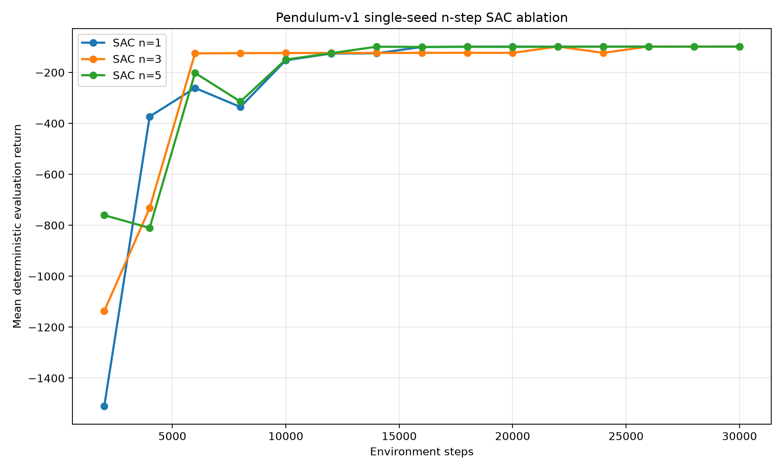
Pendulum-v1: implementation sanity check
All variants converge, so the n-step target code is not obviously broken.
All n-step variants train successfully
Final quality is similar
n=3 reaches good return quickly
Task is too simple for a strong claim
Use as sanity, not as the main evidence.
n-step SAC final project

Slide 11
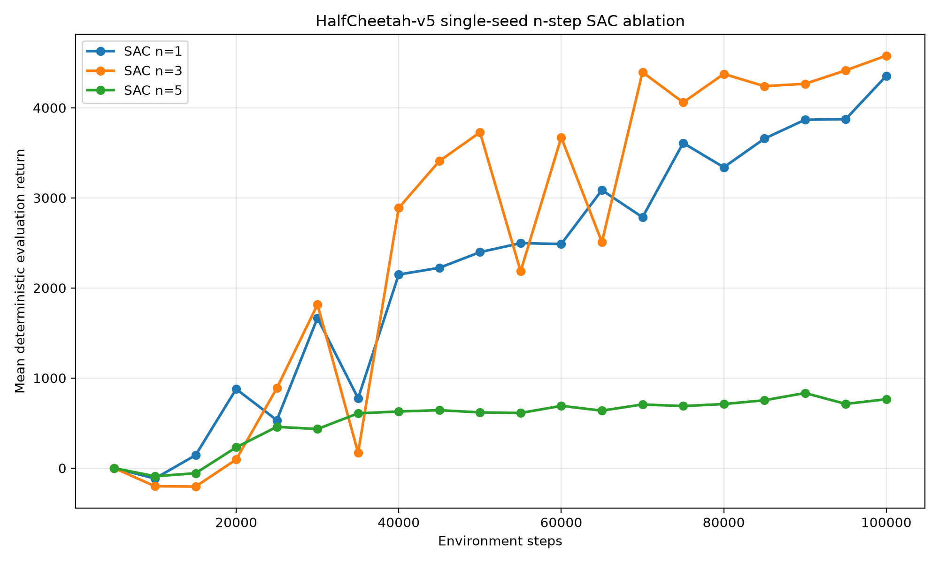
HalfCheetah-v5: main ablation
Moderate horizon helps; longer horizon fails under the same settings.
4354
4579
SAC n=1 final
SAC n=3 final
764
SAC n=5 final
Main result: n=3 learns faster and reaches the best final return.
n-step SAC final project

Slide 12
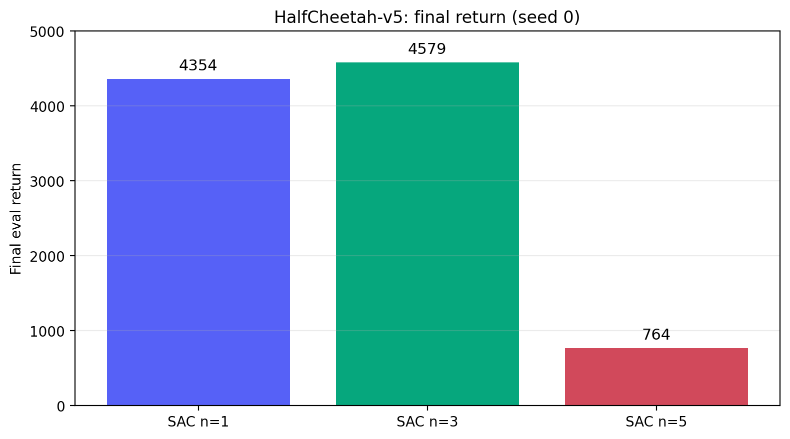
Result reading: the horizon matters
This is the useful failure mode of the project.
n=3 crosses return ≥3000 earlier than n=1
n=1 remains a strong baseline
n=5 never reaches high-return behavior
Longer is not automatically better
Moderate n-step credit assignment can help, but naive longer targets can destabilize off-policy SAC.
n-step SAC final project

Slide 13
Weaknesses and limitations
The project is useful because the claim is narrow.
Single seed only
Two environments only
No full T-SAC reproduction
No SACn correction mechanism
Same hyperparameters for all horizons
Limited laptop CPU compute
What I do not claim
Not state of the art
Not proof that n=3 is always best
Not proof that n=5 always fails
Correct claim: in this limited-compute setting, n=3 improved HalfCheetah learning; n=5 failed under the same hyperparameters.
n-step SAC final project

Slide 14
Conclusion and next steps
A small experiment, but a clear trade-off.
What was done
Main result
Implemented configurable n-step SAC
Ran Pendulum sanity experiment
Ran HalfCheetah main ablation
Logged raw CSV + plots + reproduction notes
n=3 helped
n=1 remained strong
n=5 failed
N-step horizon is a stability parameter, not a bigger-is-better knob.
n-step SAC final project

Slide 15
Backup: likely defense questions
Short answers for the discussion.
Question
Answer
Caveat
Why SAC?
Strong off-policy continuous-control baseline
Matches n-step off-policy issue
Why n=5 failed?
Likely bias/variance + same hyperparams
Needs more seeds
Can we claim n=3 is best?
No universal claim
Only this setting
Next step?
3–5 seeds + more MuJoCo envs
SACn/T-SAC variants
Main defense line: bounded reproduction, real ablation, honest limitations.
backup slide

