Slide 1
AUTO HEALER LINUX
BY
RAKESH.P
DEPARTMENT OF CYBER SECURITY
Shashidhar
Trainer and Guide

Slide 2
contents
Abstract
Introduction
Tools and Technologies
Implementation
Results
Conclusion
Future Scope

Slide 3
ABSTRACT:
.Auto-Healer for Linux is a tool written in Go (Golang) designed to enhance system reliability by ensuring that critical Linux services are always running. The primary goal of this project is to implement an automatic control mechanism that restarts services that have crashed or are not running. The tool provides real-time health checks using a Bash script, along with systemd, cron, and logging utilities. If it detects that a service is unresponsive, it attempts to restart the service through various methods, while simultaneously logging the event and notifying the administrator via email. This tool is handy for systems administrators, allowing them to keep services operational, address issues promptly, and maintain Linux servers effectively. The project showcases real-world automation, scripting, and systems monitoring.

Slide 4
INTRODUCTION:
Luckily, it’s easier than ever to keep your most important system services and applications up and running in today’s always-connected, digital world. Auto-Healer Linux is A lightweight automation service that will monitor critical services on a Linux system and heal failures. This system monitors for when a specific service crashes; when it detects that the service crashes, it automatically restarts the service, allowing for less human intervention and downtime. It records these events and can also send log information and alerts to the system administrator. Such a self-healing mechanism reinforcement increases stability and resistance of Linux systems, particularly in server applications.

Slide 5
Tools &Technologies:
Bash – primary language for automation reasons, likely this is what you are using.
systemctl – to monitor and manage the system D service
cron – to run the monitoring script at regular intervals
mail / mailx - Send email mail for the administrator for notification.
logger - to log all system actions and events to the system logs
Linux OS (Kali) – the execution platform on which you are running the script

Slide 6
Implementataion
The Auto-Healer Linux project implementation begins by taking the time to identify and list the essential system services/services types that you want to monitor used uptime (e.g., apache2, MySQL, or any application services you have created). These services can either be explicitly defined in the script or defined using a separate text-based configuration file.
The next step is to create a simple Bash script to check if each service is active by using the systemctl is-active command. If the service on the Linux server is inactive or failed, the script uses systemctl restart to restart the service, and writes it to a log file (e.g. /var/log/autohealer.log).
You would also want to run the script without worrying about the script running all the time manually, so you would set the script to run at predetermined intervals using the Linux cron scheduler by adding an entry in the crontab file (e.g., every minute).
The script could also be structured to notify the system administrator via email when a service is restarted using the mail command and mail program (e.g., associated with mailutils).
The above automated detection and recovery, as well as a log of all events, allow for system downtime to be reduced as a result of automatic corrective actions and provide a log for completing audits and debugging all events that require further review.

Slide 7
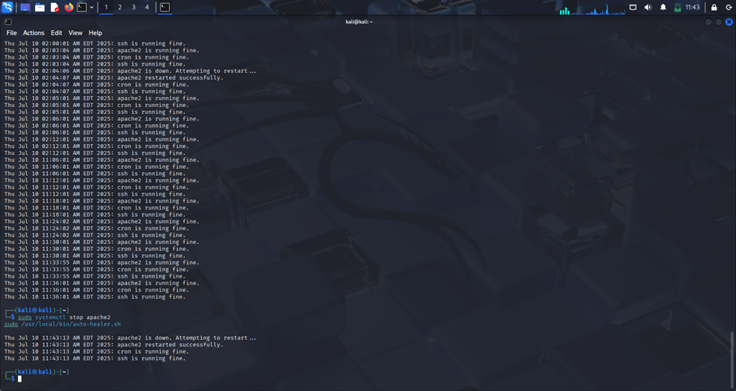
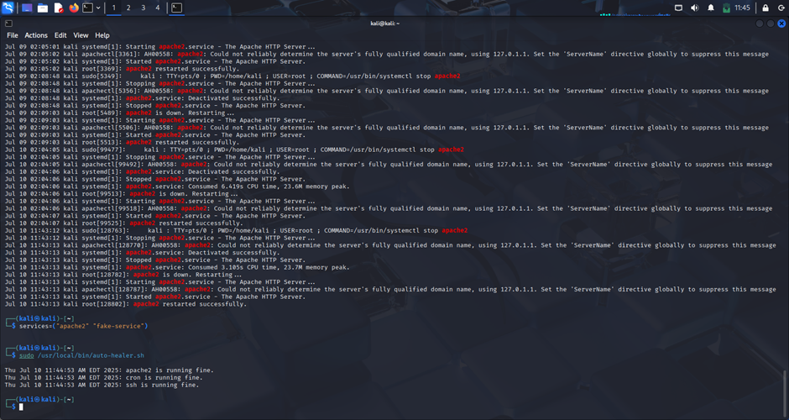
Result:

Slide 8
Future Scope:
Add a GUI or web dashboard
Use Python for more advanced logic
Integrate with messaging apps (Slack/Telegram)
Track uptime and service analytics

Slide 9
Conclusion:
The Auto-Healer Linux project is a simplistic but robust solution to help ensure high availability and reliability of critical system services. Auto-Healer offers automatic monitoring, automatic restarting of failed services, event logging, and alerts. The amount of manual actions and downtime will be significantly reduced by automatically performing repetitive actions. The automatic functions will help improve the stability of the system, which enhances the efficiency of operations in a system. Auto-Healer is designed to self-heal services that are running on a server or in production. The benefits of the Auto-Healer Linux project are minimal resource requirements and easy customized configuration to develop a real-time self-healing solution.

Slide 10
GUI (graphical user interface)
FRONT END IMPLEMENTATION
Front-end on the Auto-Heeler Linux website is designed using HTML, CSS, and JavaScript to create a clean, responsible, and user-friendly interface. The main page contains an input field where users can provide the name of a Linux System Service (eg, Apache 2 or MySQL). Under the entrance field, the interactive buttons are: "Check status", “Restart Service", and "Show Logs". When a user clicks on any of these buttons, JavaScript (using the Fetch API) sends a request to the backend, which drives the actual Linux. The results are shown dynamically on the website without loading again, which makes the interface more comfortable. Front-end also includes a rolling log area, where the latest rows of the Linux system log are displayed, which helps the user to look at previous features and errors. Alternative promotion as bootstrap, can be added to styling, which gives the interface a more polished, modern look

Slide 11
TOOLS AND TECHNOLOGIES
Backend Python, Flask
Frontend HTML, CSS, JavaScript,
Linux systemctl, Bash,
Monitoring Python subprocess

Slide 12
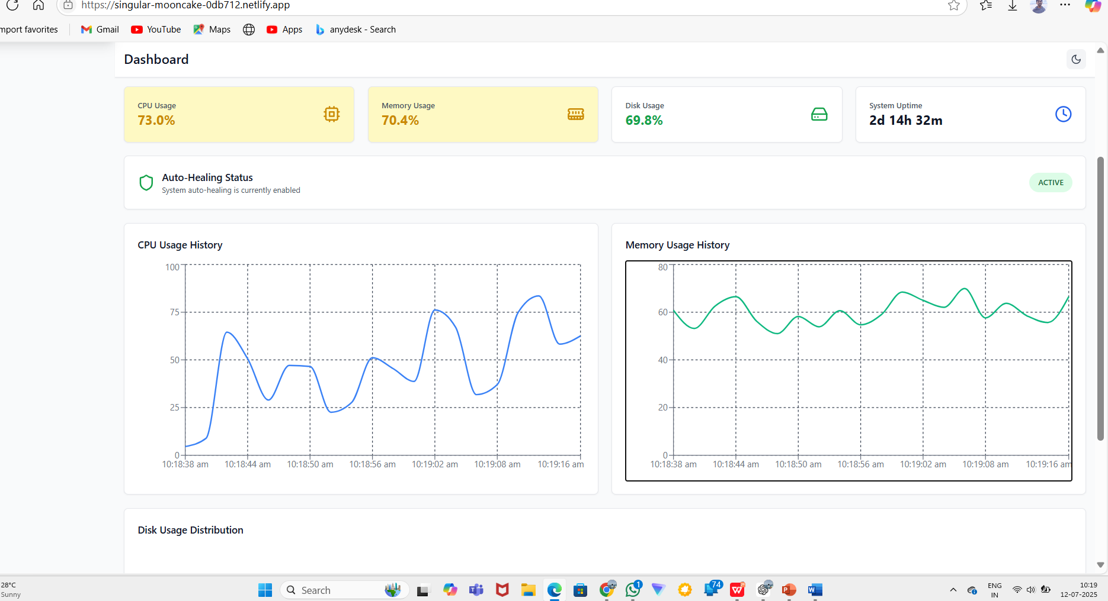

Slide 13
THANK YOU

