Slide 1
Kujaga 🛡️
Autonomous Identity Security Agent for Indonesian Public Figures RISTEK x Build Club OpenClaw Agenthon 2026

Slide 2
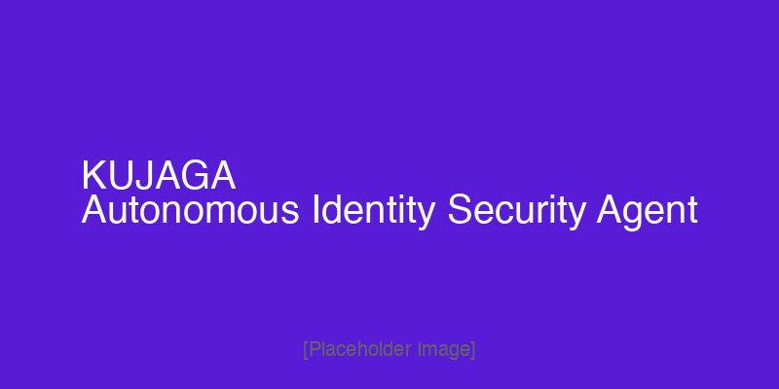
💡 Inspiration
• Indonesia lost Rp 9.1 Trillion to cybercrime last year
• 432,000+ digital fraud cases — increasing 40% YoY
• 148 Million Indonesian citizens affected by data breaches
• Public figures (influencers, creators, entrepreneurs) are prime targets:
• - Account cloning for financial fraud
• - Impersonation for investment scams
• - Data doxxing and physical threats
• Enterprise security costs Rp 500Juta-Rp 5Million/month
• Only ~35% of Indonesian creators have any digital protection
• "Kujaga" = pelindung (protector) in Sanskrit

Slide 3
🎯 What It Does
• Kujaga is an Autonomous Identity Security Agent that works 24/7:
•
• 🔐 Breach Detection — Monitor emails across 15B+ breach records
• 👁️ Brand Monitoring — Track name mentions across the internet
• 🎣 Phishing Block — Detect impersonating domains
• 📄 PDUPA Letter Gen — AI-generated Indonesian PDP Law letters
• 📱 Telegram Alerts — Real-time notifications in Indonesian
• ⏰ 30-Day Tracker — Auto-escalate to Kominfo if no response
•
• Setup once. Kujaga protects forever.

Slide 4

🔧 How We Built It
• OpenClaw — Self-hosted AI gateway on VPS
• Telegram Bot (@Kujaga_bot) — Primary user channel
• MiniMax API — Letter generation with Indonesian context
• Supabase — Database + pg_cron for scheduled monitoring
• Next.js 14 — Dashboard UI
•
• FREE Security APIs:
• • HIBP (Have I Been Pwned) — Breach check
• • Google Alerts RSS — Brand mentions
• • Google News RSS — Company breach news
• • VirusTotal — URL safety check

Slide 5
🏗️ Architecture
User → Telegram → OpenClaw Gateway → Kujaga Agent → Supabase + Security APIs

Slide 6

📱 Demo Preview
Telegram conversation with @Kujaga_bot showing breach check, brand monitoring, and PDUPA letter generation

Slide 7
⚠️ Challenges We Ran Into
• OpenClaw Gateway Configuration
• - Default loopback-only binding required discovery
• - Correct syntax: gateway.bind lan
•
• MiniMax API Integration
• - Model configured but API key auth needed careful setup
•
• Stateless vs Stateful
• - Balancing autonomous monitoring with stateless API design
•
• Indonesian PDP Law Context
• - Generic LLMs lack Indonesian legal terminology
• - Letter generation required proper legal language

Slide 8
🏆 Accomplishments
• ✅ Functional autonomous agent — 24/7 monitoring, zero triggers
• ✅ Telegram-native experience — Setup in 2 minutes
• ✅ Free security tools — HIBP k-anonymity, Google RSS, VirusTotal
• ✅ Complete user flow — Signup to PDUPA letter generation
• ✅ OpenClaw Hackathon submission — Built on OpenClaw framework
•
• Tagline: "Kujaga menjaga namamu, data kamu, dan reputasi kamu."

Slide 9
📚 What We Learned
• Single agent architecture is correct for monitoring tasks
• (sequential, not parallel — based on Google Research paper)
•
• OpenClaw's personal trust model fits Kujaga perfectly
•
• Indonesian language AI needs careful prompt engineering
• for proper PDP Law terminology
•
• Telegram-first is the right call
• 50-70M Indonesian users already on the platform

Slide 10
🚀 What's Next for Kujaga
• Short-term:
• • Full Supabase integration (users, threats, documents)
• • Real DOKU payment integration
• • API keys for all security services
•
• Long-term:
• • Mobile app with deeper Telegram integration
• • White-label for agencies/managers
• • Multi-language support
• • Partnership with Indonesian cybersecurity firms

Slide 11
👥 Team Kujaga
• Built with ❤️ for the RISTEK x Build Club OpenClaw Agenthon 2026
•
• Special thanks to:
• • OpenClaw Team — For the amazing agent framework
• • RISTEK x Build Club — For organizing this hackathon
• • Indonesian cybersecurity community — For inspiration
•
• GitHub: github.com/Therealratoshen/OpenClaw2026_Kujaga
• Telegram: @Kujaga_bot

Slide 12
Terima Kasih! 🙏
"Kujaga menjaga namamu, data kamu, dan reputasi kamu." @Kujaga_bot

