Slide 1
GCP-Data Engineering Project Steps

Slide 2
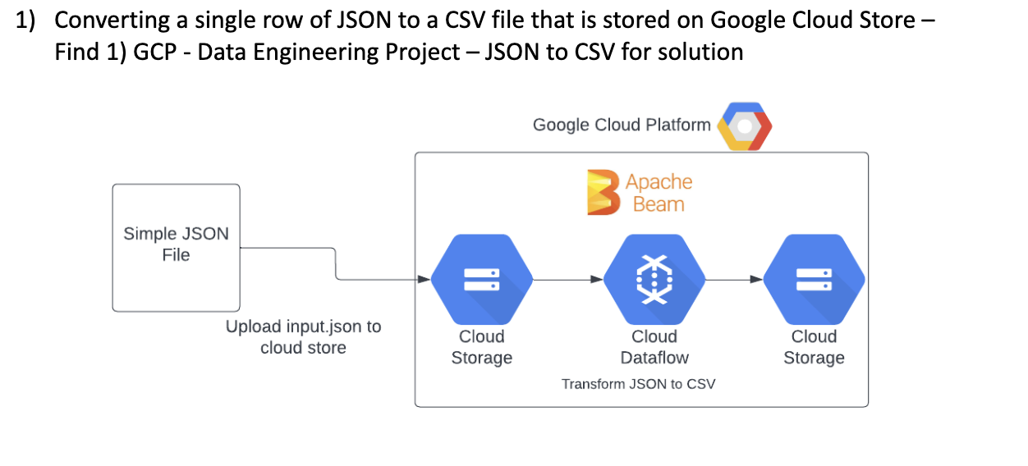
Step 1: Focused on Transform JSON to CSV

Slide 3
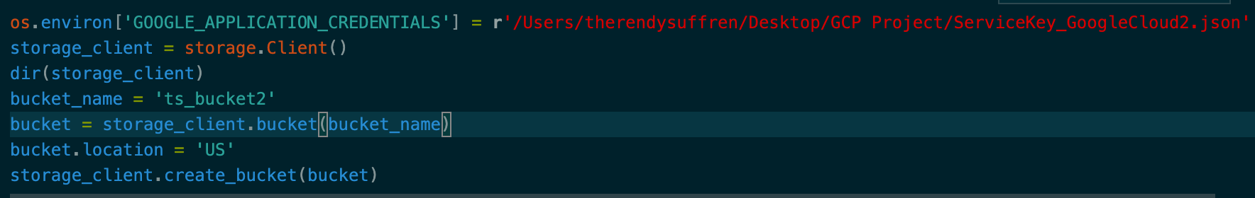
Step 2: Watch a YouTube Video
My Code:
Create a google cloud account
Create a project
Enable google cloud storage service
Create a Service Account
Enable Google Cloud Storage API
Install Google Cloud Storage Python Library
Create a new bucket using Python
Accessing a bucket using Python
Resource:
https://www.youtube.com/watch?v=pEbL_TT9cHg&t=125s
Using Google Cloud Storage API in Python For Beginners

Slide 4
Step 3: Found Online Example
Online example to Convert JSON to CSV using Google Data Flow pipeline
Install apache beam
pip install 'apache-beam[gcp]’
Upload a sample json file
Create an input folder within a bucket
CSV to JSON
JSON to CSV
Etc…
PROBLEM: Did not understand !!!!
Website:
Convert JSON to CSV using Google Data Flow pipeline
https://www.thecodebuzz.com/convert-json-to-csv-using-python-google-data-flow-pipeline/

Slide 5


Step 4: Udemy Course
Section 1: Concepts of Apache beam
Section 2: Apache beam main functions
Section 3: Batch dataflow pipelines
Course Name : Data Engineer with Google Dataflow and Apache beam
Link: https://www.udemy.com/course/data-engineering-with-google-dataflow-and-apache-beam/learn/lecture/27849874?start=150#content

Slide 6
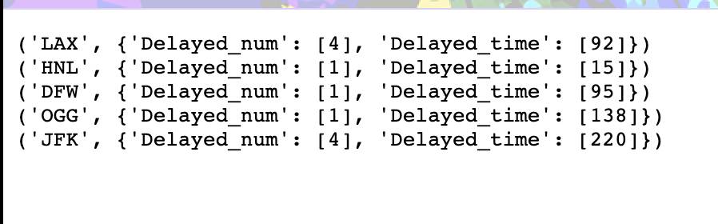
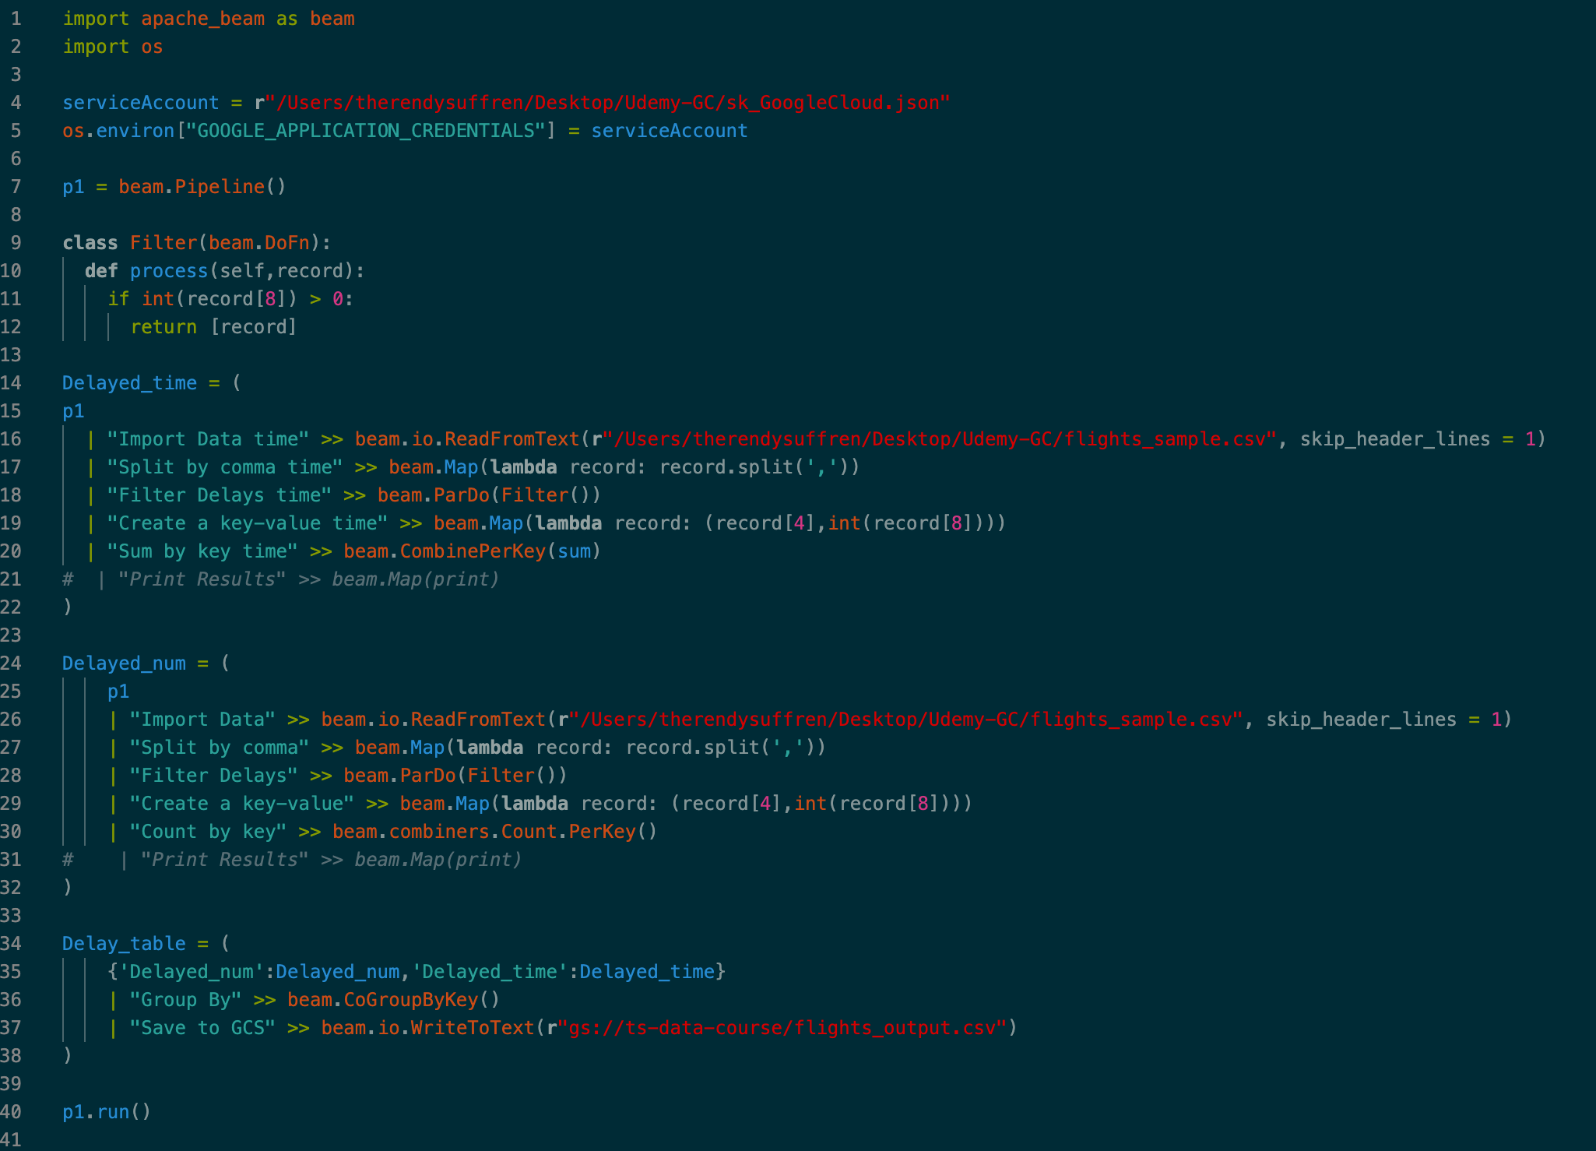
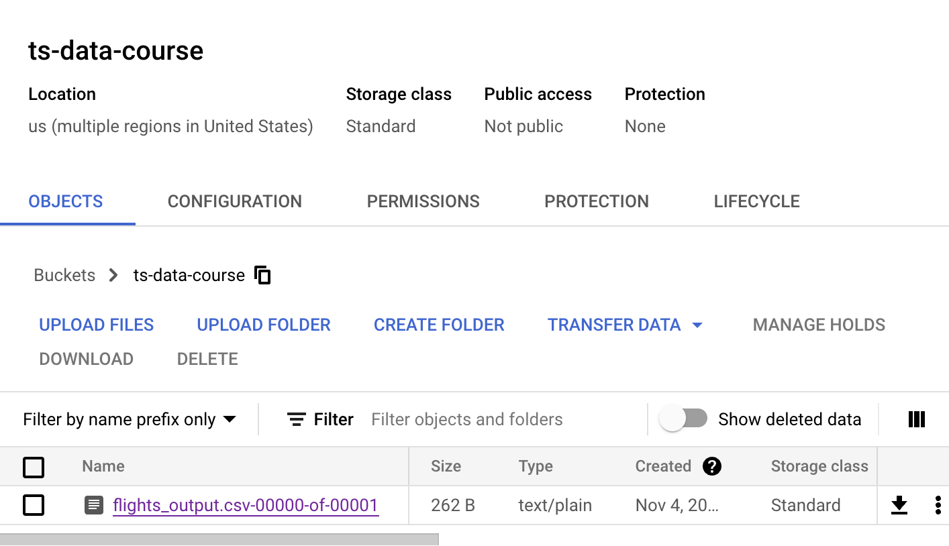
Udemy Demo
PROBLEM : DIDN’T KNOW HOW TO APPLY WHAT IVE LEARNED TO THE PROJECT

Slide 7
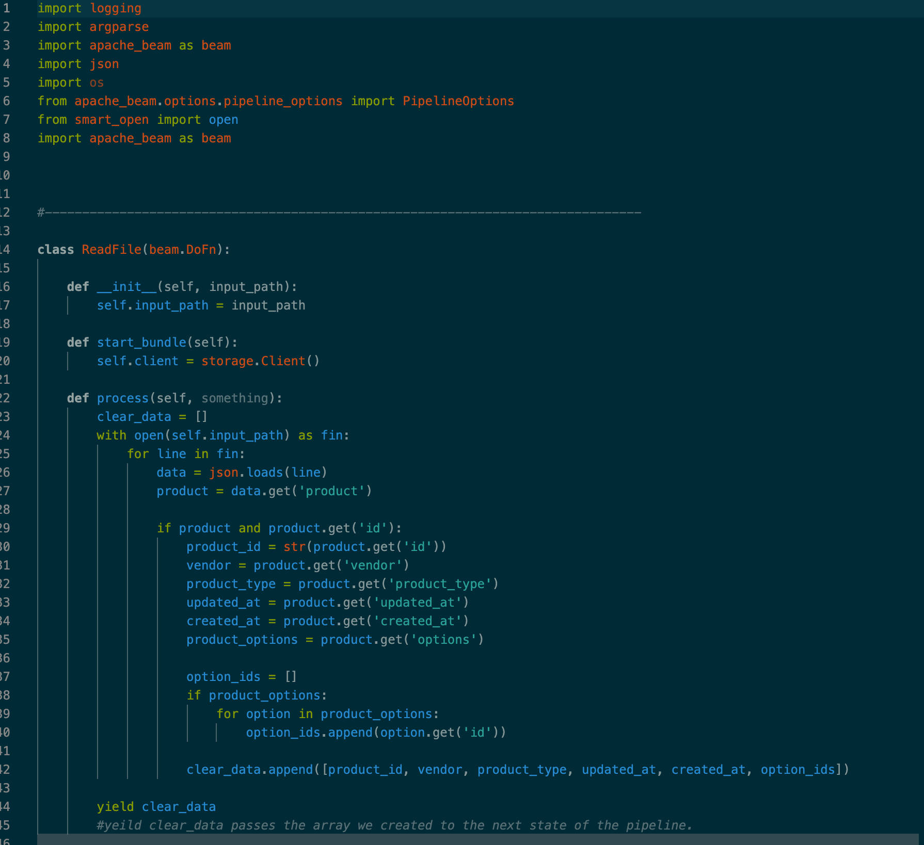
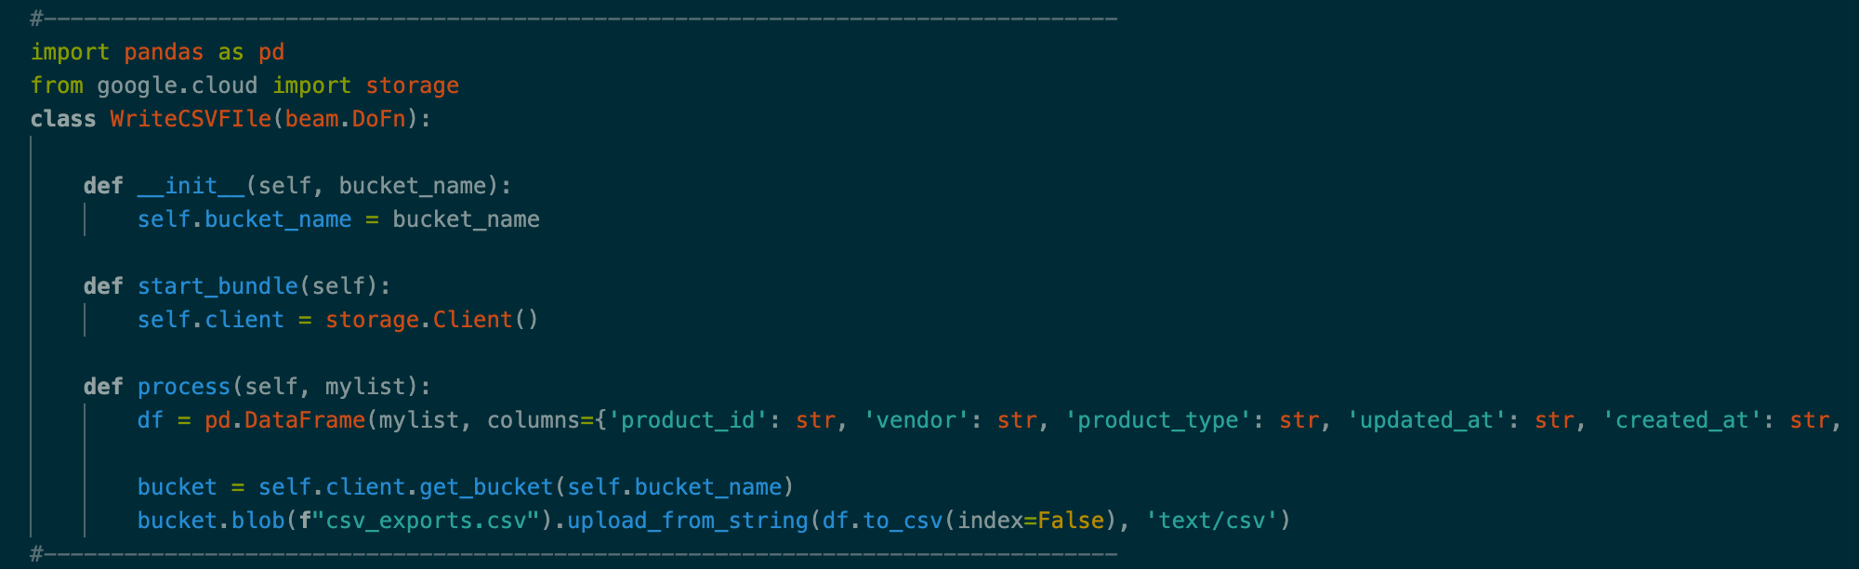
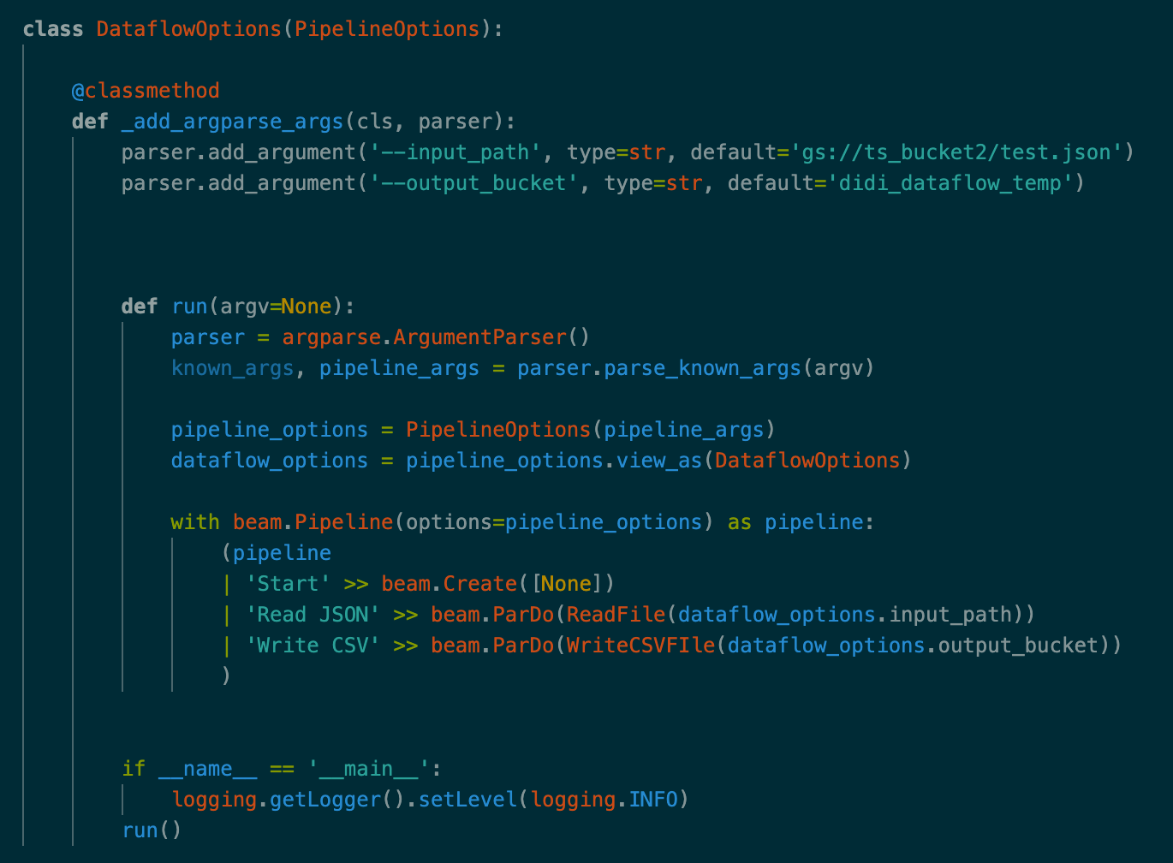
Step 5: Another Online Example
Online example to transform Json to CSV from Google bucket using a Dataflow Python pipeline
Create a service account
Set an environment variable
Parse a json
Write the pipeline which reads the json file directly from the bucket
Gets the data and writes the CSV file to the output path using pandas
Write the actual dataflow pipeline save it as DataflowTest.py
Includes a requirements.txt
Create temp and staging folders
Run the Following commands (see picture)

Slide 8
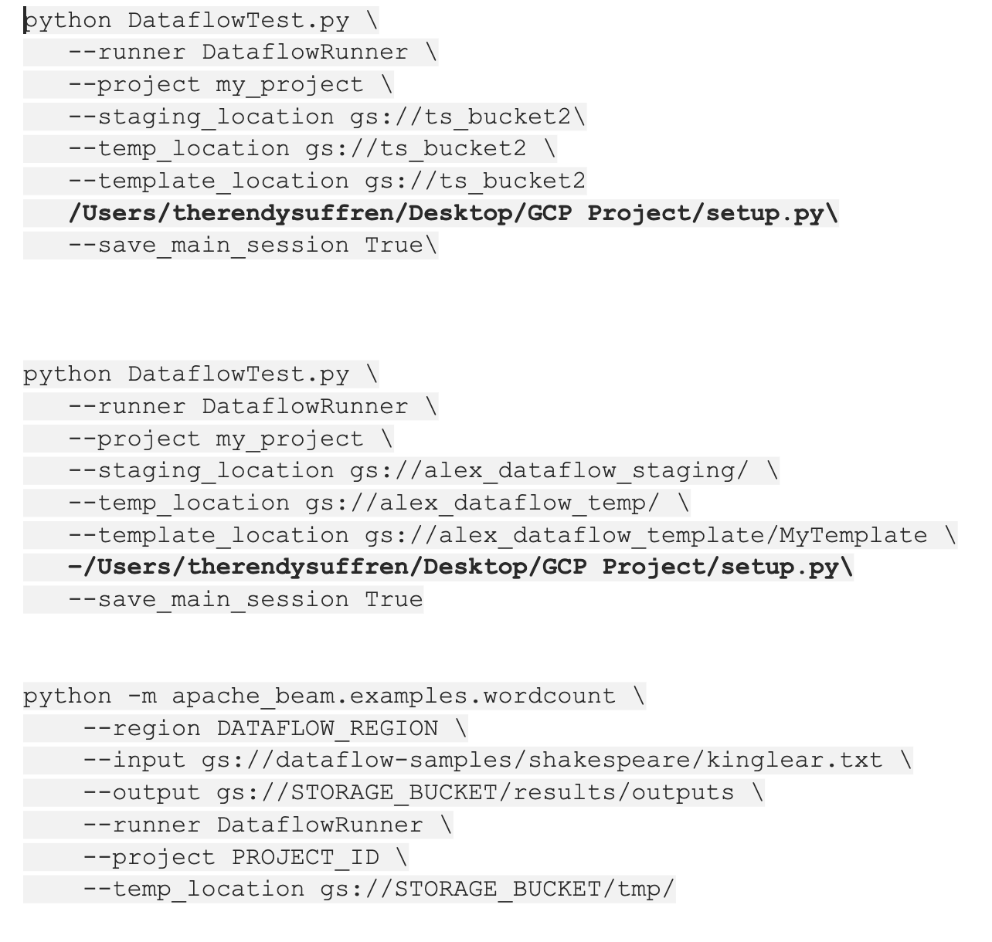
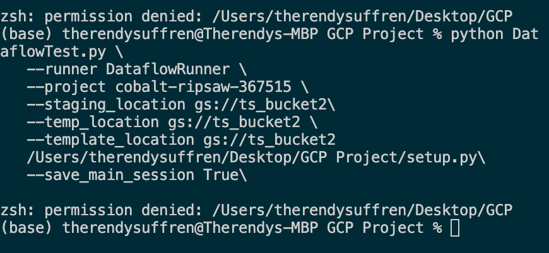
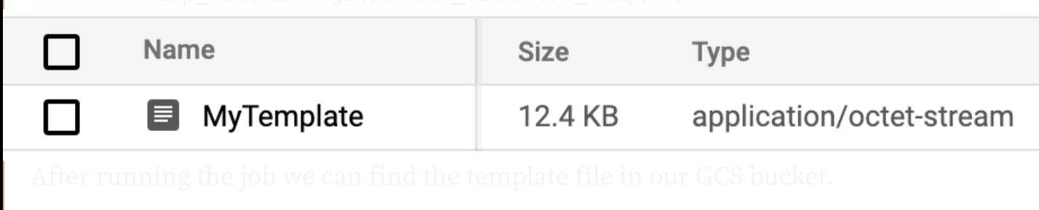
Problem with the Online Example
Running the command
Permission Denied
This should be the result :

Slide 9
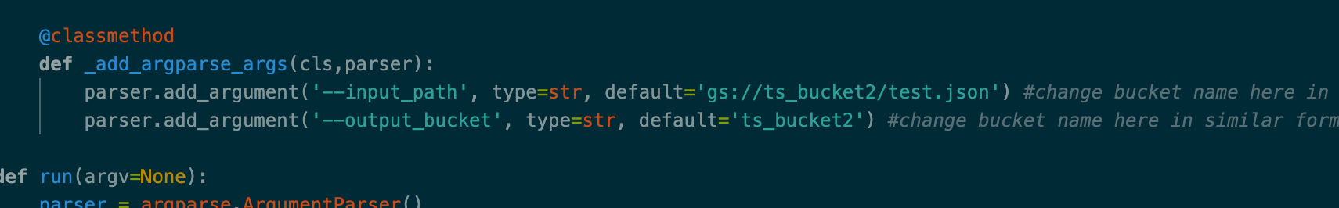
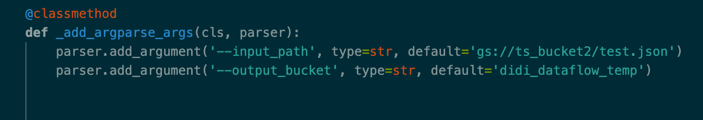
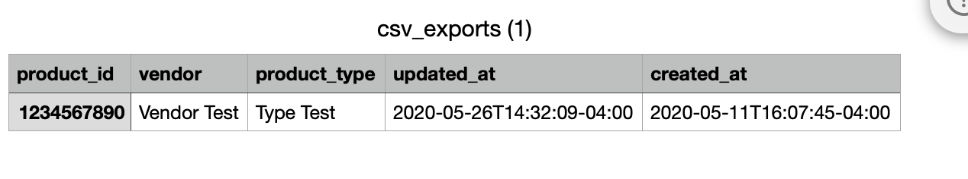
Step 6: Got solutions and Compare
Vs.
Results:

Slide 10
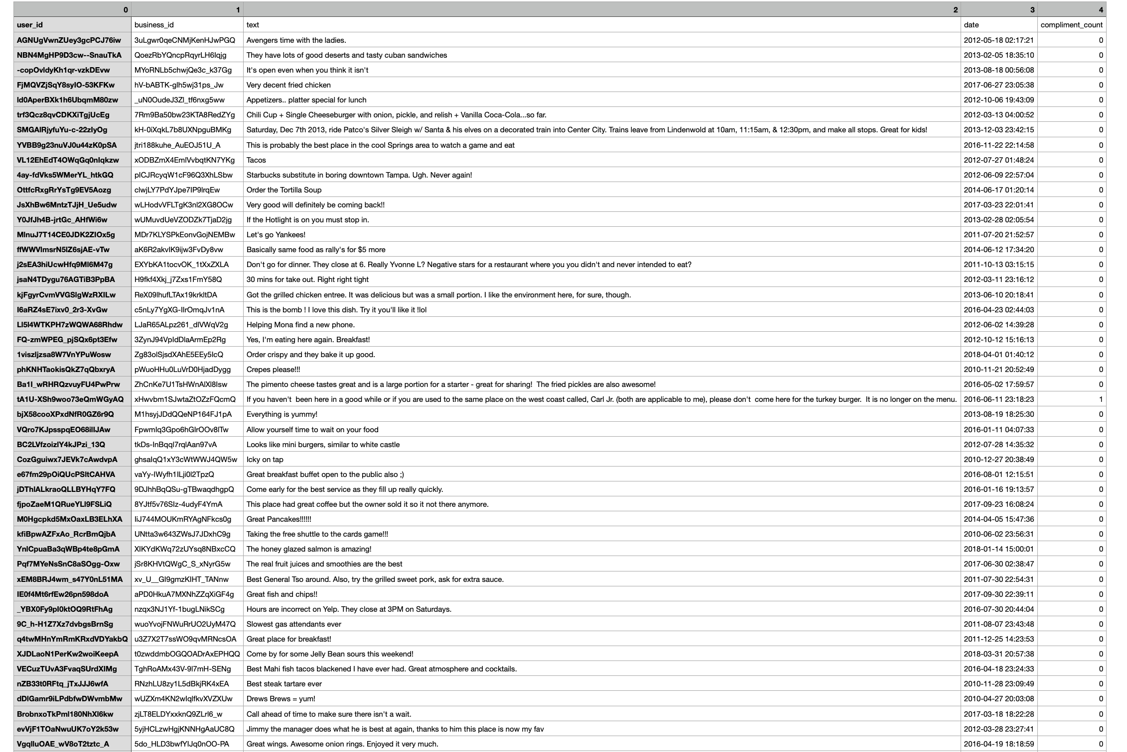
Step: 7 : Solution to Project Using Yelp
Results:

Slide 11
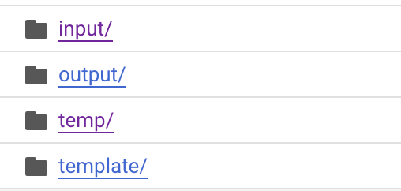
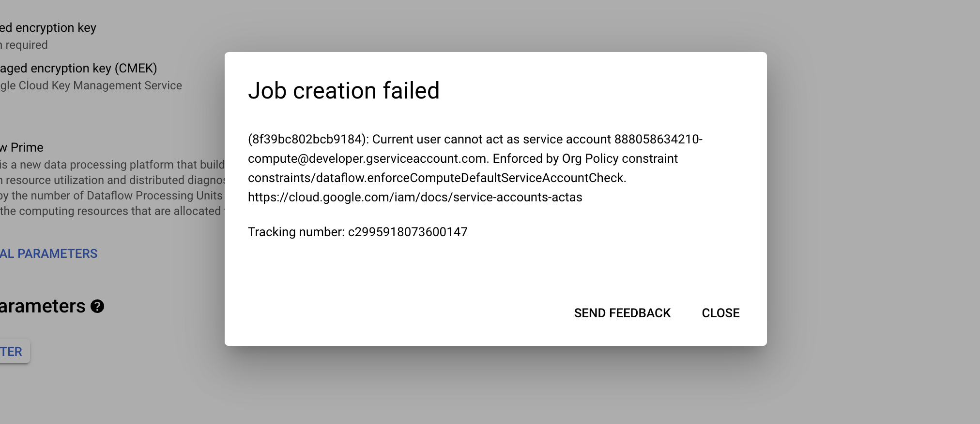
Step 8: Continue with Udemy Course
Learned how to create a dataflow template
Input : is the csv file
Output: file after the process
Temp: staging files during execution
Template: dataflow template
Executing batch job in dataflow

Slide 12
Batch vs. stream processing

Slide 13

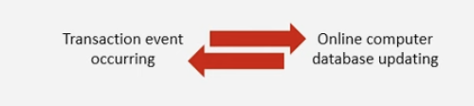
Batch processing Stream processing
-The Collection and storage of data, for processing at a scheduled time when a sufficient amount of data has been accumulated
The immediate processing of data after the transaction occurs, with the database being updated at the time of the event

Slide 14
Batch Examples. Stream Examples
Cheque Clearing
Generation of Bills
Credit Card Transactions (The actual transactions takes place until a later date)
Reservation systems
Points of Sales Terminals (POS)

Slide 15
Advantages/ Disadvantages
Batch Processing
Many transactions are completed at one time in a single process
Data takes time to be processed
Stream Processing
Data is processed immediately
The act of processing data is repetitive

