Slide 1
EQ2341 – Activity Recognition
Theresa Hösl

Slide 2
Objective
Implementation of a classifier for activity recognition based on data from the phone’s sensors.
The algorithm should be able to accurately discriminate between three activities: standing still, walking, and running.
An infinite HMM with three underlying states can solve this problem.

Slide 3
Data
Sequence of column vectors of length three captured by phone’s app while performing the activities.
Training:
One sequence of standing, walking and running each
One sequence where the three activites were performed several times in different orders
Testing:
Three sequence of standing, walking and running each
One sequence where the three activites were performed several times in different orders

Slide 4
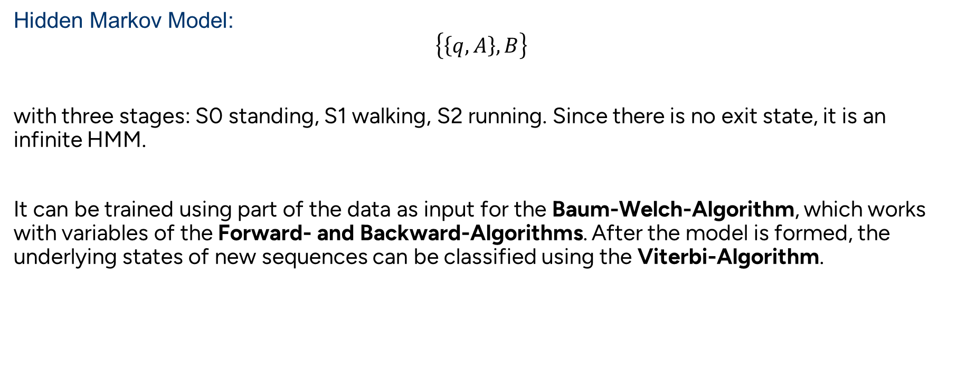
Methodology
Hidden Markov Model:
$$\left\{\left\{q, A\right\}, B\right\}$$
with three stages: S0 standing, S1 walking, S2 running. Since there is no exit state, it is an infinite HMM.
It can be trained using part of the data as input for the Baum-Welch-Algorithm, which works with variables of the Forward- and Backward-Algorithms. After the model is formed, the underlying states of new sequences can be classified using the Viterbi-Algorithm.

Slide 5
Methodology
Baum-Welch-Algorithm:
The algorithm converges only to local maxima, not global ones. Therefore, the values for the initialization can improve/ decrease the performance.
The probability for a sequence to start with any of the states is equal → q is initialized with 1/3 for each state
The probability to stay in the current state is bigger than to switch one of the other two states. We can assume that the A matrix will have high values in the diagonal.
The output distributions can be assumed to be normal distributed with different means and covariance matrices.

Slide 6
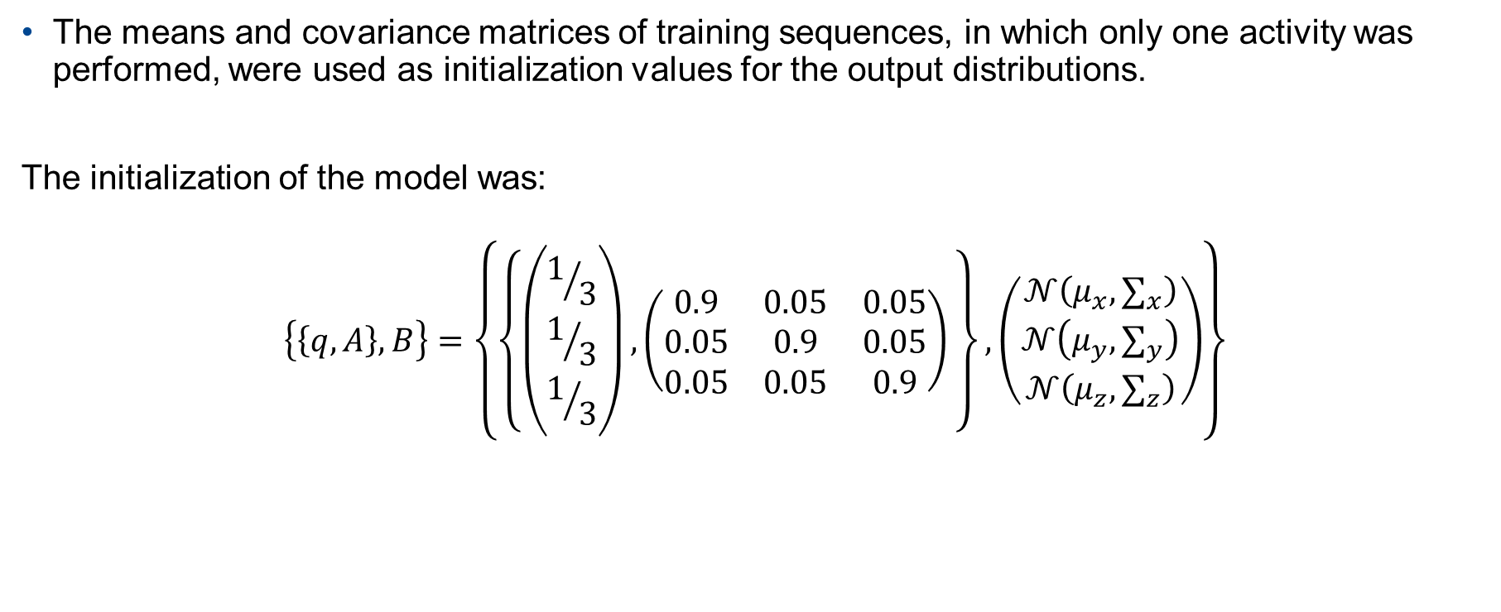
Methodology
The means and covariance matrices of training sequences, in which only one activity was performed, were used as initialization values for the output distributions.
The initialization of the model was:
$$\left\{\left\{q, A\right\}, B\right\}=\left\{\left\{\left(\begin{aligned}1/3 \\ 1/3 \\ 1/3\end{aligned}\right),\left(\begin{matrix}0.9 & 0.05 & 0.05 \\ 0.05 & 0.9 & 0.05 \\ 0.05 & 0.05 & 0.9\end{matrix}\right) \right\},\left(\begin{aligned}𝒩\left(μ_{x},∑_{x}\right) \\ 𝒩\left(μ_{y},∑_{y}\right) \\ 𝒩\left(μ_{z},∑_{z}\right)\end{aligned}\right)\right\}$$

Slide 7
Methodology
Since the Baum-Welch-Algorithm is quite effective, it usually converges after 5 till 10 iterations. The model was trained with 5 iterations.

Slide 8
Assignment 3
Problem:
Calculate the expected information gain corresponding to each of the six attributes
Result:
For all three datasets brings A5 the most information gain → split tree according to that attribute
Dataset | A1 | A2 | A3 | A4 | A5 | A6
MONK-1 | 0.075 | 0.006 | 0.005 | 0.026 | 0.287 | 0.001
MONK-2 | 0.004 | 0.002 | 0.001 | 0.016 | 0.017 | 0.006
MONK-3 | 0.007 | 0.294 | 0.001 | 0.003 | 0.256 | 0.007

Slide 9
Assignment 4
Problem:
How does the entropy of the subsets look like? How can you motivate to use the information gain for splitting?
Result:
Entropy of subsets is minimized (see formula for information gain)
We try to split tree that gives subset with least randomness
Information gain gives the difference of entropy before and after split
To reduce randomness (= entropy) we go for that attribute which produces highest information gain

Slide 10
Assignment 5 - 1
A5
1
2
3
4
TRUE
A4
A6
A1
1
2
3
1
2
1
2
3
FALSE
FALSE
FALSE
FALSE
FALSE
FALSE
FALSE
TRUE

Slide 11
Assignment 5 - 2
Problem:
Compute the train and test set errors for the three Monk datasets for the full trees.
Result:
Error for training sets is 0, because they were used to build the tree
 | E_train | E_test
MONK-1 | 0 | 0.171
MONK-2 | 0 | 0.307
MONK-3 | 0 | 0.056

Slide 12
Assignment 6
Problem:
Explain pruning from a bias variance trade-off perspective.
Result:
A too complex model results in a low bias but high variance (overfitting)
Pruning simplifies the model, increasing the bias but reducing the variance. We might increase performance to a certain degree until the model is too simple for the dataset and the bias becomes too high, we underfit.

Slide 13
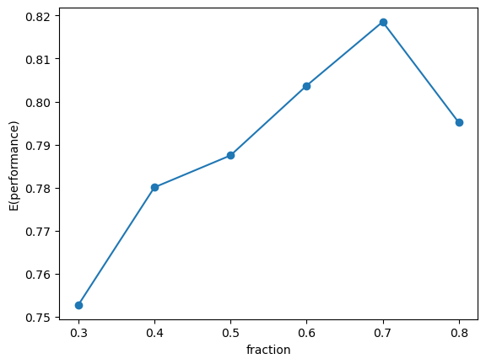
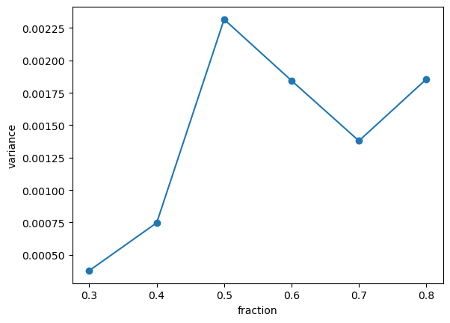
Assignment 7 - 1
Problem:
Plot the classification error on the test sets as a function of the parameter fraction.
Result for MONK-1: best fraction is 0.7
Mean performance over 10 runs
Variance of the performance over 10 runs

Slide 14
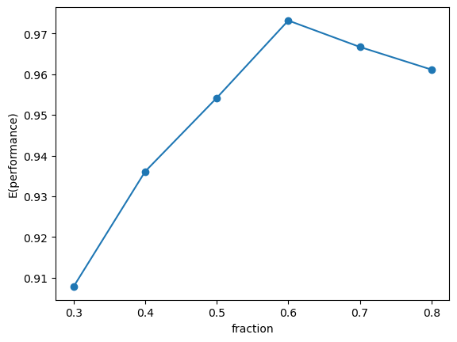
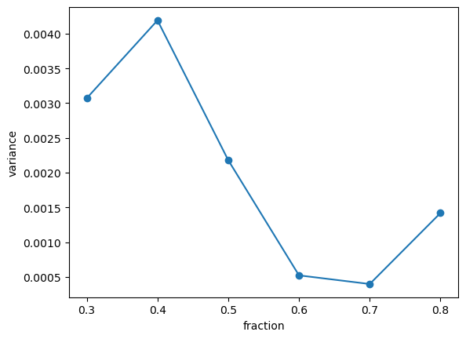
Assignment 7 - 2
Problem:
Plot the classification error on the test sets as a function of the parameter fraction.
Result for MONK-3: best fraction is 0.6
Mean performance over 10 runs
Variance of the performance over 10 runs

