Slide 1
EQ2341 – Activity Recognition
Theresa Hösl
Repository: https://github.com/TheresaHoesl/PatternRecognition_MachineLearning/tree/main/Final_project

Slide 2
Objective
Implementation of a classifier for activity recognition based on data from the phone’s sensors.
The algorithm should be able to accurately discriminate between three activities: standing still, walking, and running.
An infinite HMM with three underlying states can solve this problem.

Slide 3
Data
Sequence of column vectors of length three (ax, ay, az) captured by phone’s app while performing the activities.
Training:
One sequence of standing, walking and running each
One sequence where the three activites were performed several times in different orders
Testing:
Three sequence of standing, walking and running each
Three sequences in which the three activites were performed for 5 sec several times in different orders

Slide 4
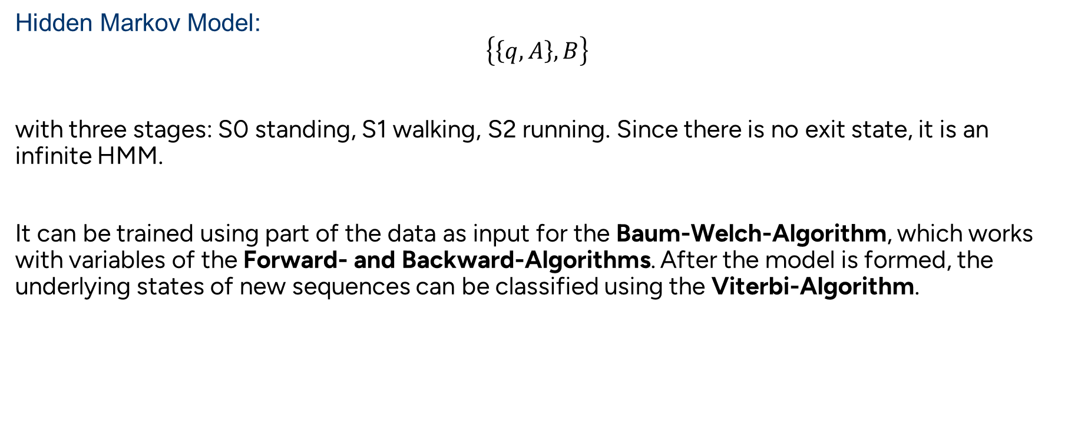
Methodology
Hidden Markov Model:
$$\left\{\left\{q, A\right\}, B\right\}$$
with three stages: S0 standing, S1 walking, S2 running. Since there is no exit state, it is an infinite HMM.
It can be trained using part of the data as input for the Baum-Welch-Algorithm, which works with variables of the Forward- and Backward-Algorithms. After the model is formed, the underlying states of new sequences can be classified using the Viterbi-Algorithm.

Slide 5
Methodology
Baum-Welch-Algorithm:
The algorithm converges only to local maxima, not global ones. Therefore, the values for the initialization can improve/ decrease the performance.
The probability for a sequence to start with any of the states is equal → q is initialized with 1/3 for each state
The probability to stay in the current state is bigger than to switch to one of the other two states. We can assume that the A matrix will have high values in the diagonal.
The output distributions can be assumed to be multivariate normal distributed with different means and covariance matrices for the three distributions.

Slide 6
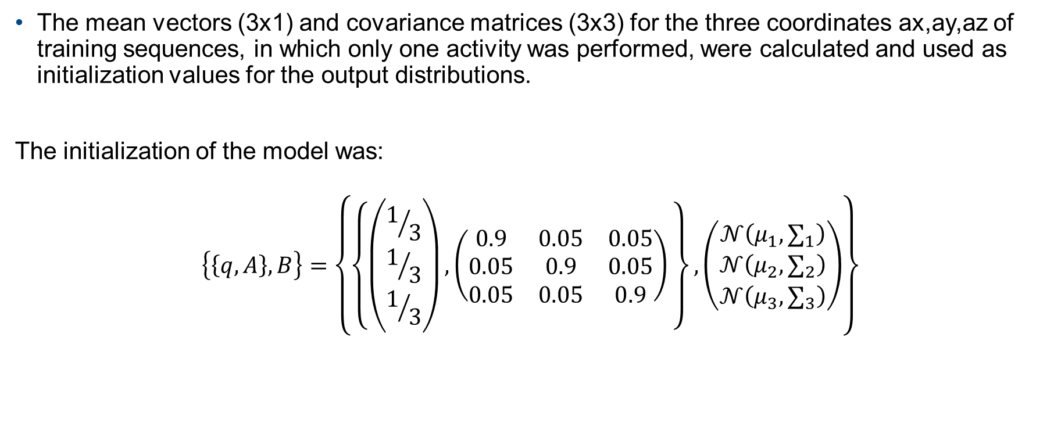
Methodology
The mean vectors (3x1) and covariance matrices (3x3) for the three coordinates ax,ay,az of training sequences, in which only one activity was performed, were calculated and used as initialization values for the output distributions.
The initialization of the model was:
$$\left\{\left\{q, A\right\}, B\right\}=\left\{\left\{\left(\begin{aligned}1/3 \\ 1/3 \\ 1/3\end{aligned}\right),\left(\begin{matrix}0.9 & 0.05 & 0.05 \\ 0.05 & 0.9 & 0.05 \\ 0.05 & 0.05 & 0.9\end{matrix}\right) \right\},\left(\begin{aligned}𝒩\left(μ_{1},∑_{1}\right) \\ 𝒩\left(μ_{2},∑_{2}\right) \\ 𝒩\left(μ_{3},∑_{3}\right)\end{aligned}\right)\right\}$$

Slide 7
Methodology
Since the Baum-Welch-Algorithm is quite effective, it usually converges after 5 till 10 iterations. The model was trained with 5 iterations.
The Baum-Welch-Algorithm was implemented in the function train(seq) of the class HMM according to „Leijon, Arne. (2016) Pattern Recognition. KTH, Stockholm“
As the model was trained with only one sequence, the initial probability vector q has a very high value close to one for the state with which the training sequence started. The other two values are close to zero. However, new sequences can start with any state, so q is reset to equal probabilities for all states.

Slide 8
Methodology
Viterbi-Algorithm:
It was implemented in the function states = viterbi(seq) of the class HMM according to „Leijon, Arne. (2016) Pattern Recognition. KTH, Stockholm“. It returns the most probable underlying state sequence of the input sequence.
Data Handling and pre-processing:
This is handled in the function data = readFile(name) of the class DataHandler. It reads the file with the input name into a dataframe, drops unnecessary columns and applys the moving average filter. The data is stored and returned in the form of a numpy.array.

Slide 9
Verification
For three sequences with only one activity:
The model was tested with three sequences of each activity. The accuracies to detect the correct state at every time instance were:
The confusion matrix:
State | Standing (S0) | Walking (S1) | Running (S2)
Accuracy | 1 | 0.86 | 0.94
Actual\Predicted | Standing (S0) | Walking (S1) | Running (S2)
Standing (S0) | 1 | 0 | 0
Walking (S1) | 0 | 0.86 | 0.14
Running (S2) | 0 | 0.06 | 0.94

Slide 10
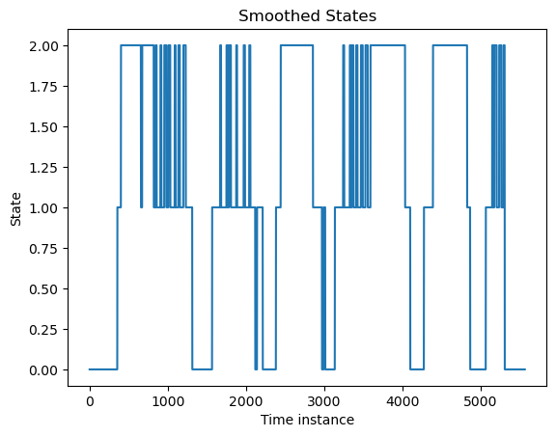
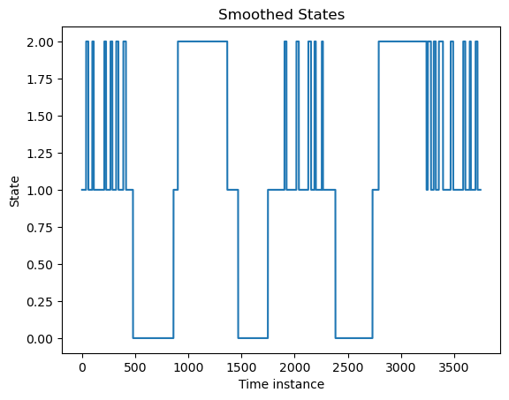
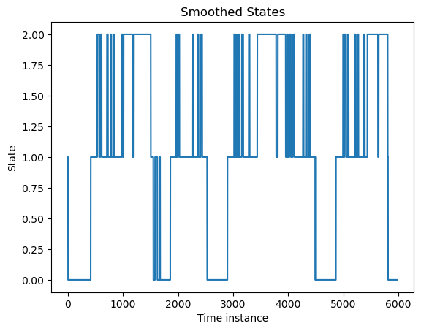
Verification
For sequences with alternating activities:
Every five seconds, the activity was randomly changed. The output was then filtered with a majority filter. Still, the HMM alternates very often between walking and running. Furthermore, it is almost impossible for humans to switch from running to standing and vice versa without a short walking sequence.

Slide 11
Conclusion
The HMM can classify the activity “standing” very well. However, “walking” and “running” get confused more easily. This can be improved by filtering the state sequence to detect single outliers.
Other possible improvements:
With more and more complex training data (captured form different people, turning the phone instead of holding it parallel to the ground) the model can be made more robust.
k fold cross-validation
More pre-processing of data
Better initial estimation to find global maximum

