Slide 1




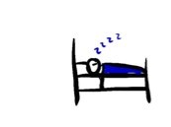
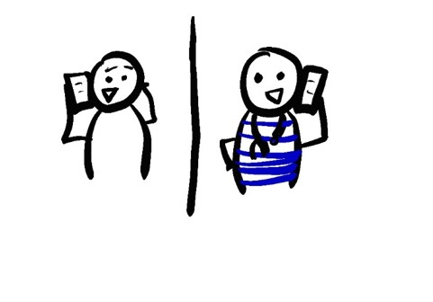
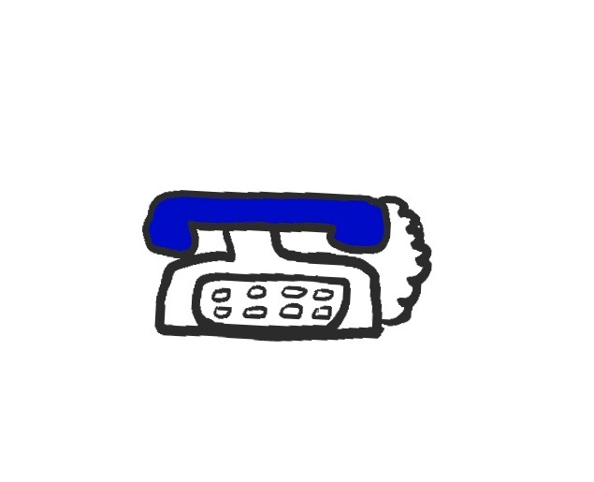

WHAT TO EXPECT IF YOU ARE HOSPITALIZED FOR COVID
YOU ARE BEING ADMITTED BECAUSE YOU MAY HAVE COVID-19 WHICH IS VERY INFECTIOUS.
WE WANT TO PROTECT YOUR HEALTH, AND HEALTH OF THE STAFF AND OTHER PATIENTS.
OUR PROMISE TO YOU
YOU WILL NEVER BE ALONE. WE MAY BE OUTSIDE THE ROOM BUT WE ARE HERE FOR YOU
FOR YOUR SAFETY, YOU CANNOT HAVE VISITORS, BUT YOU CAN TALK TO FAMILY AND FRIENDS
WE WILL ALWAYS ANSWER YOUR QUESTIONS
WE WILL NEVER STOP CARING FOR YOU
THIS IS THE ISOLATION FLOOR
PLEASE DO NOT LEAVE YOUR ROOM EVEN TO SMOKE
NO VISITORS ARE ALLOWED
WE WILL HELP YOU FILL OUT A CONTACT FORM SO WE KNOW WHO TO CALL IF YOU GET SICKER VERY QUICKLY
WE WILL COME INTO YOUR ROOM LESS OFTEN
WE HAVE A PLAN TO MAKE SURE
YOU GET UPDATES FROM YOUR MEDICAL TEAM
YOU CAN COMMUNICATE YOUR QUESTIONS AND CONCERNS TO US
NURSES WILL CLUSTER YOUR CARE AND MEDICATIONS AROUND MEAL TIMES
BREAKFAST IS 8-9AM
LUNCH IS 11-NOON
DINNER IS 4:30-5:30
THIS WILL ALSO HELP YOU GET MORE REST, BECAUSE YOU WON’T BE DISTURBED.
IF THE BLUE PHONE RINGS, IT IS YOUR HEALTH CARE TEAM. IF YOU NEED SOMETHING, PRESS THE CALL LIGHT
ANSWER THE BLUE PHONE SO YOUR HEALTH CARE TEAM CAN TALK TO YOU
IF YOU PREFER A LANGUAGE OTHER THAN ENGLISH, WE CAN HAVE AN INTERPRETER ON THE PHONE CALL
TELL THE PERSON WHO ANSWERS THE CALL LIGHT WHAT YOU NEED
@epiellie
@benjaminlinas
@the_BMC

Slide 2
A KISA POU W’ ATANN OU SI OU OSPITALIZE POU COVID
YO ADMÈT OU LOPITAL PASKE LI POSIB KE OU GENYEN COVID-19, YON MALADI KI KA KONTAMINE ANPIL MOUN . NOU VLE PWOTEJE SANTE W’, SANTE MOUN KI AP TRAVAY LOPITAL LA AK SANTE LÒT PASYAN YO.
SA NOU PROMÈT OU
OU PA P’ JANM POUKONT OU. MENM LÈ NOU GENDWA RETE DEYÒ PÒT CHANM NAN, NOU LA AVÈ W’
POU SEKIRITE W’, OU PA KA GEN VIZITÈ, MEN OU GENDWA PALE AK ZANMI E AK FANMI W’
N’AP TOUJOU REPONN KESTYON W’
NOU PA P’ JANM SISPANN PRAN SWEN W’
SA SE ETAJ IZÒLMAN
TANPRI PA KITE CHANM OU, MENM POU W’ AL FIMEN
VIZITÈ PA GENDWA RANTRE LA
N’AP EDE W’ RANPLI YON FÒMILÈ POU NOU KA KONNEN KIYÈS POU NOU RELE SI KA OU VIN PI GRAV
NOU PA P’ PEDE ANTRE/SOTI NAN CHANM OU
NOU GEN YON JAN POU NOU ASIRE KE
OU GEN TOUT ENFÒMASYON DE EKIP MEDIKAL LA POU OU KONNEN KISA K’AP PASE
OU KA POZE KESTYON OU BYEN KOMINIKE NENPÒT ENKYETID OU GENYEN
ENFIMYÈ YO AP BA OU MEDIKAMAN AK SWEN EN GRAP, VÈ LÈ MANJE W’
MANJE MATEN SE DE 8-9AM
MANJE MIDI SE DE 11-MIDI
MANJE APRÈ MIDI SE DE 4:30-5:30
L’AP EDE W’ REPOZE W’ PASKE OU PA P’ DERANJE
SI TELEFÒN BLE A SONNEN, SE EKIP MEDIKAL OU K’AP RELE. SI OU BEZWEN YON BAGAY, PEZE BOUTON “CALL” LA
REPONN TELEFÒN BLE A POU EKIP MEDIKAL LA KA PALE AVÈ W’
SI OU PITO YON LÒT LANG PASE ANGLÈ, NOU KA GEN YON ENTÈPRÈT SOU APÈL LA
SI OU PEZE BOUTON “CALL” LA, DI MOUN KI REPONN NAN SA W’ BEZWEN
@epiellie
@benjaminlinas
@the_BMC

