Slide 1
LensBlock
Intelligent Protection Against Visual Hacking
Abdullah Asim
atomcamp AI Cohort 15

Slide 2
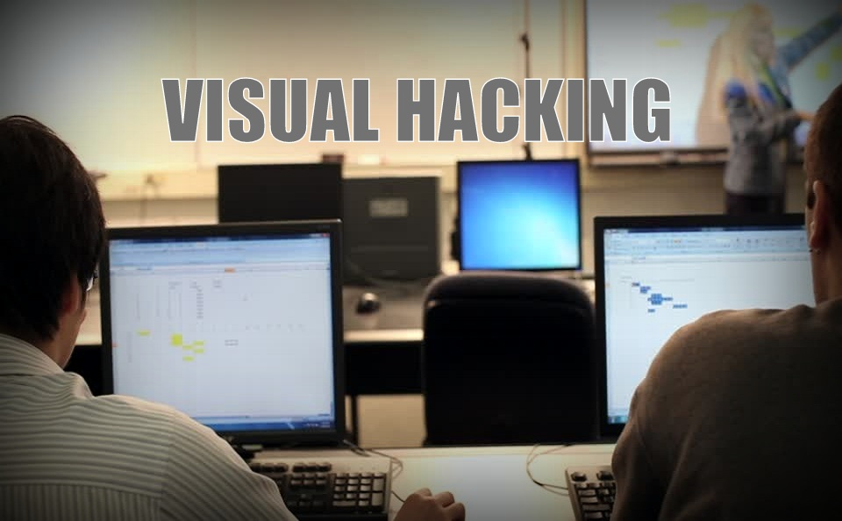
Visual hacking

Slide 3
Project Overview
LensBlock is an endpoint security system designed to enforce:
Zero Trust Architecture
Using host system resources
Obfuscation upon detection

Slide 4
"Paragon Solutions" Vulnerability
High profile intelligence failure
Spyware firm “Paragon Solutions”
Employee Negligence
News Source: The Israeli Spyware Firm That Accidentally Just Exposed Itself

Slide 5
Addressing the market gap
Traditional DLP Tools
LensBlock digitizes the "No Photography" policy
It provides an automated, always-on watchdog
Whether for a malicious copy or an act of negligence

Slide 6
The v2 evolution
v1 (Shield Mode):
Full screen blackout upon threat detection
Highly secure but actively disruptive
v2 (Censorship Mode) Discussed in Q/A Session:
Real time privacy
Blurs confidential info in camera feed

Slide 7
Architecture
Python (3.11.x)
YOLOv26-Nano
ONNX Runtime
OpenCV
PyQt6
Pyvirtualcam

Slide 8
Hardening & Edge Cases
Temporal Hysteresis Memory Buffer
ROI Padding
Smart CLAHE Contrast Enhancement
Kalman Filter

Slide 9
Caveats
Hardware Requirements
Virtual Camera Dependency
AI Limitations (False Positives, True Negatives)
Target Scope

Slide 10
Future Roadmap
Authorized Person Whitelisting
Low Level Device Control
Lower Inference Requirements
Support for more devices/OS
Improved Detection

