Slide 1
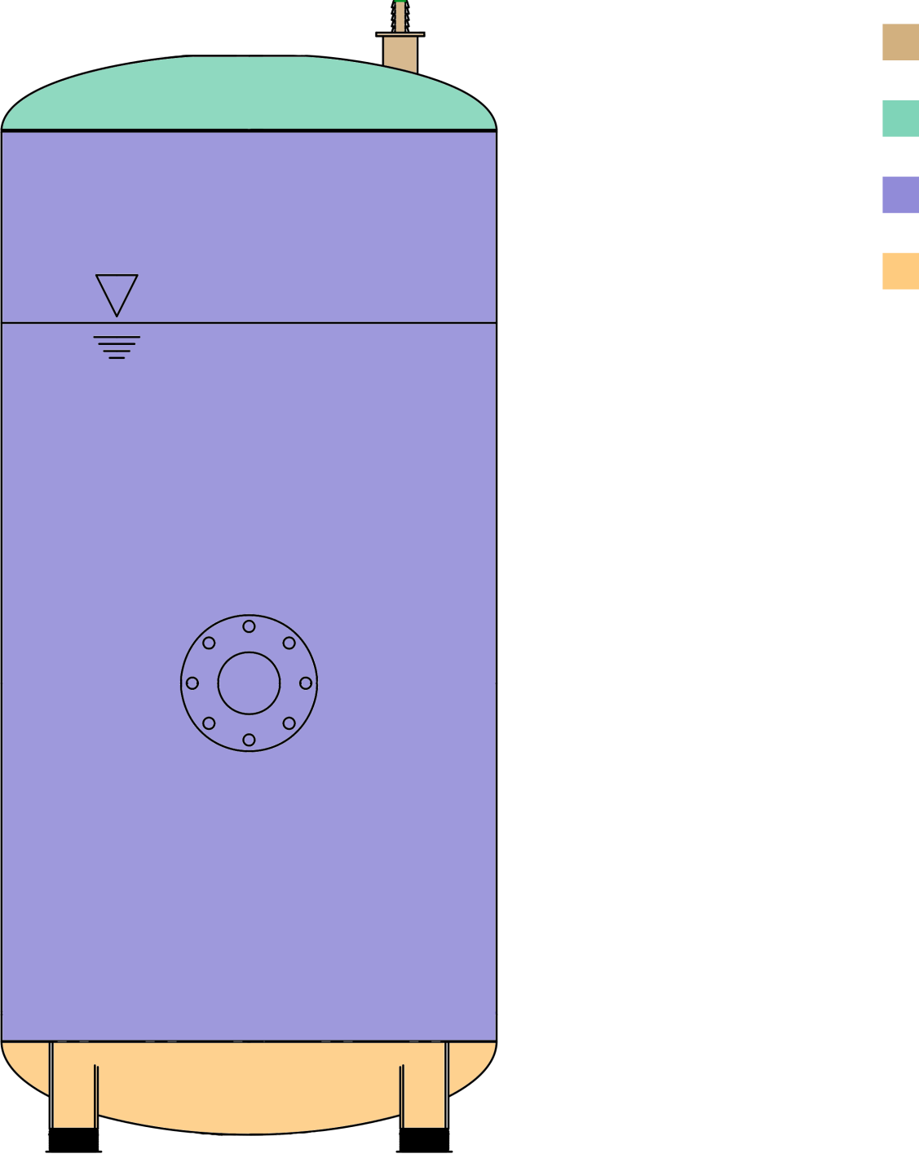
Tank Top
Steam Relief
Tank Top Cap
Tank Cylinder
Tank Bottom Cap
Fill
Height
Hot Inlet CL
Tank Bottom

