Slide 1

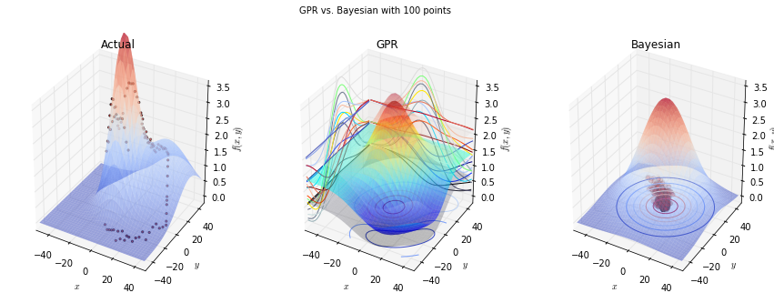
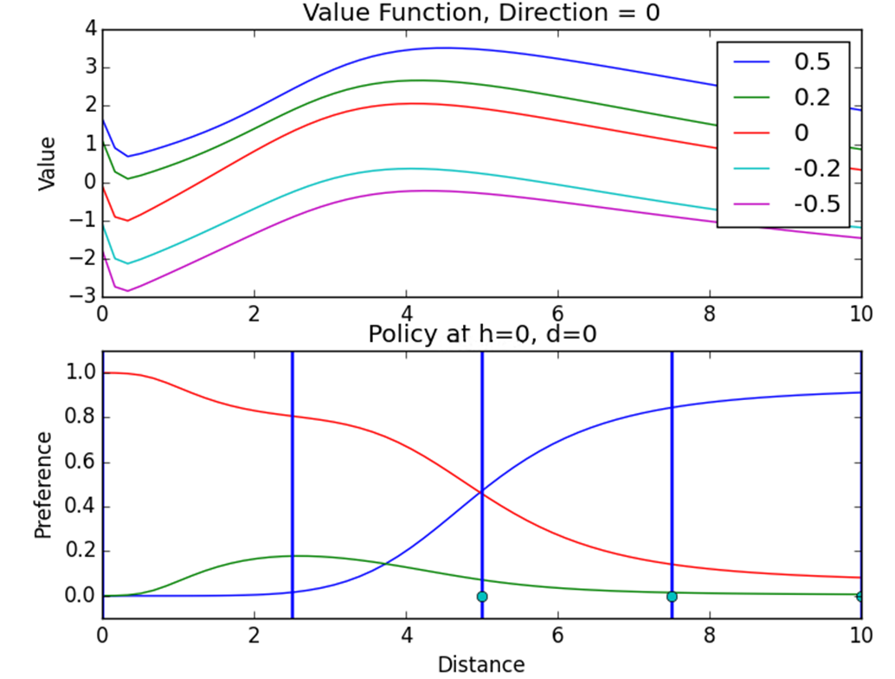
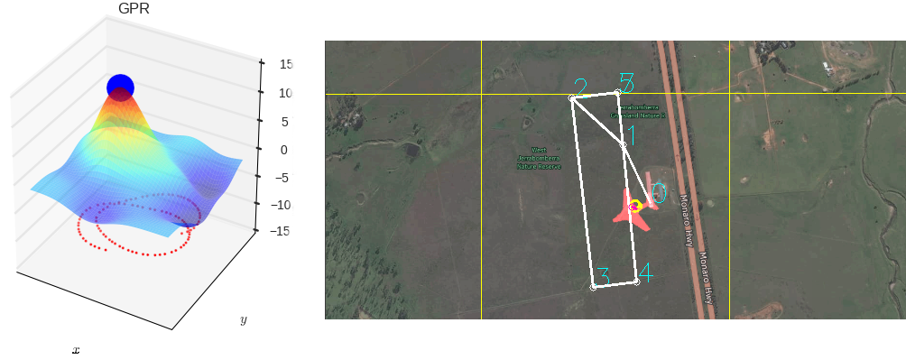

Machine Learning for Thermal Soaring
Autonomously mimic the soaring habits of birds with a glider
Travis Crumley, David Egolf, and Garrett Wilson
Edward F. Cross School of Engineering, Walla Walla University, College Place, Washington
ABSTRACT
Our project was to create and implement the software necessary for a glider to autonomously find and use the updrafts from thermals to sustain longer flight times. The project was divided into three parts: a basic implementation of existing algorithms, an exploration of thermal identification methods, and an exploration of machine learning to provide better soaring decisions.
IMPROVEMENT: THERMAL IDENTIFICATION
The centroid method merely provides an estimate of where the thermal center may be. One improvement upon this method would be to predict what the entire thermal looks like. We investigated two possible approaches: Bayesian parameter estimation, which predicts a probability distribution over possible values each parameter of a model could take on, and Gaussian process regression, which predicts a Gaussian probability distribution over values each point in a $n$-dimensional space could take on. Because of its superior predictions and execution speed in tests, Gaussian process regression was pursued further and implemented in simulation.
IMPROVEMENT: POLICY DEVELOPMENT
Under the centroid method, the flexibility of the energy extraction strategy is limited. We tried to create a more flexible strategy in three ways, all using machine learning: table-based Q-learning, neural fitted Q-learning, and dynamic programming with neural interpolation. Table-based Q-learning discretizes the state space, and estimates the value of each possible action in each state space chunk. We used this method successfully in a low dimensional setting, but we had difficulty scaling it up. Neural-fitted Q-learning uses a neural network to stores value estimates, but we had difficulty properly incorporating new information into the neural network. Dynamic programming with neural interpolation uses a system model to simulate interactions. To allow for a continuously varying policy, we store the resulting value and policy estimates using neural networks.
INTRODUCTION
You may have noticed that hawks and other birds tend to soar in large circles or loops in the sky. What they’re actually doing is taking advantage of hot air rising in the atmosphere. By flying in that hot section of air they rise with it and can soar for hours with little effort. This project seeks to mimic these birds using sensors and software.
BASIC IMPLEMENTATION
After researching the subject, the basic implementation we decided on was a combination of a paper from Daniel Edwards and a paper from Michael Allen, one of our sponsors on the project.
The first step was to create an equation capable of using sensor data on the glider to find how much thermal energy was in the air. This resulted in the following energy equation, which we continuously calculate at a rate of 20 Hz.
Figure 2: Gaussian process regression (center) compared with Bayesian parameter estimation (right) learning what a simple Gaussian-shaped thermal model looks like given only discrete points along a circular flight path (left)
The next step uses that energy data to decide whether to actually try and use this thermal or not. If the thermal looks strong enough, the glider latches onto it and moves to Michael Allen’s centroid method to find where the center of the thermal is.
The centroid method examines the relation between the location of the glider and the energy data, and then selects the range where the energy seems to be highest as the likely center point. It then adjusts for the movement of the thermal by comparing old and new data before giving a final value for the thermal center.
Gather Data
Find Current Thermal Energy
Check The Strength
Make Latching Decision
Estimate Thermal Center
Figure 3: Gaussian process regression (left) run live on data collected from a glider flying in the simulator (right)
Figure 4: Value and policy estimates with thermal at 5, and with the UAV facing the origin.
In the value plot (above), the legend refers to the UAV height.
In the policy plot (below), blue = travel towards origin, green = travel away from origin, and red = orbit.
A
B
RESULTS. As the glider flies a flight path gaining altitude, it collects and runs the last 45 seconds of data through Gaussian process regression predicting the vertical velocity in a 20-meter radius around the glider. Because it predicts a probability distribution, which provides a measure of uncertainty, this can be used in determining whether it is beneficial to latch onto a thermal. The glider will start circling the point of the highest predicted vertical velocity if with 85 percent confidence this velocity is above a certain threshold. Figure 3 shows a test in simulation where the glider successfully found a thermal and has orbited it twice.
RESULTS. Using dynamic programming with neural interpolation, the learning agent learned a plausible and flexible policy, which adjusted in response to thermal position and shape. This was carried out in an idealized environment, with the following state variables: distance from center of thermal, height of UAV, and direction of UAV. Current work is focused on testing the developed algorithms in the more sophisticated CRRCSim simulator, with additional states and additional actions.
Figure 1: The Process Cycle
While the energy remains high enough to gain continous lift, the aircraft then orbits this center point, constantly updating it by running the cycle shown in Figure 1. If the energy drops too low, it unlatches and continues on its original route.
REFERENCES
Allen, Michael J. "Autonomous soaring for improved endurance of a small uninhabited air vehicle." Proceedings of the 43rd aerospace sciences meeting, AIAA. 2005.
Edwards, Daniel J. Autonomous Locator of Thermals (ALOFT) Autonomous Soaring Algorithm. No. NRL/FR/5712--15-10. NAVAL RESEARCH LAB WASHINGTON DC, 2015.
Korb, Kevin B., and Ann E. Nicholson. Bayesian Artificial Intelligence. Boca Raton, FL: CRC, 2010. Print.
Lawrance, Nicholas RJ. Autonomous soaring flight for unmanned aerial vehicles. Diss. University of Sydney, 2011.
SUMMARY
Successfully implemented a basic soaring algorithm using existing research from Daniel Edwards and Michael Allen.
Gaussian process regression was successfully used to identify complex thermals and circle them in the CRRCSIM simulator.
Dynamic programming with neural interpolation was successfully used to develop an adaptive policy in a simplified environment.
RESULTS. While not the most efficient, this method seems to work well for most simple use cases. In simulation with the Piccolo autopilot it was able to detect and orbit a variety of thermals in its path. However it does not always provide the best use of the thermal, leading to possible improvements.
In partial fulfillment of the requirements for ENGR 498, Senior Seminar

