Slide 1

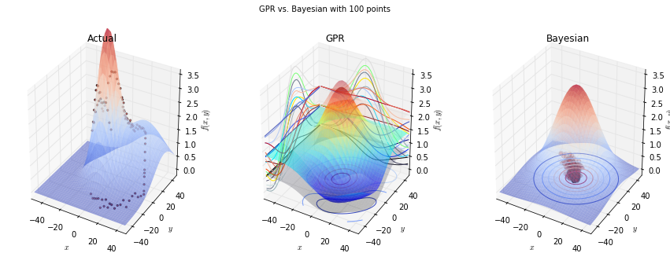
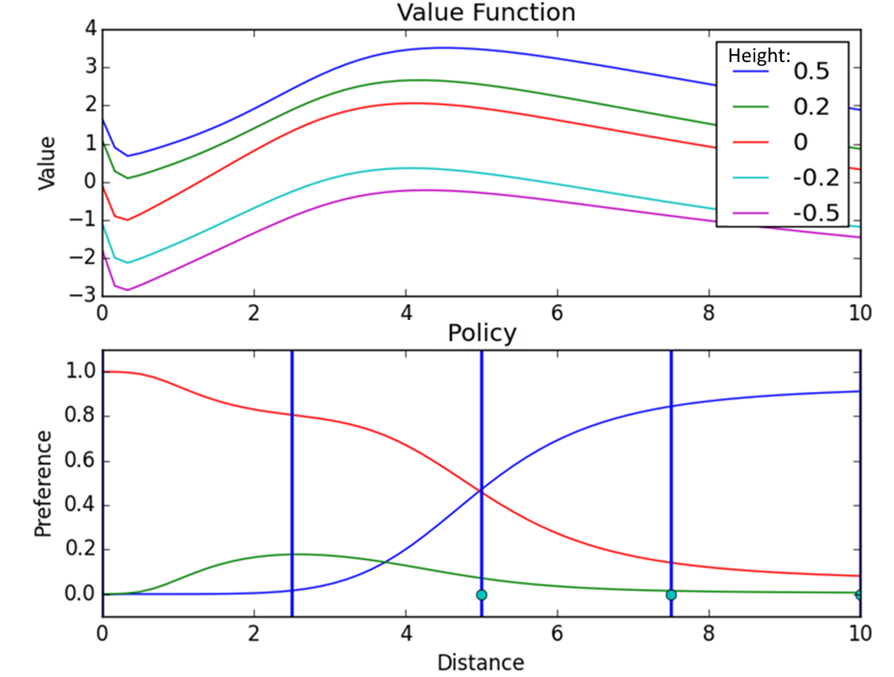
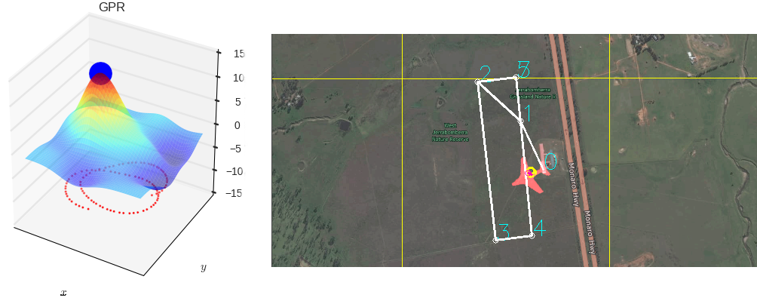

Machine Learning for Thermal Soaring
Autonomously mimic the soaring habits of birds with a glider
Travis Crumley, David Egolf, and Garrett Wilson
Edward F. Cross School of Engineering, Walla Walla University, College Place, Washington
ABSTRACT
Our goal was to increase glider flight time by writing software for autonomously finding and using thermal updrafts. We split our work into three parts: basic implementation of an existing algorithm, exploration of thermal identification methods, and exploration of machine learning methods for more flexible decision making.
IMPROVEMENT: THERMAL IDENTIFICATION
The centroid method merely provides an estimate of where the thermal center may be. One improvement upon this method would be to predict what the entire thermal looks like. We investigated two possible approaches: Bayesian parameter estimation, which predicts a probability distribution over possible values each parameter of a model could take on, and Gaussian process regression, which predicts a Gaussian probability distribution over values each point in a $n$-dimensional space could take on. Because of its superior predictions and execution speed in tests, Gaussian process regression was pursued further and implemented in simulation.
IMPROVEMENT: FLEXIBLE DECISION MAKING
Under the centroid method, the flexibility of the energy extraction strategy is limited. We tried to create a more flexible strategy in three ways, all using machine learning: table-based Q-learning, neural fitted Q-learning, and dynamic programming with neural interpolation. Table-based Q-learning discretizes the state space, and estimates the value of each possible action in each state space chunk. We used this method successfully in a low dimensional setting, but had difficulty scaling it up. Neural-fitted Q-learning uses a neural network to store value estimates, but we had difficulty properly incorporating new information into the neural network. Dynamic programming with neural interpolation uses a system model to simulate interactions. To allow for a continuously varying policy, we store the resulting value and policy estimates using neural networks.
INTRODUCTION
You may have noticed that hawks and other birds tend to soar in large circles or loops in the sky. What they’re actually doing is taking advantage of hot air rising in the atmosphere. By flying in that hot section of air they rise with it and can soar for hours with little effort. This project seeks to mimic these birds using sensors and software.
BASIC IMPLEMENTATION
After researching the subject, the basic implementation we decided on was a combination of a paper by Daniel Edwards and a paper by Michael Allen, one of our sponsors on the project.
The first step was to create an equation that uses sensor data from the glider to find how much thermal energy is in the air. Here is the resulting energy equation, which we recalculate at a rate of 20 Hz:
Figure 2: Gaussian process regression (center) compared with Bayesian parameter estimation (right) learning what a simple Gaussian-shaped thermal model looks like given only discrete points along a circular flight path (left)
The next step was to use the energy data to decide whether to use the current thermal or not. If the thermal looks strong enough, the glider latches onto it and uses Michael Allen’s centroid method to find where the center of the thermal is.
The centroid method examines the relation between the location of the glider and the energy data, and then selects the range where the energy seems to be highest as the likely center point. It then adjusts for the movement of the thermal by comparing old and new data before giving a final value for the thermal center.
Gather Data
Find Current Thermal Energy
Check The Strength
Make Latching Decision
Estimate Thermal Center
Figure 3: Gaussian process regression (left) running live on vertical velocity measurements collected from a glider flying in the CRRCSim simulator (right)
Figure 4: Value and policy estimates. The thermal is at 5, and the UAV faces the origin.
In the policy plot (below), blue = travel towards origin, green = travel away from origin, and red = orbit.
A
B
RESULTS. As the glider flies a flight path gaining altitude, it collects and runs the last 45 seconds of data through Gaussian process regression predicting the vertical velocity in a 20-meter radius around the glider. Because it predicts a probability distribution, which provides a measure of uncertainty, this can be used in determining whether it is beneficial to latch onto a thermal. The glider will start circling the point of the highest predicted vertical velocity if with 85 percent confidence this velocity is above a certain threshold. Figure 3 shows a test in simulation where the glider successfully found a thermal and has orbited it twice.
RESULTS. Using dynamic programming with neural interpolation, the glider learns a plausible and adaptive policy that adjusts in response to thermal position and shape. This learning occurred in an idealized environment with the following state variables: distance of glider from thermal center, height of glider, and direction of glider. Current work is focused on testing the developed algorithm in the more sophisticated CRRCSim simulator, with additional states and actions.
Figure 1: The Process Cycle
While the energy remains high enough to gain continuous lift, the aircraft then orbits this center point, constantly updating it by running the cycle shown in Figure 1. If the energy drops too low, it unlatches and continues on its original route.
SUMMARY
Implemented a basic soaring algorithm using existing research from Daniel Edwards and Michael Allen.
Used Gaussian process regression to identify complex thermals and circle them in the CRRCSim simulator.
Used dynamic programming with neural interpolation to develop an adaptive policy in a simplified environment.
REFERENCES
Allen, Michael J. "Autonomous soaring for improved endurance of a small uninhabited air vehicle." Proceedings of the 43rd aerospace sciences meeting, AIAA. 2005.
Edwards, Daniel J. Autonomous Locator of Thermals (ALOFT) Autonomous Soaring Algorithm. No. NRL/FR/5712--15-10. NAVAL RESEARCH LAB WASHINGTON DC, 2015.
Korb, Kevin B., and Ann E. Nicholson. Bayesian Artificial Intelligence. Boca Raton, FL: CRC, 2010. Print.
Lawrance, Nicholas RJ. Autonomous soaring flight for unmanned aerial vehicles. Diss. University of Sydney, 2011.
RESULTS. While not the most efficient, this method seems to work well for most simple use cases. In simulation with the Piccolo autopilot it was able to detect and orbit a variety of thermals in its path. However it does not always provide the best use of the thermal, and so we focused on improvements in the remainder of our work.
In partial fulfillment of the requirements for ENGR 498, Senior Seminar

