Slide 1

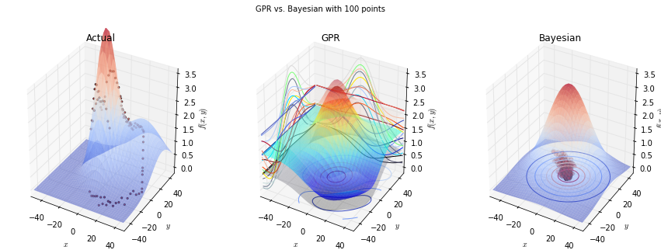
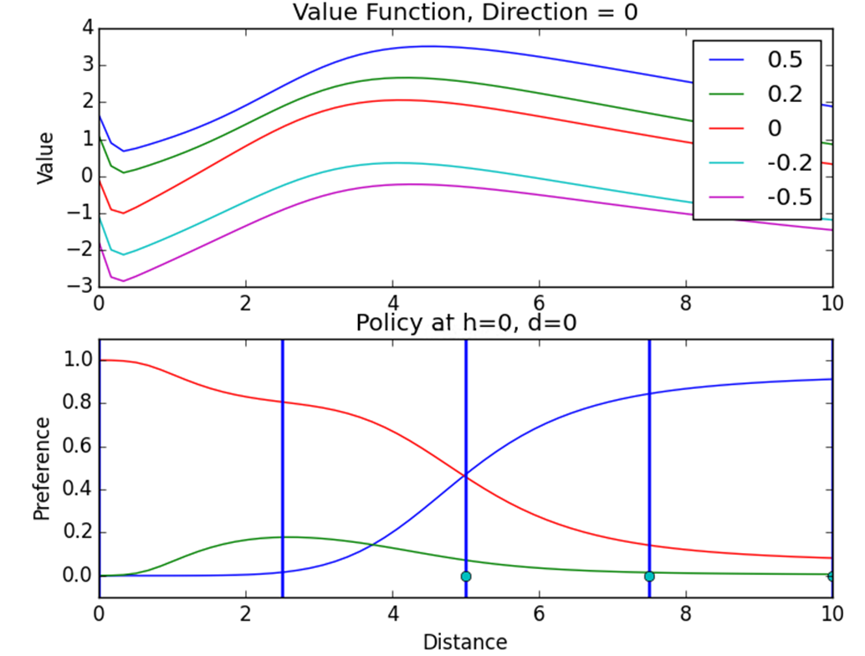
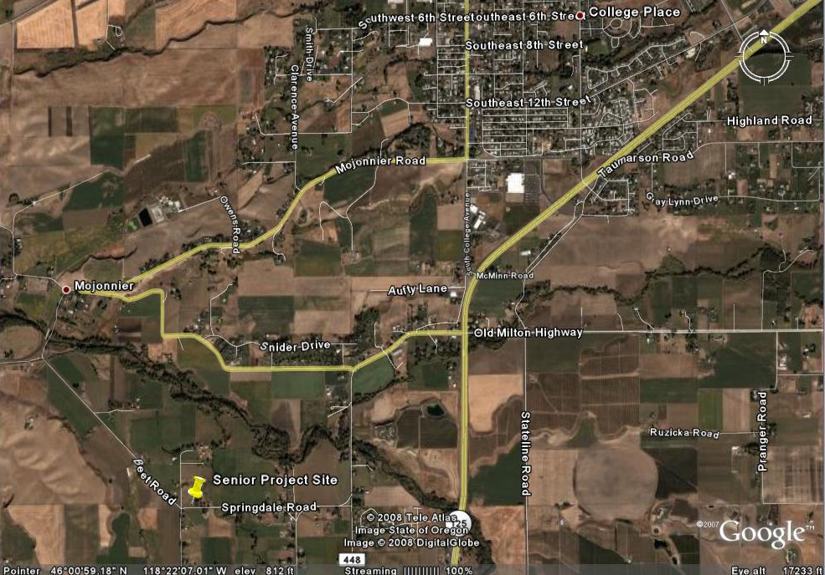
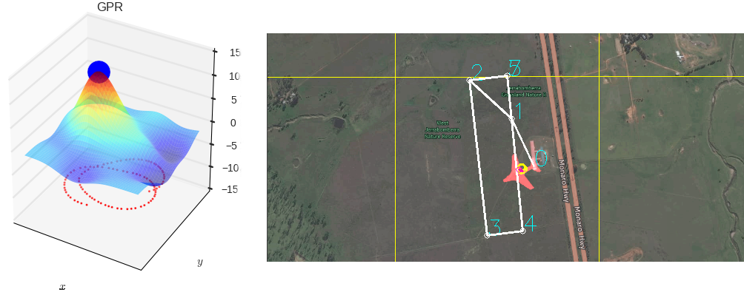
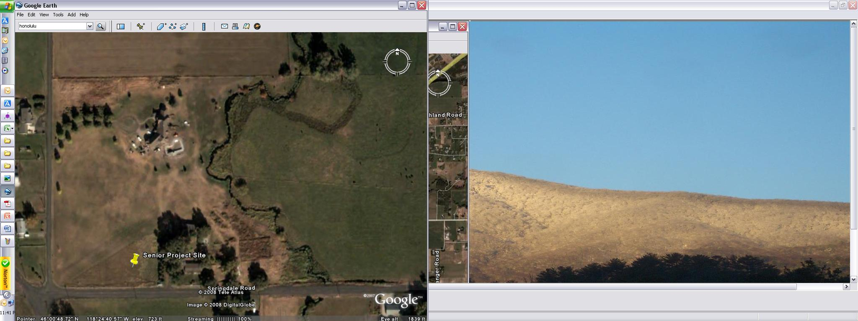

Machine Learning for Thermal Soaring
Autonomously mimic the soaring habits of birds with a glider
Travis Crumley, David Egolf, and Garrett Wilson
Edward F. Cross School of Engineering, Walla Walla University, College Place, Washington
ABSTRACT
Our project to create and implement the software necessary for a glider to autonomously find and use the updrafts from thermals to sustain longer flight times was divided into three parts: a basic implementation of existing algorithms, an exploration of thermal identification methods, and an exploration of machine learning to provide better soaring decisions.
IMPROVEMENT: THERMAL IDENTIFICATION
The centroid method merely provides an estimate of where the thermal center may be. One improvement upon this method would be to predict what the entire thermal looks like. We investigated two possible approaches: Bayesian parameter estimation, which predicts a probability distribution over possible values each parameter of a model could take on, and Gaussian process regression, which predicts a Gaussian probability distribution over values each point in a $n$-dimensional space could take on. Because of its superior predictions and execution speed in tests, Gaussian process regression was pursued further and implemented in simulation.
IMPROVEMENT: POLICY DEVELOPMENT
Under the centroid method, the flexibility of the energy extraction strategy is limited. We tried to create a more flexible strategy in three ways, all using machine learning: table-based Q-learning, neural fitted Q-learning, and dynamic programming with neural interpolation. Table-based Q-learning discretizes the state space, and estimates the value of each possible action in each state space chunk. We used this method successfully in a low dimensional setting, but we had difficulty scaling it up. Neural-fitted Q-learning uses a neural network to stores value estimates, but we had difficulty properly incorporating new information into the neural network. Dynamic programming with neural interpolation uses a system model to simulate interactions. To allow for a continuously varying policy, we store the resulting value and policy estimates using neural networks.
INTRODUCTION
The 13-acre property where the structure is to be built is located about five miles south of College Place, WA in Walla Walla County. The relative terrain is mostly flat with a few trees and a small river, the East Walla Walla River, passing through the property. However, some 40 foot bluffs unique to the Walla Walla Valley are within 1,500 feet of the proposed building site. A grass landing strip bisects the property diagonally (See Figure 1.)
Figure 2: Gaussian process regression (center) compared with Bayesian parameter estimation (right) learning what a simple Gaussian-shaped thermal model looks like given only discrete points along a circular flight path (left)
A
B
Figure 3: Gaussian process regression (left) run live on data collected from a glider flying in the simulator (right)
Figure 4: Value and policy estimates with thermal at 5, and with the UAV facing the origin.
In the value plot (above), the legend refers to the UAV height.
In the policy plot (below), blue = travel towards origin, green = travel away from origin, and red = orbit.
RESULTS. As the glider flies a flight path gaining altitude, it collects and runs the last 45 seconds of data through Gaussian process regression predicting the vertical velocity in a 20-meter radius around the glider. Because it predicts a probability distribution, which provides a measure of uncertainty, this can be used in determining whether it is beneficial to latch onto a thermal. The glider will start circling the point of the highest predicted vertical velocity if with 85 percent confidence this velocity is above a certain threshold. Figure 3 shows a test in simulation where the glider successfully found a thermal and has orbited it twice.
RESULTS. Using dynamic programming with neural interpolation, the learning agent learned a plausible and flexible policy, which adjusted in response to thermal position and shape. This was carried out in an idealized environment, with the following state variables: distance from center of thermal, height of UAV, and direction of UAV. Current work is focused on testing the developed algorithms in the more sophisticated CRRCSim simulator, with additional states and additional actions.
Figure 1: Senior Project Site (Google Earth)
The specified dimensions are 40 feet by 60 feet by 12 feet tall with a roof slope of 3 in 12. The airplane door is 40 foot by 10 foot. Five moment frames providing resistance to transverse direction loads are evenly spaced along the 60 foot dimension. Connecting beams and tension-only braces transfer longitudinal loadings to the foundation.
REFERENCES
Allen, Michael J. "Autonomous soaring for improved endurance of a small uninhabited air vehicle." Proceedings of the 43rd aerospace sciences meeting, AIAA. 2005.
Edwards, Daniel J. Autonomous Locator of Thermals (ALOFT) Autonomous Soaring Algorithm. No. NRL/FR/5712--15-10. NAVAL RESEARCH LAB WASHINGTON DC, 2015.
Korb, Kevin B., and Ann E. Nicholson. Bayesian Artificial Intelligence. Boca Raton, FL: CRC, 2010. Print.
Lawrance, Nicholas RJ. Autonomous soaring flight for unmanned aerial vehicles. Diss. University of Sydney, 2011.
SUMMARY
-Successfully implemented basic energy / centroid algorithm works
-Gaussian process regression was successfully use to identify non-ideal thermals and circle them in the CRRCSIM simulator.
-Dynamic programming with neural interpolation was successfully used to develop an adaptive policy in a simplified environment.
In partial fulfillment of the requirements for ENGR 498, Senior Seminar

