Slide 1

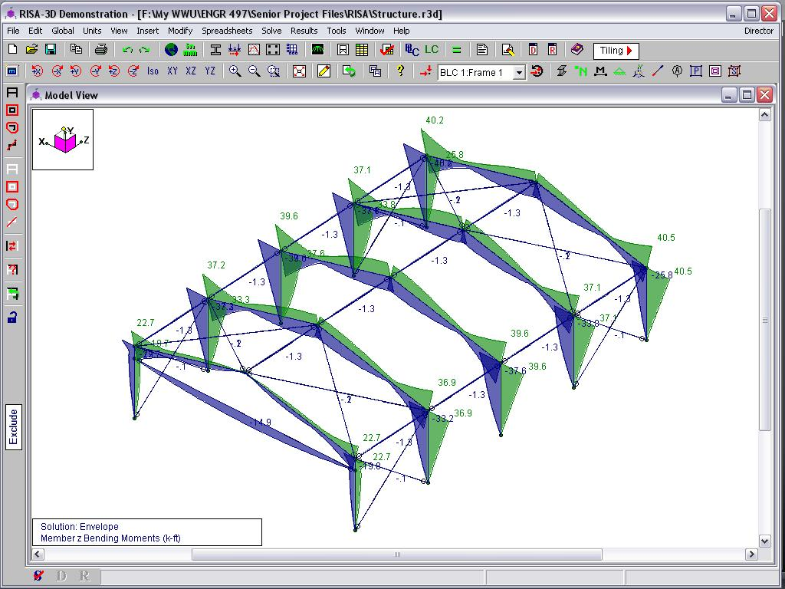
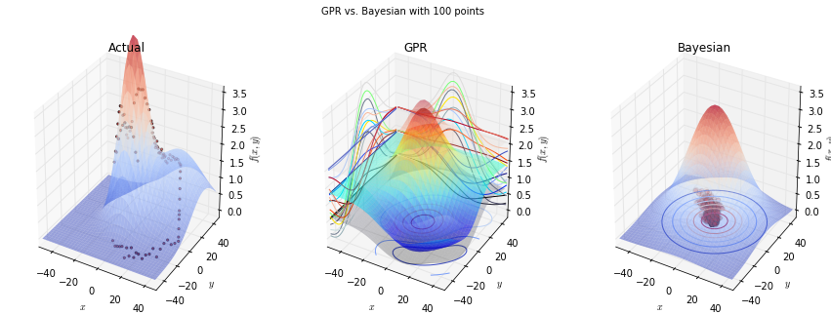
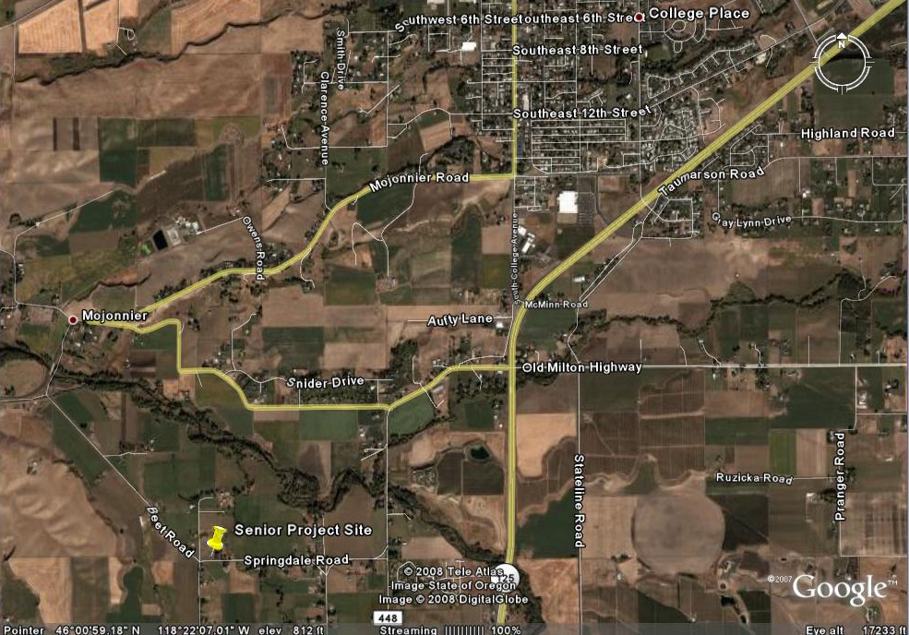
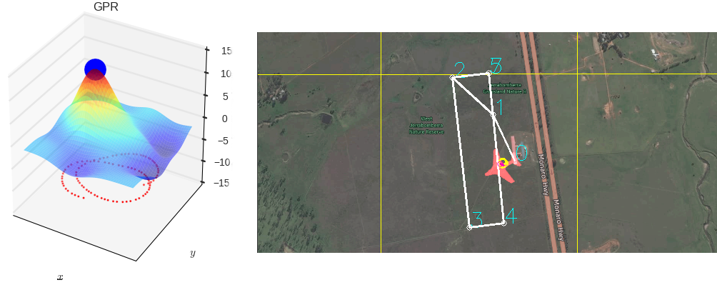
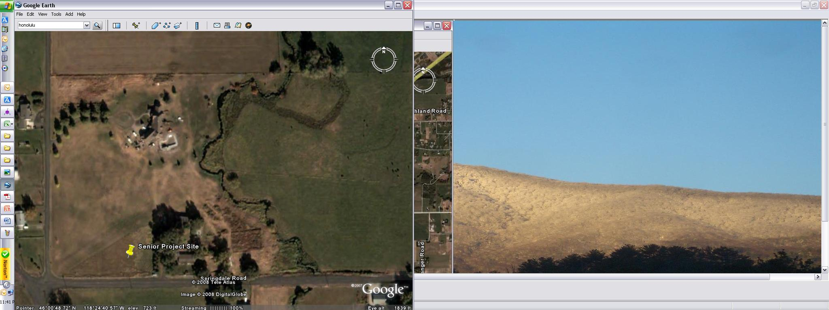

Machine Learning for Thermal Soaring
Autonomously mimic the soaring habits of birds with a glider
Travis Crumley, David Egolf, and Garrett Wilson
Edward F. Cross School of Engineering, Walla Walla University, College Place, Washington
ABSTRACT
Our project to create and implement the software necessary for a glider to autonomously find and use the updrafts from thermals to sustain longer flight times was divided into three parts: a basic implementation of existing algorithms, an exploration of thermal identification methods, and an exploration of machine learning to provide better soaring decisions.
IMPROVEMENT: THERMAL IDENTIFICATION
The centroid method merely provides an estimate of where the thermal center may be. One improvement upon this method would be to predict what the entire thermal looks like. We investigated two possible approaches: Bayesian parameter estimation, which predicts a probability distribution over possible values each parameter of a model could take on, and Gaussian process regression, which predicts a Gaussian probability distribution over values each point in a $n$-dimensional space could take on. Because of its speed and superior prediction in tests, Gaussian process regression was pursued further, being implemented in simulation.
RESULTS
The final choice for the design was a W12X40 for the moment frames, a 10X49 for the door beam, W10X33 for the connecting beams, and a ¾ inch tension rod. The maximum deflection in the roof was just over a half inch and just over a quarter of an inch in the walls. The door beam experienced a deflection of a half inch in the local-y direction and just over 2 inches in the local-x direction.
INTRODUCTION
The 13-acre property where the structure is to be built is located about five miles south of College Place, WA in Walla Walla County. The relative terrain is mostly flat with a few trees and a small river, the East Walla Walla River, passing through the property. However, some 40 foot bluffs unique to the Walla Walla Valley are within 1,500 feet of the proposed building site. A grass landing strip bisects the property diagonally (See Figure 1.)
Figure 2: Gaussian process regression (center) compared with Bayesian parameter estimation (right) learning what a simple Gaussian-shaped thermal model looks like given only discrete points along a circular flight path (left)
Figure 3: Example of RISA’s Output
The cost for the engineered structure represented February 2008 steel prices, secondary frame, cladding, and estimated engineering costs. The cost was slightly lower than that obtained from a custom steel builder but much greater than the pre-engineered building suppliers and also higher than a comparable wood structure as shown in Figure 4.
Figure 3: Gaussian process regression (left) run live on data collected from a glider flying in the simulator (right)
A
B
RESULTS. As the glider flies a flight path gaining altitude, it collects and runs the last 45 seconds of data through Gaussian process regression predicting the vertical velocity in a 20-meter radius around the glider. Because it predicts a probability distribution, which provides a measure of uncertainty, this can be used in determining whether it is beneficial to latch onto a thermal. The glider will start circling the point of the highest predicted vertical velocity if with 85 percent confidence this velocity is above a certain threshold. Figure 3 shows a test in simulation where the glider successfully found a thermal and has orbited it twice.
Figure 1: Senior Project Site (Google Earth)
The specified dimensions are 40 feet by 60 feet by 12 feet tall with a roof slope of 3 in 12. The airplane door is 40 foot by 10 foot. Five moment frames providing resistance to transverse direction loads are evenly spaced along the 60 foot dimension. Connecting beams and tension-only braces transfer longitudinal loadings to the foundation.
Figure 4: Cost Comparison
REFERENCES
AISC Steel Construction Manual. 13th ed. 2006-.
ASCE 7-05 Minimum Design Loads for Buildings and other Structures. 2006-.
International Building Code. 2006-.
McCormac, Jack C. Structural Steel Design. 4th ed. 2008.
Summers, Mark. Technical Advisor. U.S. Army Corps of Engineers.
Walla Walla Ordinance No. 346. 2007-.
SUMMARY
Success!!!
In partial fulfillment of the requirements for ENGR 498, Senior Seminar

