Slide 1
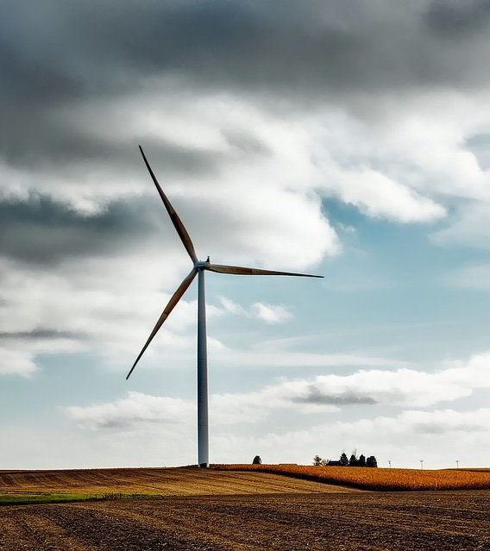
ME 300:
Engineering Thermodynamics
Example:
Energy Conservation and Cycle Analysis

Slide 2
Calculate P, v, and T at each state point of the cycle on the right. Also calculate the work and heat for each process, as well as the change in internal energy if the working fluid is air.
T1=300 K
P1 = 0.2 MPa
T2 = 800 K
M = 1 kg
R=287 J/kg-K
Cv = 720 J/kg-K
Cp = 1001 J/kg-K
1-2: isobaric heat addition
2-3: isochoric heat removal
3-1: isothermal heat removal

Slide 3


Which of the following assumptions is NOT appropriate for this problem?
Quasi-equilibrium
ΔKE = ΔPE = 0
Ideal gas
They are all appropriate

Slide 4
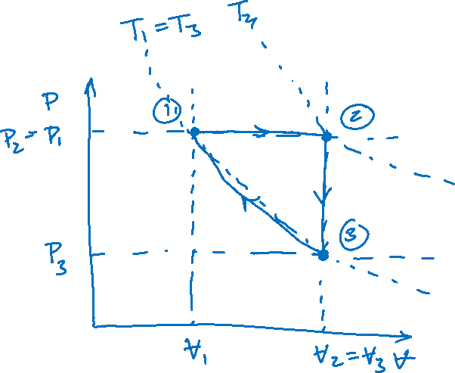
Draw the cycle on a P-V diagram:
1-2: isobaric heat addition
2-3: isochoric heat removal
3-1: isothermal heat removal

Slide 5
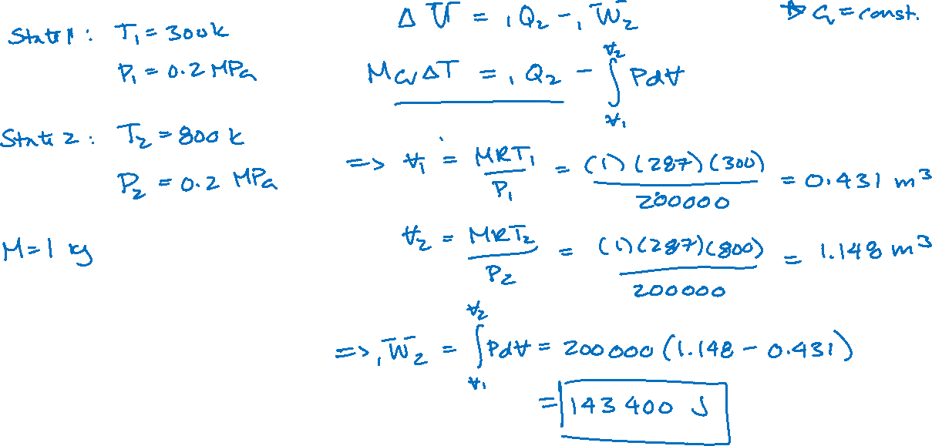
Process 1-2

Slide 6
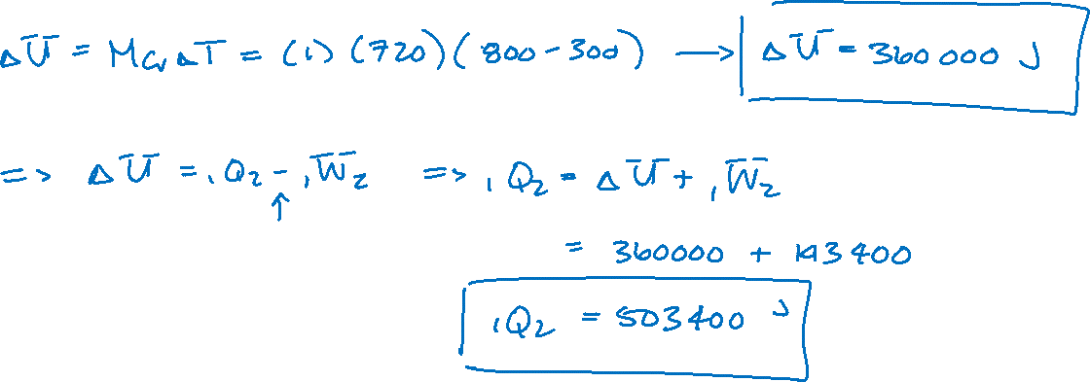
Process 1-2

Slide 7
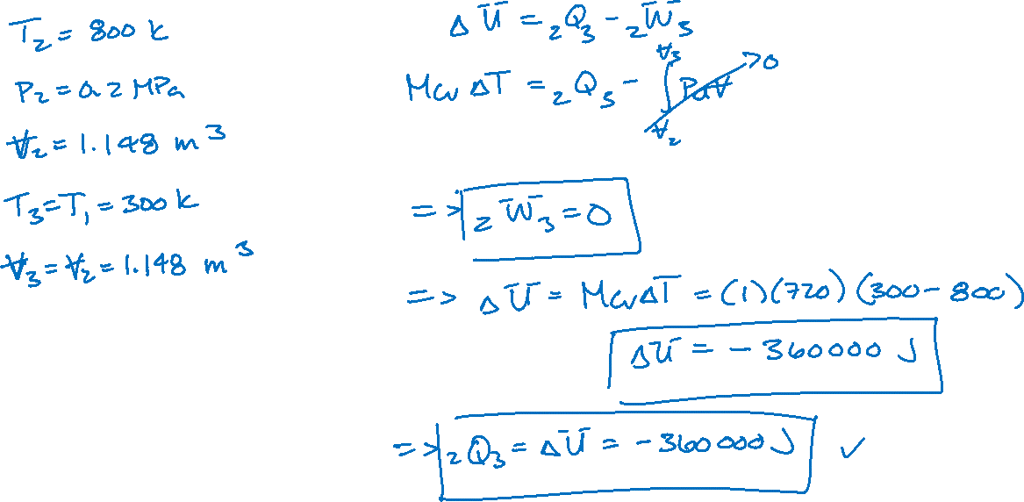
Process 2-3

Slide 8
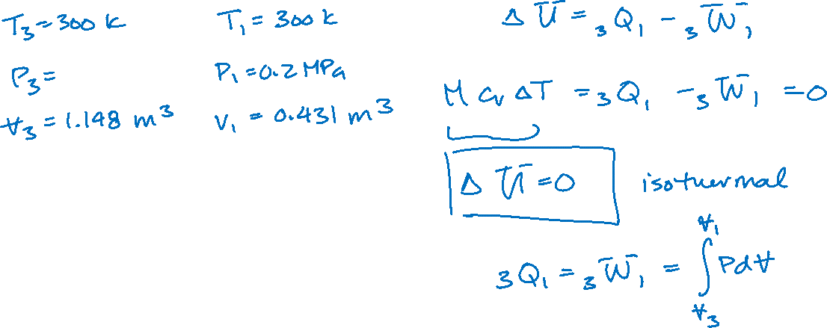
Process 3-1

Slide 9
What is the sign of work in process 3-1?
Positive
Negative
Work is zero

Slide 10
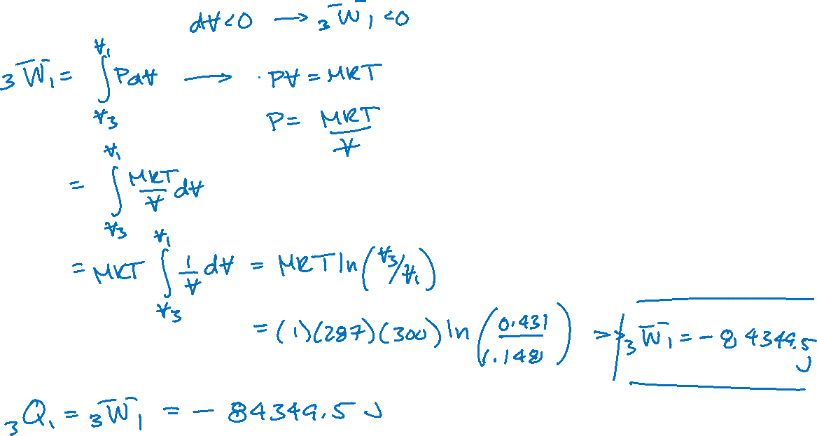
Process 3-1

Slide 11
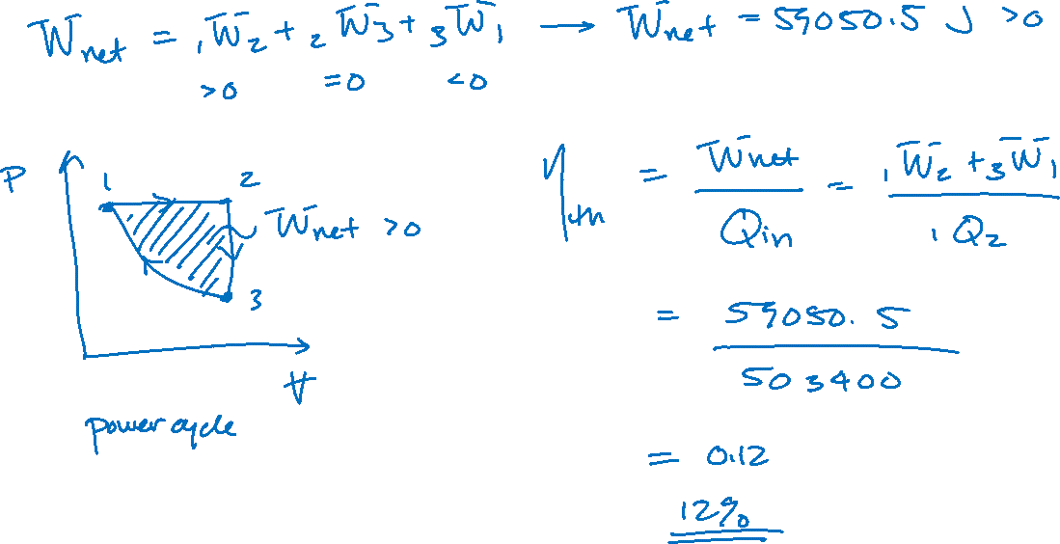
Total Cycle

