Slide 1
ME300 Office Hours
Wednesday, August 9, 2023

Slide 2
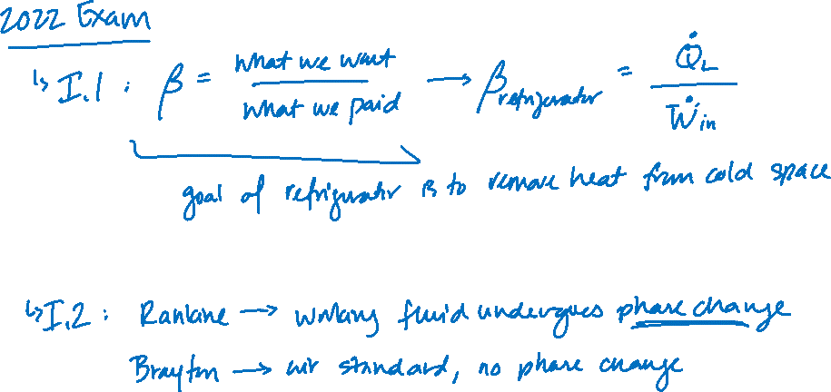

Slide 3
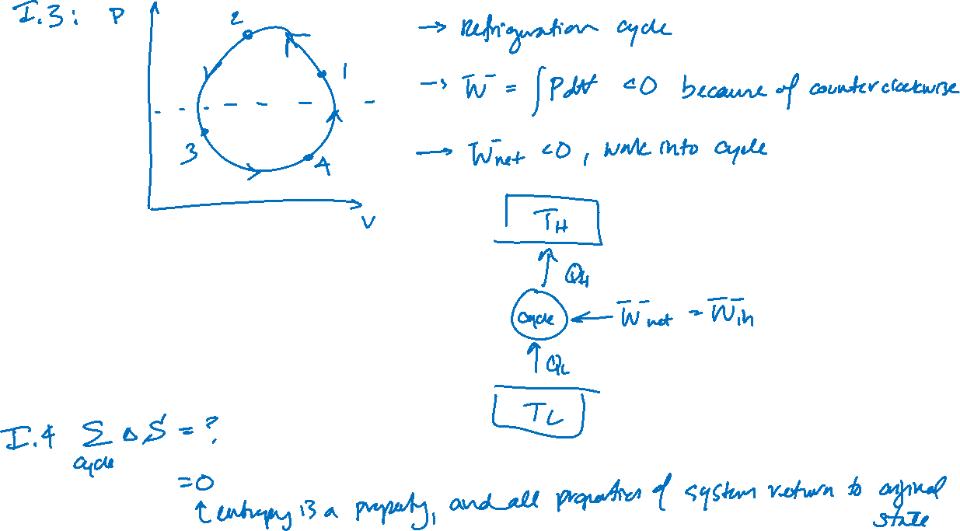

Slide 4
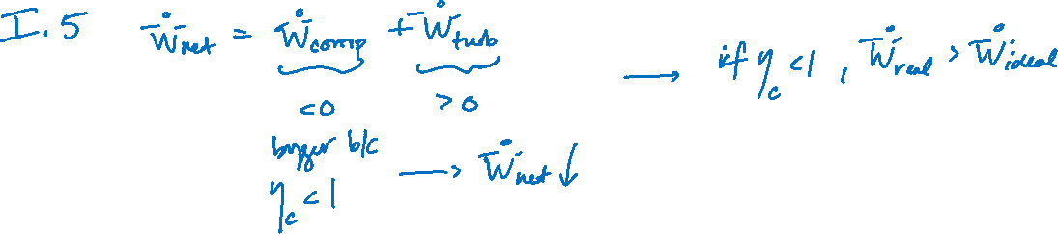

Slide 5
















Slide 6













Slide 7







Slide 8












Slide 9








Slide 10








Slide 11







Slide 12







