Slide 1

ME300 Su23
Exam 2 review
Tuesday, July 18

Slide 2
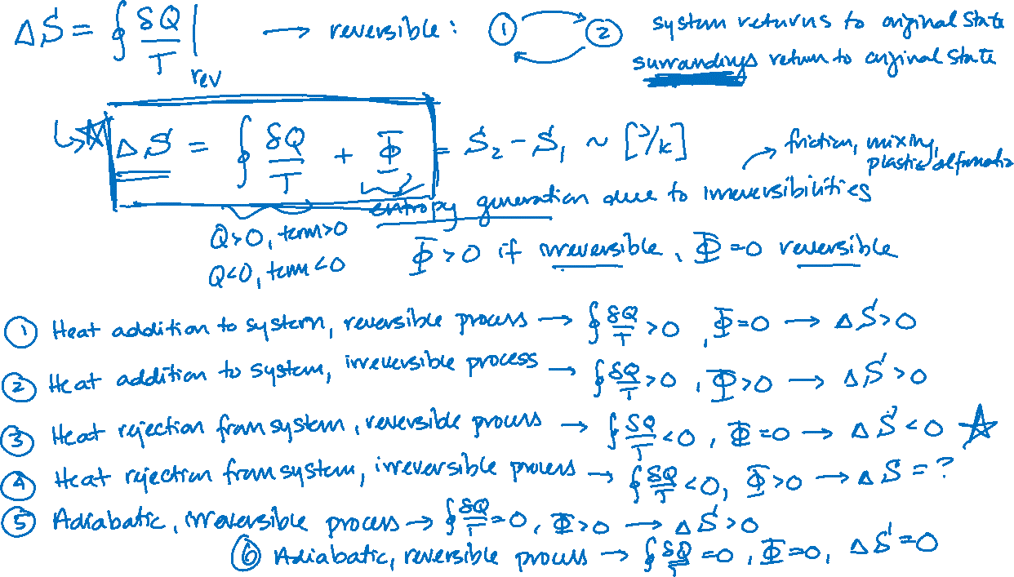

Slide 3
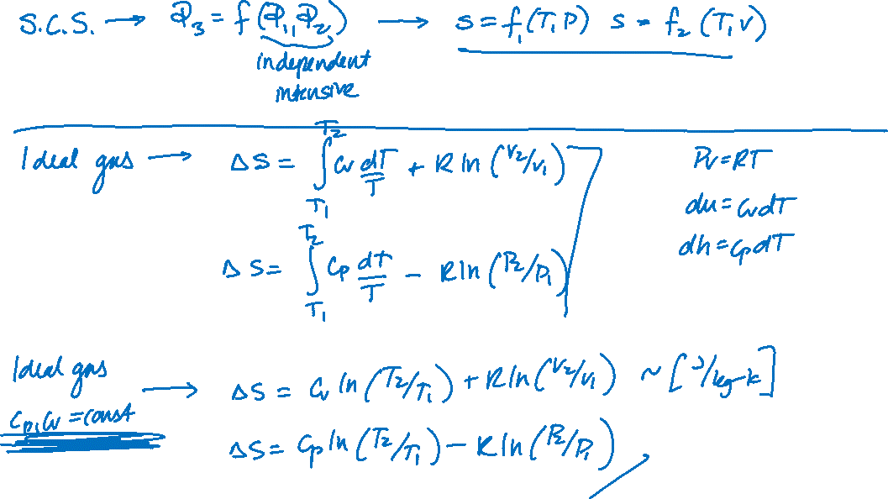

Slide 4
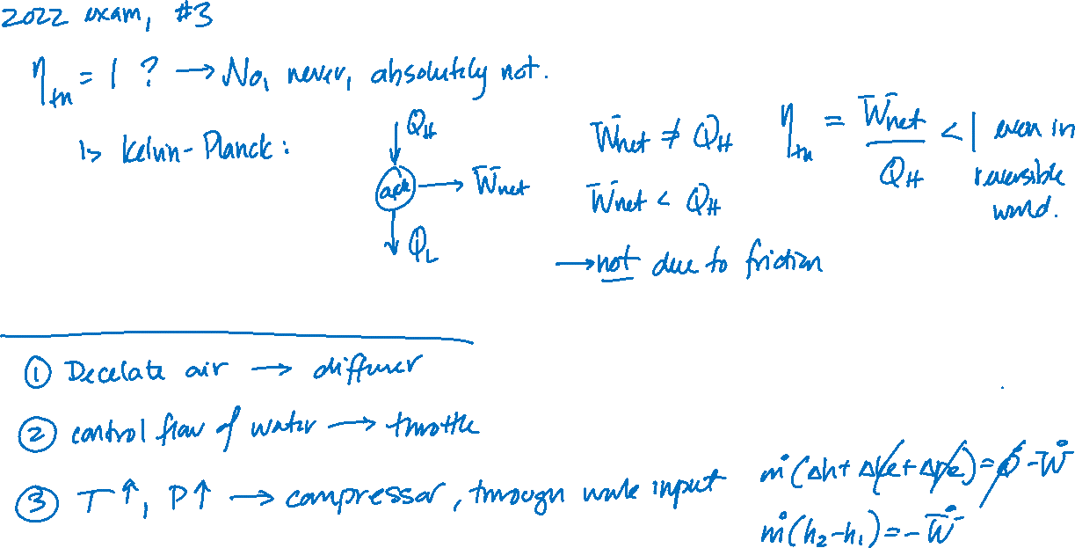

Slide 5



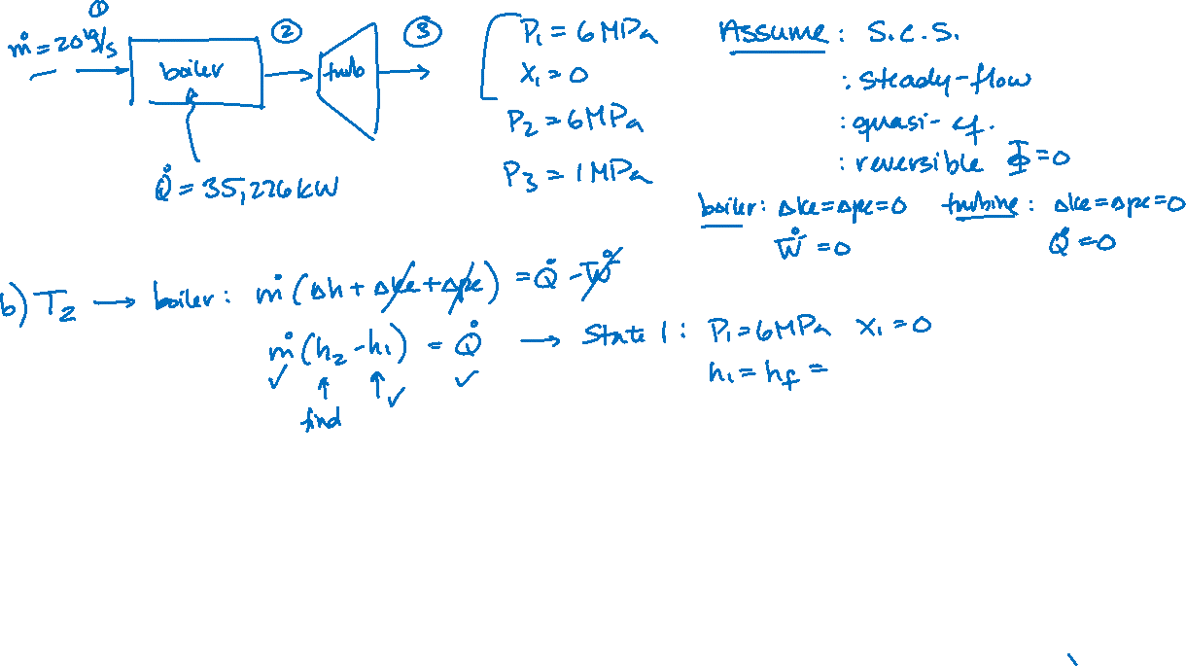

Slide 6






Slide 7





Slide 8





Slide 9












Slide 10








Slide 11





Slide 12










Slide 13












Slide 14








Slide 15














Slide 16















