Slide 1
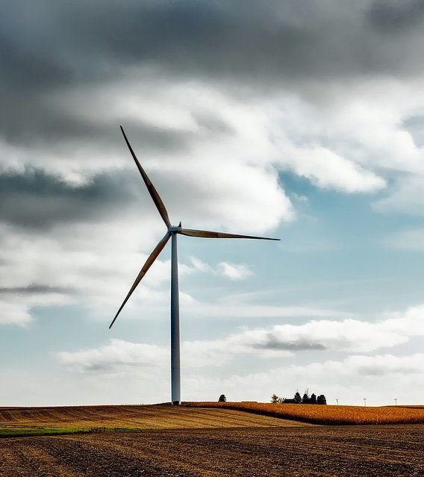
ME 300:
Engineering Thermodynamics
Example:
Energy Conservation with Phase Change

Slide 2

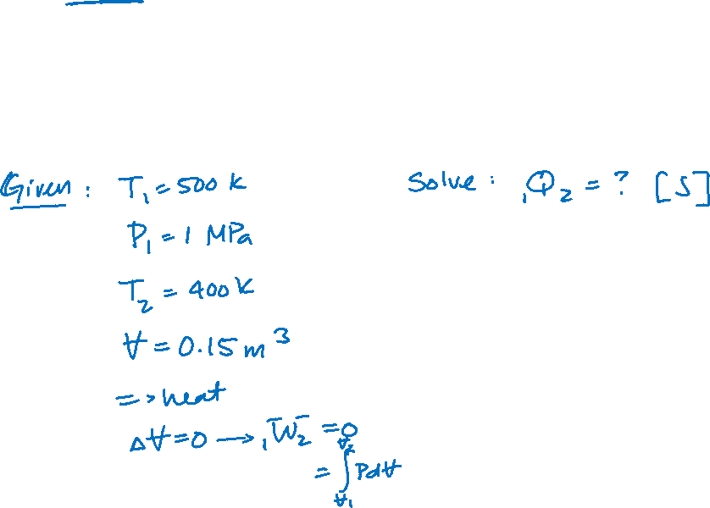
H₂O is contained in a rigid tank at 500 K and 1 MPa. A cooling coil removes energy from the steam as heat until a final temperature of 400 K is reached. The tank volume is 0.15 m³. Determine the amount of heat removed.

Slide 3


Which of the following assumptions is NOT appropriate for this problem?
Quasi-equilibrium
ΔKE = ΔPE = 0
Ideal gas
They are all appropriate

Slide 4
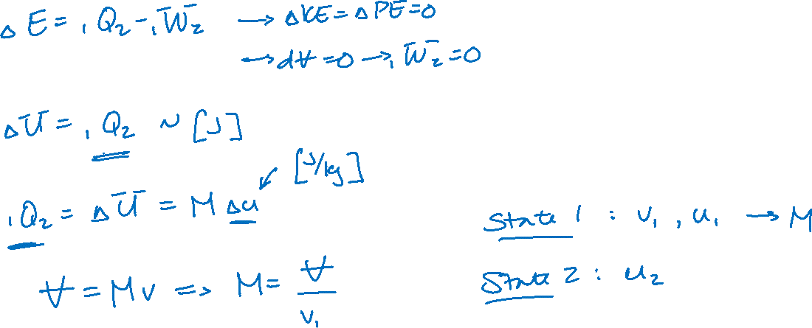
Energy Conservation

Slide 5

What phase is the fluid at State 1?
  T1 = 500 K
  P1 = 1 MPa
Saturated liquid
Liquid + vapor
Saturated vapor
Superheated vapor

Slide 6

What phase is the fluid at State 2?
  T2 = 400 K
  v2=0.22064 m3/kg
Saturated liquid
Liquid + vapor
Saturated vapor
Superheated vapor

Slide 7






State 1

Slide 8
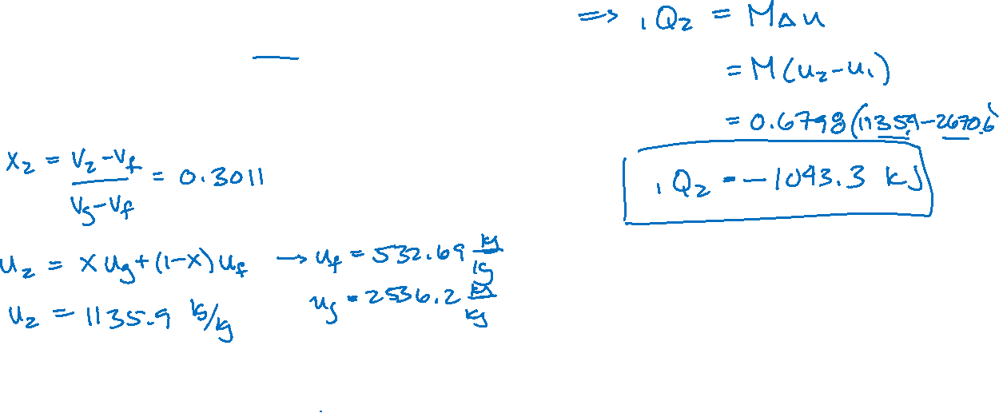
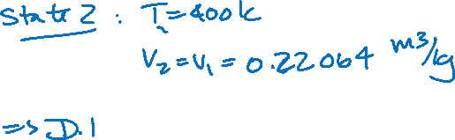
Energy Conservation

