Slide 1

ME 300:
Engineering Thermodynamics
Review of the Course So Far

Slide 2
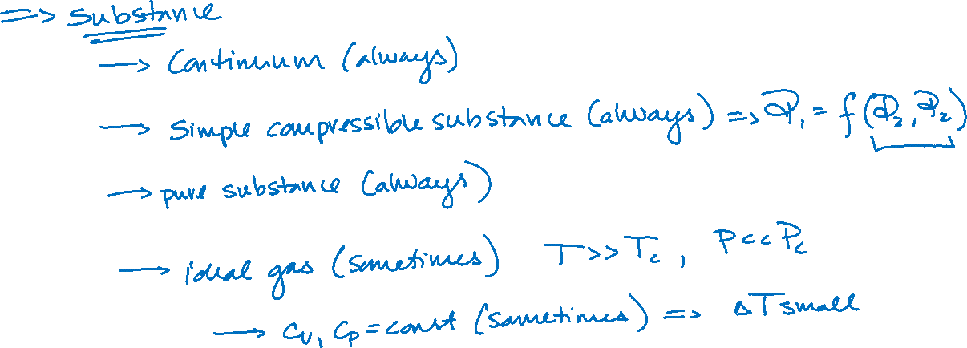
Assumptions

Slide 3
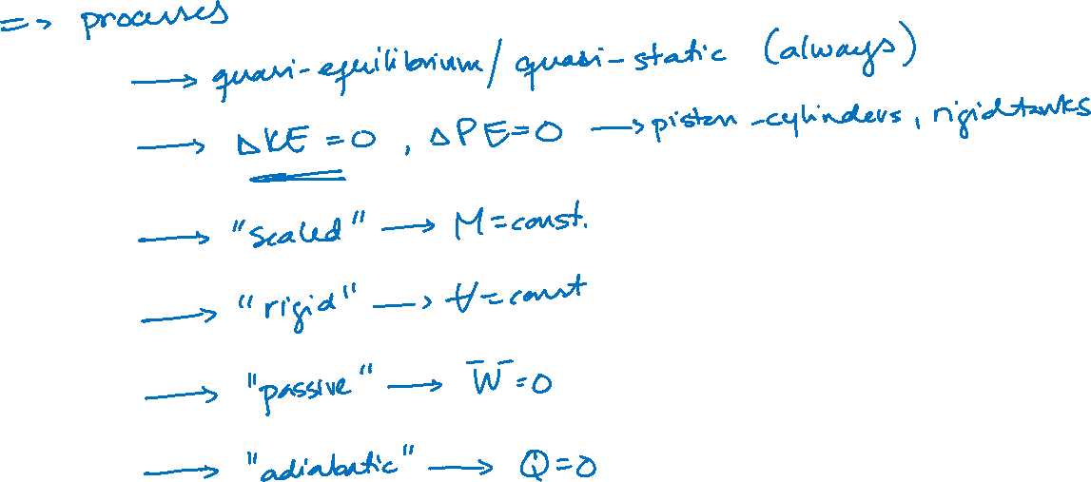
Assumptions

