Slide 1




Profile of people in urgent need of humanitarian aid in Haiti (2019 - 2020)
Food security, Nutrition, Shelter, Health, Education
Source:

Slide 2
Haiti Presentation
Haiti Population 2020: 11 067 777 Habitants
Langues officielles:Créole haïtien,Français haïtien
Capitale: Port-au-Prince
Superficie totale: 27 750 km2
Densité: 399 hab./km2
Monnaie: Gourde haïtienne (HTG​)

Slide 3

Table of Contents
Introduction
Problems to solve
Goal
Audience
Data Source
Result
Recommandations

Slide 4
Introduction
In 2020, 4.6 million people will need humanitarian assistance according to the humanitarian response. This number is up from 2.6 million in 2019.
Knowing the importance of health and education, I could not have the luxury of remaining insensitive, seeing the children malnourished, the problem of shelter and their lack of access to education, the adults unprotected by health, food insecurity, ...
All these situations would incite me to use my highest degree of empathy and it is for this reason that I have chosen to analyze the profile of the people urgently needing humanitarian aid in Haiti and give the State, the NGOs, the volunteers of the national territory and the diaspora, the opportunity to better target and reach the people really in need.

Slide 5
Goals
The analysis will be based on the core data set to understand the vulnerable people or groups of people and the specific types of vulnerabilities.
The analysis will cover the entire country based on the quality and quantity of sectorial data available at the commercial and/or departmental level.
For effective intervention in aid distribution:
Identify the urgent needs of people by department
Identify needs by gender
Identify needs by age
Identify the most affected departments for each sector

Slide 6
Audience
The target audience is:
Ministry of Public Health and Population, for nutrition and health needs
Ministry of Social Affairs and Labor, for protection and shelter
Ministry of National Education and Vocational Training, for children's education needs
NGOs
National and diaspora volunteers

Slide 7
Data Source
Data found at this link https://data.humdata.org/dataset/haiti-cible-hrp-2019-2020. This dataset is produced by the United Nations for the Coordination of Humanitarian Affairs (OCHA) in collaboration with humanitarian partners in Haiti.

Slide 8
Methodology
1 Collect data (produced by the United Nations for the Coordination of Humanitarian Affairs (OCHA) in collaboration with humanitarian partners in Haiti.)
2) Cleaning data: remove and replace null values and the wrong values.
3) Machine Learning (K_means Clustering)

Slide 9
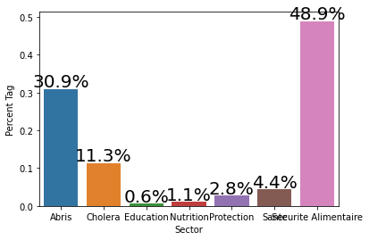
Result
West Department

Slide 10
Recommandations

Slide 11
Bootcamp Participant
Hardiles THERMORIS
Bachelor of Computer Science, Data Science in formation
Contact : hardilesthermoris@gmail.com
Project link :
https://https://github.com/Thermoris1212/Ayiti-Analytics-Capstone-project.git

Slide 12
Study on
Thank you!!!
People in need (Haiti 2019-2020)
Food security, Nutrition, Shelter, Health, Education
Source:

