Slide 1



« Let's help each other »
Profile of people in urgent need of humanitarian aid in Haiti (2019 - 2020)
Food security, Nutrition, Shelter, Health, Education

Slide 2
Haiti Presentation
Haiti Population 2020: 11,067,777 Inhabitants
Official languages: Haitian Creole, Haitian French
Capital: Port-au-Prince
Total area: 27,750 km2
Density: 399 inhab./km2
Currency: Haitian gourde (HTG)

Slide 3

Table of Contents
Introduction
Goal
Audience
Data Source
Result
Recommandations

Slide 4

Introduction
In 2020, 4.6 million people will need humanitarian assistance according to the humanitarian response. This number is up from 2.6 million in 2019.
Knowing the importance of health and education, I could not have the luxury of remaining insensitive, seeing the children malnourished, the problem of shelter and their lack of access to education, the adults unprotected by health, food insecurity, ...
All these situations would incite me to use my highest degree of empathy and it is for this reason that I have chosen to analyze the profile of the people urgently needing humanitarian aid in Haiti and give the State, the NGOs, the volunteers of the national territory and the diaspora, the opportunity to better target and reach the people really in need.

Slide 5

Goals
The analysis will be based on the core data set to understand the vulnerable people or groups of people and the specific types of vulnerabilities.
The analysis will cover the entire country based on the quality and quantity of sectorial data available at the commercial and/or departmental level.
For effective intervention in aid distribution:
Identify the urgent needs of people by department
Identify needs by gender
Identify the most affected departments for each sector

Slide 6

Audience
The target audience is:
Ministry of Public Health and Population, for nutrition and health needs
Ministry of Social Affairs and Labor, for protection and shelter
Ministry of National Education and Vocational Training, for children's education needs
NGOs
National and diaspora volunteers

Slide 7
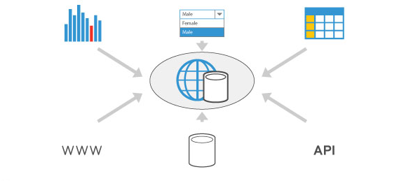
Data Source
Data found at this link https://data.humdata.org/dataset/haiti-cible-hrp-2019-2020. This dataset is produced by the United Nations for the Coordination of Humanitarian Affairs (OCHA) in collaboration with humanitarian partners in Haiti.

Slide 8

Methodology
1 Collect data (produced by the United Nations for the Coordination of Humanitarian Affairs (OCHA) in collaboration with humanitarian partners in Haiti.)
2) Cleaning data: remove and replace null values and the wrong values.
3) Machine Learning (K_means Clustering)

Slide 9
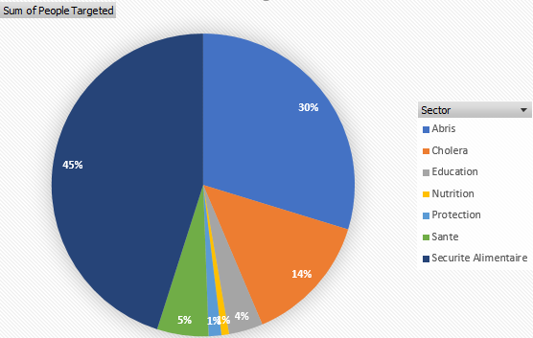
Haiti: 2 400 304 People in Urgent Need in the dataset
Result
Urgent need by Sector
Food Safety: 1 082 267
Shelters: 713 878
Cholera: 333 249
Health: 131 669
Education: 87 300
Protection: 32 434
Nutrition: 19 507

Slide 10
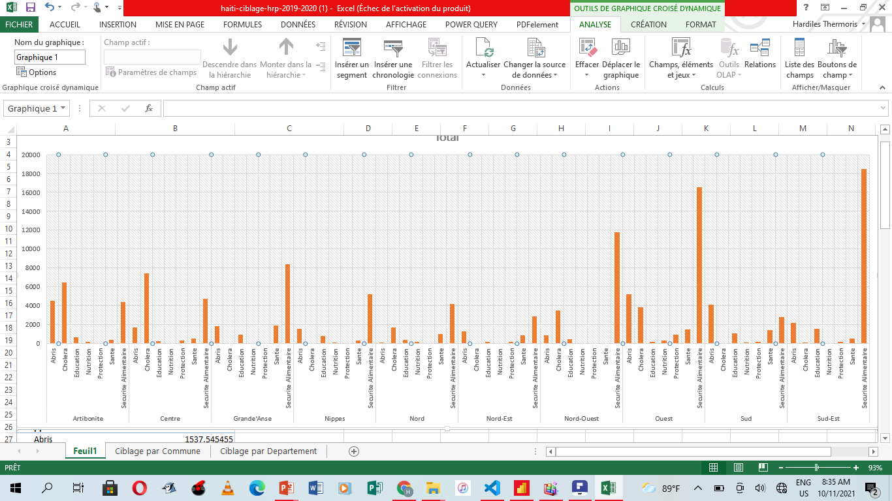
Urgent need by Departement
Result

Slide 11
People in urgent Need by Department
Result
The biggest need of Grand Anse, Nippes, Nord, Nord-Est, Nord-Ouest, Sud-Est and Ouest departements is Food Safety
The biggest need of Centre and Artibonite departements is Cholera
The biggest need of Sud departement is Chelters

Slide 12
Unsupervised Machine Learning
Result
We will perform a k-mean clustering which consists in grouping the data in several groups of commune according to their similarities level of need after having determined the optimal number of group or cluster = k.
k=3

Slide 13
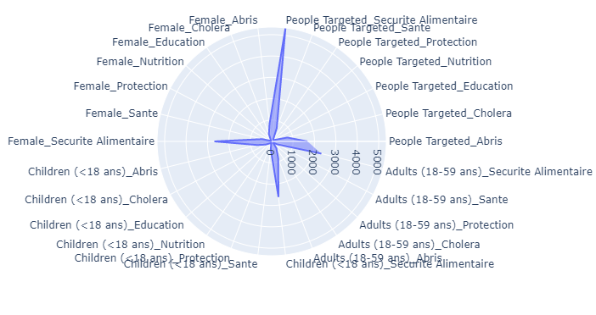
Result
Profil 1
This profile count 116 communes , and their biggest need is food security. The most affected are women

Slide 14
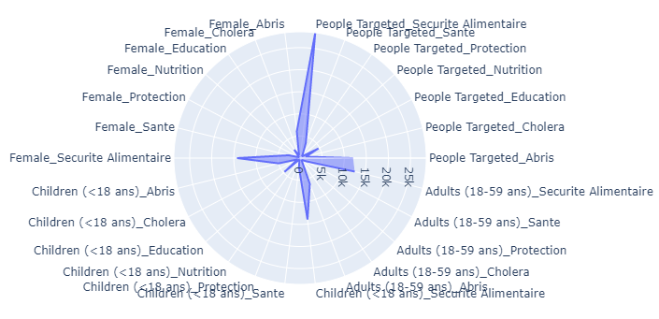
Profil 2
This profil count 12 communes , and their biggest need is food security and Education. The most affected are women and Children

Slide 15
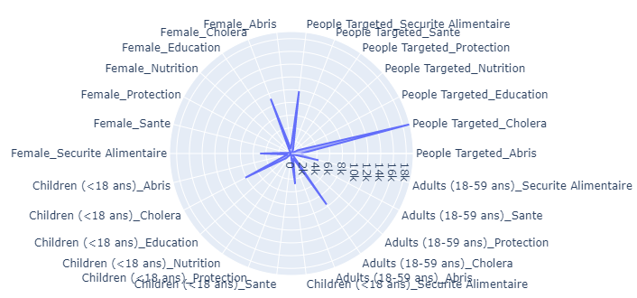
Profil 3
This profil count 12 communes , and their biggest need is food security and Cholera. The most affected are adults

Slide 16
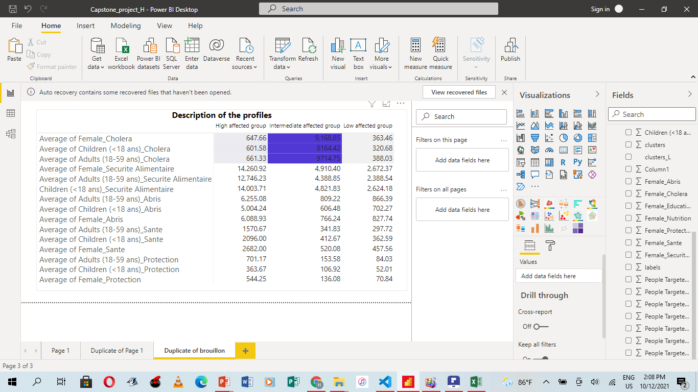
Result
This is a description of the three clusters.
The low affected group is the profile (profil 1) have less urgent people need than any other groups.

Slide 17
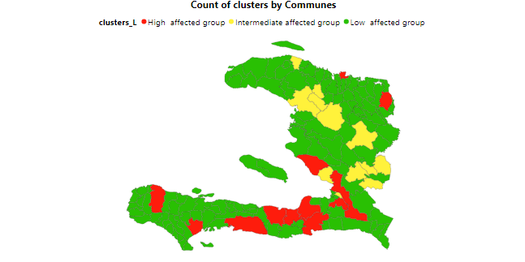
Red Color→ The high affected group is the profile (Profil 3) have more urgent people need than any other groups. → cluster=12 Communes
Result
Archaie, Ouest
Cap-Haiten, Nord
Petion-Ville, Ouest
Leogane, Ouest
Ouanaminthe,
Nord-Est
Grand-Goave, Ouest
Petit-Goave, Ouest
Croix Des Bouquets.
Ouest
Aquin, Sud
West Department 6/12
50%
Jeremie, Grand’Anse
Les Cayes , Sud
Jacmel, Sud-Est

Slide 18
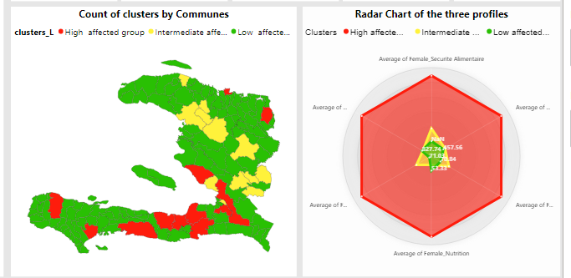
Dashboard
Result

Slide 19

General recommendation
According to our analysis, 70% of the departments across the country have food security problems, the state Officials should invest, rethink or set up a new structure to
Strengthen agricultural production
Facilitate access to food for all
Use an agricultural production system approach
Specific recommendation
Considering profile 3, no less than 12 communes are in a state of extreme emergency with regard to health, cholera and food security, among them 6 are in the West department. I suggest to the state officials to intervene quickly in these communes that are in urgent need, especially in the metropolitan area.

Slide 20

Bootcamp Participant
Hardiles THERMORIS
Bachelor of Computer Science, Data Science in formation
Contact : hardilesthermoris@gmail.com
Project link :
https://https://github.com/Thermoris1212/Ayiti-Analytics-Capstone-project.git

Slide 21

Study on
Thank you!!!
« Let's help each other »
Long Live Haiti
People in need (Haiti 2019-2020)
Food security, Nutrition, Shelter, Health, Education
Source:

