Slide 1
汇编语言
第十二讲 代码优化（二）
——微结构相关的优化

Slide 2
第十二讲 代码优化
处理器微结构与程序性能
挖掘指令并行性
转移的开销
访存的优化

Slide 3
处理器微结构
PC
IC
Fetch
Decode1
Decodek
Regmap
Dispatch
Dispatch Queue
…
BrP
ReadRF
Reg File
Reorder queue
Memory
LL Cache
DC
TLB
Ldstn
…
Ldst1
Execute
WtBack
Commit
Falum
…
Falu1
Alul
…
Alu1

Slide 4
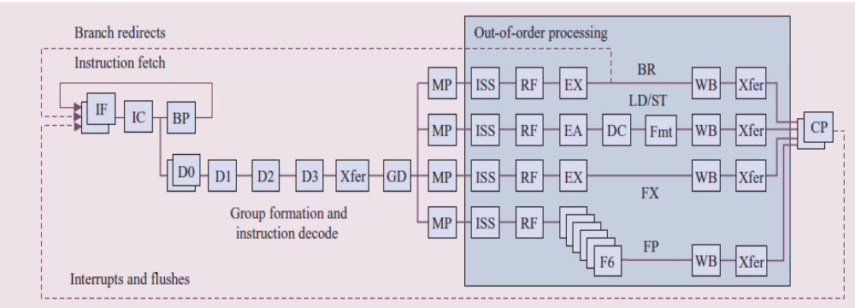
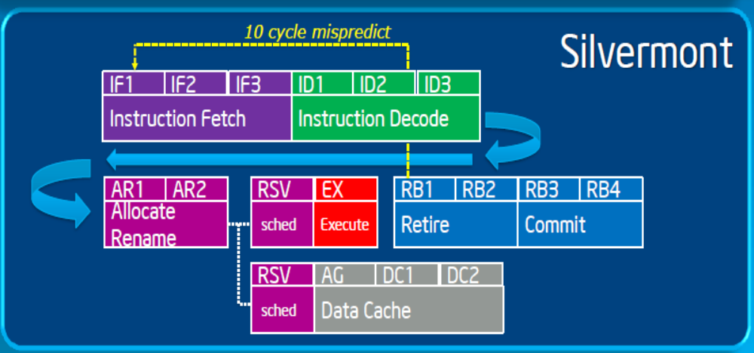
POWER5

Slide 5
（一）Pipeline
Pipeline目的是提高处理器部件的利用率
Fetch
Decode
ReadRF
Execute
WtBack
单条指令CPI =5
理想CPI接近1
 | 周期k-4 | 周期k-3 | 周期k-2 | 周期k-1 | 周期k | 周期k+1
Fetch | 指令i | 指令i+1 | 指令i+2 | 指令i+3 | 指令i+4 | 指令i+5
Decode |  | 指令i | 指令i+1 | 指令i+2 | 指令i+3 | 指令i+4
ReadRF |  |  | 指令i | 指令i+1 | 指令i+2 | 指令i+3
Execute |  |  |  | 指令i | 指令i+1 | 指令i+2
WtBack |  |  |  |  | 指令i | 指令i+1

Slide 6
Deep pipeline
Deep pipeline ：Basic pipeline ≥ 9
  主流处理器都是Deep pipeline
Deep pipeline目的是提高处理器的主频
  理想性能是1条pipeline1个Cycle执行1条指令
  主频越高，Cycle值越小，指令吞吐率越高
  目前主流处理器主频都在2.0~4.0GHz之间，Power系列超过4.0GHz，Power6达到6GHz

Slide 7
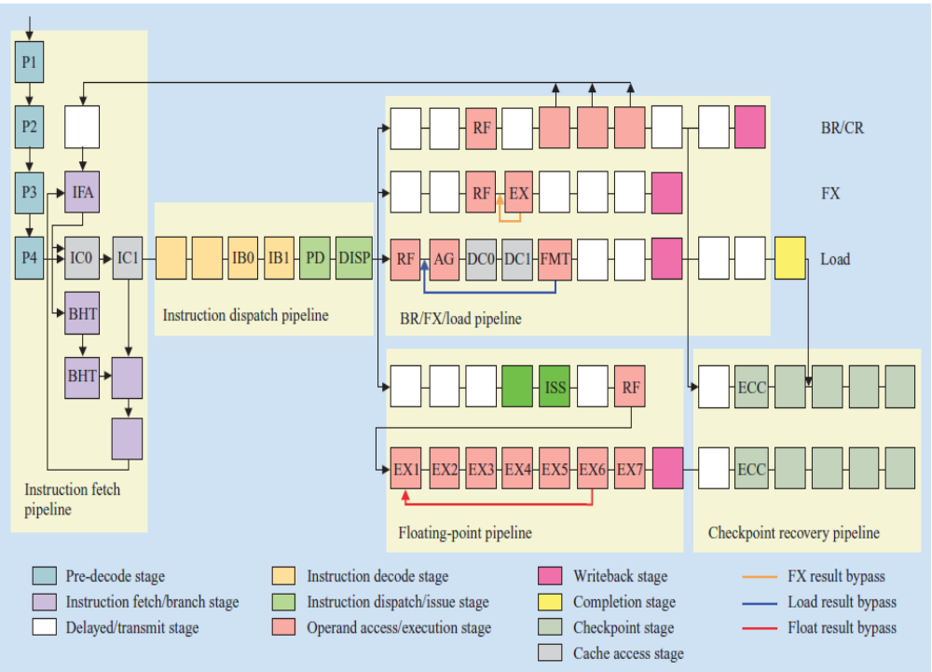
Power6 Pipeline

Slide 8
（二）Superscalar
多条Pipeline，1个Cycle发射和执行多条指令
Fetch
Decode
ReadRF
Execute
WtBack
 | 周期k-4 | 周期k-3 | 周期k-2 | 周期k-1 | 周期k | 周期k+1
Fetch | 指令i+1 指令i | 指令i+3 指令I+2 | 指令i+5 指令i+4 | 指令i+7 指令i+6 | 指令i+9 指令i+8 | 指令i+11 指令i+10
Decode |  | 指令i+1 指令i | 指令i+3 指令I+2 | 指令i+5 指令i+4 | 指令i+7 指令i+6 | 指令i+9 指令i+8
ReadRF |  |  | 指令i+1 指令i | 指令i+3 指令I+2 | 指令i+5 指令i+4 | 指令i+7 指令i+6
Execute |  |  |  | 指令i+1 指令i | 指令i+3 指令i+2 | 指令i+5 指令i+4
WtBack |  |  |  |  | 指令i+1 指令i | 指令i+3 指令i+2

Slide 9
Superscalar
Most modern CPUs are superscalar.
  Intel: since Pentium (1993)
超标量处理器通常都是动态调度和乱序执行，最后顺序提交。
Benefit: 处理器自动调度，利用程序所具有的指令级并行性

Slide 10
动态调度与顺序提交
动态调度
PC
IC
Fetch
Decode1
Decodek
Regmap
Dispatch
Dispatch Queue
顺序提交
…
BrP
ReadRF
Reg File
Reorder queue
Memory
LL Cache
DC
TLB
Ldstn
…
Ldst1
Execute
WtBack
Commit
Falum
…
Falu1
Alul
…
Alu1

Slide 11
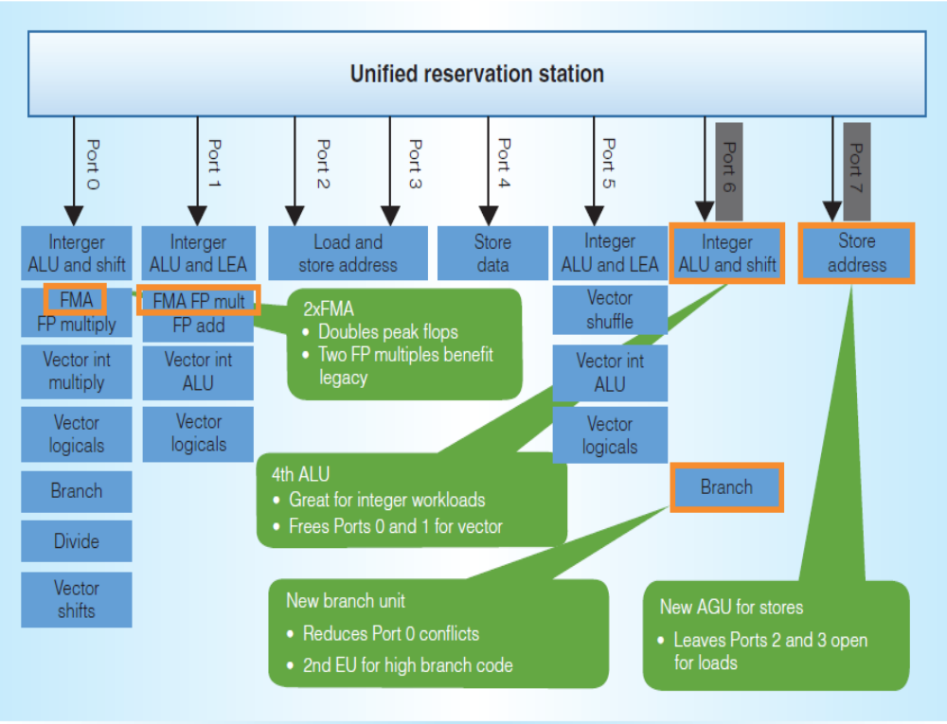
Multi-issue, multi-function-unit
Intel Haswell

Slide 12
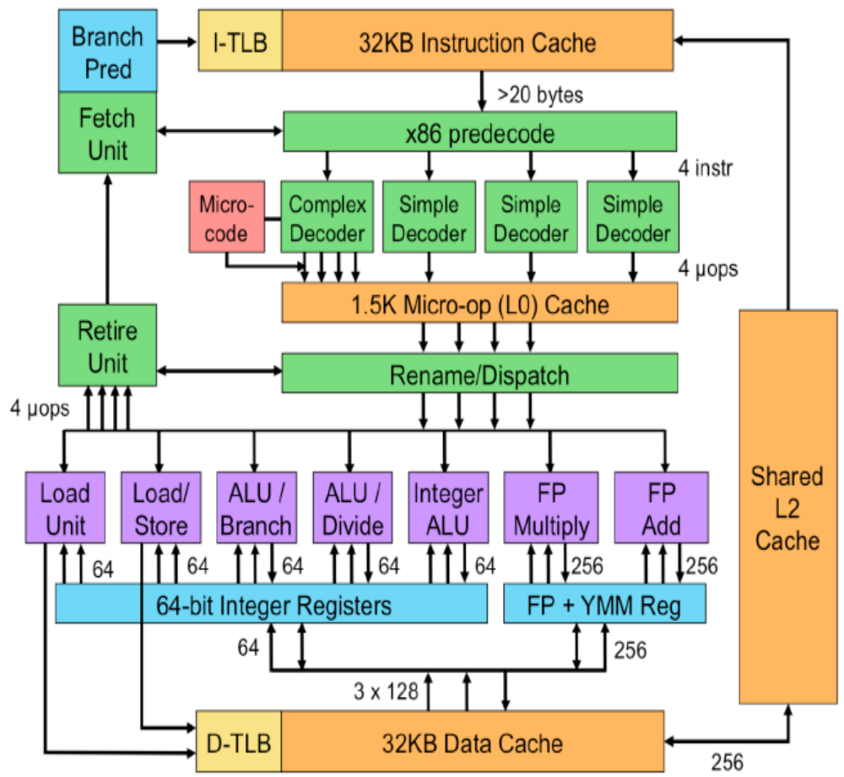
Intel SandyBridge

Slide 13
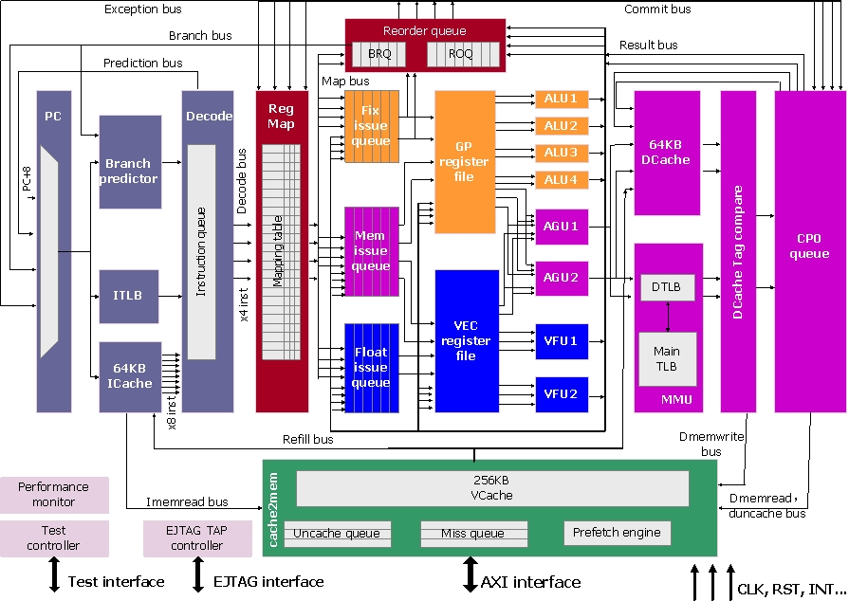
Loongson 3A4000

Slide 14
（三） Memory Hierarchy
L0:
CPU registers hold words retrieved from L1 cache
Registers
L1:
L1 cache
(SRAM)
Smaller,
faster,
costlier
per byte
L1 cache holds cache lines retrieved from L2 cache
L2:
L2 cache
(SRAM)
L2 cache holds cache lines retrieved from main memory
L3:
Larger,
slower,
cheaper
per byte
Main memory
(DRAM)
Main memory holds disk blocks retrieved from local disks
L4:
Local secondary storage
(local disks)
Local disks hold files retrieved from disks on remote network servers
Remote secondary storage
(tapes, distributed file systems, Web servers)
L5:

Slide 15
Intel Core i7 Cache Hierarchy
Processor package
L1 i-cache and d-cache:
  32 KB, 8-way,
  Access: 4 cycles
L2 unified cache:
  256 KB, 8-way,
  Access: 11 cycles
L3 unified cache:
  8 MB, 16-way,
  Access: 30-40 cycles
Block size: 64 bytes for all caches.
Memory:
Acess: >100 cycles
Core 0
Core 3
Regs
Regs
L1
d-cache
L1
i-cache
L1
d-cache
L1
i-cache
…
L2 unified cache
L2 unified cache
L3 unified cache
(shared by all cores)
Main memory

Slide 16
存储层次对访存性能的改善
Average access time =
Hitrate_{L1}× Lat_{L1} +
(1- Hitrate_{L1})×(Hitrate_{L2} × Lat_{L2} +
(1-Hitrate_{L2}) ×(Hitrate_{L3} × Lat_{L3} +(1-Hitrate_{L3}) × Lat_{m}))
Average access time1 =
0.95×4+0.05×(0.9×11 + 0.1×(0.9×40 + 0.1× 100))
=3.8 + 0.05×(9.9 + 0.1 × (36 +10)) = 4.525
Average access time2 =
0.99×4+0.01×(0.9×11 + 0.1×(0.9×40 + 0.1× 100))
=3.96 + 0.01×(9.9 + 0.1 × (36 +10)) = 4.105

Slide 17
程序理想性能与实际性能
程序的理想性能就是处理器流水线利用率100%，IPC = Pipeline number
  但实际利用率平均在50%左右
指令存在三类相关
  数据相关
  控制相关
  资源相关

Slide 18
数据相关
Inst 1: mov data, %eax
Need 3~100 cycles
数据相关
Inst 2: add $10, %eax
After 3~100 cycles
今天我去办护照
需要 9~11天
数据相关
出国旅游要护照
至少 9~11天后

Slide 19
控制相关
Inst 1: test %eax, %eax
Inst 2: jz L1
Need M cycles
控制相关
控制相关
Inst 3: mov $1, %ebx
……
L1:
Inst n: add %ecx, %ebx
1
2
3
4
5
6
7
8
9
PC
Fetch
Decode
Regmap
Dispatch
ReadRF
Execute
WtBack
Commit
M = 7

Slide 20
资源相关
……
Inst i : add $1, %eax
Inst i+1: add $1, %ebx
Inst i+2: add $4, %ecx
Inst i+3: add $4, %edx
……
Fetch
Decode
ReadRF
Execute
Alu1
WtBack
Alu2
周期k | Inst i : add $1, %eax | Inst i+1: add $1, %ebx
周期k+1 | Inst i+2: add $4, %ecx | Inst i+3: add $4, %edx

Slide 21
面向微结构的程序优化
挖掘指令并行性
  superscalar/vector
尽可能消除相关，或者将相关的依赖距离拉长
  提高pipeline的利用率
提高高层次存储的命中率
  L1 Cache，L2/LL Cache

Slide 22
第十二讲 代码优化
处理器微结构与程序性能
挖掘指令并行性
转移的开销
访存的优化

Slide 23
挖掘指令并行性
Superscalar能够同时执行多条指令
  不同处理器有所不同，需要了解处理器的手册
  Haswell：4 dispatch ，8 issue
  SandyBridge：4 dispatch， 6 issue
指令并行性主要受限于指令间的相关性
简单的变换可以产生显著的性能提升
  但编译器很难做这些变换
  需要程序员自己来优化

Slide 24
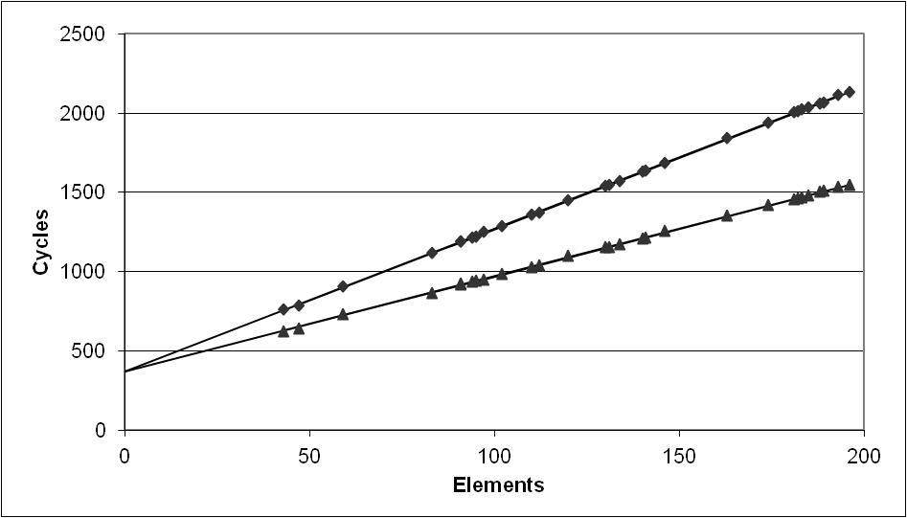
Cycles Per Element (CPE)
用于评价向量或链表的性能
  Length = n
  CPE = cycles per OP
  T = CPE*n + Overhead
    CPE is slope of line
psum1
Slope = 9.0
psum2
Slope = 6.0

Slide 25
Example: Data Type for Vectors
/* data structure for vectors */
typedef struct{
size_t len;
data_t *data;
} vec;
len
0
1
len-1
data
Data Types
  Use different declarations for data_t
  int
  long
  float
  double
/* retrieve vector element
and store at val */
int get_vec_element
(vec *v, size_t idx, data_t *val)
{
if (idx >= v->len)
return 0;
*val = v->data[idx];
return 1;
}

Slide 26
测试的benchmark
void combine1(vec *v, data_t *dest)
{
long int i;
*dest = IDENT;
for (i = 0; i < vec_length(v); i++) {
data_t val;
get_vec_element(v, i, &val);
*dest = *dest OP val;
}
}
Compute sum or product of vector elements
Data Types
  Use different declarations for data_t
  int
  long
  float
  double
Operations
  Use different definitions of OP and IDENT
  + / 0
  * / 1

Slide 27
测试程序
#include <stdio.h>
#include <stdlib.h>
#include <string.h>
#include <sys/time.h>
#define data_t long
#define OP +
#define IDENT 0
#define ELE_SIZE 20000
/* data structure for vectors */
typedef struct{
size_t len;
data_t *data;
} vec;
long vec_length(vec *v)
{
return v->len;
}

Slide 28
/* retrieve vector element and store at val */
int get_vec_element
(vec *v, size_t idx, data_t *val)
{
if (idx >= v->len)
return 0;
*val = v->data[idx];
return 1;
}
void combine1(vec *v, data_t *dest)
{
long int i;
*dest = IDENT;
for (i = 0; i < vec_length(v); i++) {
data_t val;
get_vec_element(v, i, &val);
*dest = *dest OP val;
}
}

Slide 29
static inline unsigned long long rdtsc(void)
{
unsigned long long tick;
asm volatile ("rdtsc":"=A"(tick));
return tick;
}
int main(void)
{
data_t *str;
data_t dest;
vec vc;
unsigned long long tick1, tick2;
long i;
str = malloc(ELE_SIZE*4);
vc.len = ELE_SIZE;
vc.data = str;
for(i = 0; i< ELE_SIZE; i++) vc.data[i] = 1;
tick1 = rdtsc();
combine1(&vc, &dest);
tick2 = rdtsc();
printf("CPE = %lf\n", (tick2 - tick1)*1.0/ELE_SIZE);
printf("dest = %ld \n", dest);
return 0;
}

Slide 30
Benchmark Performance
void combine1(vec *v, data_t *dest)
{
long int i;
*dest = IDENT;
for (i = 0; i < vec_length(v); i++) {
data_t val;
get_vec_element(v, i, &val);
*dest = *dest OP val;
}
}
Compute sum or product of vector elements
Method | Integer
Operation | Add | Mult
Combine1 unoptimized | 22.68 | 20.02
Combine1 –O1 | 10.12 | 10.12
Results in CPE (cycles per element)

Slide 31
Basic Optimizations
void combine4(vec *v, data_t *dest)
{
long i;
long length = vec_length(v);
data_t *d = get_vec_start(v);
data_t t = IDENT;
for (i = 0; i < length; i++)
t = t OP d[i];
*dest = t;
}
vec_length外提
消除了每次循环get_vec_element的调用
引入临时的累加/积变量

Slide 32
Effect of Basic Optimizations
void combine4(vec_ptr v, data_t *dest)
{
long i;
long length = vec_length(v);
data_t *d = get_vec_start(v);
data_t t = IDENT;
for (i = 0; i < length; i++)
t = t OP d[i];
*dest = t;
}
Method | Integer
Operation | Add | Mult
Combine1 –O1 | 10.12 | 10.12
Combine4 | 1.27 | 3.01
消除了循环中原有的一些开销

Slide 33
Pipelined Functional Units
Stage 1
long mult_eg(long a, long b, long c) {
long p1 = a*b;
long p2 = a*c;
long p3 = p1 * p2;
return p3;
}
Stage 2
Stage 3
 | Time
 | 1 | 2 | 3 | 4 | 5 | 6 | 7
Stage 1 | a*b | a*c |  |  | p1*p2
Stage 2 |  | a*b | a*c |  |  | p1*p2
Stage 3 |  |  | a*b | a*c |  |  | p1*p2
  计算分解为多个流水级，流水级之间传递中间结果
  Stage i 把中间结果传递给Stage i+1后可以开始新的计算
  例，尽管1个乘法需要3拍，但3级流水后3个乘法只要7拍

Slide 34
Haswell CPU
  8 Total Functional Units
Multiple instructions can execute in parallel
  2 load, with address computation
  1 store, with address computation
  4 integer
  2 FP multiply
  1 FP add
  1 FP divide
Some instructions take > 1 cycle, but can be pipelined
  Instruction Latency Cycles/Issue
  Load / Store 4 1
  Integer Multiply 3 1
  Integer/Long Divide 3-30 3-30
  Single/Double FP Multiply 5 1
  Single/Double FP Add 3 1
  Single/Double FP Divide 3-15 3-15

Slide 35
x86 Compilation of Combine4
Inner Loop (Case: Integer Multiply)
.L8: # loop:
imull (%ebx,%eax,4), %edx # t = t* d[i]
addl $1, %eax # i++
cmpl %ecx, %eax # cmp length, i
jne .L8 # if >, goto loop
Method | Integer
Operation | Add | Mult
Combine4 | 1.27 | 3.01
Latency Bound | 1.00 | 3.00

Slide 36
Combine4 仍是串行计算(OP = *)
1
d₀
Computation (length=8)
  ((((((((1 * d[0]) * d[1]) * d[2]) * d[3])
  * d[4]) * d[5]) * d[6]) * d[7])
Sequential dependence
  Performance: determined by latency of OP
*
d₁
*
d₂
*
d₃
*
d₄
*
d₅
*
d₆
*
d₇
*

Slide 37
Loop Unrolling (2x1)
void unroll2a_combine(vec_ptr v, data_t *dest)
{
long length = vec_length(v);
long limit = length-1;
data_t *d = get_vec_start(v);
data_t x = IDENT;
long i;
/* Combine 2 elements at a time */
for (i = 0; i < limit; i+=2) {
x = (x OP d[i]) OP d[i+1];
}
/* Finish any remaining elements */
for (; i < length; i++) {
x = x OP d[i];
}
*dest = x;
}
Perform 2x more useful work per iteration

Slide 38
Effect of Loop Unrolling
Method | Integer
Operation | Add | Mult
Combine4 | 1.27 | 3.01
Unroll 2x1 | 1.01 | 3.01
Latency Bound | 1.00 | 3.00
Integer add提高了
  接近 latency bound
Integer Mult没有改进?
  Still sequential dependency
x = (x OP d[i]) OP d[i+1];

Slide 39
Loop Unrolling with Reassociation (2x1a)
void unroll2aa_combine(vec_ptr v, data_t *dest)
{
long length = vec_length(v);
long limit = length-1;
data_t *d = get_vec_start(v);
data_t x = IDENT;
long i;
/* Combine 2 elements at a time */
for (i = 0; i < limit; i+=2) {
x = x OP (d[i] OP d[i+1]);
}
/* Finish any remaining elements */
for (; i < length; i++) {
x = x OP d[i];
}
*dest = x;
}
Compare to before
x = (x OP d[i]) OP d[i+1];
改善了mult的性能，但add没有变化?

Slide 40
Effect of Reassociation
Method | Integer
Operation | Add | Mult
Combine4 | 1.27 | 3.01
Unroll 2x1 | 1.01 | 3.01
Unroll 2x1a | 1.01 | 1.51
Latency Bound | 1.00 | 3.00
乘法提高了近2倍？
  消除了顺序依赖
x = x OP (d[i] OP d[i+1]);

Slide 41
Reassociated Computation
x = x OP (d[i] OP d[i+1]);
What changed:
  Ops in the next iteration can be started early (no dependency)
Overall Performance
  N elements, D cycles latency/op
  (N/2+1)*D cycles:
  CPE = D/2
d₀
d₁
*
d₂
d₃
1
*
d₄
d₅
*
*
d₆
d₇
*
*
*
*

Slide 42
ADD没有改变的原因
Combine4:
.L8:
addl (%ebx,%eax,4), %edx #1 add, 1 load
addl $1, %eax #1 add
cmpl %ecx, %eax #1 cmp
jne .L8 #1 jne
1 iteration
Func unit | LD1 | LD2 | ALU1 | ALU2 | ALU3 | ALU4/Br
Cycle i | load |  | add | add | cmp | jne
Cycle i+1

Slide 43
ADD没有改变的原因
unroll21:
.L8:
addl (%ecx,%edx,4), %eax #1add, 1load
addl 4(%ecx,%edx,4), %eax #1add, 1load
addl $2, %edx #1add
cmpl %edx, %edi #1cmp
jg .L8 #1jg
2 iteration
Func unit | LD1 | LD2 | ALU1 | ALU2 | ALU3 | ALU4/Br
Cycle i | load | load | add | add | cmp | jg
Cycle i+1 |  |  | add
Cycle i+2 |  |  | add
Cycle i+3 |  |  | add

Slide 44
ADD没有改变的原因
unroll21a:
.L8:
movl 4(%ebx,%eax,4), %ecx #1load
addl (%ebx,%eax,4), %ecx #1load, 1add
addl %ecx, %edx #1add
addl $2, %eax #1add
cmpl %eax, %ebp #1cmp
jg .L8 #1jg
2 iteration
Func unit | LD1 | LD2 | ALU1 | ALU2 | ALU3 | ALU4/Br
Cycle i | load | load | add | add | cmp | jg
Cycle i+1 |  |  | add
Cycle i+2 |  |  | add
Cycle i+3 |  |  | add

Slide 45
MUL改变的原因
Combine4:
.L8:
imull (%ebx,%eax,4), %edx #1load, 1mul
addl $1, %eax #1add
cmpl %ecx, %eax #1cmp
jne .L8 #1jne
1 iteration
Mul: 3 cycles
Func unit | LD1 | LD2 | ALU1 | ALU2 | ALU3 | ALU4/Br
Cycle i | load |  | add | mul | cmp | jne
Cycle i+1
Cycle i+2
Cycle i+3 |  |  |  | mul

Slide 46
MUL改变的原因
unroll21a:
.L8:
movl (%ebx,%eax,4), %ecx #1load
imull 4(%ebx,%eax,4), %ecx #1load, 1mul
imull %ecx, %edx #1mul
addl $2, %eax #1add
cmpl %eax, %ebp #1cmp
jg .L8 #jg
2 iteration
Func unit | LD1 | LD2 | ALU1 | ALU2 | ALU3 | ALU4/Br
Cycle i | load | load | add | mul | cmp | jne
Cycle i+1 |  |  |  | mul
Cycle i+2
Cycle i+3 |  |  |  | mul
Cycle i+4 |  |  |  | mul

Slide 47
Loop Unrolling with Separate Accumulators (2x2)
void unroll2a_combine(vec_ptr v, data_t *dest)
{
long length = vec_length(v);
long limit = length-1;
data_t *d = get_vec_start(v);
data_t x0 = IDENT;
data_t x1 = IDENT;
long i;
/* Combine 2 elements at a time */
for (i = 0; i < limit; i+=2) {
x0 = x0 OP d[i];
x1 = x1 OP d[i+1];
}
/* Finish any remaining elements */
for (; i < length; i++) {
x0 = x0 OP d[i];
}
*dest = x0 OP x1;
}
Different form of reassociation

Slide 48
Effect of Separate Accumulators
Method | Integer
Operation | Add | Mult
Combine4 | 1.27 | 3.01
Unroll 2x1 | 1.01 | 3.01
Unroll 2x1a | 1.01 | 1.51
Unroll 2x2 | 0.81 | 1.51
Latency Bound | 1.00 | 3.00
Int + 形成2条独立的计算流水线
x0 = x0 OP d[i];
x1 = x1 OP d[i+1];

Slide 49
Separate Accumulators
x0 = x0 OP d[i];
x1 = x1 OP d[i+1];
What changed:
  Two independent “streams” of operations
Overall Performance
  N elements, D cycles latency/op
  Should be (N/2+1)*D cycles:
  CPE = D/2
1
d₀
1
d₁
*
d₂
*
d₃
*
d₄
*
d₅
*
d₆
*
d₇
*
*
*

Slide 50
Unrolling & Accumulating
理想结果
  Can unroll to any degree L
  Can accumulate K results in parallel
  L must be multiple of K
限制
  不能超越功能部件的限制
Method | Integer |  | Double FP
Operation | Add | Mult | Add | Mult
Latency Bound | 1.00 | 3.00 | 3.00 | 5.00
Throughput Bound | 0.50 | 1.00 | 1.00 | 0.50
4 func. units for int +
2 func. units for load
2 func. units for FP *
2 func. units for load

Slide 51
Unrolling & Accumulating: Double *
Case
  Intel Haswell，x86-64
  Double FP Multiplication
  Latency bound: 5.00.
FP * | Unrolling Factor L
K | 1 | 2 | 3 | 4 | 6 | 8 | 10 | 12
1 | 5.01 | 5.01 | 5.01 | 5.01 | 5.01 | 5.01 | 5.01
2 |  | 2.51 |  | 2.51 |  | 2.51
3 |  |  | 1.67
4 |  |  |  | 1.25 |  | 1.26
6 |  |  |  |  | 0.84 |  |  | 0.88
8 |  |  |  |  |  | 0.63
10 |  |  |  |  |  |  | 0.51
12 |  |  |  |  |  |  |  | 0.52
Accumulators

Slide 52
Unrolling & Accumulating: Int +
Case
  Intel Haswell
  Integer addition
  Latency bound: 1.00.
Int + | Unrolling Factor L
K | 1 | 2 | 3 | 4 | 6 | 8 | 10 | 12
1 | 1.27 | 1.01 | 1.01 | 1.01 | 1.01 | 1.01 | 1.01
2 |  | 0.81 |  | 0.69 |  | 0.54
3 |  |  | 0.74
4 |  |  |  | 0.69 |  | 1.24
6 |  |  |  |  | 0.56 |  |  | 0.56
8 |  |  |  |  |  | 0.54
10 |  |  |  |  |  |  | 0.54
12 |  |  |  |  |  |  |  | 0.56
Accumulators

Slide 53
Achievable Performance
Method | Integer |  | Double FP
Operation | Add | Mult | Add | Mult
Best | 0.54 | 1.01 | 1.01 | 0.52
Latency Bound | 1.00 | 3.00 | 3.00 | 5.00
Throughput Bound | 0.50 | 1.00 | 1.00 | 0.50
Limited only by throughput of functional units
Up to 42X improvement over original, unoptimized code

Slide 54
Programming with AVX2
YMM Registers
  16 total, each 32 bytes
  32 single-byte integers
  16 16-bit integers
  8 32-bit integers
  8 single-precision floats
  4 double-precision floats
  1 single-precision float
  1 double-precision float

Slide 55
SIMD Operations
  SIMD Operations: Single Precision
  SIMD Operations: Double Precision
vaddps %ymm0, %ymm1, %ymm1
%ymm0
+
+
+
+
+
+
+
+
%ymm1
vaddpd %ymm0, %ymm1, %ymm1
%ymm0
+
+
+
+
%ymm1

Slide 56
Using Vector Instructions(X86-64)
Method | Integer |  | Double FP
Operation | Add | Mult | Add | Mult
Scalar Best | 0.54 | 1.01 | 1.01 | 0.52
Vector Best | 0.06 | 0.24 | 0.25 | 0.16
Make use of AVX Instructions
  Parallel operations on multiple data elements

Slide 57
第十二讲 代码优化
处理器微结构与程序性能
挖掘指令并行性
转移的开销
访存的优化

Slide 58
分支指令的影响
Challenge
  Instruction Control Unit must work well ahead of Execution Unit
  to generate enough operations to keep EU busy
  When encounters conditional branch, cannot reliably determine where to continue fetching
    Branch Taken: Transfer control to branch target
    Branch Not-Taken: Continue with next instruction in sequence
404663: mov $0x0,%eax
404668: cmp (%rdi),%rsi
40466b: jge 404685
40466d: mov 0x8(%rdi),%rax
. . .
404685: repz retq
Executing
How to continue?

Slide 59
Branch Outcomes
  Cannot resolve until outcome determined by branch/integer unit
404663: mov $0x0,%eax
404668: cmp (%rdi),%rsi
40466b: jge 404685
40466d: mov 0x8(%rdi),%rax
. . .
404685: repz retq
Branch Not-Taken
Branch Taken
1
2
3
4
5
6
7
8
9
PC
Fetch
Decode
Regmap
Dispatch
ReadRF
Execute
WtBack
Commit
7 cycles

Slide 60
Branch Prediction
Idea
  Guess which way branch will go
  Begin executing instructions at predicted position
    But don’t actually modify register or memory data
404663: mov $0x0,%eax
404668: cmp (%rdi),%rsi
40466b: jge 404685
40466d: mov 0x8(%rdi),%rax
. . .
404685: repz retq
Predict Taken
Begin
Execution

Slide 61
Branch Prediction Through Loop
401029: vmulsd (%rdx),%xmm0,%xmm0
40102d: add $0x8,%rdx
401031: cmp %rax,%rdx
401034: jne 401029
Assume
vector length = 100
i = 98
Predict Taken (OK)
401029: vmulsd (%rdx),%xmm0,%xmm0
40102d: add $0x8,%rdx
401031: cmp %rax,%rdx
401034: jne 401029
i = 99
Predict Taken
(err)
401029: vmulsd (%rdx),%xmm0,%xmm0
40102d: add $0x8,%rdx
401031: cmp %rax,%rdx
401034: jne 401029
Read invalid location
Executed
i = 100
401029: vmulsd (%rdx),%xmm0,%xmm0
40102d: add $0x8,%rdx
401031: cmp %rax,%rdx
401034: jne 401029
Fetched
i = 101

Slide 62
Branch Misprediction Invalidation
401029: vmulsd (%rdx),%xmm0,%xmm0
40102d: add $0x8,%rdx
401031: cmp %rax,%rdx
401034: jne 401029
Assume
vector length = 100
i = 98
Predict Taken (OK)
401029: vmulsd (%rdx),%xmm0,%xmm0
40102d: add $0x8,%rdx
401031: cmp %rax,%rdx
401034: jne 401029
i = 99
Predict Taken
(err)
401029: vmulsd (%rdx),%xmm0,%xmm0
40102d: add $0x8,%rdx
401031: cmp %rax,%rdx
401034: jne 401029
i = 100
Invalidate
401029: vmulsd (%rdx),%xmm0,%xmm0
40102d: add $0x8,%rdx
401031: cmp %rax,%rdx
401034: jne 401029
i = 101

Slide 63
Branch Misprediction Recovery
401029: vmulsd (%rdx),%xmm0,%xmm0
40102d: add $0x8,%rdx
401031: cmp %rax,%rdx
401034: jne 401029
401036: jmp 401040
. . .
401040: vmovsd %xmm0,(%r12)
i = 99
Definitely not taken
Reload
Pipeline
Performance Cost
  Multiple clock cycles on modern processor
  Can be a major performance limiter

Slide 64
分支猜测机制
2-bit BHT
4096-item
PC 32-bit
0 | 1
1 | 1
1 | 0
…
1 | 1
0 | 0
0 | 1
1 | 0
0 | 0 | 1 | …… | 1 | 0 | 0
1 | 1 | 0 | 0 | 1 | 0 | 1 | 0
GHR 8-bit

Slide 65
转移猜测的例子
for(i = 0; i < SIZE; i++)
{
if(pbrflag[i] < 0) data -= 1;
else if(pbrflag[i] > 0) data +=pbrflag[i];
else data+=1;
}
Pbrflag[]是一个数组，指示分支转移的方向
  如果pbrflag[]的值没有规律，分支预测很困难
  如果pbrflag[]的值有规律，分支预测有作用

Slide 66
无规律分支
#include <stdio.h>
#include <stdlib.h>
static inline unsigned long long rdtsc(void){……}
#define SIZE 3*1024*1024
int main(void)
{
char *pbrflag;
long data = 0，i, negi=0, posi=0,zeroi = 0;
unsigned long long tick1, tick2;
pbrflag = malloc(SIZE);
for(i = 0; i<SIZE; i++)
{
pbrflag[i] = (char)((random()%3)*2 -2);
negi += (pbrflag[i] < 0);
zeroi += (pbrflag[i] == 0);
posi += (pbrflag[i] >0);
}
tick1 = rdtsc();
{ 被测代码}
tick2 = rdtsc();
printf("tick elasped %lld\n", tick2 - tick1);
printf("data = %ld negi = %ld zeroi = %ld posi = %ld\n",data, negi, zeroi, posi);
free(pbrflag);
return 0;
}

Slide 67
无规律分支
$ gcc -O2 -S branch.c
$ gcc -O2 -o branch branch.c
$ ./branch
tick elasped 53979858
data = 2098007 negi = 1048317 zeroi = 1048498 posi = 1048913
$ ./branch
tick elasped 55859490
data = 2098007 negi = 1048317 zeroi = 1048498 posi = 1048913

Slide 68
有规律分支
#include <stdio.h>
#include <stdlib.h>
static inline unsigned long long rdtsc(void){……}
#define SIZE 3*1024*1024
int main(void)
{
char *pbrflag;
long data = 0,i,j;
unsigned long long tick1, tick2;
pbrflag = malloc(SIZE);
for(i = 0,j = 0; j<1048317; j++,i+=3)
pbrflag[i] = -2, pbrflag[i+1] = 0, pbrflag[i+2] = 2;
for(j=0; j< 181; j++,i+=2)
pbrflag[i] = 0, pbrflag[i+1] = 2;
for(j=0; j< 415; j++,i++)
pbrflag[i] = 2;
tick1 = rdtsc();
{被测代码}
tick2 = rdtsc();
printf("tick elasped %lld\n", tick2 - tick1);
free(pbrflag);
return 0;
}

Slide 69
被测代码汇编
无规律分支
有规律分支
rdtsc
xorl %edi, %edi
movl %edx, -44(%ebp)
movl %eax, -48(%ebp)
movl -32(%ebp), %edx
jmp .L6
.L3: je .L5
addl %eax, %edi
.L4: addl $1, %ebx
cmpl %edx, %ebx
je .L11
.L6: movsbl (%ebx), %eax
testb %al, %al
jns .L3
addl $1, %ebx
subl $1, %edi
cmpl %edx, %ebx
jne .L6
.L11:
rdtsc
……
.L5: addl $1, %edi
jmp .L4
rdtsc
xorl %ebx, %ebx
movl %eax, -32(%ebp)
movl %edx, -28(%ebp)
jmp .L8
.L5: je .L7
addl %eax, %ebx
.L6: addl $1, %ecx
cmpl %ecx, %esi
je .L15
.L8: movsbl (%ecx), %eax
testb %al, %al
jns .L5
addl $1, %ecx
subl $1, %ebx
cmpl %ecx, %esi
jne .L8
.L15:
rdtsc
……
.L7: addl $1, %ebx
jmp .L6

Slide 70
有规律分支结果
$ gcc -O2 -o branch1 branch1.c
$ gcc -O2 -S branch1.c
$ ./branch1
tick elasped 13727268
data = 2098007
$ ./branch1
tick elasped 13694877
data = 2098007
$ ./branch
tick elasped 53979858
data = 2098007 negi = 1048317 zeroi = 1048498 posi = 1048913
有规律分支运行时间 ：无规律分支运行时间
=
1 ： 4

Slide 71
第十二讲 代码优化
处理器微结构与程序性能
挖掘指令并行性
转移的开销
访存的优化

Slide 72
Memory Hierarchy
L0:
CPU registers hold words retrieved from L1 cache
Registers
L1:
L1 cache
(SRAM)
Smaller,
faster,
costlier
per byte
L1 cache holds cache lines retrieved from L2 cache
L2:
L2 cache
(SRAM)
L2 cache holds cache lines retrieved from main memory
L3:
Larger,
slower,
cheaper
per byte
Main memory
(DRAM)
Main memory holds disk blocks retrieved from local disks
L4:
Local secondary storage
(local disks)
Local disks hold files retrieved from disks on remote network servers
Remote secondary storage
(tapes, distributed file systems, Web servers)
L5:

Slide 73
Intel Core i7 Cache Hierarchy
Processor package
L1 i-cache and d-cache:
  32 KB, 8-way,
  Access: 4 cycles
L2 unified cache:
  256 KB, 8-way,
  Access: 11 cycles
L3 unified cache:
  8 MB, 16-way,
  Access: 30-40 cycles
Block size: 64 bytes for all caches.
Memory:
Acess: >100 cycles
Core 0
Core 3
Regs
Regs
L1
d-cache
L1
i-cache
L1
d-cache
L1
i-cache
…
L2 unified cache
L2 unified cache
L3 unified cache
(shared by all cores)
Main memory

Slide 74
Cache结构
v | tag | Data block (32B~64B)
v | tag | Data block (32B~64B)
 | … | …
v | tag | Data block (32B~64B)
v | tag | Data block (32B~64B)
v | tag | Data block (32B~64B)
v | tag | Data block (32B~64B)

Slide 75
通过数据局部性提高 cache命中率
Temporal locality:
  2nd through N^{th} accesses to same
  location will be hits
Spatial locality:
  Cache blocks contains multiple words,
  so 2nd to N^{th} word accesses can be hits
  on cache block loaded for 1st word
替换算法

Slide 76
矩阵乘法
C = A ×B
c_{ij} = ∑a_{ik}×b_{kj}
n
k=1
j
=
k
x
j
i
i
k
C
A
B

Slide 77
矩阵乘法特征
计算复杂度：O(N³)
访存复杂度：O(N²)
计算访存比： N：1
void matrix(double *a, double *b, double *c, long n)
{
long i, j, k;
double tmp;
for(i = 0; i < n; i++)
for(j = 0; j < n; j++)
for(k= 0; k < n; k++)
c[i*n+j] += a[i*n+k]*b[k*n+j];
}

Slide 78
#include <stdio.h>
#include <stdlib.h>
#include <string.h>
#include <sys/time.h>
int main(void)
{
double *ptr_a; double *ptr_b; double *ptr_c;
struct timeval tv1, tv2; long i,j,n;
printf("Input matrix size :"); scanf("%ld",&n);
ptr_a = malloc(n*n*8); ptr_b = malloc(n*n*8); ptr_c = malloc(n*n*8);
for(i = 0; i< n; i++)
for(j =0; j < n; j++)
{ ptr_a[i*n+j] = 2.0; ptr_b[i*n+j] = -2.0; ptr_c[i*n+j] = 0.0; }
gettimeofday(&tv1, NULL);
matrix(ptr_a, ptr_b, ptr_c, n);
gettimeofday(&tv2, NULL);
printf("time elapse %ld s: %ld us\n", (unsigned)tv2.tv_sec - tv1.tv_sec, (unsigned)tv2.tv_usec - tv1.tv_usec);
return 0;
}
测试主程序

Slide 79
编译选项
gcc -o matrix -O2 -mfpmath=sse -march=pentium4 matrix.c
输入参数n：128、256、512、1024、2048

Slide 80
不同规模的矩阵对比
矩阵规模（DP） | 运行时间 | 占用空间
128×128 | 0.008s | 3×128KB
256×256 | 0.05s | 3×512KB
512×512 | 0.6s | 3×2MB
1024×1024 | 16s | 3×8MB
2048×2048 | 128s | 3×32MB

Slide 81
优化一
void matrix(double *a, double *b, double *c, long n)
{
long i, j, k;
double tmp;
for(i = 0; i < n; i++)
for(j = 0; j < n; j++)
{
tmp = 0.0;
for(k= 0; k < n; k++)
tmp += a[i*n+k]*b[k*n+j];
c[i*n+j] = tmp;
}
}
提高寄存器的使用
改进到13~15s左右

Slide 82
最内层循环差别
… （初始的）
.L7:
movsd (%ecx), %xmm1
movl %ebp, %edx
xorl %eax, %eax
.L6:
movsd (%esi,%eax,8), %xmm0
mulsd (%edx), %xmm0
addsd %xmm0, %xmm1
movsd %xmm1, (%ecx)
addl $1, %eax
addl %edi, %edx
cmpl %ebx, %eax
jne .L6
addl $1, (%esp)
addl $8, %ecx
addl $8, %ebp
cmpl %ebx, (%esp)
jne .L7
… （优化的）
.L7:
movl %edi, %edx
movapd %xmm2, %xmm1
xorl %eax, %eax
.L6:
movsd (%ebx,%eax,8), %xmm0
mulsd (%edx), %xmm0
addsd %xmm0, %xmm1
addl $1, %eax
addl %ebp, %edx
cmpl %ecx, %eax
jne .L6
movl (%esp), %eax
movsd %xmm1, (%eax,%esi,8)
addl $1, %esi
addl $8, %edi
cmpl %ecx, %esi
jne .L7

Slide 83
优化二
void matrix(double *a, double *b, double *c, long n)
{
long i, j, k;
double tmp,tmp1;
for(i = 0; i < n; i++)
for(j = 0; j < n; j+=2)
{
tmp = tmp1 = 0.0;
for(k= 0; k < n; k++)
{
tmp += a[i*n+k]*b[k*n+j];
tmp1 += a[i*n+k]*b[k*n+j+1];
}
c[i*n+j] = tmp;
c[i*n+j+1] = tmp1;
}
}
循环展开+局部性
改进至10s左右

Slide 84
循环展开提高A矩阵局部性
void matrix(double *a, double *b, double *c, long n)
{
long i, j, k;
double tmp,tmp1;
for(i = 0; i < n; i++)
for(j = 0; j < n; j+=2)
{
tmp = tmp1 = 0.0;
for(k= 0; k < n; k++)
{
tmp += a[i*n+k]*b[k*n+j];
tmp1 += a[i*n+k]*b[k*n+j+1];
}
c[i*n+j] = tmp;
c[i*n+j+1] = tmp1;
}
}
Inner loop:
(*,j)
(i,j)
(i,*)
A
B
C
Row-wise
Column-
wise
Fixed

Slide 85
优化三
void matrix(double *a, double *b, double *c, long n)
{
long i, j, k;
double tmp,tmp1,tmp2,tmp3;
for(i = 0; i < n; i++)
for(j = 0; j < n; j+=4)
{
tmp = tmp1 = tmp2 = tmp3 = 0.0;
for(k= 0; k < n; k++)
{
tmp += a[i*n+k]*b[k*n+j];
tmp1 += a[i*n+k]*b[k*n+j+1];
tmp2 += a[i*n+k]*b[k*n+j+2];
tmp3 += a[i*n+k]*b[k*n+j+3];
}
c[i*n+j] = tmp;
c[i*n+j+1] = tmp1;
c[i*n+j+2] = tmp2;
c[i*n+j+3] = tmp3;
}
}
可用寄存器的上限
改善至8s左右

Slide 86
.L6:
movsd (%ebx,%edx,8), %xmm0
movsd -8(%eax), %xmm5
mulsd %xmm0, %xmm5
addsd %xmm5, %xmm1
movsd (%eax), %xmm5
mulsd %xmm0, %xmm5
addsd %xmm5, %xmm2
movsd 8(%eax), %xmm5
mulsd %xmm0, %xmm5
addsd %xmm5, %xmm3
mulsd 16(%eax), %xmm0
addsd %xmm0, %xmm4
addl $1, %edx
addl %edi, %eax
cmpl %ecx, %edx
jne .L6
movsd %xmm1, -8(%esi)
movsd %xmm2, (%esi)
movsd %xmm3, 8(%esi)
movsd %xmm4, 16(%esi)
…
最内层循环

Slide 87
矩阵分块
j
=
k
x
j
i
i
k
C
A
B
j
=
k
x
j
i
11
12
i
11
12
k
11
12
21
22
21
22
21
22
C
A
B
C₁₁ = A₁₁ ×B₁₁ ＋ A₁₂ ×B₂₁

Slide 88
优化四
void matrix(double *a, double *b, double *c, long n)
{
long i, j, k, l, m = n >>5;
double tmp,tmp1,tmp2,tmp3;
for(l = 0; l<m; l++)
for(i = 0; i < n; i++)
for(j = 0; j < n; j+=4)
{
tmp = c[i*n+j]; tmp1 = c[i*n+j+1];
tmp2 = c[i*n+j+2]; tmp3 = c[i*n+j+3];
for(k= l*32; k < (l+1)*32; k++)
{
tmp += a[i*n+k]*b[k*n+j];
tmp1 += a[i*n+k]*b[k*n+j+1];
tmp2 += a[i*n+k]*b[k*n+j+2];
tmp3 += a[i*n+k]*b[k*n+j+3];
}
c[i*n+j] = tmp; c[i*n+j+1] = tmp1;
c[i*n+j+2] = tmp2; c[i*n+j+3] = tmp3;
}
}
分块，提高一级Cache命中率
0.8s

Slide 89
调整计算顺序 (ikj)
Inner loop:
/* ikj */
for (i=0; i<n; i++) {
for (k=0; k<n; k++) {
r = a[i][k];
for (j=0; j<n; j++)
c[i][j] += r * b[k][j];
}
}
(i,k)
(k,*)
(i,*)
A
B
C
Fixed
Row-wise
Row-wise
Misses per inner loop iteration:
  A B C
  0.0 0.25 0.25
1~2s

Slide 90
调整计算顺序 (kij)
/* kij */
for (k=0; k<n; k++) {
for (i=0; i<n; i++) {
r = a[i][k];
for (j=0; j<n; j++)
c[i][j] += r * b[k][j];
}
}
Inner loop:
(i,k)
(k,*)
(i,*)
A
B
C
Fixed
Row-wise
Row-wise
Misses per inner loop iteration:
  A B C
  0.0 0.25 0.25
1~2s

Slide 91
调整计算顺序 (kji)
/* kji */
for (k=0; k<n; k++) {
for (j=0; j<n; j++) {
r = b[k][j];
for (i=0; i<n; i++)
c[i][j] += a[i][k] * r;
}
}
Inner loop:
(*,k)
(*,j)
(k,j)
A
B
C
Column-
wise
Fixed
Column-
wise
Misses per inner loop iteration:
  A B C
  1.0 0.0 1.0
~50s

Slide 92
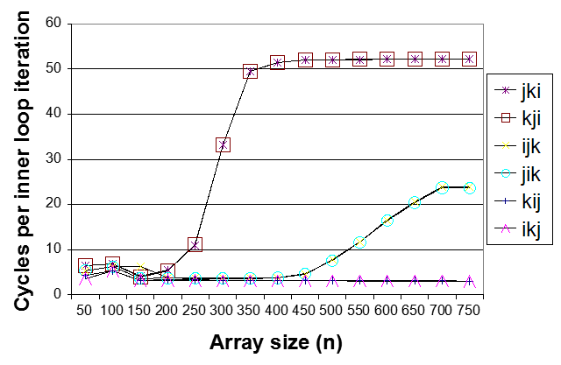
Core i7 Matrix Multiply Performance
jki / kji
ijk / jik
kij / ikj

Slide 93
总结：如何获得更高的性能？
好的编译器和选项
程序员
  找出算法中效率低下的部分
  编写编译器更易优化的代码
    procedure calls & memory references
  仔细优化内部循环 (where most work is done)
根据处理器调整代码
  挖掘指令并行性
  避免分支预测失败
  利用好Cache

