Slide 1
Movie Recommendation System
AIL303m - Machine Learning Minicapstone
Team 5 Members: Hải, Minh, Đức, Chung, Dương

Slide 2
Motivation & Problem Statement
Information overload: Users face huge catalogs on streaming platforms.
Recommender Systems help filter relevant content based on history.
Goal: Accurately predict ratings and generate personalized Top-N suggestions.

Slide 3
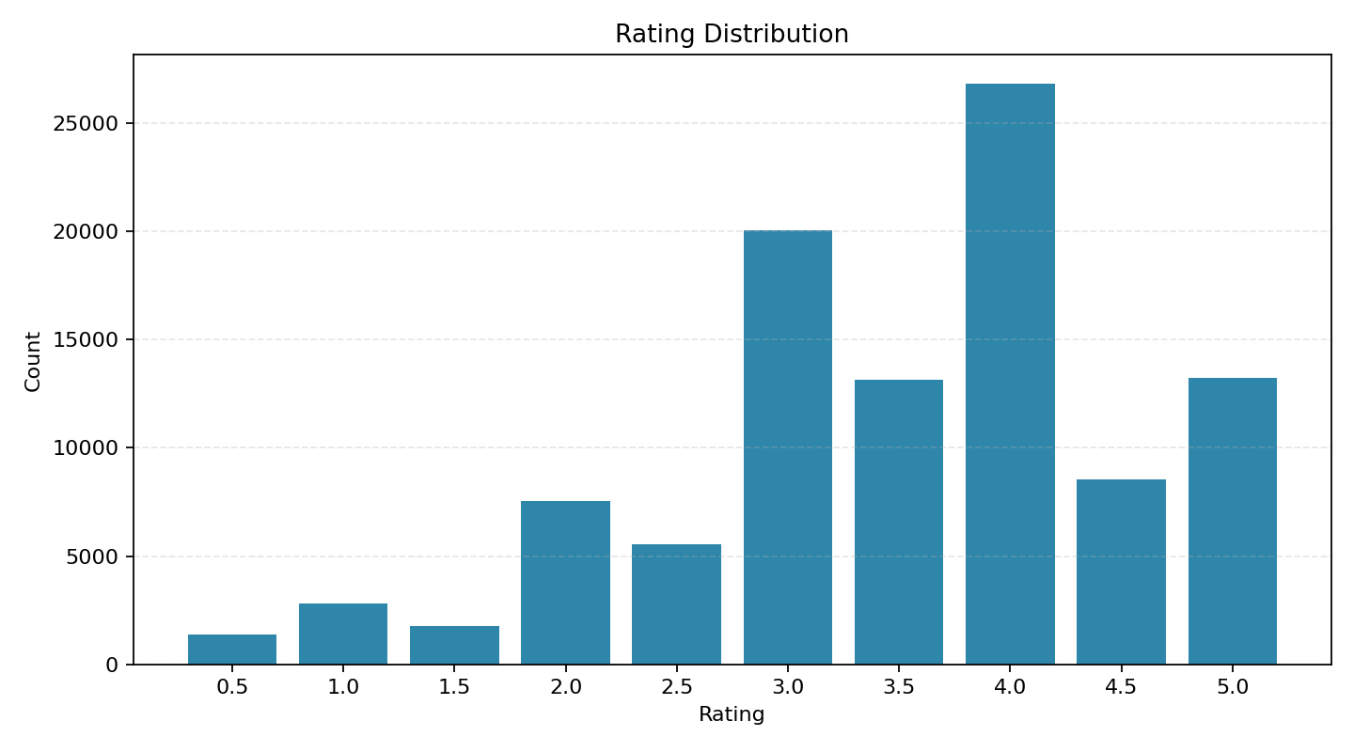
Dataset & Characteristics
Dataset: MovieLens ml-latest-small
100k Ratings across 610 Users and 9.7k Movies.
High Sparsity: ~98.3% (Missing data is the main challenge).

Slide 4
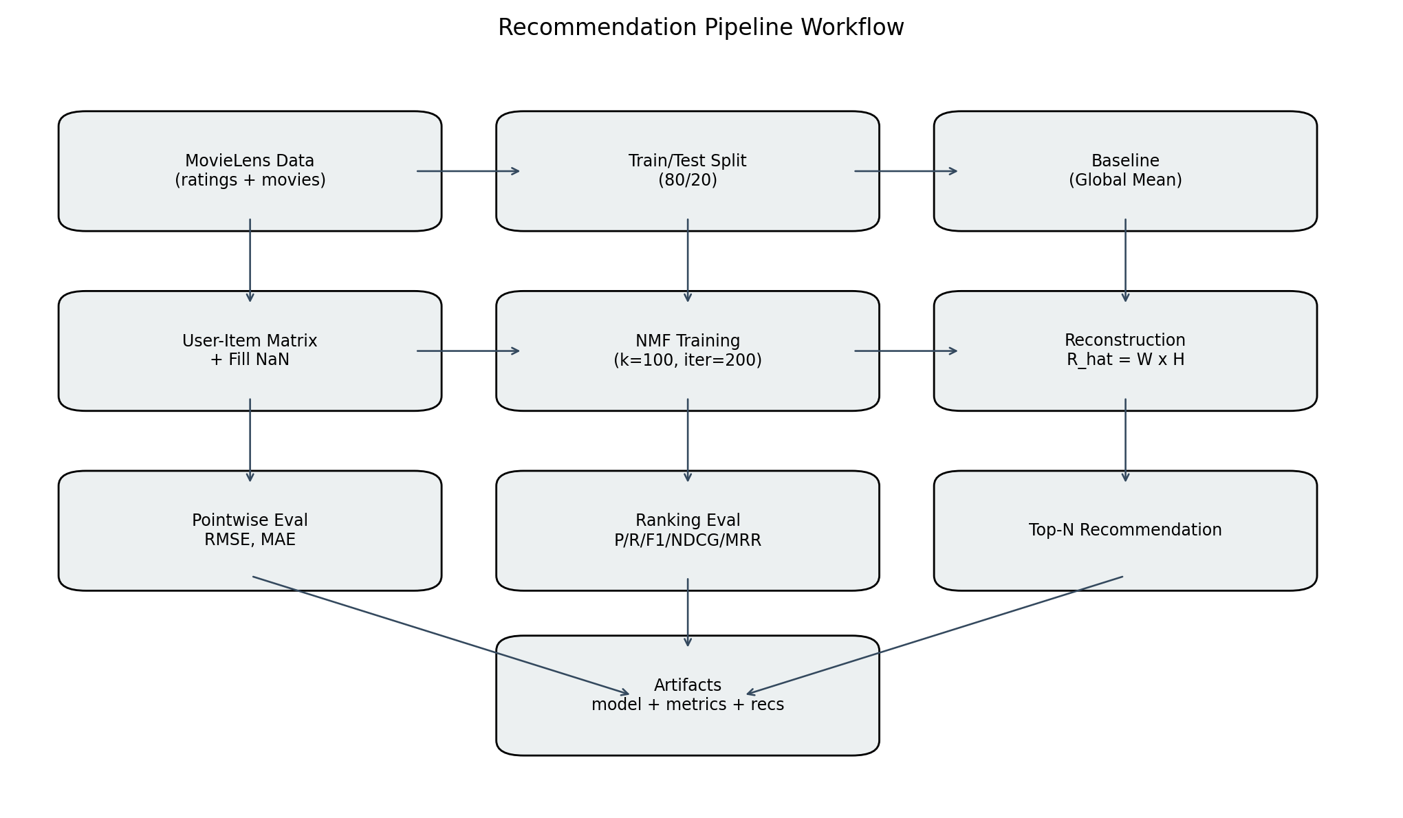
Methodology & Workflow
Baseline: Global Mean fallback.
Advanced Model: Non-negative Matrix Factorization (NMF).
Why NMF? It effectively learns latent factors from highly sparse matrices.

Slide 5
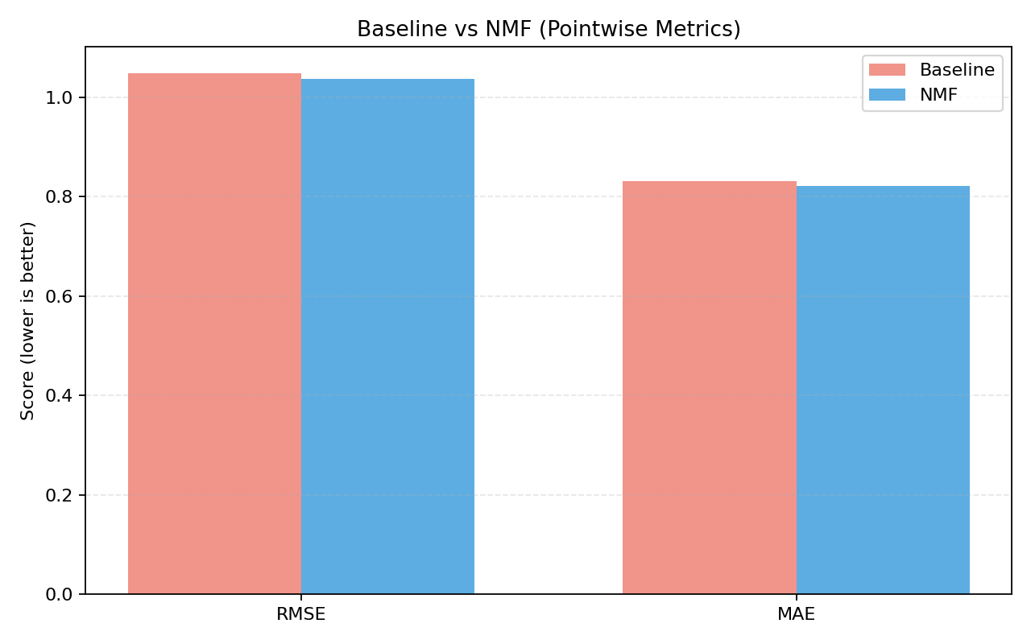
Results: Pointwise Metrics
Baseline RMSE/MAE: 1.0488 / 0.8316
NMF RMSE/MAE: 1.0365 / 0.8212
Improvement: +1.18% (RMSE) and +1.25% (MAE).

Slide 6
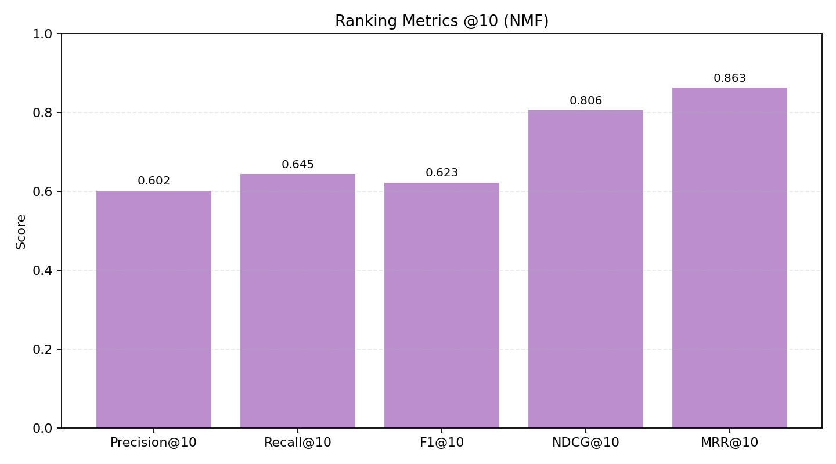
Results: Ranking Metrics
Beyond precision errors, ranking is crucial for user experience.
Precision@10: 60.23% (User enjoys 6/10 recommended movies).
NDCG@10: 0.8056, MRR@10: 0.8628.

Slide 7
Discussion & Conclusion
Moderate ~1% gain is a hard physical limit for highly sparse, explicit static data.
Fallback strategy (Popularity) must be used for Cold-Start users.
Conclusion: The Matrix Factorization pipeline systematically outperforms aggregations.

