Slide 1

Equipment Renting System
ECS 200 Software Engineering and Project

Slide 2
Team Members Group C
Thesara Wickramaarachchi | wickramaarachchit@sltc.ac.lk | AA2122
J.C.B. Kehelwatta | kehelwattajc@sltc.ac.lk | AA2129
M.C Jananath Bandara | bandaram@sltc.ac.lk | AA1600
Nimesh Mendis | nimeshm@sltc.ac.lk | AA1424
Ishara Madhushan | madhushanmh@sltc.ac.lk | AA2025
Adiththa Imasha | adiththai@sltc.ac.lk | AA1378
Dinusha Werapitiya | werapitiyad@sltc.ac.lk | AA1391
Pubudu Karunaratne | karunaratneib@sltc.ac.lk | AA2048
Sasindu Iduwara | ranathungais@sltc.ac.lk | AA2209

Slide 3
Table of contents
Introduction
Architecture and solution
Demonstration
Q & A

Slide 4
Introduction
Today everything is bonded with technology. It is very hard finding anything that is not connected with technology
We developed a software to effectively manage an equipment rental service.
We used java and PHP to build the software of the rental equipment management system.

Slide 5
Architecture and solution
An equipment rental management system have the following basic functions
Adding new equipment
Adding details of new users.
Rent out equipment
View borrow history
Calculating the charges for the equipment

Slide 6
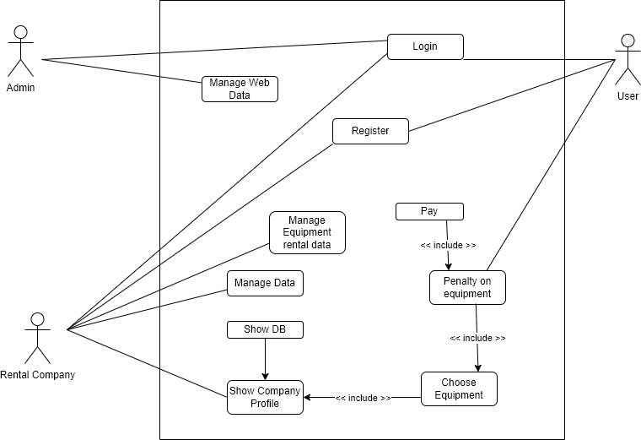
Use Case Diagram

Slide 7
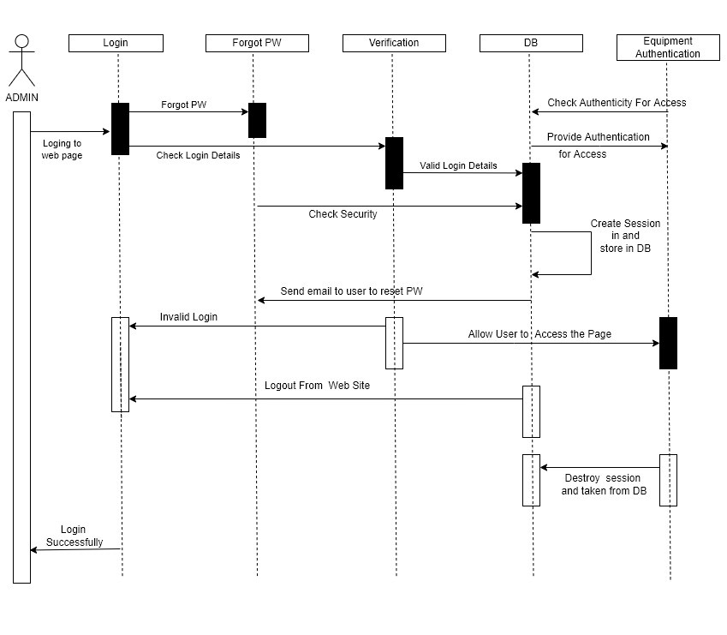
Sequence diagram

Slide 8
Difficulties arisen
Lack of programming knowledge.
Communication problems among team members.
Gathering information regarding equipment renting services.
Making the interface user friendly.

Slide 9
DEMONSTRATION

Slide 10
Q & A

Slide 11


