Slide 1

Second Earth Future Implications

Slide 2
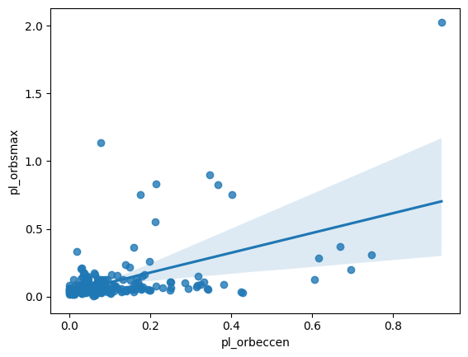
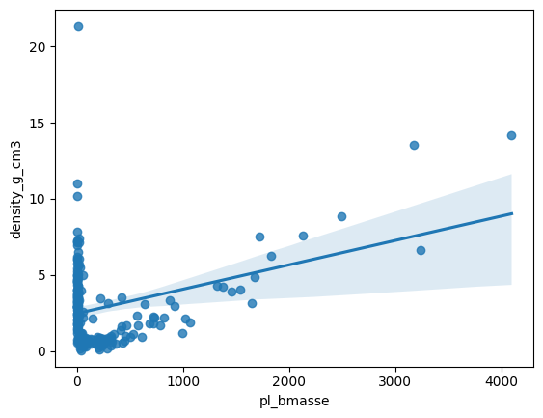
Regression Lines with Lines OF Best FiT?
- We can leverage these models to identify new variables that enhance the adaptability and robustness of future models. A necessary first step is to locate features that exhibit strong correlations. - For example, the correlation is 0.503 above, while the bottom one is 0.338. - Discovering relationships with a correlation coefficient above 0.75 would provide a much stronger foundation for building more predictive, resilient models.

Slide 3
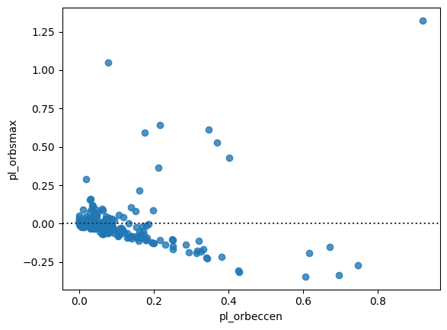
Beyond Linear Models?
There may be a more complex relationship that extends beyond a simple linear model. Residual plots can help diagnose this possibility. In our example, the residuals show a discernible pattern rather than random scatter, suggesting that an exponential or other non-linear modeling approach may provide a better fit.

Slide 4
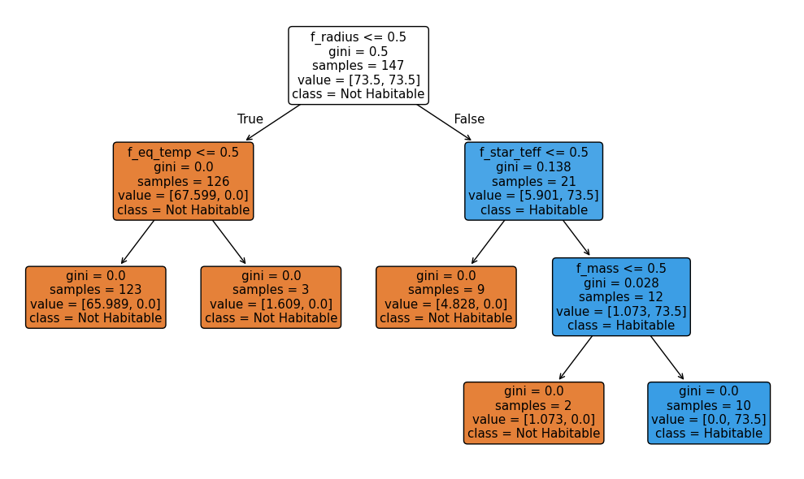
Classification With Decision Tree?
As we uncover stronger correlations and deeper relationships among the variables, we can increasingly leverage the power of machine learning to make confident classifications of planetary habitability. Overall, Second Earth can compass researchers a direction, but with more data (like composition) and more sample, we envision a product that can facilitate exploration and bring optimism in a sustainable matter, especially with Machin Learning.

