Slide 1
GitOps at Scale
The App of Apps Pattern with Argo CD
Thessaloniki DevOps Meetup · May 7, 2026

Slide 2
Who Are We?
S
D
Stelios Mantzouranis
Diomidis Panagiotis Tsouridis
DevOps Engineer
DevOps Engineer

Slide 3
Agenda
01
The Old Way
07
Built-in Resources & CRDs
CI/CD pushing kubectl apply -f
Native types vs custom extensions
02
What is GitOps?
08
App of Apps Pattern
Git as the source of truth
A parent that rules them all
03
The 4 Principles
09
Our Demo Repo
Declarative, versioned, pulled, reconciled
Repo structure & parent YAML
04
Why Teams Move to GitOps
10
Public vs Custom Charts
Audit, security, rollbacks
Public Helm Chart vs Custom Helm Chart
05
Argo CD Basics
11
Developer Flow
The GitOps operator for K8s
Edit → commit → sync → running pods
06
Argo CD Features
12
Live Demo
Argo CD's important behaviors
See it sync in real time

Slide 4

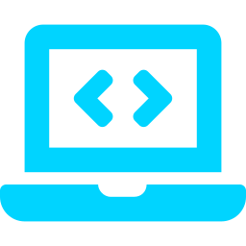
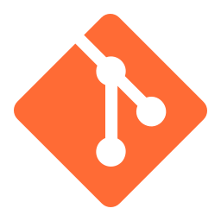
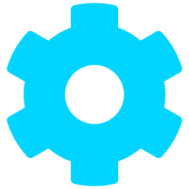

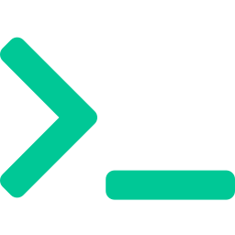
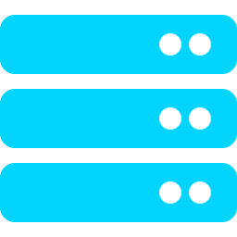
The Old Way
Push-based CI/CD: deployments were pipeline-driven (kubectl / Helm)
→
→
→
→
→
Developer
Git Repo
CI Pipeline
Registry
kubectl apply
Cluster
git commit
source code
build + test
push image
from CI runner
hopefully updated
⚡ The real problems
✗
CI pipelines require cluster access credentials, increasing the risk surface
✗
A simple kubectl edit can cause drift - Git no longer matches reality
✗
No easy way to answer: which commit is actually deployed right now?
✗
Rollbacks depend on re-running previous deployments
Notes:
"CI pipelines require cluster access credentials, increasing the risk surface" — Accurate. The gitops.tech documentation explicitly describes this as the "god-mode" problem: the CI server needs admin credentials to every environment it deploys to. Multiple sources confirm this is the #1 security concern with push-based CD.
"A simple kubectl edit can cause drift - Git no longer matches reality" — Accurate. The Unleash article calls this out directly: traditional pipelines are "fire-and-forget mechanisms" that assume the target environment stays in the state they left it. Configuration drift is one of the core motivators for GitOps.
"No easy way to answer: which commit is actually deployed right now?" — Accurate. The cloudowski article says traditional pipelines "often lack robust audit trails, making it difficult to track who made what changes and when." There's no single source of truth linking what's running to a specific commit.
"Rollbacks depend on re-running previous deployments" — Accurate. In push-based CD, rolling back means re-triggering a pipeline with old parameters and hoping nothing else changed. Every GitOps source contrasts this with the simplicity of git revert.

Slide 5
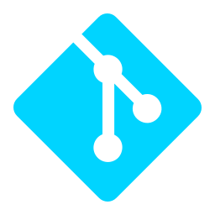
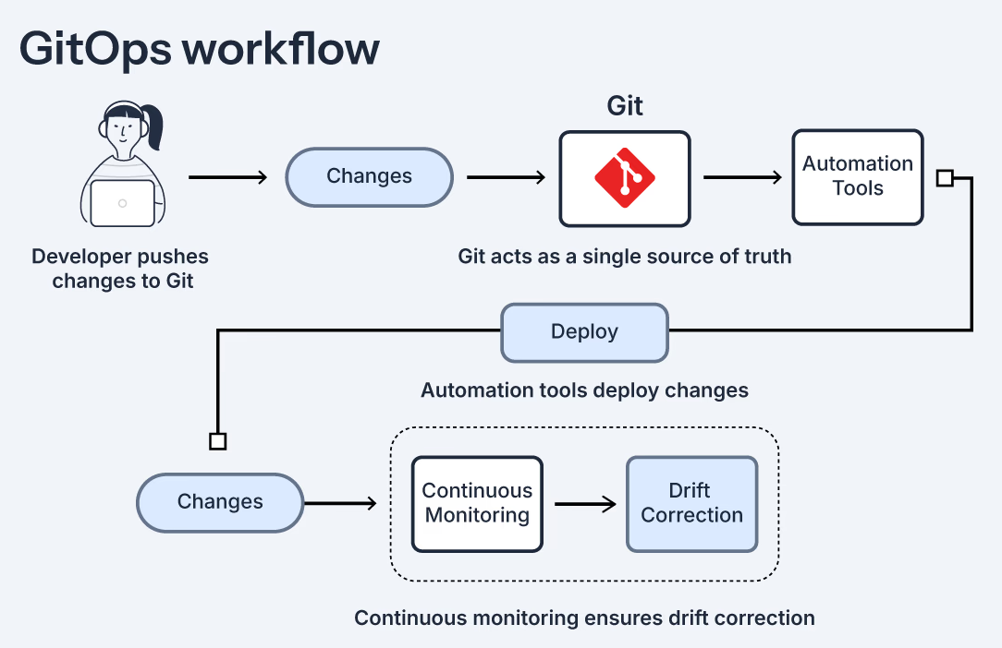
What is GitOps?
Instead of pushing changes, the cluster pulls its desired state from Git and keeps itself in sync.
Git is the Source of Truth
Every config, manifest, Helm value and policy lives in Git. If it's not in Git, it shouldn’t exist. The cluster will correct anything that drifts from it.
Notes:
"Git is the source of truth" means: if you want to know what's running in your env, you don't kubectl get — you open Git. That's the answer.
Drift correction is the part people don't expect: if someone goes and kubectl edit as deployment by hand, the agent sees the drift and reverts it back to match Git. Git wins, always.
Git becomes the API to your infrastructure. Every change is a commit

Slide 6

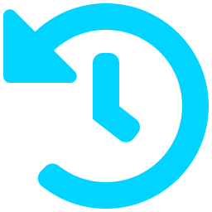


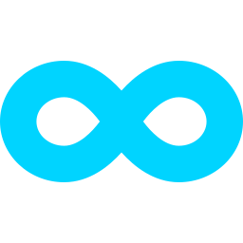
The 4 principles of GitOps
Versioned and Immutable
Declarative, Not Imperative
Desired state is stored in a way that enforces immutability, versioning and retains a complete version history.
A system managed by GitOps must have its desired state expressed declaratively. You describe what you want, not how to get there.
Pull, Don't Push
Continuously Reconciled
A controller automatically pulls the desired state declarations from the source.
Software agents continuously observe actual system state and attempt to apply the desired state.
Source: https://akuity.io/blog/getting-into-gitops

Slide 7







Why Teams Move to GitOps
Git isn't just storage — it becomes your audit log, your rollback button, and your safety net.
Complete Audit Trail
Automated Drift Correction
Easy Rollbacks
Every change is a Git commit. You always know who changed what, when, and why. No guessing.
If someone changes the cluster manually, the agent detects the drift and syncs it back to match Git. Every time.
Something broke? Revert the commit. The cluster syncs it back to the previous state. No need to re-run pipelines.
Improved Security
Consistency Across Environments
Faster Reliable Deployments
The GitOps agent runs inside the cluster and pulls from Git. CI/CD never needs cluster credentials. Huge security win.
All environments deploy from the same declarative source. Same configs, same process, consistent everywhere.
Changes flow through Git. Reviewed, approved and applied automatically. Fewer manual steps, fewer errors, faster releases.
Sources: opengitops.dev · gitops.tech · cncf.io/blog · about.gitlab.com/topics/gitops

Slide 8

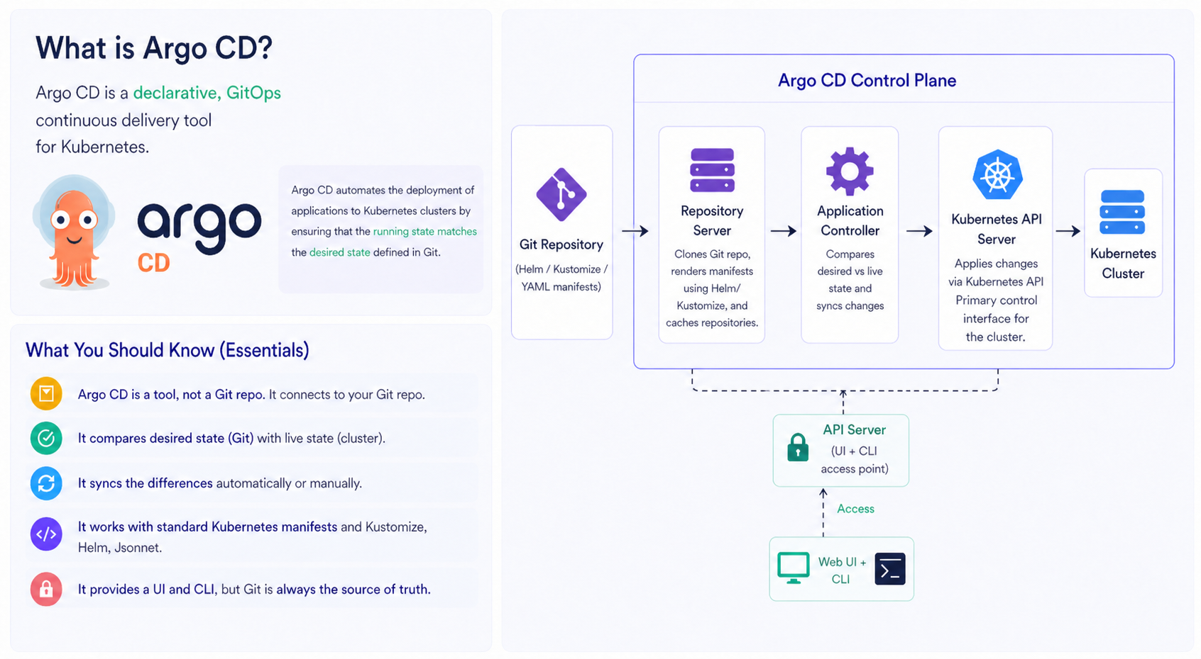
Argo CD Basics
Notes:
"We've talked about GitOps as a concept — now let's look at the tool we'll actually use to do it."
Argo CD is a GitOps operator for Kubernetes. There are others (Flux is the other big one), but Argo CD is the one with the rich UI and the bigger ecosystem.
It runs as a controller inside your cluster. You point it at a Git repo and it handles syncing.

Slide 9
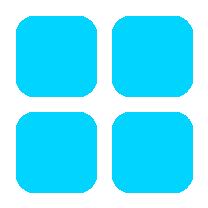
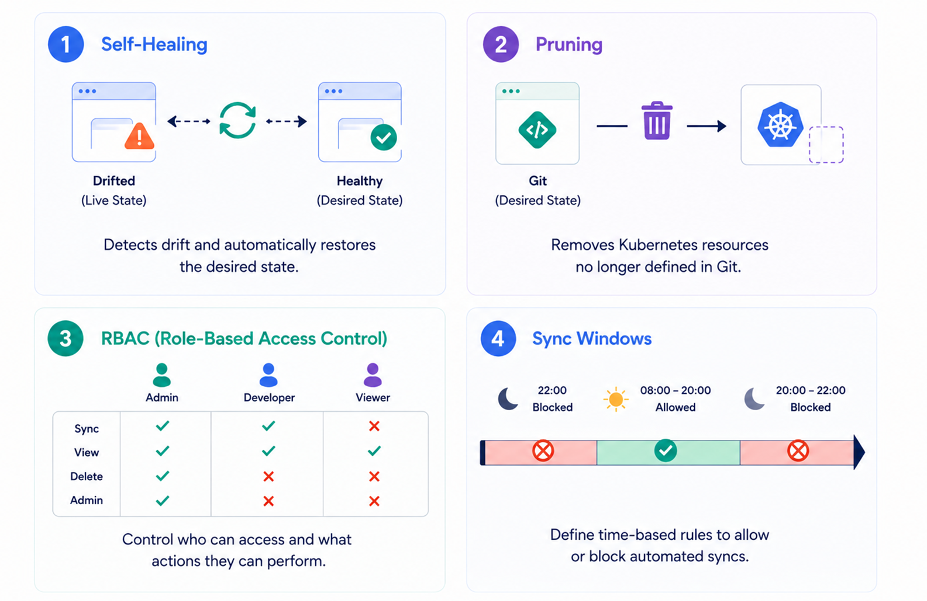
Argo CD – 4 Features Worth Knowing
WHO USES IT
Source: CNCF End User Survey (2025)
Nearly 60%
of surveyed
Kubernetes Clusters
use ARGO CD
CNCF graduated project
Red Hat · IBM · Intuit
...and thousands more
Notes:
Lead with the punchline: nearly 60% of surveyed Kubernetes clusters run Argo CD. That's not a niche pick — that's the default. Sandbox
“Early-stage experimental projects with smaller communities and limited adoption.”
Incubating
“Growing projects with increasing stability, adoption, and community support.”
Graduated
“Mature, production-ready projects with strong governance and wide industry adoption.”
CNCF graduated project — same maturity tier as Kubernetes itself, Prometheus, dapr,kubernetes,opentelemetry, istio. Production users include Red Hat, IBM, Intuit, and thousands more. Source is the CNCF End User Survey 2025 Walk through the 4 quadrants, then end on the adoption sidebar.
Pruning — Sync is apply — it only creates and updates, never deletes. Pruning is the separate flag that says "also delete what's gone from Git." Without it, removed resources just sit in the cluster forever.

Slide 10
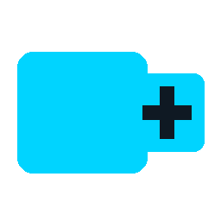
Built-in Resources & CRDs
Two kinds of resources. One is built in. One is defined
Built-in Resources
CRDs (Custom Resource Definitions)
Every cluster starts with some native resource types. They are incorporated into the Kubernetes API server itself.
A Custom Resource Definition is how you extend Kubernetes API by defining a new type of resource
Pod — A running instance of your app (smallest deployable unit)
Service — A stable way to access your app (network entry point)
Deployment — Keeps your app running with desired number of copies
Secret / ConfigMap — Sensitive & non-sensitive data
Examples of CRDs in real tools:
Argo CD → Application (defines desired application state from Git)
cert-manager → Certificate (defines TLS certificates to be issued and renewed)
Istio → VirtualService (defines traffic routing rules in the mesh)
💡 In this talk, we’ll use kind: Application

Slide 11


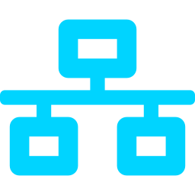
The App of Apps Pattern
A single parent Application that watches a folder in Git and automatically manages all child Applications it finds.
⚙️ How it works
Parent Application
app-of-apps-meetup-demo
The parent scans a Git folder for Application files
Argo CD creates each child Application it finds
Each child independently manages its own resources
💡 Why it clicks
✓
One file deploys your entire platform
dummy
nginx
✓
Adding a service means adding a file
charts/dummy (local)
Public Helm chart
✓
See the whole platform visible in one UI tree
custom chart
public chart
✓
Git owns everything means pure GitOps
Argo CD syncs the parent → parent scans envs/demo/ → finds both children → syncs them automatically

Slide 12
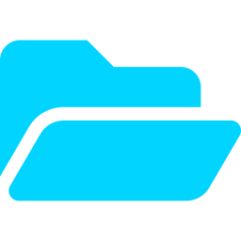
Our Demo Repo: One Parent, Two Children
github.com/smantzou/app-of-apps-meetup-demo — a parent watching envs/demo/ with two children inside.
📁 Repository layout
📄 apps/demo.yaml (parent)
app-of-apps-meetup-demo/ ← root repo
kind: Application # Defines an Argo CD app metadata: name: app-of-apps-meetup-demo # Parent app name spec: source: path: envs/demo # Folder containing child apps
repoURL: github.com/smantzou/app-of-apps-meetup-demo # Git Repo
targetRevision: main # Branch/tag to track directory: recurse: true # Scan subfolders for apps destination: { server: https://kubernetes.default.svc } # Target Cluster syncPolicy: { automated: { prune: true, selfHeal: true } } # Policies
├── apps/
│ └── demo.yaml ← parent app
├── envs/
│ └── demo/
│ ├── dummy/application.yaml ← child app
│ └── nginx/application.yaml ← child app
└── charts/
└── dummy/ ← local chart
├── Chart.yaml
✨ What happens when you apply this one file
├── values.yaml
1.
Argo CD scans envs/demo/ recursively for Applications
├── values.demo.yaml ← demo overrides
2.
It finds and creates dummy and nginx child Applications
└── templates/
3.
Each child syncs its Helm chart into its own namespace

Slide 13
Public Charts vs Custom Charts
Argo CD doesn't care where the chart lives. Both children use the same Application CRD — just different sources.
nginx
PUBLIC CHART
dummy
CUSTOM CHART
Pulled from an external public Helm repository. No code in our repo.
A Helm chart we wrote, lives in the same repo under charts/dummy.
source: repoURL: charts.bitnami.com/bitnami # Helm repo URL chart: nginx # chart name to install targetRevision: 23.0.0 # chart version helm:
releaseName: nginx # Helm release name valuesObject: # inline Helm value overrides service: { type: ClusterIP } # use ClusterIP service serverBlock: |- # custom NGINX config ... proxy_pass → dummy.svc
source: repoURL: github.com/smantzou/... # Git repo with Helm chart path: charts/dummy # path inside repo to the chart targetRevision: main # branch/tag to deploy helm:
releaseName: dummy # Helm release name valueFiles: # load values from chart files
- values.yaml # base chart values - values.demo.yaml # environment-specific overrides
→ Argo CD fetches the chart from Bitnami on every sync
→ Argo CD renders the chart straight from our Git repo
→ Available Customisation via valuesObject, no code ownership
→ Full control since templates, values, versioning live with us
→ Fast to adopt, upgraded by bumping targetRevision
→ Per-environment overrides via values.<env>.yaml files

Slide 14
Developer Flow, End-to-End
A change to a replica count, from a developer's keyboard to running pods — in 60 seconds, no kubectl.
1
→
2
→
3
→
4
→
5
Edit
Commit
Detect
Sync
Run
Developer edits
PR → merge to main
Argo CD polls Git
Auto-sync kicks in
Pods scale up
Open deployment.yaml. Change replicas: 1 → 3. Save.
Push branch, open PR, reviewer approves, merge. Git now says: 3 replicas.
Within ~1-2 min, Argo notices the cluster is OutOfSync.
Argo applies the updated manifest to the cluster. No kubectl, no CI runner touching the cluster.
Kubernetes reconciles: 2 new pods spin up. UI shows Healthy + Synced. Done.
💡 Developers never log in to Argo CD or the cluster. The repo IS the deployment interface.

Slide 15

Live Demo
Let's watch Argo CD sync a change from Git to the cluster — in real time.
github.com/smantzou/app-of-apps-meetup-demo

Slide 16
Thank You
Resources & Links
Questions / Discussion
🔗
github.com/smantzou/app-of-apps-meetup-demo
📖
argo-cd.readthedocs.io
📰
cncf.io/blog · App of Apps pattern
🎬
opengitops.dev · principles
DevOps Meetup · Thessaloniki · May 7, 2026

