Slide 1


Asp.net core the evergreen workshop
“Oh, you have a flame; feel it in your heart. And down at the core is the hottest part. We can burn without fuel.” –
Eric Clapton – The core
Constantinos Ziazios
Notes:
Quick start
Install asp.net core
Install vscode
Unlike the image of HAL 9000 we are going to talk about ai in small scale and to code about it
How many of you do you know about ml
How many of you have you build something
What technologies

Slide 2
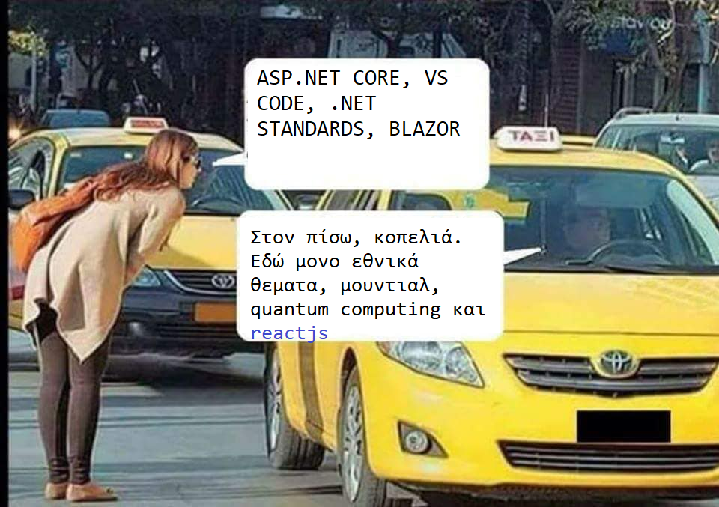

Slide 3

About Thessaloniki.net meetup
https://www.meetup.com/Thessaloniki-NET-Meetup
Next Monday: End of season meetup with java folks
Stay tuned!

Slide 4


Contents
Quick Intro
What’s new
Setting Up Bits
.Net Core Workshop
QA Workshop
Reactjs Workshop
Discussion

Slide 5
About me
Engineer/Developer/Coder and .net guy
Experience in AI, and machine learning, but not an expert
Find me at @ziaziosk
https://github.com/ziaziosk
https://github.com/ThessalonikiNet-MeetUp

Slide 6
Pre-requisites
Install Git
https://git-scm.com/download/win
Install vs code
http://aka.ms/VSCODE
Install dotnetcore
http://aka.ms/DotNetCore21
Install node
https://nodejs.org/en/download/
Notes:
https://download.microsoft.com/download/8/8/5/88544F33-836A-49A5-8B67-451C24709A8F/dotnet-sdk-2.1.300-win-gs-x64.exe

Slide 7
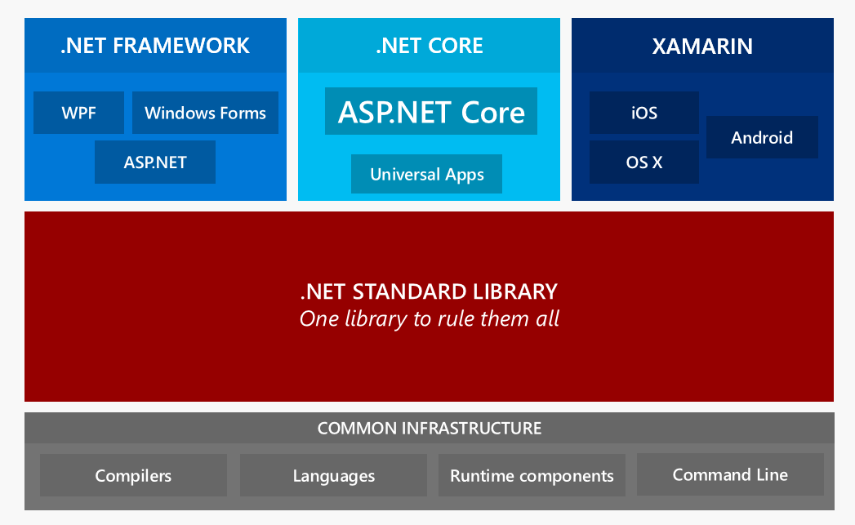
About asp.net core
Free
Open Source
Cross Platform
Mutli-Language
One consistent API (.net standards 2.0)
Modern
Performant
API Development / Client Development

Slide 8
What’s new in asp.net core 2.1
SignalR
https is default
Better Swagger support
ActionResult<T>
Asp.net Identity library (With GDPR support)
MVC Functional testing
GDPR
New Microsoft.AspNetCore.App package
Blazor ??

Slide 9

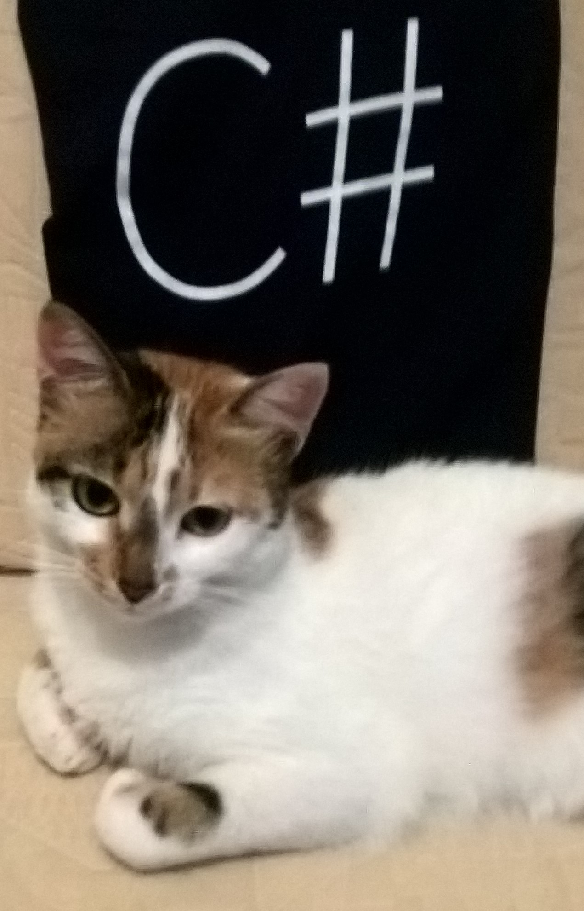
Let’s code
>dotnet --help >dotnet new console >dotnet restore >dotnet run
>dotnet new mvc >dotnet restore >dotnet run

Slide 10
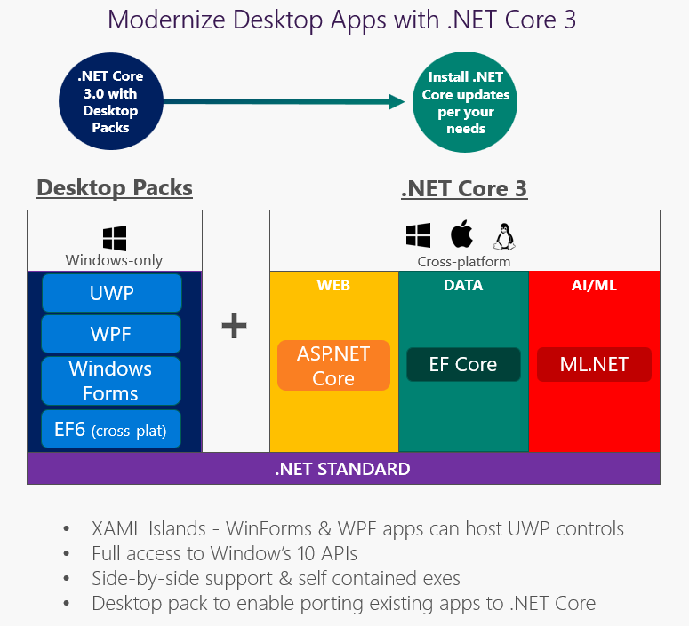
ROAD AHEAD
We have grouped the ASP.NET Core 2.2 release into a few themes:
APIs & Services
Server improvements
SignalR
Rough Schedule
We are currently planning to have 3 previews before RTM:
August – Preview 1
September - Preview 2
October - Preview 3
Before End-of-year – RTM

Slide 11

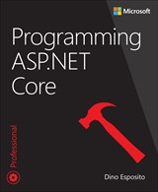
Reference
https://www.microsoft.com/net/learn/what-is-dotnet
https://dotnet-presentations.github.io/
https://mva.microsoft.com/learning-path/asp-net-core-2-0-23
MVC Application Design using .NET Core 2.0 - edX

Slide 12
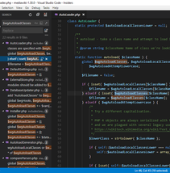
Tools
https://code.visualstudio.com/
Visual studio 2017

Slide 13
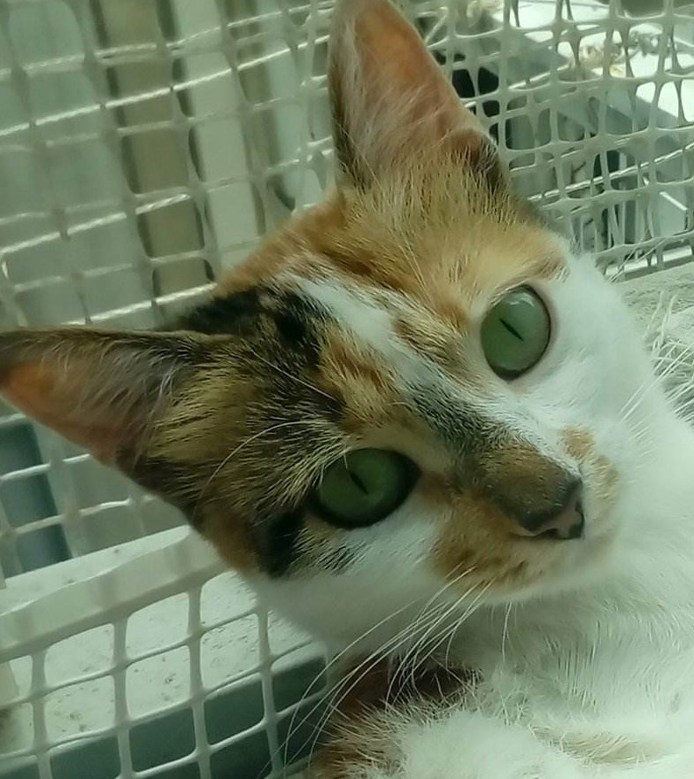
Thank you
Questions ?

